Slide 1


The Silicon Tracking System of the CBM at FAIR: detector development and system integration.
A. Lymanets^{1,2}, E. Lavrik¹, H.-R. Schmidt¹
University of Tübingen¹, Kiev Institute for Nuclear Research²
TIPP ’14, Amsterdam
KINR

Slide 2
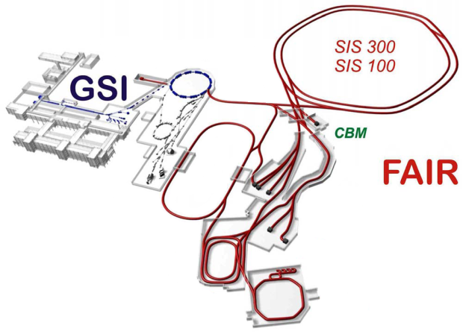
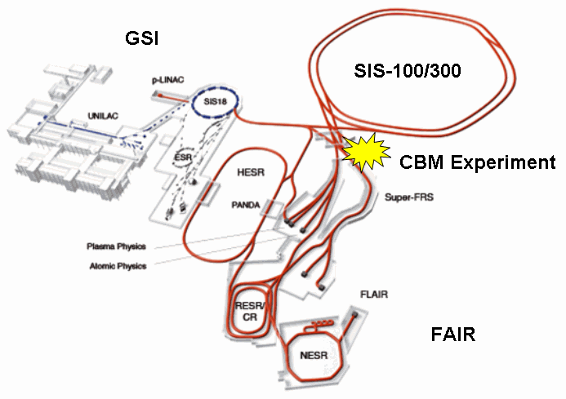
Facility for Antiproton and Ion Research
magnets: 300 Tm bending power
high-intensity DC beam:
10⁹ ions/s at CBM
max. beam energies:
  heavy ions: 45 GeV/u
  protons: 90 GeV
2012: World intensity record for low Charge State Heavy Ions (e.g., U²⁸⁺)

Slide 3
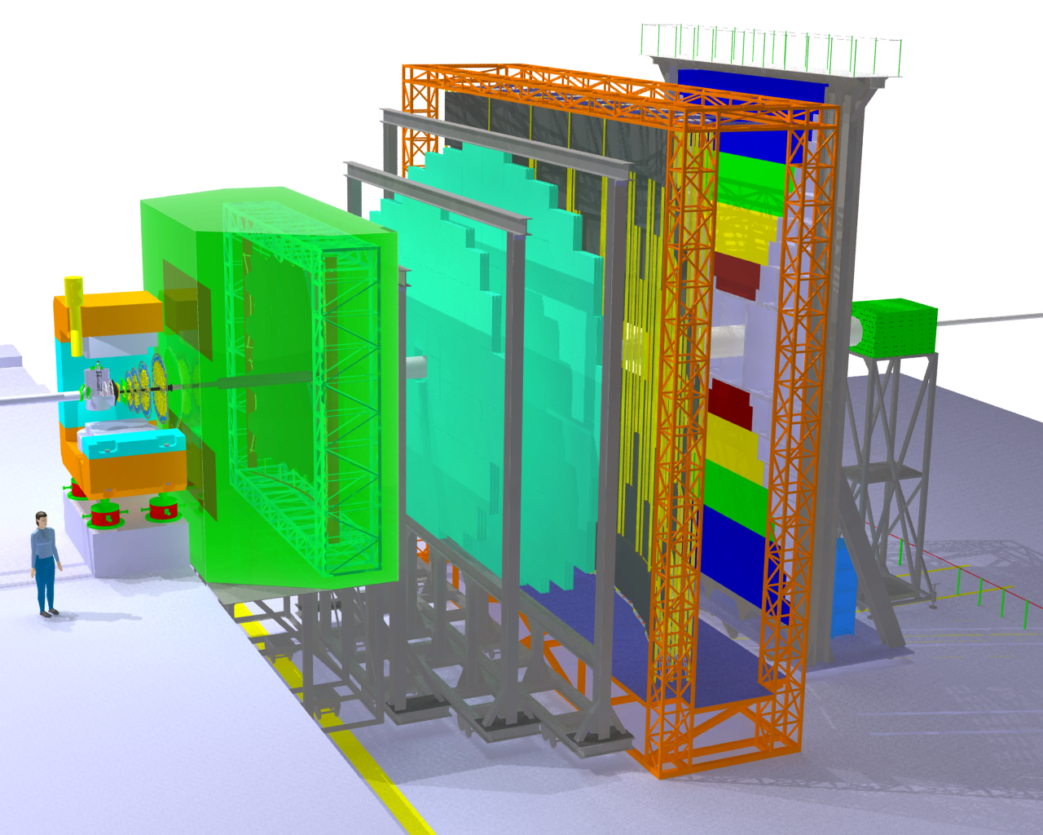
CBM experiment
Electro-
magnetic
Calorimeter
Ring Imaging
Cherenkov
Detector
Silicon
Tracking
System
Micro
Vertex
Detector
Projectile
Spectator
Detector
(Calorimeter)
Resistive
Plate
Chambers
(TOF)
Dipole
magnet

Slide 4
Tracking challenge
Central Au+Au@25AGeV UrQMD event
Au+Au at 10 MHz interaction rate
Up to 700 charged particles/evt
Track densities up to 30 cm⁻²/evt
Need fast and radiation hard detectors as well as fast data acquisition system for online event selection

Slide 5
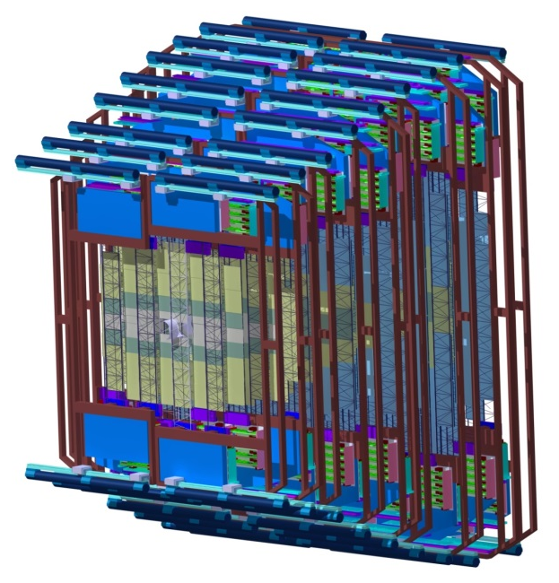

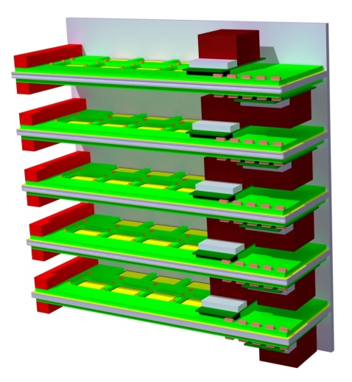
Silicon Tracking System
2133k r/o channels
212 FEE blocks at 140 W (10 FEBs with 14 W each) + 60 W (HUB chip)
FEE heat dissipation of 42.4 kW
Total power dissipated by sensors after irradiation ~ 1 W → Convective cooling
8 stations
Cooling R&D:
Open blown CO₂ system
1 kW CO₂ system TRACI-XL
Plans for 50 kW system
106 ladders
212 FEE blocks

Slide 6
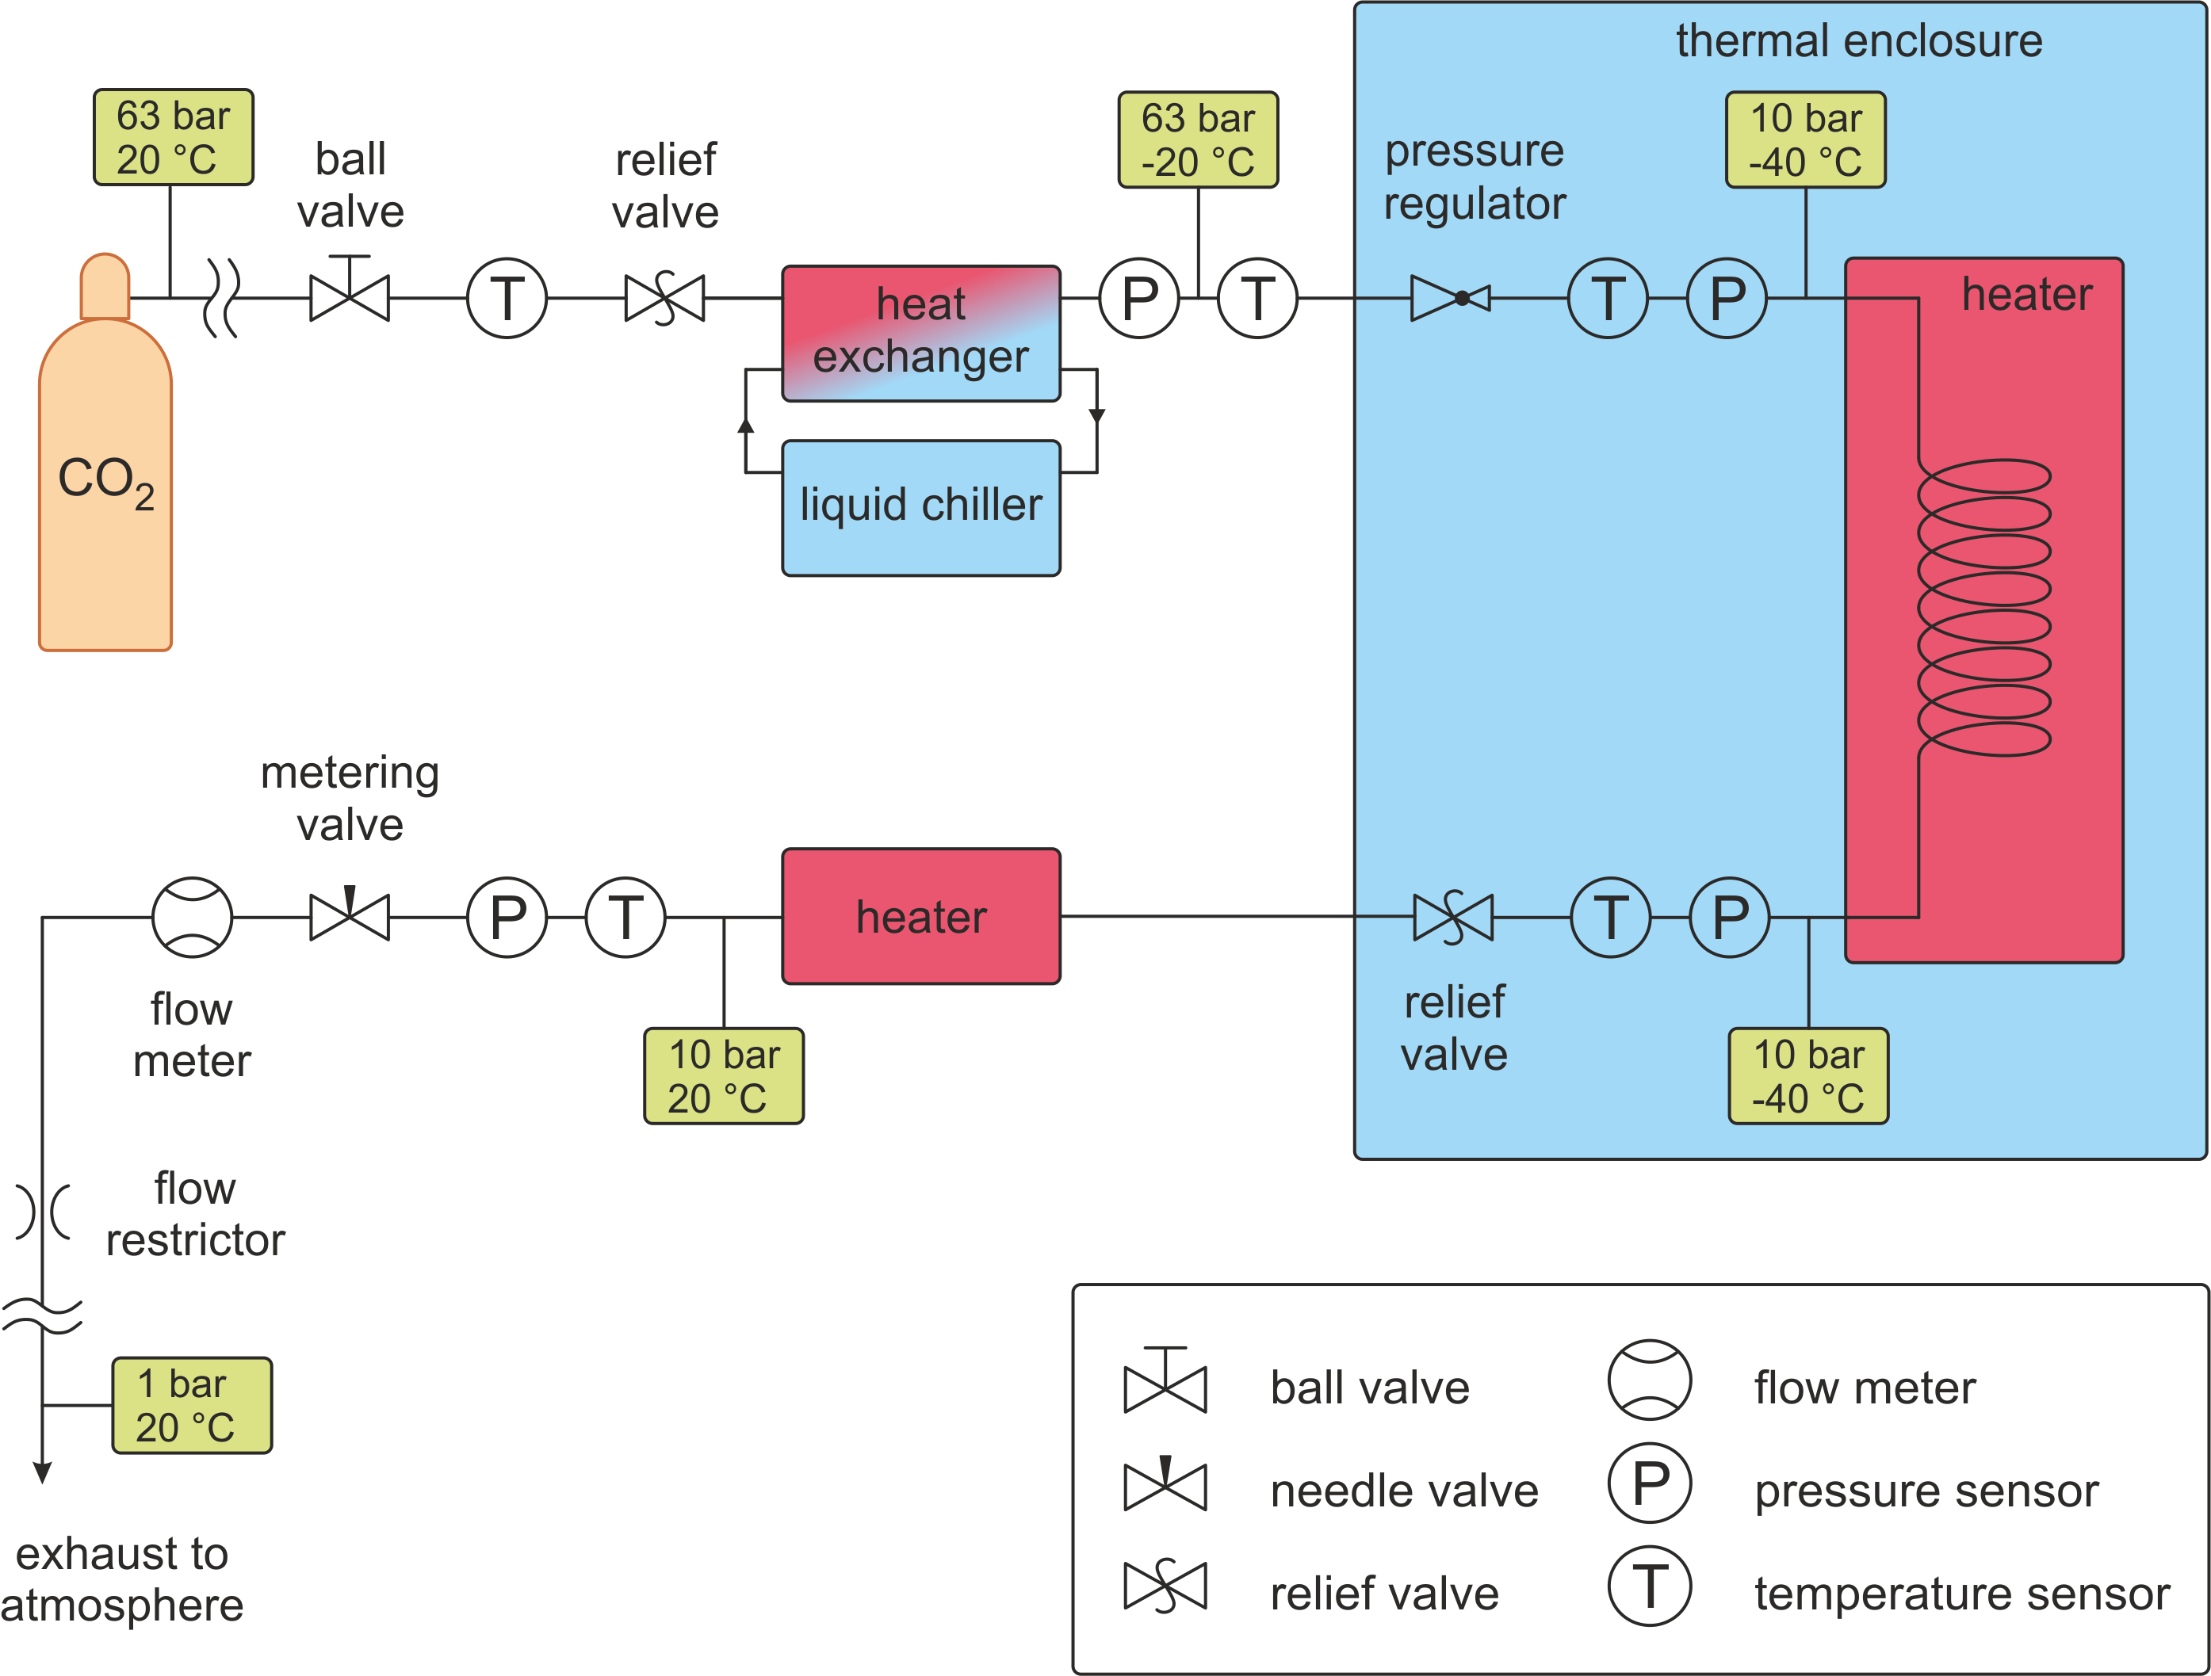
Open CO₂ system
Built to validate heat exchanger design. Currently commissioned and running.

Slide 7
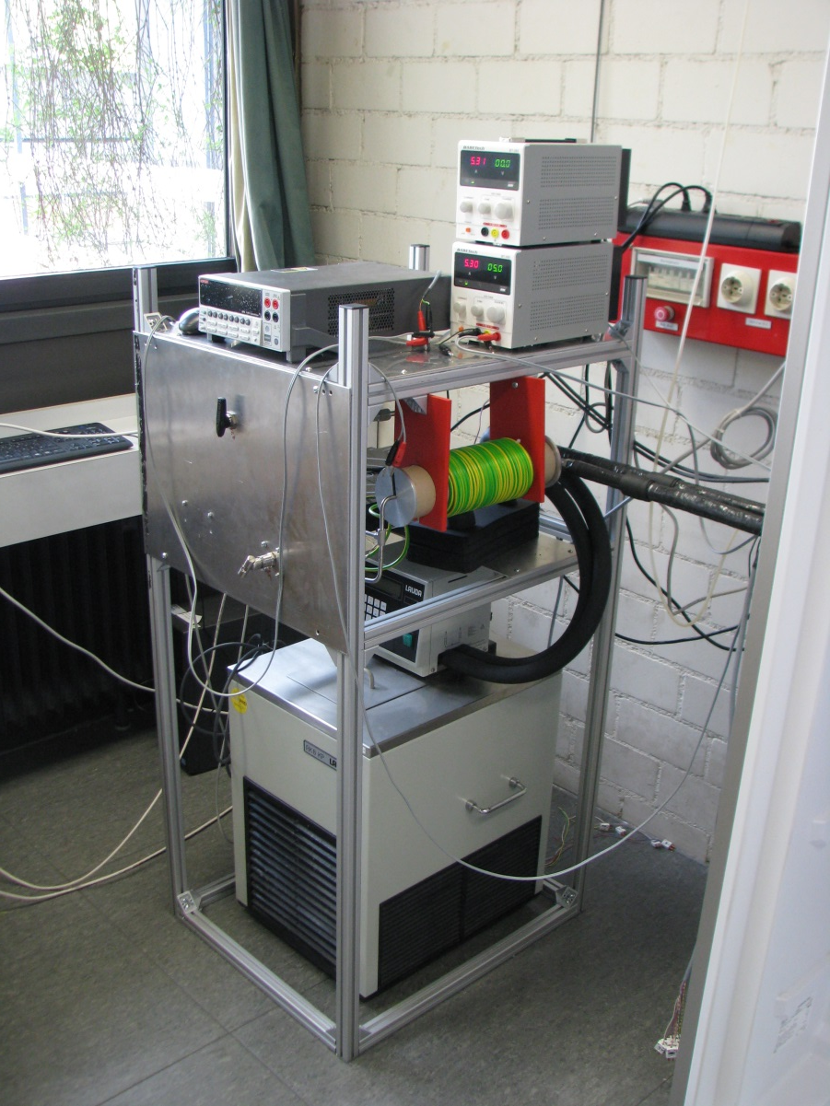
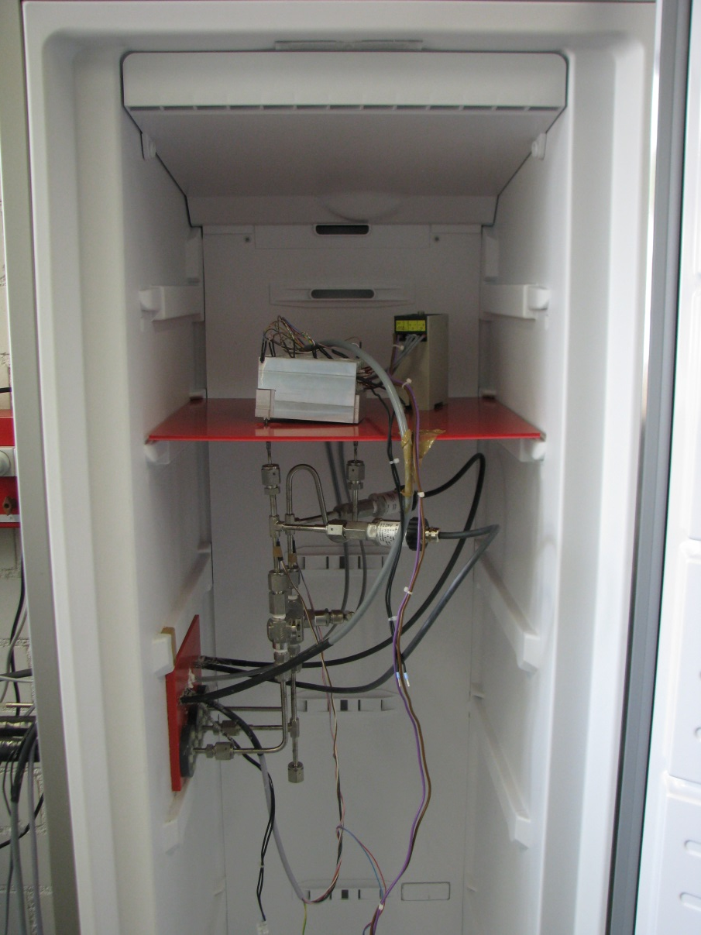
Experimental setup
Humidity sensor
Control panel
FEB box with
heating elements
Chiller
Pressure sensors
Induction coil

Slide 8
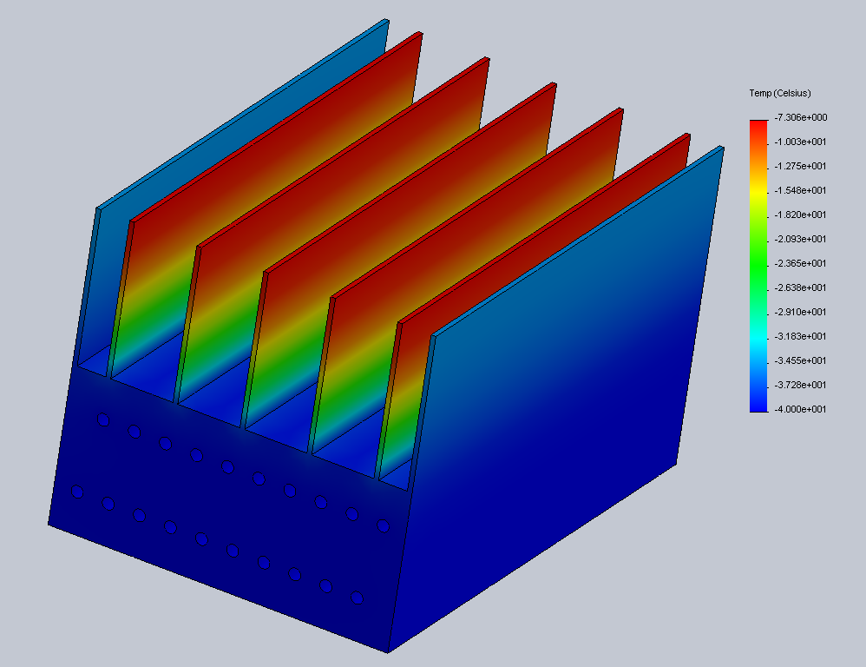
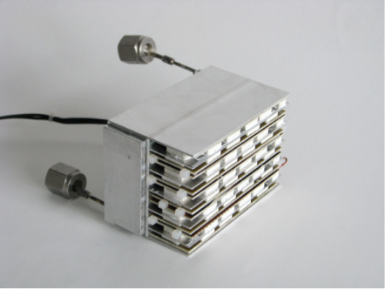
Heat exchanger studies
Simulation studies
Prototype
FEM calculation (Solid Works)
200 W input power
1 mm thick fins
200 W heat load by resistors
1.8 m long tube with ø1.8 mm
(optimal parameters)
Obtain temperature distributions
Check thermal contact
Goal: optimize heat exchanger/cooling fins geometry. Guarantee thermal neutrality (-5 ˚C).

Slide 9
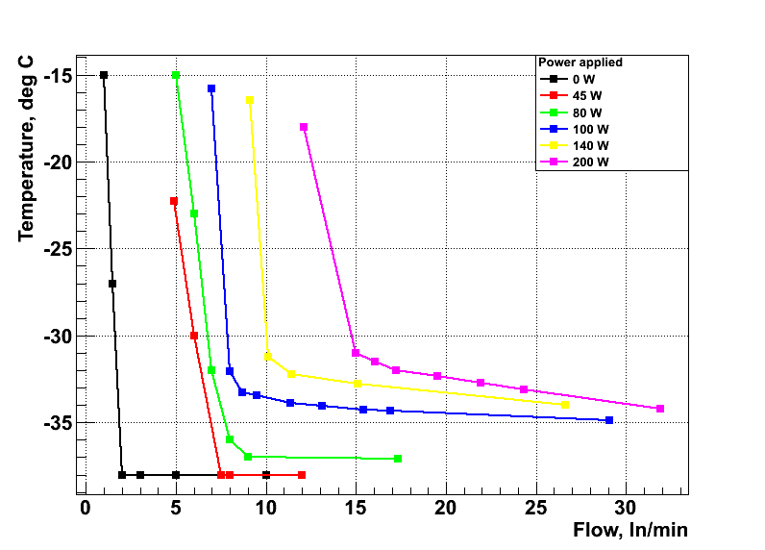
Very first results
P_{in}
input power P_{in}: 0, 45, 80, 100, 140, 200 W
liquid CO₂ input temperature T_{in}: -40 °C
T_{HeatExchanger}
T_{in}
T_{out}
nominal flow to neutralize 200 W:
1 g/s = 27 l_{n}/min
saturation temperature T_{HX} is reached at flows > 15 l_{n}/min

Slide 10
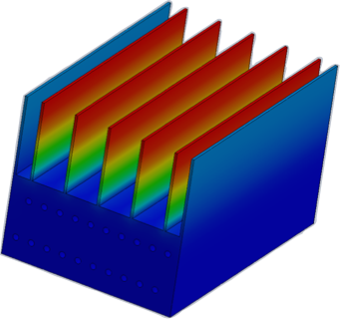
Very first results II
Much higher than -5 °C
(not thermally neutral)
probable cause: insufficient thermal contact between heat exchanger and FEB box
32 °C
36 °C
42 °C
38 °C
32 °C
18 °C
-34 °C
Flow: 30 l_{n}/s, input power: 200 W

Slide 11
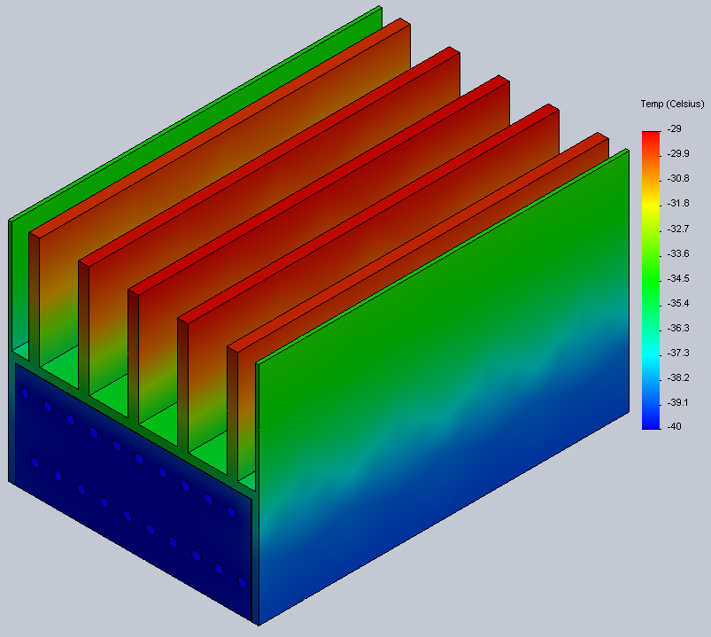
Simulations studies
Temperature maximum
Fin width | all aluminum | air gap (100 µm) | thermal grease gap | grease with Cu-FEB Box | grease with all Cu
1 mm | -7.05 | 35.1 | -3.97 | -18.2 | -18.5
2 mm | -21.4 | 24.7 | -18.3 | -26.2 | -26.6
3 mm | -26.9 | 20.9 | -23.4 | -29 | -29.4
simulations confirm experimental observations
good thermal coupling and wider fins (2 mm) should allow complete thermal neutralization
experimental verification underway

Slide 12
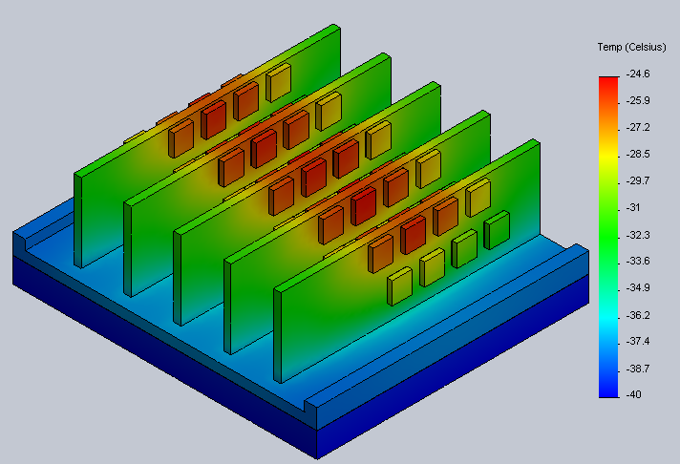
Simulations with detailed layout
Temperature maximum °C
fin width | all aluminum | air gap | thermal grease gap | grease with Cu FEB box | grease with all Cu
1 mm | -5.09 | 34.2 | 7.18 | -9.54 | -10
2 mm | -11.4 | 23 | -8.92 | -20 | -20.5
3 mm | -18.4 | 18.7 | -15.7 | -24.1 | -24.6
4 mm | -22.8 | 15.8 | -20 | -26.8 | -27.3
realistic placement of heat sources suggests 2-3 mm fins

Slide 13
New measurements: improved thermal contact

Slide 14
New measurements: T @ 100 W
-13.5 °C
-11 °C
-11 °C
-10 °C
-15 °C
-34 °C
SolidWorks simulations predict -19.4 °C highest temperature in this regime
Flow: 20.5 ln/s,
applied heat power: 100 W
-40.3 °C
Solidworks reproduces measurement trends correctly.
Thermal neutrality is achieved with thicker fins.

Slide 15
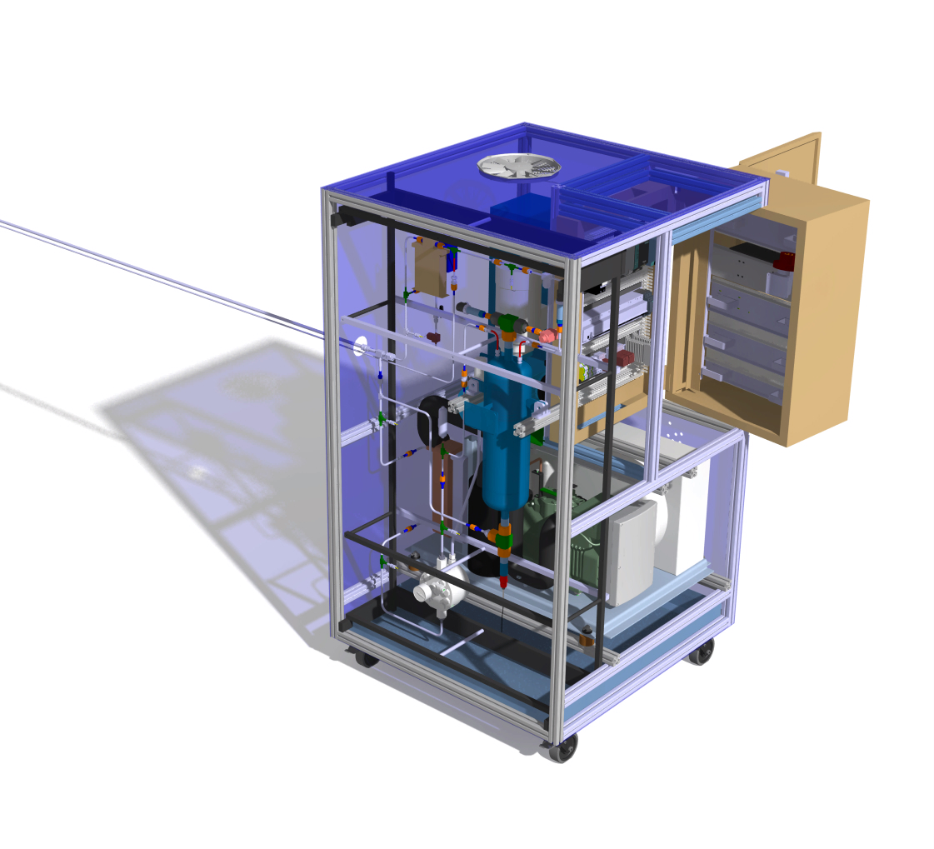

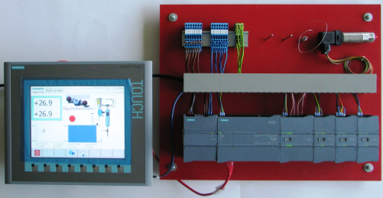
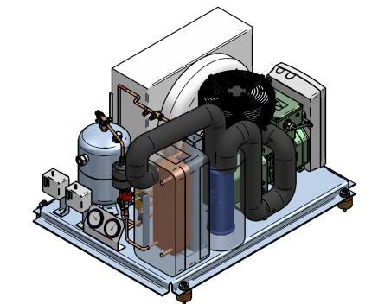
TRACI-XL Main components
Technical specifications
Power: 1kW @ -40 ⁰C
Power supply: three-phase
Weight almost 600 kg
Dimensions: 1132x1153x1900
PLC controlled
Aluminum profiles frame:
Item profiles 8 40x40 mm
Top Exhaust:
Extract pump + electronics heat
1153
Control cabinet:
2 Layer (HV + LV)
HMI for friendly User experience
GSI+Tübingen
Transfer line to Remote control box + Experiment
1900
CO₂ Front Panel:
Easy removable for maintenance
Armaflex foam insulated
Next slide
Condensing unit:
Easily detachable
FU to adapt to different load situations
1132
Drip Pan:
Tray to detect CO₂ leakages
With TRACI-XL you will be able to test 7 FEE blocks of 140 W
For example ¼ Stations 4, 5 or 6 →
Thermal box is foreseen to have this size or maybe half station size with dummy loads instead the rest of blocks

Slide 16
Commercial CO₂ power plant
No oil-free setup needed
No particular temperature stability requirement
50 kW externally cooled liquid CO₂ system with
1 kW standby power
Company: Hafner-Muschler (http://www.hafner-muschler.de/)
System similar to CERN 2PACL principle with liquid CO₂
(not transcritical)

Slide 17
Conclusions
CO₂ based cooling system is required to cool 42 kW of power.
Heat exchanger design has been optimized using
simulation approach
Verified by the measurements
1 kW TRACI-XL system is in production.
Commissioning to start in July
Industry partners identified for a final STS cooling system.

