Slide 1


Study of the Radiation Damage of Hamamatsu Silicon Photo Multipliers
Wander Baldini
Istituto Nazionale di Fisica Nucleare and
Universita’ degli Studi di Ferrara
Technology and Instrumentation in Particle Physics, Amsterdam June 2-6 2014

Slide 2
Outlook
Silicon Photo Multipliers
The Louvain Cyclotron Facility
Experimental Setup & Measurements
Results
Conclusions

Slide 3
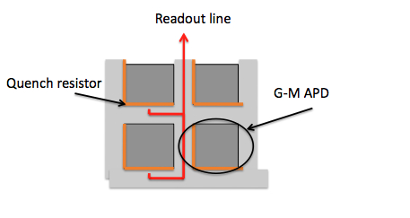
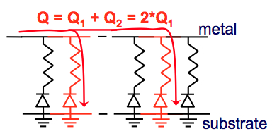
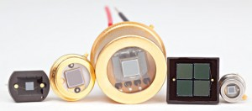
Silicon Photo Multipliers
SiPMs are recently developed semiconductor photo detectors composed by a matrix of Geiger Mode Avalanches Photo Diodes (GMAPD)
The working point is a few Volts above the breakdown voltage
The output signal is the sum of the charge produced by each pixel
The shape of the active area and the dimension of the pixels can be customized according to user’s needs

Slide 4
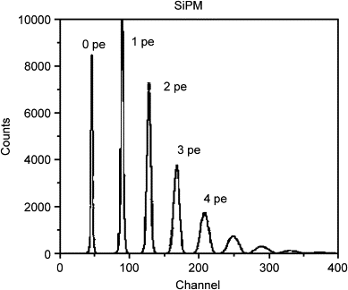
Silicon Photo Multipliers
High gain ≈ 10⁶
No sensitivity to magnetic fields
Small-sized
Single photon resolution
Low bias voltage (<100V)
Drawbacks:
High dark count (typically ≈ 100s kHz at room temperature, 0.5 p.e. threshold )
  greatly improved in the last few years
Radiation damage
    requires extensive studies for applications in high radiation environment (like High Energy Physics)
Main topic of this presentation
Charge spectra

Slide 5
The Louvain Cyclotron 110 Facility
50 MeV deuterons on Be target
Continuous spectrum up to 50MeV
Peak at ≈23MeV
Filters for γ and low energy neutrons (98% purity)
Neutron fluence precisely controlled
Cooling box up to -25 C°
n

Slide 6
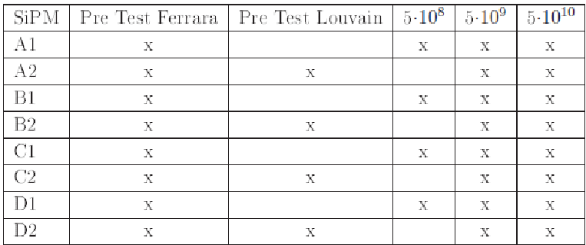
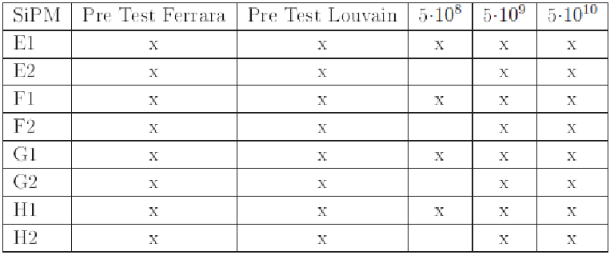
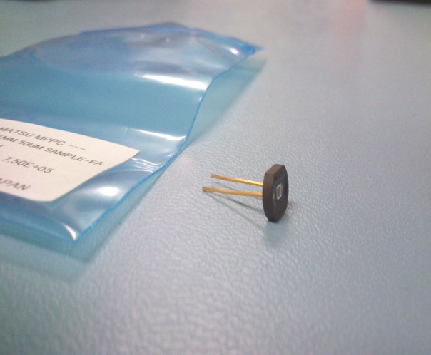
SiPM Hamamatsu Sample
We tested 16 devices of 8 different types and 3 categories:
  A, B: conventional MPPC like devices
  C,E,F,G,H: “low after pulse” devices
  D: special device with a new structure
All devices had the same geometry:
  1x1 mm² active area on plastic support
  50x50 μm² pixel size
Two devices for each type

Slide 7
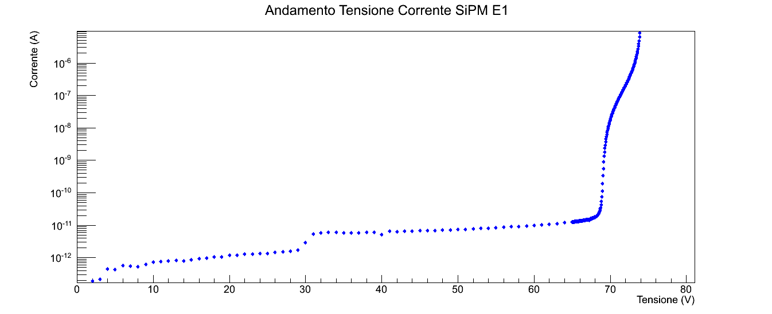
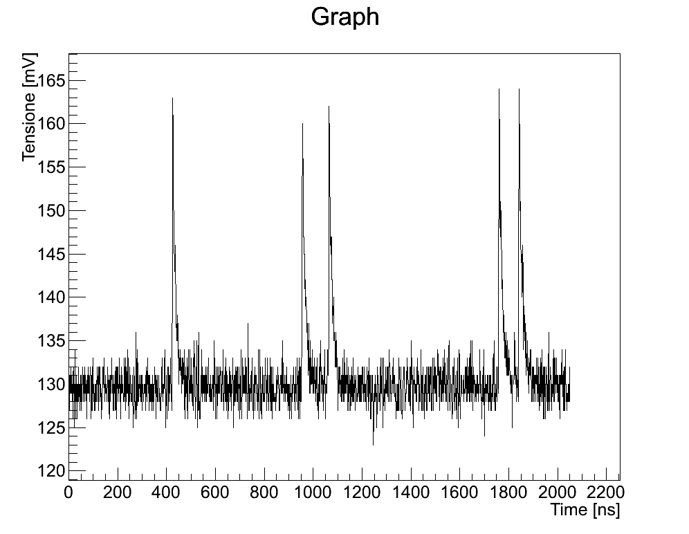
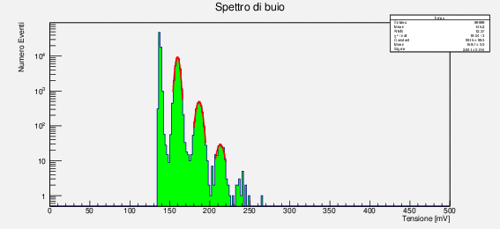
Measurements
For each SiPM we measured:
  I-V characteristic curve
  Acquired a sample of 100k waveforms, from which we:
    Estimate the dark rate
    Measure the Gain
The above measurement were done after each irradiation step:
  Before irradiation
  5 x 10⁸ 1MeV-eq n/cm²
  5 x 10⁹ 1MeV-eq n/cm²
  5 x 10¹⁰ 1MeV-eq n/cm²
The temperature was monitored and the measurements corrected offline
I-V curve
acquired waveform
dark spectra

Slide 8
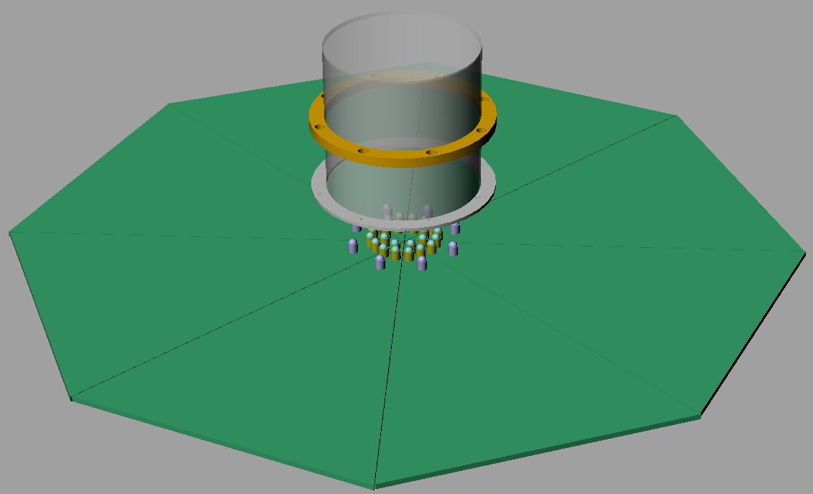
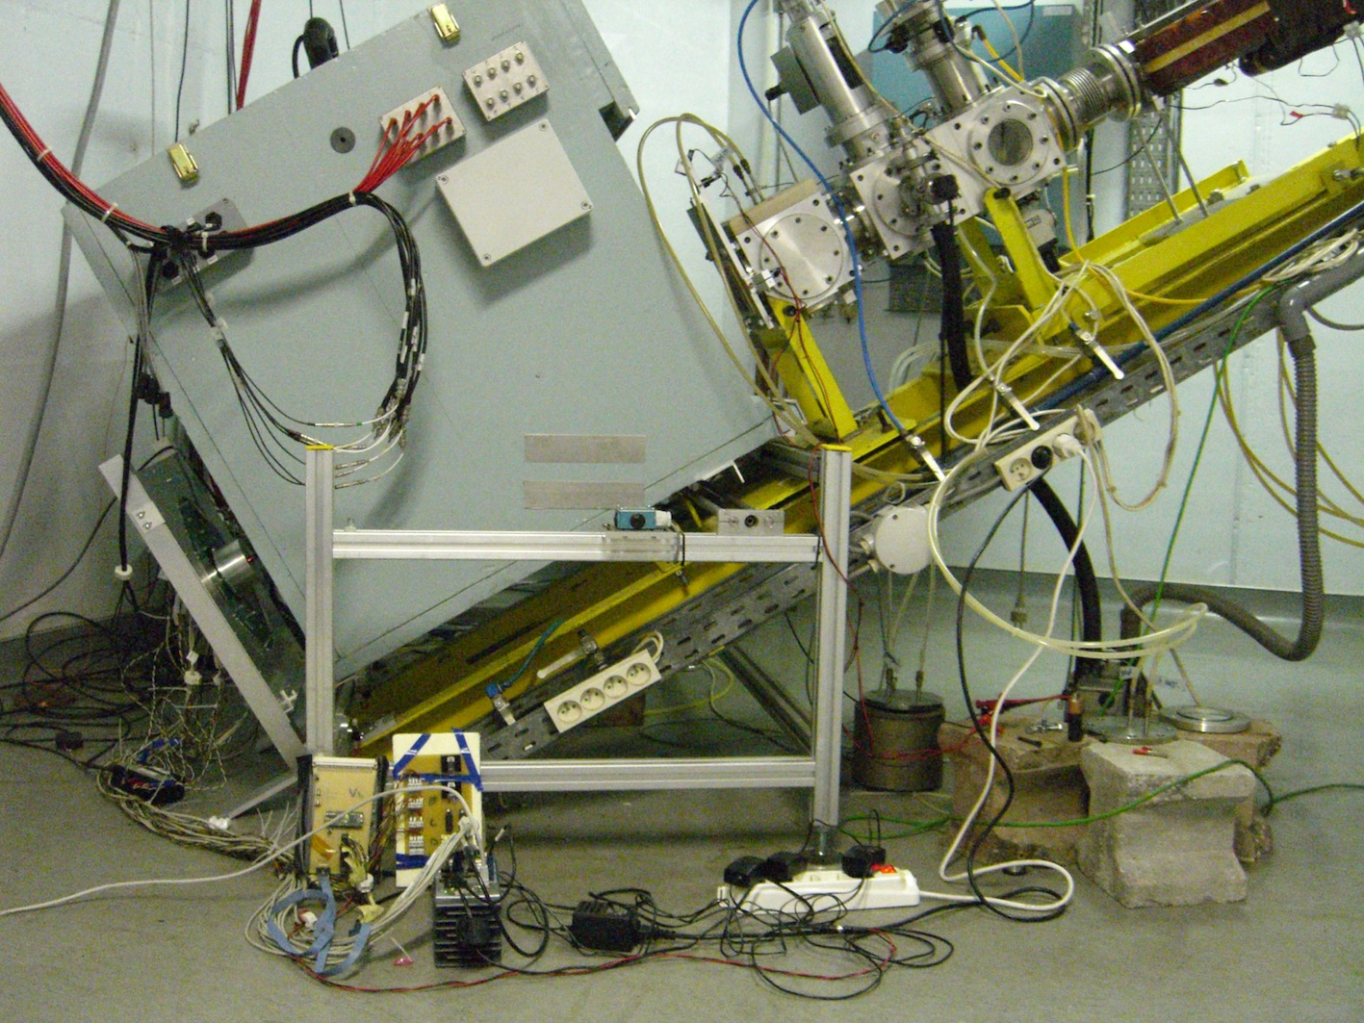
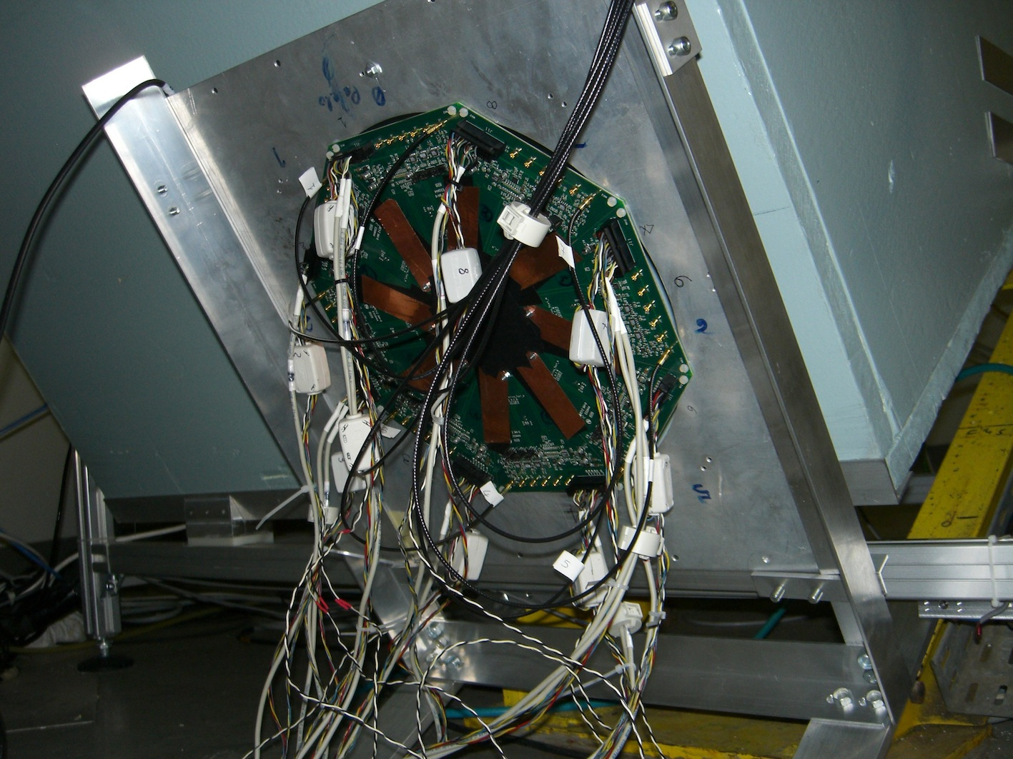
Experimental Setup
n
The SiPMs were mounted on a custom made PCB:
  Bias the SiPMs
  Connect the SiPMs with the DAQ
  Monitor the SiPMs temperature (4 pt100 probes)
The SiPMs were protected and light tightened through an aluminum cap fixed on the PCB
I-V characteristic curves were measured with a Keithley pico-Ammeter
Waveforms were acquired thanks to a CAEN Digitizer (2Gs, 12 bits)
SiPMs
Neutron beam line
SiPM holder

Slide 9
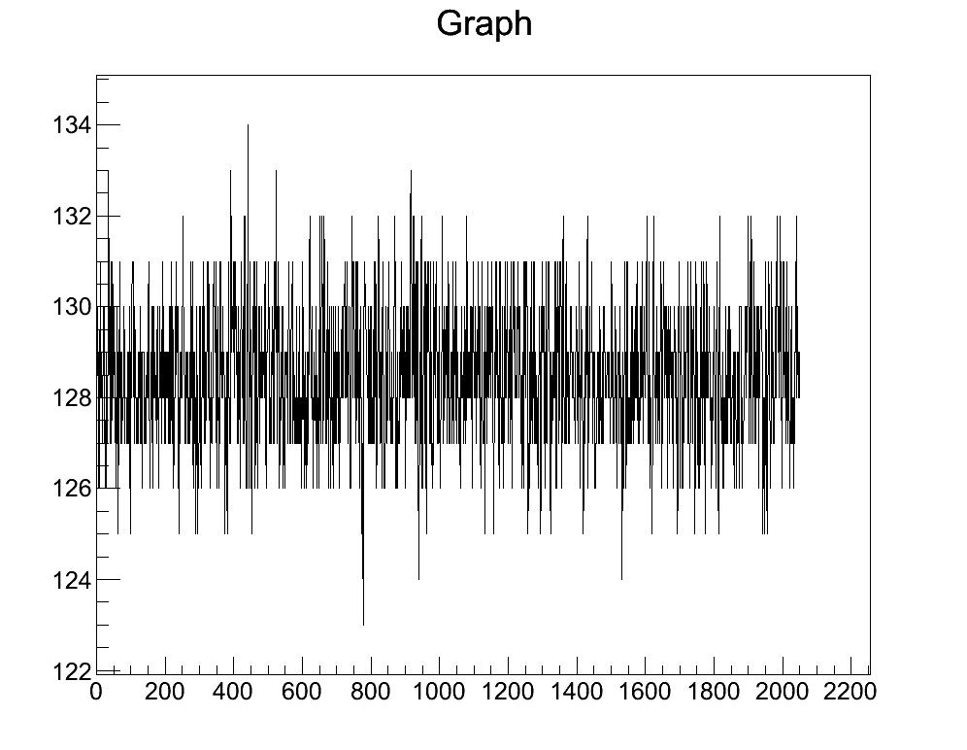
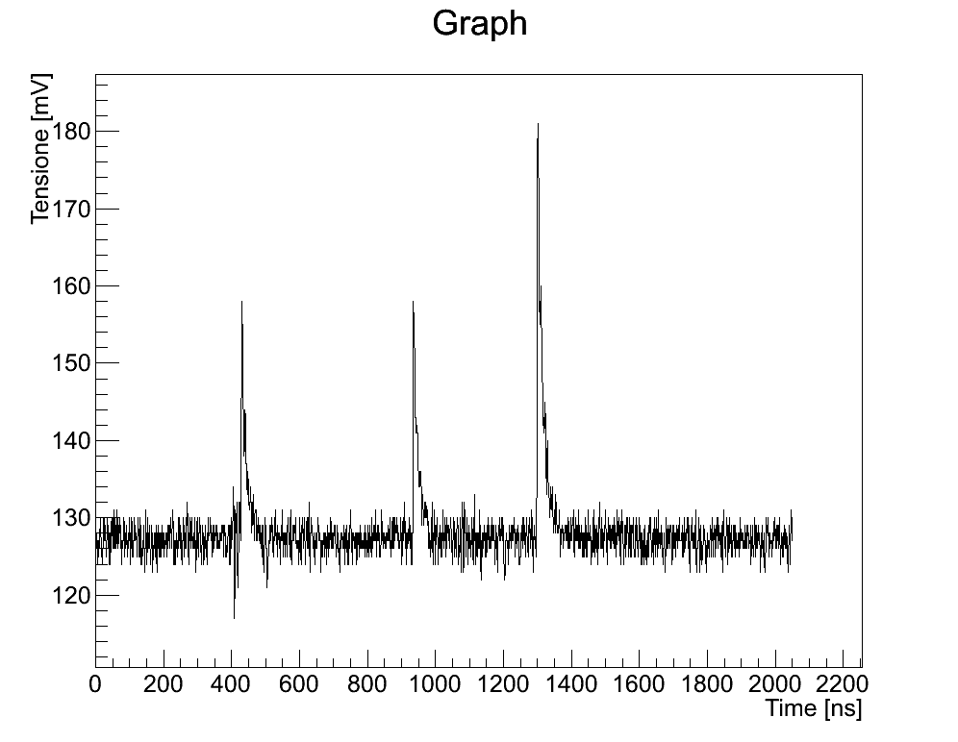
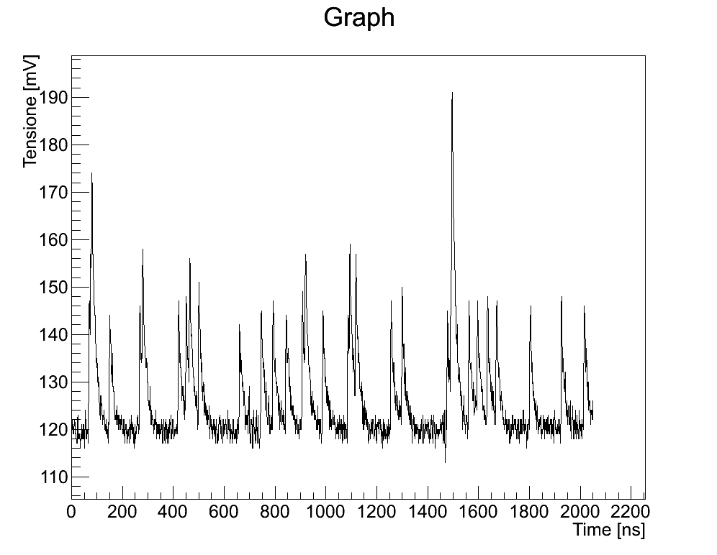
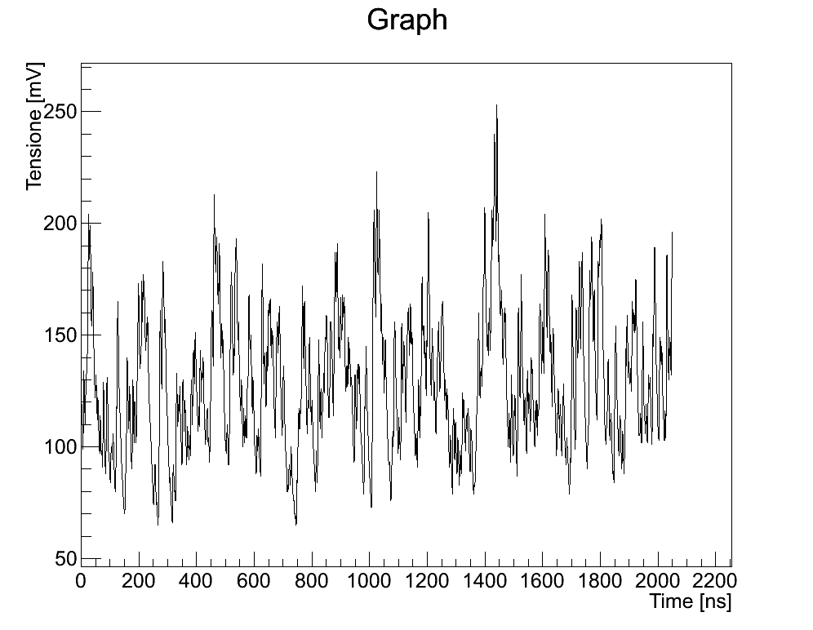
Results: Radiation Effect at a Glance
The radiation damage is very clear looking at the dark noise:
Before irradiation
5 x 10⁸ neq/cm²
5 x 10⁹ neq/cm²
5 x 10¹⁰ neq/cm²

Slide 10
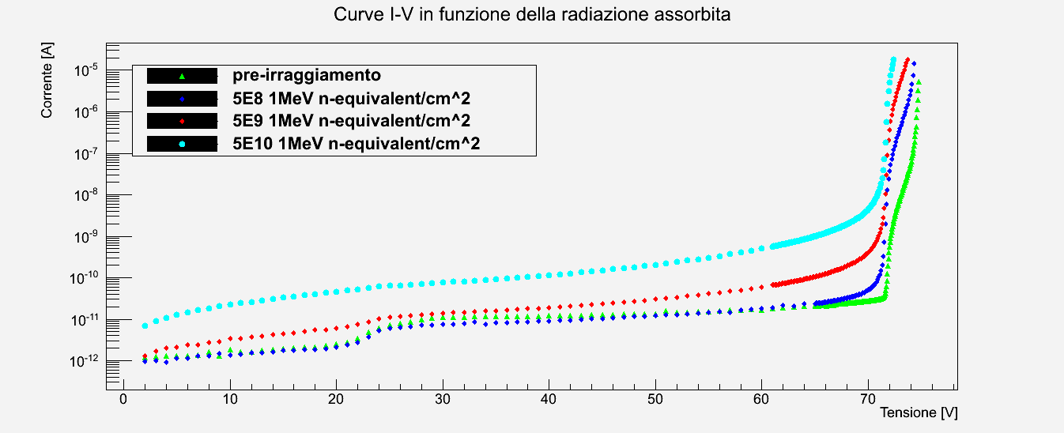
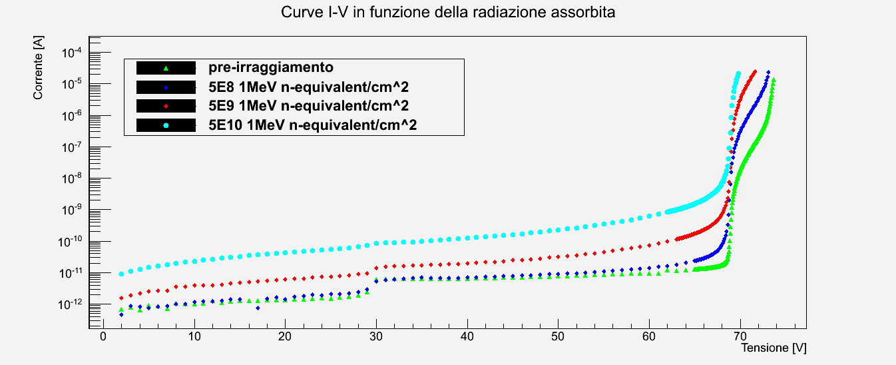
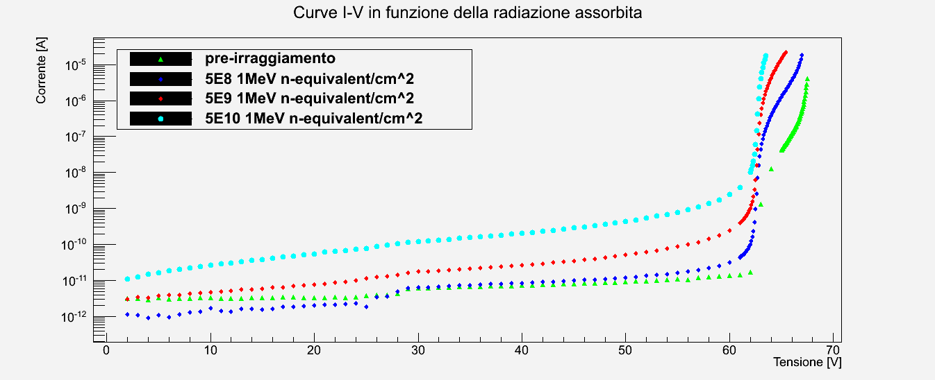
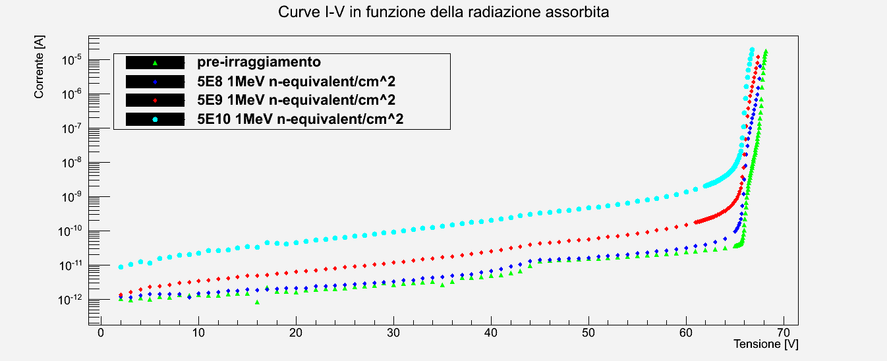
Results: I-V Characteristic Curves
Standard type:
Low afterpulse
Low afterpulse
New structure
In general all the devices show an increase of a factor ≈100 in the dark current
The breakdown point become less sharp and starts a few volts earlier
No significative differences among the devices

Slide 11
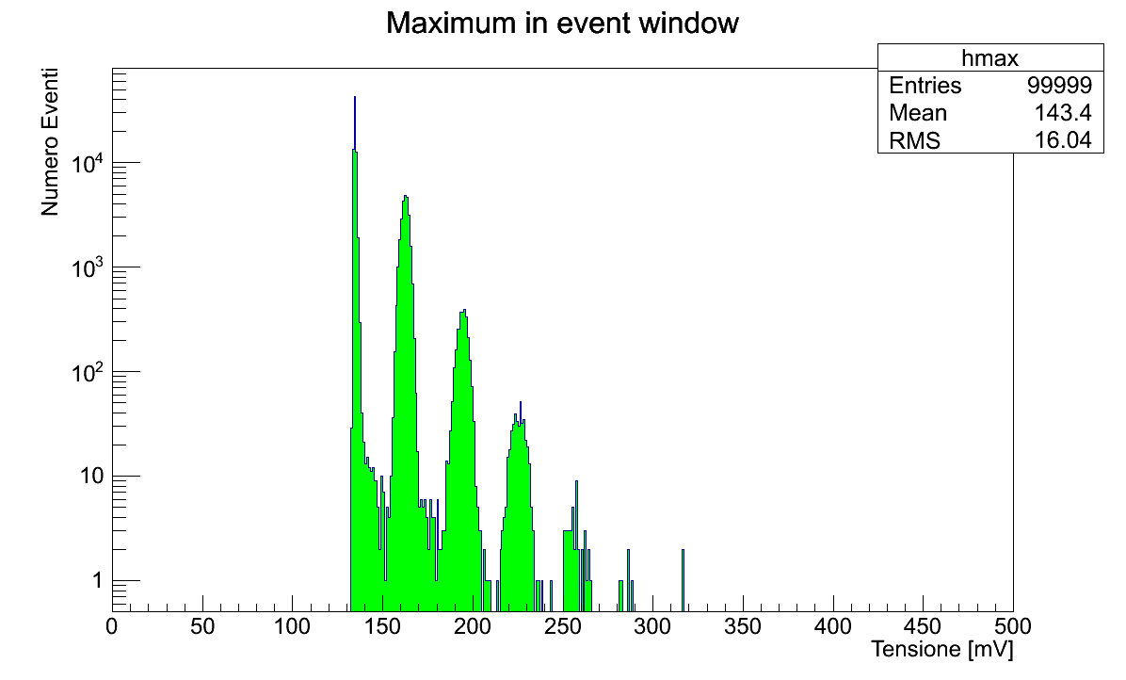
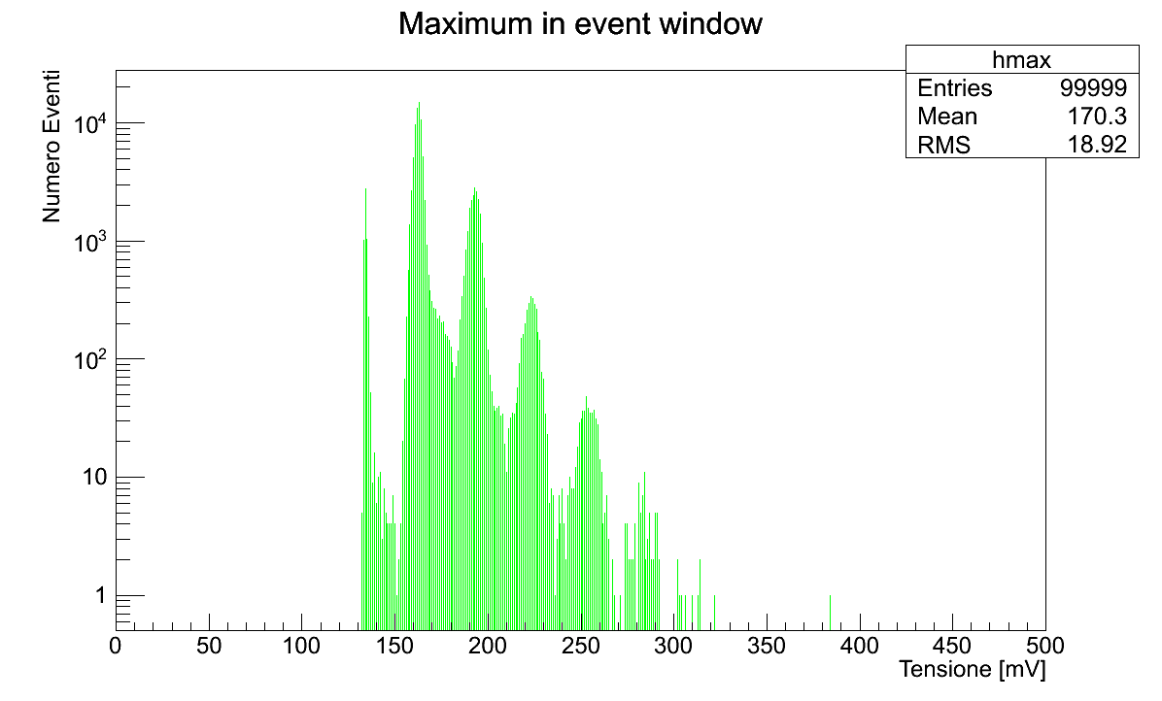
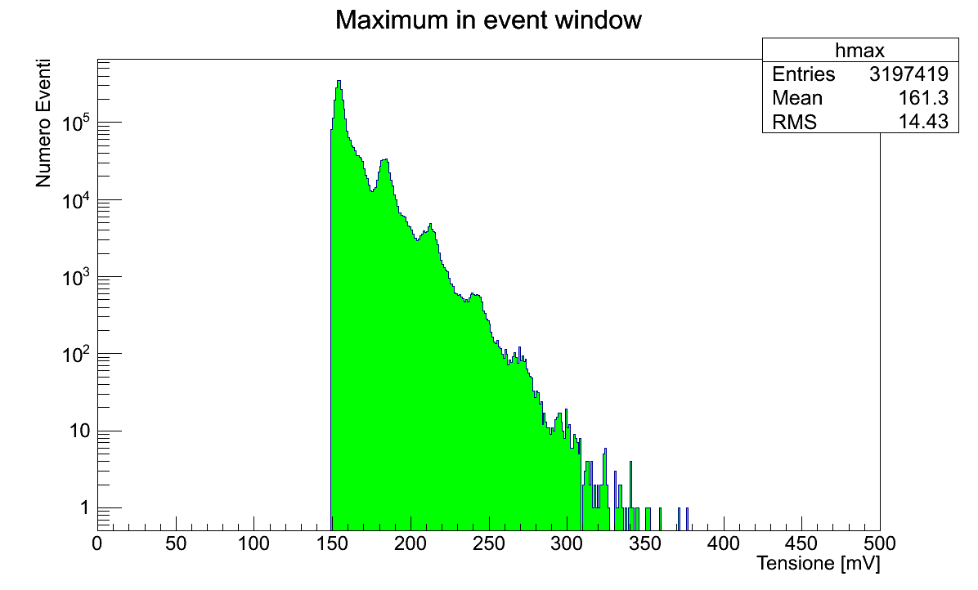
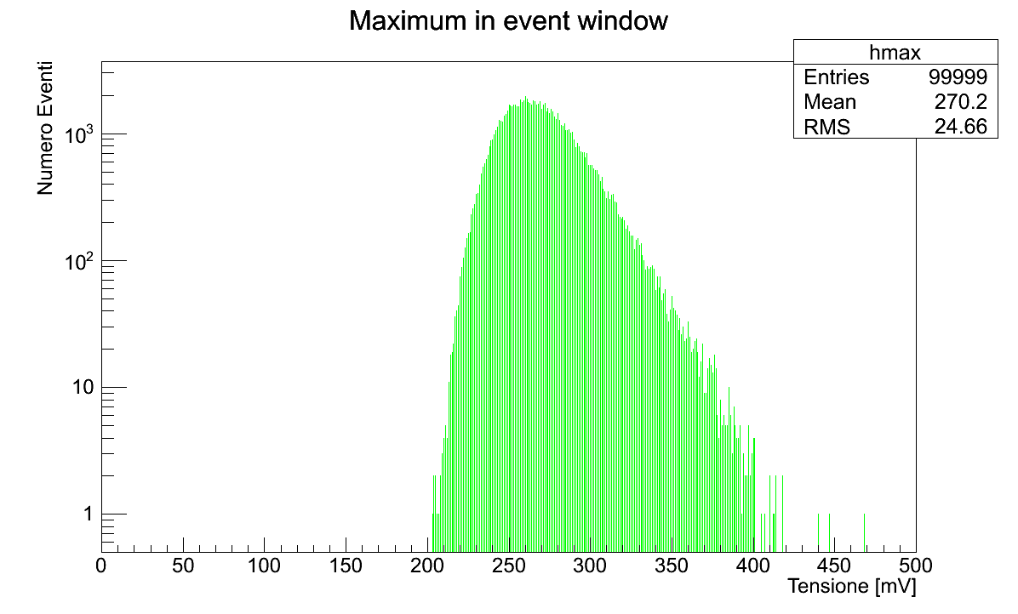
Results: Dark Spectra vs Dose
Before irradiation
5 x 10⁸ neq/cm²
5 x 10⁹ neq/cm²
5 x 10¹⁰ neq/cm²

Slide 12
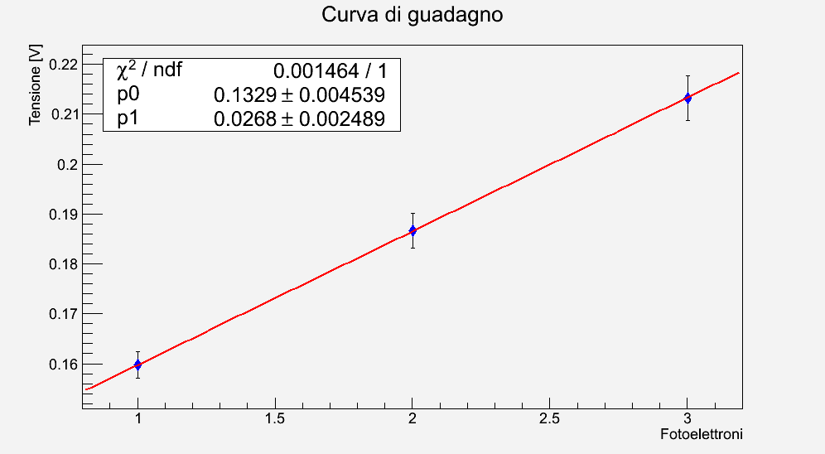
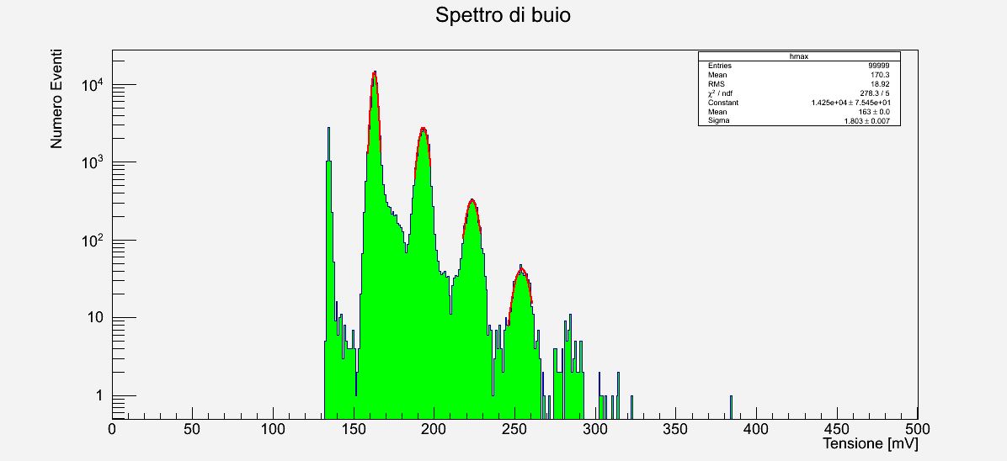
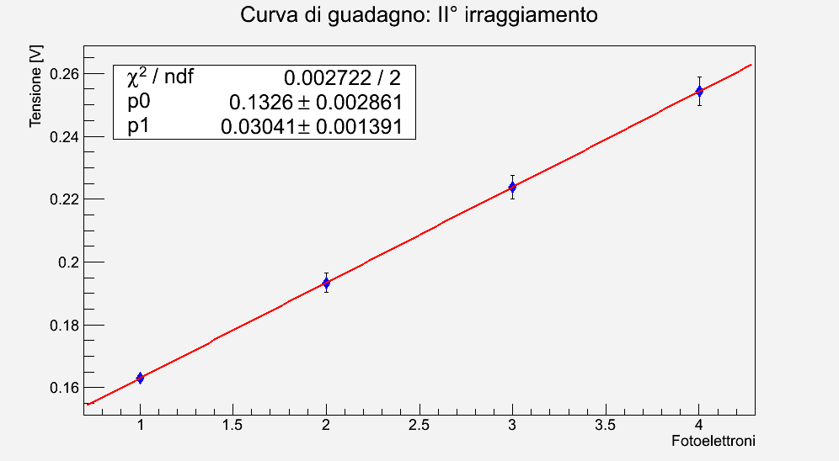
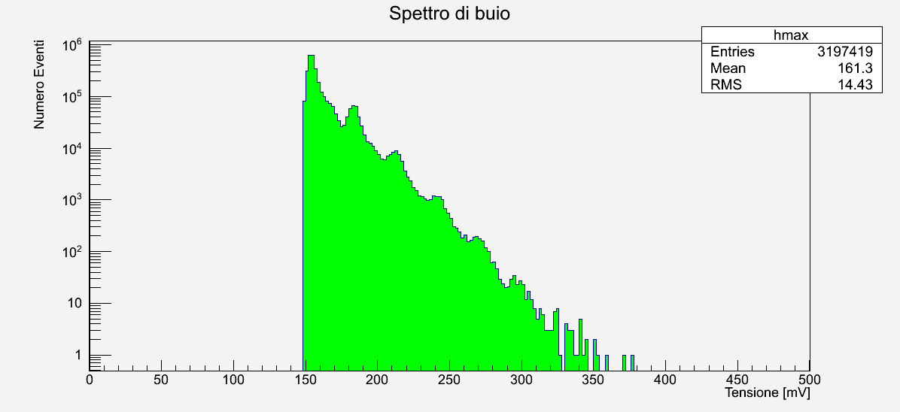
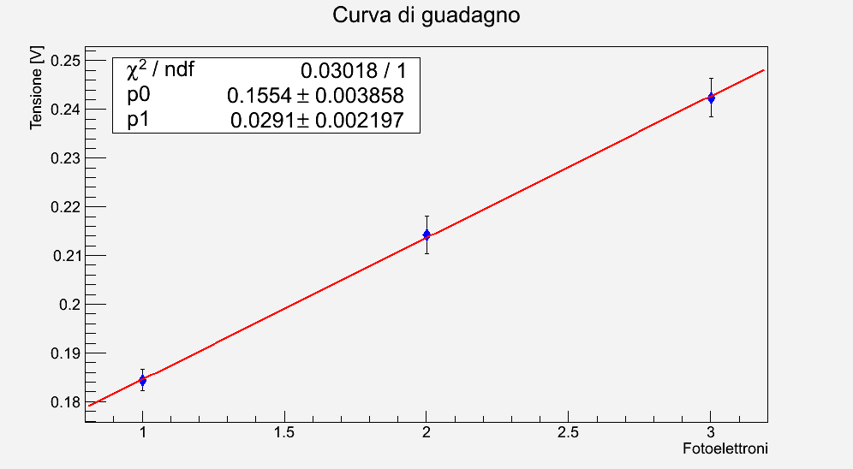
Results: Gain vs Dose
The Gain can be measured as long as the p.e. peaks are visible, i.e.
up to 5 x 10⁹ neq/cm²
Before irradiation
5 x 10⁸ neq/cm²
5 x 10⁹ neq/cm²

Slide 13
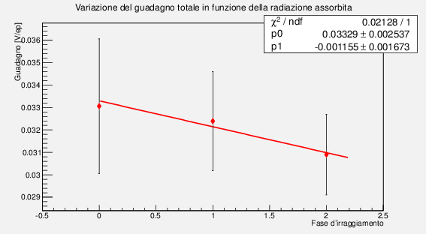
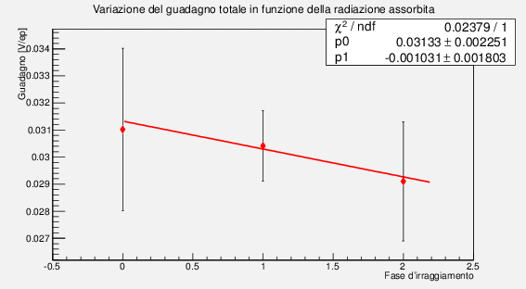
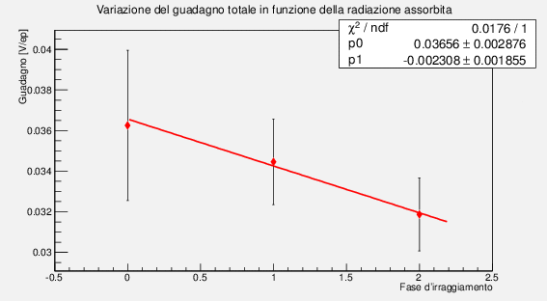
Results: Gain vs Dose
G₀ ≈ 33 mV/p.e.
G₀≈ 31 mV/p.e.
Standard type
Low afterpulse
The Gain reduction is ≈ 6.5% for the standard and low afterpulse types, about 11% for the new structure type
Initial gain of the new structure SiPM was ≈ 10% higher
Temperature effects have been corrected
G₀≈ 36 mV/p.e.
New structure

Slide 14
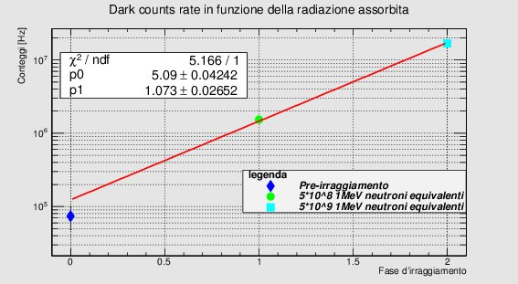
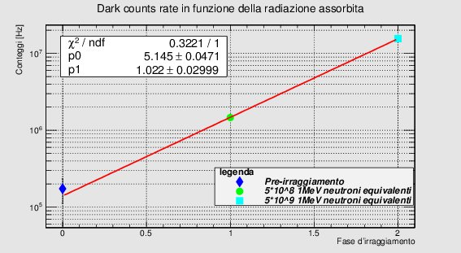
Results: Dark Noise
0.5 p.e. threshold
0.5 p.e. threshold
standard device
low afterpulse
The rate was measured counting the average number of signals above 0.5 p.e. in the acquired time window (2 μs)
The dark count rate increases ≈ factor 10 at each irradiation step
No significative differences among the devices

Slide 15
Conclusions
16 SiPM Hamamatsu have been irradiated on a 23MeV neutron beam in Louvain-la-Neuve
The devices were of 3 types: standard MPPC-like, low afterpulse, new structure
The integrated 1MeV equivalent doses were:
  5 x 10⁸ 1MeV-eq n/cm²
  5 x 10⁹ 1MeV-eq n/cm²
  5 x 10¹⁰ 1MeV-eq n/cm²
After each step and for each device we acquired:
  the characteristic I-V curve
  a sample of 100k waveform, to measure gain and dark count
According to our measurements, no significative differences in the main parameters have been observed
A more detailed analysis is ongoing

Slide 16
Spare

Slide 17
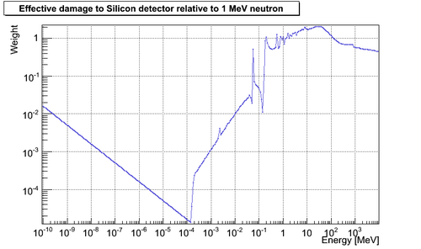
NIEL (Non Ionizing Energy Loss) curve for silicon

