Slide 1
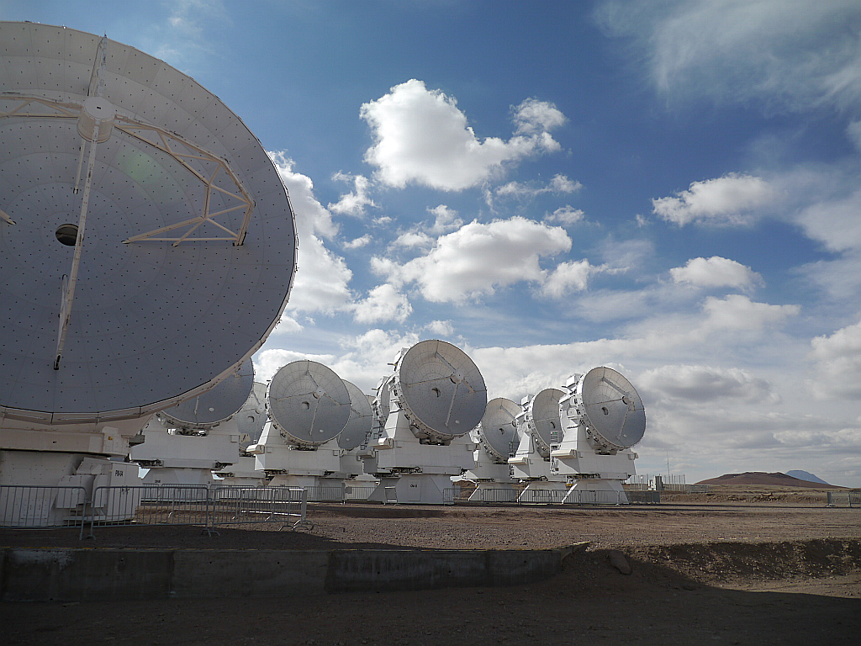


AMKID and ALMA
Large Submillimeter Instruments in Atacama desert
A. Baryshev
SRON/Kepteyn Astronomical Institute/RuG

Slide 2
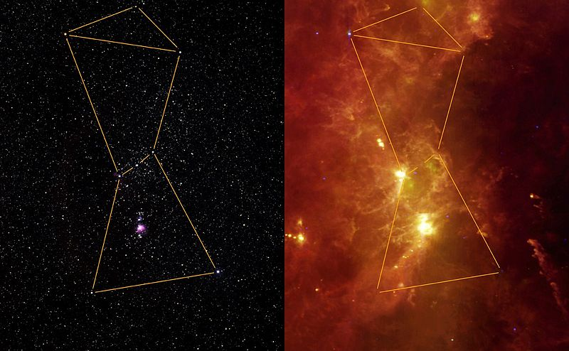
Why far-infared submillimeter astronomy
Optical
Far infrared
Orion

Slide 3
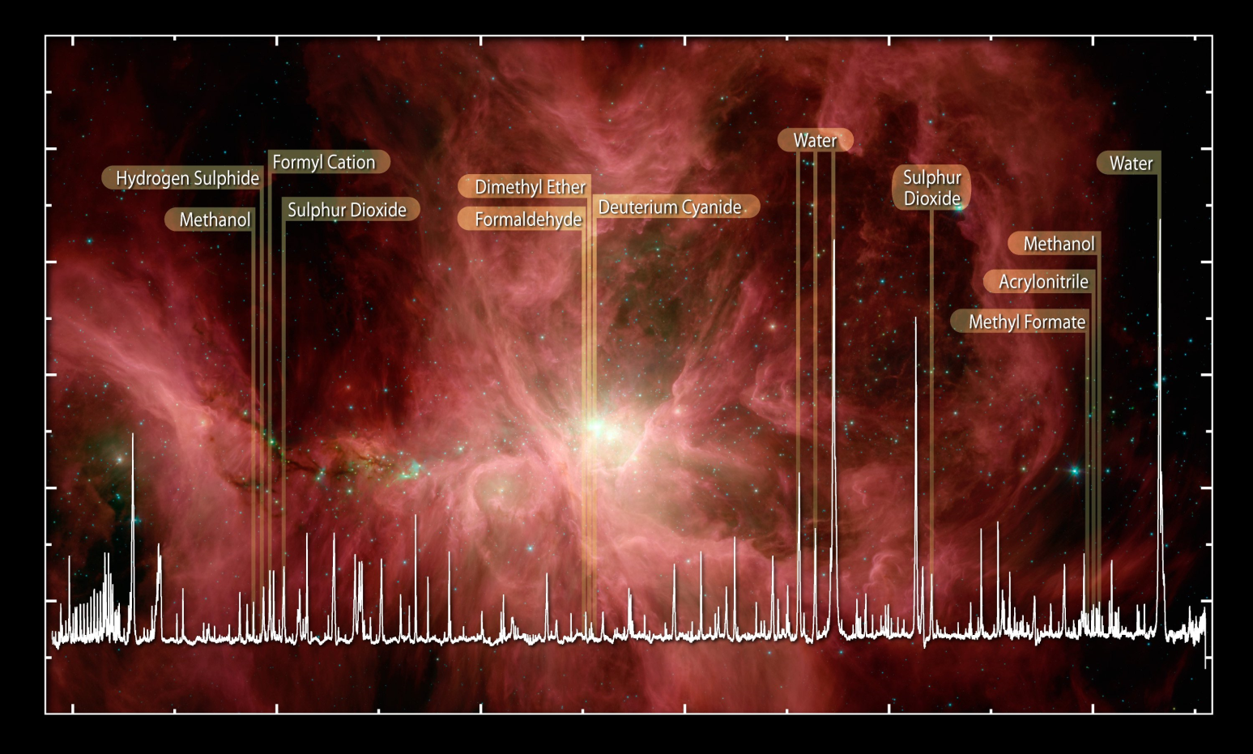
A lot of chemical information in spectral lines
Sugar – yes!, coffee – Not yet
Orion spectrum by Hershel HIFI

Slide 4
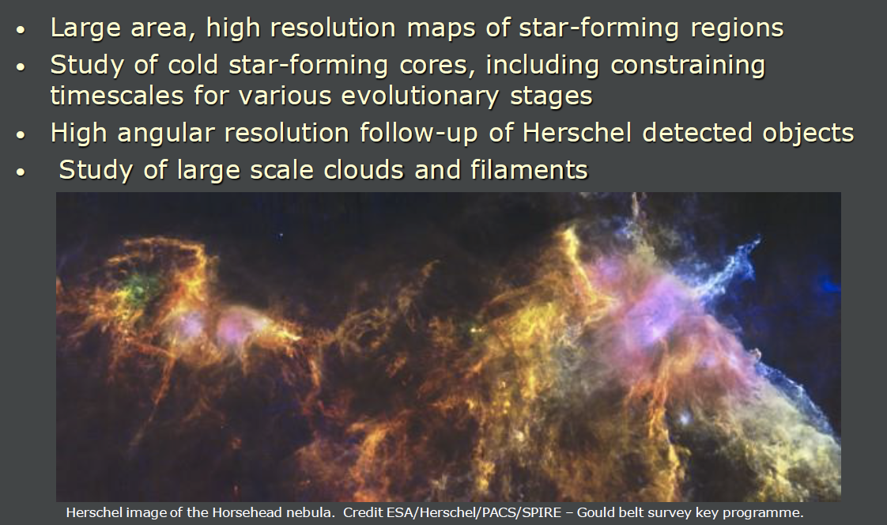
Star formation
And much much more

Slide 5
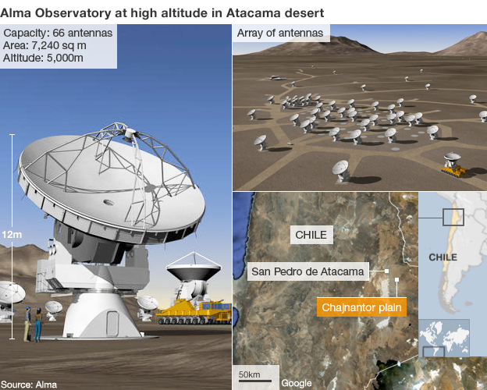
Atakama large millimeter submillimeter array (ALMA)

Slide 6
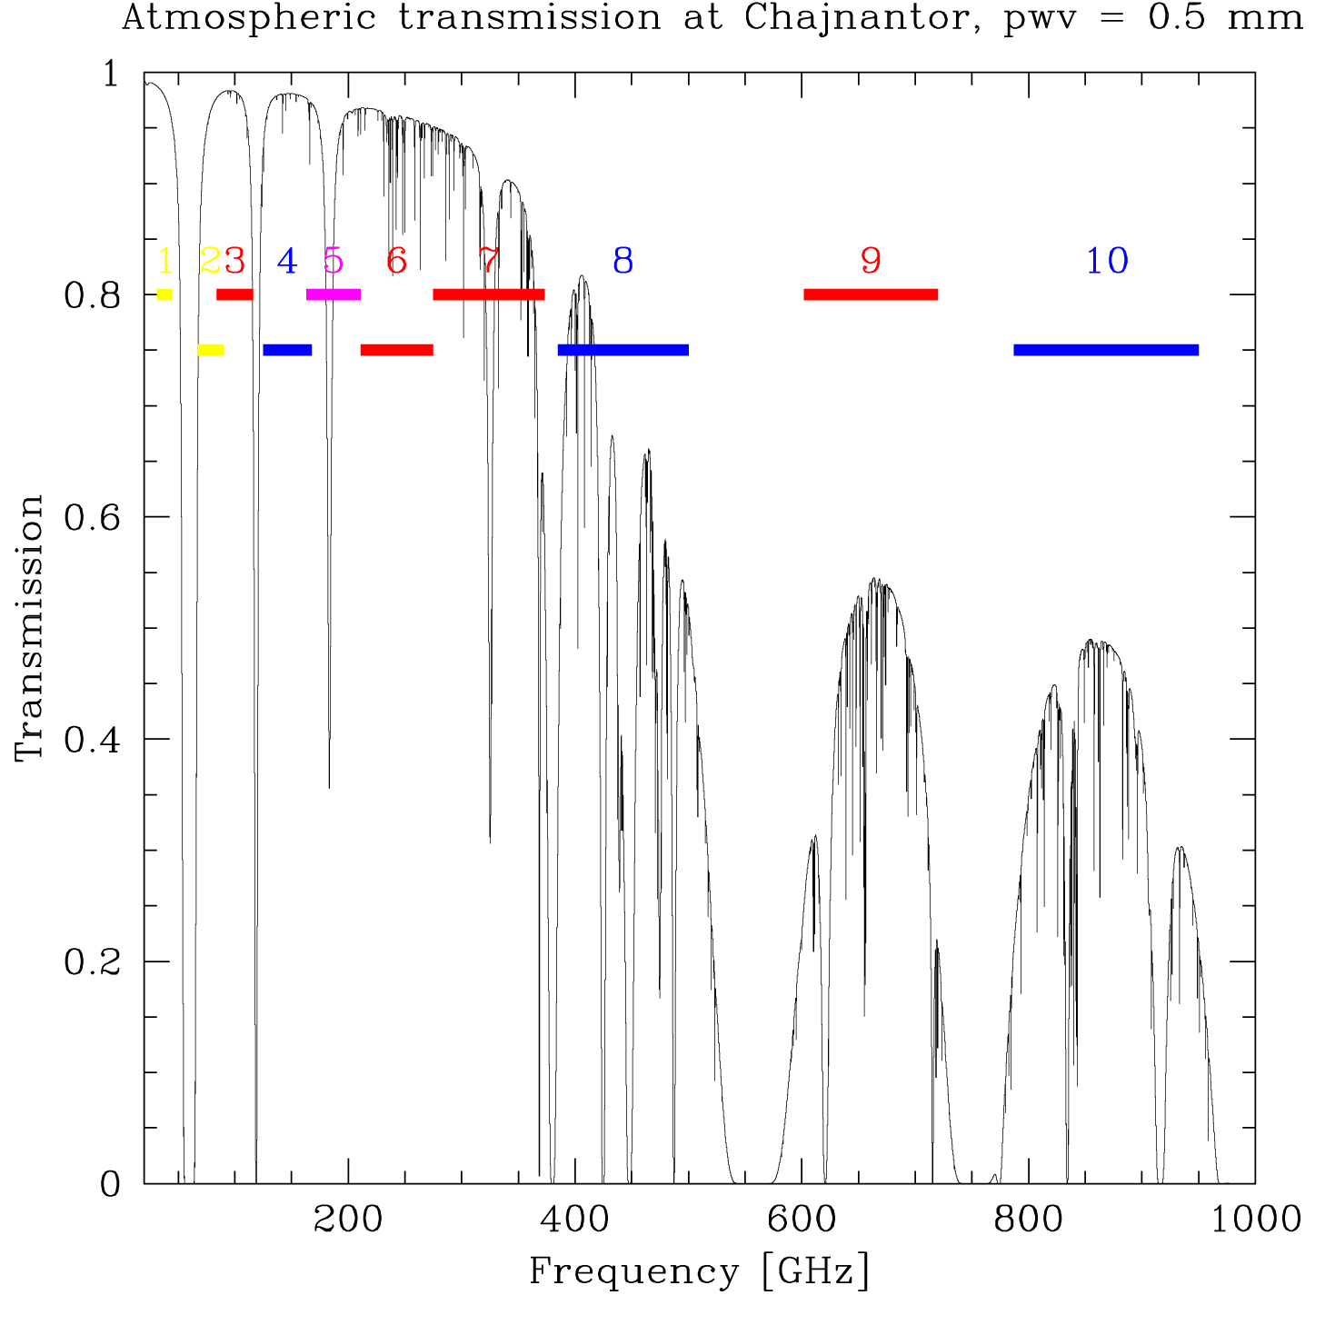
ALMA Frequency bands, athmosphere

Slide 7
ALMA project
Initial project
  Europe (ESO+Spain) + North America (NRAO+Canada) + Chile
  50 12-m antennas at 5000-m in the Atacama desert in Chile
  antenna baselines = 150 m to 18 km (reconfigurable)
  4 receiver bands around 100, 250, 325, and 650 GHz (first light)
    DSB/2SB receivers
    Dual polarization
    Wide band IF (4-12 GHz)
    Cryogenic temperatures
  possibility to expand to 10 bands over 30 GHz to 1 THz
  Wide band IF (4-12 GHz) 6 Mb/s average data rates (60 Mb/s peak)
After Japan has joined in 2004
  additional 4 12-m + 12 7-m antennas (compact array)
  additional correlator
  receiver bands around 150 and 450 GHz (+ possibly 850 GHz)
1200 M$ (Y2K)

Slide 8
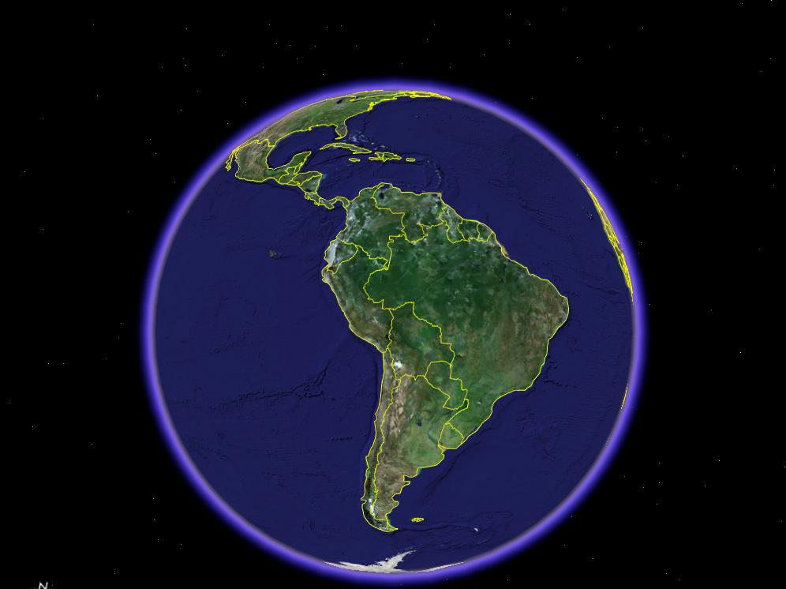
The ALMA Site

Slide 9
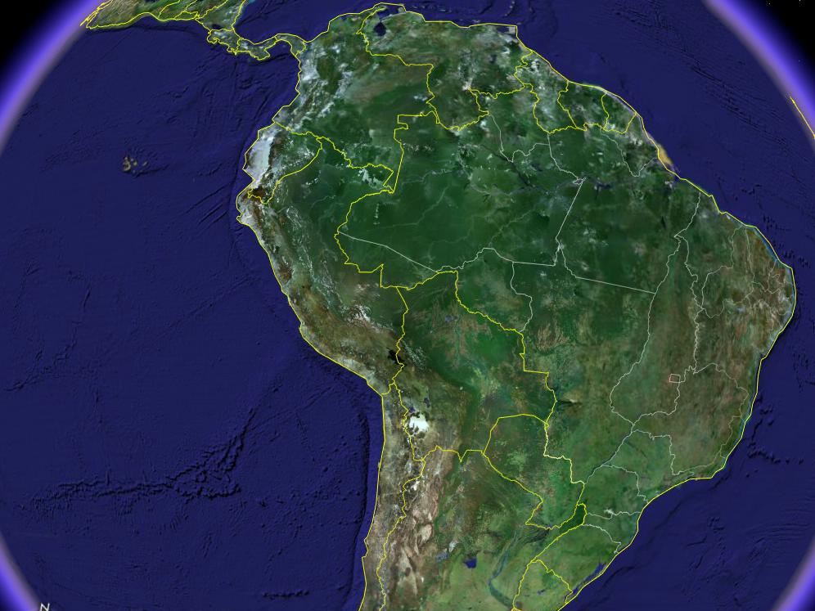

Slide 10
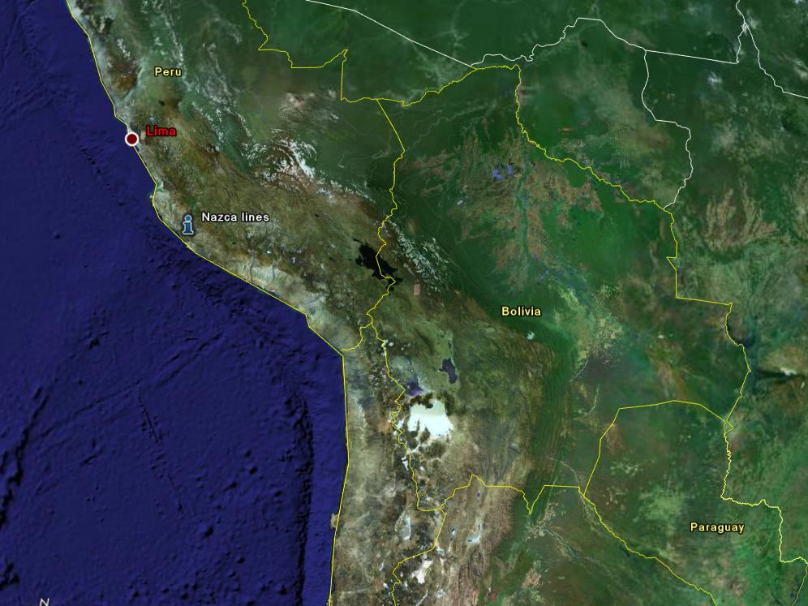

Slide 11
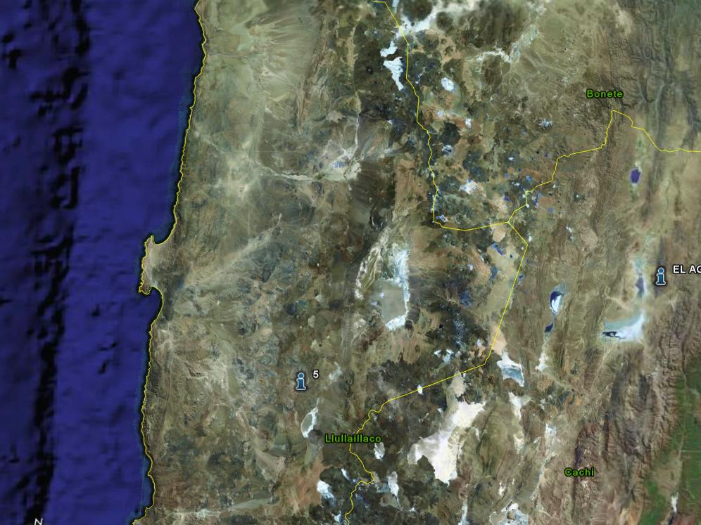

Slide 12
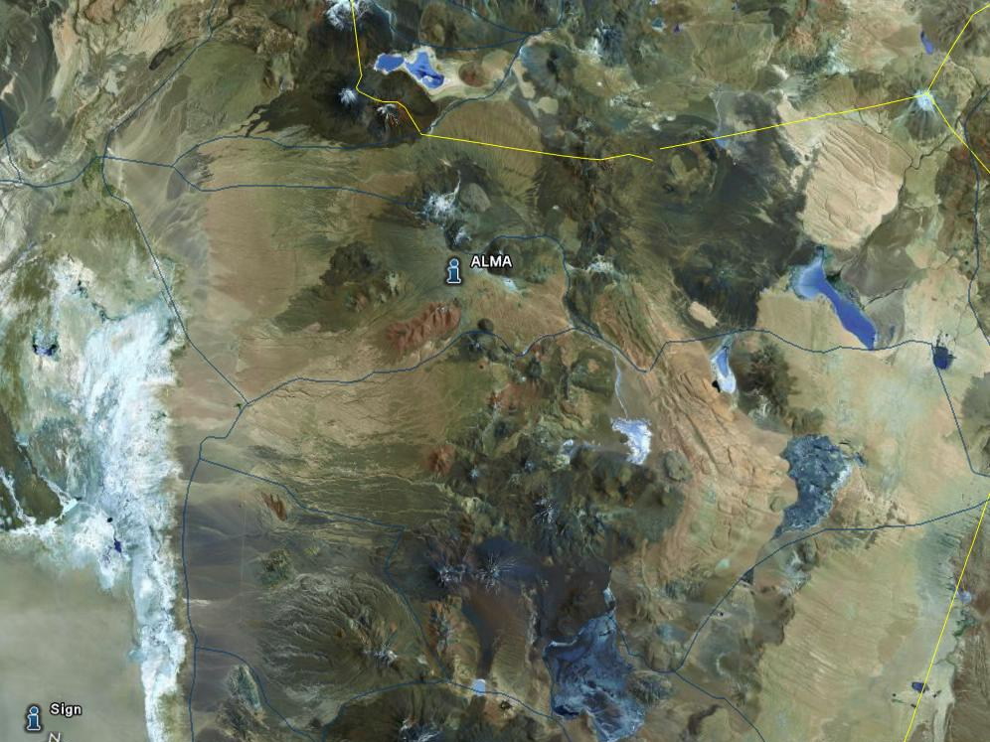

Slide 13
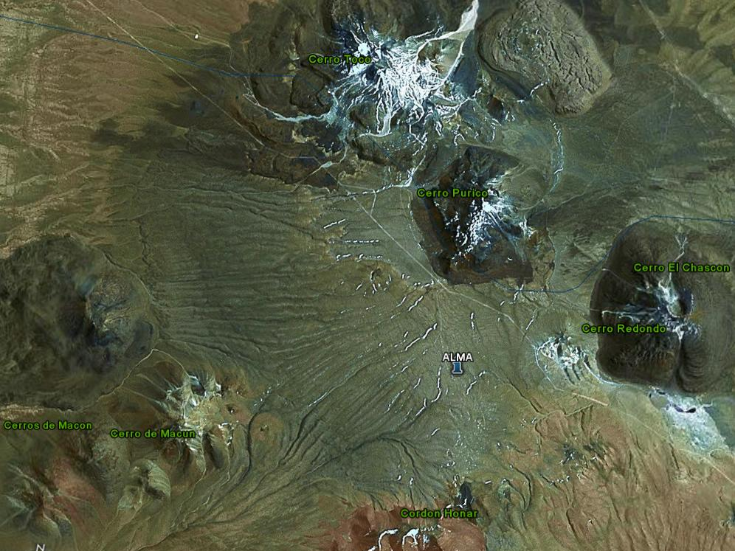

Slide 14
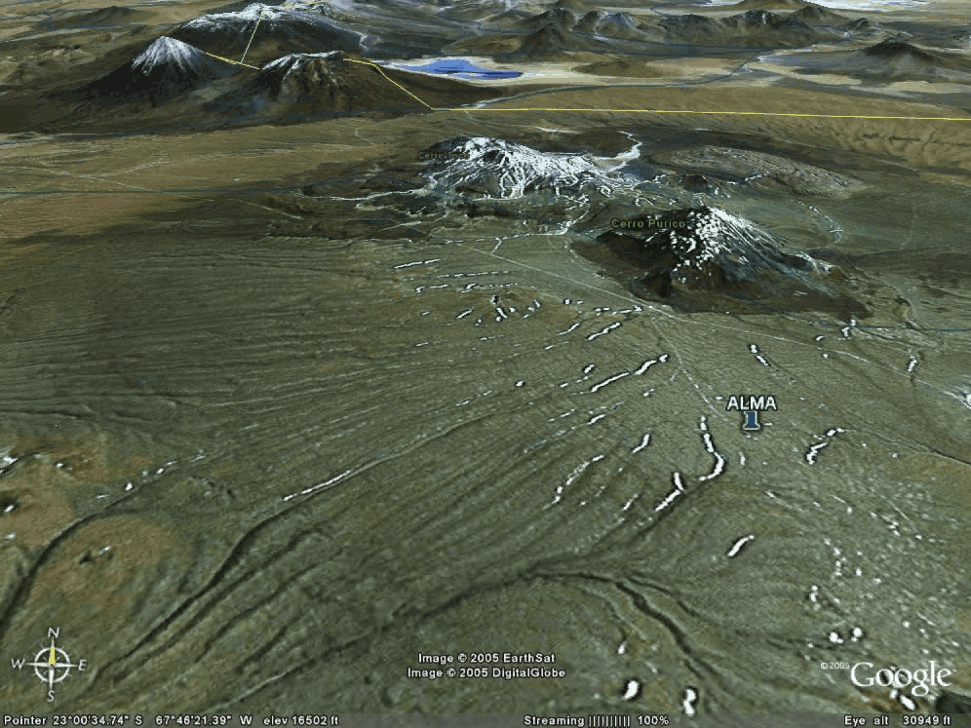

Slide 15
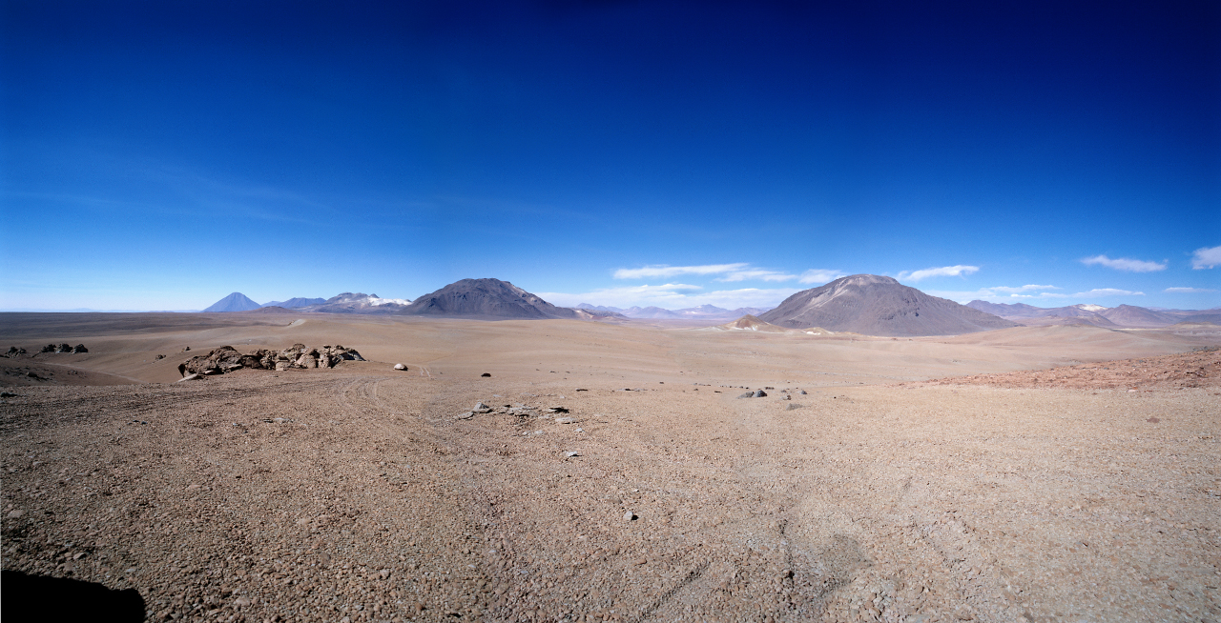
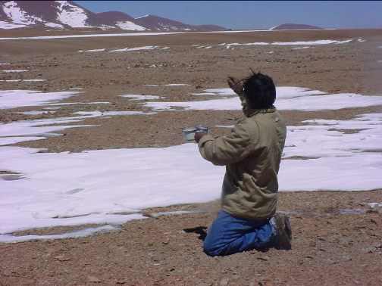
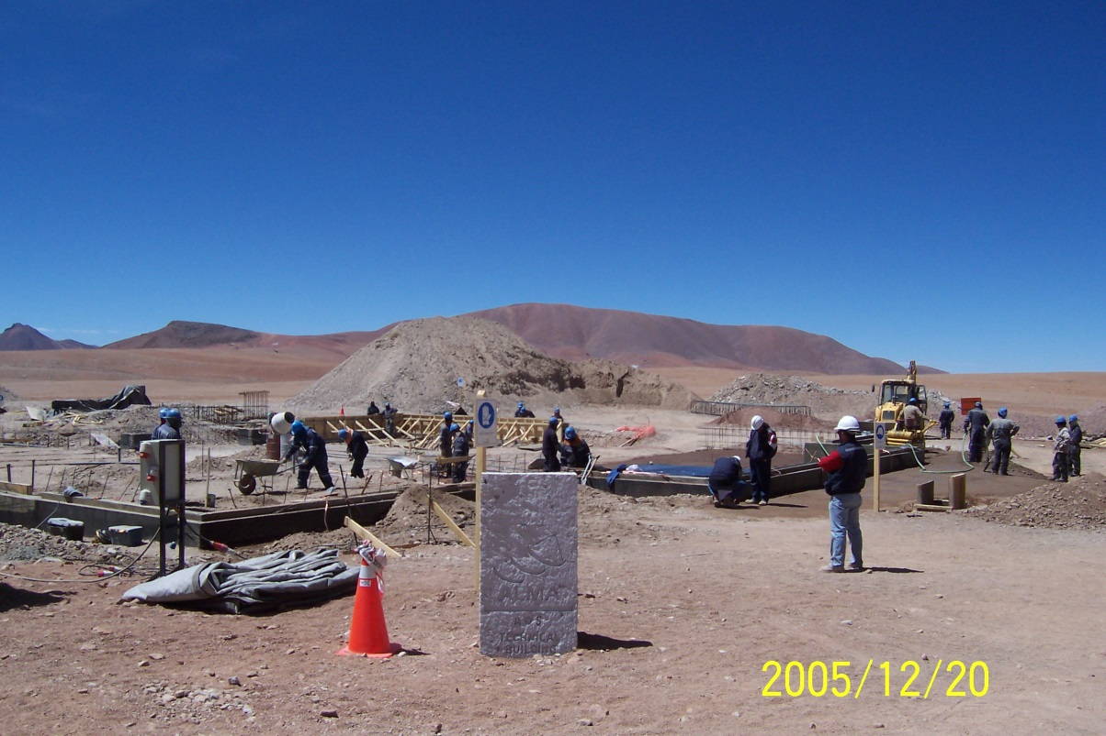
The ALMA Site
Shaman
Building activity

Slide 16
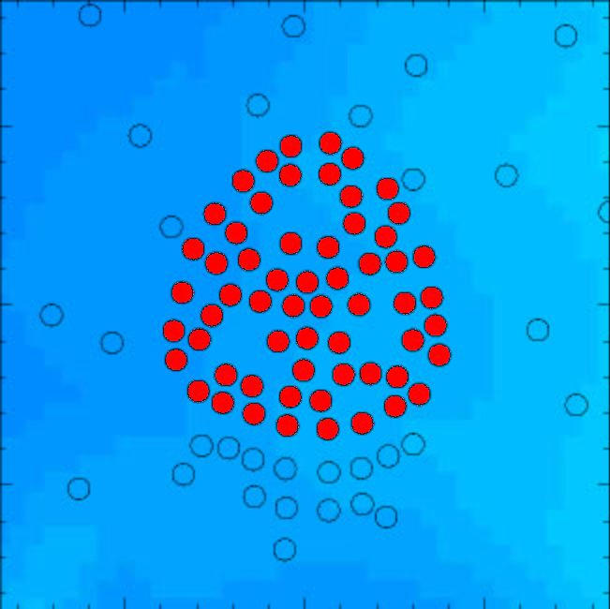
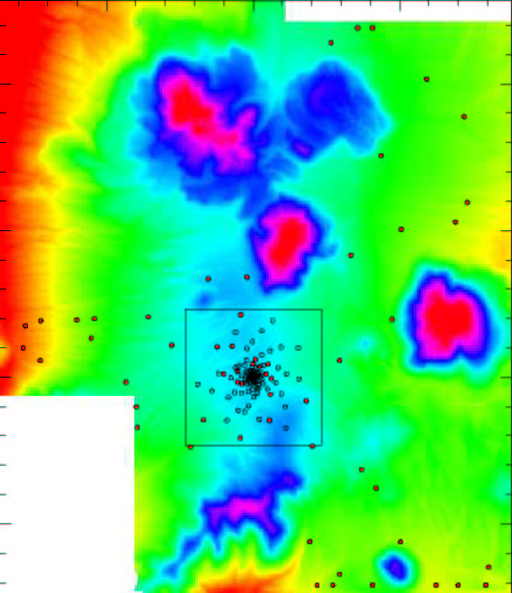
ALMA Configurations
150 m Maximum Baseline
18 km Maximum Baseline

Slide 17
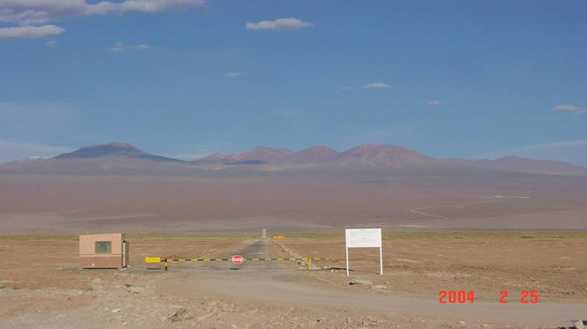
Operation Support Facility
between San Pedro de Atacama and the ALMA site
  2900 m altitude, private road to ALMA site (under construction)
array operations, including
  final integration of the antennas before transport to site
  maintenance and repair (not on site due to altitude)
To AOS (43km)
OSF Site (15km)

Slide 18
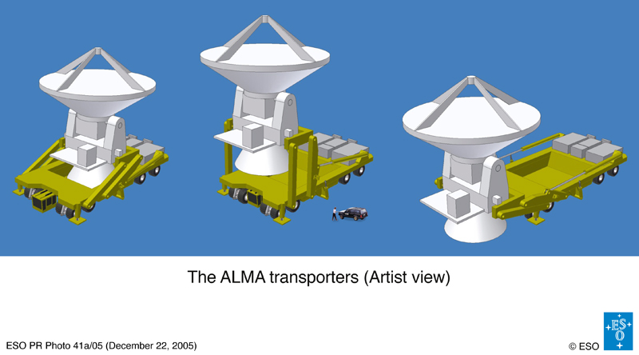
ALMA Transporter

Slide 19
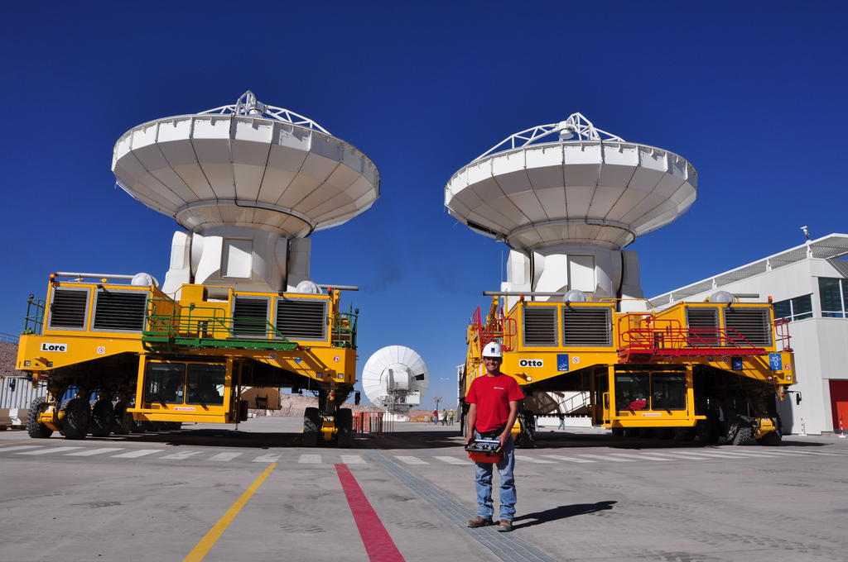
Lore en Otto

Slide 20
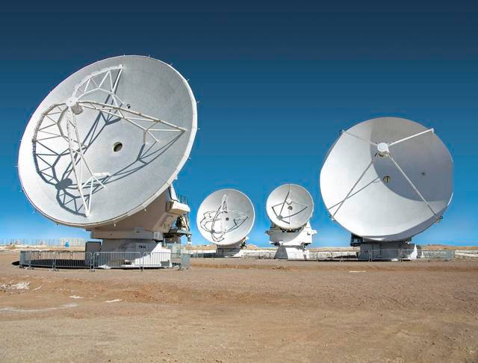
4 telescope types

Slide 21
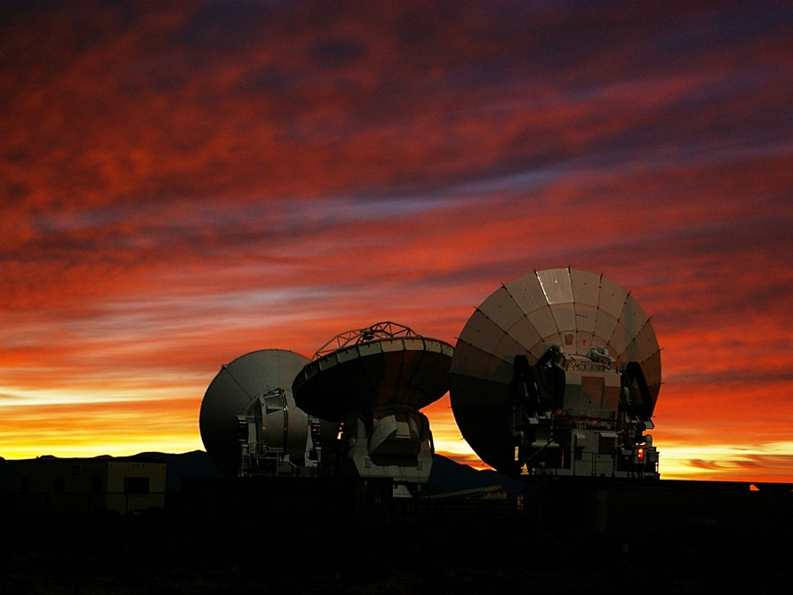
ALMA Antennas
JP
US
EU
12 m, 0.5 deg/sec rotation, 1.5 degree switch, 25 micron shape accuracy, 15 micron phase stability

Slide 22
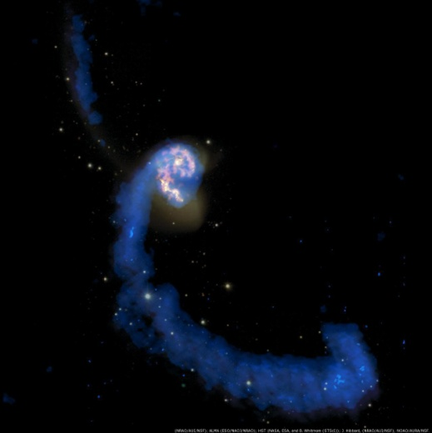
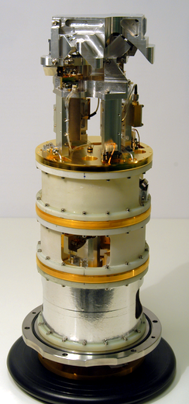
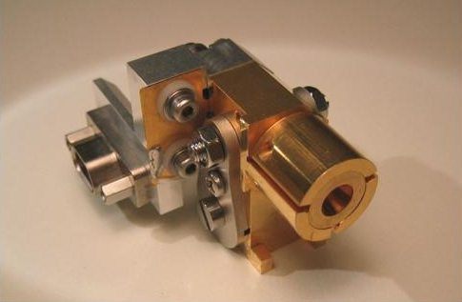
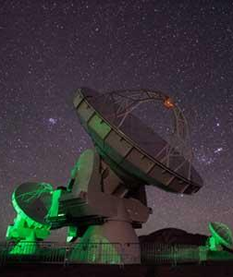
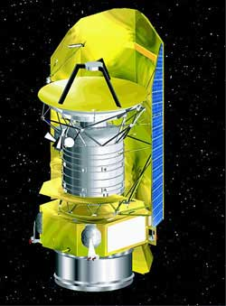
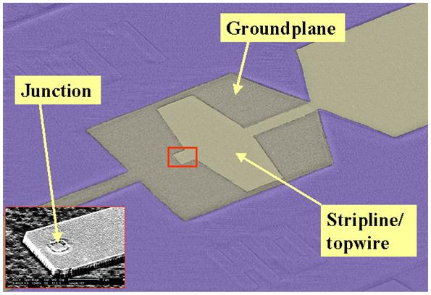
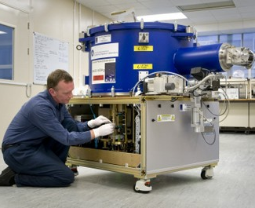
ALMA heterodyne receiver technology
Sky object
SIS mixer
Telescope
Front-end
Detector chip

Slide 23
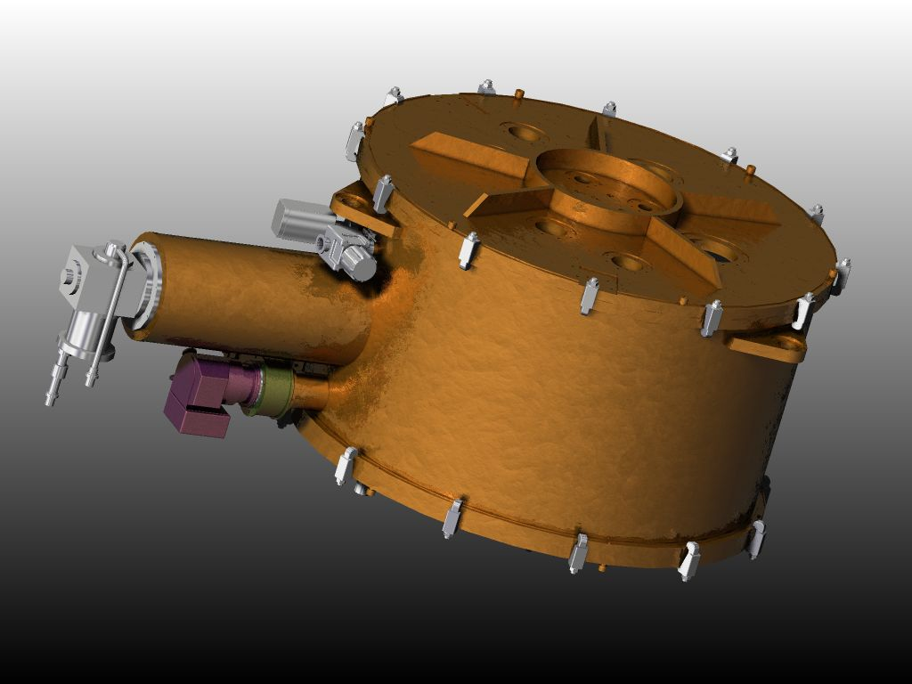
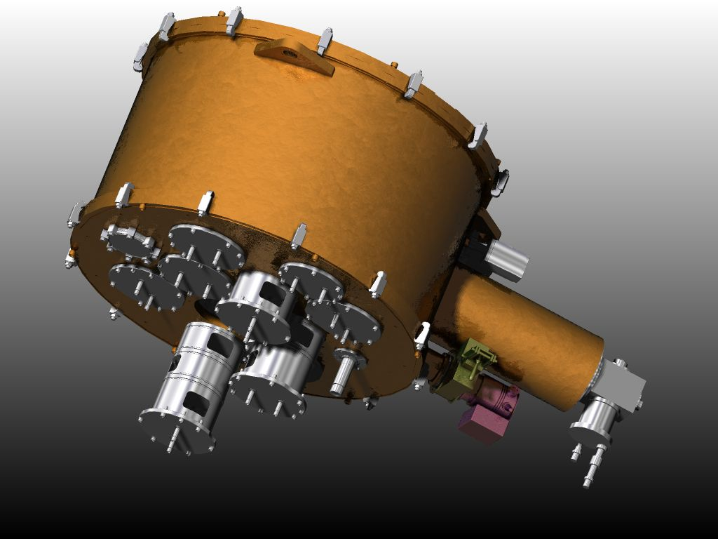
Achter elke telescoop:1 Cryostaat
1 m diameter, ~ 65 cm hoog
Plek voor 10 ontvangers
Koelen tot 4 K

Slide 24
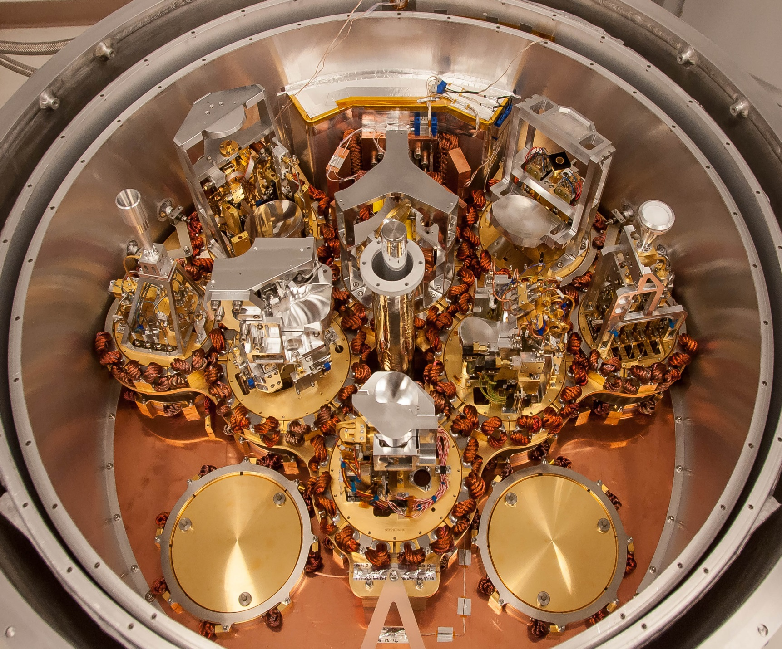
Cryostat met banden 3 tot 10

Slide 25
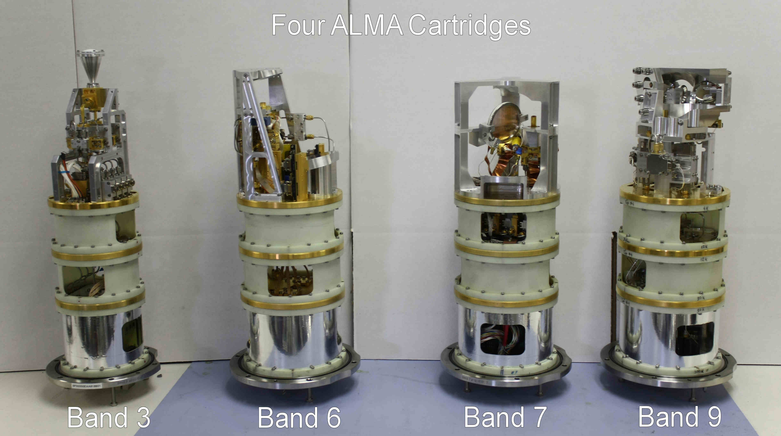
Baseline receivers

Slide 26
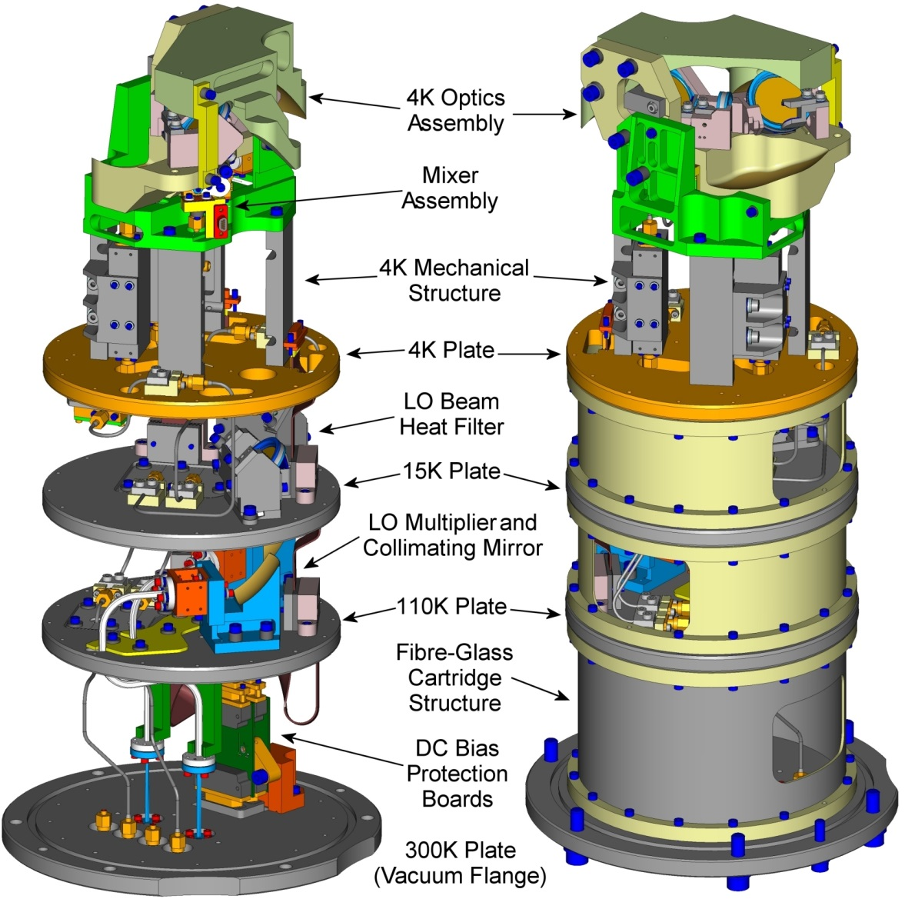
ALMA Band 9 design
field-replaceable unit
  “core” of a heterodyne front end
  “plug-and-play” in the cryostat
solid-state broad-band tunable LO
  mm-wave (100 GHz) power amplifiers in warm structure
  cold frequency multipliers to operating frequency
low-noise mixers at 4K
  DSB SIS mixers
focal plane optics
low-noise IF amplifier chain
  1 cryogenic + 1 warm amplifier
rigid structure
monitor and control electronics
2 linearly polarized channels

Slide 27
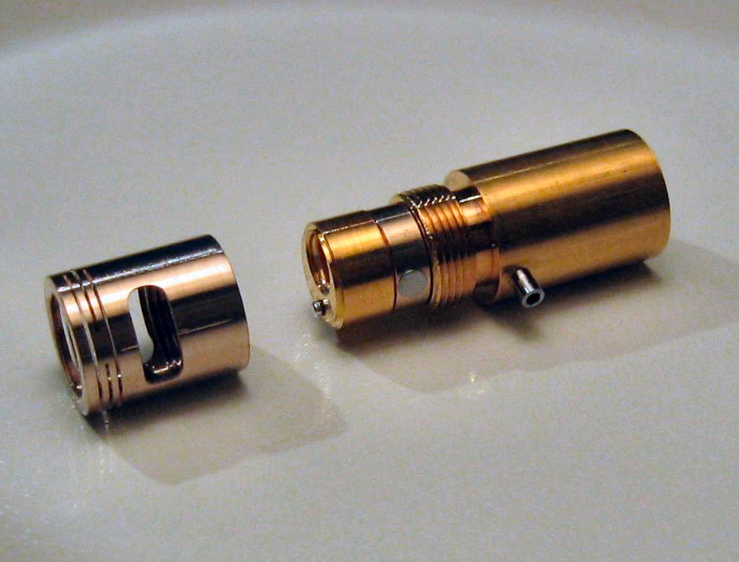
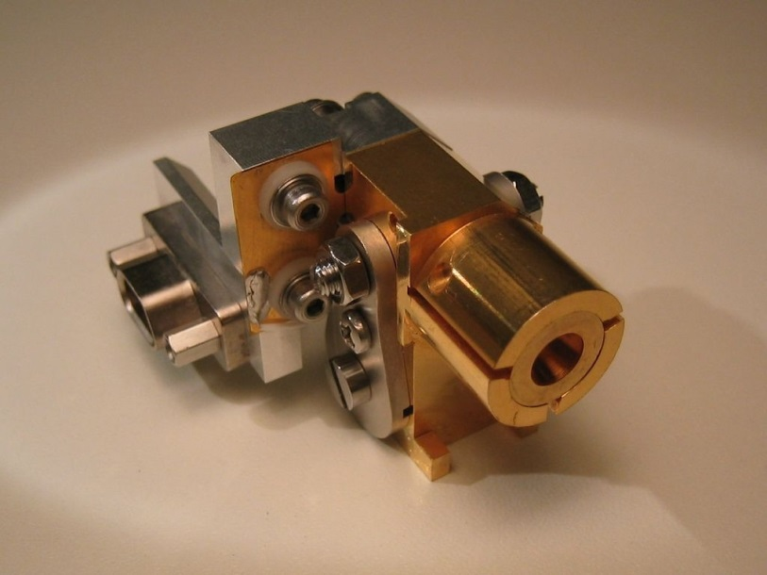
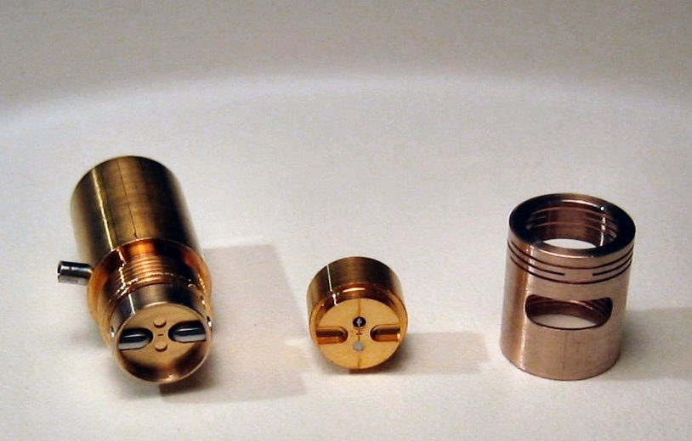
SIS Mixer
Simple construction,
Easy to assemble

Slide 28
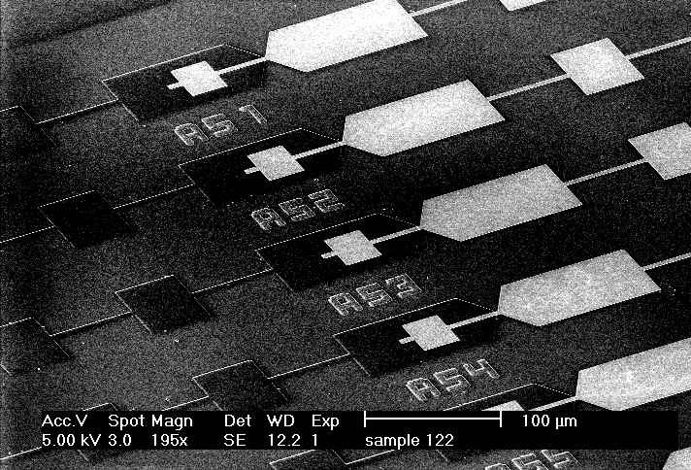
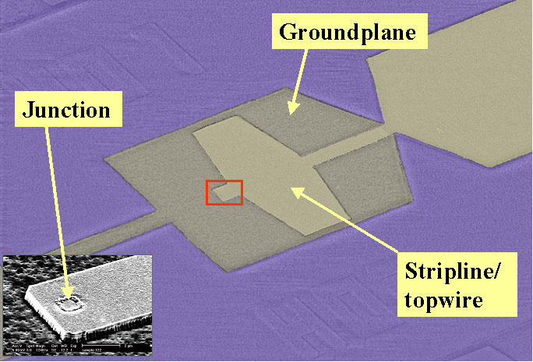
SIS Technology
THz SIS mixers
  quantum-limited sensitivities
  600-720 GHz bandwidth
    LO tuning range
  4-12 GHz IF bandwidth
    4-8 GHz in HIFI
SIS junctions (TU Delft)
  Nb SIS technology
  optimized fabrication
    larger quantities
    improved pattern accuracy
    1 µm structures are 1 µm
waveguide device mounts
  optimized for series production
corrugated horn antennas (RPG)
  commercial product
  100 µm structures +/- 5 µm
SIS Junctions (TU Delft)

Slide 29
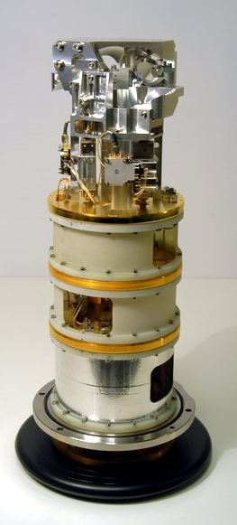
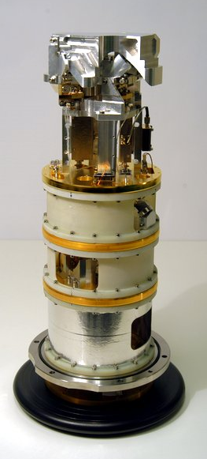
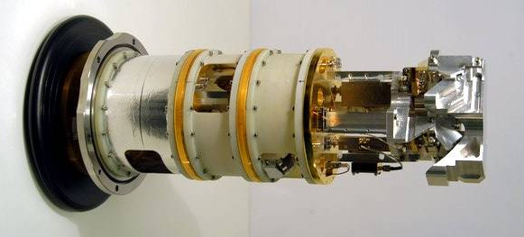
ALMA BAND 9

Slide 30
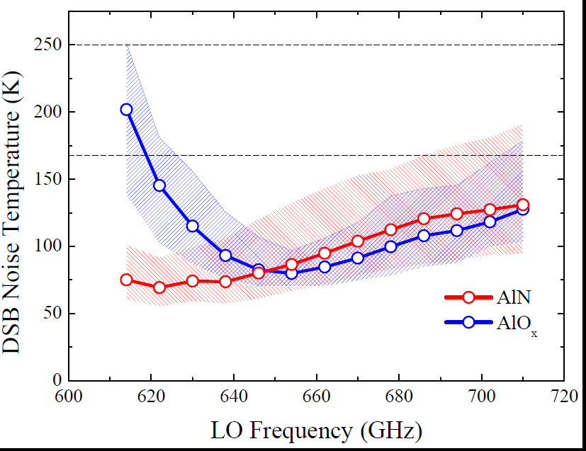
ALMA band 9, performance of almost all 73 receivers

Slide 31
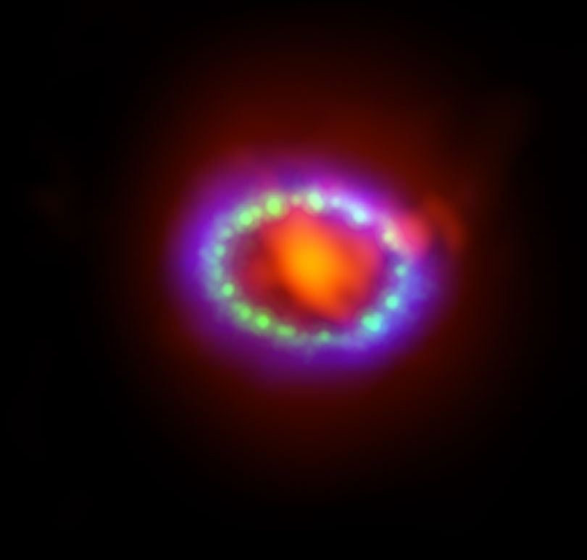
Recente observation: Super Nova 1987A

Slide 32
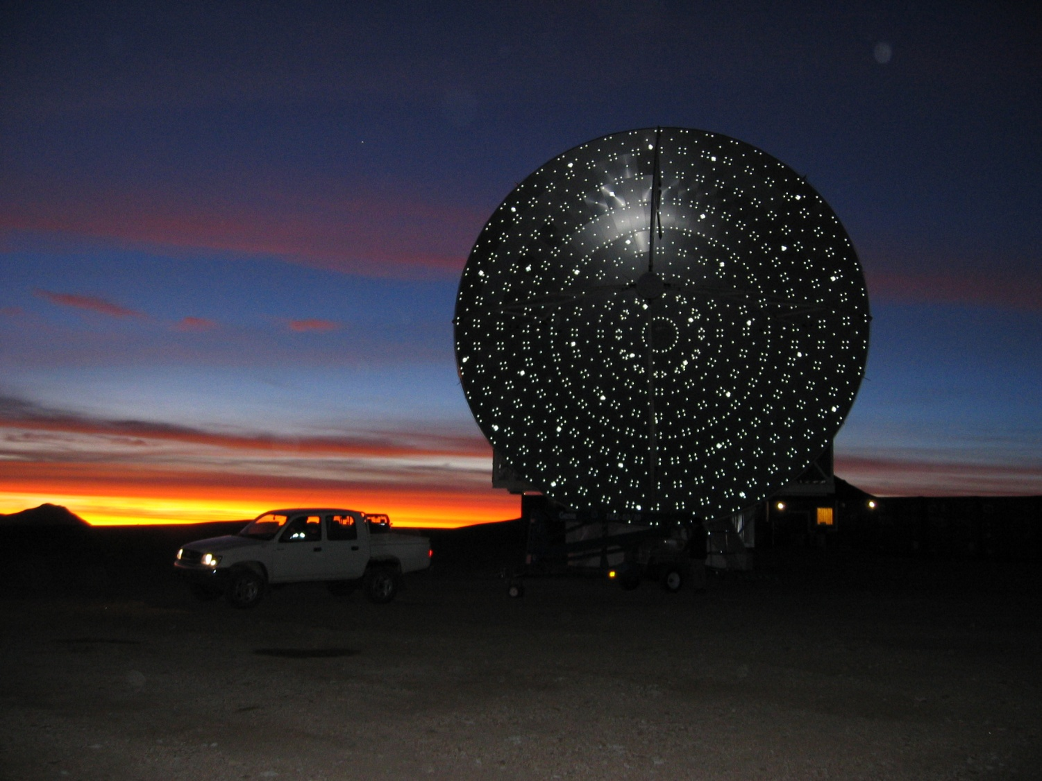
How to do large scale mapping
APEX telescope

Slide 33
Detectors
MKID: superconducting pair breaking detector
antenna determines RF-band
resonator determines KID-readout frequency
detector + multiplexing filter in one structure
hν
Cooper Pairs: Quasiparticles:
Inductance iωL(P_{sky}) Resistance R(P_{sky})
2Δ
Z_{s} = R + iωL
Light
Dark

Slide 34
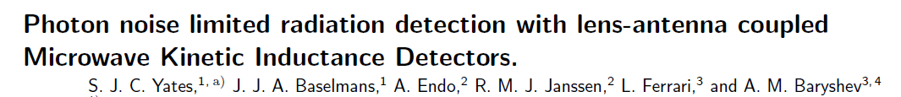
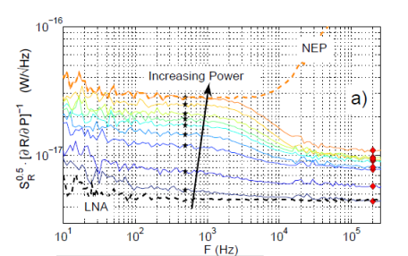
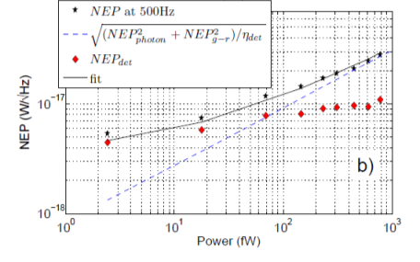
Hybrid KIDs
Photon noise limited at P>100 fW
APEX loading: 3-10 pW

Slide 35
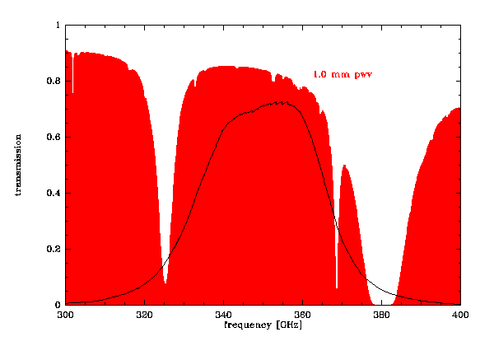

AMKID Specifications
dual color APEX direct detection camera
  LFA: 347 GHz ( 34 GHz width, from 330 to 364 GHz / HP width)
  HFA: 850 GHz (100 GHz width, from 800 to 900 GHz / HP width)
squared field of view: > 15 x 15 arcmin²
number of pixels
  pixel spacing 1 Fλ
  hexagonal arrangement
  ➔ 3520 pixel in LFA
  ➔ 21600 pixel in HFA
detectors operating with sensitivities dominated by the sky background
good system stability that allows mapping of extended structures
cooling:
  two 4K pulse-tube closed cycle systems
  He 10 sorption cooler (<300 mK)
LFA
HFA
MPIfR, SRON, NOVA, TUD

Slide 36


Slide 37

Draft sensitivities
B. Sybthorpe

Slide 38
Optics layout
dominated by the space available within the APEX Cassegrain cabin
fully reflective optics ➔ no losses due to imperfect anti-reflection coating and absorption
four imaging mirrors (M3, M4, M5 und M6)
two “flat” mirrors (FM1 und FM2)
  FM2 is used to compensate for aberration („glasses“ for the dewar-optics) and therefore has also a slightly structured surface.
magnification : ~ 4
size of the dewar-window: approx. 150 x 150 mm²

Slide 39


cabin layout
8-channel readout
beam-path
telescope Focal-plane
FM1
baffling structure (4K)
window
M6
1250 mm
M5
pulse-tube cooler
M3
temperature monitoring
FM2
IF power supply
H10 cooler
detectors
M4

Slide 40




Concept prove at APEX
J2253+161
APEX test-camera @ 345GHz
wet-dewar
He4+He3 cooler
hold-time 24h @ 250 mK
16 pixel
results of one observing night in August 2011
mean sensitivity: 220 mJy √s
PKS0537-441
PMNJ0210

Slide 41


Slide 42

King test cryostat
Started ~Oct 2012 – working June-July 2013…

Slide 43



Optics Box

Slide 44



Slide 45



Final integration

Slide 46


Cryostat overvew

Slide 47


Dark Tests

Slide 48



AIV on latest chips
Responce
Responce
NEP

Slide 49


Outlook
installation at APEX in Nov/ Dec 2013 done
Upgrade of chips 1 Jan - 26 May 2014 complete
Commisioning / Science operations August/September 2014
Good science till 2017 inclusive
Atlasgal

