Slide 1

R&D on Calorimetry for sPHENIX experiment at RHIC
E. Kistenev, BNL
TIPP 2014
Amsterdam, June 6th, 2014

Slide 2
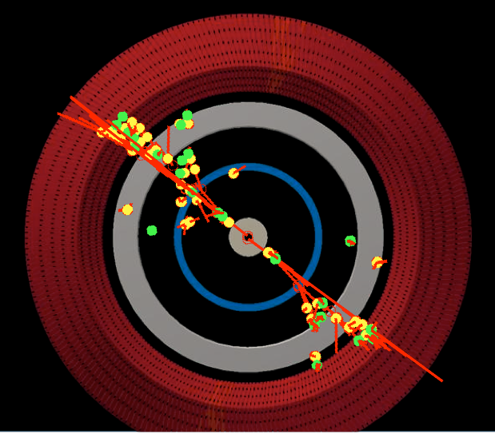
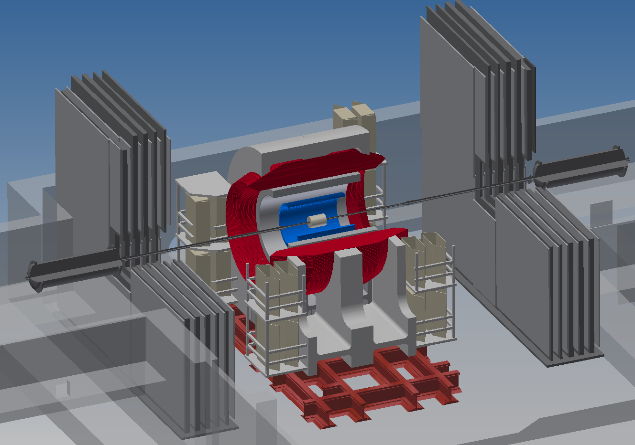
sPHENIX is the calorimetry based upgrade to PHENIX
HCal
EmCal
Solenoid

Slide 3
Calorimeter controls in sPHENIX
Large solid angle coverage (± 1.1 in η, 2π in φ)
Moderate energy resolution
  EMCAL ~ 15%/√E
  HCAL ~ 75 %/√E (single particle), ~100 %/√E (jet)
Compact (for EMCAL ⇒ small R_{M}, short X₀)
  Physically small (dense) – occupies minimal space
  High segmentation for heavy ion collisions
Hermetic
Projective (approximately)
Readout works in a magnetic field
Low cost
Technology Choices:
EMCAL → Tungsten Scintillating Fiber
HCAL → Iron Scintillating Tile with WLS Fiber
Readout → SiPMs

Slide 4

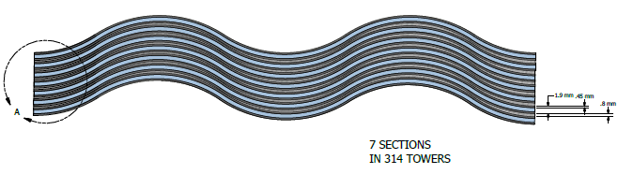
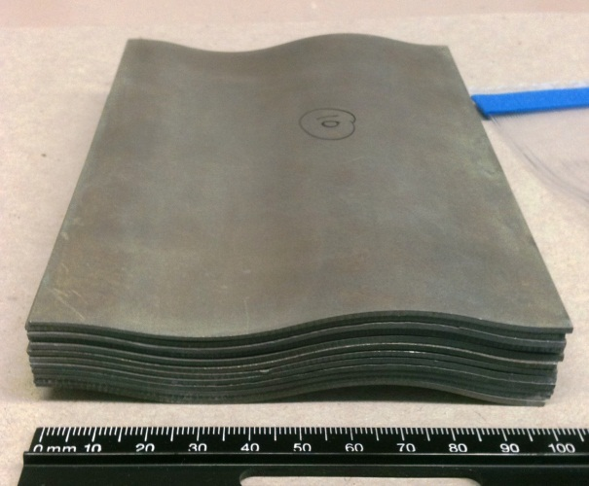
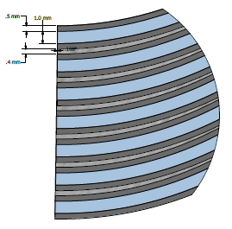
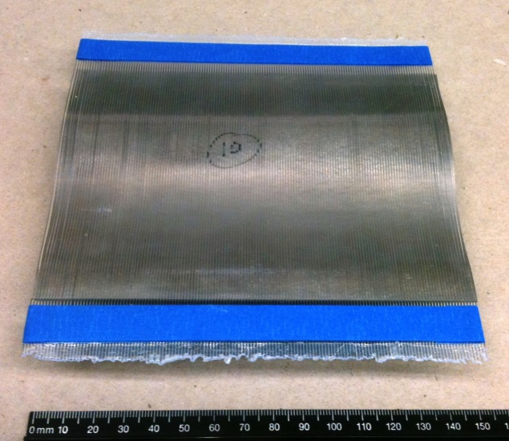
Super compact EMCal : W & SciFi
SBIR
~ 10 cm
18 X₀
2 W plates/layer ⇒ 0.6 X₀ sampling
Pure tungsten metal sheets (ρ ~ 19.3 g/cm³) Thickness: 2x1.0 mm
Epoxy (~ 0.1 mm)
Scintillating fibers
1.0 mm
X₀ = 5.3 mm
R_{M} = 15.4 mm
Very ambitious, very difficult and ….. too expensive ….

Slide 5
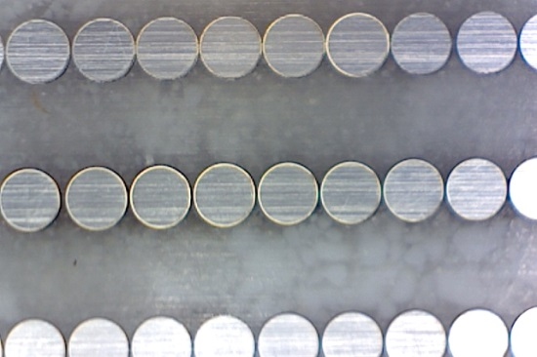
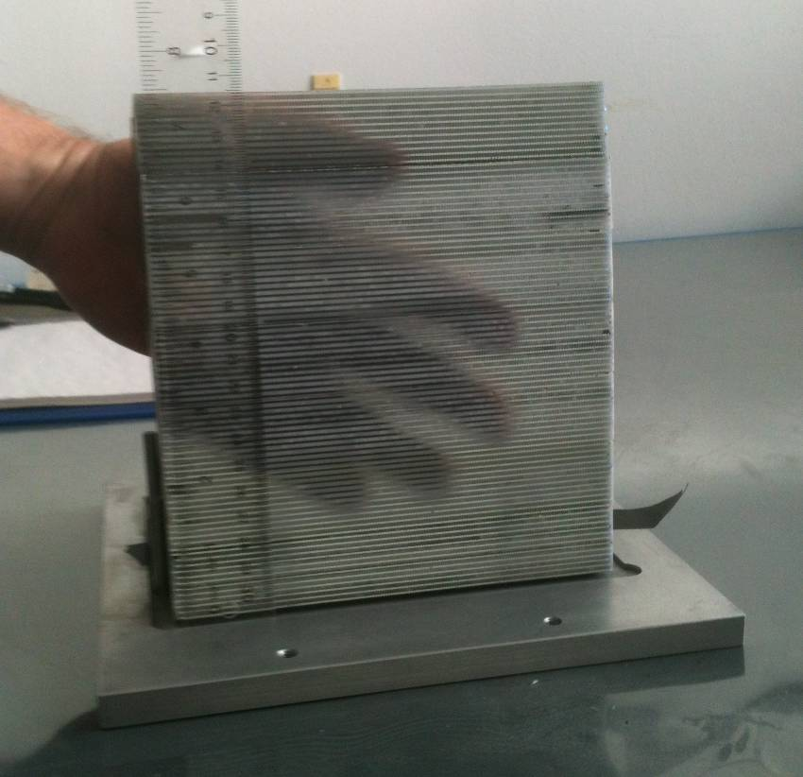
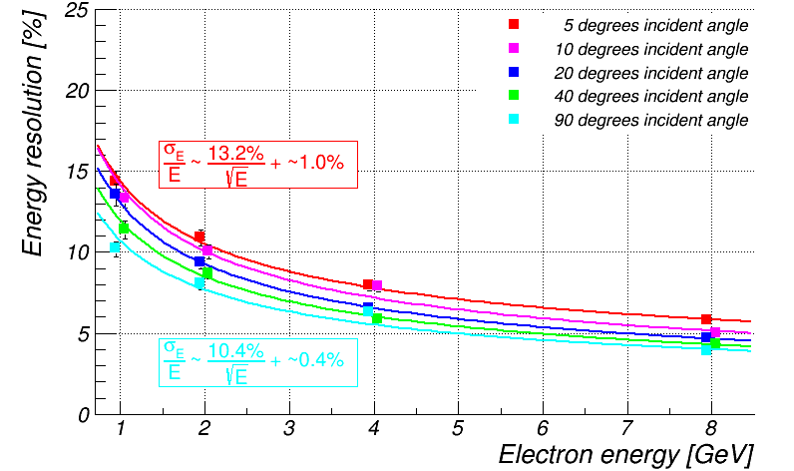
Compact & Realistic W-SciFi EMCal
(tilted tiles)
1mm W + 1mm Fiber
Common concern:
  Implicit designed in asymmetry between along-tile and across-tile impacts->constant term

Slide 6
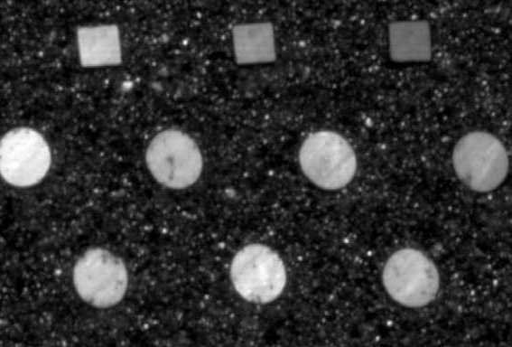
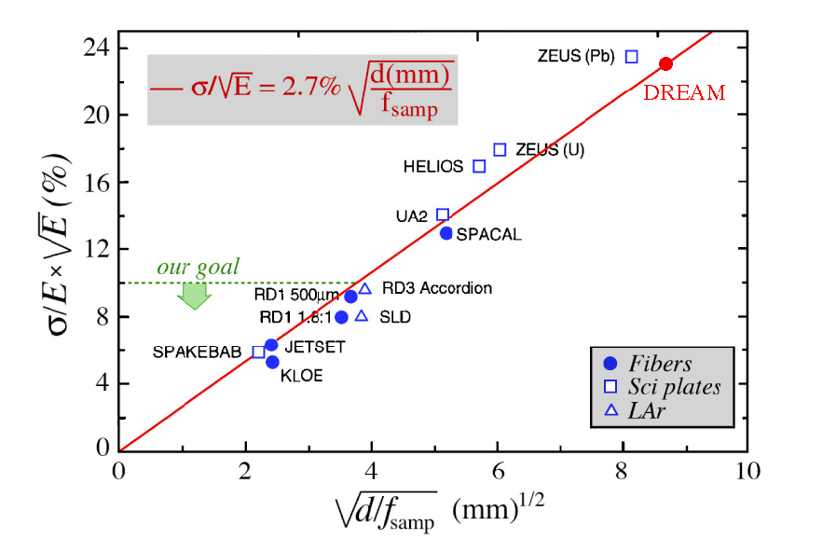
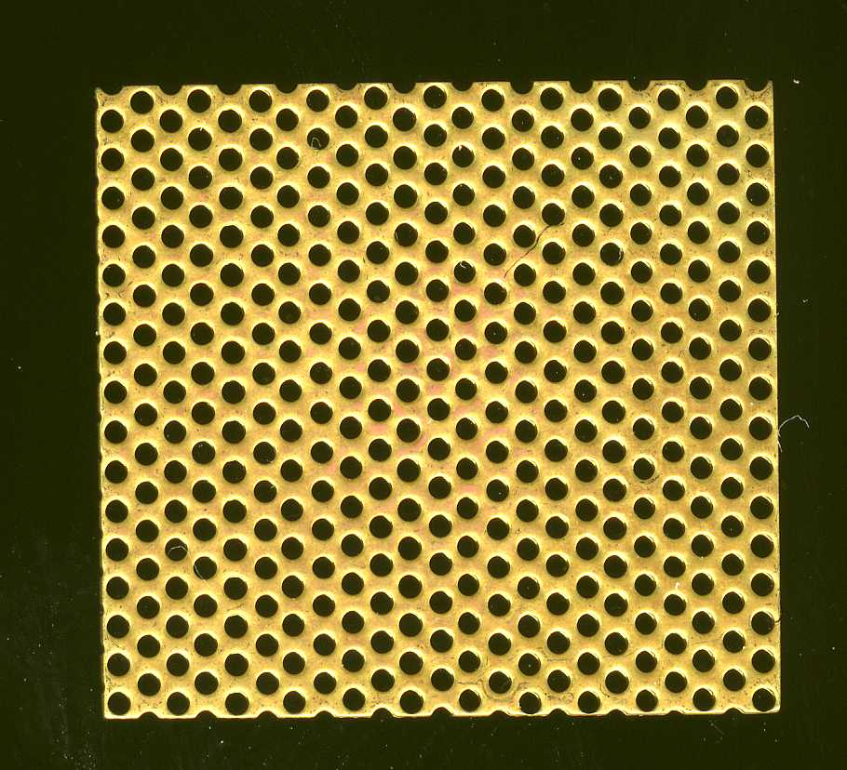
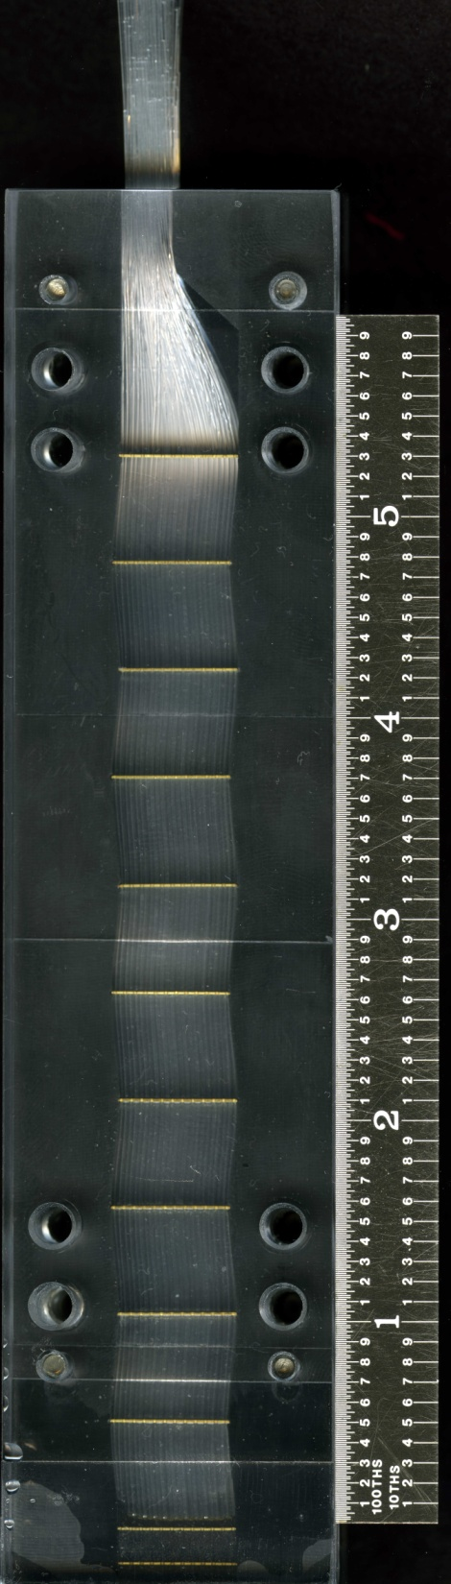
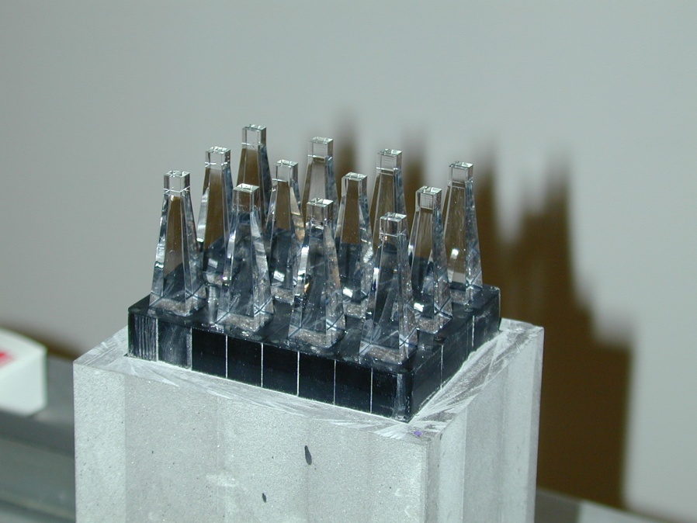
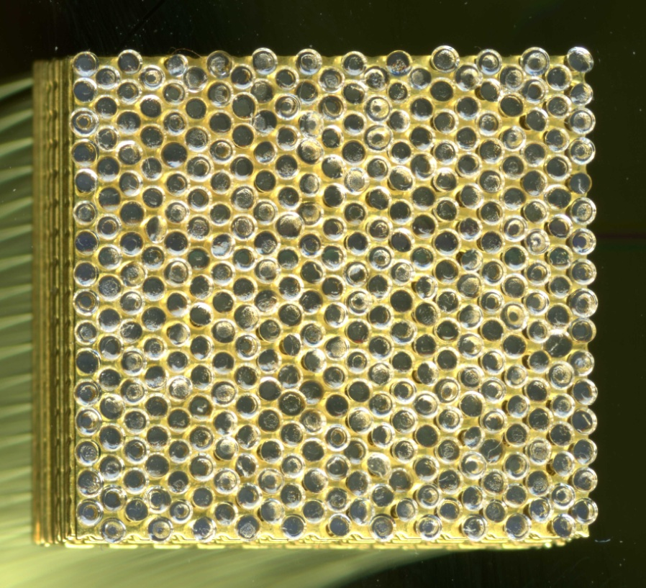
Safe bet: SciFi in W-epoxy compound
Stack of meshes
UCLA : W compound - SciFi prototype, 0.3 mm fibers, 0.8 mm spacing
Compact: ρ~10.17 g/cm3,
X0 ~ 7 mm, Rm ~ 2.3 cm
Fibers dropped in, meshes separated
Readout ready
towers
W Compound polimerized
Pictures from O.Tsai, UCLA

Slide 7
More about HCal
PHENIX (BNL)
BNL (Physics, CAD, …)
INR (Moscow, Russia)
CSU (Boulder, Colorado)
GSU (Atlanta, Florida)
Uniplast
(Vladimir, Russia)
Physics requirements
  Containment up to 60 GeV hadrons
  Hermeticity, uniformity & projectivity
  Energy resolution ≤ 100%/√E
  Full azimuthal coverage for |η|<1.
  Granularity to allow correlated
  jet-jet and γ-jet measurements
Design goals
  Simple to construct
  Simple to collect and digitize signals
  Use well established technologies
  Readout electronics identical to EMCAL
  Serves as flux return for solenoid

Slide 8
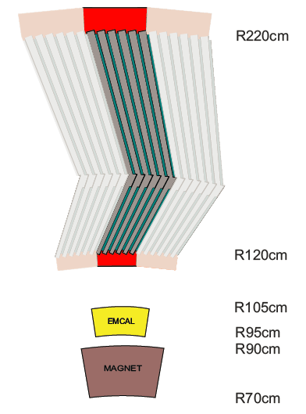
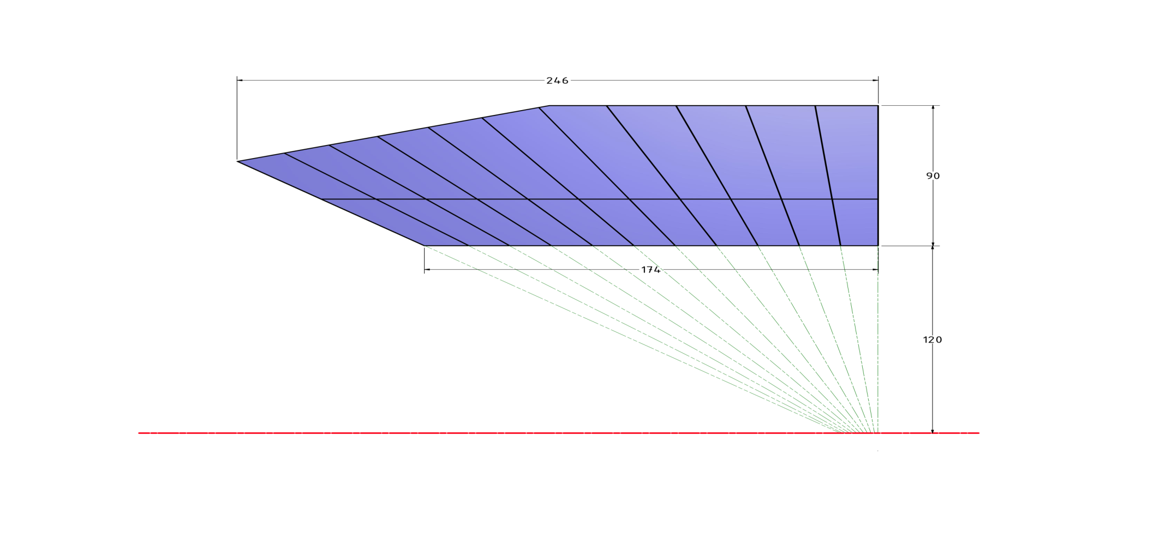
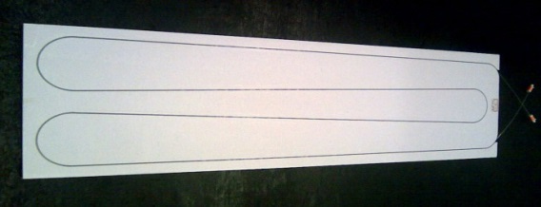
Hcal: Concept 2012
  Sampling Fe-Scintillating tile calorimeter
  Sampling cells (layers of Fe and scintillator extending along the beam line) tilted at a small angle to developing shower core
  Self-supporting, dead area free,
  Longitudinally segmented to avoid channeling and to minimize sampling fraction variations;

Slide 9
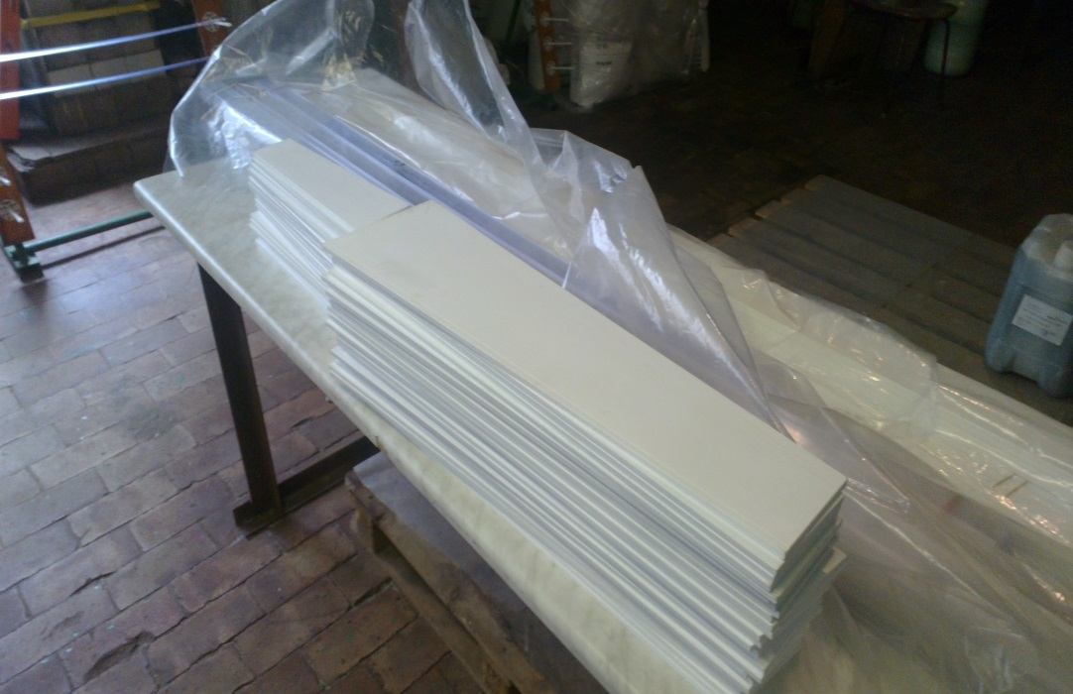
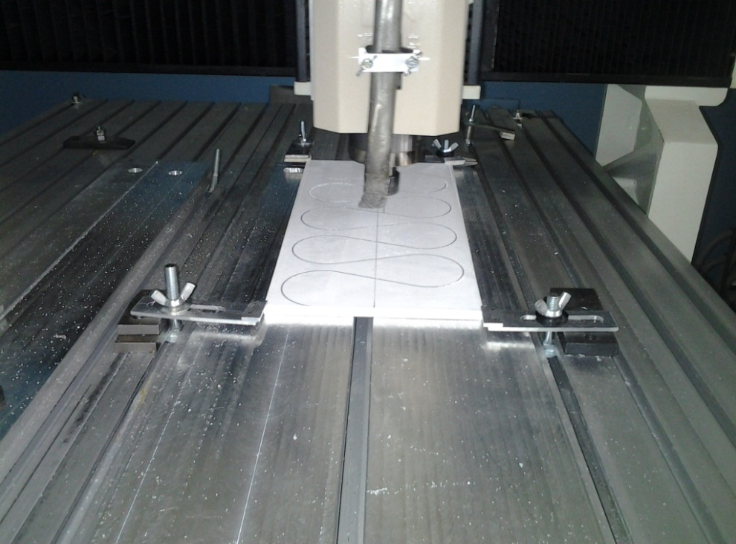
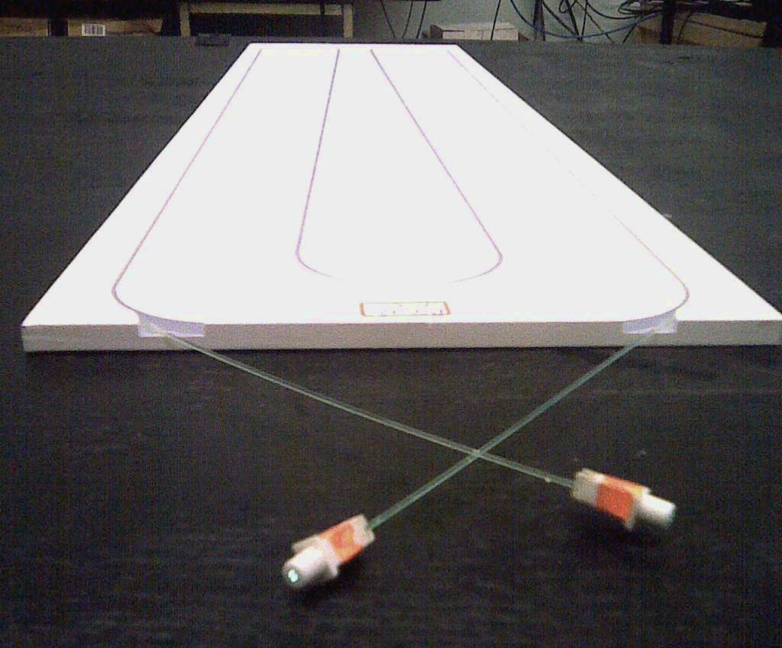
Light collection: patterning & containment
sPHENIX
Design rules:
  Minimum bending diameter of 55mm;
  Maximum point-to-fiber distance of 27mm
  WLS fibers uncut
Response uniformity measurements with cosmic muons and source were made at INR and in Boulder, Colorado

Slide 10
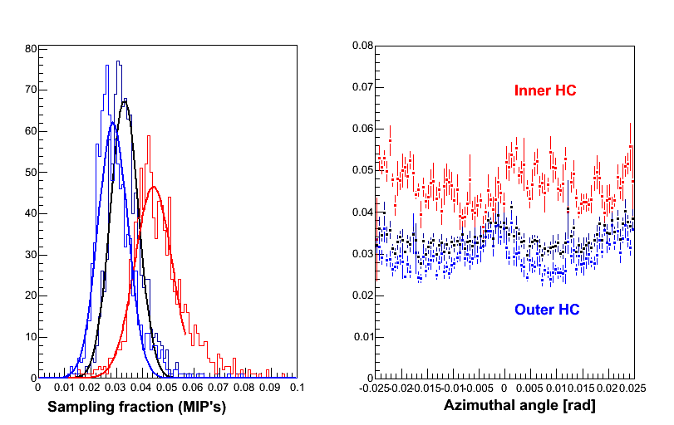
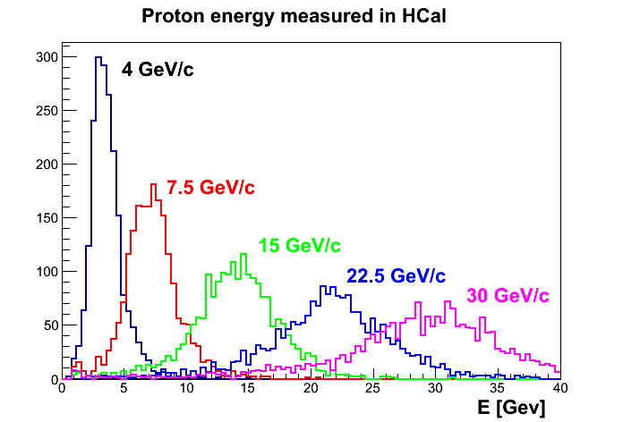
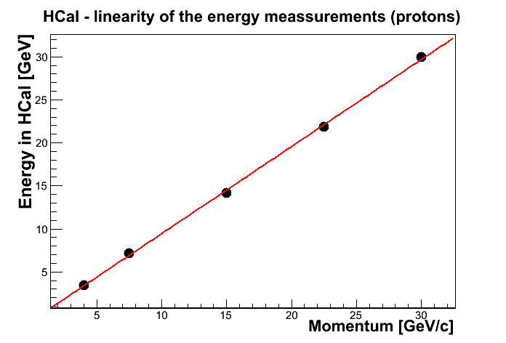
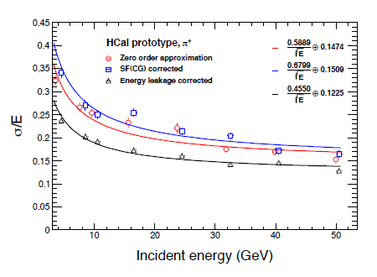
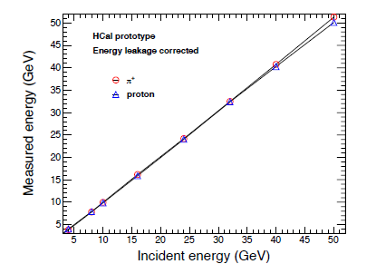
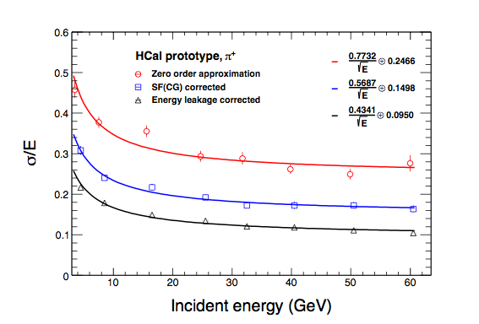
Hcal: expectations (G4) 2012
HCal radiography with μ’s
Simulation effort has continued since the submission of the proposal to refine the design and optimize analysis software
Tilt 12º
HC
HC Inner
HC Outer
Events
Sampling fraction

Slide 11
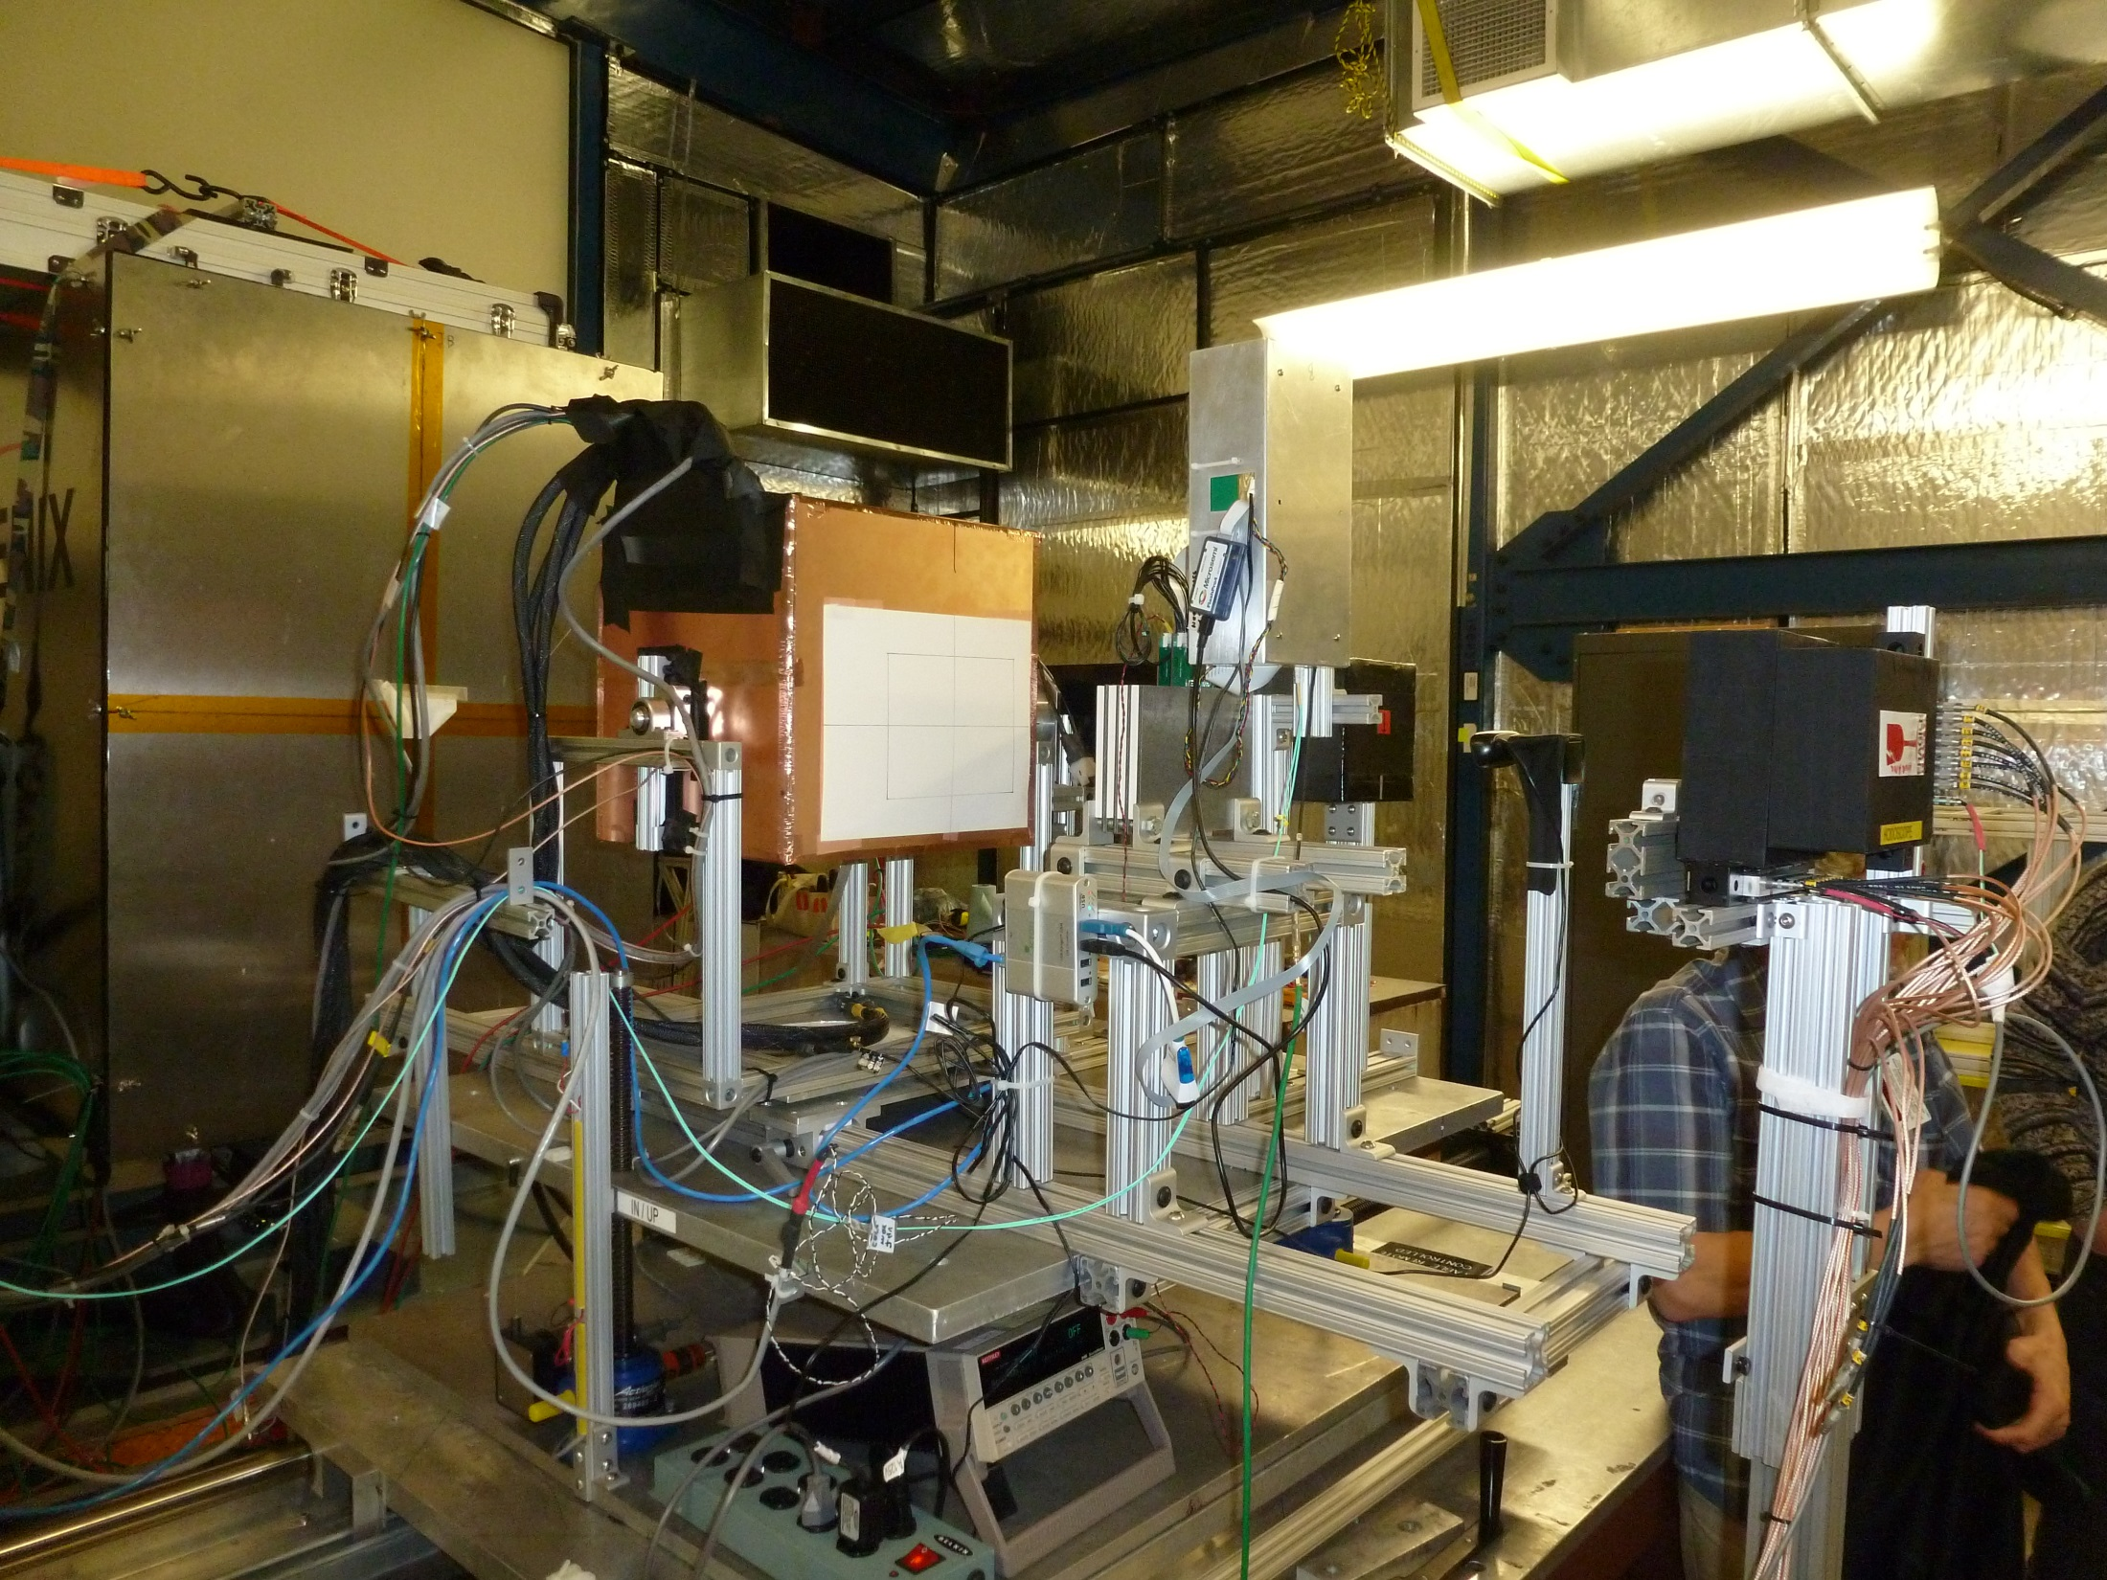
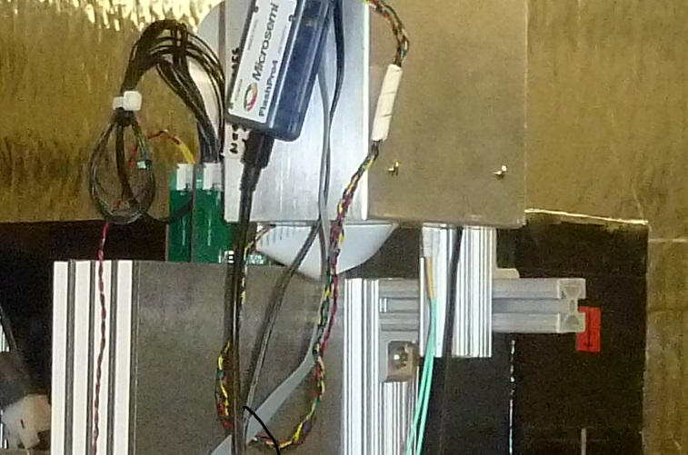
sPHENIX 2014: Test beam

Slide 12
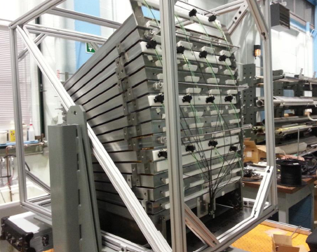
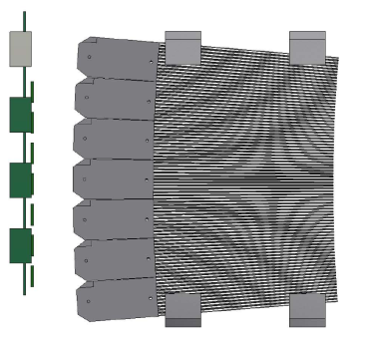
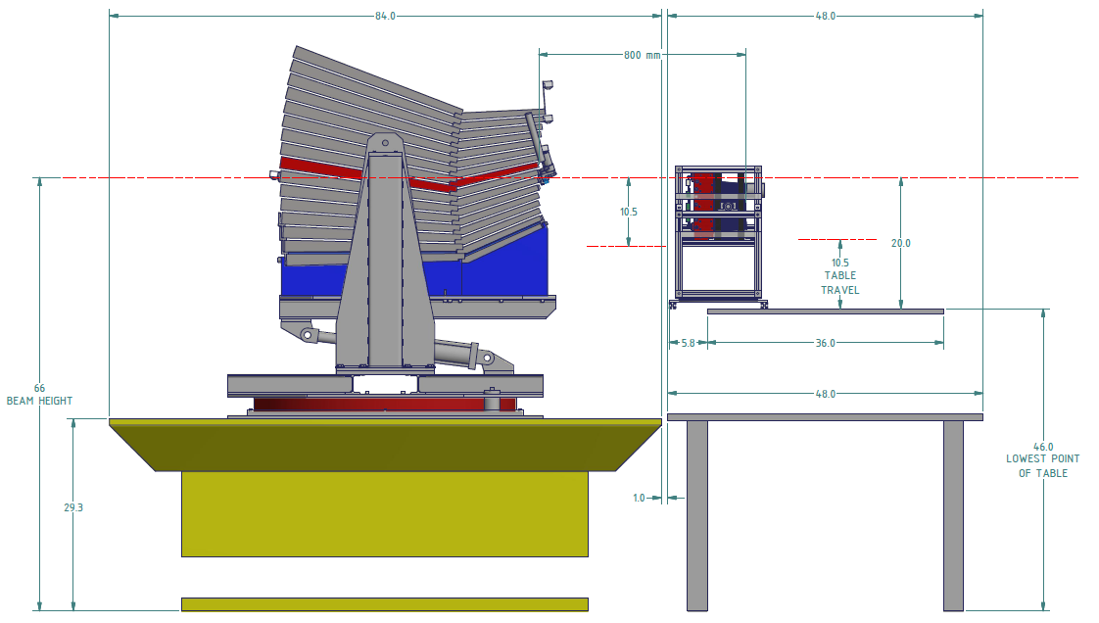
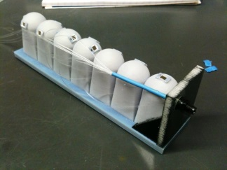
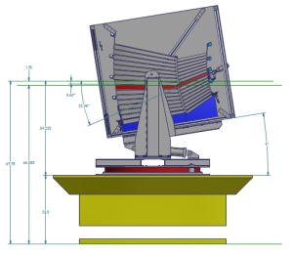
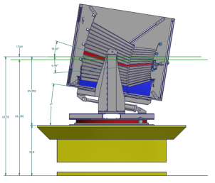
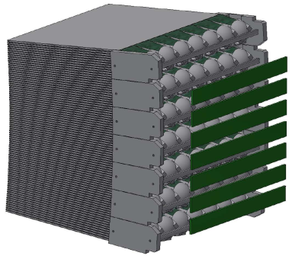
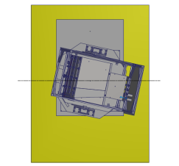
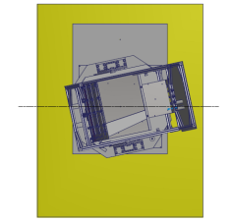
Inside the boxes
Beam

Slide 13
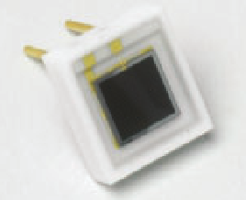
MPPC based optical readout
MPPC 3x3 (S10363-33-025)
Sensitive area: 3x3 mm²
Number of pixels: 14400
Fill factor: 30.8%
EMCal
Fibers:
  Kuraray SCSF7, 1mm diameter, double clad;
Sampling fraction: %;
Single MPPC per tower of 20x20 mm2;
Light collection:
  Air domes ~3cm tall;
  Average efficiency = 4.7% (compare to area ratio of 1.3%);
  Nonuniformity (Max/Min ratio) of 1.7;
Light yield:
    3900 p.e./GeV of energy deposited in calorimeter measured with calibrated phototube;
    180 p.e./GeV of energy deposited in calorimeter with MPPC’s and collection efficiency of 4.7%
Hcal
Scintillator:
  extruded, polystyrene based (PTP+POPOP) tiles;
  chemically developed reflective coating for light containment; wrapped with Aluminized miler and protective plastic wrap;
Fibers:
  Kuraray Y11 single clad, 1mm OD;
Sampling Fraction: 2.5-5%
Single MPPC per Tower
Light yield (photoelectrons per MIP per fiber):
  F. Ends: 11.9 – 12.9 ; F.Total 24.8 (tile center)
  F. Ends: 12.9 – 14.4; F.Total 27.3 (far from MPPC)
  F. Ends 11.3 – 12.8 ; F.Total 24.1 (close to MPPC)
4 sc. Tiles, 8 fiber ends bundled to point towards single MPPC. Air gap about 10 mm.

Slide 14
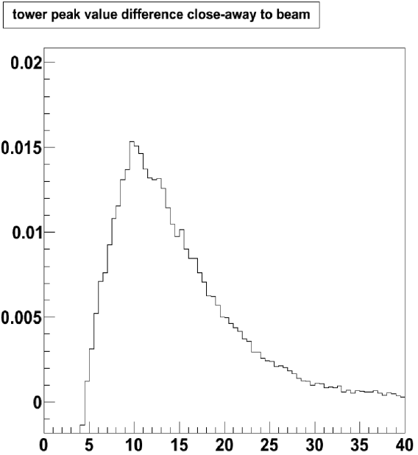
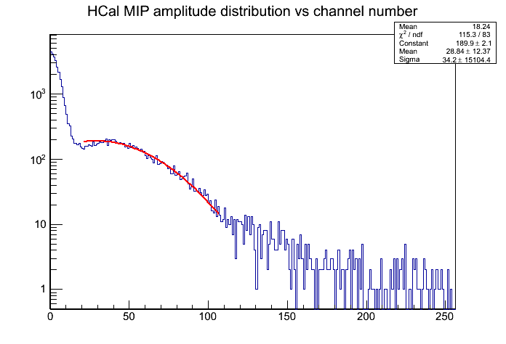
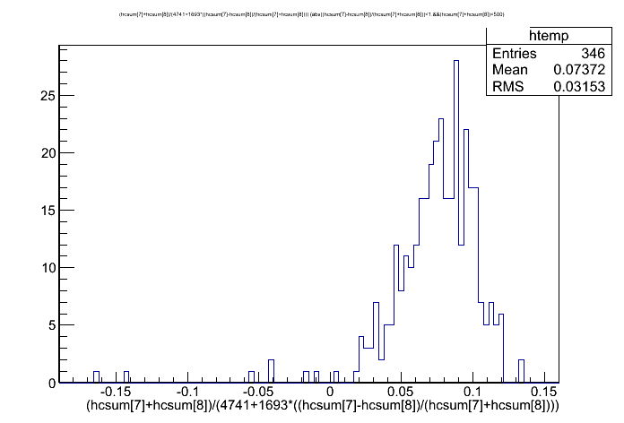
Test beam: Calibration
120 GeV/c p (longitudinal)
single tower
Both detectors are calibrated combining highest momentum beam data (protons at 120 GeV/c) with cosmic muon exposure (important for Hcal towers on the detector edges).
EMCal
ADC counts
Cosmics (lateral)
single tower
120 GeV/c p (longitudinal)
single tower
HCal
E[MeV]
E[GeV]

Slide 15
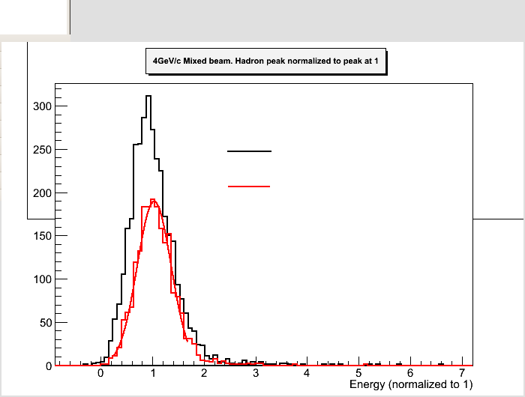
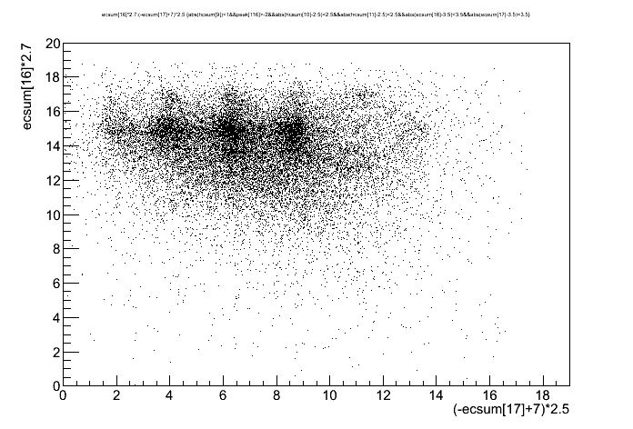
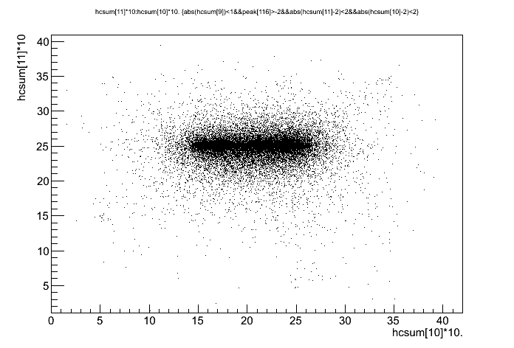
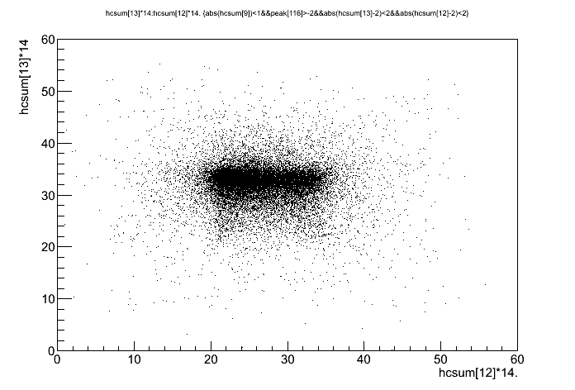
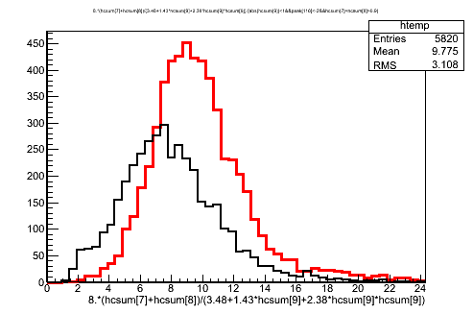
System at a glance
And it works
EMCal
4 GeV/c
HCAL
Y[cm]
HCal-inner
Y[cm]
X[cm]
HCal-outer
Y[cm]
8 GeV/c
EMC+HCAL
(norm at 4 GeV)
X[cm]
X[cm]

Slide 16
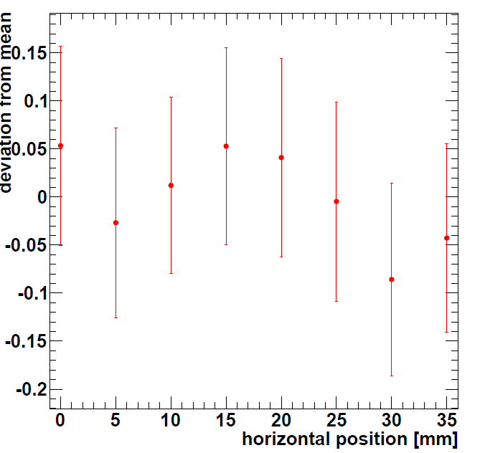
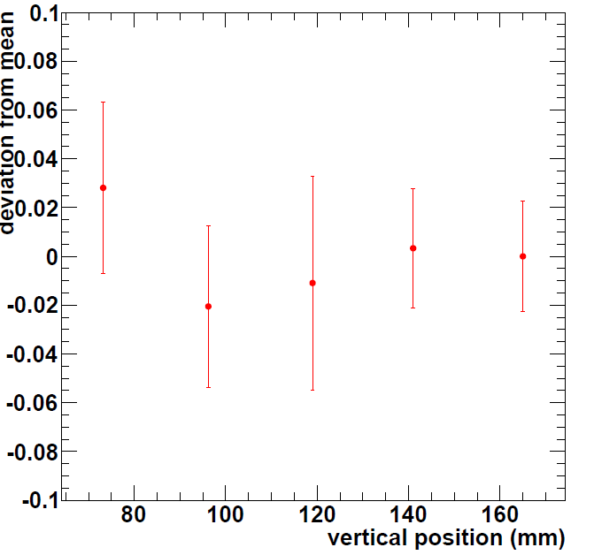
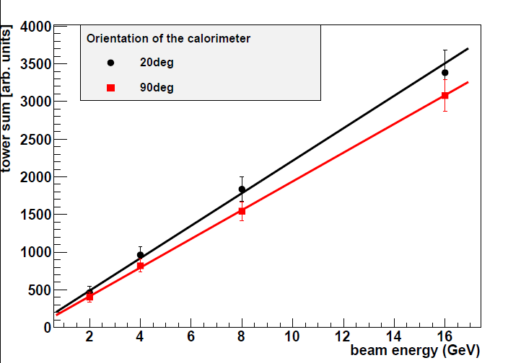


ECal – W-SciFi compound is baseline technology
BNL: tilted flat tiles W-SciFi EMC prototype
UCLA : W-epoxy compound SciFi prototype

Slide 17

Hcal: Performance at a glance
e/π = 1.17
e/μ = 0.77
Linear everywhere in the energy range tested;
In the energy range of sPHENIX (below 50GeV) energy resolution is dominated by stochastic fluctuations) ;
Constant term will be reduced with LCG dependent corrections.

Slide 18



HCal vs HCal

Slide 19


SF variations & energy leakage
Tested prototype is only 5 Labs deep. Energy leakage exceeds 5% for energies above 30GeV contributing comparably to constant term in energy resolution.
In the calorimeter section with depth dependent sampling fraction the fluctuations in the shower profile may lead to overestimates to upstream energy and underestimates to downstream energy. The asymmetry estimator (E1-E2)/(E1+E2) then becomes neither linear nor unambiguous function of LCG.
Measuring LCG and correcting leakage and shower fluctuations needs better constrained data (EMC or third longitudinal segment) , minimizing the scale of SF variations (optimization to segment boundaries) and corrections. We are working on it.
R.Wigmans, Scientifica Acta 2, 1, 18-55 (2008)

Slide 20

Constant term and tilt plates geometry
Trigger Scintillators for cosmic calibration
Pivot
Beam
Plates in the HCal are tilted at an angle chosen to keep the number of scintillating tiles crossed by geantino independent of azimuth. In the prototype the sampling fraction:
drops by x1.4 towards outside due to increases in Fe plate thickness;
varies by ~15% azimuthally with the angle between radius and scintillating tile at crossings;
Two effects are mutually compensating and tunable using the light collection controls. We are working on it.

Slide 21



Constant term and consistency of light collection
3D printing is neither precise, nor repeatable;
Parts need further machining to match;
Surface reflectivity inside cavity is unknown.;
Air gap coupling is plainly not practical when light yield and consistency are essential. We are looking into one SiPPM per tile solution.

Slide 22
Summary
The calorimeters for sPHENIX are conceived to be intrinsically uniform devices with minimal dead-areas and fit to build in industry;
Prototype calorimeters are built and tested with e’s & hadrons at FNAL. Test beam data is now compared with simulation;
Conclusions and observations based upon test beam performance of the 2012 concept prototype calorimeters are currently used to predict and optimize EMC&HCal system performance in 2014 geometry built around preexisting BaBar superconducting solenoid;
Plans are for upgraded prototypes in the test beam in 2015.

