Slide 1
A multi-purpose digital acoustic sensor
for the deep-sea environment
Kay Graf – ECAP, University of Erlangen
for the KM3NeT Collaboration
TIPP 2014, Amsterdam, Netherlands
June 2-6, 2014

Slide 2
What is KM3NeT?
future deep-sea research infrastructure in the Mediterranean Sea
includes multi-cubic-kilometre scale neutrino telescope
exceeds existing telescopes by substantial factor in sensitivity
provides node for earth and marine sciences

Slide 3
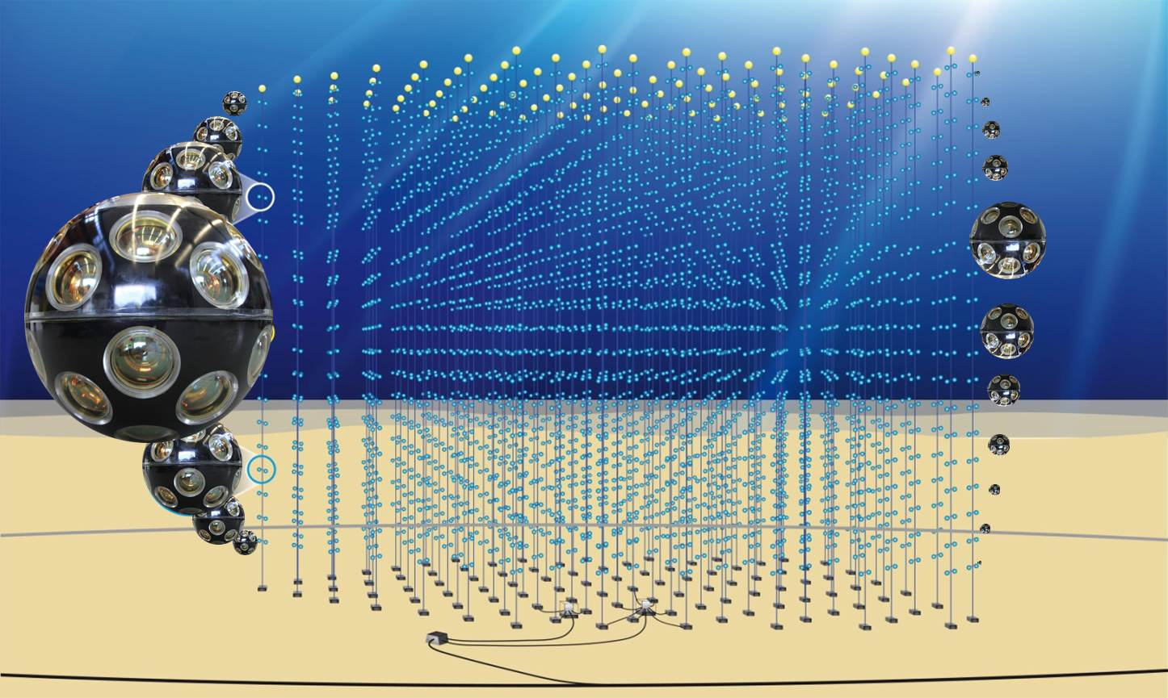
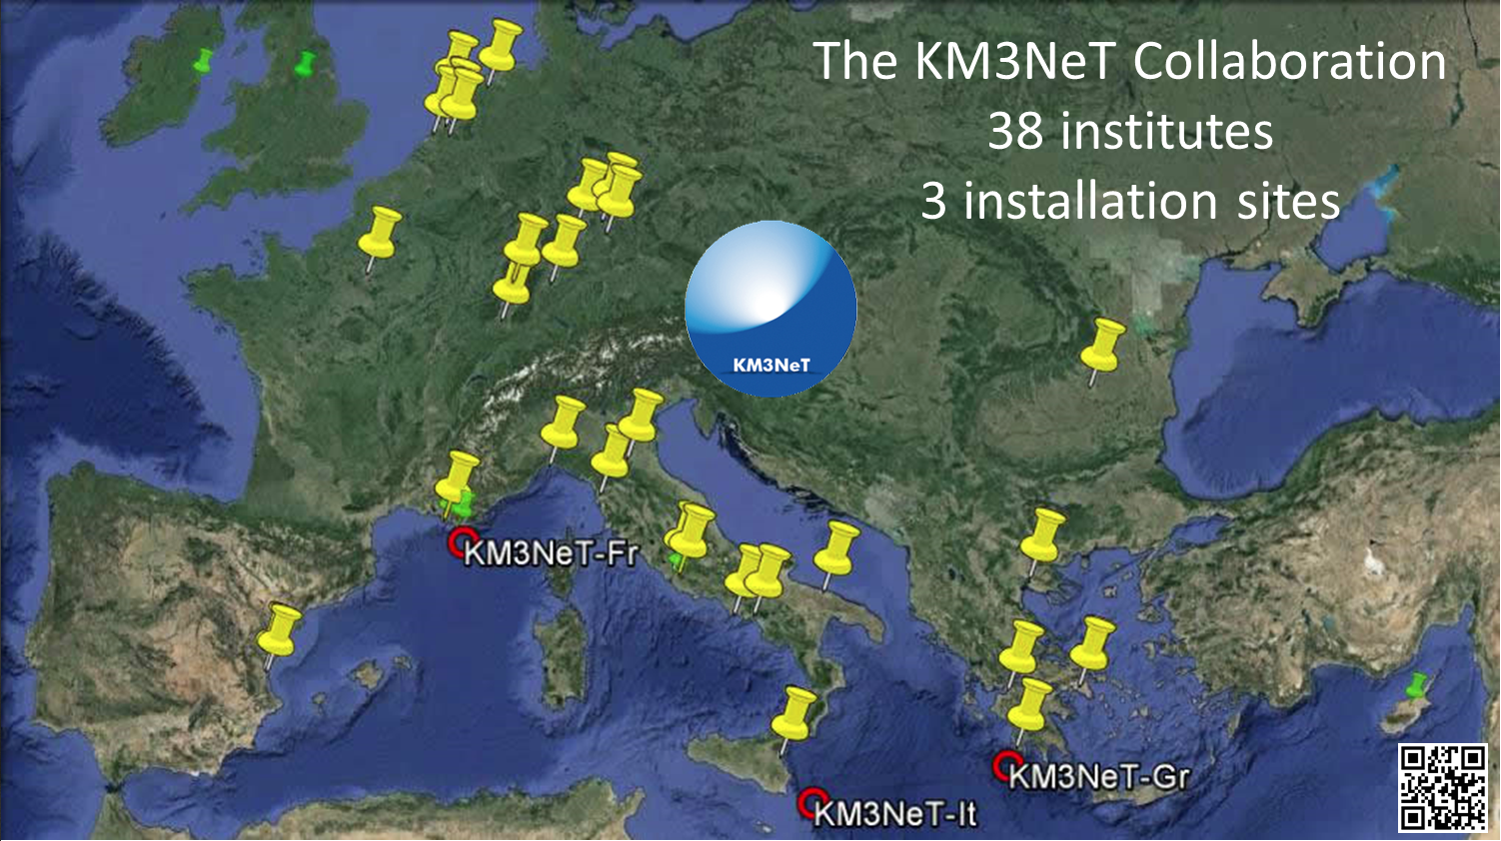
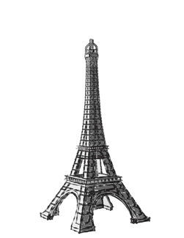
KM3NeT: Detector and Collaboration
38 institutes
3 installation sites
starting installation of first phase
artist’s view
ANTARES

Slide 4
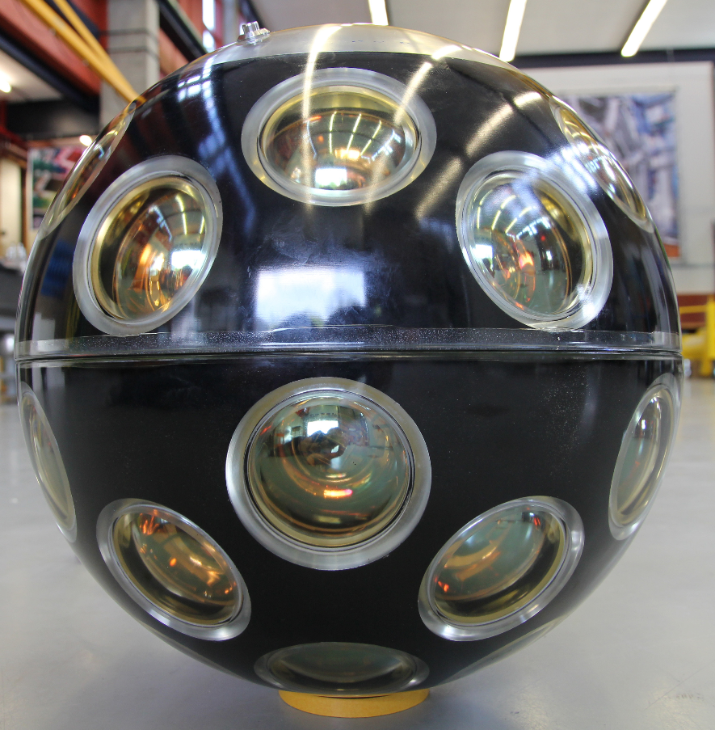
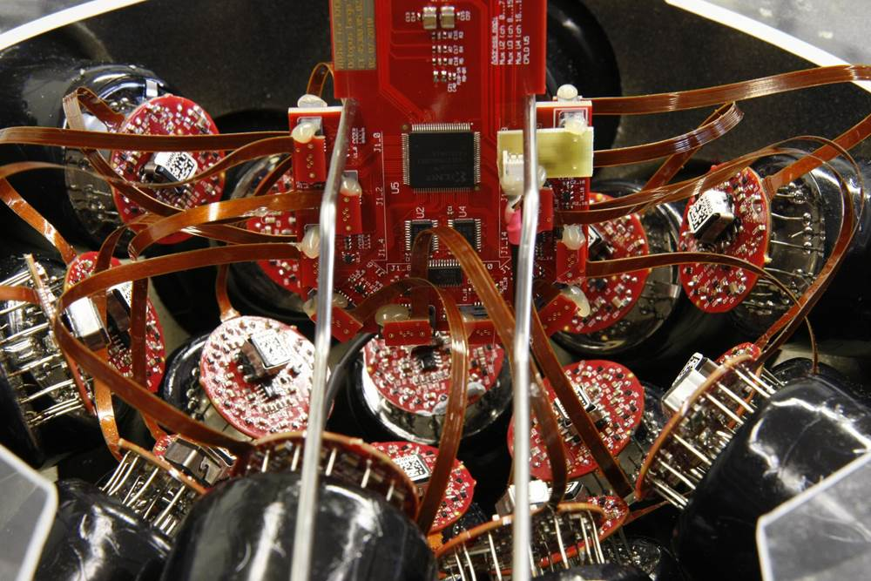
Digital Optical Modules (DOMs)
glass sphere (⌀ 43 cm)
31 3-inch photomultipliers
(PMTs)
electronics
  FPGA-based DAQ
  “all-data-to-shore”
  digitisation
  (“time over threshold”)
  data transfer via SFP transceivers
  additional instrumentation
    acoustic sensor
    compass and tiltmeter (AHRS)
    optical emitters
    environment sensors
Notes:
SFP Small form-factor pluggable transceiver
AHRS attitude and heading reference system

Slide 5
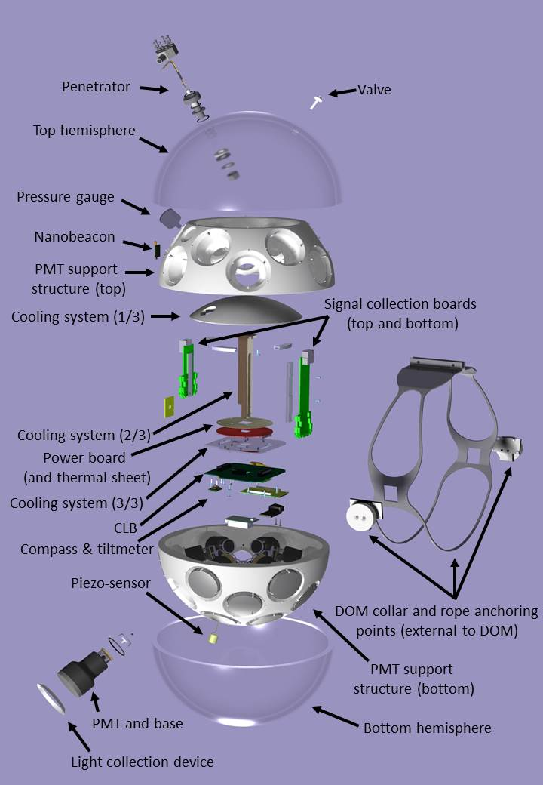
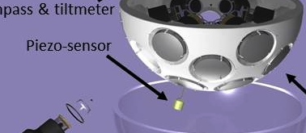
DOM Specifications
pressure and corrosion resistant
(sea water up to 4 km depth)
stable operation for
10+ years
low power (<10W)
compact design
minimal “external”
components

Slide 6
Acoustic Positioning System
detection units not rigid, bending in sea current
monitoring of position with ~10 cm accuracy
⇒ acoustic positioning system
⇒ acoustic sensor in DOM
detection unit
receiver
acoustic
transceiver

Slide 7
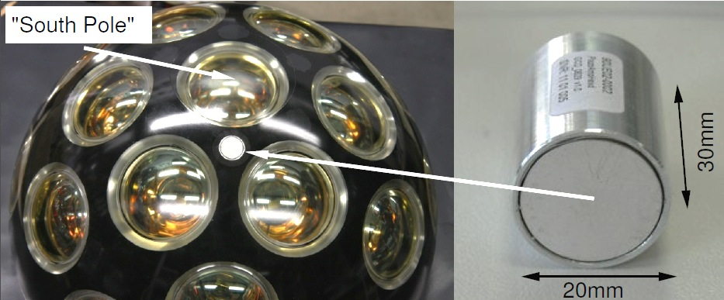
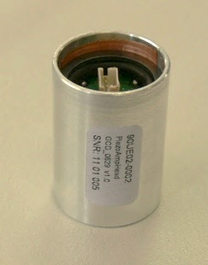
Basic Concept
Integration of acoustic sensor(s) in DOMs
⇒ compact, low-cost integrated acoustic sensors needed
⇒ main challenge: electromagnetic interference from photomultipliers
Reference: www.km3net.org

Slide 8
Acoustic Sensor Design Steps
additional boards
prototype:
analogue
sensor
sensor
head
main amplifier
DAQ
(FPGA)
ADC
piezo + preamplifier
main amplifier + filter
all data
to shore
final design for KM3NeT:
digital sensor
sensor
head
DAQ
(FPGA)
⇒ on shore: data processing in computer farm
(filtering, time of arrival, position calculation)

Slide 9
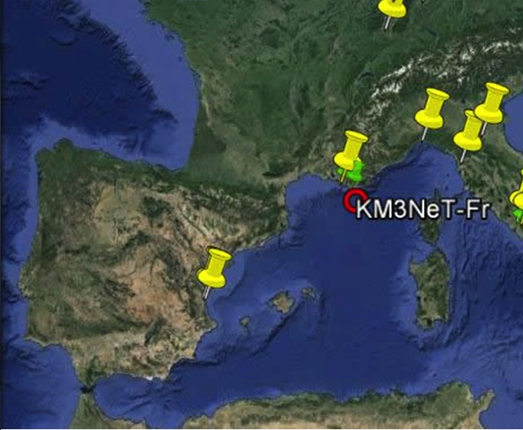
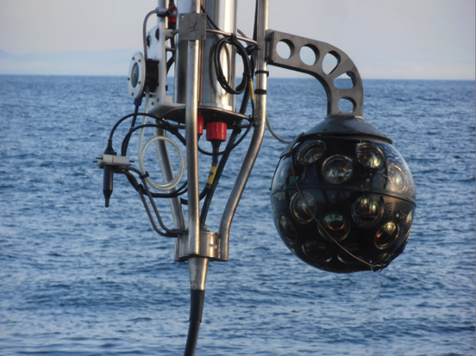
ANTARES Detector
ANTARES
prototype

Slide 10
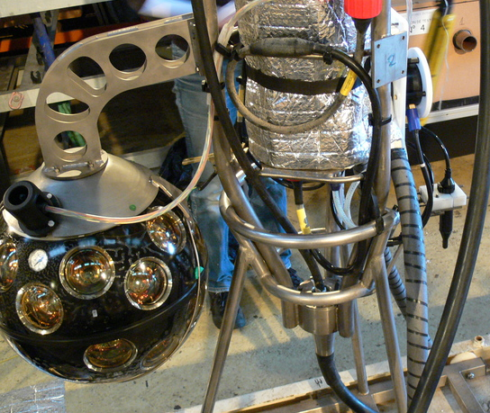
Prototype Tests in ANTARES
DOM including analogue sensor
hydrophone:
- proven
technology
- various devices
available
⇒ comparable performance for position calibration

Slide 11
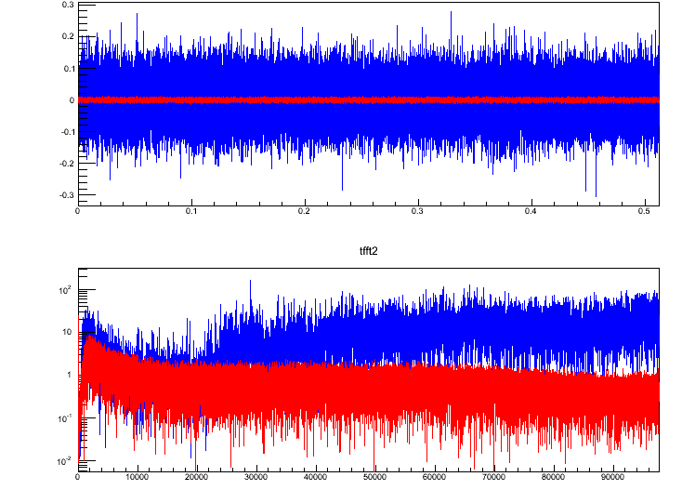
Laboratory Measurements
0.3
0.2
0.1
0
-0.1
-0.2
-0.3
KM3NeT preliminary
signal [V]
PMTs off
PMTs on
operation of
PMTs injects
noise into
system
0 0.1 0.2 0.3 0.4 0.5
time [s]
100
10
1
0.1
0.01
KM3NeT preliminary
signal [a.u.]
0 10 20 30 40 50 60 70 80 90
frequency [kHz]

Slide 12
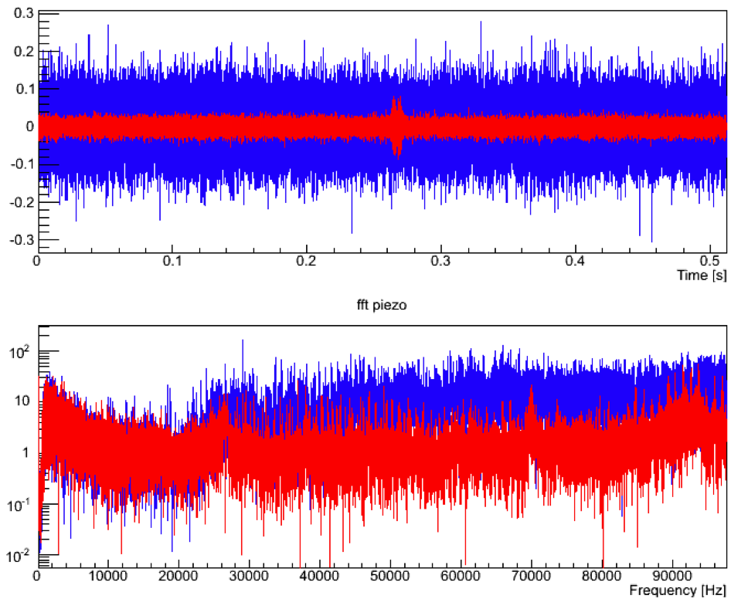
Comparison: Performance in Lab and Sea
0.3
0.2
0.1
0
-0.1
-0.2
-0.3
KM3NeT preliminary
signal [V]
PMTs on:
Sea
Lab
less noise
in the sea
0 0.1 0.2 0.3 0.4 0.5
time [s]
100
10
1
0.1
0.01
KM3NeT preliminary
signal [a.u.]
0 10 20 30 40 50 60 70 80 90
frequency [kHz]

Slide 13
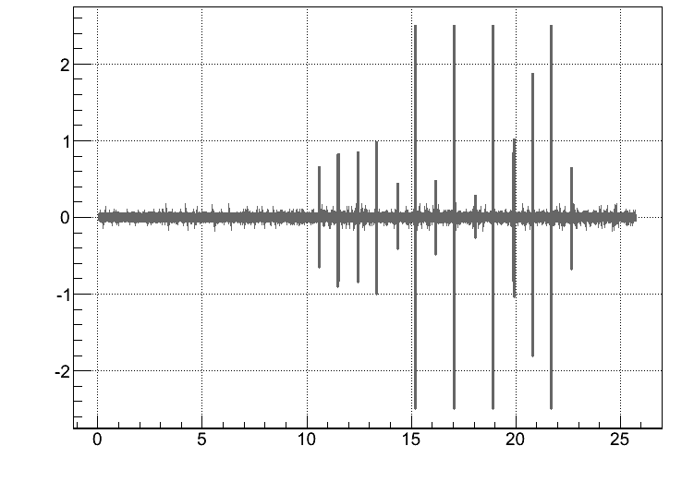
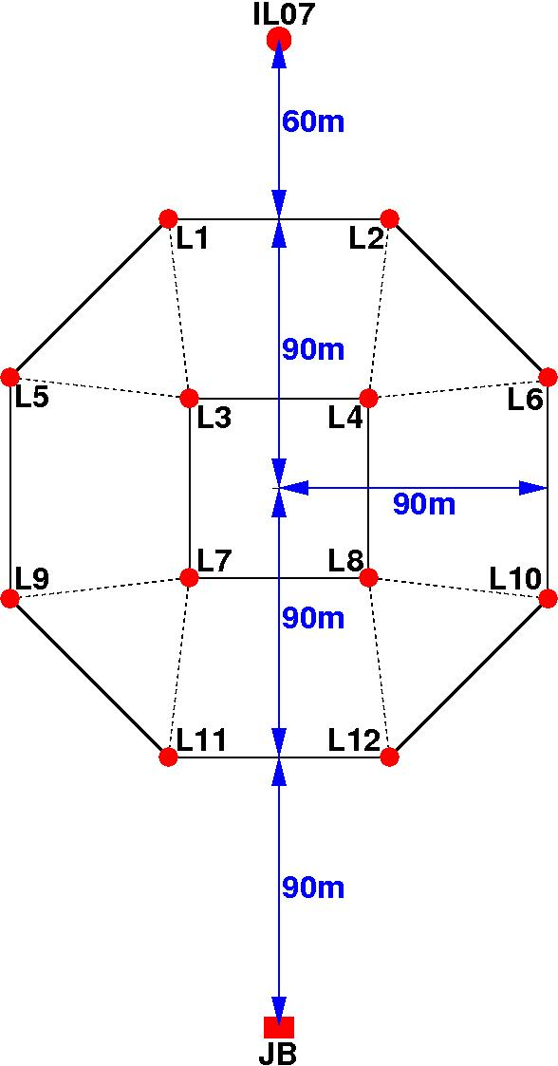
Acoustic Data from Prototype
saturation
signal [V]
acoustic emitter cycle
from ANTARES
emitters on anchors
prototype
footprint
of ANTARES
KM3NeT preliminary
time since run start [s]
⇒ allows for position calibration with statistical error

Slide 14
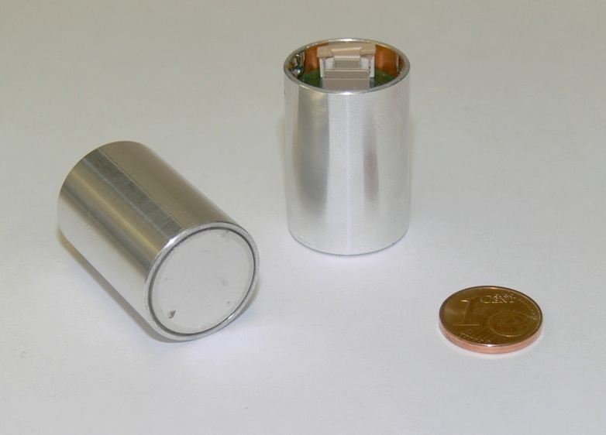
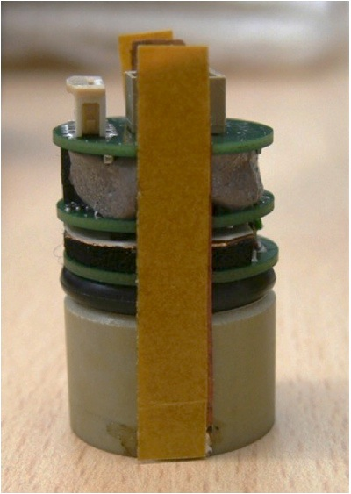
Digital Sensors
KM3NeT prototypes
Advantages:
  compact design
  easy to integrate into different systems due to digital interface
  less susceptible to electromagnetic interference at signal transmission
Disadvantages of digital sensor:
  higher power dissipation (~400 mW) in small volume
  depending on external readout (clock) – can be integrated

Slide 15
Digital Sensor Characteristics
piezo ceramic (PZ 27 disc, ⌀=18 mm, h=11.5 mm)
pre-amplifier (2-stage)
high-pass filter
ADC (sigma-delta AD7764, 24bit, 4V)
FPGA (ICE40LP1K, AES-3 output)
interfaces (clock in, read out, programming)
Characteristics
    versatile digital interface – adaptable
    ~190kSps sampling rate (5 – 80 kHz flat response) – adaptable
    low noise:
    high sensitivity: – adaptable
Notes:
Der ADC enthält auch einen Anti-Alias-Filter ; das ist das raffinierte an den Sigma-Delta ADCs, sie haben sehr hohes oversampling, d.h. das analoge Filter muss nicht sehr steil sein, die Steilheit kann dann aber mit einem Digitalen Filter nach dem Sampling auf die Auslese-Rate angepasst werden. Sigma-Delta ADC sind also gar nicht so unattraktiv, nur hat Giorgio leider mit dem Audio-Stereo ADC meines Erachtens keine besonders schlaue Wahl getroffen, aber das ist eine andere Geschichte.
FPGA-Auslese ist AES-3 vom digitalen Standard, aber nicht vom elektrischen (wir benutzen LVDS, Standard wäre RS-485 oder so was ähnliches).

Slide 16
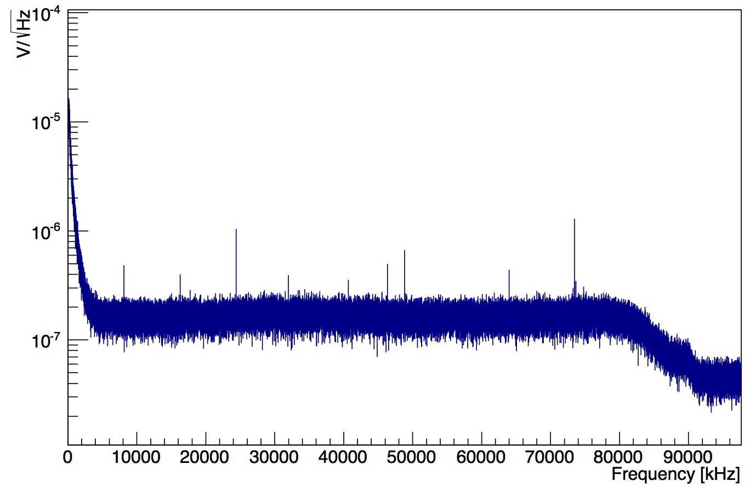
Laboratory Measurements
KM3NeT preliminary
5 kHz
Spectral Density [V/√Hz]
Frequency [Hz]

Slide 17
Laboratory Measurements
full frequency range
mean = 14760 LSB
σ = 1398 LSB
DR = 80 dB
1 LSB ~ 0.24 µV
KM3NeT preliminary
Amplitude [LSB]

Slide 18
Laboratory Measurements
region > 5kHz
mean = 0 LSB
σ = 296 LSB
DR = 92 dB
1 LSB ~ 0.24 µV
KM3NeT preliminary
Amplitude [LSB]

Slide 19
Next Steps and Additional Possibilities
10 prototypes produced
started production of 600 digital sensors for first phase of KM3NeT
testing and integration until end of 2014
Characteristics
  wide frequency band
  high sensitivity, low noise
  versatile due to programmable digital interface
allow for different fields of application:
  position calibration
  (deep) water bio-acoustics, acoustic pollution
  acoustic neutrino detection
  …
application as digital hydrophone possible – coating of sensor

Slide 20
Summary and Conclusion
developed digital acoustic sensor for underwater applications
primary application: position calibration for the future
KM3NeT neutrino telescope
compact and versatile design
characteristics allow for different fields of application:
  acoustic position calibration
  marine science
  acoustic particle detection

Slide 21
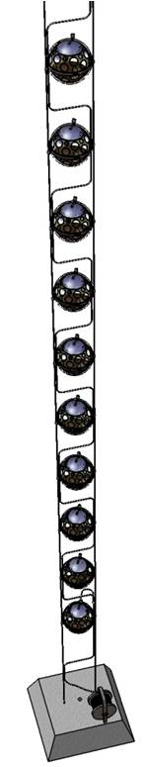
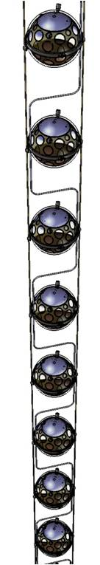
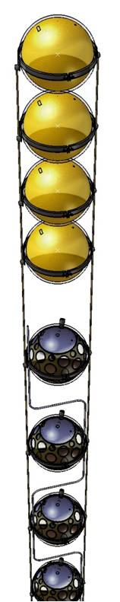
Detection Units (DUs)
vertical unit of the detector:
  underwater buoy, anchor
  2 Dyneema©-ropes (∅ 4 mm)
  18 digital optical modules (DOMs),
  36m vertical distance
  total height ~700m
electro-optical cable:
  flexible hose (∅ 6mm)
  oil-filled
  contains optical fibres and copper wires

