Slide 1
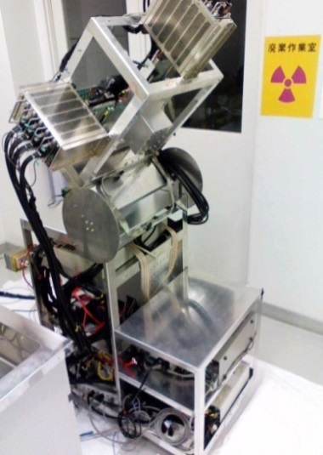
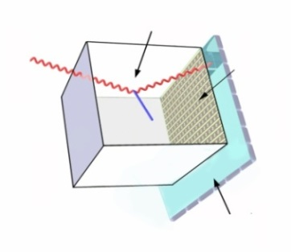
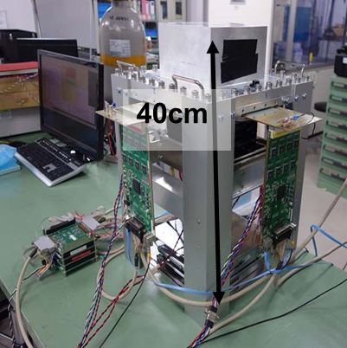
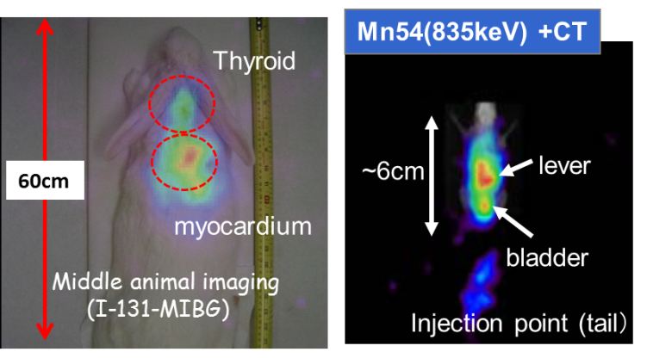

Real-time Imaging of prompt gammas in proton therapy using improved Electron Tracking Compton Camera (ETCC)
Pixel Scintillator Arrays (PSA)
μTPC
RI reagent
Electron Tracking Compton Camera (ETCC) & its Medical application
Improvement in new ETCC in SMILE-II
Result from Beam test
Summary
3/June/2014 TIPP2014@Amsterdam
T.Tanimori¹ H.Kubo¹, A.Takada¹, S.Iwaki¹, S.Komura¹, .Matsuoka¹, , K.Miuchi², T.Mizumoto¹, Y.Mizumura¹, K.Nakamura¹, S.Nakamura¹, M.Oda¹. J.D.Parker¹, T.Sawano¹ S.Sonoda¹, D.Tomono¹, S.Kurosawa³
1)Dep. of Phys, Kyoto Univ., Kyoto, Japan, 2) Dep.of Physics Kobe University, Japan,
3) Institute of Material Research, Tohoku University, Japan

Slide 2
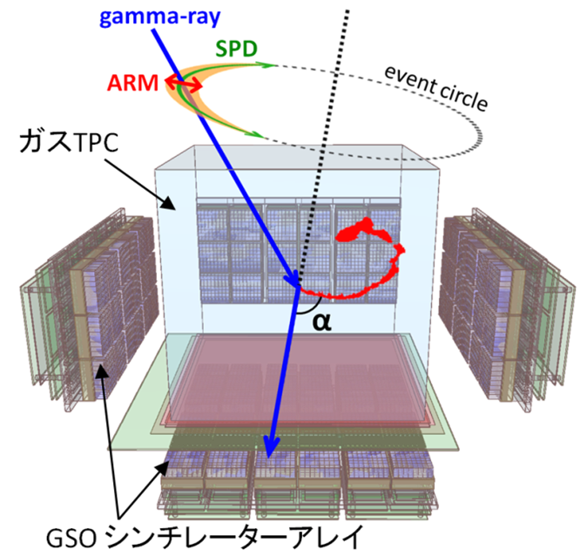
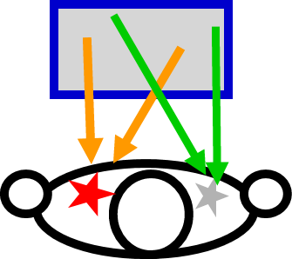
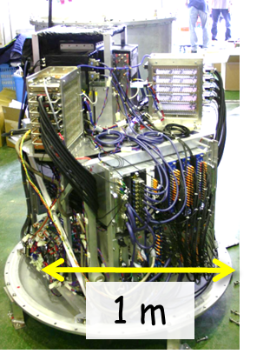
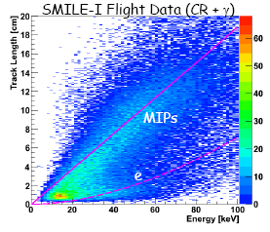
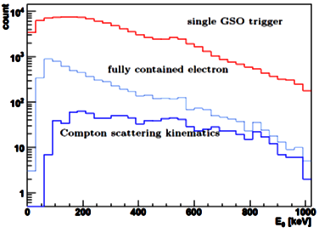
Electron Tracking Compton Camera (ETCC)
direction of photon by photon with SPD useful for Noise cut. & Clear Imaging
Noise Reduction by Kinematics(a)+dE/dx
Large FoV >4str(good for monitoring)
Modular structure
Gas TPC
gas
μPIC with 400μm pitch
Old Medical ETCC based on SMILE-I (2006) balloon model
GSO pixel scintillator
SMILE-I (2006)
10cm-cube ETCC
New one based on SIMLE-II (2013)
W(I-131:364keV)
  dE/dx background cut
dE/dx
Event Selection
2

Slide 3
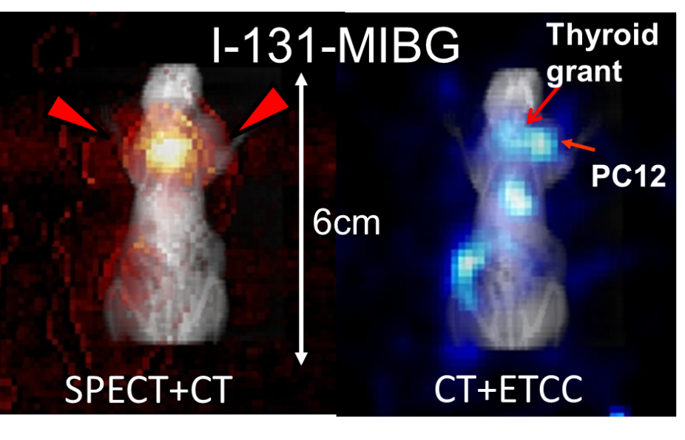
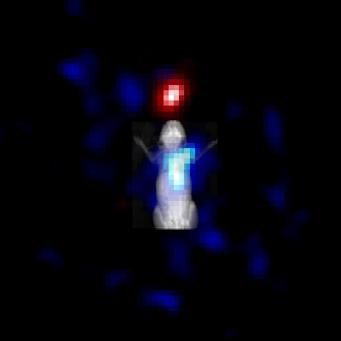
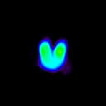

Variety of RI applications in ETCC
 | Ce-139 | Cr- 51 | Ba-133 | I- 131 | Au- 198 | Na- 22 | F- 18 | Cu- 64 | Cs-137 | Mn-54 | Fe- 59 | Zn-65 | Co- 60
Energy [keV] | 167 | 320 | 354 | 364 | 410 | 511, 1275 | 511 | 511 | 662 | 835 | 1095, 1292 | 1116 | 1173, 1333
Life | 137.6 day | 27.7 day | 10.52year | 8.01 day | 2.6 day | 2.609 Ｙear | 109.8 min | 12.70 hour | 30.04 year | 312.1 day | 44.5 day | 244 day | 5.271 year
SPECT
PET
Energy dynamic range : 167 – 1333 keV.
ETCC
I-131 364keV
Thyroid gland phantom from one direction
Zn-65-Porphyrin (1.2MeV)
Cal.source
Ba. 335keV
6cm
(I-131:364keV)
W (364keV)
Rainbow： 511keV（FDG)
Orange： 365keV(MIBG)
Zn-65-Porphyrin (1.1MeV)
Notes:
3
3
3

Slide 4
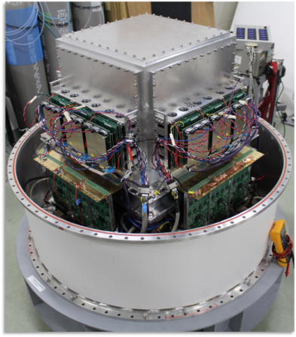
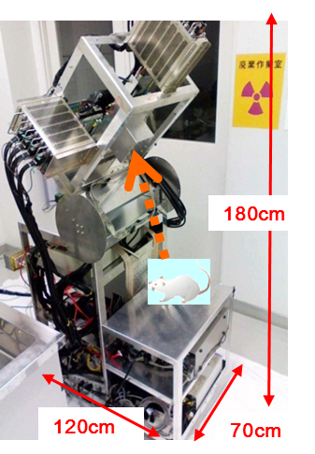

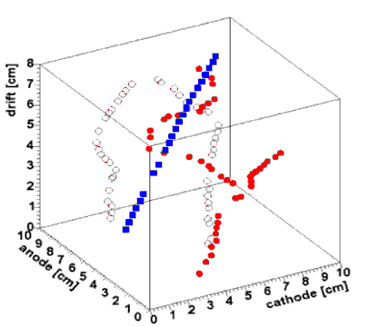
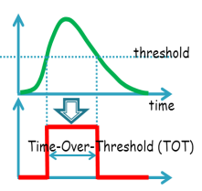
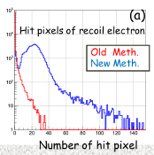
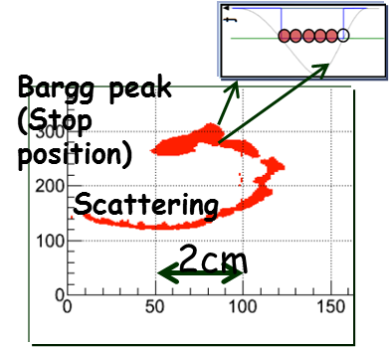
Improvement from 1stMedicalETCC
1st Medical 10cm-cube ETCC
SMILE-II (2013)
TPC
30cm –cube-ETCC
New Med. ETCC Head
GSO
GSO
30cm
~1 m
GSO
Tacking. Eff. -> 100% in SMILE-II
Fast electronics x 100 and more
Good Angular resolution ->5º GSO
proton
Observation Time: ~3 hours
Pos. Res.: 8-5mm(FWHM)
(8º at 662keV GSO)
Energy range: 150keV-2MeV
FoV：2 0x20cm＠10cm front
Max. Trigger rate <30Hz
SMILE-I
electron
Due to ~10% tracking efficiency
& slow Electronics

Slide 5
Features of ETCC for Molecular Imaging & Nuclear Medicine
  New Tracers using new RI with its decay time similar to biological decay time; Visualizations of immunity and enzyme : (FDG for visualization of metabolism)
  Multi RI Tracer Image ^{99m}Tc +¹⁸F
  3D imaging from one directional observation for operation supporting
  Imaging for beam therapy (proton, ion, neutron)

Slide 6
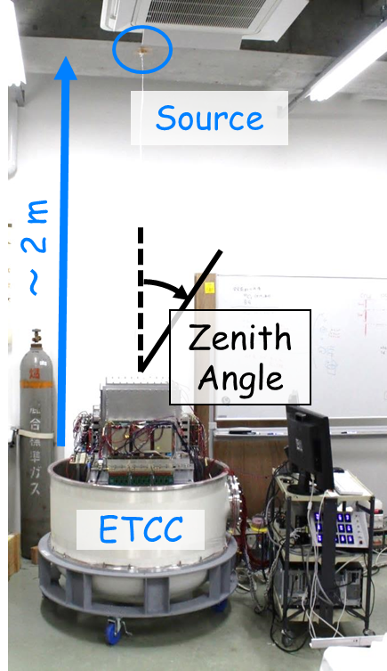
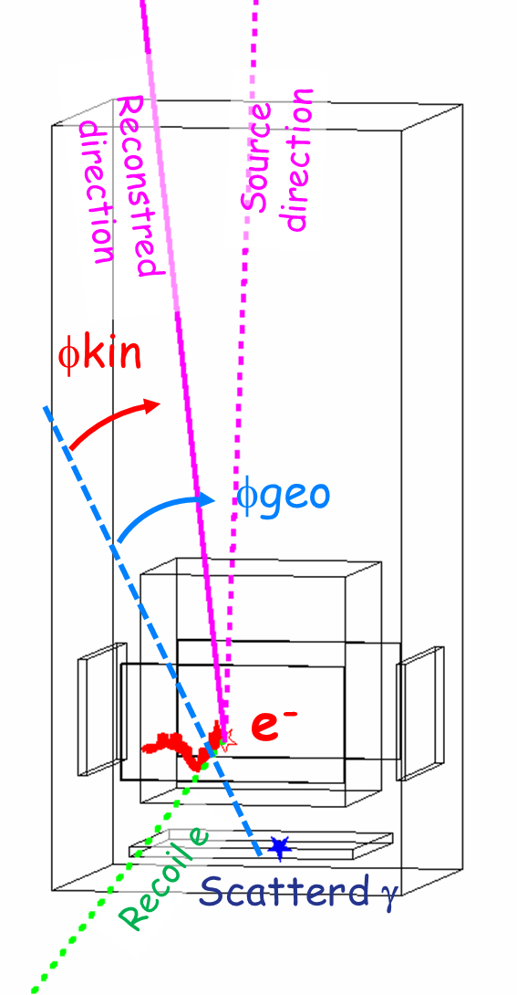
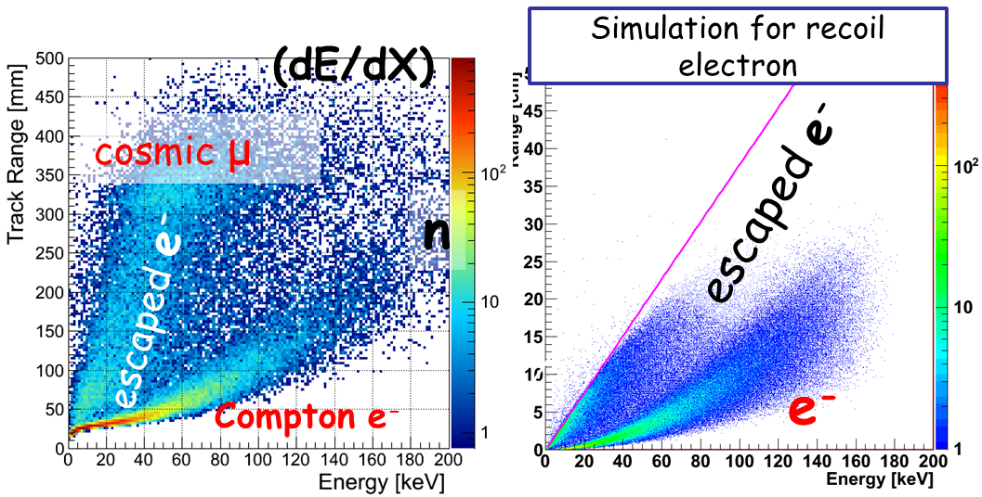
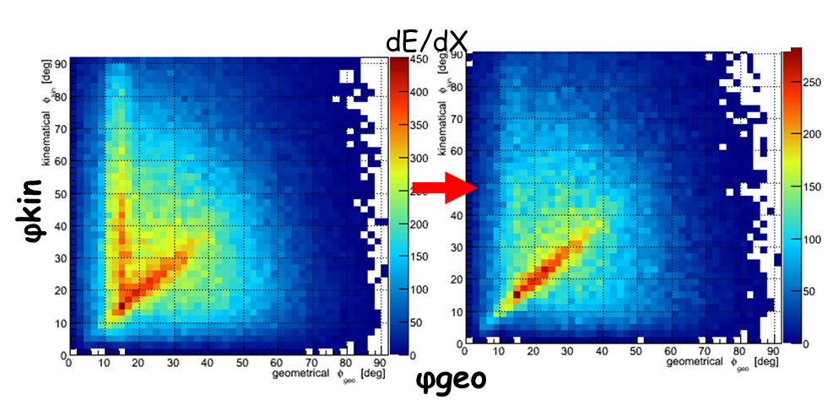
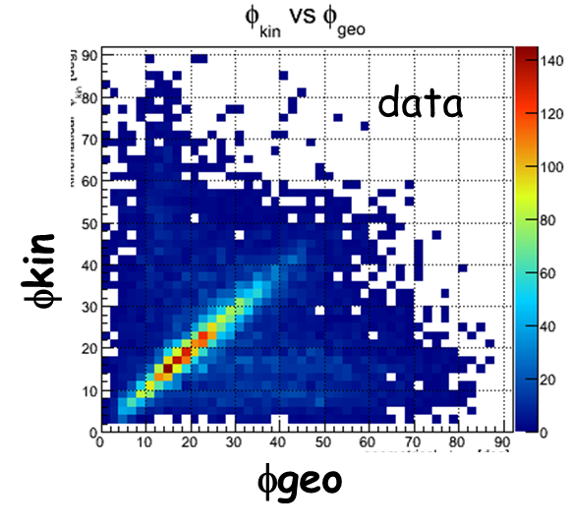
Imaging Test in 30cm ETC
¹³⁷Cs(～0.85MBq)
Noise reduction by Energy loss rate dE/dx
Preliminary
⇒ Continuum fully gamma events selected by dE/dx cut
Energy Cut
Diffuse gamma

Slide 7
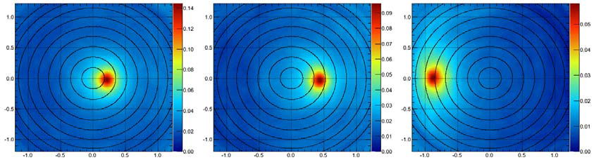
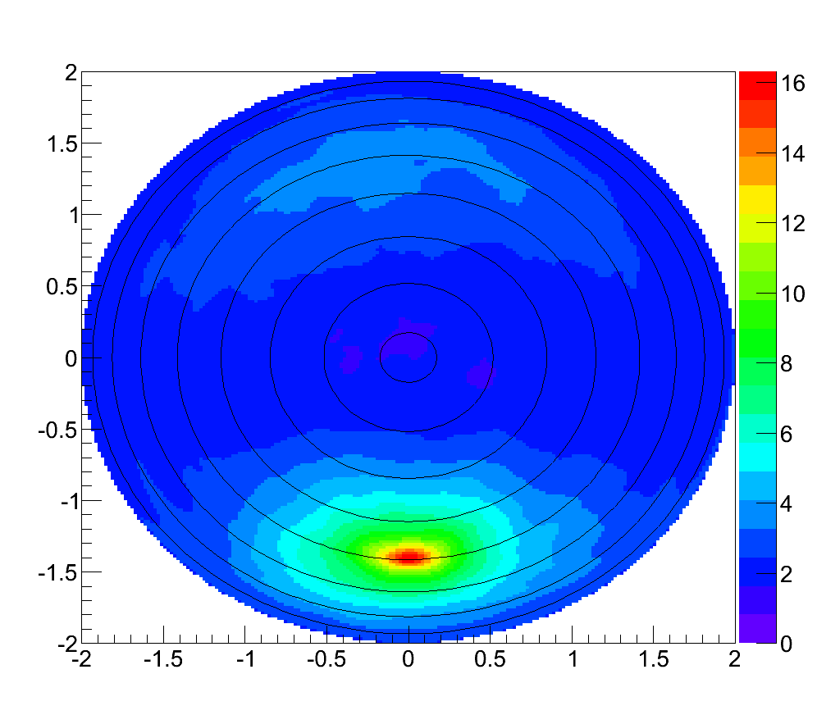
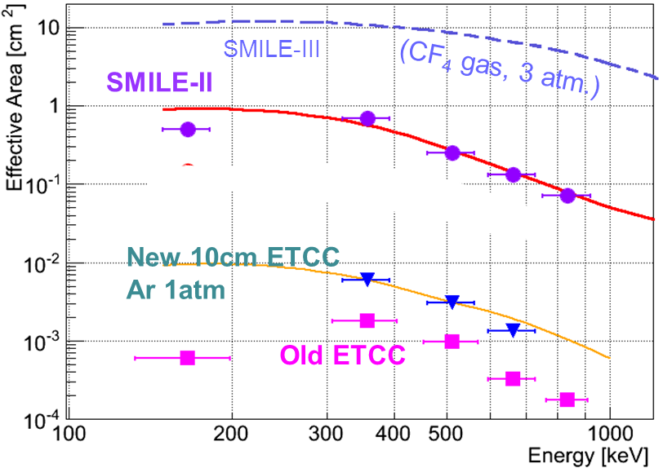
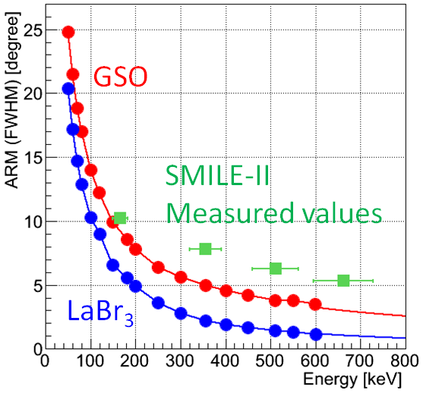
Performance of 30cm-cube ETCC
15 deg.
30 deg.
60 deg.
Reliable efficiency
(Good consistency with MC )
Good ARM res.
Simple Analysis (dE/dx)
High contrast image
large Eff.Area
Preliminary
90deg.
Wide Field of View (6 sr)
Eff.Area 1cm² =10⁻² efficiency in 10cm ETCC
LaBr3 use 10cm front
^{99m}Tc -> ~5mm
511keV-> ~2mm
ARM 5.3º (@662 keV)
Old ETCC ~10º
CF4 3atm
Aｒ１．５atm +2 RL.GSO
Preliminary

Slide 8
Miss reconstruction events in Compton Camera
C
Forward detector
Usual CC hardly distinguish
those events from good Compton events
γ
A
γ
Forward detector
E₁
E₁
Mult scattering in F,D.
Recoil electron hits B.D.
E₂
Backward Detector
E₂
Backward Detector
ETCC perfectly remove miss reconstructed events
A: Multi scattering in F.D.
B: electron escapes from F.D.
Ｃ：electron hits to B.D.
B
γ
Forward detector
γ
E₁
E₁
Recoil electron escapes
E₂
Backward Detector
ETCC easily detects one recoil electron fully contained in TPC

Slide 9
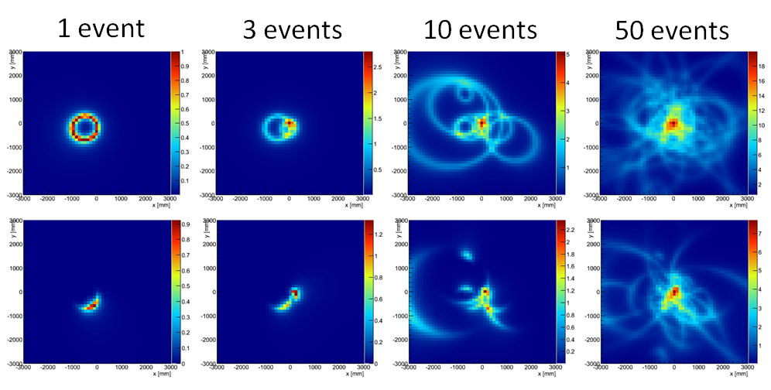
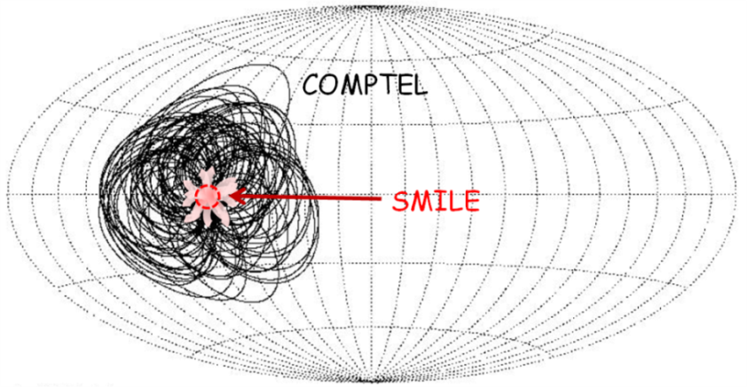
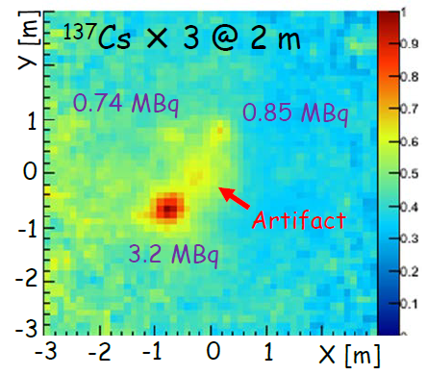
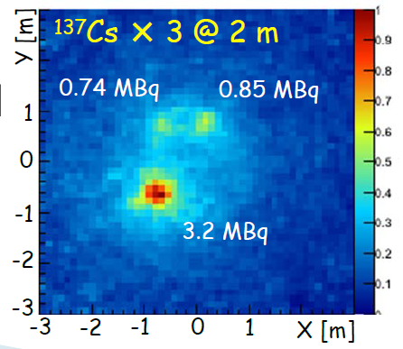
Imaging Improvement by SPD
Usual CC
:ETCC
Ryan, J. M., NewAR, 48, 199 (2004).
(SPD=200°)
no use Electron track
use Electron track
artifact
RI
Preliminary
⇒ ～3times better contrast image

Slide 10
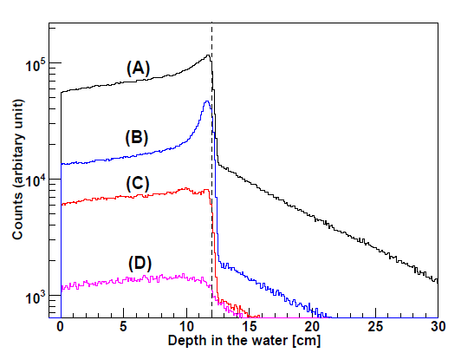
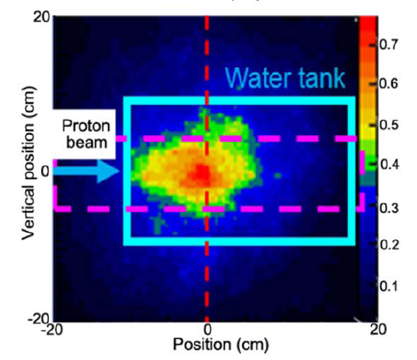
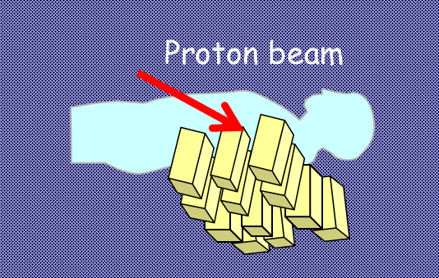
First Proton Therapy Beam-on Imaging @2009
Kurosawa et al. (2012)
Simulation
First Imaging of continuum gammas at Beam-on by ETCC using SMILE-I technology.
But intensity <0.01nA &
Trigger rate <50Hz !!
All energy
>2000keV
800-2000 keV
511 keV
511keVγ
800-2000keVγ
Bragg Peak
Notes:
10

Slide 11
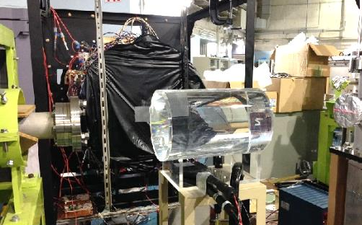
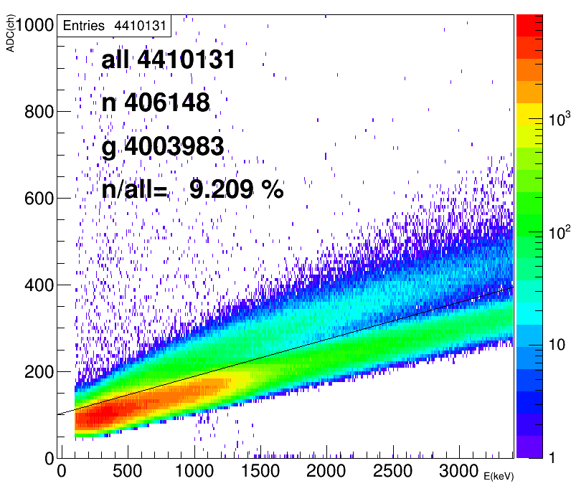
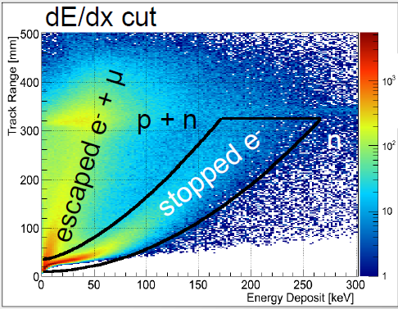
New 30cmETCC beam test using 140MeV p
140MeV
Proton
>0.1nA
Liquid
Scintillator
150cm
70cm
30cm
ETCC
¹³⁷Cs
0.7MBq
Proton beam
GSO Scintillator
30cm
TPC
6x6 PSAs
H2O Target
Shield Plate
Scintillator
Plastic
Scintillator
water
3x6 PSAs
ETCC
Ring Cyclotron @RCNP Osaka Univ.
140MeV p beam Intensity >01.nA
Trigger rate 0.3-1kHz
Liquid Scintillator
ETCC dE/dx
neutron
p +n
gamma
MIPs
keV
・Similar intensity of neutron to gammas (~1/10)

Slide 12
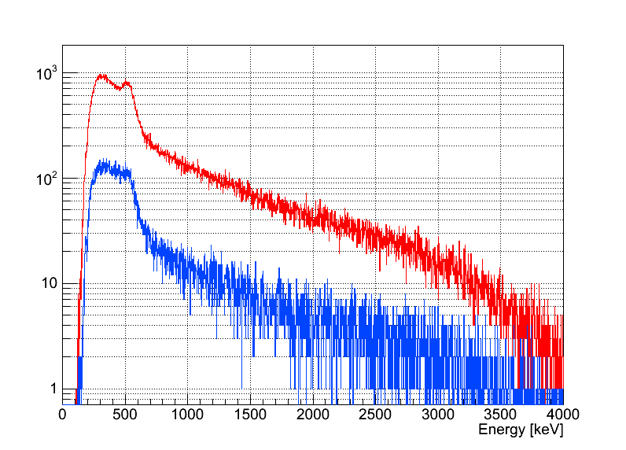
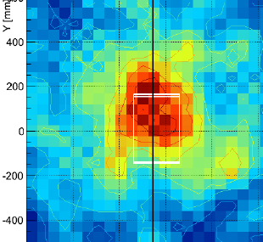
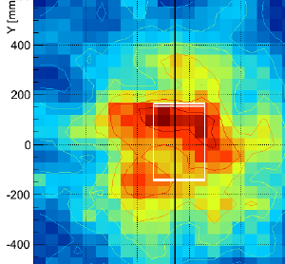
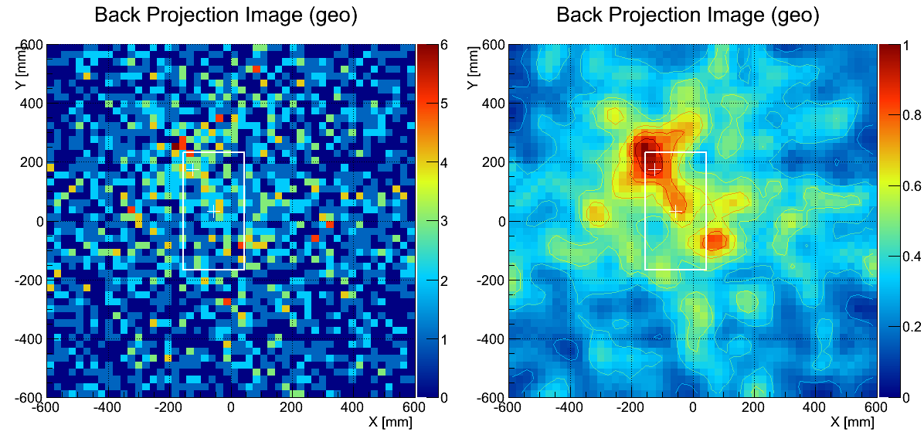
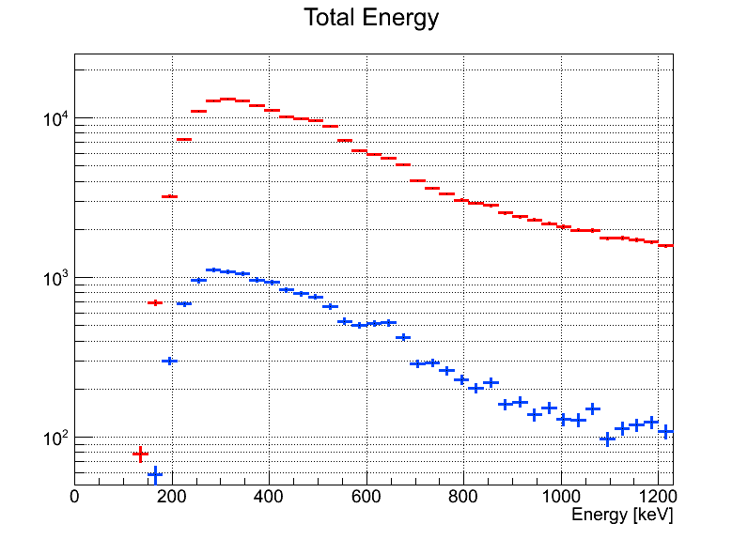
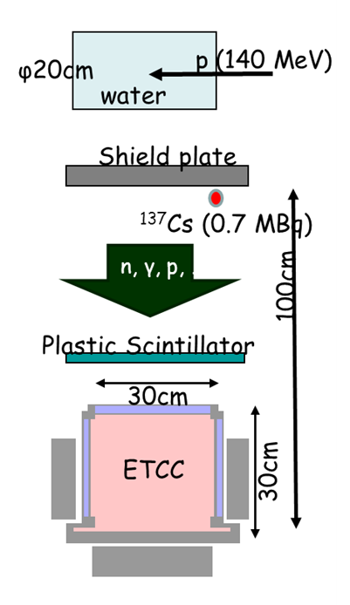
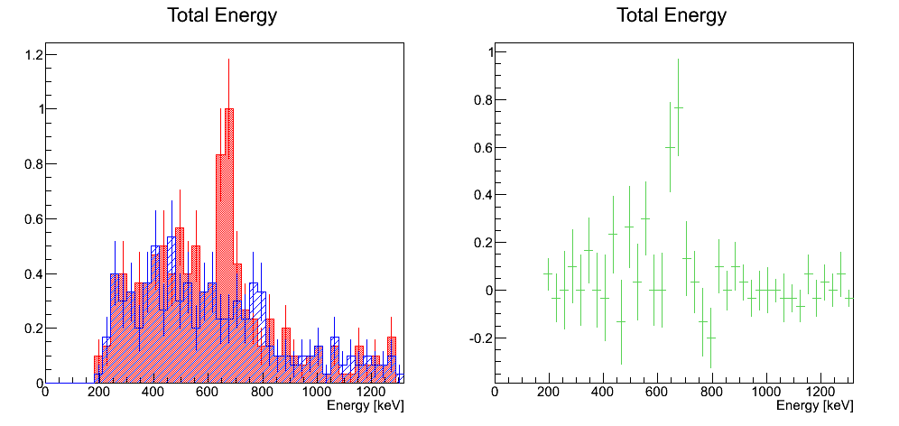
Imaging test in intense BG environment
ETCC Energy Spectrum
Direct gamma-ray Back Projection Image
~2000 gammas >1.5MeV
Measured time 14min.
Water Target
beam
beam
dE/dx cut
511 keV ± 10%
> 1500 keV
↑ Top
Bragg peak
1MeV
Preliminary
3MeV
Beam line
background 1/10 by ｄE/dx cut
Sexcess @ 511, 662 keV
¹³⁷Cs
Raw data
150cm
Preliminary
gamma
662 keV
Trigger rate ~500Hz
ETCC detected gamma ray correctly with same efficiency as no beam.

Slide 13
What are needed in Practical use
Expected Trigger
500x (10x50) x10= ~10⁶ Hz
But
Energy threshold >0.8 MeV -> 1/4
+ limited Field of View x1/4
=> Expected Trigger rate 10⁵ Hz
DAQ Improvement
VME bus (~2KHz) -> network x >10²
2KHz x 10² ~2x10⁵Hz
Multi heads => several 10⁴Hz
Possible by present hardware !
Beam Therapy Imaging
Present Status
-> 3 gammas/sec >1.5MeV
Development factor s
1. Distance 1.5m ->40cm x 10
2. Efficiency develop. x 50
3. Beam Intensity x ~10
Total 5x10³
Expected gammas >1MeV
1.5x10⁴ /sec.
Bragg peak position determination
1cm position resolution for 1 gamma
-> 100 gammas for <1mm accuracy per second
at least several x10² gammas/sec >1MeV is needed !

Slide 14
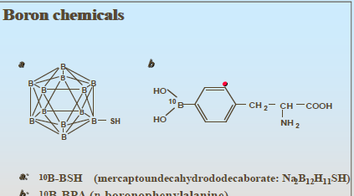
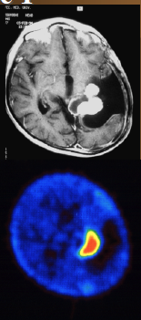
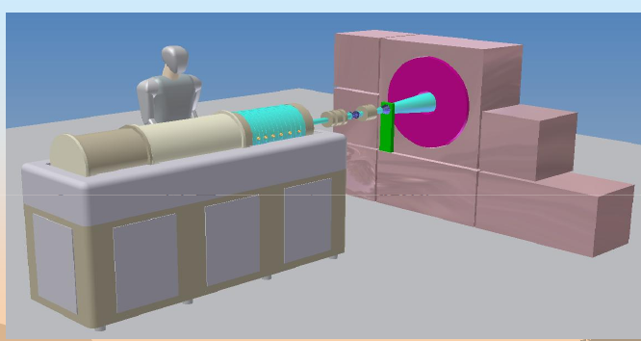
Imaging for Boron chemicals in BNCT
Boron Chemicals (BCs)
¹⁰B+n -> ⁷Li* +α (94%)
⁷Li* -> ⁷Li +γ(478keV)
Only ETCC may image this γ under neutron background !
Imaging of Boron chemicals(BC)
BC+ ¹⁸F for PET
However, no guarantee for BC+¹⁸F with same distribution as BC in body
PET image
Imaging System of BC in mice is inevitable for developing new BCs
Solution:
Small neutron source ( 3MeV proton LINAC+ modulator) + ETCC

Slide 15
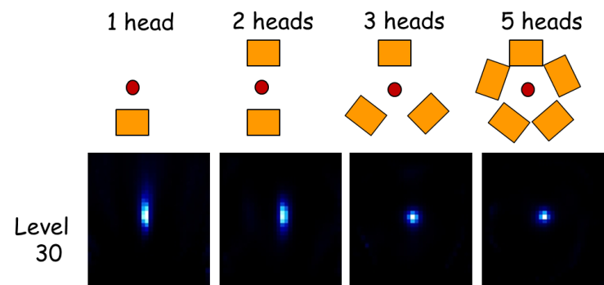
Way to Practical Use of ＥＴＣC
New Medical ETCC head
GOAL for Medical ETCC head in Practical Use
Position Resolution -> 2-3mm in human
Observation Time -> 10 minutes for human
High Efficiency -> ~1% (3atm CF₄ gas in 10cm ETCC)
High counting rate >50KHz at one head
3-6 ETCC ring heads system for CT imaging
Near future developments
New Medical ETCC is now OK( ~1KHz operation) and 2nd one soon
Following tests using 2 ETCC heads will be done in 1-2 years.
Multi tracer 3D image with ^{99m}Tc and FDG in mouse
¹⁰B imaging in mouse
High through put rate imaging under intense radiation for particle therapy
Detail of SMILE=II is presented in 4th evening
in II.b Astro & Space session1

Slide 16
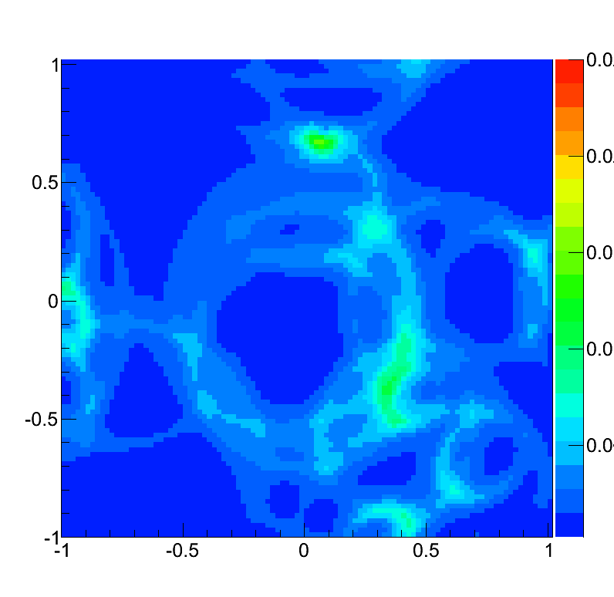
Observation of time variation
0.025
835 keV±10%
~3 hours
~10 min/frame
0.020
ETCC
No source
0.015
0.010
30˚
0.005
~20 min
60˚
+0.01 mSv/h
ETCC
~3 m
⁵⁴Mn (835 keV, 1 MBq)
SMILE-II clearly detected
gamma-ray source with only 10 minutes.

Slide 17

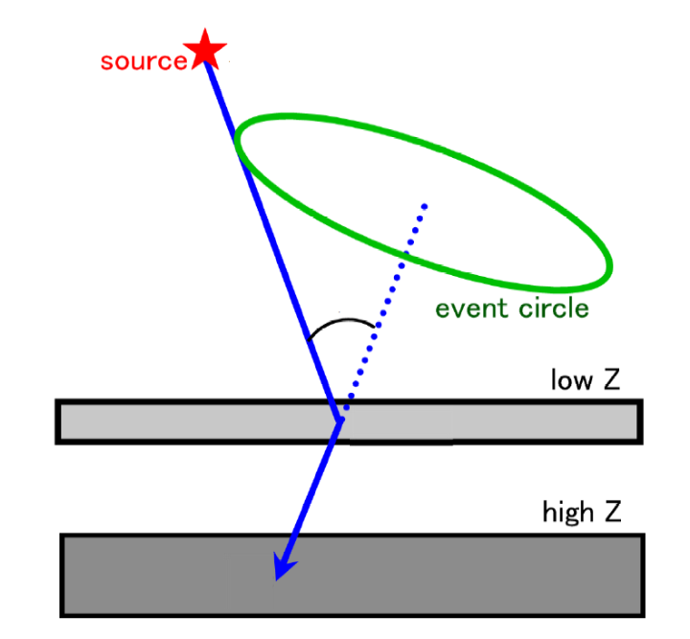
Difference in Noise reduction
E₀
γ
θ
E₁
E₁
dE/dx
E₂
TPC
E₂
Noise reduction in Classical CC
Only Cut for E1 or E2, or E₁/E₂
Anyway, some of real gamma events are lost
Noise reduction in ETCC
Only cut for dE/dx,
dE/dx is not used for event reconstruction,
Good dE/dx reduces backgrounds without loss of real gamma events

