Slide 1




AGIPD, The Electronics for a High Speed X-ray Imager at the Eu-XFEL
Peter Göttlicher
Amsterdam, June 5th 2014
for the AGIPD consortium:
Allagholi, J. Becker, L. Bianco, A.Delfs, R. Dinapoli,
E. Fretwurst, P. Göttlicher, H. Graafsma, D. Greiffenberg,
M. Gronewald, B. Henrich, H. Hirsemann, S. Jack, R. Klanner, A. Klyuev, H. Krüger, A. Marras, D. Mezza, A. Mozzanica,
I. Sheviakov, B. Schmitt, J. Schwandt, X. Shi, U. Trunk, Q. Xia, J. Zhang, M. Zimmer

Slide 2
Outline
Introduction: Free Electron Laser and its experiments
Concepts for AGIPD
Functional block of the electronics
System aspects and logic realization
Off-Detector-Head data handling
First Measurements
Summary and Outlook

Slide 3
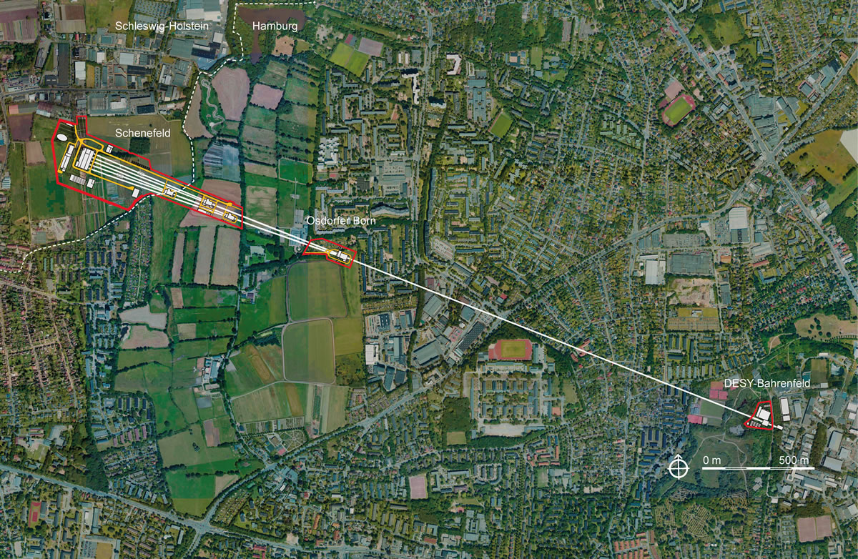
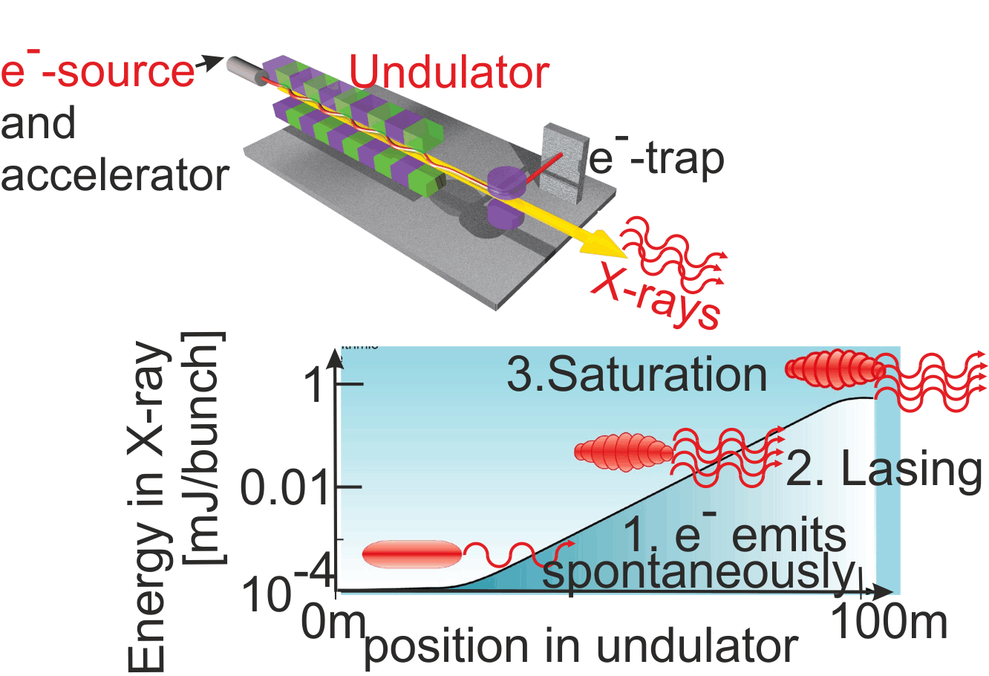

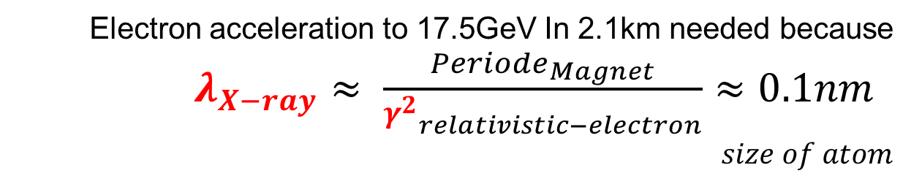


Introduction: Free Electron Lasers (Eu-XFEL)
Electron acceleration to 17.5GeV In 2.1km needed because $λ_{X−ray}≈ \frac{{Periode}_{Magnet}}{{γ^{2}}_{relativistic−electron}}≈0.1nm$
$$size of atom$$
X-rays
$${10}^{12}$$
$$\frac{Photons}{bunch}$$
<100fs bunch length
by lasing “SASE”
e⁻
DESY

Slide 4
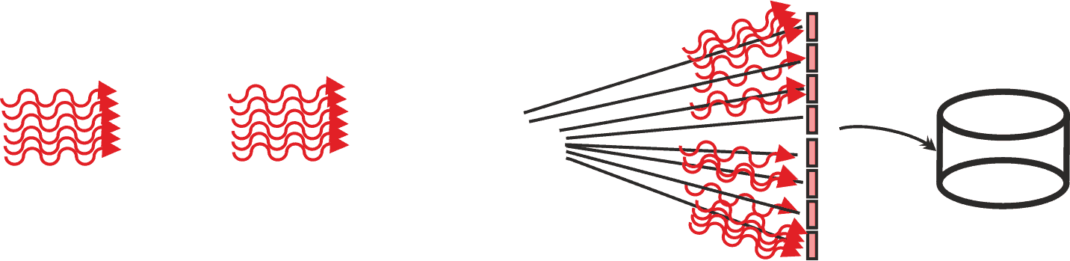
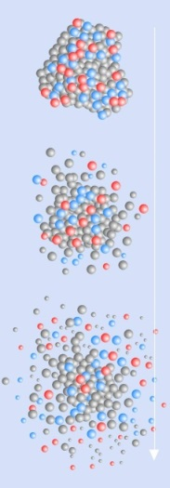

Introduction: Experiments at Eu-XFEL
Accelerator X-rays as trains
27000 bunches/sec
2700 bunches spaced by 220ns
Experiment:
222ns time to catch each image
600µs with 2700 scatterings
99.4ms time to process signals
99.4ms time to transfer data out of detector – and pipelined process the signals of next train
600µs 100ms
100ms
<100fs X-rays
220ns
Imaging detector:
- 2-dimensional
Scattered X-rays
of bunch 1
Seen by
- bunch 1
- bunch 2
- bunch 3
Storage per bunch
X-rays of bunch 3
… of bunch 2
X-ray flashes:
Intense, high repetitive, very short allows to study new science: Objects destroyed by X-rays
– even small intensity
Need to handle
Image per bunch
every 220ns
e.g. biological
molecule

Slide 5
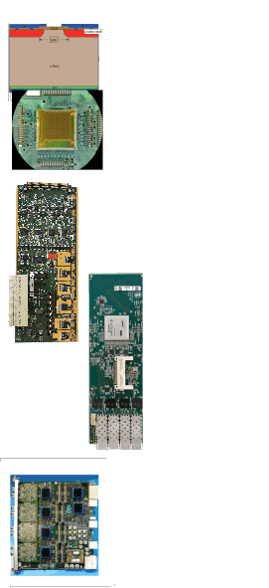
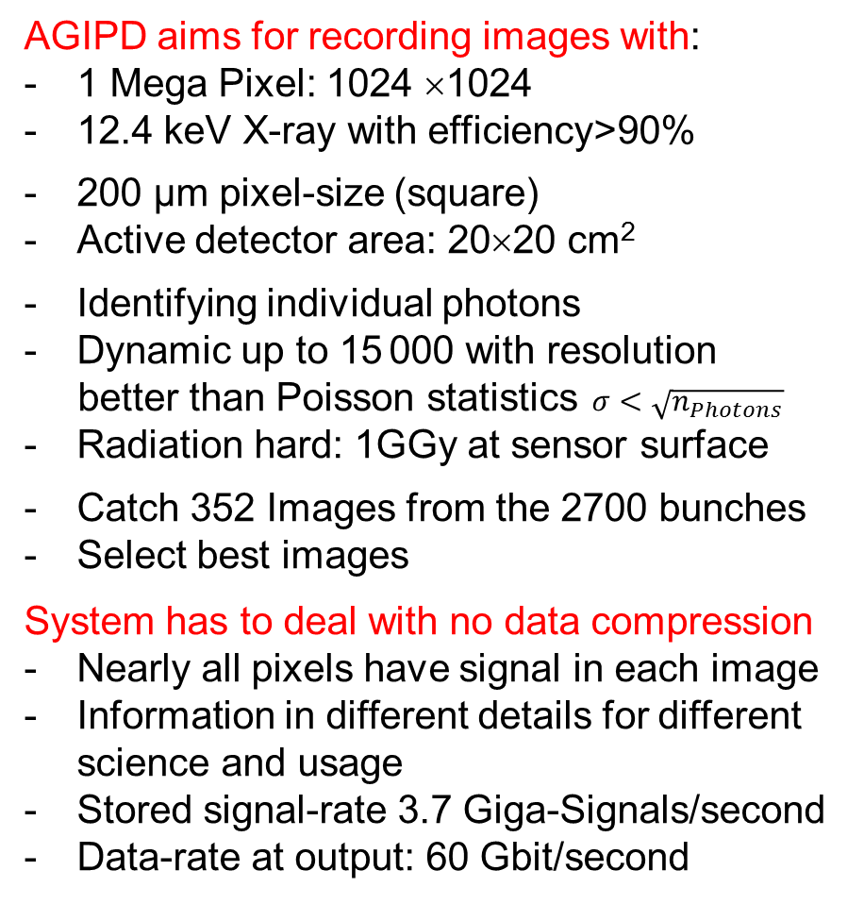
Concept: Signal Chain for a 2-dimensional Camera
AGIPD aims for recording images with:
1 Mega Pixel: 1024 ×1024
12.4 keV X-ray with efficiency>90%
200 µm pixel-size (square)
Active detector area: 20×20 cm²
Identifying individual photons
Dynamic up to 15 000 with resolution
better than Poisson statistics$σ<\sqrt{n_{Photons}}$
Radiation hard: 1GGy at sensor surface
Catch 352 Images from the 2700 bunches
Select best images
System has to deal with no data compression
Nearly all pixels have signal in each image
Information in different details for different science and usage
Stored signal-rate 3.7 Giga-Signals/second
Data-rate at output: 60 Gbit/second
- Silicon sensor
- ASIC for signal
preparation, storage
and multiplexing
- Analogue PCB
for digitizing
- Digital PCB
for digital
preprocessing,
storage and
multiplexing to
10GbE
- Off-detector data
processing and
storage

Slide 6
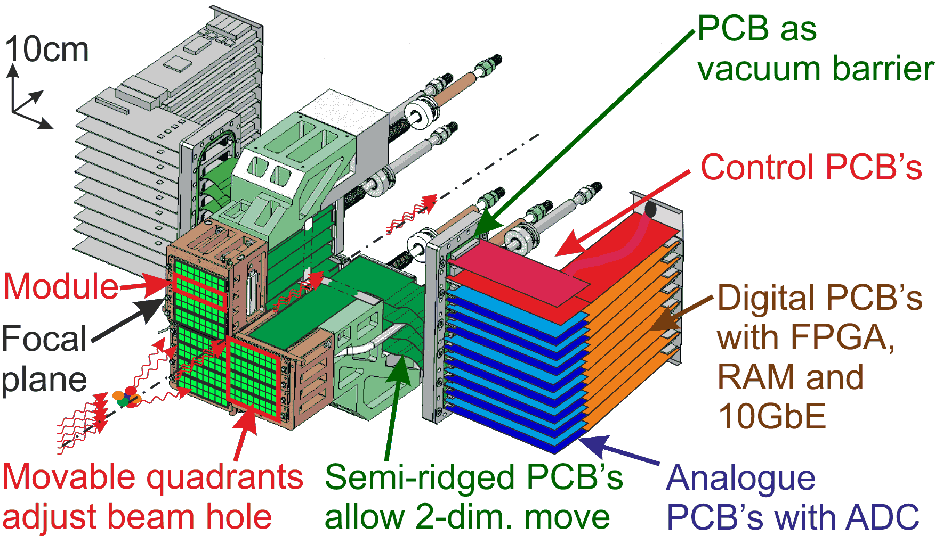
Concept: Mechanical for a 2-dimensional Camera
Focal plane in probe-vacuum cooled to ~ -15-20⁰C
Focal plane sticking close to probe through flange
Electronics as wings to the side allows down-stream small angle detectors
PCB electronics: Closed-loop air cooled outside vacuum
Thick Multilayer-PCB as vacuum barrier with plugged and micro-vias
Interfaces always limited by number of contacts in connectors

Slide 7
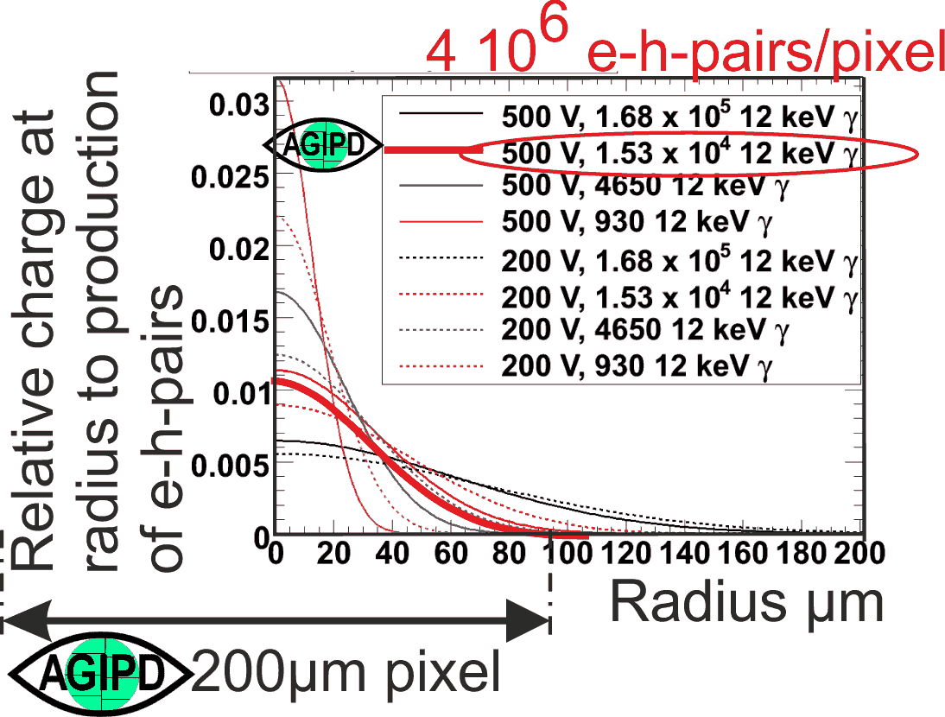
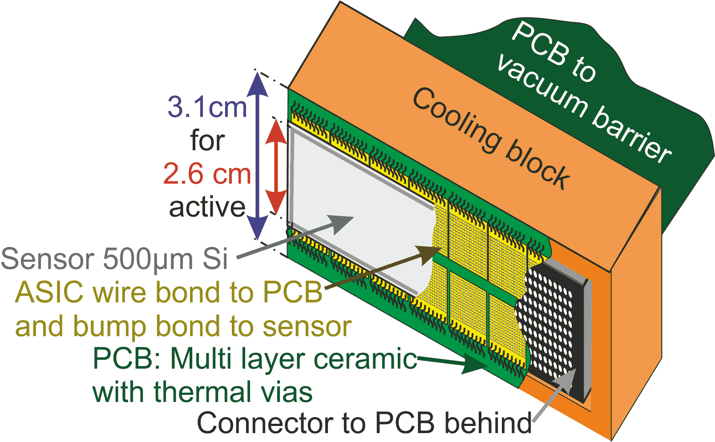
Functional Block: Focal Plane
Sensor design and operation point
Keep the charge within pixel, even
for intense pulses
Modularity: 512×128 pixel
and 16 modules to get
1Mega-Pixel
Focal Plane:
8×2 ASIC’s for each sensor
Pixel electronics behind each pixel within 200µm ×200µm and than multiplexed to fit with
Dense connector
500 pins share space with
Cooling interface

Slide 8


Functional Block: Functionality of the ASIC
Within pixel-area
200µm×200µm
Bump bond
to sensor
352 cells for
2700 bunches
Common
for ASIC:
64 x 64 pixels
4.5M-bunches/s
Command Interface with 16 bit/bunch
  3 LVDS
  (clock, data, strobe=bunch-start)
  Random write/read access
  to analogue memory
  Control of settings and readout
Output driver: 4 differential analogue
  into 100Ω-lines with 33MS/s
  Common usage for analogue + gain
  Each for 64x16 pixels
3 gain states
Dynamic switching of the
gain per image at threshold in
the integrating input amplifier
Dynamics: X-rays/pixel/image
Single X-ray identifying
up to 15000
Adaptive
Gain
Integrating
Pixel
Detector

Slide 9
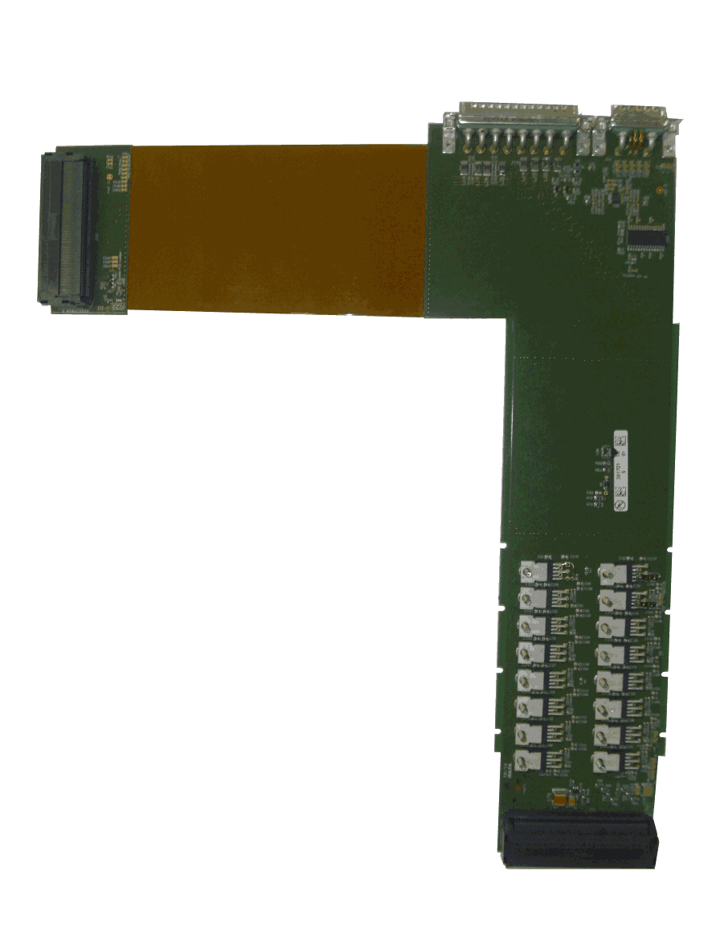
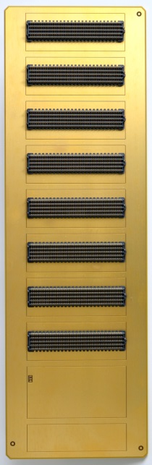
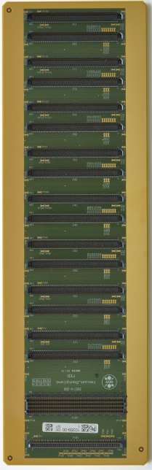
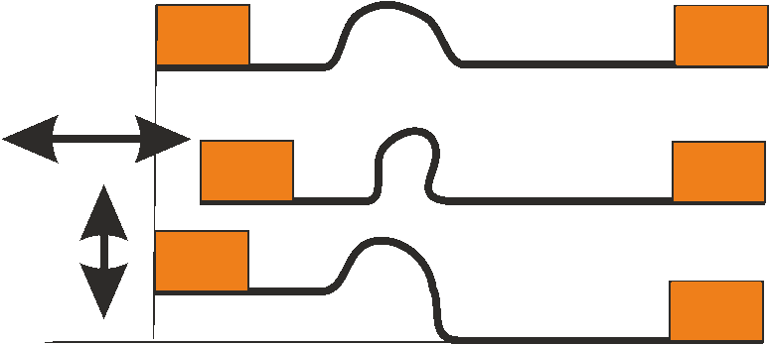
Functional Block: Interconnecting PCB’s
3. Backplane for
½ Mega Pixel as
vacuum barrier
512 analogue
feed trough's
48 digital controls
for time synchronic
operation
Slow control
I²C branched network
Vacuum tide: Multilayer with copper-GND and plugged/micro-vias
8×2 analogue PCB’s
2. Interconnect
to vacuum
barrier
Semi rigid multilayer
64 analogue pairs
3 control pairs
I²C slow control
Voltage regulators for ASICs: ~24A/module
Connectors
for
control
boards
air vacuum
1. Dense interconnect
from wire bonded ASICs
to 500 pin connector:
PCB out of ceramic (LTCC)
Multilayer
Thermal and micro-vias
Ceramic capacitors for power/bias

Slide 10
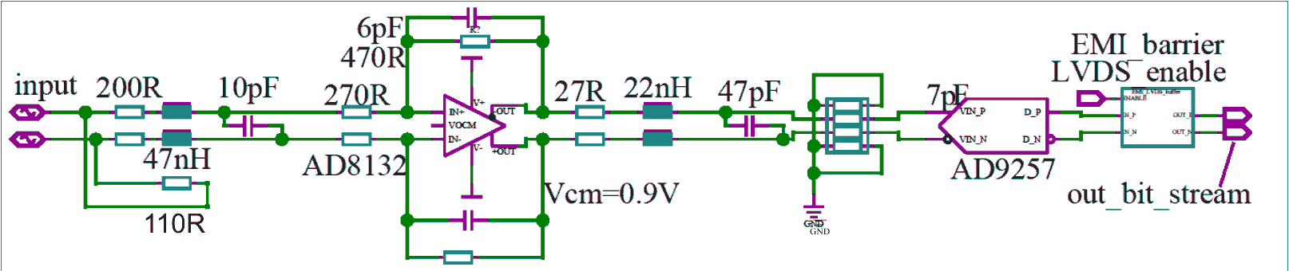
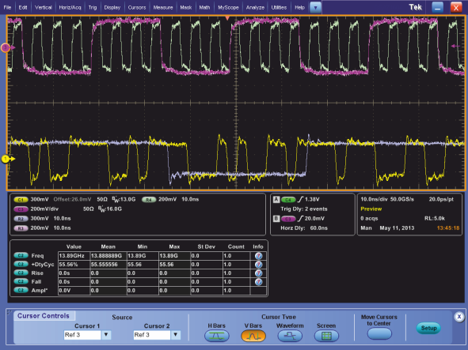
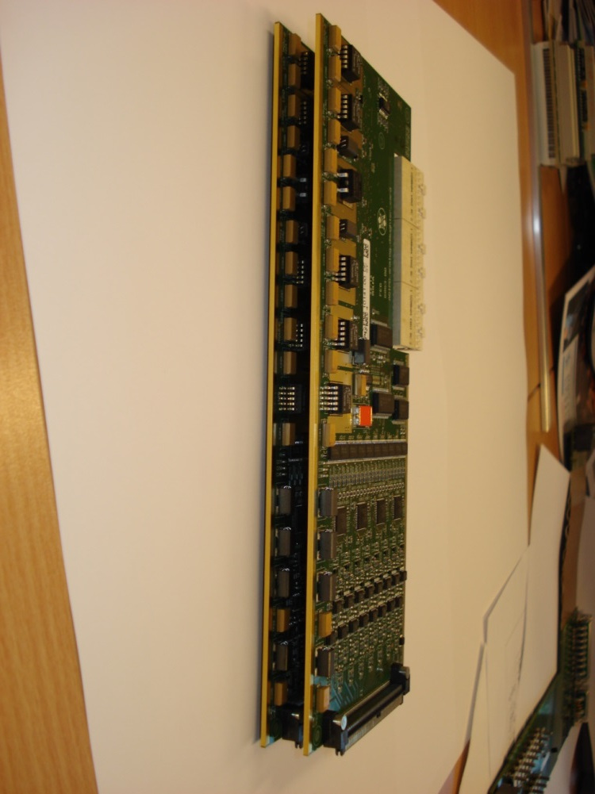
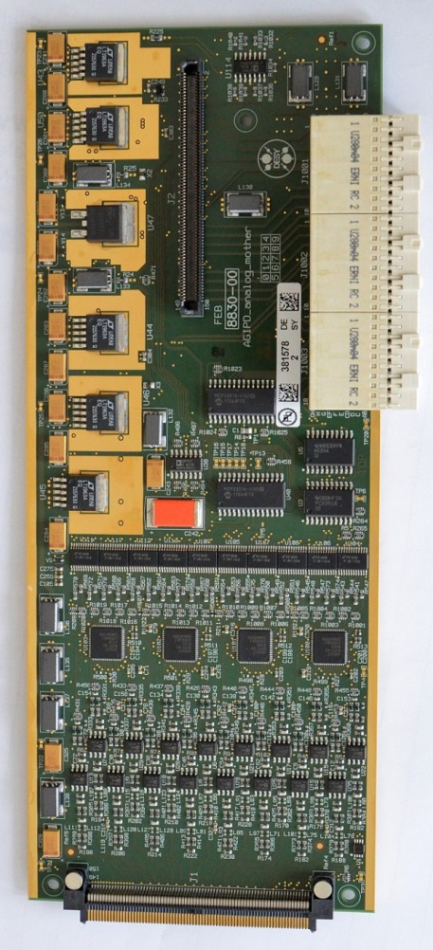
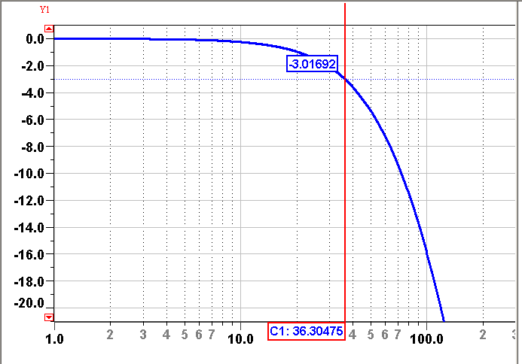
Functional Block: Analogue Signal Chain
64 channel as 2 PCB’s each 2 sides: Minimal components/channel:
Differential noise filter to sample rate within 8mm of PCB-side
Multichannel 14-bit ADC’s with
serial output stream: 33MS/s
64 x 465Mbit/s to digital part
Serial LVDS bitstream, 420Mbit/s
Data transfer
to digital board
Scan of pulse shape
with ADC
Settling to 11 bits
While full scale is just
128 X-rays full scale
14-bit ADC allows
to calibrate
0,1,2 X-rays as peaks
Sampling
point
-50 -25 0
Neg. delay of sample time [ns]
0
-10
-20
Voltage at ADC [dB]
Frequency response of the filter (simulated)
-3dB @
36MHz
1MHz 10MHz 100MHz

Slide 11
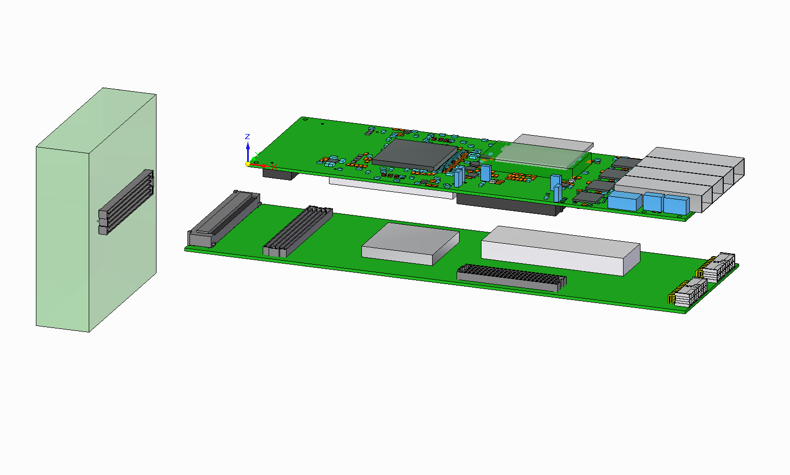
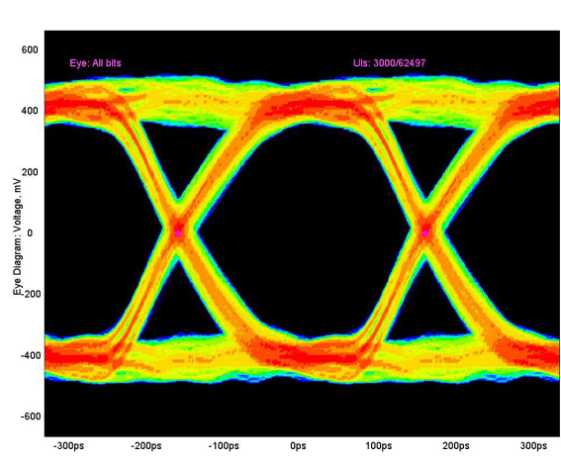
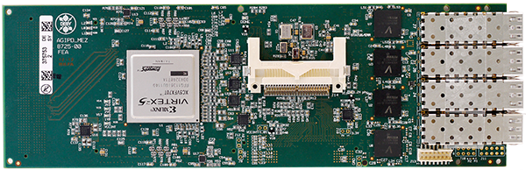
Functional Block: Digital Processing
Need is 64 ADC inputs with design goal per one of 16 modules
50MS/s with 14bit or 700Mbit/s/channel In: 45Gbit/s
Gain sampling: Reducing 14bit to 2 bits for 3 states
Forth 2 bit code allow to transfer debug information for uncertain decoding
Output word for pixel and image: 16 BIT: 14bit for analog + 2 for gain
Sorting data to small geometrical pattern needs write/read to memory:
SODIMM 128 I/O’s, >250MHz-DDR Memory: 55Gbit/s
Formatting to 10GbE
Data stream to Off-detector through whole following train Out: 3.7Gbit/s
for 1×10GbE optical Link with UDP as protocol
Realized around Virtex-5 as central FPGA as combination
Multi-project mezzanine with 4×10GbE and
Project-specific carrier
[mV]
4 x 4 x 3.125Gbit/s
400
Differential voltage
Well
open
eyes
0
-400
XAUI’s for 10GbE
-200 0 200ps
Peter Göttlicher | TiPP 2014 | June 5th 2014 | Page 11

Slide 12
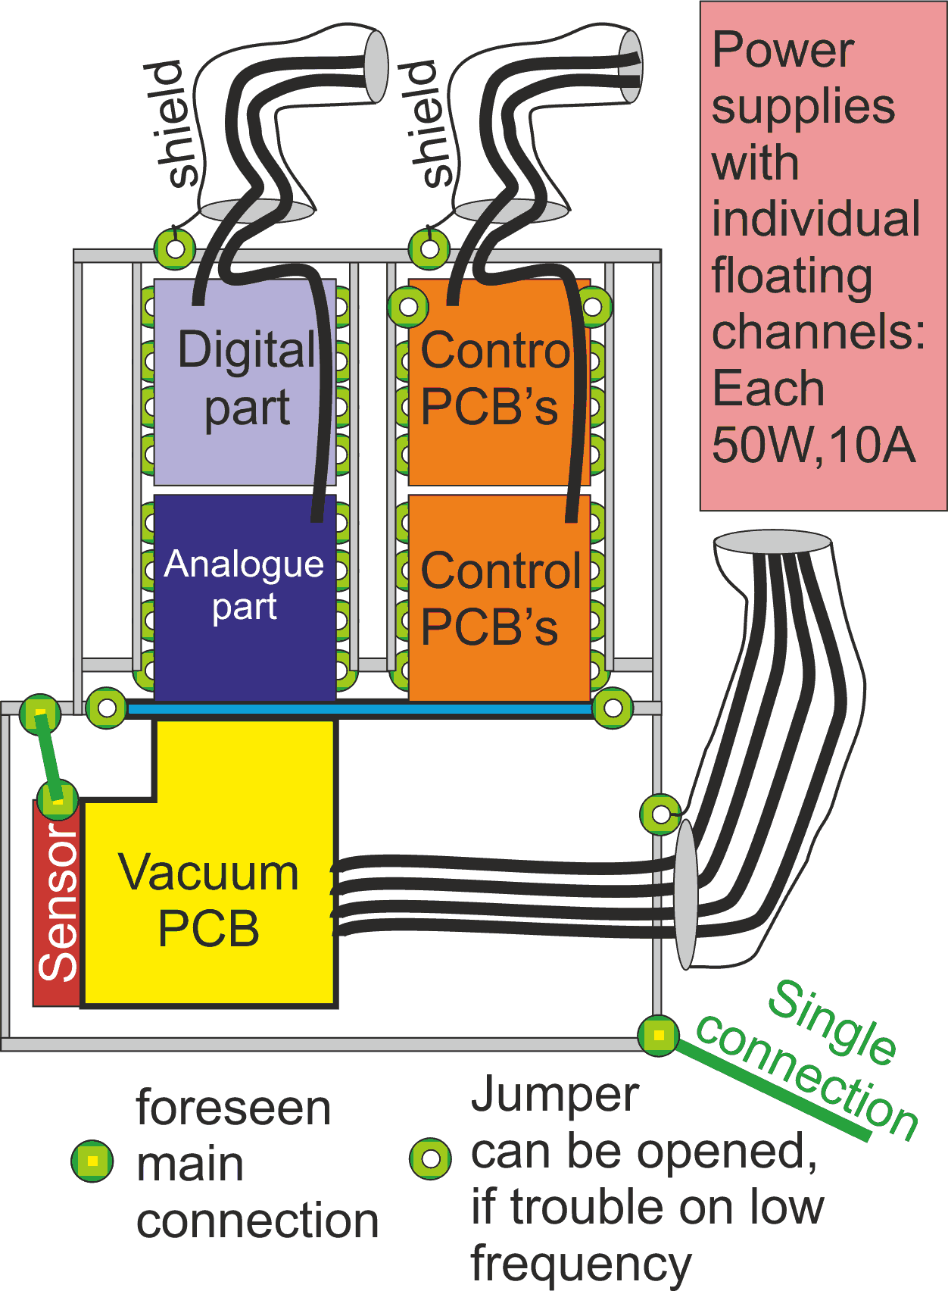
System: Grounding/EMI for a high Current Camera
AGIPD deals with
600A current consumption
14 bit ADC’s
Signal transfers on geometrical
scale of PCB’s
Frequency is open: DC-33MHz
Techniques for handling
Single point GND to external “zoning”
Internal: Most sensitive to chassis, sensor
Minimal usage of GND as current return:
Floating, low ripple supplies and
connection at usage
Ferrite to block unflavored currents paths
Guiding induced currents locally back
to chassis (default, option to open)
Differential signals from ASIC to FPGA
I²C, single ended, but slow: minimal allowed edge: >20ns
SPI with LVDS or quite while data taking

Slide 13
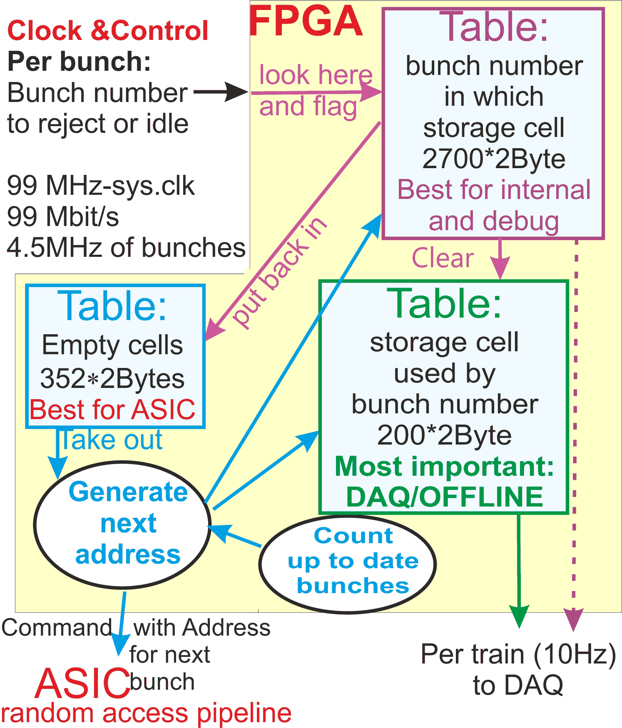
System: Numbering and Selecting best Scatterings
Accelerator defines unique numbers for bunch
Is scattering expected to be good?
Experiments and accelerator get fast sensors like
Scattering generates fluorescence light
currents, monitor losses, intensities, ….
The beam hutch infrastructure sends telegrams
with 22 bits per bunch to detector head:
- Can contain the number of any bad old bunch
AGIPD
Records every bunch until memory is full
- 352 memory cells but 2700 bunches
- Random access analogue memory within ASIC
- With external information the cell is declared free
Book keeping with three table allow easy
- Cell definition for ASIC-write from table of free cells,
- Function bunch-nr(memory-cell) for offline and
- Function “memory-cell+status”(bunch-number) as full information for
interpretation of telegrams and full history for debug

Slide 14
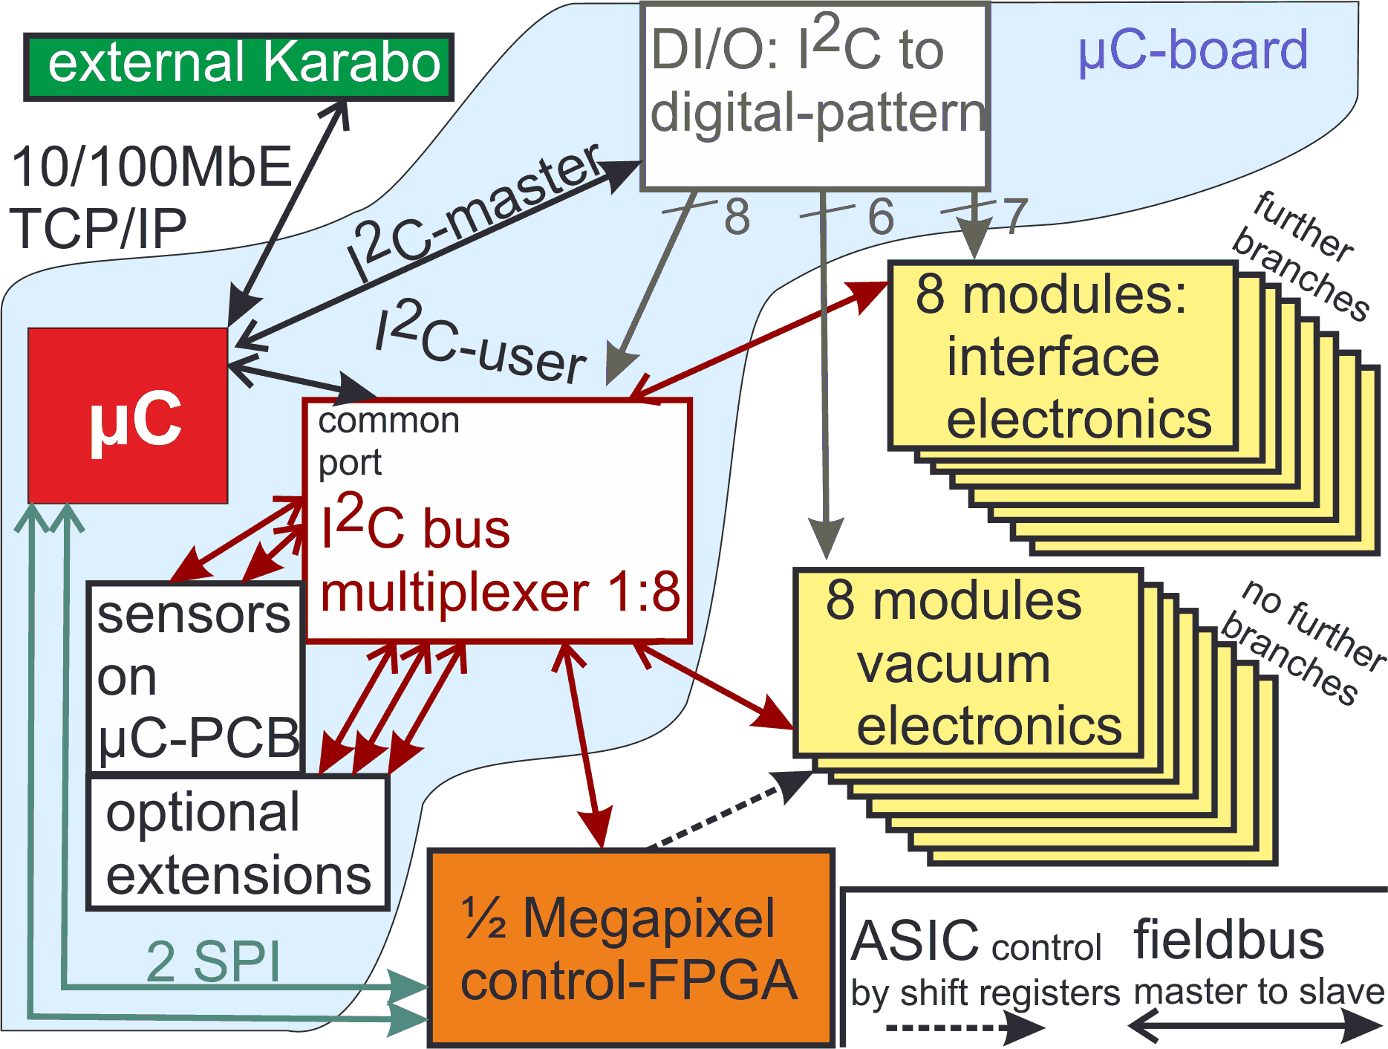
System: Slow Control within Detector-head
Constrains:
Micro-controller have few I²C-buses
AGIPD has many identical modules
Each module has identical devices
with no external address-modifier
Method to overcome
Use two I²C of micro-controller
Use one as master for control,
which sets final branch to address
Send command to device
That can be repeated on a PCB itself without having there two I²C-buses
“branched I²C network”
Benefits, which appears with it
Total length to drive is shorter
Independent developments with full range of addresses
Multiple usage of same chips easing the programming and purchase,
no limit on I/O-channel
Price: Programming effort, few lines through system, slow control

Slide 15
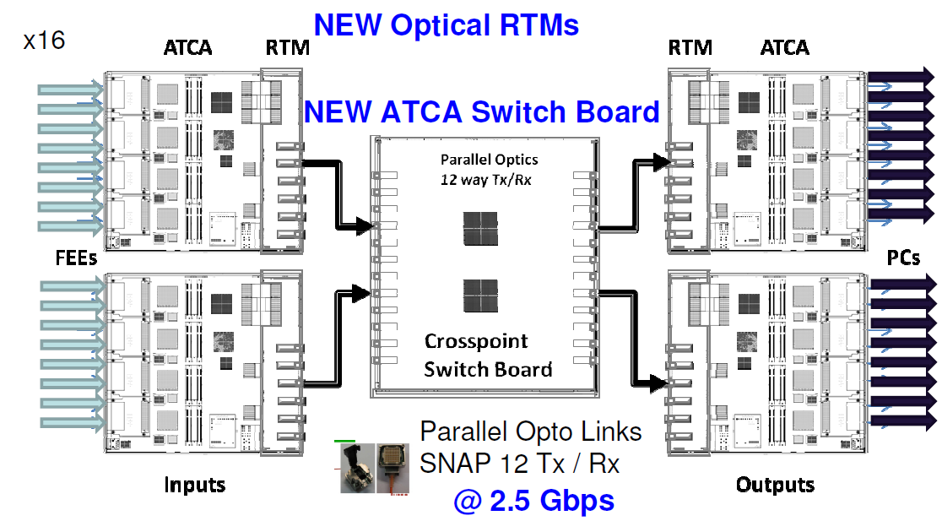
Off-Detector-head Data Handling
DAQ-System is developed for
all experiments at Eu-XFEL
Train builder in ATCA
J.Coughlan at TWEPP 2012
1. FPGA housed in ATCA
process the data
“Train builder”
2. Transfer into PC farm
with 10GbE, TCP/IP
3. Processing, disk-storage
by a PC-farm
Cross
Point
switch
FPGA’s
Detector Head
PC-farm
Actions:
- Frontend “FEE” delivers on 16 links (10GbE, UPD) fractions of the images
Train builder sorts from each group of 8 links the data to ½-images and orders pixels according to geometry
with FPGA’s and cross point switches
Train builder sorts with next cross point switch to full images and trains
All data are sent to a PC farm (>80Gbit/s)
No information loss by compression is allowed
Pure compression has low effect for general science,
may be for given users after experience

Slide 16
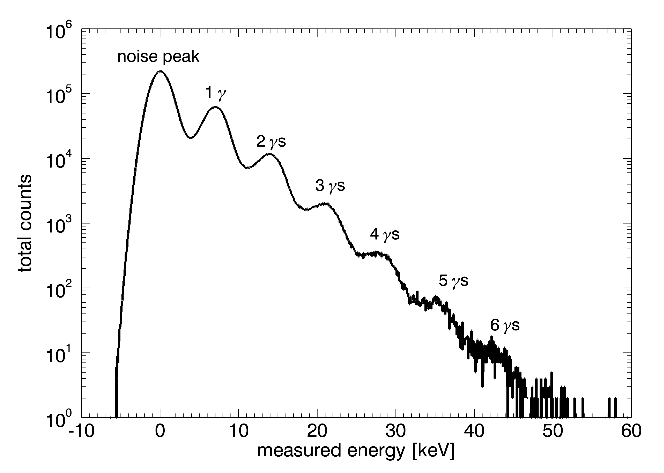
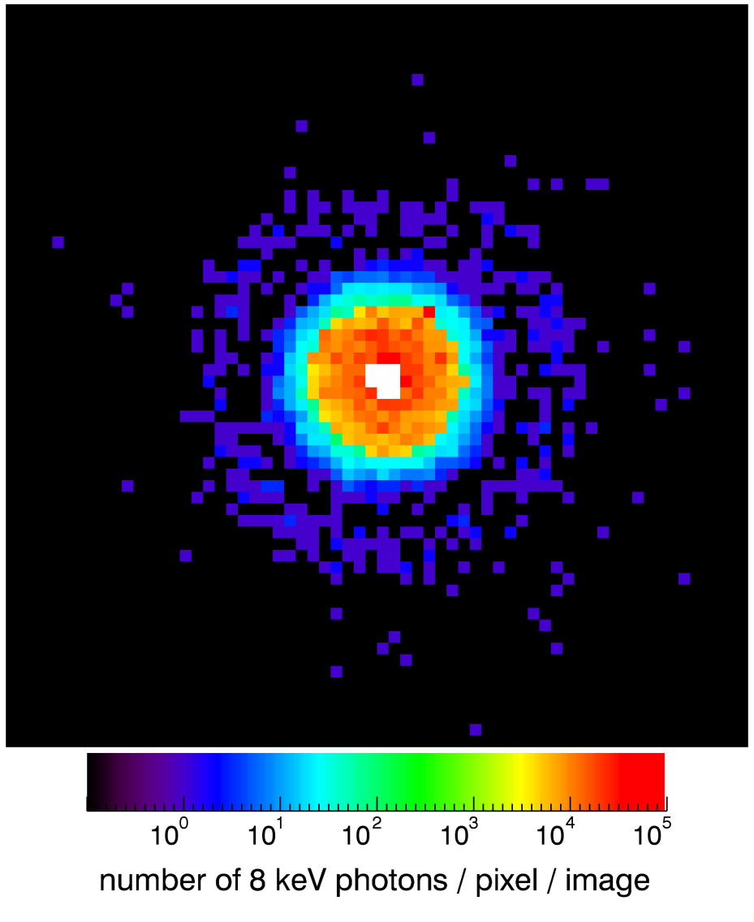
First Data
Data to single chip 64 ×64 Pixels in direct beam of PETRA-III @ DESY
8keV photons
First tests at PETRA shows
Single photons even for 8keV,
specifications for 12keV.
Full dynamic range is recorded
This week: Full module test with electronics-chain at APS (512×128 pixel)
1 10 100 1k 10k 100k
Number of 8keV-photons/pixel/image

Slide 17
Summary and Outlook
A new field of science opens with intense X-ray sources: FEL’s
e.g. diffraction of X-rays can be used to study objects,
which gets destroyed by X-rays.
Need of dedicated detector developments to handle speed and rates
Technology overlap with other fields of large scale instrumentation
AGIPD will be a camera with 1Mega-Pixel and 4.5MHz image recording
Electronics for signal-chain fully designed and test in blocks
Dedicated control boards in progress
Single full scale chip tests are done
A module test is just in progress
Next:
System integration to full 1Mega-Pixel to be done
Open to integrate test results into electronics for next generation
Firmware development ready for operation of signal-chain
Evolving process
EU-XFEL will deliver first beams in 2016 and first user operation in 2017

