Slide 1
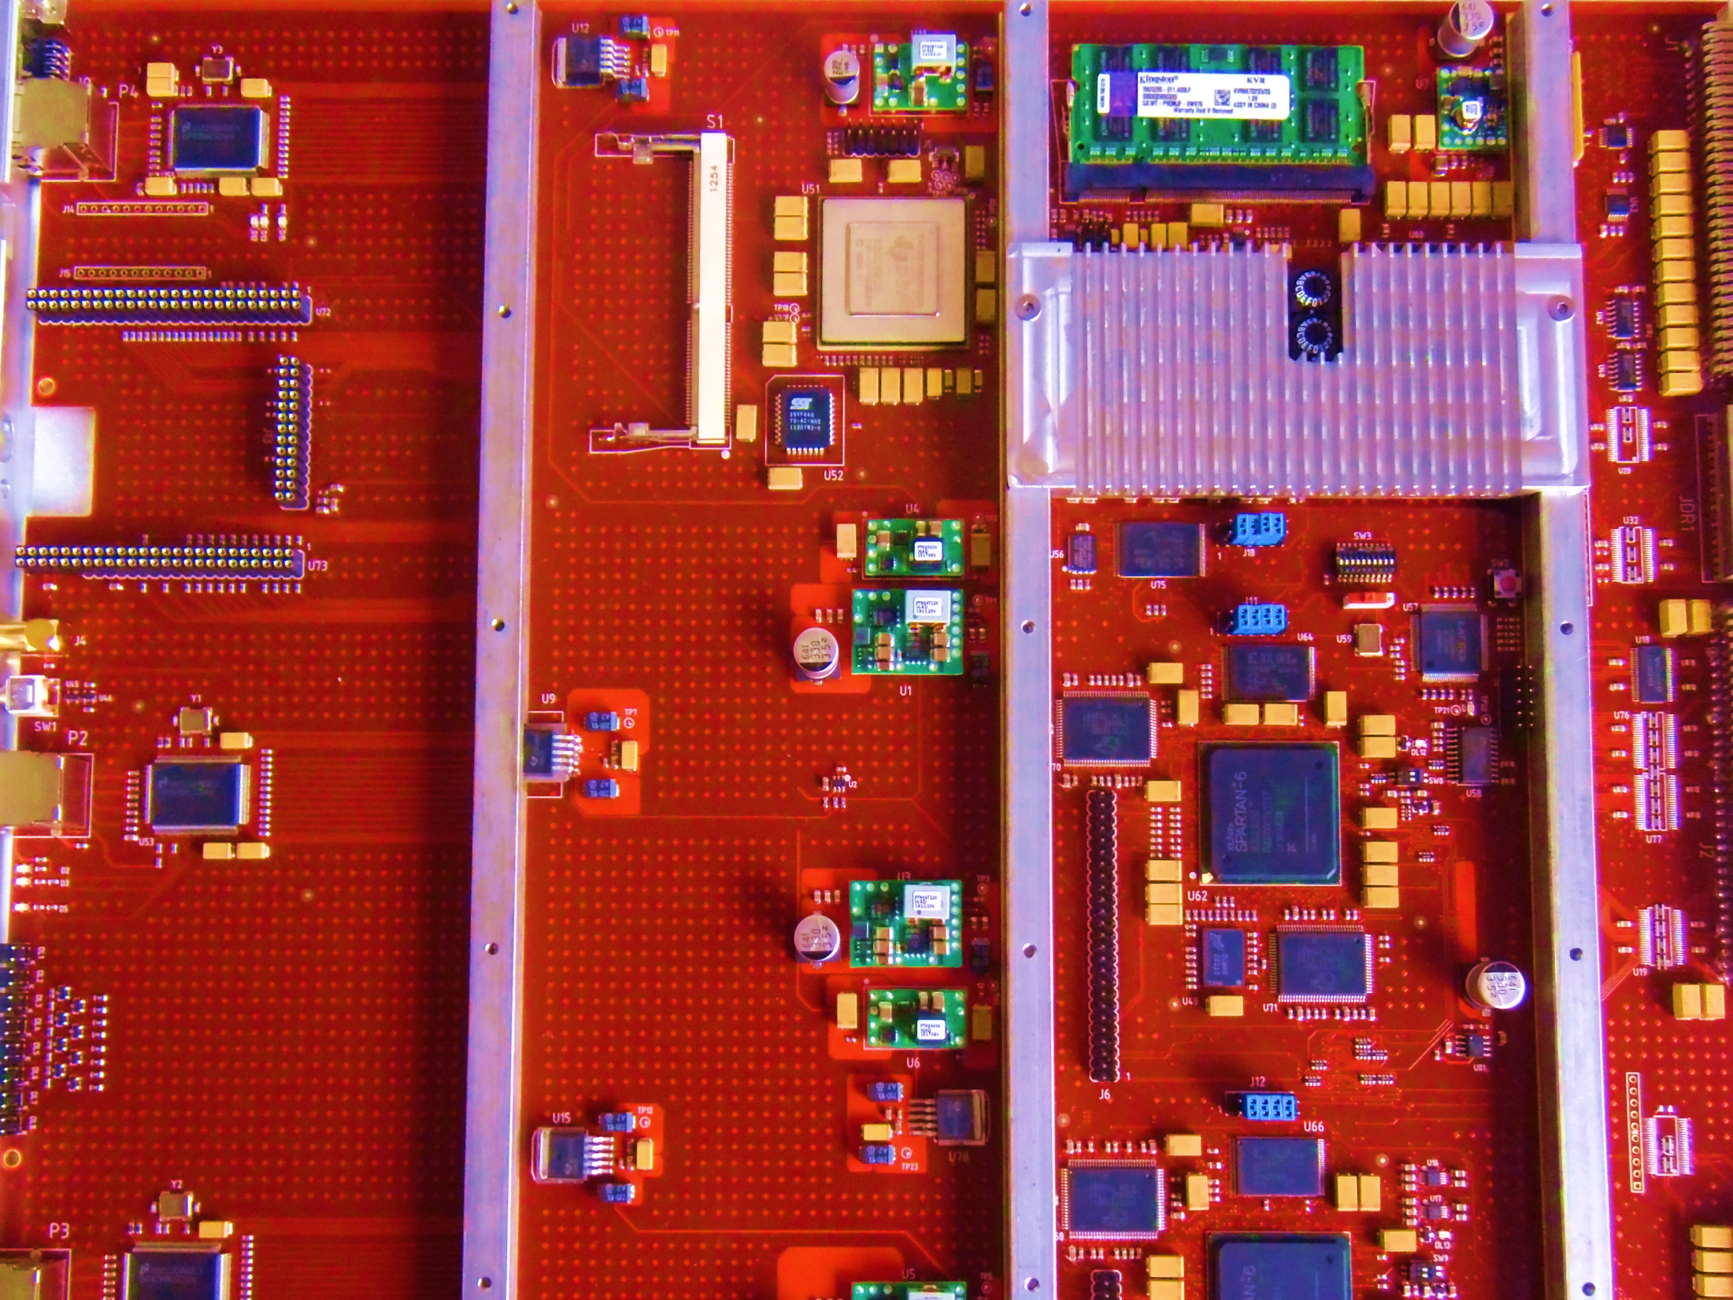

Firmware development and testing of the ATLAS IBL Readout Driver card
Shaw-Pin Chen, University of Washington
on behalf of the ATLAS IBL DAQ group
TIPP2014, Amsterdam, 2nd-6th of June 2014
TIPP2014, Amsterdam
Shaw-Pin Chen, University of Washington
Page 1 of 22

Slide 2
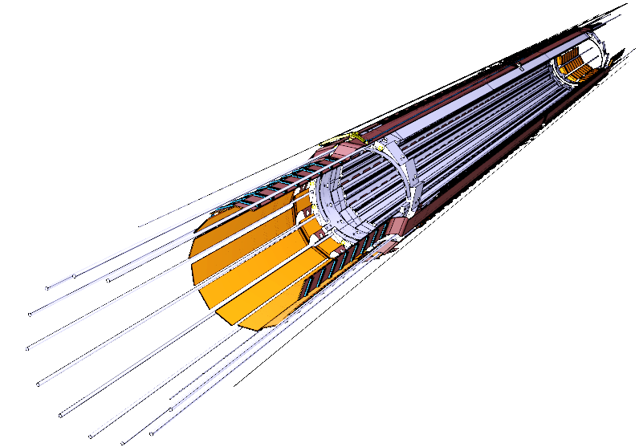
The Insertable-B Layer
The successfully installed (May 2014) new inner layer of the ATLAS Pixel detector at the LHC at CERN
Higher luminosity and closer to interaction point
→ higher occupancy expected
Existing Pixel FE inefficient for IBL readout
New FEs (FE-I4) with larger active area
and higher readout speed
New Readout Drivers and
Back of Crate Cards
Details on IBL covered in Cecile Lapoire’s talk
TIPP2014, Amsterdam
Shaw-Pin Chen, University of Washington
Page 2 of 22
Notes:
FE-I4 functions highly integrated: 8b/10b encoded data at rate of 160 Mbit/s or more
New optical-electrical communication board and readout processors are built
Motivations for new readout electronics

Slide 3
Trigger DAQ
Sensor
FE-I4
IBL Staves
Based on the VMEx64 Pixel TDAQ
On-detector (staves)
Optical communication to
off-detector (ROD/BOC)
TTC Interface Module (TIM)
VME-crate cards (TIM/ROD
/BOC)
New FitServer (for calibration)
Readout Subsystem (ROS) with
Readout Buffer INput (ROBIN) cards
S-Link: CERN’s data transmission protocol
BOC-RODs
Level 1
Trigger
LVL 1
Accept
Fit
Server
Region of
Interest
(ROI)
S-Links
Level 2
Farm
req.
ROS
ROI data
Event Builder
Event
Filter
(Level 3)
“raw data”
Mass Storage
Details on IBL BOC covered in Marius Wensing’s talk
TIPP2014, Amsterdam
Shaw-Pin Chen, University of Washington
Page 3 of 22
Notes:
Motivation for the upgrade
Only IBL shown here. There are other ATLAS sub detectors
New calibration approach move the time consuming processes externally

Slide 4
ROD-BOC Communication
IBL Stave
IBL BOC
IBL ROD
ROD Bus
@ 40 MHz
16 cmd channels
@ 40 MHz
Control
TX
32x
FE
32 RX channels
@ 160 Mbit/s
96-bit data RX
@ 80 MHz
Data Processing
4 S-Links
@40 MHz
TIPP2014, Amsterdam
Shaw-Pin Chen, University of Washington
Page 4 of 22
Notes:
ROD control path and data path, will talk a little bit more on data path and process flow later
16 serial command lines at 40 MHz
Each S-Link off to ROS transmits at 5.12 Gbit/s

Slide 5
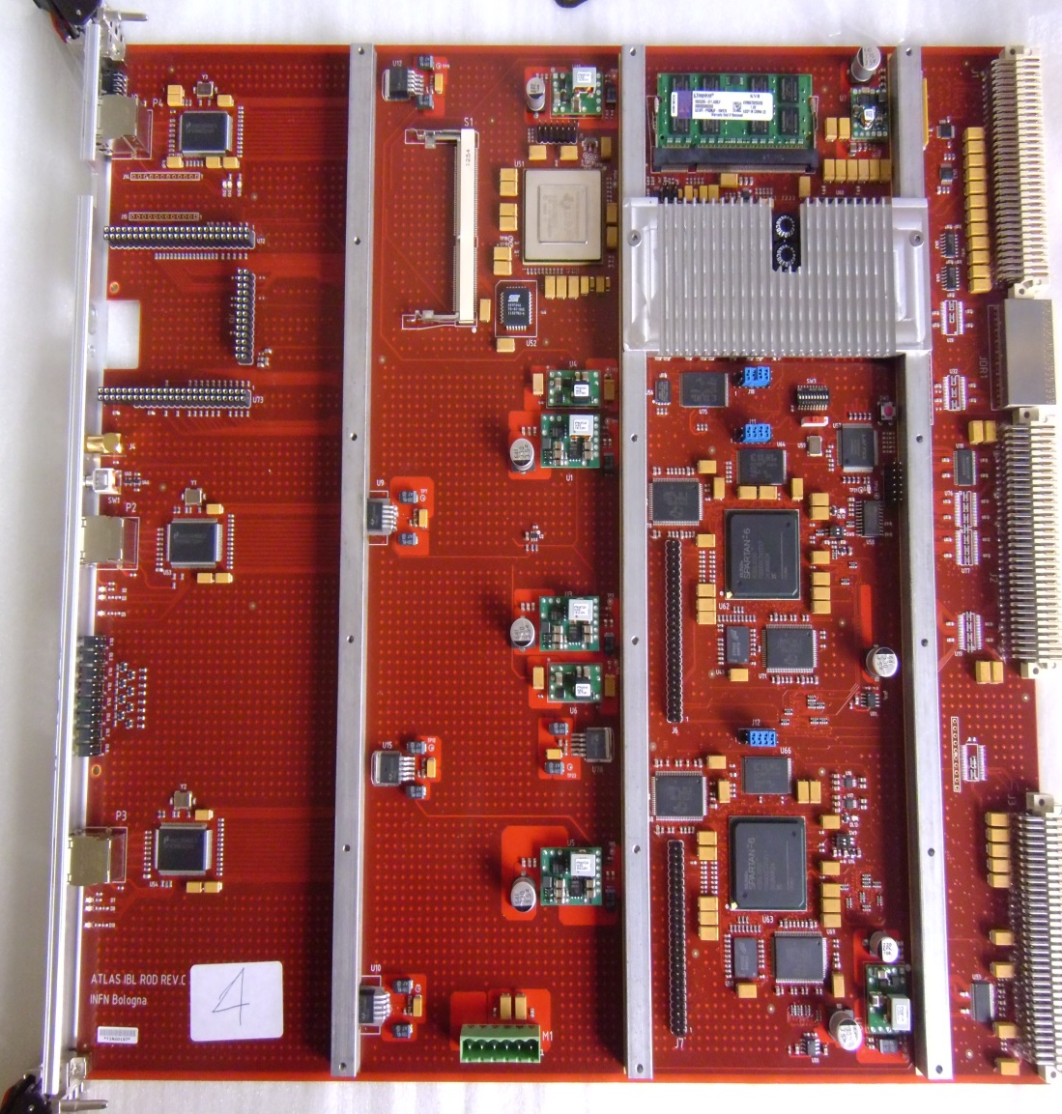
ATLAS IBL ROD Card
FE control and readout
Fast histogramming for FEs
Main Components:
  1 Master FPGA
  2 Slave FPGA
  1 PRM FPGA
2 SSRAMs,1 DDR2 per slave
32 FE data processing
PowerPC controller
Upgrades for Pixel Layer
1 & 2
15 productions cards ready
(RevC and RevD)
Ethernet
Master
/PPC
Slave
Ethernet
Ethernet
Slave
TIPP2014, Amsterdam
Shaw-Pin Chen, University of Washington
Page 5 of 22
Notes:
High level, non real-time and real time lower level
PPC drives the ROD bus, config FE, slave, scan
PRM
26 RODs for Layer 2 and 38 for Layer 1.
1 ROD-BOC for DBM

Slide 6
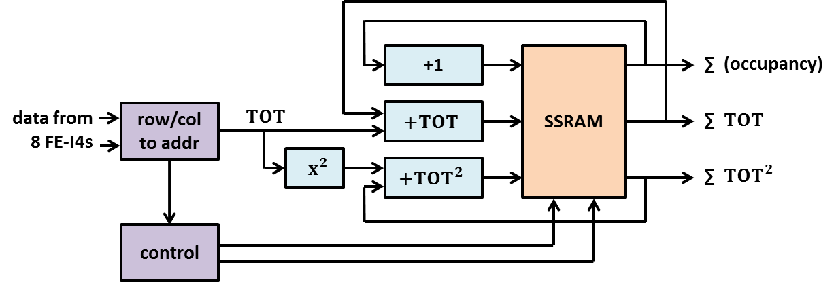
Detector Calibration
Set uniform readout threshold for all channels
Find and reject noisy readout cells
Max. hit rate of 85 MHz by serializing 8 FE-I4s.
Histograms stored and updated in external SSRAMs @ 50 MHz (speed upgrade in progress)
Histograms transfer:
SSRAMs → dual DMA → DDR2 → MicroBlaze TCP/IP transfer → Gbit Ethernet → FitServer
TIPP2014, Amsterdam
Shaw-Pin Chen, University of Washington
Page 6 of 22
Notes:
Calibration & data taking shares most of the data processing path
Update SSRAM in a pipelined fashion
Theoretically SSRAM can run at above 200 MHz.

Slide 7
ROD Data Processing
Modular VHDL Firmware based on Pixel ROD
  Internalized many discrete FIFOs and memory
Real-time @ 80 MHz
De-randomizing FIFOs
FE service records
Error checking
Busy handling
Generate S-Link data
Readout link test data
FE0
FE1
FEn
. . .
Gather Data & Event Building
Event
Info
S-Link Trailers
Trailer
Data Record
Service Record
Data Header
Frontend Data
S-Link Headers
Frontend Event
TIPP2014, Amsterdam
Shaw-Pin Chen, University of Washington
Page 7 of 22
Notes:
S-Link header and trailer formats are specific using control words.

Slide 8
IBL ROD Control & Data Flow
Trigger Processor
PowerPC
software
triggers
Collect triggers and event descriptions from TIM for data taking or PPC for calibration
Calibration scan, ROD bus control
TTC triggers
TTC
Interface
Module
FE Command Processor
Event Processor
ROD Master
Generate serial frontend-specific fast and slow commands
Builds event and synchronization information
FEs
Master Busy
Formatter 1
Event Builder
Slave Busy
Histogrammer
Gather 4 FE data, disable links, runtime errors, data in chip order
Distribute event information, check event IDs, process data errors, generate S-Link data, provide S-Link test data
Build histogrammers for scanned pixels during calibration
Data Router
FE
Data
Store or forward S-Link data, decode detector hits
S-Link
Fit Server
Formatter 2
“Half Slave” inside ROD Slave
TIPP2014, Amsterdam
Shaw-Pin Chen, University of Washington
Page 8 of 22

Slide 9
ROD Slave Event Fragment Builder
Event Data FIFO A
Formatter
Data
(link 0-3)
Event ID checker
Error detector
Data formatter
pop
Event ID
FIFO A
Error Word
FIFO A
Event Data
Count FIFO A
mem
To Router
Event Data
from
Master
Fragment Generator
Play1
S-Link headers
+ FE data
+ S-Link trailers
Event data decoder
Event Header
FIFO
Play2
Event ID
FIFO B
Error Word
FIFO B
Event Data
Count FIFO B
mem
pop
Formatter
Data
(link 4-7)
Event ID checker
Error detector
Data formatter
Event Data FIFO B
TIPP2014, Amsterdam
Shaw-Pin Chen, University of Washington
Page 9 of 22

Slide 10
Data path simulation with realistic
FE-I4 Model
“realistic” FE-I4B
cdr_8b10b_decode
Mux_BOC2ROD
ROD Slave
rx_fifo
Half_Slave0
S-Link0
configuration,
triggers,
charge injection
Simplified BOC
Half_Slave1
S-Link1
Event ID,
register R/W
register
FEI4 pack
ROD Slave pack
HDL model from the FE-I4 developers
Service records and allows hits injection
Accelerated ROD data path firmware development and greatly reduced debugging time
TIPP2014, Amsterdam
Shaw-Pin Chen, University of Washington
Page 10 of 22
Notes:
Motivation!!
The model is black box, which excludes many IO pads for convenience but it is very real
Custom inject digital TOT to desired pixels (in parallel!)
Correct S-Link data, error handling functionality, etc

Slide 11
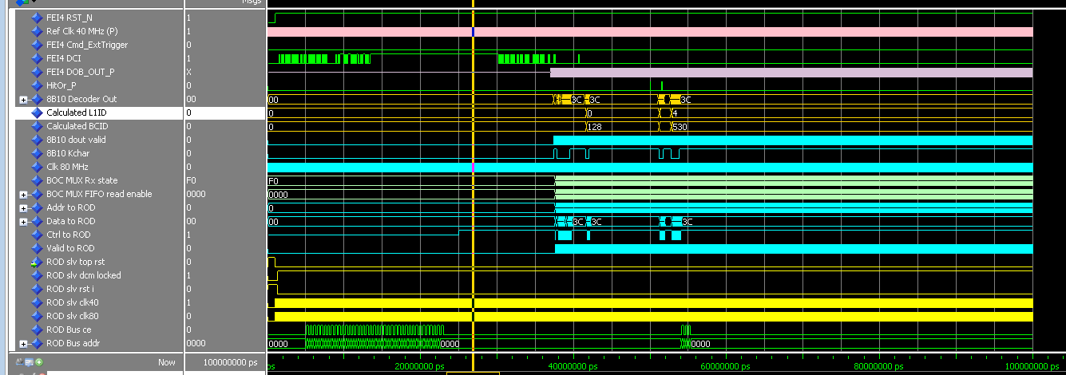
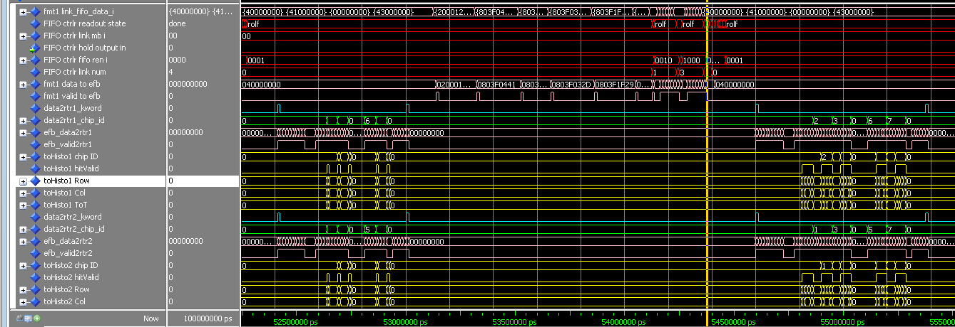
Simulation Results
FE-I4 model configured
Output with injected hits
Decoded 8b/10b idle signal
S-Link data
to the Router
Extracted hit
Info for the
Histogrammer
TIPP2014, Amsterdam
Shaw-Pin Chen, University of Washington
Page 11 of 22

Slide 12
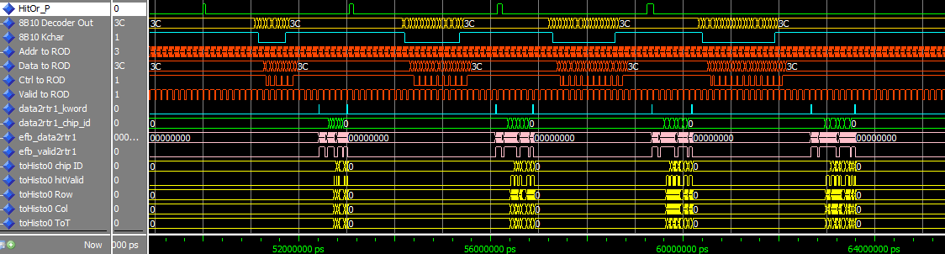
Simulation Results cont.
event counter reset
external trigger
TOT injections and self-triggering
L1A triggers through serial cmd
TIPP2014, Amsterdam
Shaw-Pin Chen, University of Washington
Page 12 of 22

Slide 13
Hardware Readout Chain Tests
TIM – ROD – BOC – S-Link – ROBIN
Two sources of data are used:
  ROD slave-generated readout link test data to ROS
  Triggers to all 32 FE emulators on each BOC, process event on ROD, and send to ROS
ROD can process all FE data at trigger rate of 200 KHz
  No data corruption at ROS
  ROBIN buffer becomes full quickly
  IBL expect to run at 100 kHz
Successfully triggered 16 million emulated events at 50 kHz without data corruption at ROS
TIPP2014, Amsterdam
Shaw-Pin Chen, University of Washington
Page 13 of 22
Notes:
Tested at CERN, majority of the IBL TDAQ Level 1 components
Significance of these for the integration test (nothing changed in the ROS)

Slide 14
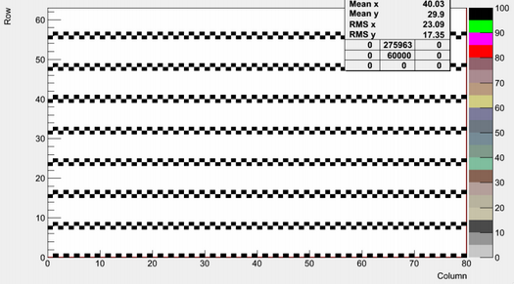
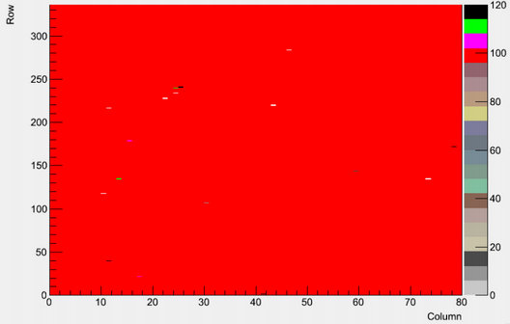
Calibration Scan Results
Digital scan, 100 triggers,
1/8 mask
Analog scan, 100 triggers,
8/8 mask
TIPP2014, Amsterdam
Shaw-Pin Chen, University of Washington
Page 14 of 22
Notes:
Histograms generated, transferred to FitServer Farm, downloaded from the FitServer
Mask stepping and color correspondence
analog scan process as well as digital scan process

Slide 15
Summary
New FPGA-based IBL RODs are commissioned for the IBL
Higher bandwidth and integration
Data taking and calibration functions in place
Realistic FE model used in data path firmware development
ROD data taking functionality verified via ROS test.
Near future developments:
  Develop built-in tests for IBL ROD firmware
  Integration of Pixel readout into IBL ROD
TIPP2014, Amsterdam
Shaw-Pin Chen, University of Washington
Page 15 of 22
Notes:
Foresaw bandwidth limitation of the Pixel ROD for higher luminosity run.
The link bandwidth is proportional to the product of occupancy and trigger rate of the front-end devices.
Developments to be carried out by LBNL and Washington groups

Slide 16









Thank you for your attention!
TIPP2014, Amsterdam
Shaw-Pin Chen, University of Washington
Page 16 of 22
Notes:
Questions?

Slide 17
Backup
TIPP2014, Amsterdam
Shaw-Pin Chen, University of Washington
Page 17 of 22

Slide 18
Old vs New ROD
 | Pixel ROD | IBL ROD
FPGAs | 1 Master + 8 Formatter + 1 EFB + 1 Router + 1 PRM | 1 Master + 2 Slaves + 1 PRM
Control | Master DSP + 4 Slave DSP | Embedded PPC & MicroBlaze
Memory Components | Many External | Mostly Internal to FPGA except SSRAMs + DDR2s
Data RX rate from BOC | 40 MHz (all channels enabled) | 80 MHz
TIPP2014, Amsterdam
Shaw-Pin Chen, University of Washington
Page 18 of 22

Slide 19
Pixel FE-I3 vs IBL FE-I4
 | FE-I3 (requires MCC) | FE-I4
Pixel Size | 50 um x 400 um | 50 um x 250 um
Pixels/chip | 2880 | 26880
Active area | ~75% | ~90%
Serial data out | 40 Mbit/s | 160 Mbit/s
TIPP2014, Amsterdam
Shaw-Pin Chen, University of Washington
Page 19 of 22

Slide 20
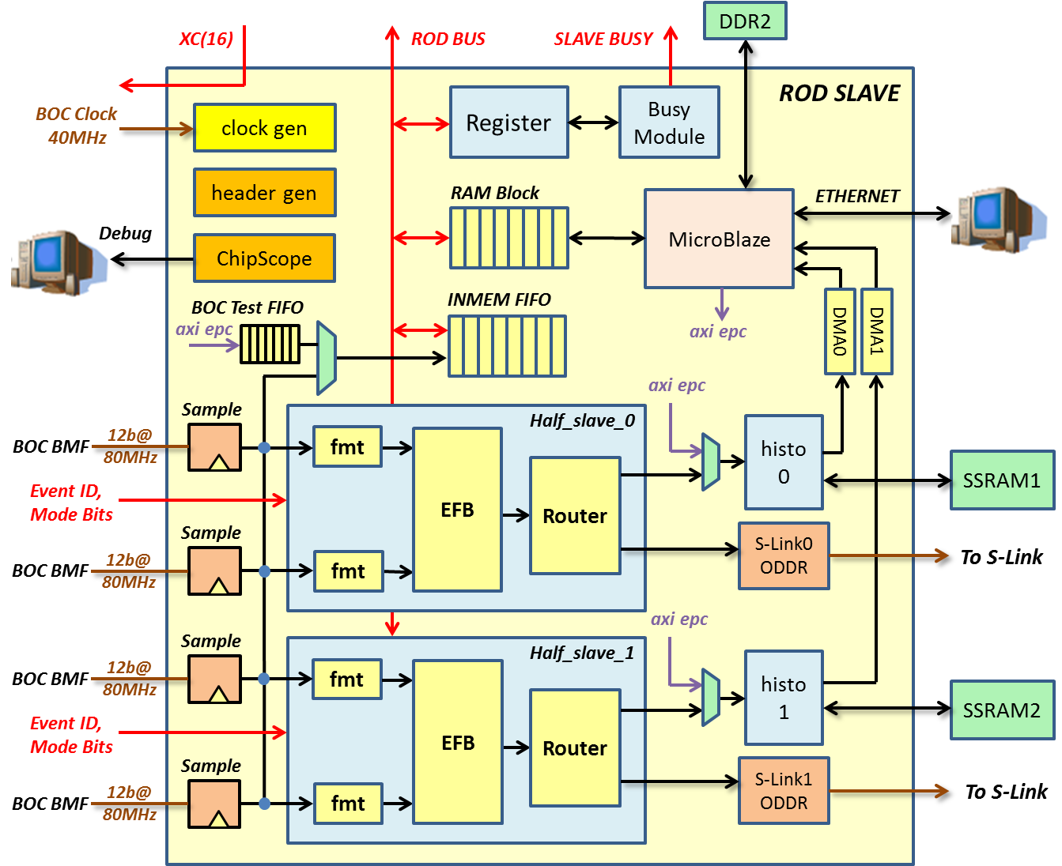
Data Path FW Structure
TIPP2014, Amsterdam
Shaw-Pin Chen, University of Washington
Page 20 of 22

Slide 21
Slave Busy Logic
force inputs
busy masks
S-Links back pressure
slave busy_n
overflows in Formatters
overflows in EFBs
overflows in Routers
edge counters
Register busy histograms readout
TIPP2014, Amsterdam
Shaw-Pin Chen, University of Washington
Page 21 of 22

Slide 22
ROD Slave Router Block
calibration mode
S-Link FIFO
EFB data (32)
register
33
k_word
k_word +
data (32)
chip_ID (3)
To S-Link
Histo FIFO A
hit data extraction
24
hit valid
pop
FIFO
chip (3)
Histo FIFO B
row (9)
24
row+1
col (7)
ToT (4)
To Histogrammer
TIPP2014, Amsterdam
Shaw-Pin Chen, University of Washington
Page 22 of 22

