Slide 1






Towards the integration of the Micro Vertex Detector in the PANDA experiment
Daniela Calvo
INFN – Sezione di Torino
on behalf of the PANDA MVD group
PANDA Collaboration
TIPP’14 - International Conference on Technology and Instrumentation in Particle Physics
2-6 June 2014, Amsterdam, The Netherlands

Slide 2


Overview
Introduction
Pixel and strip modules
Readout architecture
Service integration
Detector prototypes
Conclusions

Slide 3
Introduction

Slide 4
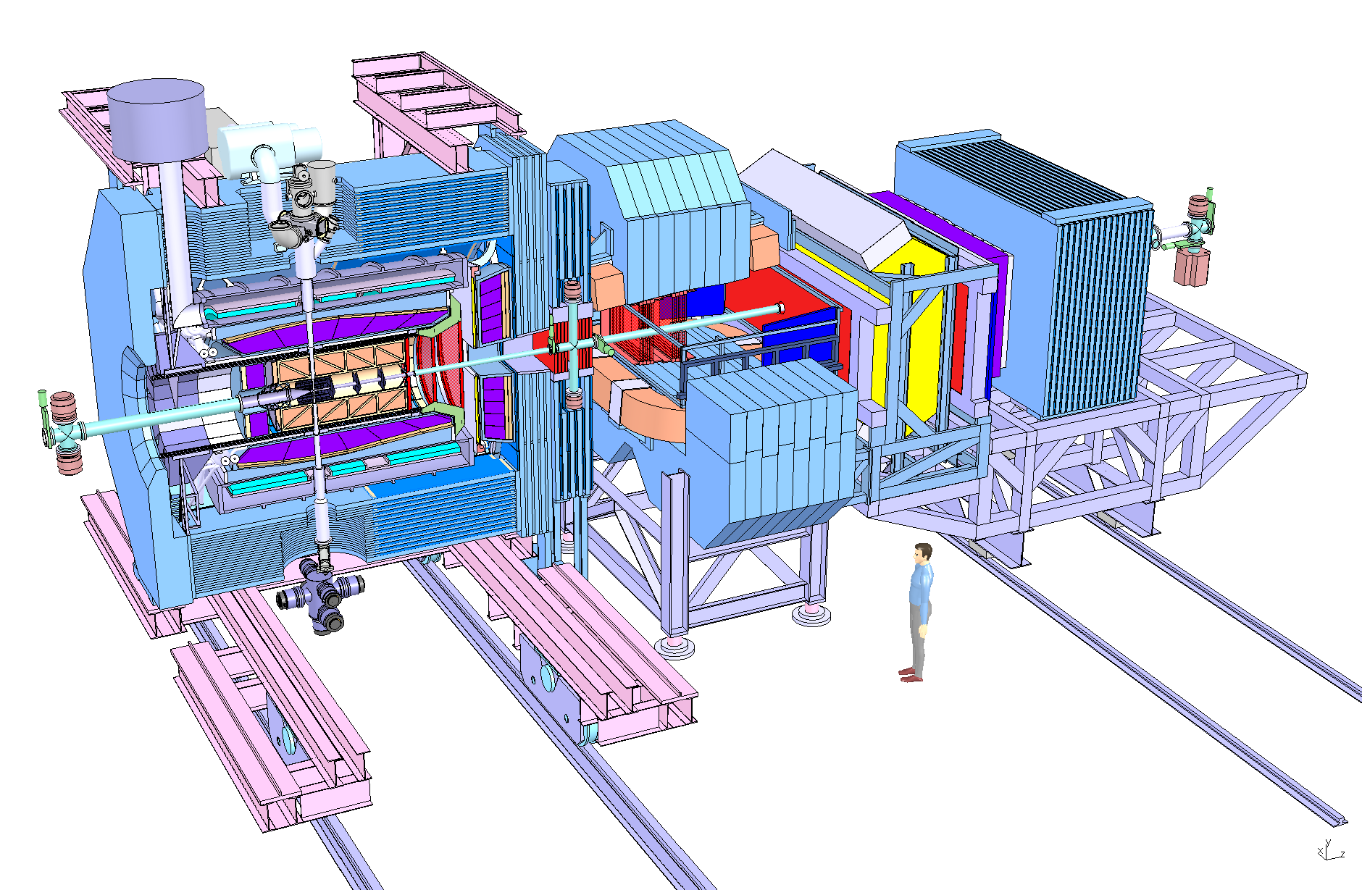
The PANDA experiment
TARGET SPECTROMETER
FORWARD SPECTROMETER
Solenoid
Target
Muon ID
Dipole
Drift Chambers
p beam
Muon
Range System
Central Tracker
Electromag. Calorimeters
DIRC
Vertex
RICH
  PANDA is a fixed target experiment with frozen hydrogen pellet and heavier nuclear targets (N, Ne, Ar…)
Hadron spectroscopy
In-medium effects
Hypernuclear physics
Charmed hadrons
4 π acceptance
High spatial and momentum resolution
No hardware trigger

Slide 5
The Micro Vertex Detector
Tasks
It must combine good space resolution with accurate time-tagging
Main functions
  Primary vertex reconstruction
  Identification of the secondary vertices (cτ of some hundreds of μm)
  Improvement in momentum resolution
  Support PID of low momentum particles by energy loss measurement

Slide 6
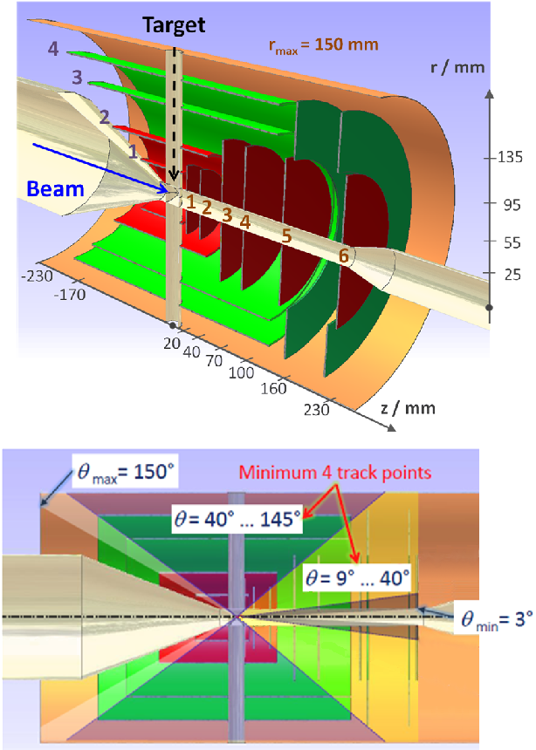
The Micro Vertex Detector
Good spatial resolution (some tens of μm in ρφ, better than 100 μm along z)
Time resolution < 10 ns
Continuous readout at 2 x 10⁷ interactions /s (clock @160 MHz)
Limited material budget X/Xo ≤ 1 % / layer
Radiation tolerance ˂ 10¹⁴ n _{1 MeV eq} cm⁻²
Provide at least four hits per track
Room temperature operation
Routing and services only in the backward region
4 barrels
Two inner layers: silicon hybrid pixel
Two outer layers: double-sided silicon strips
6 forward disks
Four disks: hybrid pixel detectors
Two last disks: mixed pixel and strips
10.3 M (pixel channels) – active area: 0.106 m²
162 k (strip channels) – active area: 0.494 m²

Slide 7
Pixel and Strip Modules

Slide 8
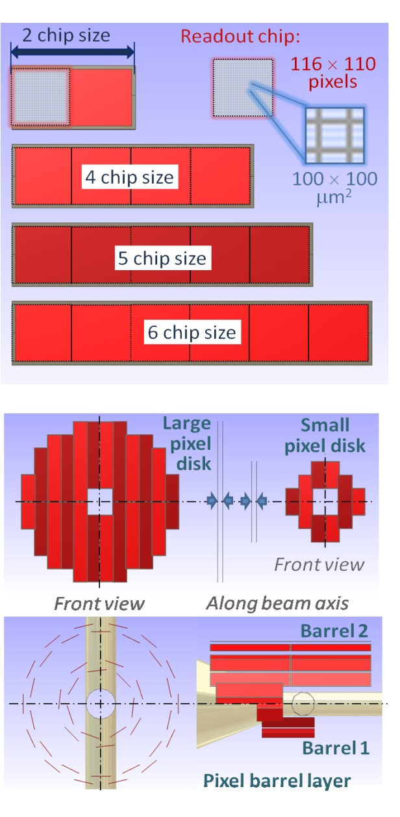
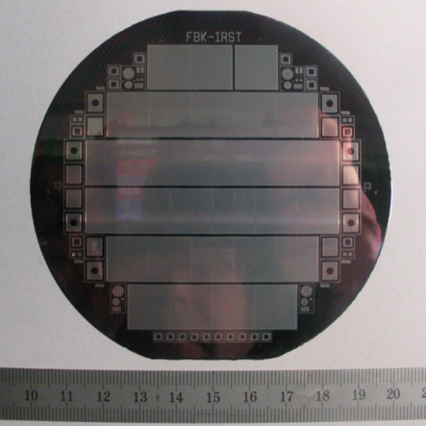
Hybrid epitaxial pixels
Standard hybrid technology
810 readout chips / 176 sensors
Epitaxial Silicon material
Pixel cell size: 100μm x 100μm x 100μm
ρ_{epi} ~ kΩ∙cm
ρ_{Cz} ~ 20-50 mΩ∙cm
ASIC in 130 nm CMOS tecnology
Triggerless
dE/dx using Time over Threshold technique
Layout based on a basic unit corresponding to a readout chip size
Modules are built by tiling from two to six units
Wafer from ITME, pixel sensor from FBK

Slide 9
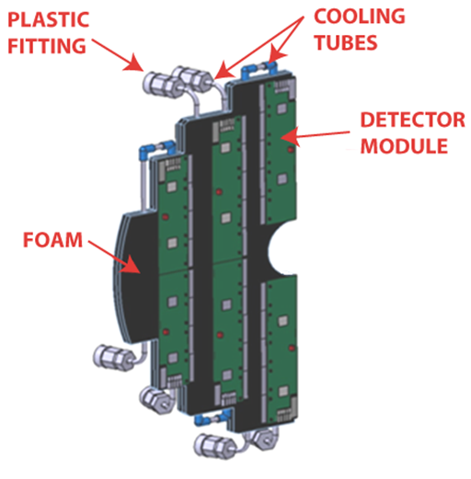
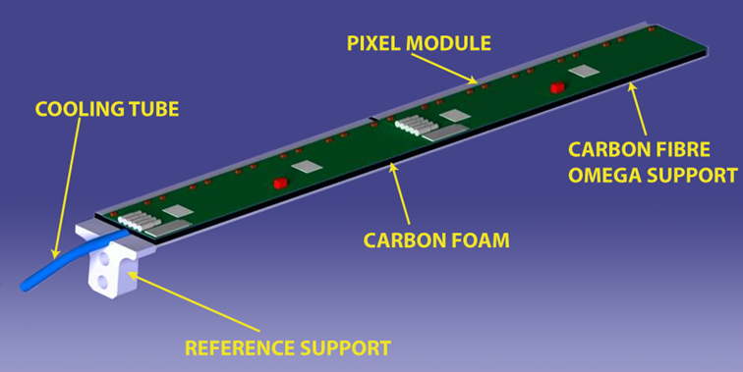
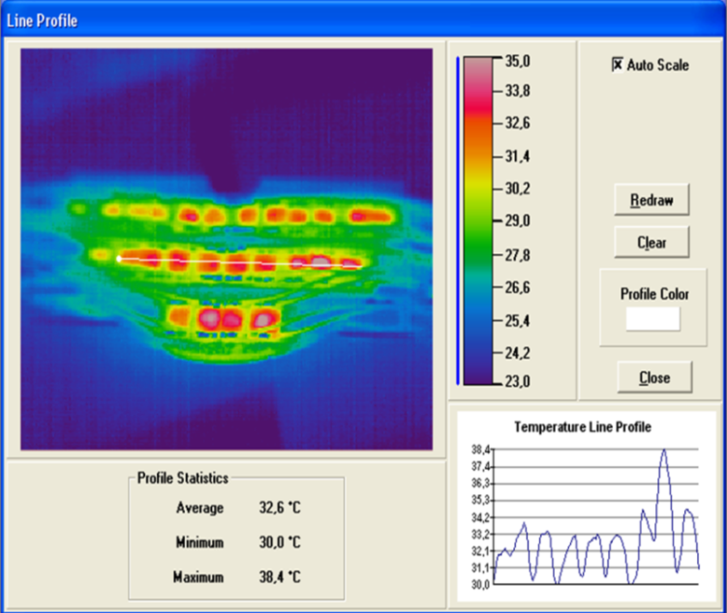
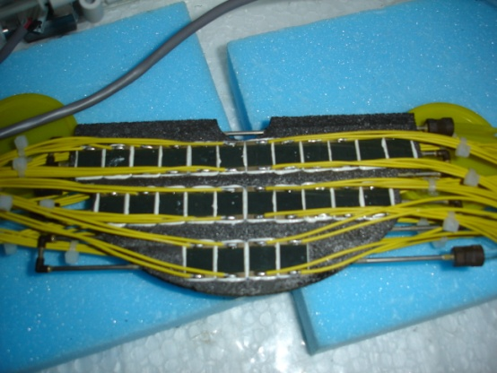
Pixel modules
Pixel disk
Pixel stave
Total power 94 W
Cooling pipe
diameter 2 mm (Ni-Co alloy)
4 mm carbon foam
Cooling flow 0,3 l/m
Inlet temperature: 18.5 °C
Th. conductivity = 50 W/m∙K

Slide 10
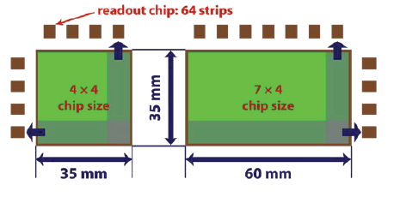
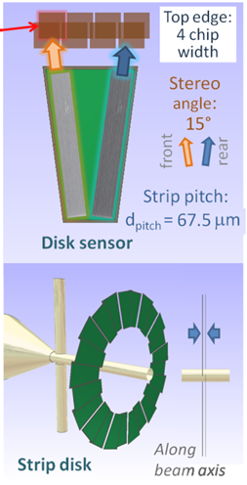
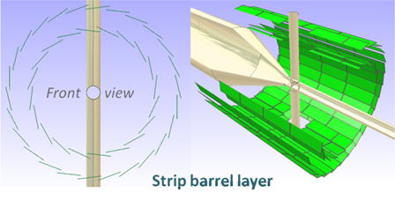
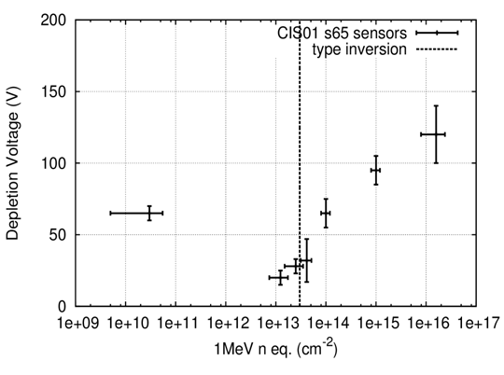
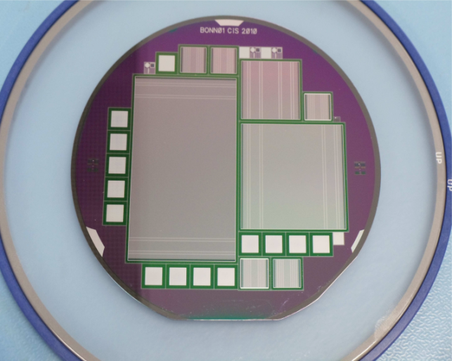
Double-sided silicon strips
Rectangular (512 x 896 strips) and squared (512 x 512 strips) sensors;
stereo angle: 90°, pitch: 65 μm
Trapezoidal (768 x 768 strips) sensors; stereo angle: 15°, pitch: 45 μm
285 μm thickness (FZ silicon wafer)
Readout every second strip
3112 readout chips / 296 sensors
Radiation damage test using 14 MeV proton beam @ Bonn
CiS Erfurt

Slide 11
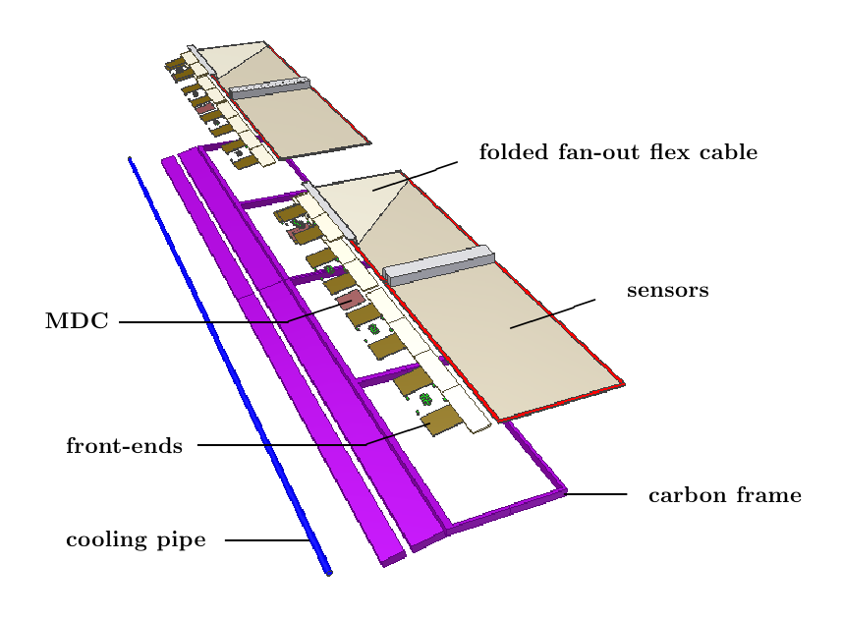
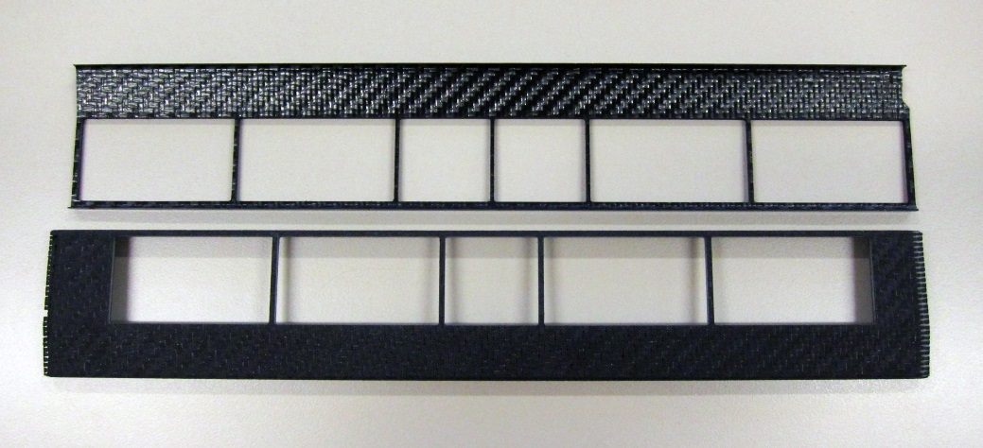
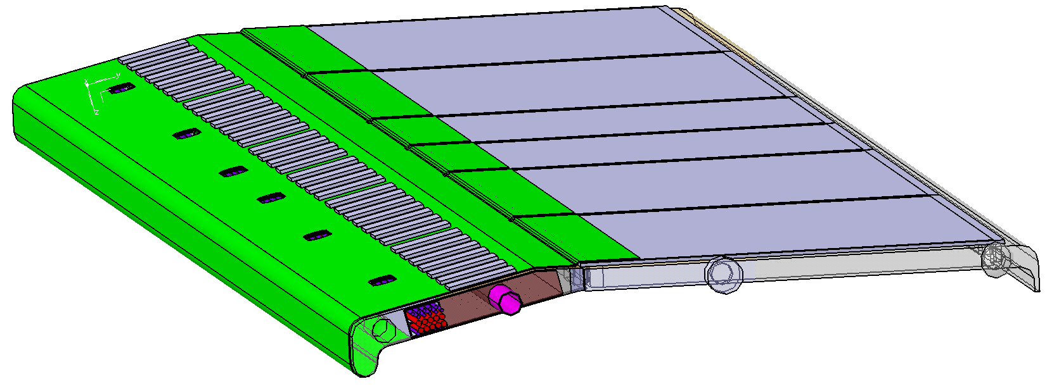
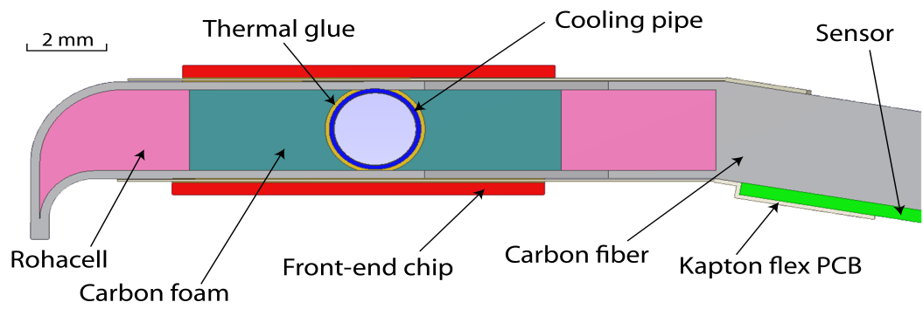
Strip staves
Sandwich structure of carbon fiber
(200 μm) and Rohacell (2 mm)
Up to 18 W dissipated on one stave
Embedded cooling pipe in Ni-Co alloy
(2 mm diameter, 80 μm wall thickness)
POCO HTC around the cooling pipe
Characterization of the PANDA MVD Trapezoidal Silicon Strip Sensor and their First Operation in a Proton Beam
Poster presented by D. Deermann

Slide 12
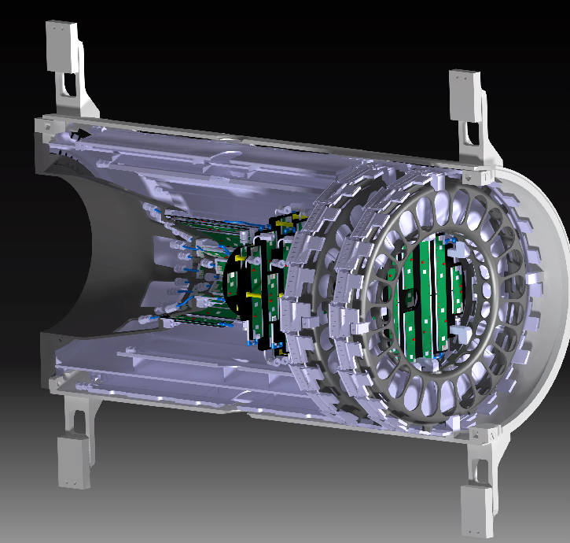
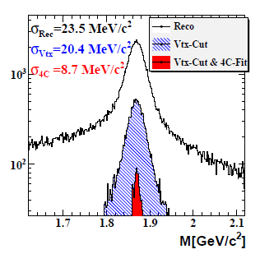
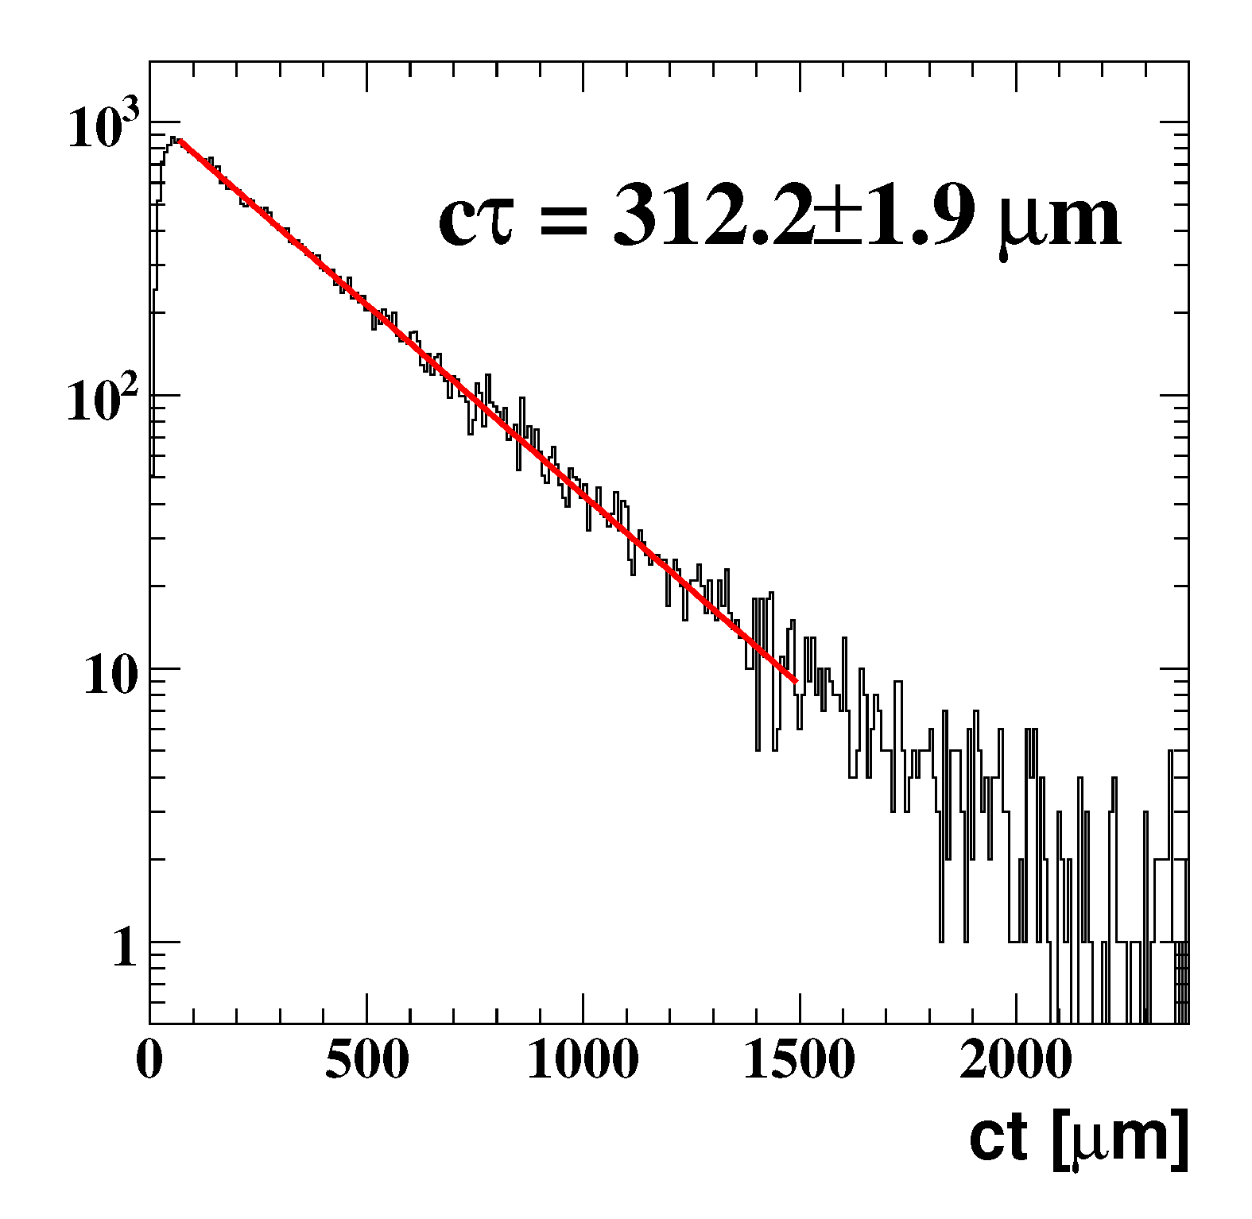
The Micro Vertex Detector
Two halves arranged around the beam-target pipes
suspended to the central tracker support
pp → D± → k⁻ π ⁺ π ⁺ k ⁺ π ⁻ π ⁻
Reconstructed D± mass
Reconstructed D± decay length

Slide 13
Readout architecture

Slide 14
Pixel detector architecture
HV Power supply
Pixel module
LV Power supply
Epitaxial silicon sensor
Power lines
DC-DC converter
Hybrid
e-links
ToPix
GBT
Computer node
MVD Multiplexer Board
Optical fibres
Optical fibres
Optical fibre
SODA

Slide 15
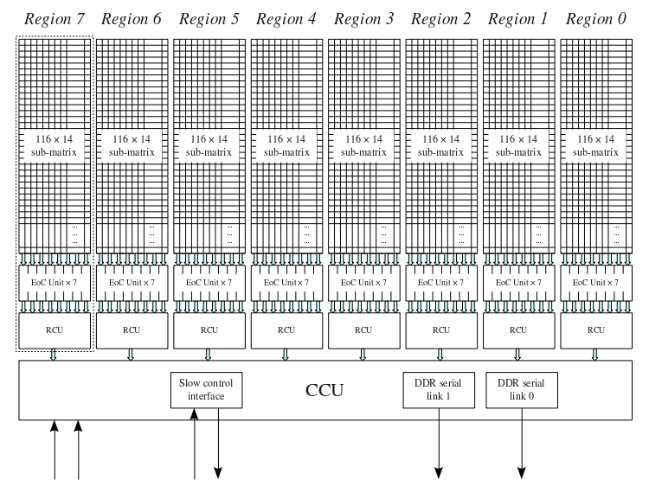
ToPix
Pixel matrix: 110 x 116
Size (to be optimized):
11.2 mm x 14.8 mm
dE/dx measurement: ToT,
12 bits dynamic range
Maximum input charge: 50 fC
Detector type: n and p
Noise floor: < 200 electrons
Input clock frequency: 160 MHz
Time resolution: ~ 6 ns
Power consumption: ≤ 0.8 W/cm²
Maximum event rate: 6.1 x 10⁶
Total ionizing dose: < 100 kGy
Data rate per chip:
up to ~ 450 Mb/s
Output bandwidth: 2 x 320 Mb/s
Supply voltage: 1.2 V
Columns divided in 8 regions with 7 double columns each
FIFO in the end of column and region control

Slide 16
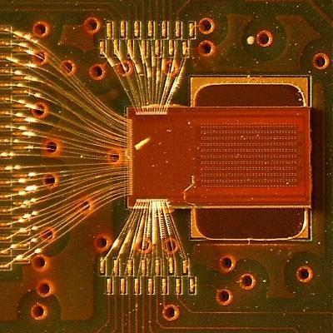
ToPix_v4
ASIC size: 3 mm x 6 mm
130 nm CMOS technology
Pixel matrix: 640 cells, 2x2x128 and 2x2x32 columns
Input clock frequency: 160 MHz
Compatible with the sensor of previous version (ToPix_v3)
Hamming encoding and TMR pixel logic protection
Leading and trailing edge registers withDICE -protected latches
SEU protected EoC
Serial data output (SDR and DDR)
GBT compatible SLVS I/O
Measured perfomance @ 160 MHz clock
640 pixel DACs completely linear
Easy calibration

Slide 17
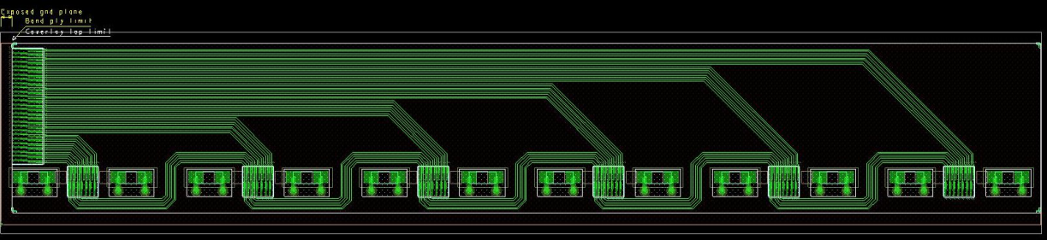
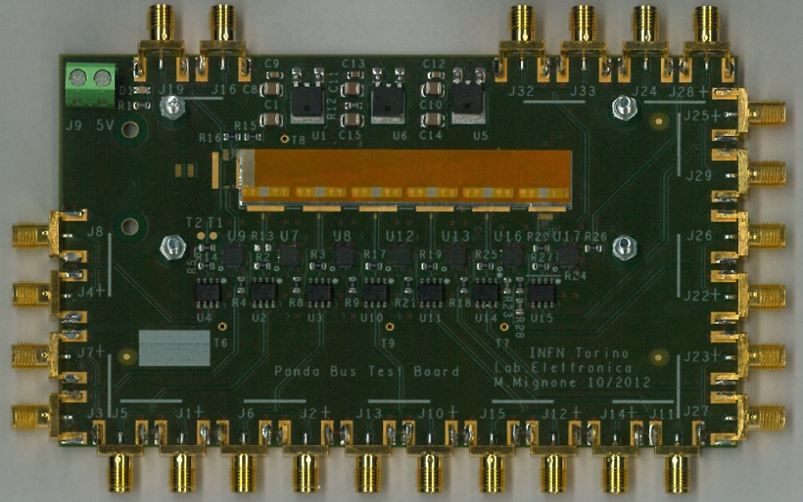
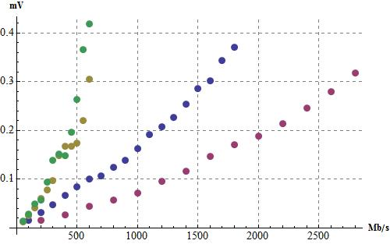
Hybrid for the pixel module
Hybrid structure for 6 readout chips
Size: 67.9 mm x 11.9 mm
15 μm Al thickness
75 μm kapton thickness
60 μm track width, 60 μm spacing
For each chip:
  3 differential pairs in daisy chain
  4 direct differential pairs
27 differential pairs in total
~ 100 ohm differential impedance
12 smd capacitors
UI
Total jitter vs data rate
Link diretto LVDS
Link diretto SLVS
Daisy chain lunga
Daisy chain corta
direct
direct
long
short

Slide 18
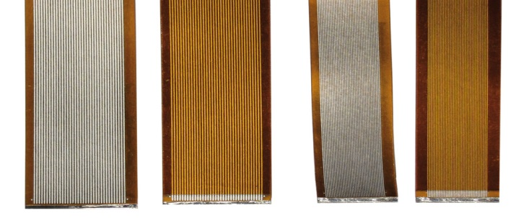
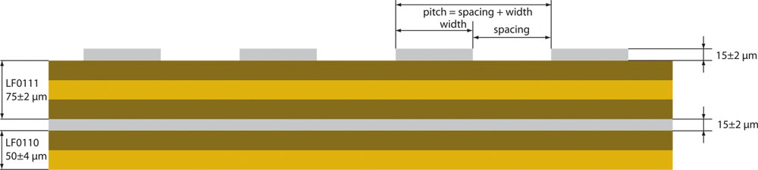
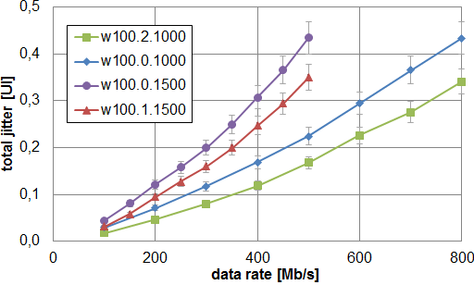
Signal transmission
1 m and 1.5 m long aluminum strip prototypes
18 differential pairs
straight coverless
Technology based on laminated aluminum on kapton, reliable for bonding, produced @ CERN according to our design
SLVS signals
c
u
Total Jitter

Slide 19
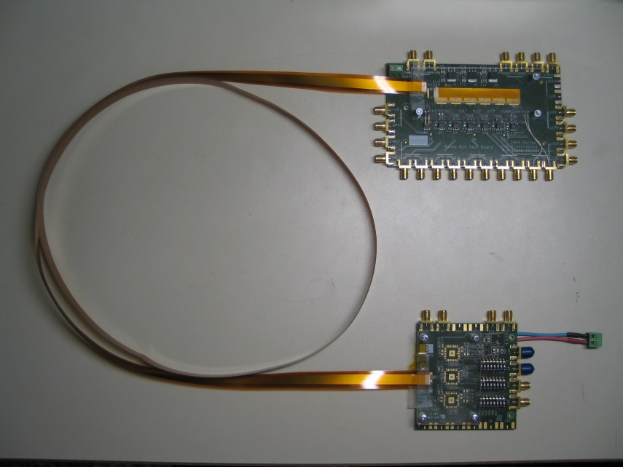
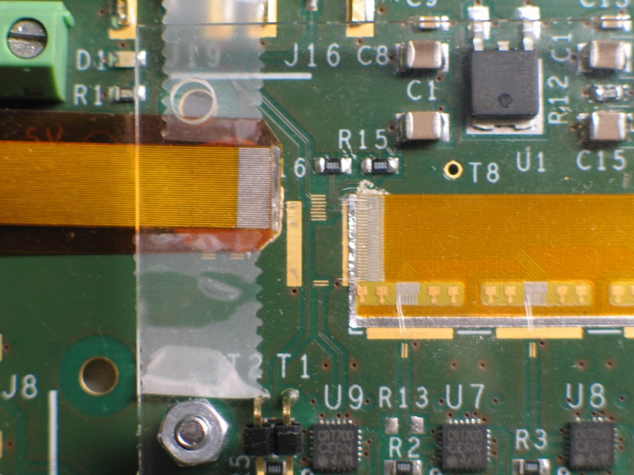
Hybrid and cable
hybrid
PRBS from
pulse generator
1.5 m long cable
To oscilloscope
SLVS signals

Slide 20
Strip detector architecture
Double-sided silicon
strip detector
HV Power supply
LV Power supply
PASTA
Power lines
PASTA
MDC
MDC
PASTA
DC-DC converter
PASTA
MDC
PASTA
MDC
e-links
PASTA
Hybrid flex adapter
GBT
Computer node
MVD Multiplexer Board
Optical fibres
Optical fibres
Optical fibre
SODA

Slide 21
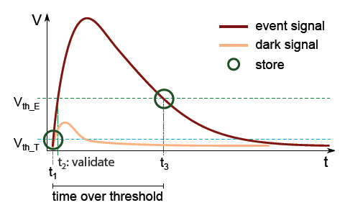
PASTA concept
64 channel, 4.2 x 5 mm² , self triggered chip
110 nm CMOS technology
Input capacitance: < 50 fF
Dynamic range: < 50 fC
Power consumption: < 4 mW/ch
Channel pitch: 60 μm
Radiation protection: 100 KGy
Dynamic range: 8 bit
Amplification and discrimination
Time interpolation, Wilkinson ADC
Control charging and initiate storing
Handling configuration and channel data

Slide 22
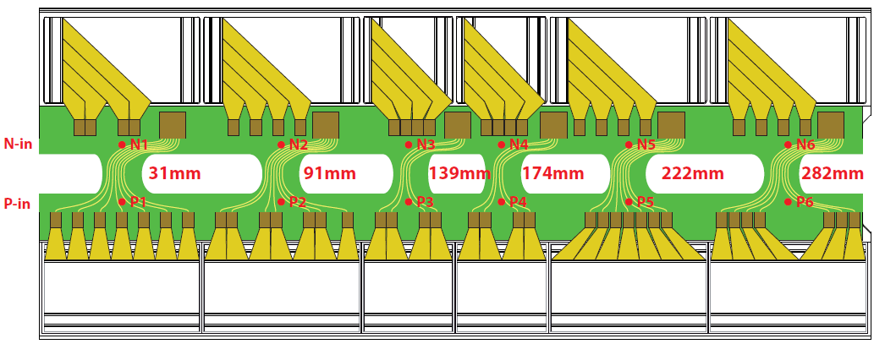
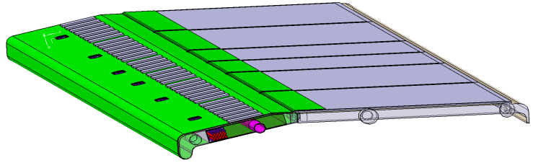
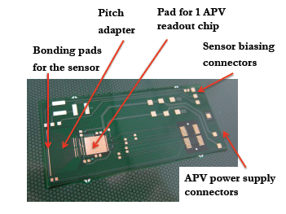
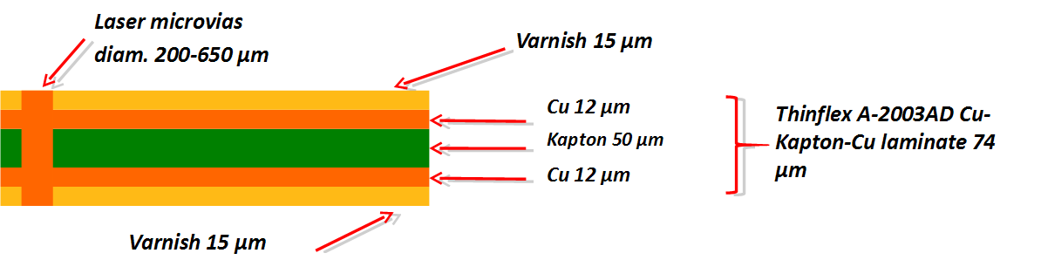
Full hybrid PCB
Folding of PCB around the stave to connect n-side and p-side r/o
Reduced scale prototype

Slide 23
MVD service integration

Slide 24
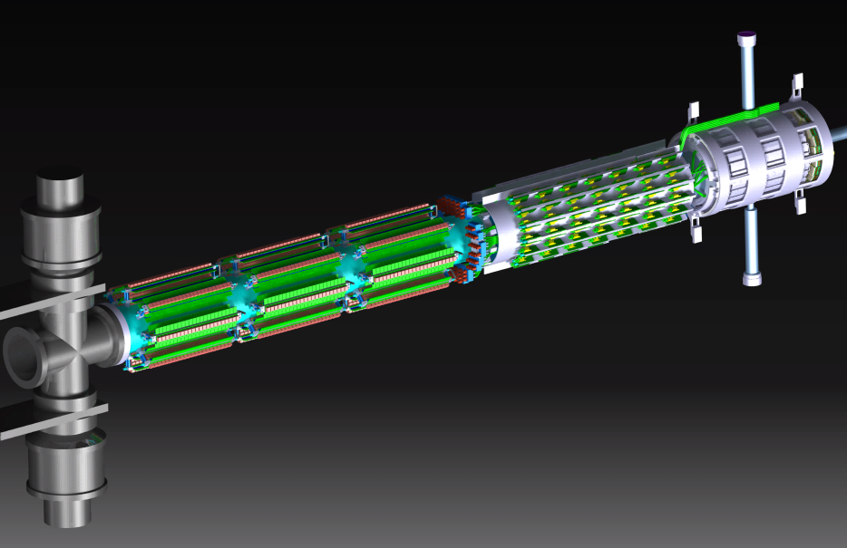
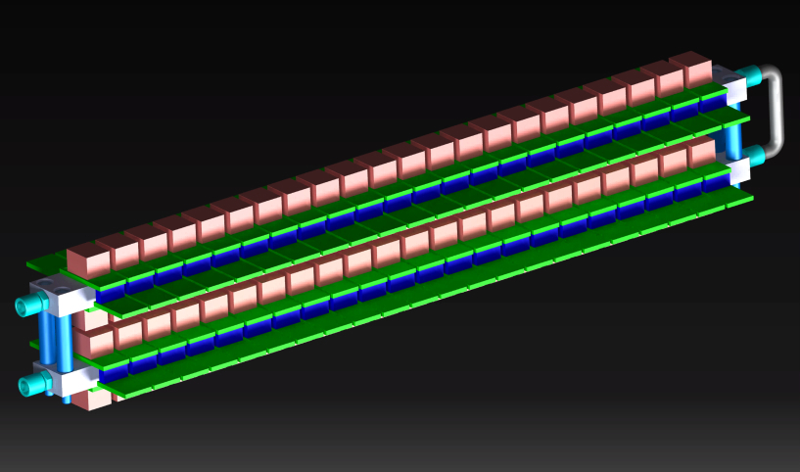
MVD services integration
DC-DC s
MVD
GBTs
2840 mm
In & Out fittings from front side
DC-DC circuit system composed of 3 sets of twin layers of boards, arranged around the beam pipe
2112 DC-DC circuits (CERN)
24 twin cooling bars equipped with 88 circuits each
168 GBT circuits (CERN)
12 cooling bars equipped with 14 circuits each
Thermal simulations in progress
360
Cooling tube embedded in an aluminum bar

Slide 25
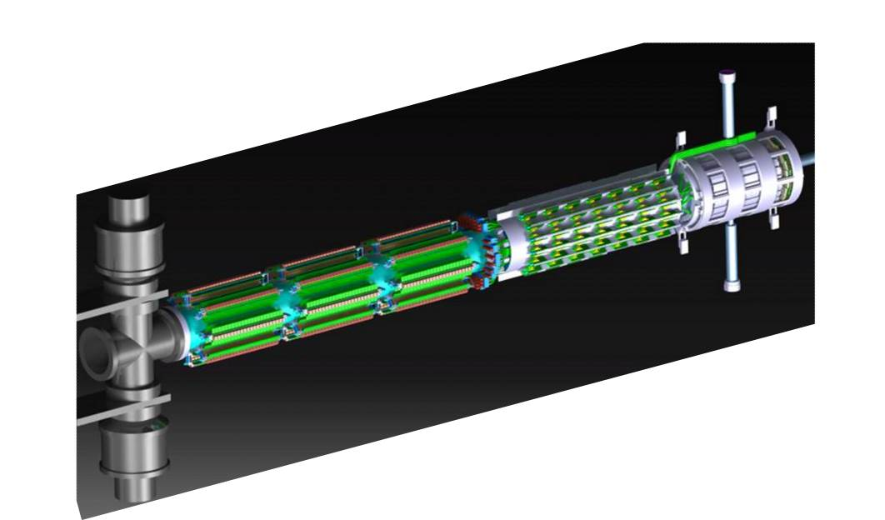
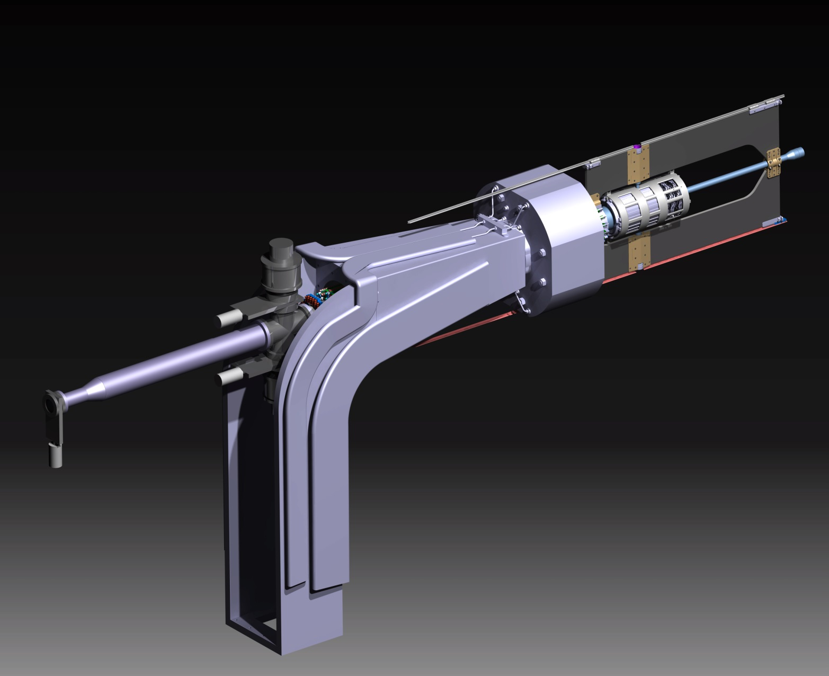
Integration in PANDA
MVD
MVD Services
Beam line pump
2840
Backward Calorimeter

Slide 26
Detector prototypes

Slide 27
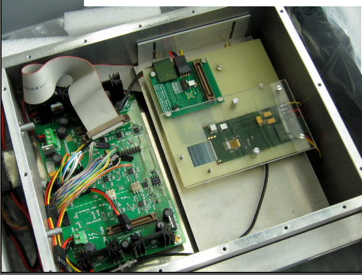
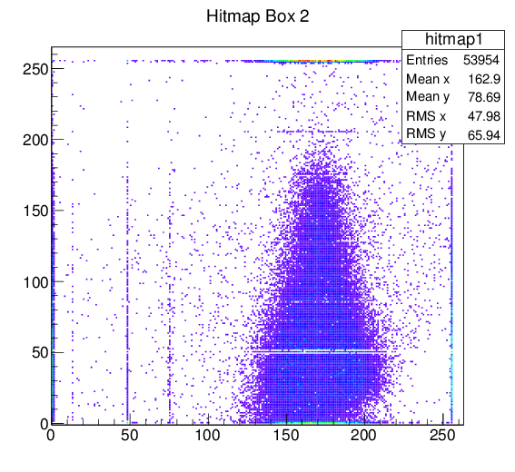
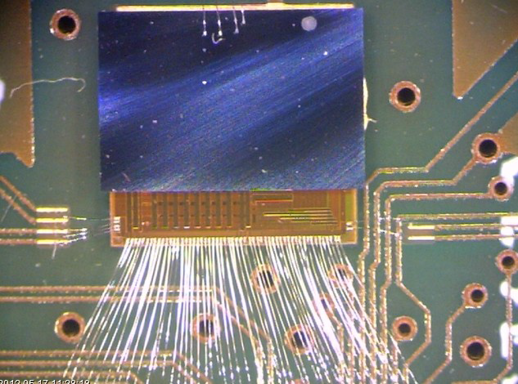
Detector prototypes
Flex-PCB and 3.5 cm x 3.5 cm PANDA fullsize strip sensor (+APV25 chips)
Test @ COSY in 2014
ToPix_3 prototype and the custom epitaxial silicon (ITME) sensor (FBK), 640 pixels arranged in long and short columns
Cz thinning + Bump bonding @ IZM (Berlin) using Sn-Pb bumps.
  Yield of the tested assemblies :
  ~ 99.5 %
The thin Cz layer is the ohmic contact for the sensor biasing.
Single chip pixel assembly

Slide 28
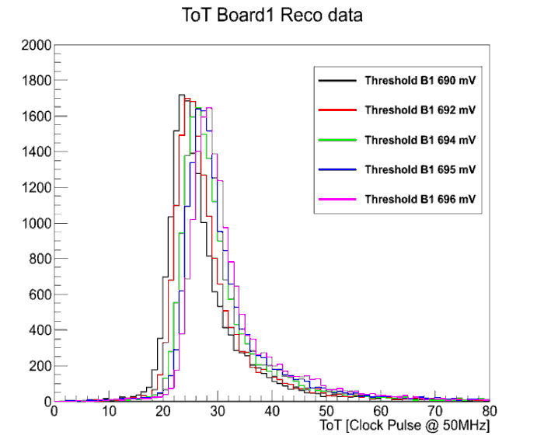
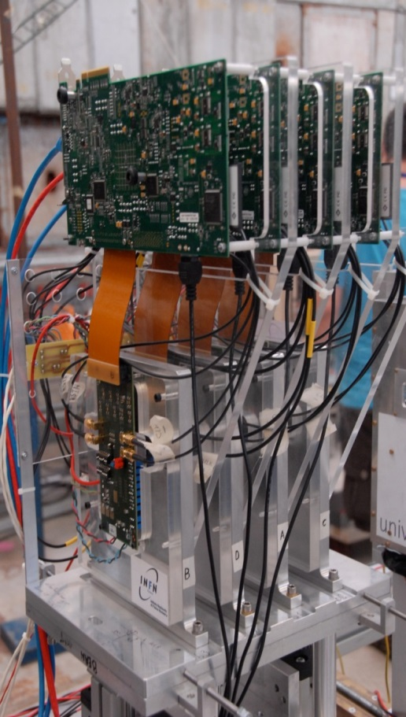
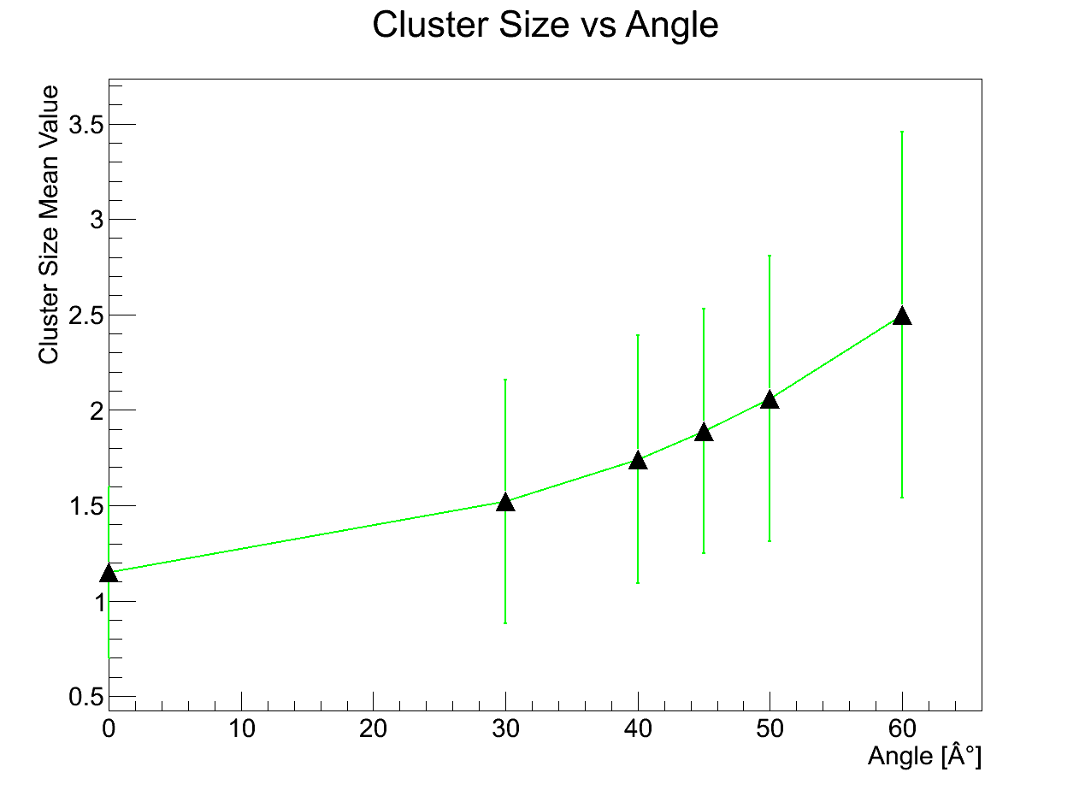
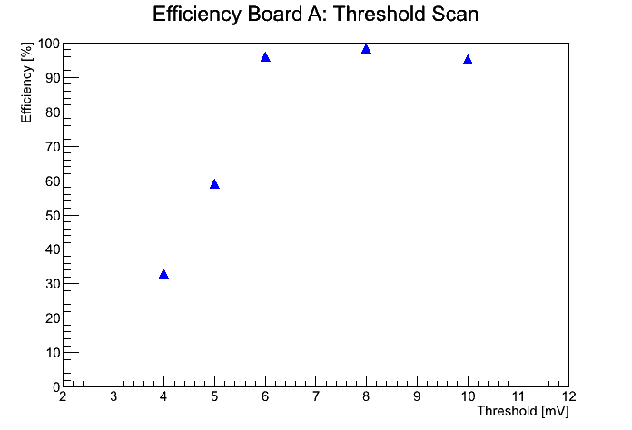
Detector prototypes
BEAM

Slide 29
Conclusions
Challenging integration of the MVD in PANDA.
The work is in progress on the service side
and
for both pixel and strip readout the custom developments are ongoing.
The prototype results support our study and design.

Slide 30
SPARES

Slide 31
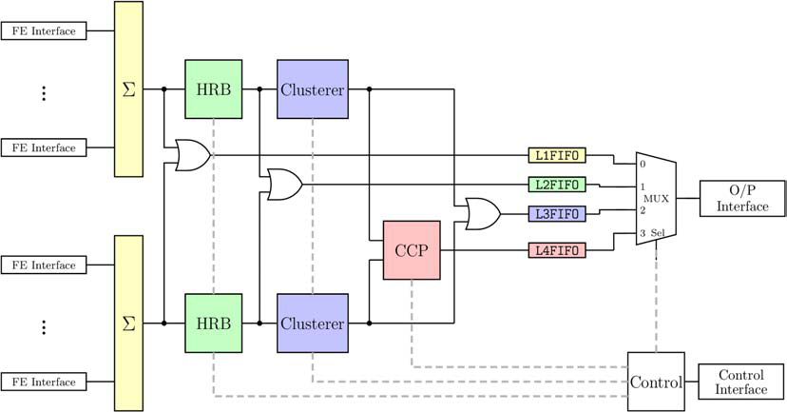
MDC - Module Data Concentrator
Time ordered hit packets (Hit Ring-Buffer)
Cluster-centroids and –sums after the 1d-clustering (Cluster Correlation Processor)
2d-hit points after the CCP
Buffering by FIFOs

Slide 32
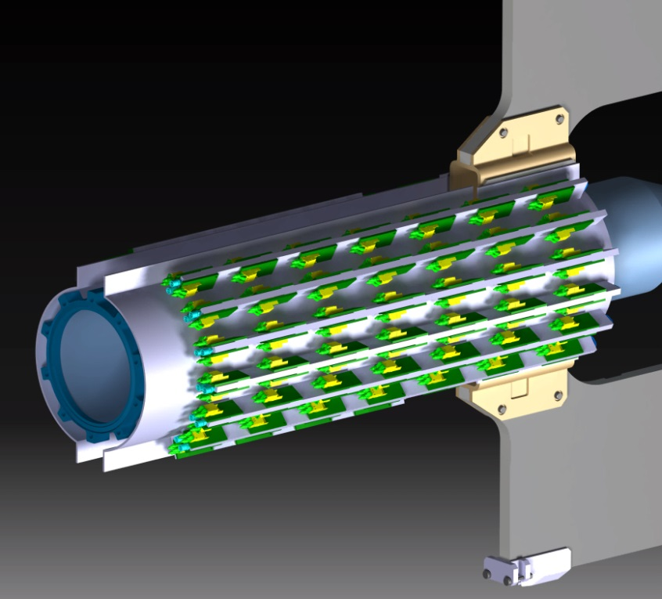
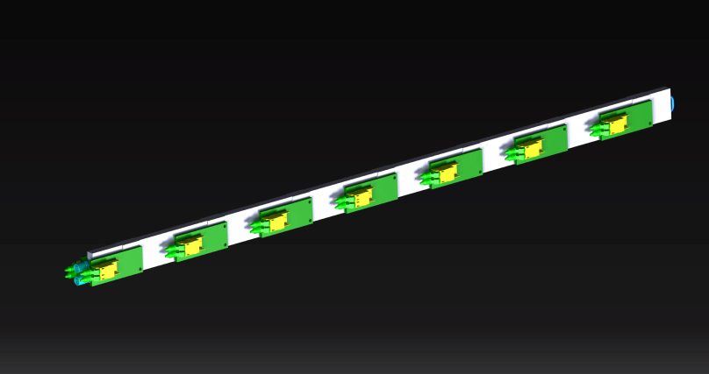
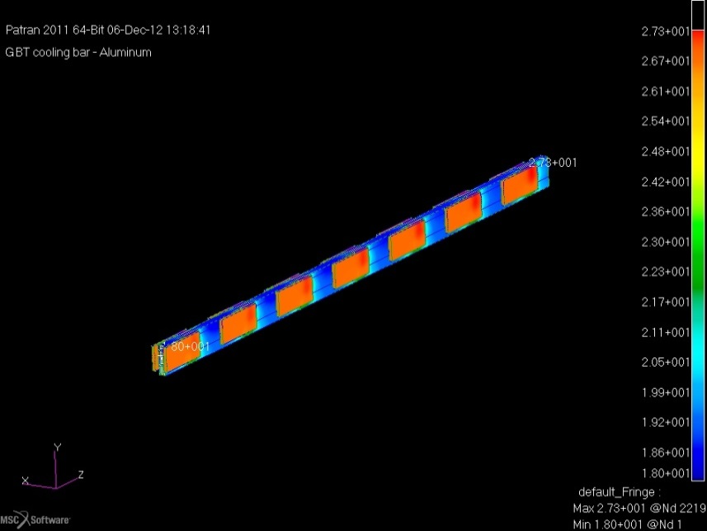
MVD services integration
Cooling tube embedded into a aluminum bar
In & Out fittings from front side
680
GBT circuits support structure is composed by two halves around the beam pipe
168 GBT circuits (CERN)
12 cooling bars equipped with 14 circuits each
Thermal simulations ongoing
  Water as cooling fluid at 18 °C inlet

