Slide 1



Discussion with LHCC Referees
Ian Bird, CERN
LHCC Referee meeting
12th June 2012

Slide 2
Follow up from RRB/RSG

Slide 3
RSG
In future will be useful to have joint meetings between LHCC and RSG
  Was missed this time – process could have benefitted
No real questions about dark/parked/delayed data
  LHCC had already commented
Generally assume that HLT farms will be available in 2013/14 and can be trivially used to account for extra resource requests for 2013
  Often an over simplification
Also that Tier 0 resource availability + HLT farms
  Together mean flat profile for resources 2012-2013

Slide 4
RSG
Recommend using “external” resources for e.g. MC production
  Not clear what these resources are; clouds?
Requests for new disk should be closely scrutinized
  Want to see data access statistics that demonstrate the data placement policies are correct
Want to see realistic estimates for 2014 and beyond

Slide 5
Update on Tier 0

Slide 6
Reminder – scope of problem
In ~2005 we foresaw a problem with the limited power available in the CERN Computer Centre
  Limited to 2.5 MW
  No additional electrical power available on Meyrin site
  Predictions for evolving needs anticipated ~10 MW by 2020
In addition we uncovered some other concerns
  Overload of existing UPS systems
  Significant lack of critical power (with diesel backup)
  No real facility for business continuity if there was a major catastrophic failure in the CC
Some mitigation:
  Bought 100 kW of critical power in a hosting facility in Geneva
    Addressed some concerns of critical power and business continuity
    In use since mid-2010
  Planned to consolidate existing CC
    Minor upgrades brought power available from 2.5 to 2.9 MW
    Upgrade UPS and critical power facilities – additional 600 kW of critical power, bringing total IT power available to 3.5 MW

Slide 7
Call for Tender
Call for tender: Sep – Nov 2011
  Included draft SLA
  Contract length 3+1+1+1+1
  Reliable hosting of CERN equipment in a separated area with controlled access
    Including all infrastructure support and maintenance
  Provision of full configured racks including intelligent PDUs
  Essentially all services which cannot be done remotely
    Reception, unpacking and physical installation of servers
    All network cabling according to CERN specification
    Smart ‘hands and eyes’
    Repair operations and stock management
    Retirement operations
Adjudicated at March 2012 FC

Slide 8
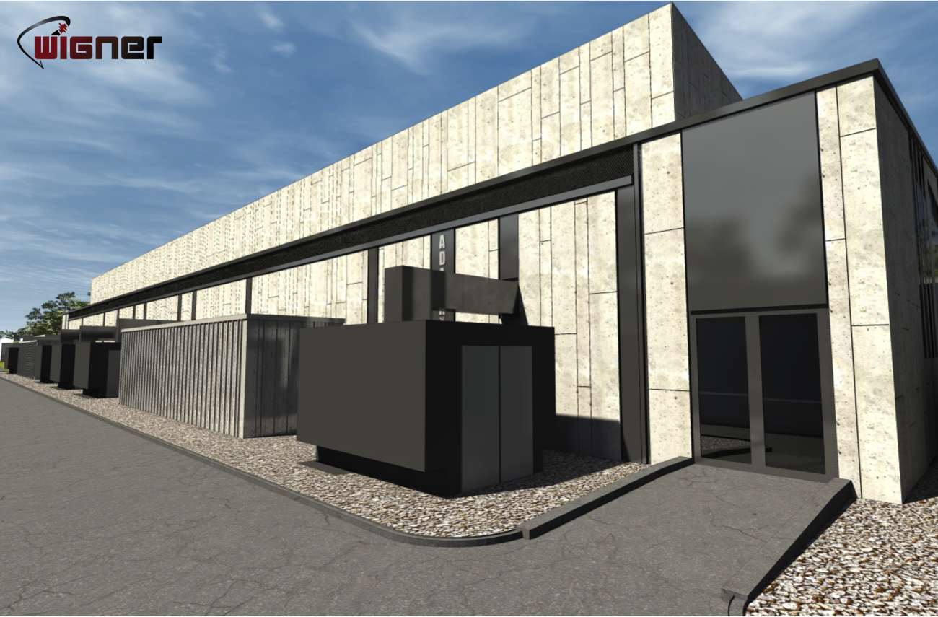
Wigner Data Centre, Budapest

Slide 9
Technical Overview
New facility due to be ready at the end of 2012
1100m² (725m²) in an existing building but new infrastructure
2 independent HV lines to site
Full UPS and diesel coverage for all IT load (and cooling)
  3 UPS systems per block (A+B for IT and one for cooling and infrastructure systems)
Maximum 2.7MW
  In-row cooling units with N+1 redundancy per row (N+2 per block)
  N+1 chillers with free cooling technology (under 18°C*)
Well defined team structure for support
Fire detection and suppression for IT and electrical rooms
Multi-level access control; site, DC area, building, room
Estimated PUE of 1.5

Slide 10
Business Continuity
With a 2nd DC it makes sense to implement a comprehensive BC approach
First classification of services against three BC options:
  Backup
  Load balancing
  Re-installation
An internal study has been conducted to see what would be required to implement BC from a networking point of view
Requires a network hub to be setup independently of the CC
  Requires an air-conditioned room of about 40-50 sqm for ~ 10 racks with 50-60kW of UPS power and good external fibre connectivity
  Several locations are being studied
All IT server deliveries are now being managed as if at a remote location

Slide 11
Use of Remote Hosting
Logical extension of physics data processing
  Batch and disk storage split across the two sites
  The aim is to make the use as invisible as possible to the user
  Actual model of use is not yet defined – several options to be investigated and tested in 2012/13:
    Transparent extension of CERN CC
    Location dependent data access
    Treat as a “Tier 1” or as a “Tier 2” (i.e. place data there)
    (undesirable) a priori allocate by experiment or function
Business continuity
  Benefit from the remote hosting site to implement a more complete business continuity strategy for IT services

Slide 12
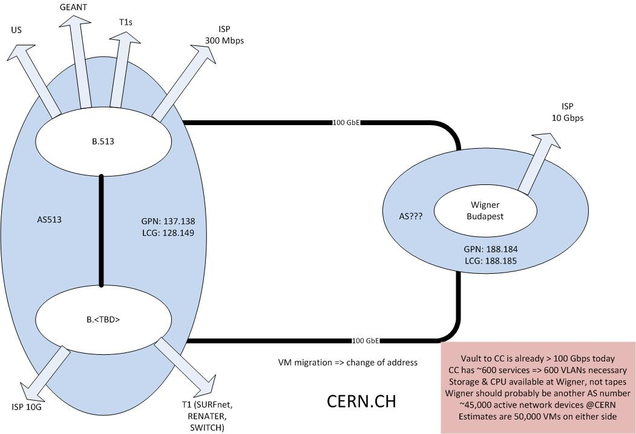
Possible Network Topology

Slide 13
Status and Future Plans
Contract was signed on 8th May 2012
During 2012
  Tender for network connectivity
  Small test installation
  Define and agree working procedures and reporting
  Define and agree SLA
  Integrate with CERN monitoring/ticketing system
  Define what equipment we wish to install and how it should be operated
2013
  1Q 2013: install initial capacity (100kW plus networking) and beginning larger scale testing
  4Q 2013: install further 500kW
Goal for 1Q 2014 to be in production as IaaS with first BC services

Slide 14
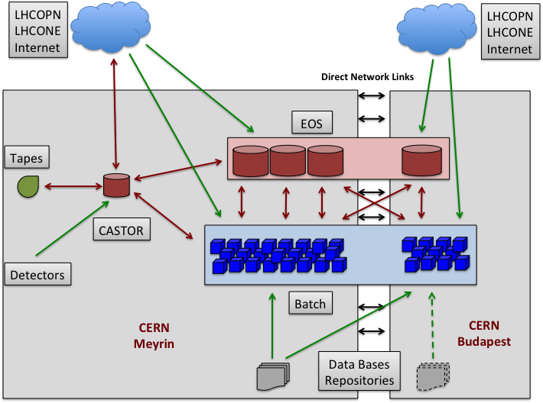
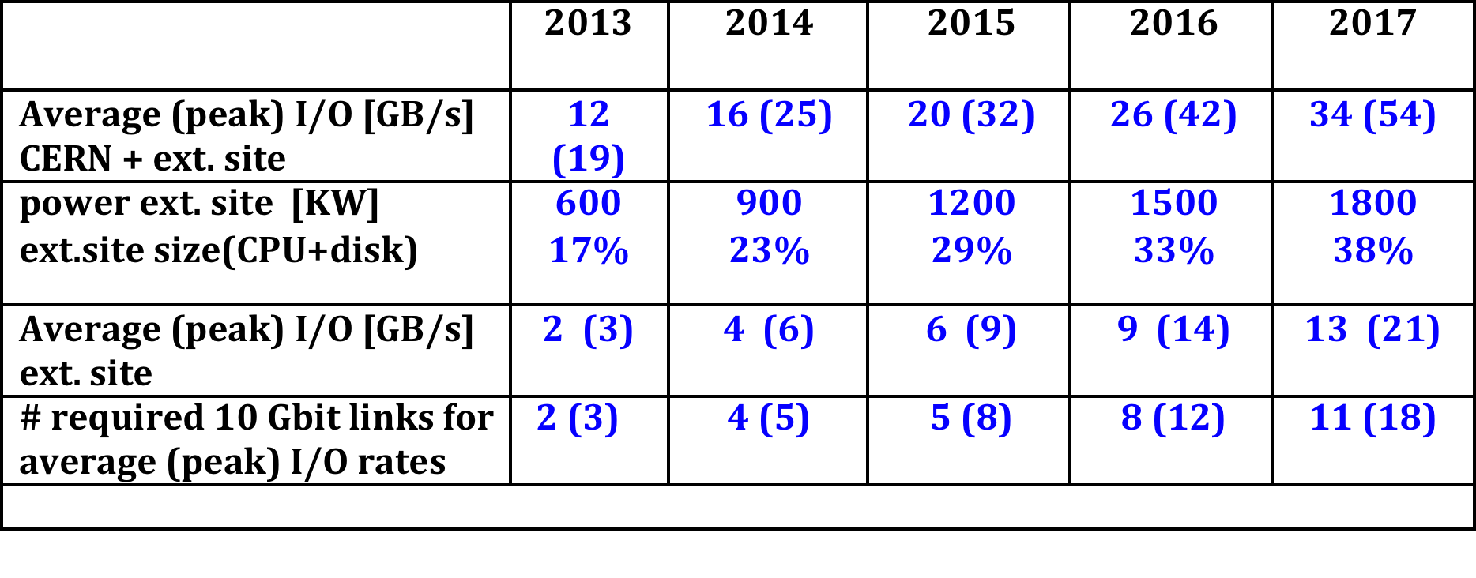
Possible usage model
Split the batch and EOS resources
between the two centers, but keep
them as complete logical entities
Rates based on measurements during last 12 months + extrapolation
Network available in 2013 → 24 GB/s

Slide 15
Possible strategies
If necessary to reduce network traffic
  Possibly introduce “locality” for physics data access
  E.g. adapt EOS replication/allocation depending on IP address
  Geographical mapping of batch queues and data servers
  More sophisticated strategies later if needed
Latency
  Inside CERN centre → 0.3 ms
  CC to Safehost or experiment pits → 0.6 ms
  CERN to Wigner (today) → 35 ms; eventual <10ms?
    Today many hops, future – “direct” connection
  Possible side effects on services:
    Response times, limit number of control statements, random I/O
  Test now with delay box with lxbatch and EOS

Slide 16
Summary
CERN CC will be expanded with a remote Centre in Budapest
Intention is to implement a “transparent” usage model
Network bandwidth not a problem
  Dependence on latency needs to be tested
  More complex solutions involving location dependency to be tested but hopefully not necessary at least initially

Slide 17
Summary of Technical working groups

Slide 18
Areas looked at
Data and storage management
Workload management
Databases
Security
Operations and tools

Slide 19
Data and storage
Tape archives distinct from disk cache
  Manage organised access to tape
  No requirement for true HSM functionality
  Implies:
    Simplification of MSS system where necessary
    Remove expectation that tape is random I/O
    Interface functionality simplified
Data federation – initially with xrootd
  Work already under way
  Some open questions on access patterns
SRM
  Retain as interface to archives and managed storage
    But necessary functionality is a limited subset
  Not there for federated storage with xrootd
  No explicit need to replace SRM –
    but watch technology development (e.g. cloud storage)

Slide 20
Data and storage – ongoing work
Access patterns & scaling
  Staging to worker node vs I/O over LAN, WAN
  Use cases for remote data (repair mode vs all remote I/O, etc)
Data security
  Distinguish between r/o data & written data needing to be stored?
    Simplify AA model for r/o – lower overhead
  Distinguish between sites that cache data and that store data?
    Cache sites would not need a full DM system
    Could use simple web caches (and tools)
These need some scale and performance testing/benchmarking
FTS-3 important – some ongoing discussions
Storage accounting important

Slide 21
Workload management
Agreement on need for traceability
  Requires user id switching → glexec deployment
Better support for pilot jobs
  Common pilot framework?
  Support for streamed submission
  How complex does the CE need to be?
Better support for “any” batch systems in use

Slide 22
Workload management
Optimisation:
  Better support for use of whole node/multi-core scheduling
  Possible for sites to optimise for CPU-bound vs I/O-bound jobs??
  NB should work with SFT concurrency project here
Virtualisation and clouds
  Virtualisation – essentially a site decision (but performance consideration)
  Cloud use cases become more visible and interesting
  Unresolved questions (AAA, etc) – work with existing groups and projects
Information system:
  Distinguish “stable” service discovery and “changing” info
  Needs short term wg to conclude actions

Slide 23
Databases
Ensure support for COOL/CORAL+server:
  Core support will continue in IT; ideally supplemented by some experiment effort
  POOL no longer supported by IT
Frontier/Squid as full WLCG service:
  Should be done now; partly already
  Needs to be added to GOCDB, monitoring etc
Hadoop: (and NoSQL tools)
  Not specifically a DB issue – broader use cases
  CERN will (does) have a small instance; part of monitoring strategy
  Important to have a forum to share experiences etc.
    GDB

Slide 24
Operations & Tools
WLCG service coordination team:
  Should be set up/strengthened
  Should include effort from the entire collaboration
  Clarify roles of other meetings
Strong desire for “Computing as a Service” at smaller sites
Service commissioning/staged rollout
  Needs to be formalised by WLCG as part of service coordination

Slide 25
Operations & tools – 2
Middleware
  Before investing too much; see how much actual middleware still has a long term future
  Simplify service management (goal of CaaS)
    Several different recommendations involved
  Simplify software maintenance
  This requires continuing work
Need to write a statement on software management policy for the future
  Lifecycle model post EMI, and new OSG model
    Proposals very convergent!

Slide 26
Security – Risk Analysis
Highlighted the need for fine-grained traceability
  Essential to contain, investigate incidents, prevent re-occurrence
Aggravating factor for every risk:
  Publicity and press impact arising from security incidents
11 separate risks identified and scored

Slide 27
Security – areas needing work
Fulfil traceability requirements on all services
  Sufficient logging for middleware services
  Improve logging of WNs and Uis
  Too many sites simply opt-out of incident response: “no data, no investigation -> no work done!”
  Prepare for future computing model (e.g. private clouds)
Enable appropriate security controls (AuthZ)
  Need to incorporate identity federations
  Enable convenient central banning
People issues:
  Must improve our security patching and practices at the sites
  Collaborate with external communities for incident response and policies
  Building trust has proven extremely fruitful – needs to continue

Slide 28
Need to do in LS1:
Testing new concepts at scale:
  FTS-3 scale testing
  On large sites separation between archives and placement layer
  Federation: run production with some fraction of data not local
    Needs good monitoring
  Test reduced data access Auth^{z} requirements
  Testing use of multicore/whole node environments? →

