Slide 1
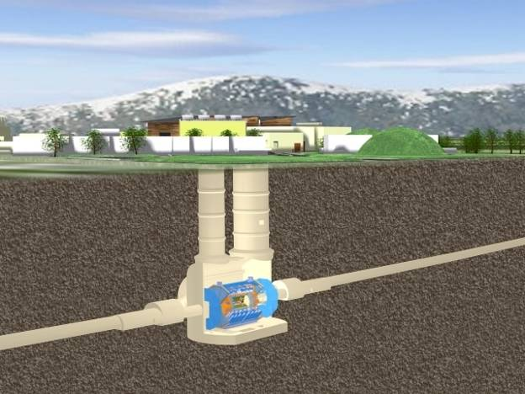
2012 - report from ATLAS
  ATLAS Distributed Computing has been working at large scale
    Thanks to great efforts from shifters and experts
    Automation and monitoring are essential
    Networking is getting more and more important
  Monte Carlo production for 8 TeV / high pileup in full swing
    ICHEP is an important milestone
    Pileup causes long time / event as everywhere, production rate limited despite access to unpledged CPU
  Towards 2015 and beyond
    Planning / implementing the work to be done during LS1
    In Distributed Computing as well as in Software – CPU, disk
    Efficient resource usage is as important as having the resources available

Slide 2
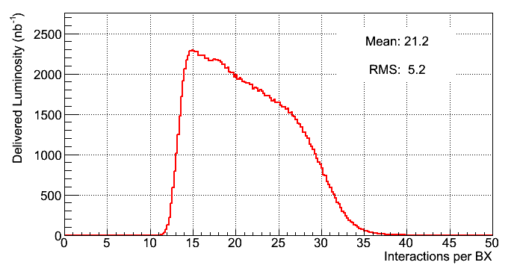
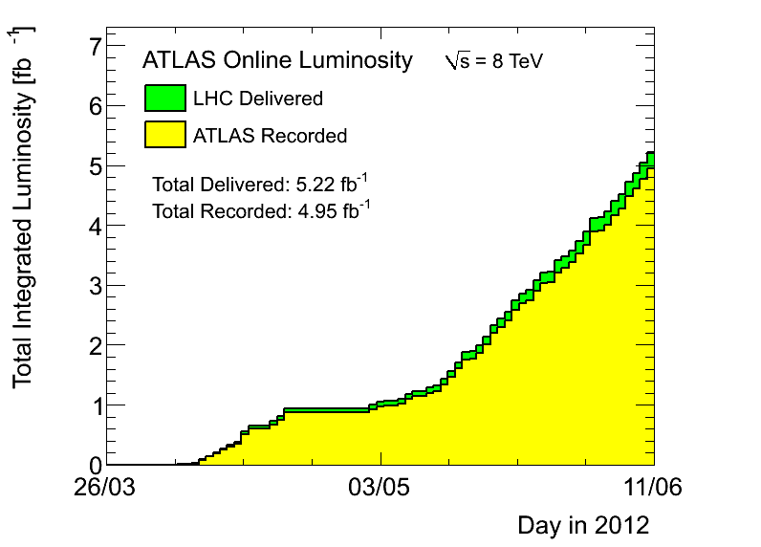
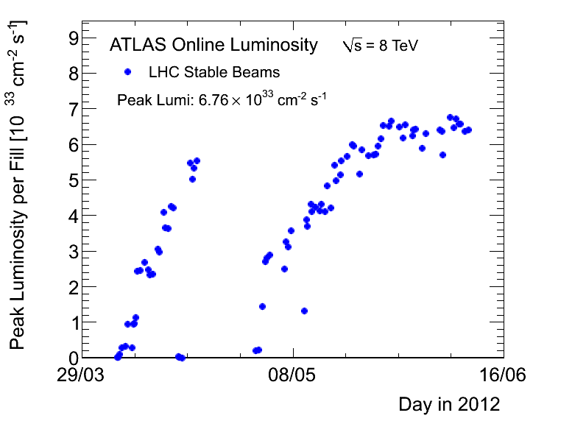
2012, LS1, towards LS2; LS3 Upgrade LoI
LHC in superb shape (again)
  Already collected 5/fb at 8 TeV, present slope 150/pb per day
  Ten more days to go until next Machine Development / Technical Stop
  So hope for 6-7/fb at 8 TeV for ICHEP, in addition to the 5/fb at 7 TeV
We could use many more simulated events for this much real data
The improvements during LS1 are the main focus of present S&C week
Between LS1 and LS2 (2015-2018)
  Expect to run at 13-14 TeV, at lumi 1.2e34/cm²/s, avg pileup ~as now (25), with 25 ns bunch spacing
  But if SPS emittance can be improved early on, could reach 2.2e34 even before LS2, pileup 48 (see Paul Collier’s talk, ATLAS Week last week)

Slide 3
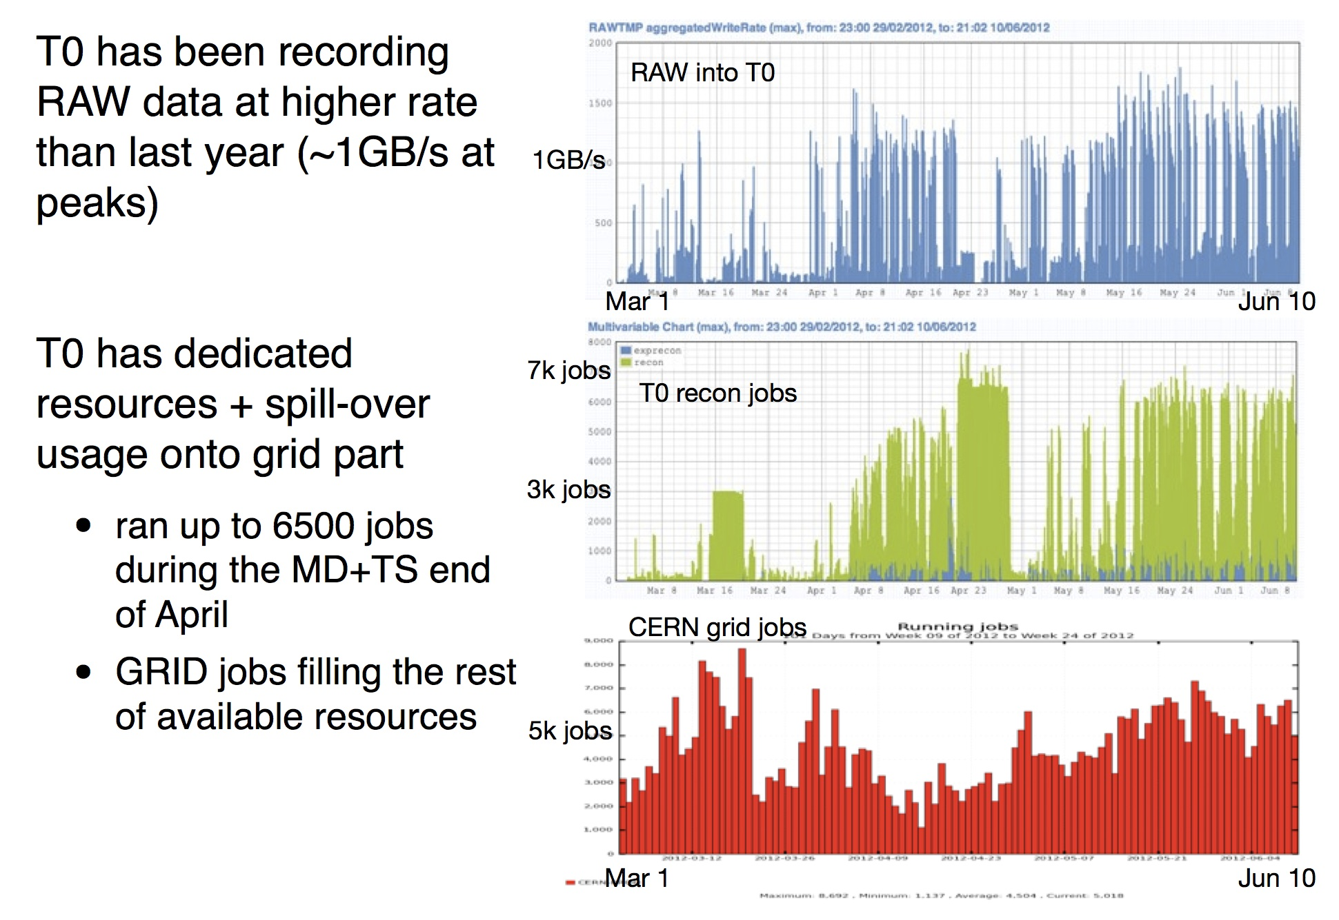
Tier-0 / CERN Analysis Facility
Physics recording average:
420Hz prompt
130Hz delayed
Fast re-
processing
Slides prepared by I Ueda

Slide 4
Tier-0 / CERN Analysis Facility
Physics recording average:
420Hz prompt
130Hz delayed
Fast re-
processing
Rolf Seuster
Slides prepared by I Ueda

Slide 5
Grid Data Processing

Slide 6
CVMFS becoming the only deployment method
Importantly, can also test nightly releases on Grid now

Slide 7
Distributed Data Management

Slide 8
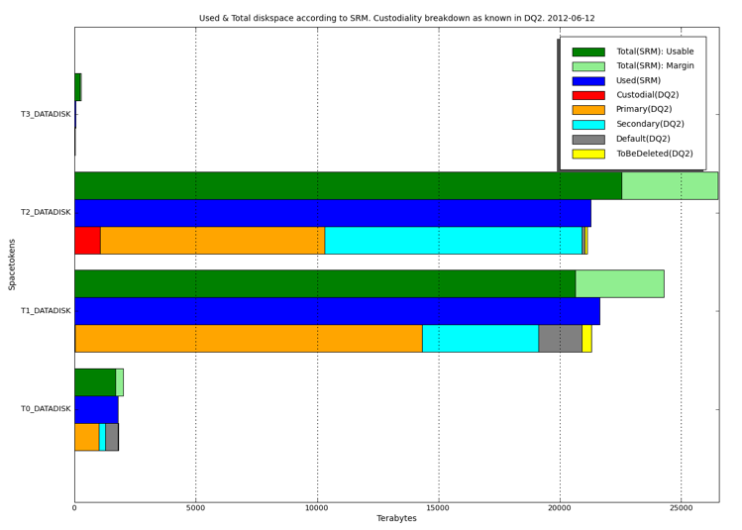
Disk usage
DATADISK plot

Slide 9
Disk usage
DATADISK plot
Note:
new DDM monitoring taking shape, pilot in place
based on Hadoop (HFS, PigLatin, Hbase) to be scalable for a long time
Hadoop also being used in other ATLAS places

Slide 10
Upgrade of S&C: ongoing work on one slide
Technical Interchange Meeting at Annecy 18-20 April
  Data Management, Data Placement, Data Storage
  Production System, Group Production, Cloud Production
  Distributed Analysis, Analysis Tools
  Recent trends in Databases, Structured Storage
  Networking
  http://indico.cern.ch/conferenceDisplay.py?confId=176443
S&C plenary week 11-15 June
  Focus on upgrades, in distributed computing and in software (TDAQ and offline)
  How to make full use of future hardware architectures – implement parallel processing on multiple levels (event, partial event, between and within algorithms)
  Enormous potential for improving CPU efficiency, if with enormous effort
  Beneficial to work with OpenLab, PH-SFT, IT-ES, CMS…
  https://indico.cern.ch/conferenceDisplay.py?confId=169698

Slide 11
CPU efficiency… talk by Andrzej Nowak / OpenLab
“The growth of commodity computing and HEP software – do they mix?”
Gains from the different levels of parallelism are multiplicative
Lower ones are harder to use in software
Efficiency of CPU usage on new hardware: HEP reaches few percent of the speedup gained by fully optimized code or by typical code
Omnipresent memory limitations hurt HEP - to be overcome first

Slide 12
ATLAS resource request doc to CRRB (20 March)
Scrutiny for 2013 not severe provided there will be no further decrease in October.
Need to concentrate on 2014 and beyond (so far assume 2 months of 14 TeV during WLCG year).

