Slide 1
LHCb computing highlights
Marco Cattaneo
CERN – LHCb

Slide 2
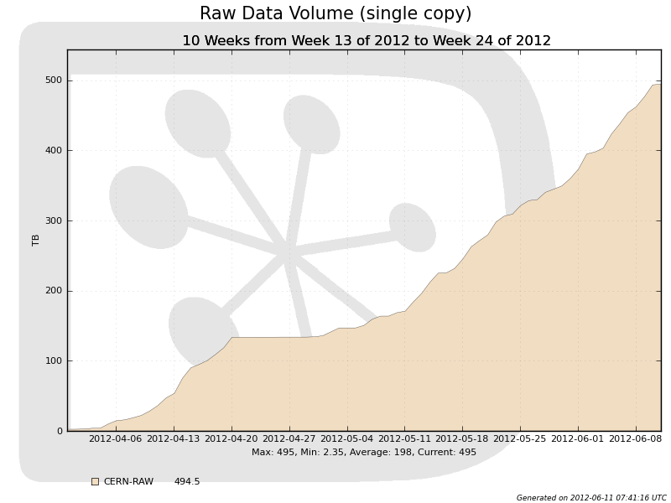
Data taking
Raw data recording:
  ~120 MB/s sustained average rate
  ~300 MB/s recording rate during stable beam
    ~4.5kHz, ~70kB/event
  ~1 TB per pb⁻¹
    ~ 1.5 PB for one copy of 2012 raw data
      ~ 25% more than start of year estimate

Slide 3
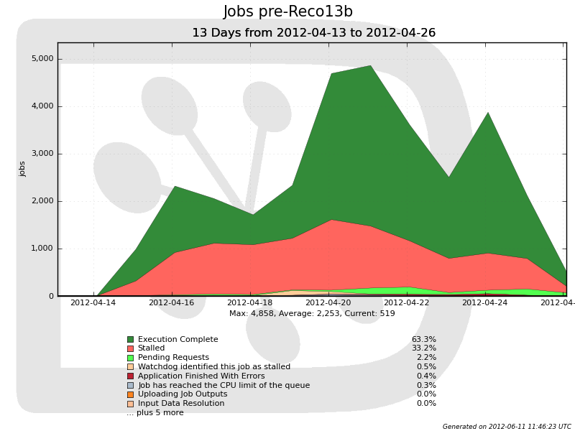
Reconstruction
Much improved track quality in 2012
  Factor 2 reduction in track chi2
  Higher efficiency for Kshort
Started with unchanged track selection
  Effectively looser cuts on clone+ghost rejection
  Higher multiplicity due to physics (4 TeV, higher pileup)
Factor two longer reconstruction time
  High job failure rate due
  to hitting end of queues
  Temporary extension of
  queue limits requested and
  granted by sites
Fixed by retuning cuts
  New Reco version late
  April for new data
    Reprocessed April data
  Still tails ~1.5 times slower than in 2011
    More improvements expected by end June

Slide 4
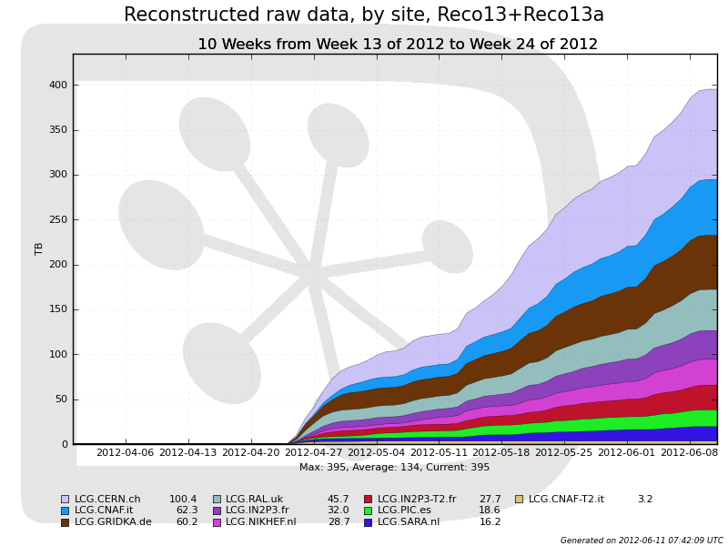
Prompt reconstruction
Follows data taking with ~5 days delay

Slide 5
Stripping
Similar problems to reconstruction for early data
  Only worse, x10 slower than required, due to combinatorics
Improved protections, retuned cuts to follow tracking improvements
  Timing now ~OK
  Output rates as expected
Memory consumption still an issue
  Due to complexity of jobs:
    ~900 independent stripping lines
      ~1 MB/line
    ~15 separate output streams
      ~100 MB/stream
    Plus “Gaudi” overhead
    Total ~3.2 GB, can exceed 3.8 GB on very large events
  Optimisation ongoing

Slide 6
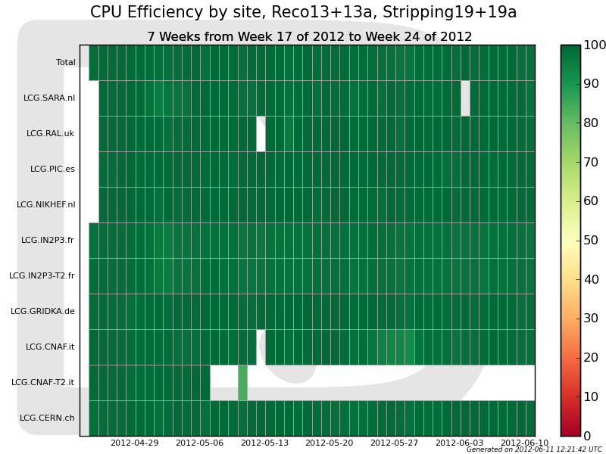
CPU efficiency

Slide 7
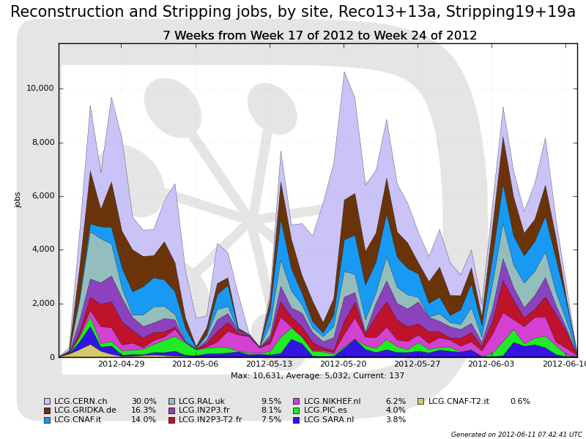
Tier1 CPU usage
Prompt production using ~60% of Tier1 resources
Little room for reprocessing in parallel with data taking
  Much greater reliance on Tier2 than in 2011

Slide 8
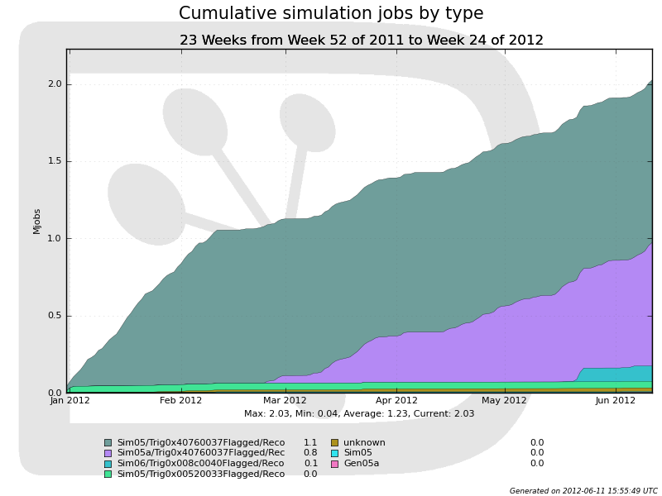
MC production
Production ongoing since December 2011 for 2011 data analysis
  ~1 billion events
  produced
  ~ 525 different
  event types
Started to produce
preliminary samples
for analysis with
early 2012 data
MC filtering in final commissioning phase
  Keep only events selected by trigger and stripping lines
  Production specific for each analysis
  Better usage of disk, but may put strain on CPU resources
~ 500 events/job
2012 samples

Slide 9
Plans
As in 2011, we plan to reprocess the complete 2012 dataset before the end of the year
  (obviously does not apply for any data taken in December)
  ~3 months starting late September
    Need ~twice CPU power than prompt processing
    Make heavy use Tier2
  Software frozen end June, commissioned during summer
Further optimisation of storage
  Review of SDST format (reconstruction output, single copy, input to stripping) to simplify workflows and minimize tape operations during reprocessing
    Include copy of RAW on SDST
      Avoids need to re-access RAW tapes when stripping
      Effectively adds one RAW copy to tape storage….
  Collection of dataset popularity data to be used as input to data placement decisions
  Deployment of stripping also for MC data

