Slide 1




Measurement of Di-Boson production and anomalous couplings with ATLAS Detector @LHC
Shu Li
On behalf of the ATLAS collaboration
Center of Particle Physics and Technology,
University of Science and Technology of China¹
& Centre de Physique des Particules de Marseille,
CNRS/IN2P3²

Slide 2
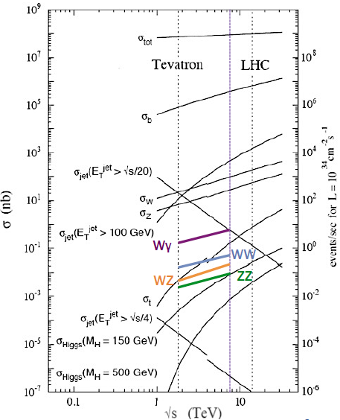
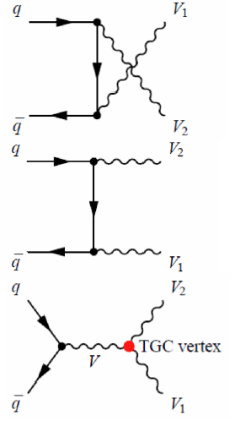
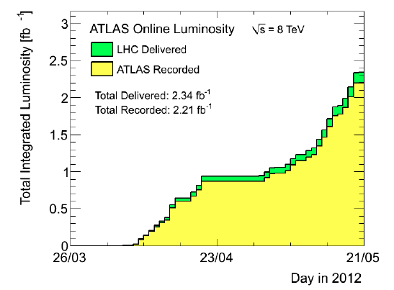
Introduction
Motivation:
  Important test of SM EW sector
  Sensitive to new phenomena.
  Irreducible background of Higgs(WW/ZZ) and relevant exotic searches
More precise measurement with full 2011 dataset(4.7fb⁻¹)

Slide 3
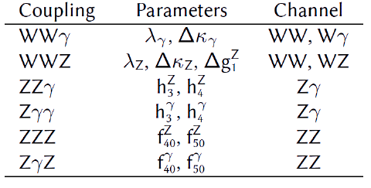

Methodologies
cross section
  N_{obs}: observed events passing selection
  N_{b}: estimated background passing selection
  L: int. luminosity
  Br: the branching ratio of V→l+l/ν
  A: the fiducial acceptance
  C: the eff. correction
aTGC limit setting
  Effect of new physics parametersized with effective field theory (aTGCs)
  Cut-off form factor to preserve unitarity at high energy
  Modify total production rate and event kinematics
  Likelihood(1D or 2D) to determine the aTGCs
Forbidden in SM

Slide 4
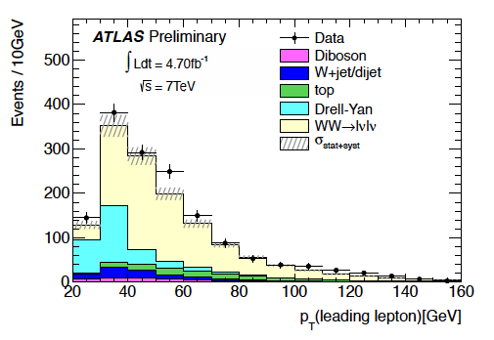
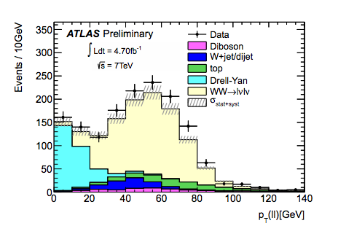
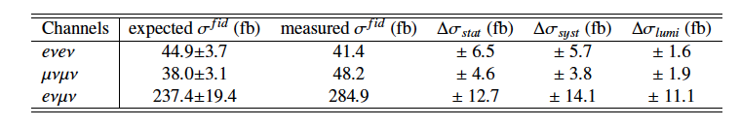
WW→lνlν
Selections:
  Exact 2 isolated leptons, pT>25(leading),20(trailing)GeV
  Z/γ* rejection: M_{ll}>15GeV, M_{ll’}>10GeV, |Mll-Mz|>10GeV
  E_{T,rel}^{miss}>55/50/25GeV(/ee/e)
  pT>25/20GeV jet/b-jet Veto
Major background: Z/γ*, Top
Measured cross section: 53.4±2.1(stat)±4.5(sys)±2.1(lumi) pb
SM NLO prediction: 45.1±2.8 pb
Fiducial cross sections:
ATLAS-CONF-2012-025

Slide 5
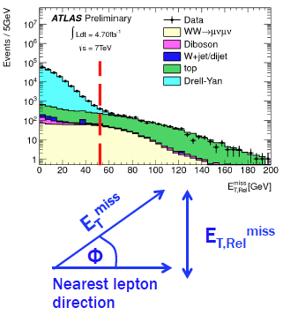
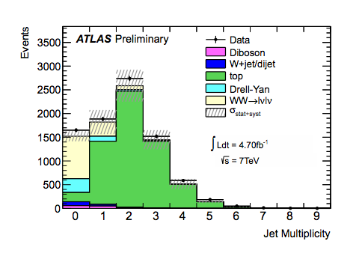
WW→lνlν background
Challeging task: higher signal rate than other DiBoson processes but extremely high background contamination
ee, µµ channels at di-lepton selection:
  Z event fraction > 99%
  WW fraction: ~0.07%;
  Top fraction: ~0.3%;
  Need rejection power: ~10⁴
Relative E_{T}^{miss} in WW events against Drell-Yan(projection to nearest lepton/jet)
Reject multi-jet events to suppress Top rates(b-jet Veto at lower pT)
Challenged by JES/JER uncertainty. Using DD estimate from b-tagging control sample tech. to cancel the systematic uncertainty

Slide 6
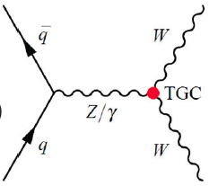
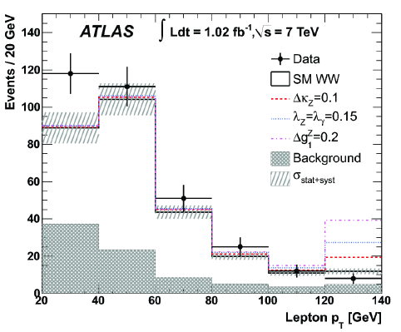
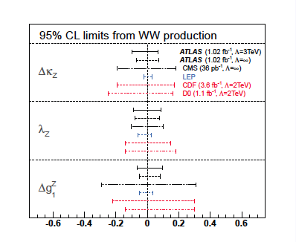
Anomalous coupling in WW
Using leading pT spectrum which is sensitive to aTGCs. Max sensitivity at pt>120GeV.
Sensitive to WWZ and WWγ aTGC vertex.
Highest sensitivity for Δκ_{V}
Bayesian likelihood limits set using LEP aTGC scenario with 3 parameters

Slide 7
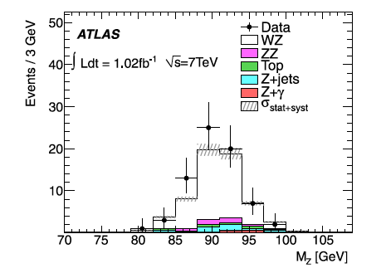
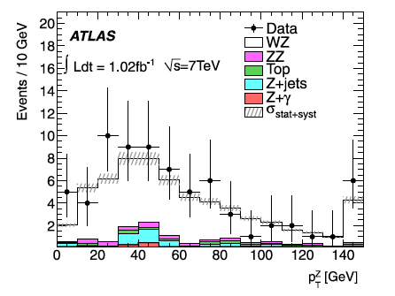



WZ→lνll
Selections:
  At least 3 prompt isolated leptons, pT>15GeV
  Z: 1st and 2nd leptons, |M_{ll}-Mz|<10GeV
  W: 3rd lepton, pT>20GeV, mT>20GeV, E_{T}^{miss}>25GeV
Major backgrounds: Z+jets/γ, ZZ, Top
  Less background contamination than WW
Measured cross section:
Total:
Fiducial:
SM prediction:
j.physletb.2012.02.053

Slide 8
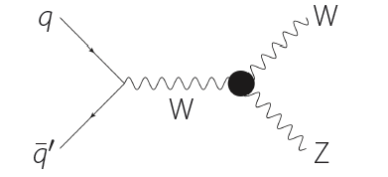
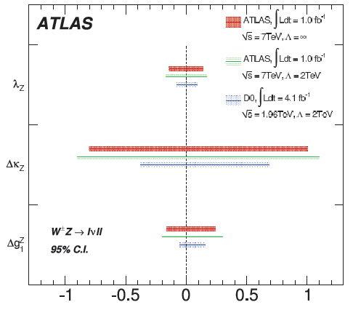
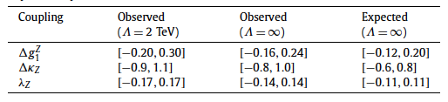
WZ responsibility for aTGC
aTGC limit using measured cross section with 1.02fb⁻¹ DATA with WZ→lνll events
Frequentist approach with the profile likelihood ratio used as the test statistic
Highest sensitivity for Δg₁^{V}
Limits are set separately on each parameter with the other couplings fixed to their SM values

Slide 9
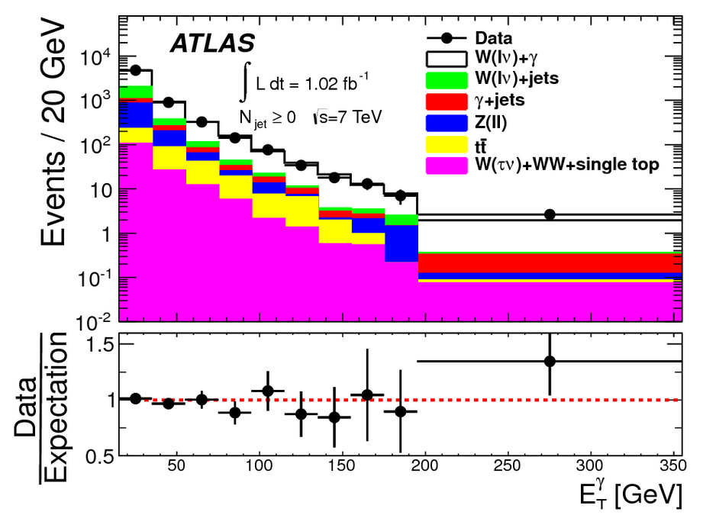
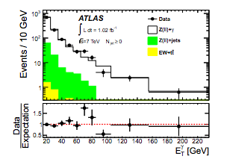
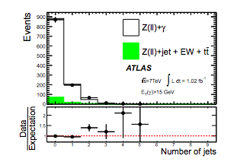
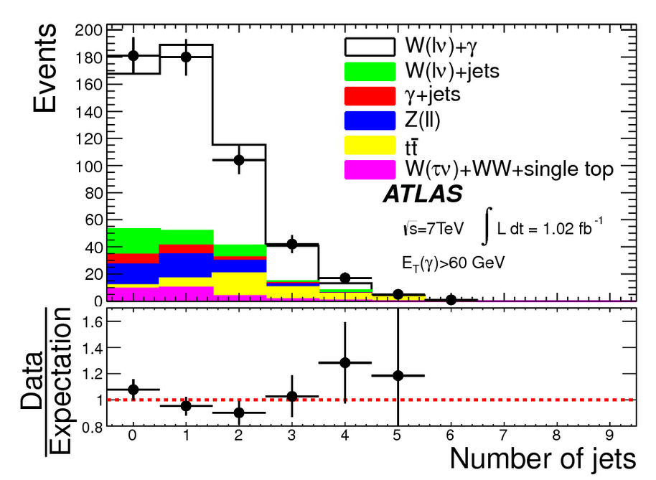
W/Z+γ
Selections:
  W: 1 isolated lepton, pT > 25 GeV, E_{t}^{miss}>25GeV, M_{T} > 40 GeV
  Z: 2 isolated leptons, pT > 25 GeV, M_{ll} > 40GeV
  γ: ET > 15 GeV, isolated, R(l,γ) > 0.7
  Exclusive measurement : veto of events containing jets with pT > 30GeV
Major background: V+jets
arxiv:1205.2531
W+γ
Z+γ

Slide 10
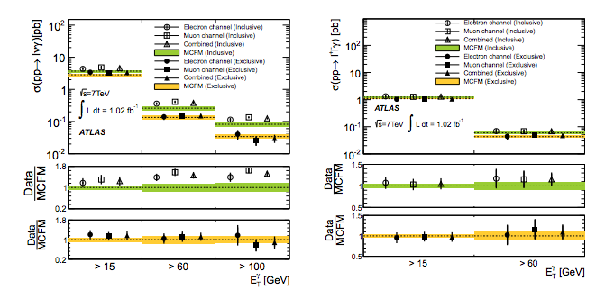
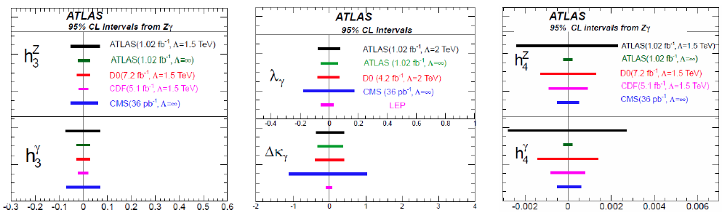

Inclusive and exclusive W/Z+γand aTGC
Inclusive and exclusive
Cross sections
W+γ
Z+γ
aTGC extraction based on observed photon E_{T} spectrum
exclusive fiducial cross section in use:

Slide 11
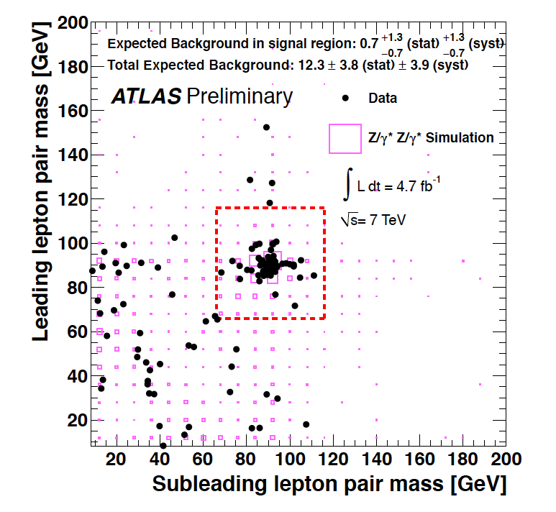
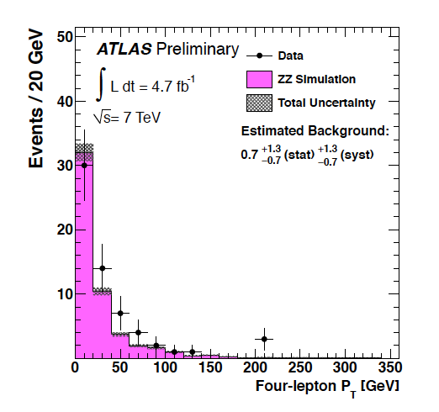



ZZ→4l
Selection:
  4 isolated leptons with pT > 7 GeV
  Leading lepton pT > 25/20 GeV (e/)
  66 < M(ll) < 116 GeV for each Z lepton pair
  Z→ττ not included
Background free(<2% contamination), residual: W/Z+jet, Top, VV
Measured cross section:
  Total:
  SM prediction:
  Fiducial:
ATLAS-CONF-2012-026

Slide 12
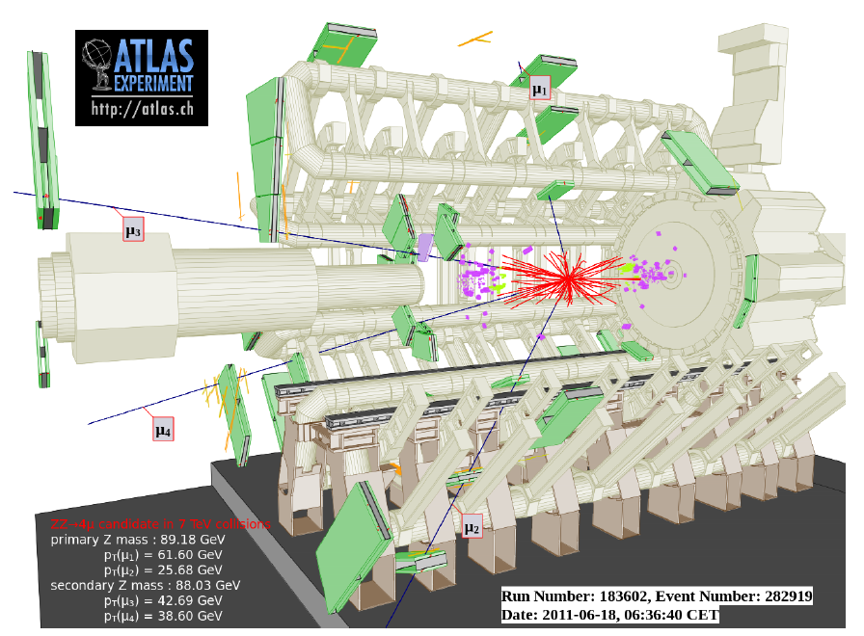
Selected Event Display for ZZ→4μ

Slide 13
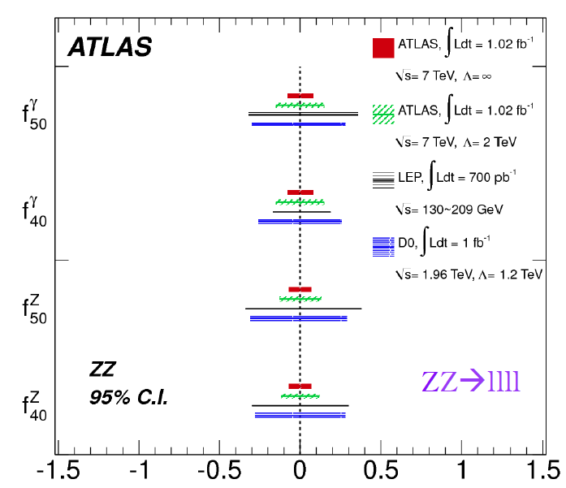
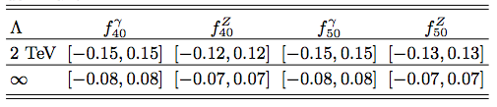
Anomalous coupling from ZZ
ZZZ and ZZγ neutral triple gauge boson couplings (nTGCs)
No tree-level contribution from s-channel quark annihilation. O(10⁻⁴) at one-loop level
Signature of non-zero nTGCs: increase of ZZ cross section at high ZZ inv.Mass and high transvers momentum
1.02fb⁻¹ anomalous nTGC limits published using the total number of observed events only.

Slide 14
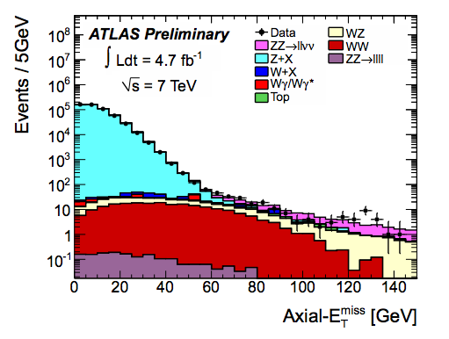
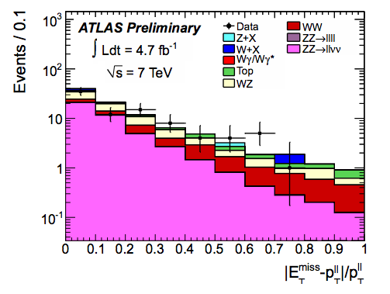
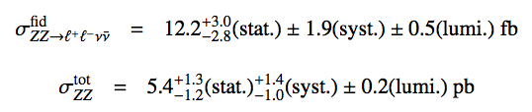

ZZ→llνν
Selection:
  2 isolated leptons, pT > 20 GeV
  Axial-E_{T}^{miss}>80GeV(E_{T}^{miss} projection along Z p_{T})
  Jet veto : remove events with jets with pT>25 GeV
  |E_{t}^{miss} - p^{Z}_{T}|/p^{Z}_{T}< 0.6
Total cross section:
SM prediction:
Fiducial cross section:
ATLAS-CONF-2012-027

Slide 15
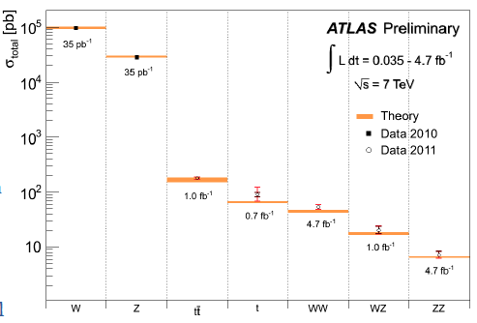
Summary
Highly appreciating LHC’s smooth and fruitful data taking in 2011
Remarkable cross sections measurement mostly updated with full 2011 dataset(4.7fb⁻¹)
aTGC all successfully derived with int. Lumi up to 1fb⁻¹. Competitive with LEP and Tevatron. Working on the combination between diboson channels.
Still working on publishing full 2011 analysis with more precise SM test while launching 8TeV taskforce meanwhile

Slide 16
Spare

Slide 17
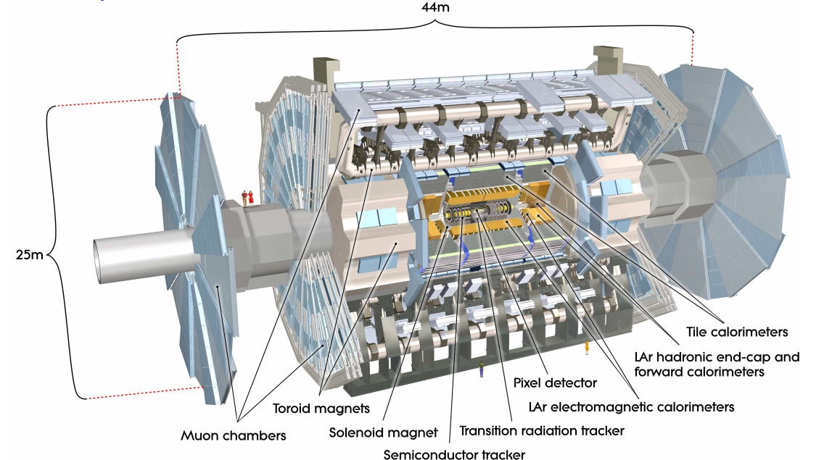
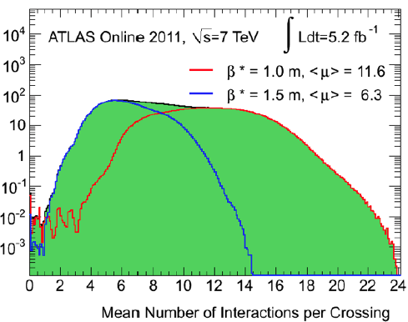
ATLAS Detector
2011 voice

Slide 18
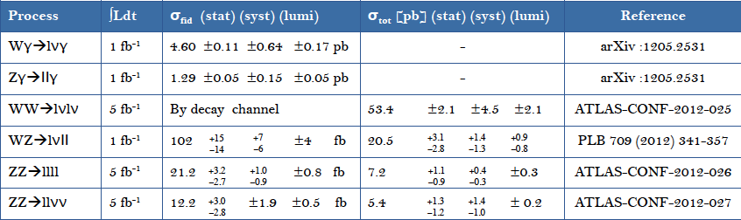
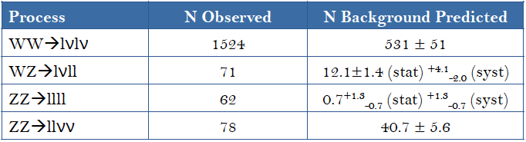
Cross section summary and observed events

Slide 19
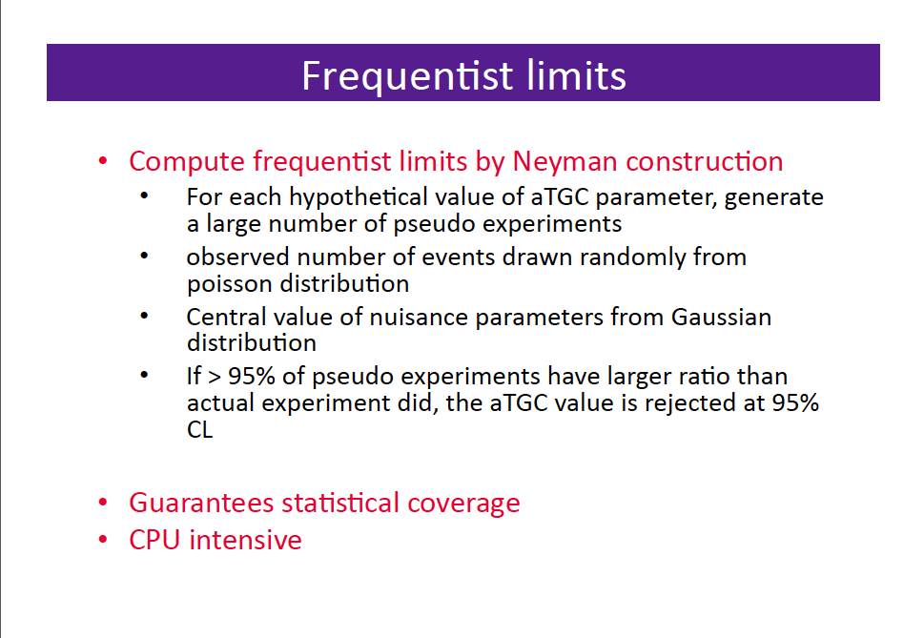

Slide 20
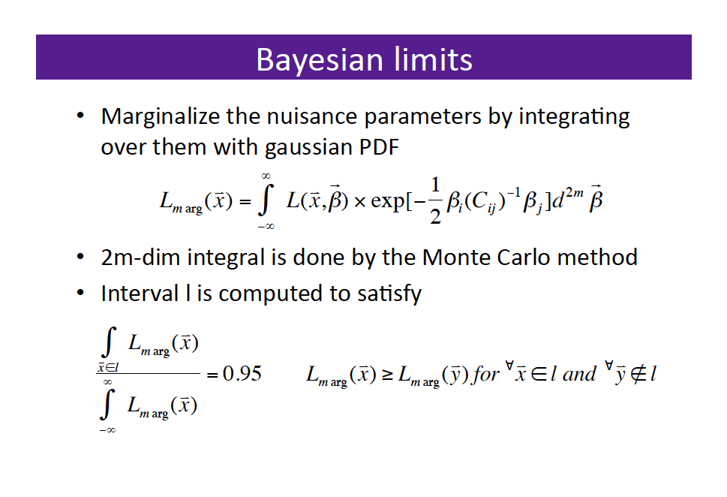

Slide 21
