Slide 1


Head and tail dump for the booster injection region
Melanie Delonca ‹
EN/STI-TCD b
Thanks to :
C. Maglioni ‹
R. Chamizo ‹
O. Aberle ‹
…

Slide 2
Outline
Dump space & layout
Loading cases
Additional consideration
Preliminary analyses :
  Instantaneous ΔT
  Steady operation
Conclusions and open questions
M. Delonca May 31, 2012 2

Slide 3
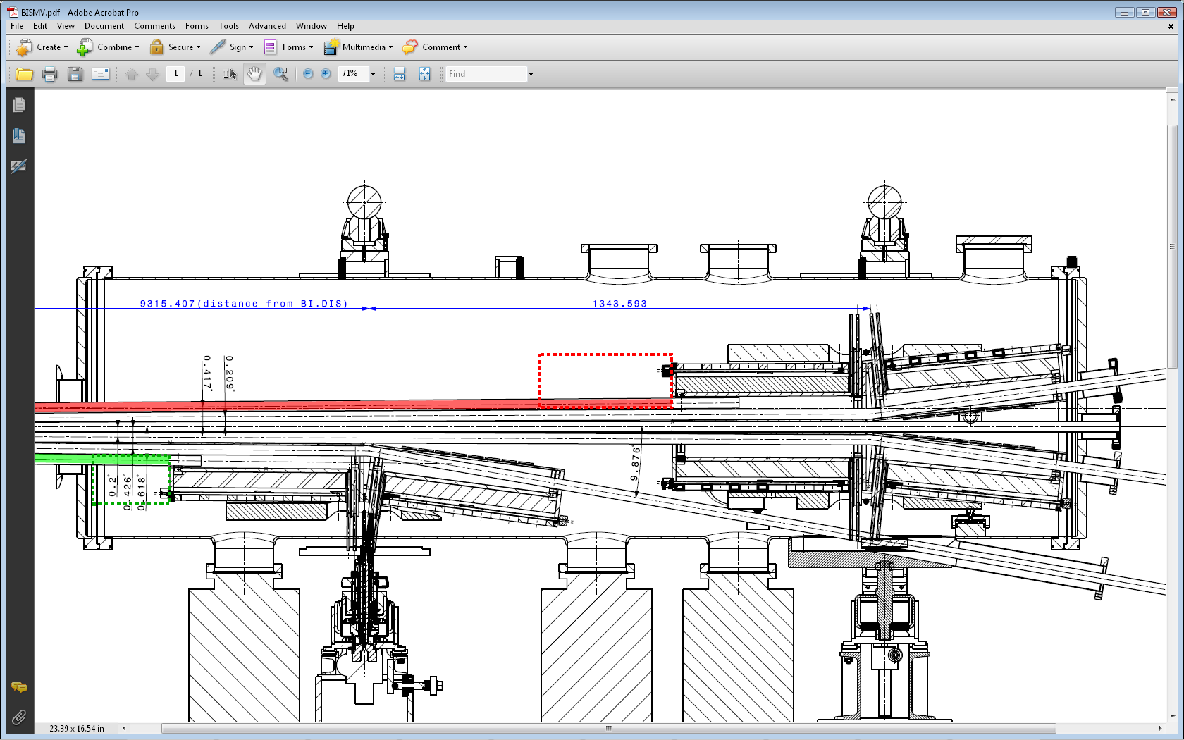
Dumps space & layout
Head
Tail
EDMS 963395
Minimum Dimensions | Head dump | Tail dump
Width W [mm] – x | 40 | 40
Height H [mm] – y | 40 | 40
Length L [mm] – z | 200 | 200
Head dump located into BI.SMV3 magnet
Tail dump located into BI.SMV1 magnet
M. Delonca May 31, 2012 3

Slide 4
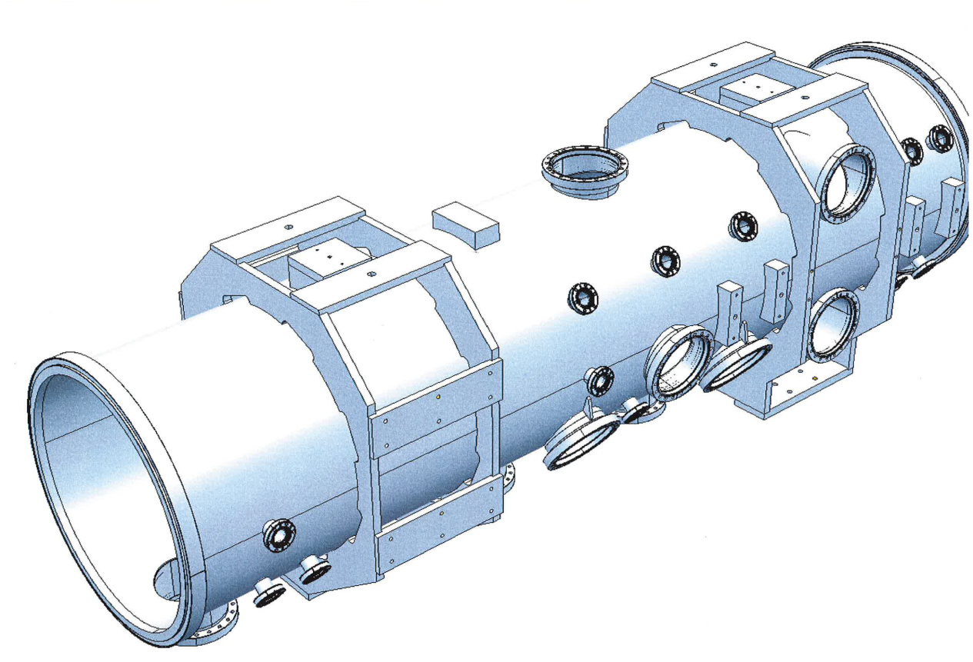
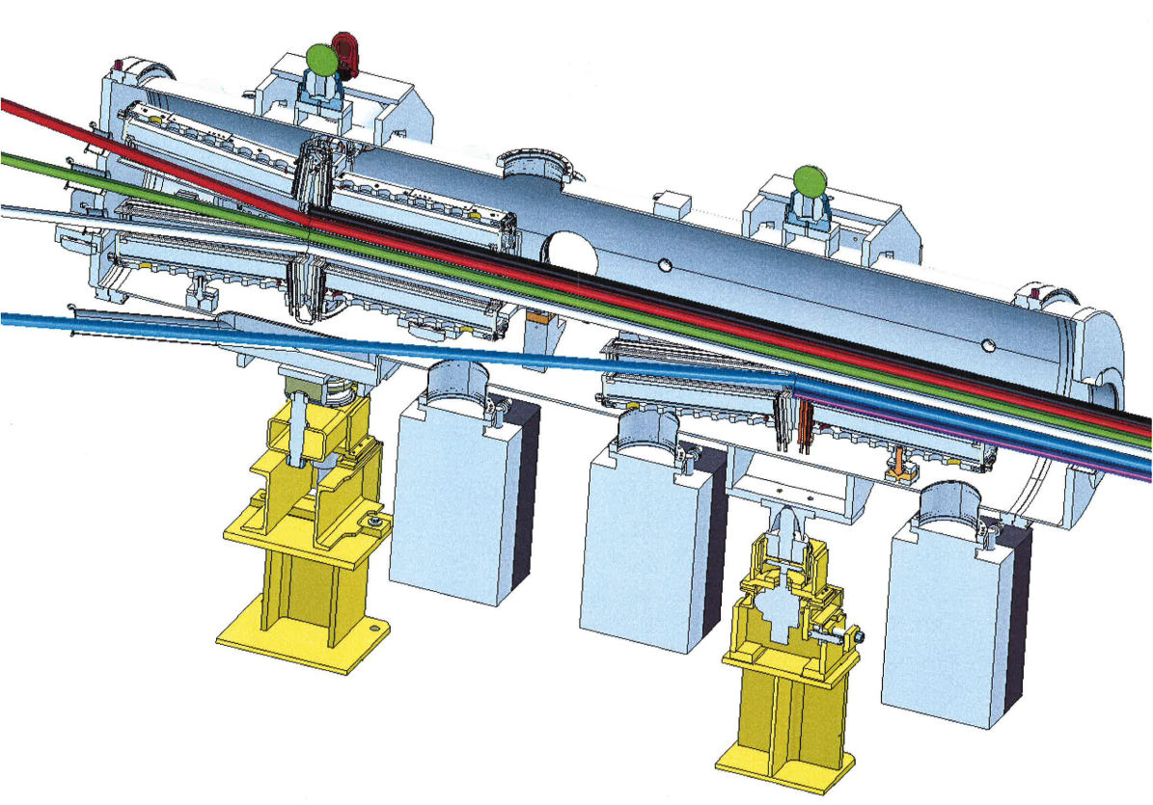
Dumps space & layout
Head
Tail
M. Delonca May 31, 2012 4

Slide 5
Loading cases
EDMS 963395
* Following discussion with C. Carli, K. Hanke and M. Vretenar about possible LLRF incident.
Worst case scenario: accident on the Head dump
BUT
Interception are possible during normal beam operation * → 2 more cases were considered and studied for the Head dump
--
--
--
Operation:
Three loading case:
(1) accident
(2) constant beam
(3) prolonged accident
1 full Linac 4 pulse → Transient
Before every beam pulse → Steady-state
At the beginning of every beam pulse, one week duration once per year → Steady-state
M. Delonca May 31, 2012 5

Slide 6
Loading cases
In Steady-state operation, low power:
No active cooling is foreseen to be necessary
Passive cooling by radiation only.
M. Delonca May 31, 2012 6

Slide 7
Additional consideration
Several aspects must be considered
Space constraint
Induced temperature and stresses
Vacuum
Activation
Fire risk
Electrical risk
Graphite R4550
M. Delonca May 31, 2012 7

Slide 8
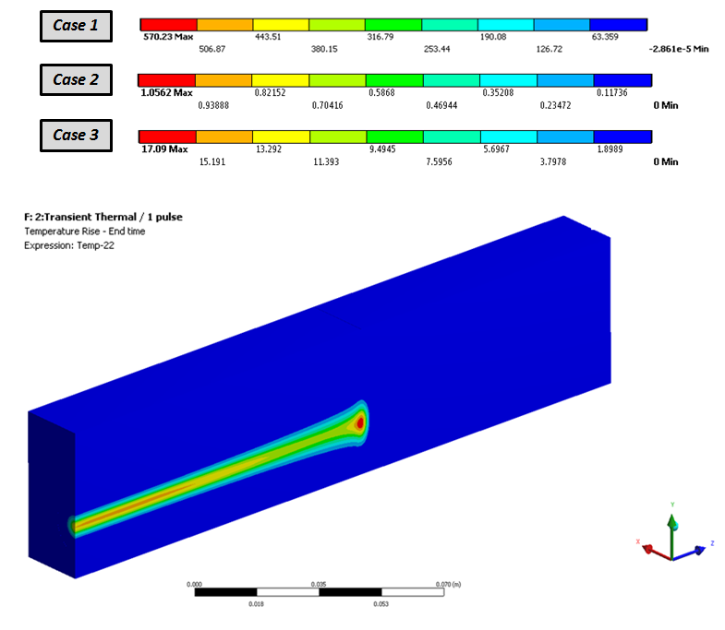
Instantaneous T
Half dump LEFT view
Maxi serv. Temperature to be defined based on degassing tests.
Standard use at CERN:
22 to 1 000°C with bake-out and appropriated pumping.
beam
M. Delonca May 31, 2012 8

Slide 9
Proposed simplified attached system
1 pulse
Limit in compression: 125 MPa
Maxi deflection allowed: 0.5 mm
(guess)
M. Delonca May 31, 2012 9

Slide 10
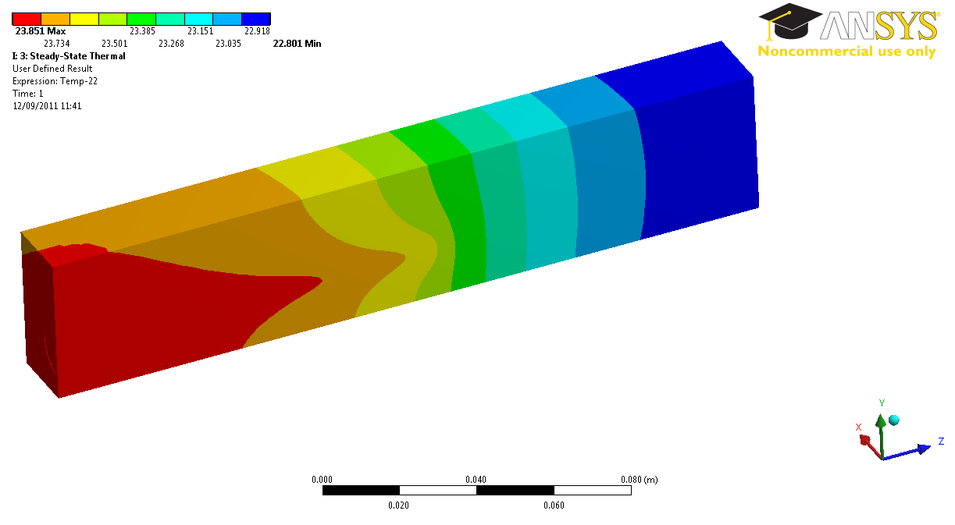
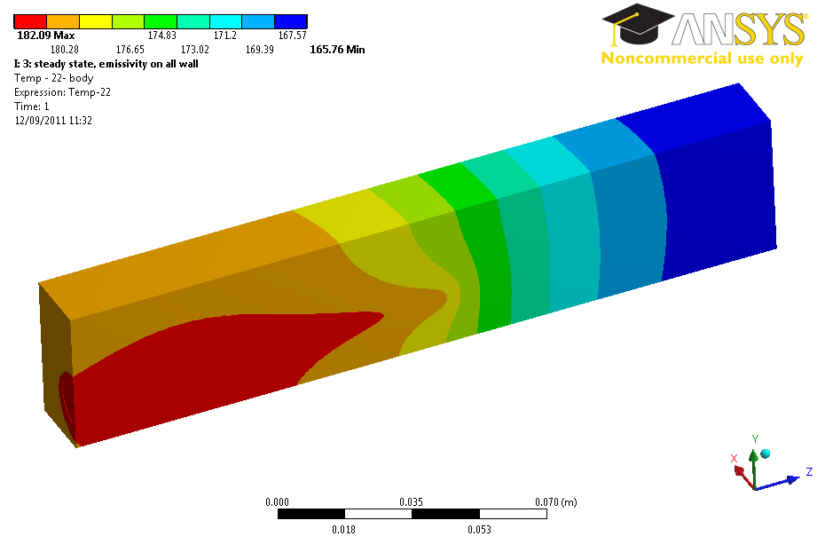
Steady operation
Passive cooling by radiation only
Case 2: After 1 h 50 min
~ 40 μm expansion (case 2)
Case 3: After 40 min
M. Delonca May 31, 2012 10

Slide 11
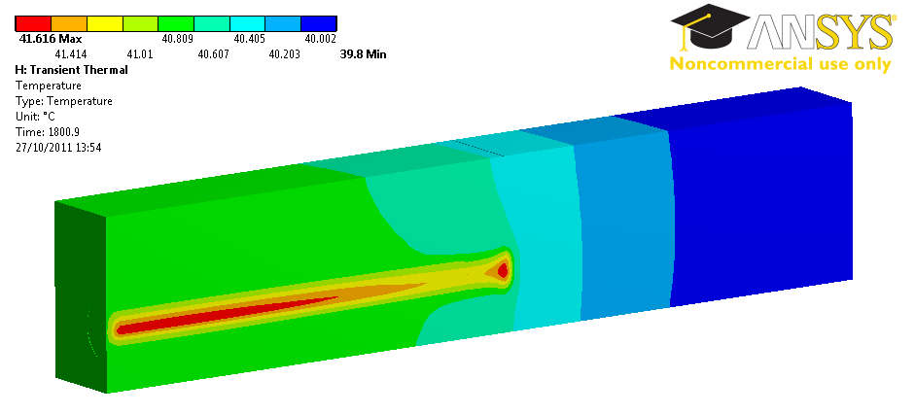
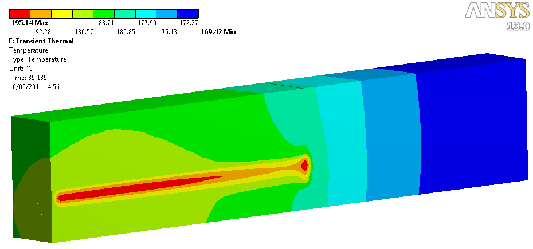
steady operation + ∆T
Passive cooling by radiation only
Case 2: After 1 h 50 min
~ 40 μm expansion (case 2)
Case 3: After 40 min
Limit in compression: 125 MPa
Maxi deflection allowed:
0.5 mm
Advised to used support type (A) or (B)
M. Delonca May 31, 2012 11

Slide 12
Conclusions and open questions
        The analyses have been done based on up-to-date specs : temperatures and stresses are not an issue
        Support type A or B are preferred
        Detailed study can be done ONLY when the support is defined
Open questions:
        Support?
        Bake-out?
        Name of the device?
M. Delonca May 31, 2012 12

Slide 13
Thank You
Melanie Delonca ‹
EN/STI-TCD b

Slide 14


Slide 15
Dear all,
After discussion at the Linac4 core meeting this morning I propose the following specifications for the head dump.
Beam hitting the head dump is divided in 2 contributions, a "constant" beam (data from Alessandra) and an "occasional accident" beam (corresponding to our discussions).
1. constant beam: 0.5 mA during 50 us before every beam pulse, max. repetition frequency 1.11 Hz.
2. occasional accident: 20 mA during 20 us at the beginning of every beam pulse, max. 1.11 Hz, "from time to time".
After the discussion, I would propose to take "from time to time" = "one week duration once per year". To be revised if we see that the activation is too high.
I draw your attention to the fact that the beam current for the occasional accident is only 20 mA; we would be crazy to send the full current to the booster if we have a LLRF accident.
Cheers,
Maurizio

Slide 16
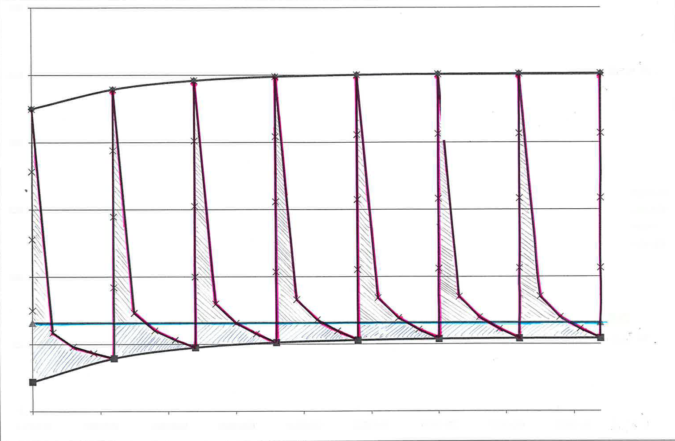
Steady State + ∆T
Steady State

