Slide 1
Telemetry Data List
S.Torii
Waseda University
& JAXA/SEUC
May 23-25, 2012
CALET/ M&S Meeting ＠NASA/GSFC

Slide 2
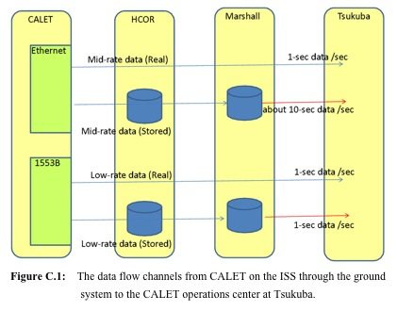
Premised Information
A) Telemetry System
Mid-rate data: Ethernet 300 kbps HK + Science Data
Low-rate data: MIL-STD1553B 20 kbps HK + Samples SD

Slide 3
B) Data Format
Mid-rate data:
1) UDP/IP format UDP Header ( Ethernet II - frame data)
used for JAXA link via DRTS with ICS as a backup of NASA link
2) CCSDS format (Default ) CCSDS Header (IEEE802.3- frame data)
used for NASA link via TDRS
These two formats are exactly same except the frame header in each packet for communication parameters.
Low-rate data
Following to the MIL-STD1553B, the data packet is organized:
16bit / word & 32 words /packet
The first data in each packet is ID for the payload (=38h)
DATA List
The data list is commonly used in the data formats for giving the
details of data structure.

Slide 4
C) Data Category
Constant Timing Data ( /s)
HK, Status, GBM (TH, PH data)
Trigger Timing Data
Calorimeter Event Data with Trigger Hit Pattern
1) Single , Low Energy, High Energy
2) Heavy Ions ( without energy threshold)

Slide 5
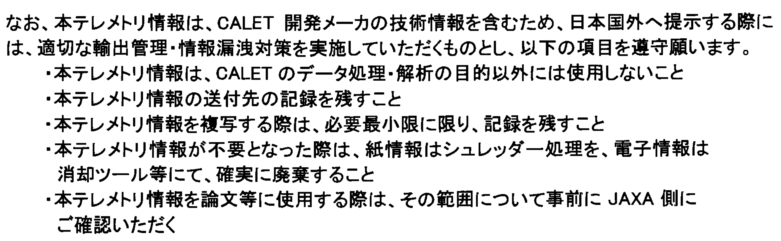
Protection of Privileged Information
Do NOT use this document except for CALET data analysis
Keep the addressee of this document
Keep the record of copying this documents, and try to minimize the pages
Destroy this document with a shredder for the paper version or erase the
data for the electric version
Confirm to JAXA in advance about the contents if you will use information
in this document

Slide 6
