Slide 1

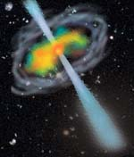
The CALET Gamma-ray Burst Monitor (CGBM): observation and instrumentation
Kazutaka Yamaoka
(Waseda University/JAXA)
Just moved from Aoyama Gakuin Univ.

Slide 2
Outline
1. Introduction of CGBM
2. Gamma-ray Burst (GRB) observations with CALET
3. CGBM instrumentation
  3.1 Sensors
  3.2 Electronics Box (E-box)
4. Testing the Bread Board Model (BBM)
5. Summary

Slide 3
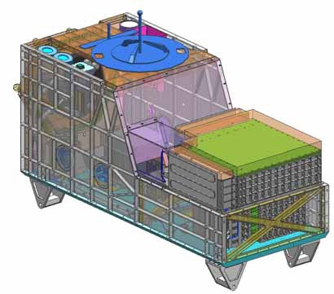
1. CALET Gamma-ray Burst Monitor (CGBM)
SGM
CAL
HXM
CALorimeter (CAL)
  Electrons: 1 GeV – 20 TeV
  Gamma-rays: 10 GeV – 10 TeV
  Protons and Heavy ions
  several 10 GeV – 1000 TeV
Gamma-ray Burst Monitor (CGBM)
  Energy range: 7 keV – 20 MeV
  Hard X-ray Monitor (HXM): 7 keV – 1 MeV
  Soft Gamma-ray Monitor (SGM): 100 keV – 20 MeV
  Targets: Gamma-ray Burst (GRB) , Soft Gamma Repeater (SGR), solar flares, bright X-ray sources

Slide 4
2. GRB observations with CALET (I)
①Simultaneous broadband coverage with CAL (GeV-TeV), CGBM (keV-MeV), and ASC (Advanced Star Camera: optical)
Parameters | CAL | CGBM
Energy | several GeV- 10 TeV (GRB trigger) | HXM: 7keV– 1MeV (Goal 3 keV--3 MeV) SGM: 100keV– 20MeV (Goal 30keV-30MeV)
Effective area | ~1000 cm² | 68 cm² (2 HXMs), 82 cm² (SGM)
Angular resolution | 2.5 deg@1 GeV, 0.4 deg@10 GeV | No localization capabilities by CGBM itself, but the IPN localization is possible
Field of view | ~45 deg.(~2 str.) | ~π str. (HXM), ~4π str. (SGM)
Dead time | ~1.8 ms | ~30 us
Time resolution | 62.5 us | GRB trigger：62.5 us (Event-by-event data) Normal mode:1/8 s with 8 channels and 4 s with 512 channels (Histogram data)

Slide 5
Comparison with EGRET, AGILE, and Fermi
 | Energy | Effective area (cm²) | FOV | Angular resolution (68%) | Dead time
CGRO /EGRET | 20 MeV-30 GeV | 1500 | ~0.5 str. | 5.5 deg.@100 MeV 1.3 deg @1 GeV 0.5 deg @10 GeV | ～100 msec
AGILE /GRID | 30 MeV - 50 GeV | 540 | ~2.5 str. | 4.7 deg @100 MeV 0.6 deg @1 GeV 0.2 deg @10 GeV | ～200 us
Fermi /LAT | 20 MeV - 300 GeV | ~3000 @100 MeV ~7000 @1 GeV ~8000 @10 GeV | ~2.4 str. | 3.5 deg @ 100 MeV 0.5 deg @ 1 GeV 0.1 deg @ 10 GeV | ~27 us
CALET /CAL | Several GeV – 10 TeV | ~1000 | ~ 2 str. | 2.5 deg @ 1 GeV 0.4 deg @ 10 GeV 0.2 deg @ 100 GeV | ~1.8 ms

Slide 6
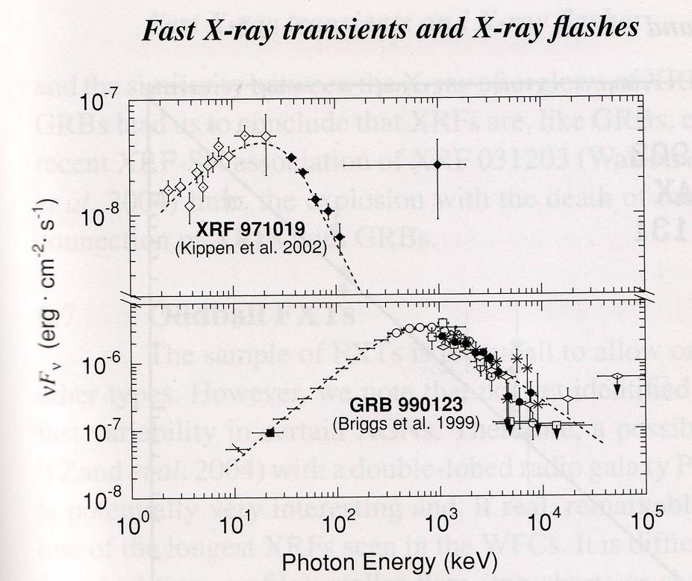
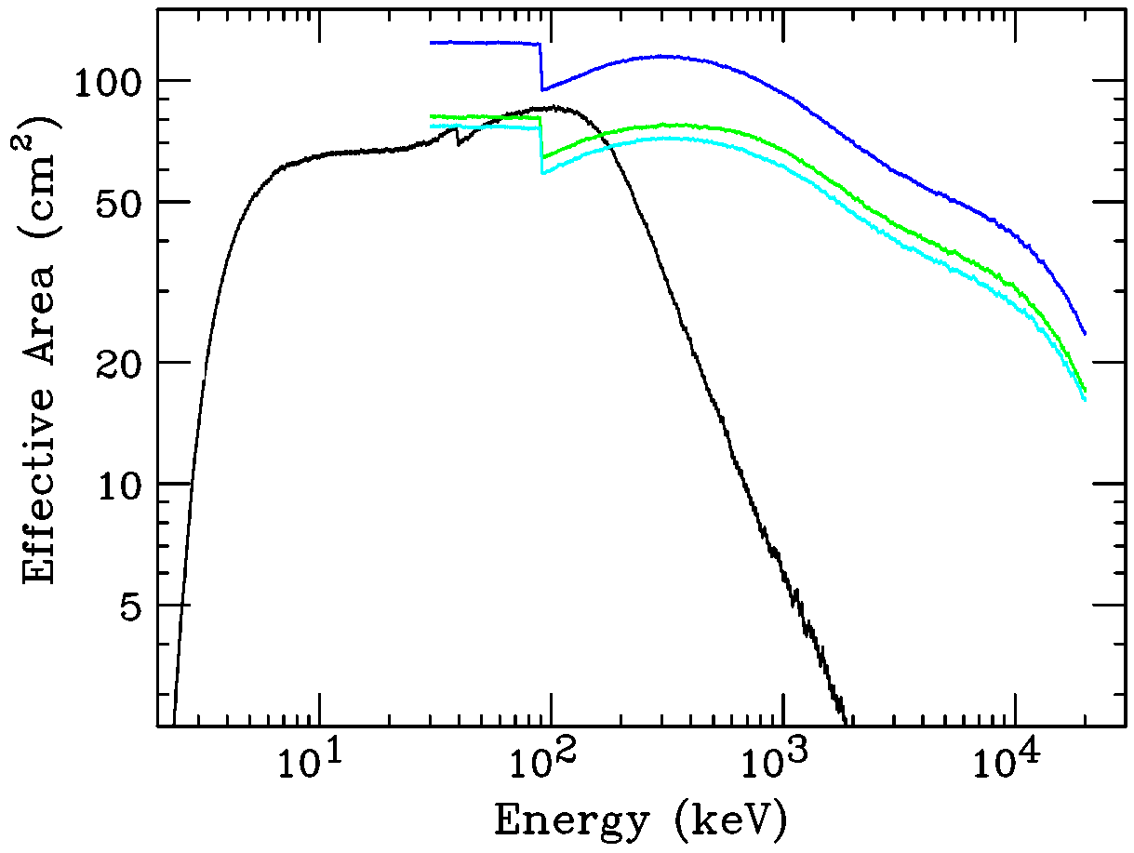
2. GRB observations with CALET (II)
②Study of X-ray flashes (XRFs) and low energy portion of normal GRBs with CGBM and MAXI/GSC (2—30 keV).
③Study of absorption features at at 20-30 keV seen by Ginga/GBD.
The CGBM effective area is comparable to that of Ginga/GBD (~60 cm²). We will expect to detect -40 GRBs/year by HXM and -80 GRBs/year by SGM.
XRF
CGBM
MAXI
Normal GRB
HXM
SGM
7 keV – 20 MeV

Slide 7
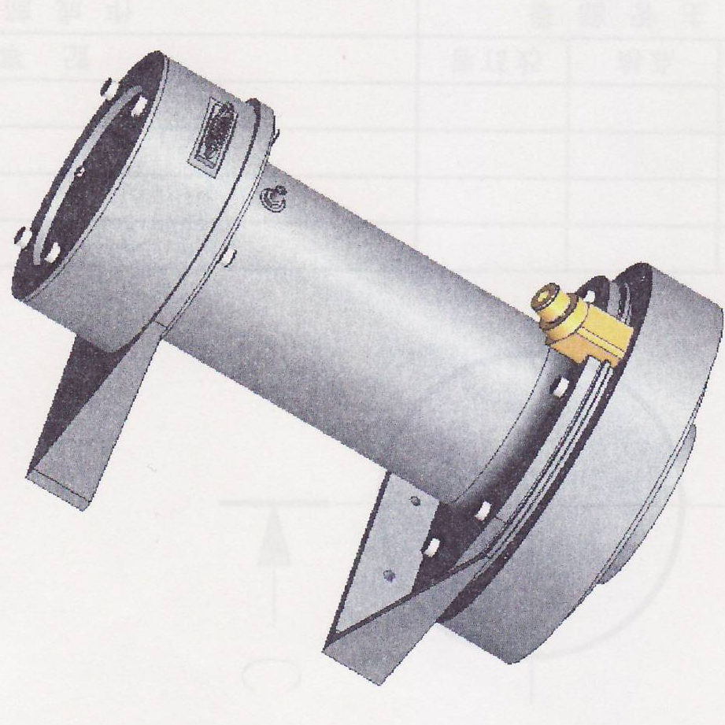
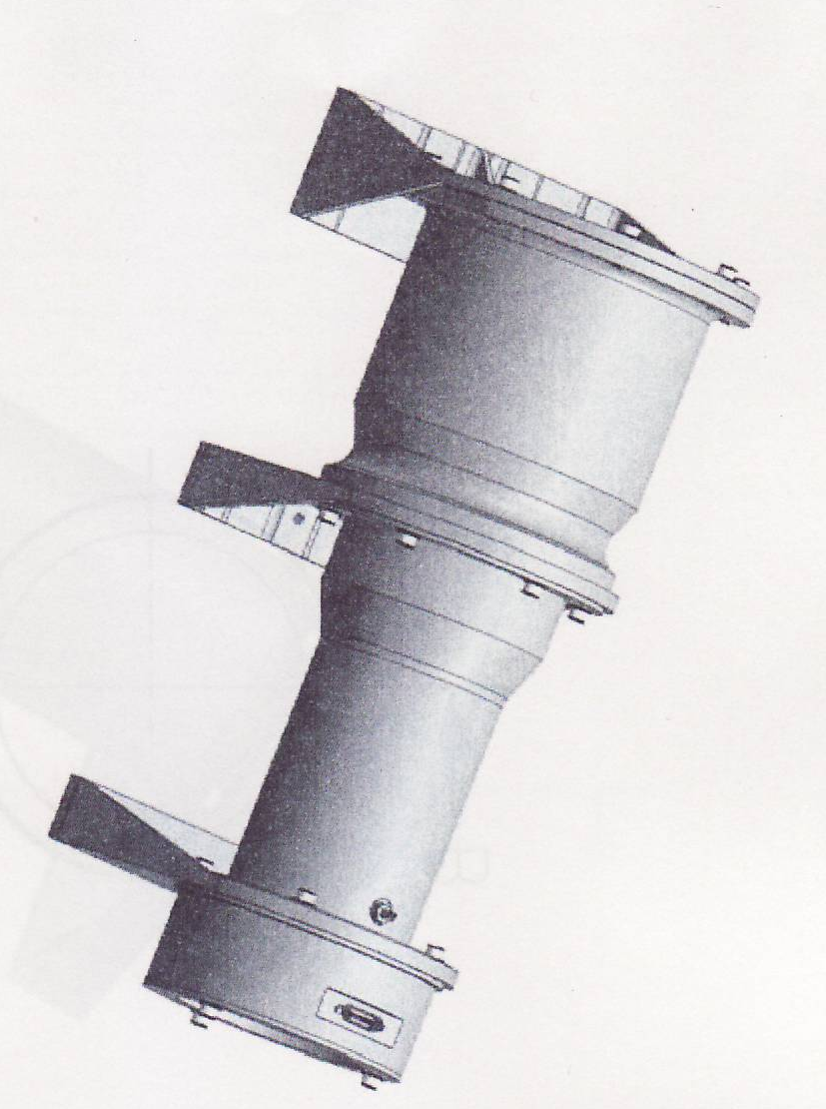
3.1 CGBM instrumentation – Sensors –
  2 Hard X-ray Monitors (HXMs)
    LaBr₃(Ce) (φ66 mm x 0.5 inch)
    with a 410 um thick beryllium
    window by Saint Gobain Crystals.
    This crystal is used in GRB
    observations for the first time.
    Hamamatsu 2.2-inch PMT R6232-05
    High voltage divider and charge-sensitive amplifier
  Soft Gamma-ray Monitor (SGM)
    BGO (φ4 inch x 3 inch) + Light guide
    by OKEN Co Ltd.
    Hamamatsu 3-inch PMT R6233-20

Slide 8
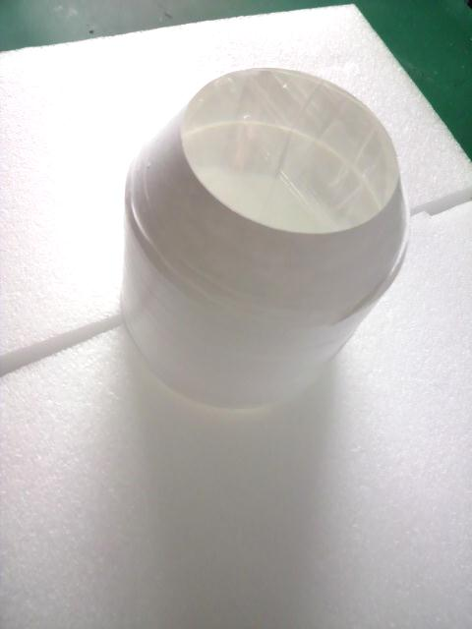
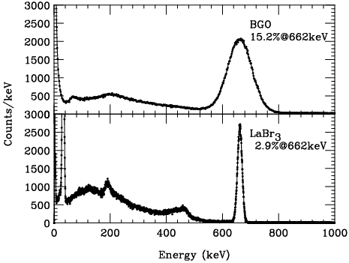
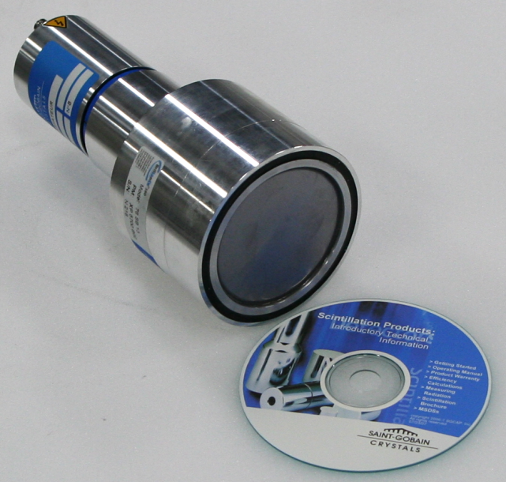
Performance Test of proto-type sensors
¹³⁷Cs spectra
BGO
Both proto-type sensors show
a good performance.
LaBr₃ (Ce)

Slide 9
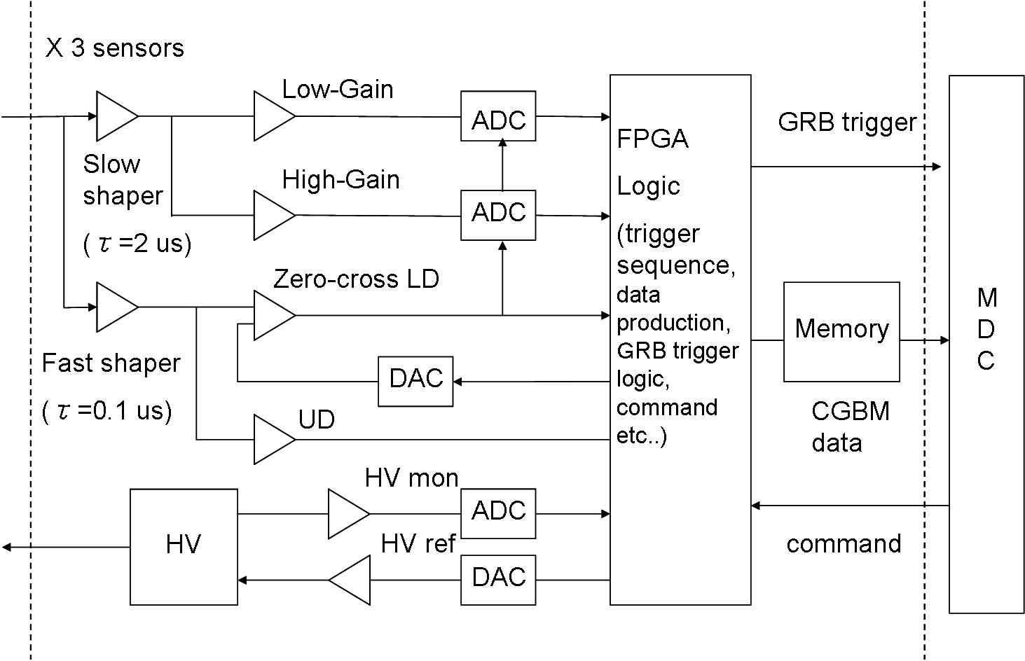
3.2 CGBM instrumentation – Electronics box –
  processes signals from 3 CGBM sensors
  Analog part: amplifiers with a wide dynamic range, peak detection circuit, LD and UDs
  Digital part: ADC, FPGA (e.g. GRB trigger system) ,
  10-Mbyte Memory (GRB data accumulation)
  High Voltage (SITAEL S9099)
E-box
Mission Data
Controller (MDC)
Sensors

Slide 10

GRB trigger logic and CGBM Data
GRB trigger logic is realized by the hardware
CGBM Data Types
ΔBg
Bg
Δｔ
Data | Event-by-event data | Monitor data PH TH
Time resolution | 62.5 us | 4 s | 1/8 s
Energy Channels | 4096 x 2 gains | 512 | 8
Time spans | Total 1.5x10⁶ events (~500 s) | Anytime

Slide 11
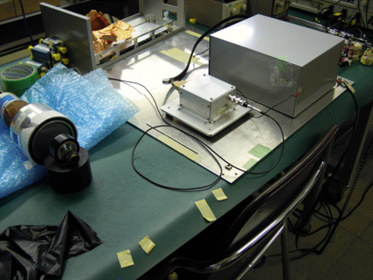
4. Bread Board Model (BBM) of the CGBM E-box
BBM of the FEC (including pre-amplifiers) and E-box has been manufactured by IHI Aerospace and Mitsubishi Precision Co Ltd.
GBM-EBOX
SGM-FEC
LaBr₃ sensors
+ lens (²³²Th)

Slide 12
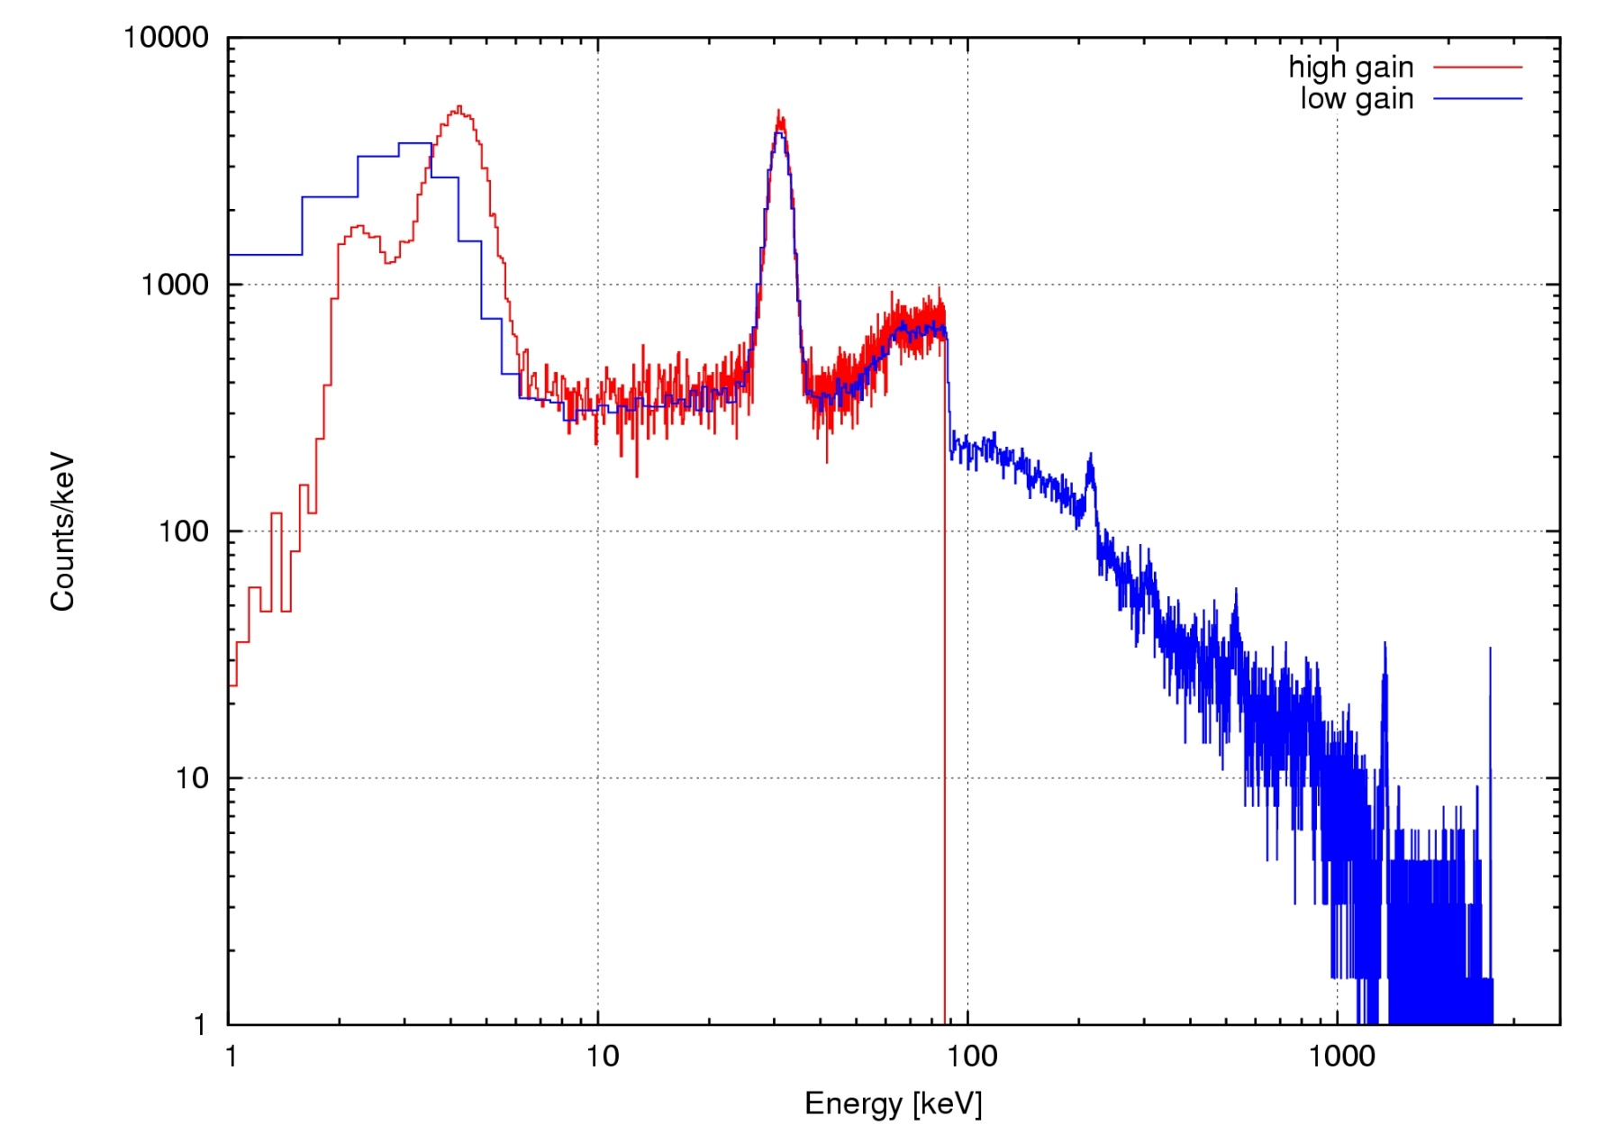
4. BBM of the CGBM E-box
– performance –
We have successfully obtained a broadband spectrum from 4.6 keV (Ba L_{X}) X-rays to 2614 keV (²⁰⁸Tl) gamma-rays.
This energy range
almost satisfies with our specification.
Performance test under a high counting rate has been just finished .
High Gain
¹³⁸La 1438 keV + ⁴⁰K 1461 keV
Low Gain
²⁰⁸Tl 2614 keV
Ba-L_{X} 4.6 keV
Ba-K_{X} 32.1 keV
1
10
100
1000
Energy (keV)

Slide 13
5. Summary
The CALET Gamma-ray Burst Monitor (CGBM) is the second scientific instrument on the CALET mission to support GRB observations with Calorimeter.
To obtain a very broad band spectrum from optical to GeV-TeV gamma-rays, the CGBM is designed to have a wide energy range of 7 keV – 20 MeV (Goal: 3 keV – 30 MeV) using LaBr₃(Ce) and BGO crystals.
A LaBr₃ (Ce) crystal is used for GRB observations in space for the first time.
The BBM model has been developed, and now being tested. We could successfully obtain a broadband spectrum in the 3 keV—3 MeV for LaBr₃ (Ce). The flight model will be manufactured next year.

Slide 14
CGBM Specification
CGBM | HXM | SGM
Detector | LaBr₃(Ce)＋PMT | BGO +PMT
Size | Φ6.6cm x 1.27cm t | Φ10.2cm x 7.6cm t
Number | 2 | 1
Energy (Goal) | ~7 keV – 1 MeV (3 keV to 3 MeV) | ~100 keV – 20 MeV (30 keV to 30 MeV)
Effective Area (cm²) | 68 cm² for two | 81 cm²
Energy Resolution | ~3%@662 keV | ~15%@662 keV
GRB position determination | No localization capability by CGBM itself, but localized by Interplanetary Network (IPN) .
Field of View | ~60 deg. (~π str.) | ~4pi str.
Time resolution | GRB trigger： 62.5 us (Event data) Normal mode: 1/8 s or 4 s (Monitor data)

