Slide 1
Gamma-ray observation with CALET
Masaki Mori
Ritsumeikan University
CALET M&S meeting, GSFC, May 23-25, 2012

Slide 2
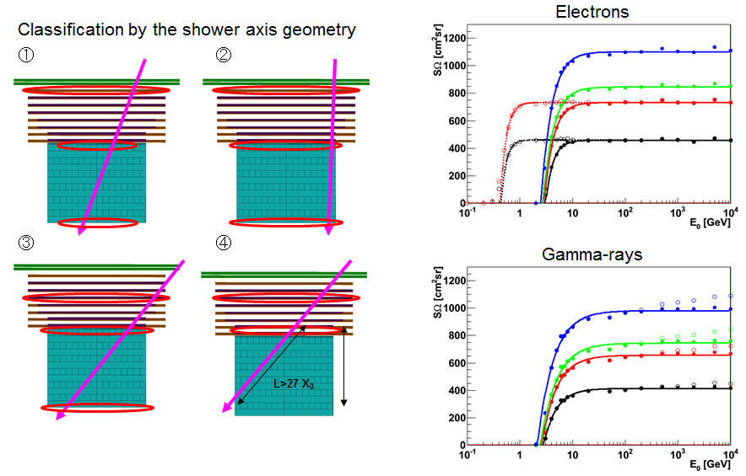
Gamma-ray simulation by Akaike-san
Geometry A
Geometry B
Geometry C
Geometry D
D
C
B
A

Slide 3
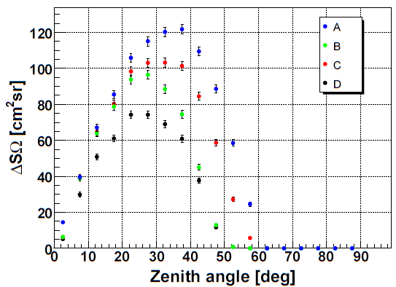
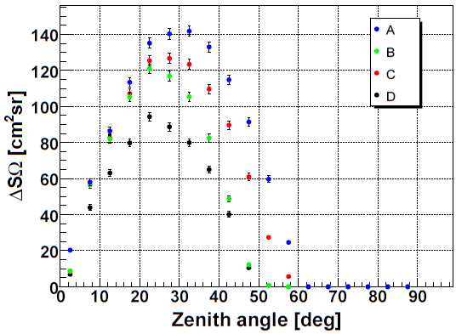
Gamma-ray detection area vs θ_{z}
10GeV
1TeV
D
C
B
A
D
C
B
A
Simulation by Akaike-san
(These plots are rather obsolete: should be updated!)
↓
Exposure has been calculated taking account of the ISS orbit

Slide 4
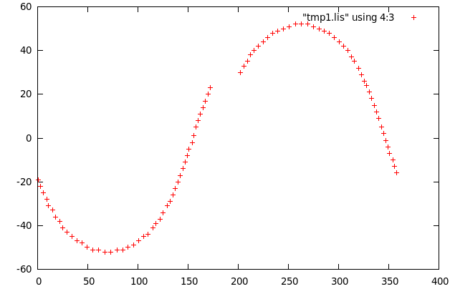
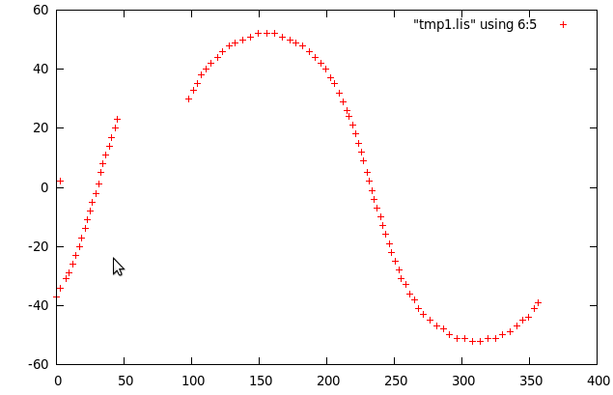
From ISS location to celestial point
ISS locations (loci in 90min)
Latitude
Declination
Longitude
Right ascension
(Assuming CALET is directed to zenith)

Slide 5
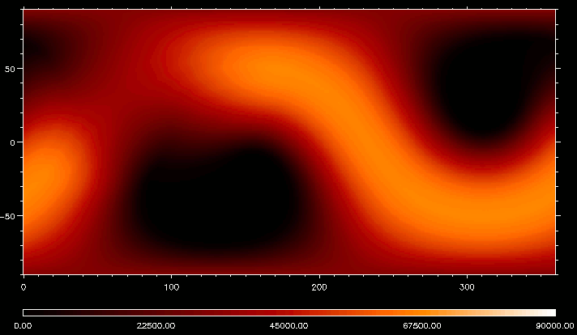
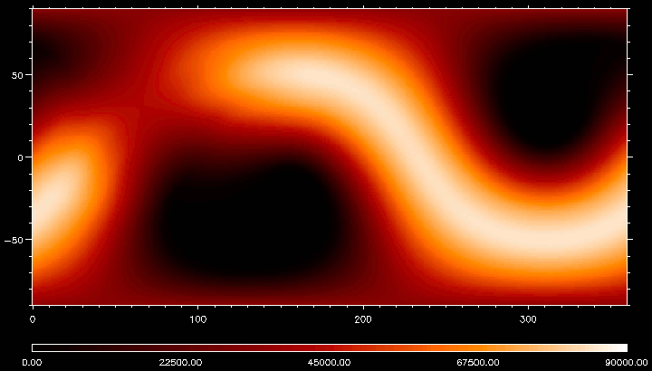
Exposure: 90min
Geometry: D
1deg x 1deg grid in R.A. and Decl.
Incl. zenith angle dependence
Preliminary
10 GeV 1 TeV
Declination
Right ascension

Slide 6
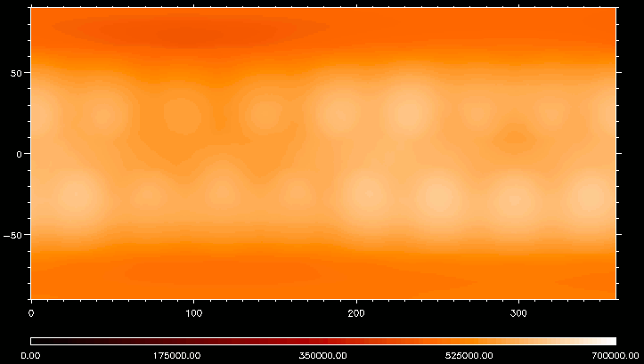
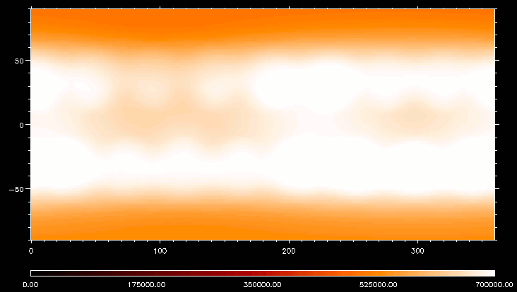
Exposure: 1day
Geometry: D
1deg x 1deg grid in R.A. and Decl.
Incl. zenith angle dependence
Preliminary
10 GeV 1 TeV
Declination
Right ascension
Almost flat exposure within 60deg from equator

Slide 7
Minimum detectable flux
Preliminary
SΩ ≈ 1000 cm²sr (>10GeV)
Angular resolution:
0.24 ~ 0.76° → Almost background free
5events-in-1yr flux:
5/(S*Ω/4π*1yr) ≈ 2.0×10⁻⁹ cm⁻²s⁻¹
For E^{-2.5}dE spectrum:
dN/dE = AE^{-2.5} = 3.0×10⁻⁹E⁻¹ cm⁻²s⁻¹GeV⁻¹
E²dN/dE = 3.0×10⁻⁹E cm⁻²s⁻¹ = 4.8×10⁻¹²E erg cm⁻²s⁻¹

Slide 8
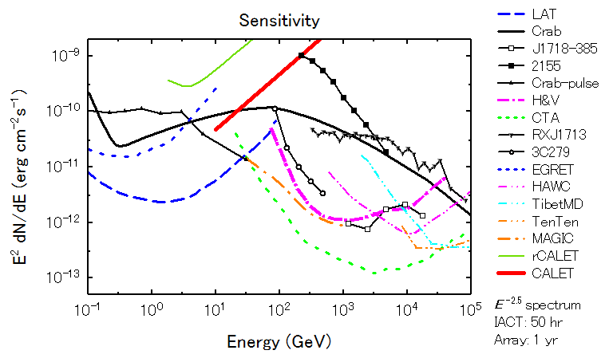
Comparison of sensitivities
(fit)
HESS/VERITAS
(Lines: sensitivities, Points: observed fluxes)

Slide 9
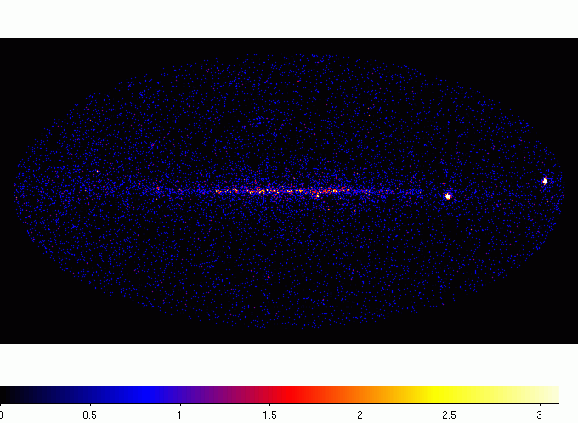
Toy simulation
Vela
Geminga
Crab
PSR J0007
PKS2155
Tool “gtobssim” in Fermi-LAT Science Tools (PSF is that of Fermi-LAT)
>10 GeV, CALET 3yr ( = LAT 5E6 sec, 1/19 in SΩ)
289 point sources significant in 10GeV band of 1FGL catalog

Slide 10
Gamma-ray analysis software for CALET
Adaptation of Fermi-LAT software
  LAT: tools are written in C++ / python
  LAT: most parameter files are in FITS format
  Interface (ROOT/FITS) needed!
LAT-base software may be useful also for electrons / protons / nuclei…
  Event / time selection
  Livetime / exposure calculation
  Display??

Slide 11
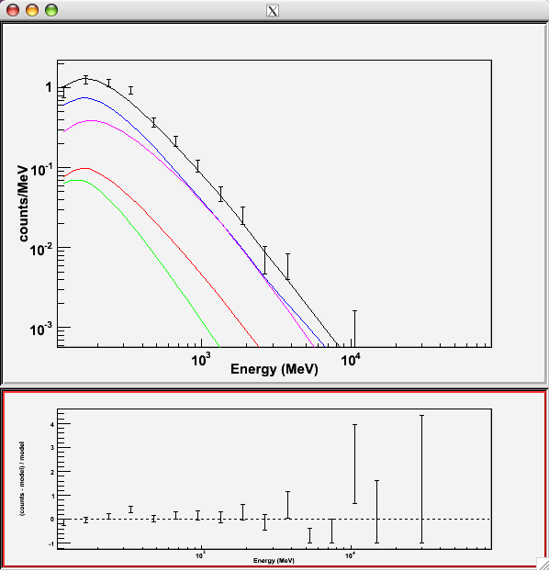
LAT: source fitting with “gtlike”
Resulting energy spectra
Event data
Likelihood fit
Source model
Background
Galactic diffuse
Isotropic
Foreground
Point sources
modeleditor
(GUI)
Catalog sources
Scaled in fitting
Least-square fitting routines: MINUIT etc.

Slide 12
To do list (gamma-rays)
More realistic simulation in ISS orbit
  Other acceptance types
More realistic simulation for point-source and diffuse source observation taking account of Fermi-LAT results
Modification of Fermi-LAT software for CALET
  ROOT/FITS interface

