Slide 1
CALET Instrument Response and Trigger Variable Definition
John Krizmanic CRESST/USRANASA/GSFC
Purpose: Develop a meaningful naming convention for the CALET instrument response variables (photo-detector sensitivity, electronics gain, etc.) that unambiguously defines the response of each unique data/electronics channel as part of the methodology of transforming simulated CALET response into a format that matches the flight data format.
Ref Docs: CALET_InsResponse_Variables-DRAFT2.xls, CALETinstrumentResponseModel-draft2.docx
Mapping of E_{Dep} into light @ photo-detectors
Forming of electronic response per channel.
Physics Simulations
Forming Trigger
Requirements:
Accurate Mass Model.
Robust Physics Modeling.
Requirements:
Individual triggers based upon flight trigger implementation.
Requirements:
Detector Specific.
Positional dependent.
Method needs to be able include calibration data.
Requirements:
Electronics-Channel Specific.
Method needs to be able include variations from ideal response.
Output given as both signal value and ADC value.

Slide 2
CALET Electronic Sub-systems
Based upon signalflow_trigger_pwo.pdf
CHD-PMT: Assumptions: 14 Scintillator paddles/layer; 2 layers with PMT readout; one PMT per Paddle; Layer Numbering: i = 1 -> 2; Paddle Numbering: j = 1 -> 14.
IMC-PMT: Assumptions: 448 Scintillating fibers/layer; 16 layers with MaPMT readout; one fiber per MaPMT anode channel; Layer Numbering: i = 1 -> 16; Fiber Numbering: j = 1 -> 448.
TASC-PMT: Assumptions: 16 PWO logs/layer; 1 layer with PMT readout; one PMT per Log; Layer Numbering: i = 1; Log Numbering: j = 1 -> 16.
TASC-PD: Assumptions: 16 PWO logs/layer; 11 layers with PD readout; one PD per Log; Layer Numbering: i = 2 -> 11; Log Numbering: j = 1 -> 16.
TASC-APD: Assumptions: 16 PWO logs/layer; 11 layers with APD readout; one APD per Log; Layer Numbering: i = 2 -> 11; Log Numbering: j = 1 -> 16.

Slide 3
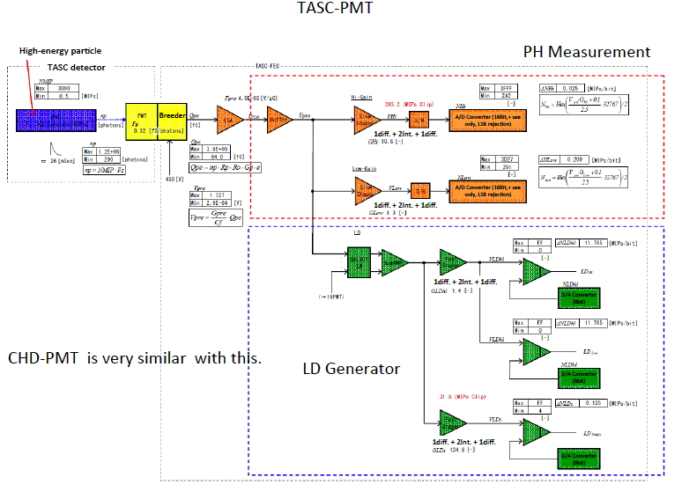
TASC-PMT/CHD-PMT Schematic

Slide 4
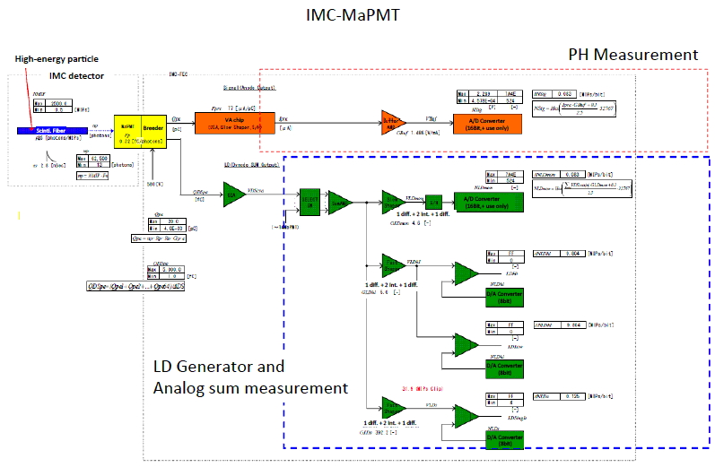
IMC-PMT Schematic

Slide 5
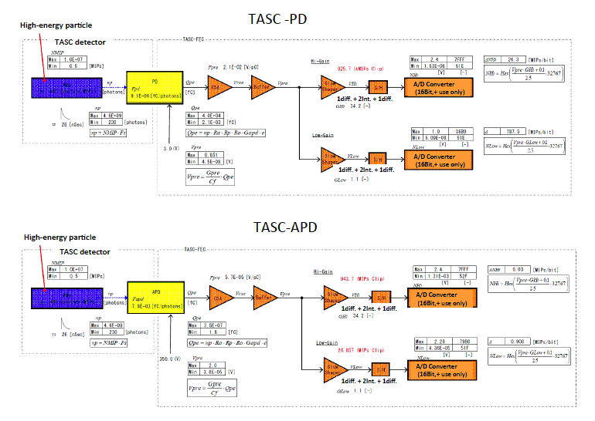
TASC-PD/APD Schematic

Slide 6
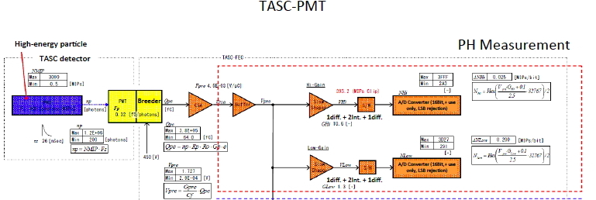
Variable Definition Example: TASC-PMT: Photon Conversion
16 PWO logs/layer; 1 layer with PMT readout; one PMT per Log; Layer Numbering: i = 1; Log Numbering: j = 1 -> 16
Input: | Variable Name | Nominal Value | Units | Equation
Edep to photon conversion (at end of log) | FUNCTION: TASC_EtoPh_ijk |  |  | Need function to convert energy deposition vs position into photons at end of log. For example, the formula can be TASC_np_ij = LY * Σ E_k_ij * ATT_k_ij where LY is the light yield in ph/MeV, E_k_ij is energy deposition in k-th artificial segment of ij log, and ATT is corresponding attenuation.
PWO photons at end of a Log | TASC_np_ij | 19.75 | photons/MeV | NOTE: Reference document has units photons/MIP; use 20.4 MeV/MIP conversion factor.
Instrument Variables:
Area of Pmt | Tpmt_area | tbd | cm^2
Area of PWO log end | Tpwo_area | 4.00E+00 | cm^2
PMT (QE_Eff * Gain) | Tpmt_Fpd_V_j | 0.32 | fC/photon | PMT Sensitivity will be dependent upon Gain/HV (denoted by_V): NOTE: Value taken from Reference document

Slide 7
Variable Definition Example: TASC-PMT: Electronic Gain
Instrument Variables:
Gain of Charge Pre-Amp | Tpmt_Fpre | 4.50E-03 | V/pC
- Hi-GAIN Channel:
Slow Shaper Gain | Tpmt_Ghi | 10.6
Hi-Gain Channel Correction Factor | Tpmt_CorHi_ij | 1
- Low-GAIN Channel:
Slow Shaper Gain | Tpmt_Glow | 1.3
Low-Gain Channel Correction Factor | Tpmt_CorLow_ij | 1

Slide 8
Variable Definition Example: TASC-PMT: Output
Output Channels:
TASC-FEC-PMT-HiGain:
Analog Signal | Tfec_PMT_HiG_ij |  | volts | TASC_np_ij * Tpmt_area/Tpwo_area * Tpmt_Fpd/1000 *Tpmt_Fpre *Tpmt_Ghi * Tpmt_CorHi_ij
ADC Value | Tfec_PMT_HiGadc_ij |  | hex | HEX((Tfec_PMT_HiG_ij+0.1)/2.5 * 32767)/2
TASC-FEC-PMT-LoGain:
Analog Signal | Tfec_PMT_LowG_ij |  | volts | TASC_np_ij * Tpmt_area/Tpwo_area * Tpmt_Fpd/1000 *Tpmt_Fpre *Tpmt_Glow * Tpmt_CorLow_ij
ADC Value | Tfec_PMT_LowGadc_ij |  | hex | HEX((Tfec_PMT_LowG_ij+0.1)/2.5 * 32767)/2

Slide 9
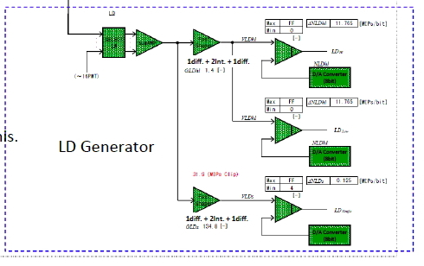
Variable Definition Example: TASC-PMT: Logic Generator
- LD Generator
INPUT SUM of 16 PMT Channels: | Tpmt_Sum |  | volts | Σ_j TASC_np_ij * Tpmt_Fpd * Tpmt_Fpre/1000
- Hi Signal Channel
Hi Signal Channel Gain | Tpmt_LD_GLDhi | 1.4
Hi Signal Gain Correction Factor | Tpmt_LD_Corhi | 1
- Single Particle Signal Channel
Single Particle Channel Gain | Tpmt_LD_GLDs | 134.8
Single Particle Gain Correction Factor | Tpmt_LD_Cors | 1
Hi-Signal LD Channels:
Input:
Hi Level Discriminator Value | Tpmt_LD_DiscHi |  | volts
Low Level Discriminator Value | Tpmt_LD_DiscLow |  | volts
Output:
TASC-LD-HiSignal | Tpmt_LD_Vhi |  | volts | Tpmt_Sum * Tpmt_LD_GLDhi * Tpmt_LD_Corhi
Hi Level Discriminator Flag | iTpmt_LDhi |  | binary | Default = 0; Equals 1 if Tpmt_LDhi >= Tpmt_LD_DiscHi
Low Level Discriminator Flag | iTpmt_LDlow |  | binary | Default = 0; Equals 1 if Tpmt_LDlow >= Tpmt_LD_DiscLow
Single Particle LD Channels:
Input:
Discriminator Value | Tpmt_LD_DiscS
Output:
TASC-LD-Single | Tpmt_LD_Vs |  | volts | Tpmt_Sum * Tpmt_LD_GLDs * Tpmt_LD_Cors
Discriminator Flag | iTpmt_LDs |  | binary | Default = 0; Equals 1 if Tpmt_LDhi >= Tpmt_LD_DiscS

Slide 10
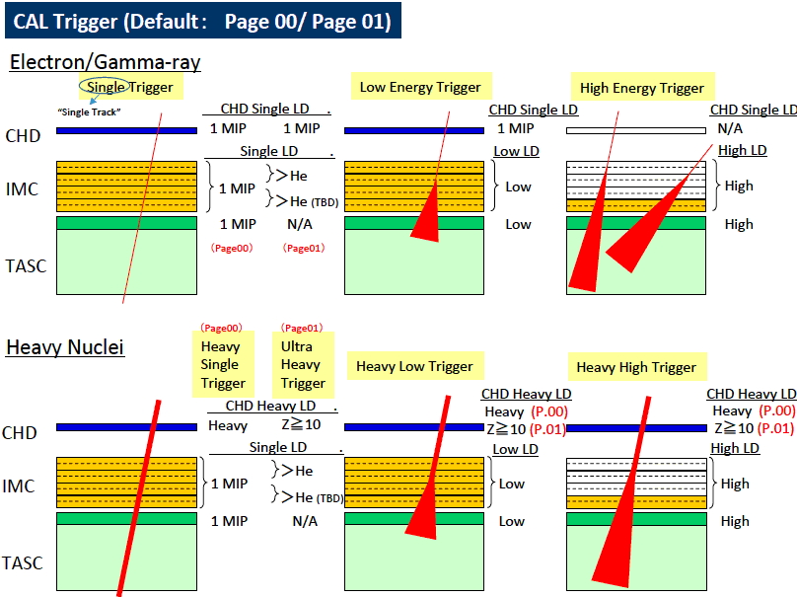
Trigger Definition

Slide 11
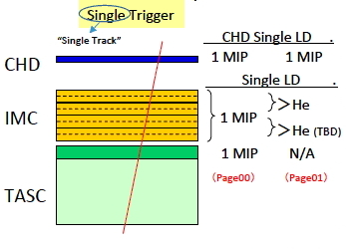
Single Particle Trigger
- CHD Hi Signal Channels: | (i=1,2)
Hi Level Discriminator Channel | iCpmt_LDhi_i
Low Level Discriminator Channel | iCpmt_LDlow_i
- CHD Single Track Channels | iCpmt_LDs_i
Single (Z=1 -> Z=?) Track | Π_i [(iCpmt_LDs_i=1) * (iCpmt_LDlow_i=0) * (iCpmt_LDhi_i=0)] * FIs[(iIpmt_LDs_i=1) * (iIpmt_LDlow_i=0) * (iIpmt_LDhi_i=0)] * (iTpmt_LDs=1) * (iTpmt_LDlow=0) * (iTpmt_LDhi=0)
 | NOTE: will accept He nuclei if (iCpmt_LDlow_i=0), (iIpmt_LDlow_i=0), and (iTpmt_LDlow=0) for Z=2
FIs | Single MIP selection function for IMC: assumption is that a minimum number of layers is required for selection and number is less than total to allow for some layers under threshold

Slide 12
Summary
A detector/electronics channel-dependent naming methodology for the response variables has been developed based upon the initial document describing the CALET electronics.
A initial mathematical formulation of the CALET triggers has been developed based upon the response variable definition and initial CALET trigger descriptions.
Default values will need to be updated as the design matures.
Variables can be replaced by functions (e.g. sampling Poisson/Gaussian distributions) to improve fidelity.
Naming convention allows incorporation of other affects, e.g. detector/electronics noise.
Need to implement version control as quantities, especially correction factors get updated from calibration data.

Slide 13
Open Questions
Parameter | Quoted Value |  | Comments and Questions
PWO Signal (PD Channel) | 460 photons/MIP |  | Using PDG values: 1 MIP in 2 cm of PWO = 20.4 MeV (=1.229 MeV/g/cm^2*8.3 g/cm^3 * 2 cm)
 |  |  | The Particle Data Group gives the PWO light yield as 0.29+0.083 = 0.373 where 100 is that for NaI(Tl)
 |  |  | For NAI(Tl): Light yield is 40,000 photons/MeV
 |  |  | which yields for PWO: 149 photons/MeV (=0.373/100*40,000)
 |  |  | This corresponds to 3044 photons/MIP in 2 cm of PWO (=149*20.4)
 |  |  | 460/3044 = 0.151
 |  |  | Question 1: Is 15.1% the assumed effective light transmission factor for a PWO crystal?
 |  |  | Question 2: Is the area of the photo-detector included in this number?
PWO Signal (APD Channel) | 460 photons/MIP |  | Question3: Since the area of the APD is 1 cm^2 and the area of the PD is (0.24)^2 cm^2, this implies photo-detector area not included in PWO signal value of 460 photons/MIP.
PWO Signal (PMT Channel) | 403 photons/MIP |  | Question4: Why is this different than than the 460 value quoted for the PD and APD PWO channels? Are the PWO bars coupled to PMTs thinner?

Slide 14
Parameter | Quoted Value |  | Comments and Questions
PD gain (Fpd) | 9.1E-6 fC/photon |  | Assumption is that 'photon' refers to PWO generated photon delivered to the end of a PWO bar, the PD area needs to be taken into account in Fpd.
 |  |  | Assuming performance of PD is given by Hamamatsu S1227-33BR (2.4 mm x 2.4 mm)
 |  |  | At 425 nm, photo-sensitivity is ~0.23 A/W; a 425 nm photon corresponds to 2.92 eV (or 4.68E-19 joules)
 |  |  | A photo-sensitivity of 0.23 A/W -> 1.1E-4 fC/DETECTEDphoton
 |  |  | Assuming the end of the PWO crystal is 2 cm x 2 cm, taking into acount the (0.24)^2 cm^2 PD area yields 1.6E-6 fC/PWOphoton
 |  |  | Question5: 9.1E-6 fC/photon is 5.7x larger. Does the PD in the hybrid package have higher photo-sensitivity than 0.23 A/W @ 425 nm?
APD gain (Fapd) | 7.8E-3 fC/photon |  | Assumption is that 'photon' refers to PWO generated photon, e.g. APD area needs to be taken into account in Fpd.
 |  |  | Assuming performance of APD is given by Hamamatsu S8664-1010 (10 mm x 10 mm)
 |  |  | At 425 nm, photo-sensitivity (gain of 50) is ~15 A/W; a 425 nm photon corresponds to 2.92 eV (or 4.68E-19 joules)
 |  |  | A photo-sensitibity of 15 A/W -> 7.0E-3 fC/DETECTEDphoton
 |  |  | Assuming the end of the PWO crystal is 2 cm x 2 cm, taking into acount the 1 cm^2 APD area yields 1.8E-3 fC/PWOphoton
 |  |  | Question6: 7.8E-3 fC/photon is 4.4x larger. Does the APD in the hybrid package have a higher photo-sensitivity than 15 A/W @ 425 nm?

Slide 15
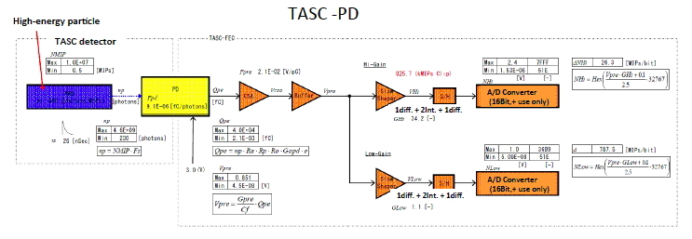
Variable Definition Example: TASC-PD: Photon Conversion
16 PWO logs/layer; 11 layers with PD readout; one PD per Log; Layer Numbering: i = 2 -> 11; Log Numbering: j = 1 -> 16
Input: | Variable Name | Nominal Value | Units | Equation
Edep to photon conversion (at end of log) | FUNCTION: TASC_EtoPh_ijk |  |  | Need function to convert energy deposition vs position into photons at end of log. For example, the formula can be TASC_np_ij = LY * Σ E_k_ij * ATT_k_ij where LY is the light yield in ph/MeV, E_k_ij is energy deposition in k-th artificial segment of ij log, and ATT is corresponding attenuation.
PWO photons at end of a Log | TASC_np_ij | 22.55 | photons/MeV | NOTE: Reference document has units photons/MIP; use 20.4 MeV/MIP conversion factor.
Instrument Variables:
Area of PD | Tpd_area | 5.76E-02 | cm^2
Area of PWO log end | Tpwo_area | 4.00E+00 | cm^2
PD sensitivity | Tpd_Fpd | 6.32E-04 | fC/photon | NOTE: Reference document assumed 9.1E-6 fC/photon which took into account PD area fraction. Value quoted here corrects for area fraction of obtain bare PD sensititity to compare to Hamamatsu performance data (which appears to be 1.08e-4 fC/photon at 425 nm for Hamamatsu S1227-33BR)

Slide 16
Variable Definition Example: TASC-PD: Electronic Gain
Gain of Charge Pre-Amp | Tpd_Fpre | 2.10E-02 | V/pC
- Hi-GAIN Channel:
Slow Shaper Gain | Tpd_Ghi | 34.2
Hi-Gain Channel Correction Factor | Tpd_CorHi_ij | 1
- Low-GAIN Channel:
Slow Shaper Gain | Tpd_Glow | 1.1
Low-Gain Channel Correction Factor | Tpd_CorLow_ij | 1

Slide 17
Variable Definition Example: TASC-PD: Output
Output Channels:
TASC-FEC-PD-HiGain:
Analog Signal | Tfec_PD_HiG_ij |  | volts | TASC_np_ij * Tpd_area/Tpwo_area * Tpd_Fpd/1000 *Tpd_Fpre *Tpd_Ghi * Tpd_CorHi_ij
ADC Value | Tfec_PD_HiGadc_ij |  | hex | HEX((Tfec_PD_HiG_ij+0.1)/2.5 * 32767)
TASC-FEC-PD-LoGain:
Analog Signal | Tfec_PD_LowG_ij |  | volts | TASC_np_ij * Tpd_area/Tpwo_area * Tpd_Fpd/1000 *Tpd_Fpre *Tpd_Glow * Tpd_CorLow_ij
ADC Value | Tfec_PD_LowGadc_ij |  | hex | HEX((Tfec_PD_LowG_ij+0.1)/2.5 * 32767)

Slide 18
 | Variable | Units | Nominal Value | Comments
Input Discriminator Settings:
- TASC Hi Signal Channels:
Hi Level Discriminator Value | Tpmt_LD_DiscHi | volts | >> 1 MIP (tbd)
Low Level Discriminator Value | Tpmt_LD_DiscLow | volts | > 1 MIP (tbd)
- TASC Single Track Channel | Tpmt_LD_DiscS | volts | 0.5 MIP (tbd)
- IMC Hi Signal Channels:
Hi Level Discriminator Value | Ipmt_LD_DiscHi_i | volts | >> 1 MIP (tbd) | i = 1 -> 16
Low Level Discriminator Value | Ipmt_LD_DiscLow_i | volts | > 1 MIP (tbd) | i = 1 -> 16
- IMC Single Track Channels | Ipmt_LD_DiscS_i | volts | 0.5 MIP (tbd) | i = 1 -> 16
- CHD Hi Signal Channels:
Hi Level Discriminator Value | Cpmt_LD_DiscHi_i | volts | >> 1 MIP (tbd) | i = 1 -> 2
Low Level Discriminator Value | Cpmt_LD_DiscLow_i | volts | > 1 MIP (tbd) | i = 1 -> 2
- CHD Single Track Channels | Cpmt_LD_DiscS_i | volts | 0.5 MIP (tbd) | i = 1 -> 2
Output Logic (LD) Channels:
- TASC Hi Signal Channels:
Hi Level Discriminator Channel | iTpmt_LDhi
Low Level Discriminator Channel | iTpmt_LDlow
- TASC Single Track Channel | iTpmt_LDs
- IMC Hi Signal Channels:
Hi Level Discriminator Channel | iIpmt_LDhi_i |  |  | i = 1 -> 16
Low Level Discriminator Channel | iIpmt_LDlow_i |  |  | i = 1 -> 16
- IMC Single Track Channels | iIpmt_LDs_i |  |  | i = 1 -> 16
- CHD Hi Signal Channels:
Hi Level Discriminator Channel | iCpmt_LDhi_i |  |  | i = 1 -> 2
Low Level Discriminator Channel | iCpmt_LDlow_i |  |  | i = 1 -> 2
- CHD Single Track Channels | iCpmt_LDs_i |  |  | i = 1 -> 2

Slide 19
EXAMPLE TRIGGER DEFINITIONs: | Equation | NOTE: This list parses some of the examples given in CALET Trigger & MDC data transfer (T. Tamura)
Single (Z=1 -> Z=?) Track | Π_i [(iCpmt_LDs_i=1) * (iCpmt_LDlow_i=0) * (iCpmt_LDhi_i=0)] * FIs[(iIpmt_LDs_i=1) * (iIpmt_LDlow_i=0) * (iIpmt_LDhi_i=0)] * (iTpmt_LDs=1) * (iTpmt_LDlow=0) * (iTpmt_LDhi=0)
 | NOTE: will accept He nuclei if (iCpmt_LDlow_i=0), (iIpmt_LDlow_i=0), and (iTpmt_LDlow=0) for Z=2
Electron (Low-Energy Shower) | Π_i [(iCpmt_LDs_i=1) * (iCpmt_LDlow_i=0) * (iCpmt_LDhi_i=0)] * FIlow[(iIpmt_LDs_i=1) * (iIpmt_LDlow_i=1) * (iIpmt_LDhi_i=0)] * (iTpmt_LDs=1) * (iTpmt_LDlow=1) * (iTpmt_LDhi=0)
Electron/Gamma (High-Energy Shower) | FIhi[(iIpmt_LDs_i=1) * (iIpmt_LDlow_i=1) * (iIpmt_LDhi_i=1)] * (iTpmt_LDs=1) * (iTpmt_LDlow=1) * (iTpmt_LDhi=1)
Heavy Nuclei - Single Track | Π_i [(iCpmt_LDs_i=1) * (iCpmt_LDlow_i=1)] * FIHeavyS[(iIpmt_LDs_i=1) * (iIpmt_LDlow_i=0) * (iIpmt_LDhi_i=0)] * (iTpmt_LDs=1) * (iTpmt_LDlow=0) * (iTpmt_LDhi=0)
 | NOTE: If (iCpmt_LDhi_i=0) then Heavy (Z<10), if (iCpmt_LDhi_i=1) then UltraHeavy (Z>=10); assumes (iIpmt_LDlow_i=0) and (iTpmt_LDlow=0) for all Z
Heavy Nuclei (Low-Energy Shower) | Π_i [(iCpmt_LDs_i=1) * (iCpmt_LDlow_i=1)] * FIHeavyLow[(iIpmt_LDs_i=1) * (iIpmt_LDlow_i=1) * (iIpmt_LDhi_i=0)] * (iTpmt_LDs=1) * (iTpmt_LDlow=1) * (iTpmt_LDhi=0)
 | NOTE: If (iCpmt_LDhi_i=0) then Heavy (Z<10), if (iCpmt_LDhi_i=1) then UltraHeavy (Z>=10)
Heavy Nuclei (High-Energy Shower) | Π_i [(iCpmt_LDs_i=1) * (iCpmt_LDlow_i=1)] * FIHeavyHi[(iIpmt_LDs_i=1) * (iIpmt_LDlow_i=1) * (iIpmt_LDhi_i=1)] * (iTpmt_LDs=1) * (iTpmt_LDlow=1) * (iTpmt_LDhi=1)
 | NOTE: If (iCpmt_LDhi_i=0) then Heavy (Z<10), if (iCpmt_LDhi_i=1) then UltraHeavy (Z>=10)
Function Description:
Π_i | Product over index i
FIs | Single MIP selection function for IMC: assuption is that a minimum number of layers is required for selection and number is less than total to allow for some layers under threshold
Filow | Low energy shower selection function for IMC: assuption is that a minimum number of layers is required for selection and number is less than total to allow for some layers under threshold
Fihi | High energy shower selection function for IMC: assuption is that a minimum number of layers is required for selection and number is less than total to allow for some layers under threshold
FIHeavyS | Single Track Heavy Nuclei selection function for IMC: assuption is that a minimum number of layers is required for selection and number is less than total to allow for some layers under threshold
FIHeavyLow | Low energy Heavy Nuclei shower selection function for IMC: assuption is that a minimum number of layers is required for selection and number is less than total to allow for some layers under threshold
FIHeavyHi | High energy Heavy Nuclei shower selection function for IMC: assuption is that a minimum number of layers is required for selection and number is less than total to allow for some layers under threshold

