Slide 1
Status of H⁻ / H⁺ source for ELENA
Cosy‘s „IBA source I“ for negative and positive ions
14. 6. 2012 | Ralf Gebel

Slide 2
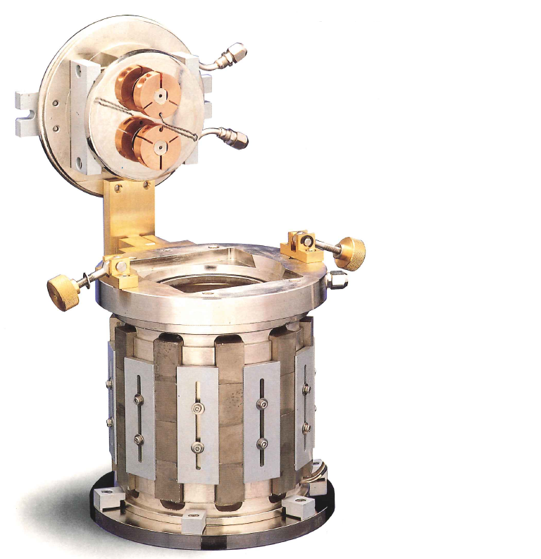
Outline
Ion sources at COSY
The ELENA source
Preparations
Status and outlook
Discussion

Slide 3
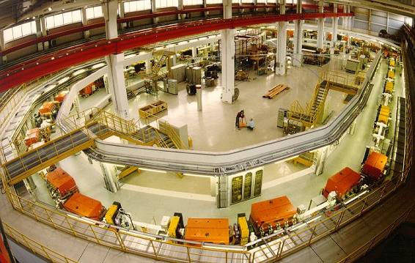
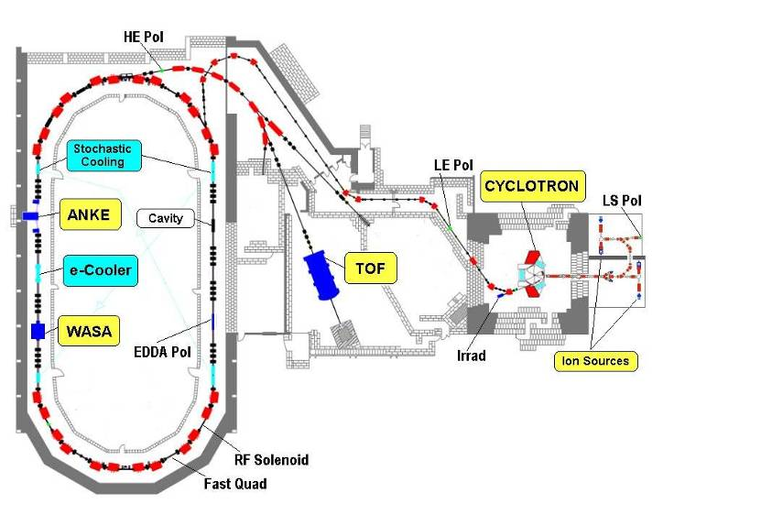
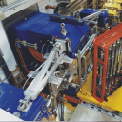
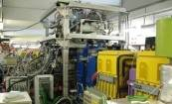
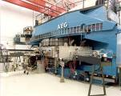
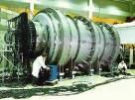
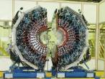
The COSY facility
PAX
Polarized p-, d- beams up to 3.7 GeV/c phase-space cooling

Slide 4
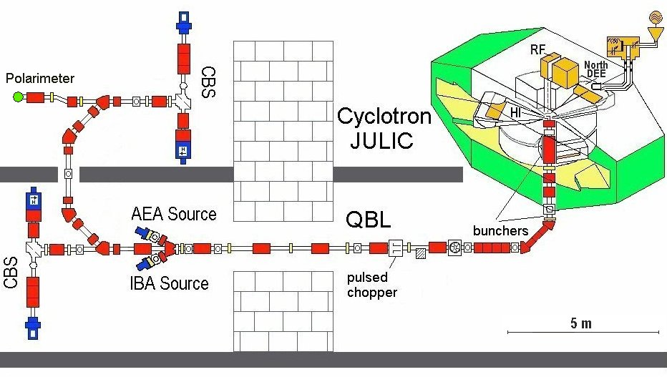
The COSY injector with ion sources
Lamb shift
BR
Wien filter
3 operational ion sources @ 4.5 keV/u (CBS incl. a Cs⁺ source @ ~45 keV)

Slide 5
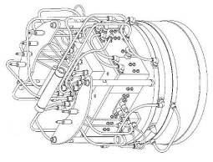
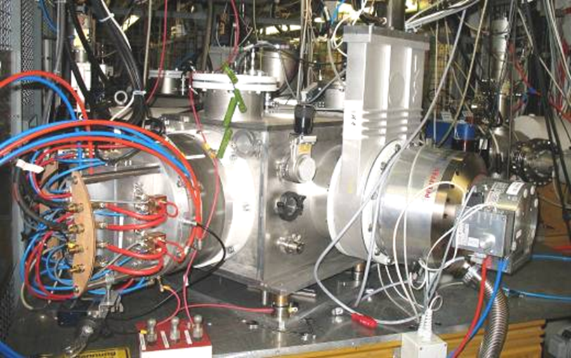
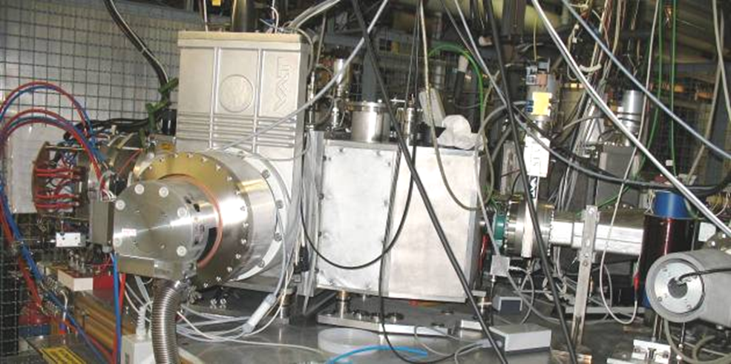
Installation of unpolarized ion sources
2 identical set-ups
AEA/IBA injector for H⁻ and D⁻
Connection to LEBT

Slide 6
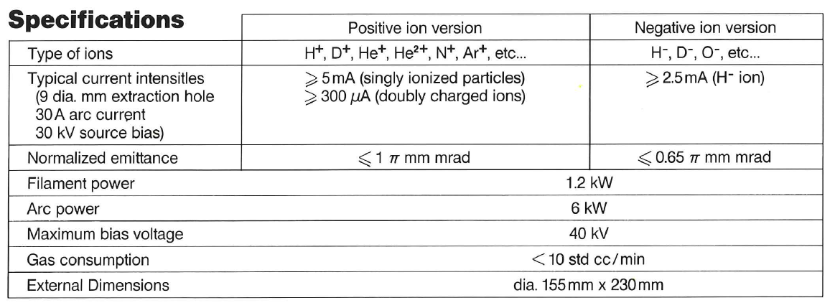
IBA‘s ion source specification
Verified for H⁻ and D⁻ at COSY
At Cosy in operation from 1996 to 2003: ~ 10000 h
Ion source body
Specs from the IBA brochure

Slide 7
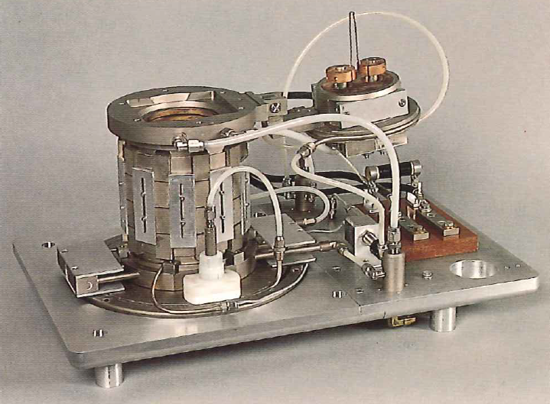
The negative ion source
Filament
PM decapole
Magnetic filter
Puller electrode

Slide 8
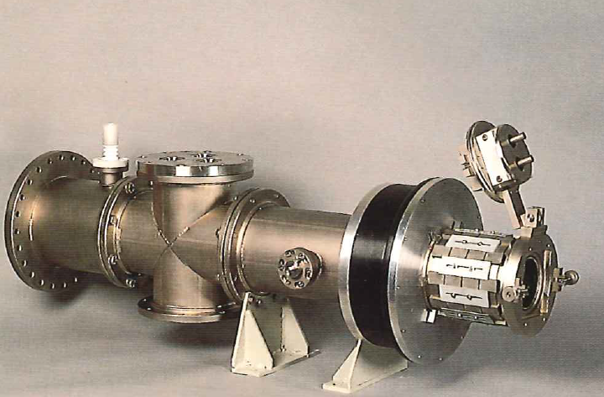
The positive ion source
Filament holder
Extraction
PM decapole
Isolator
Beam line

Slide 9
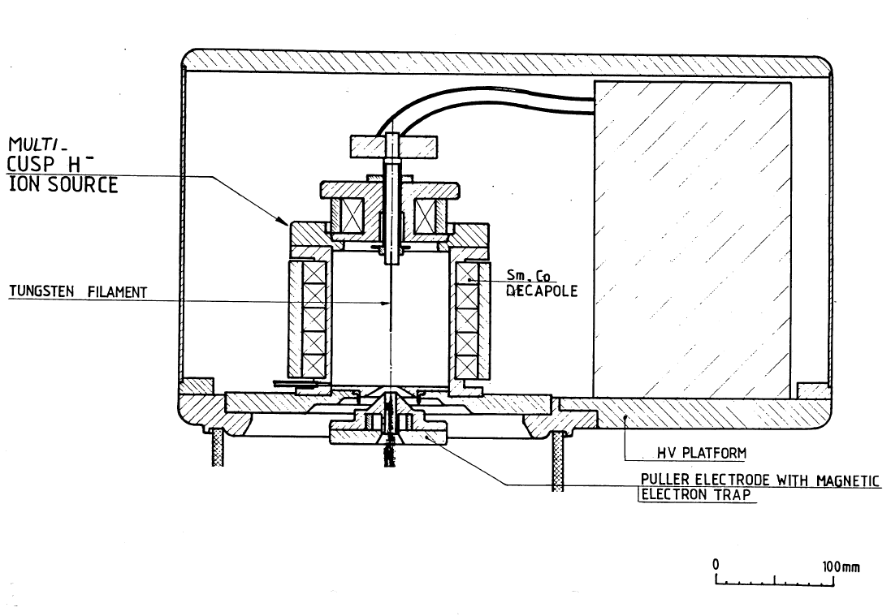
Schematic view of the source

Slide 10
Arrangement of power converters
Arc Current 30 – 40 A
Arc Voltage 100 – 120 V
Gas Flow < 0.1 mbar ℓs⁻¹
Bias Voltage 2.0 – 2.4 V
Bias Current 1.0 – 2.5 A
Filament Current 45 - 55 A / filament
Beam Current H- 5 – 8 mA
D- 1 – 3 mA
Beam Energy 25 keV H- / D-
Electron trap current 25 – 30 mA
Divergence (1/e half angle) 15 mrad
Emittance (normalized rms) <0.1πmmmrad
Modifications:
High Voltage Transistor Switches
High Voltage Terminal
Puller (extraction electrode)
Safety Cabinet
Tube used
for output cables
Ion Source Power Supply
19" Cabinet
(ref. to H.V.)
Filament PS
3 Filaments
Arc PS
Cusp
body
Electron
Electron
Sup. PS
suppressor
Plasma
HTS
grid
High Voltage
Puller PS
Transformer
Puller
Mains
Rc
Local Control
Optic fiber
System
link
HTS
30kV
To External
40mA
Control System
HV PS

Slide 11
Modification for pulsed operation
Replacement of high voltage transistor switches
  Push-pull switches (or full bridge) from Behlke
  Fixed pulse width?
Investigate the need for
  buncher
  post acceleration

Slide 12
Negative and positive ions
Investigations for negative and positive ions
Use a negative ion source with stripper
Test operation of IBA source for proton delivery
Post acceleration / Drift tube or „Tandem“ operation
Vacuum separation

Slide 13
Optional ion source arrangement
Horizontal injection
  Length > 2 m
  Vacuum separation might be an issue
Vertical injection
  Small footprint
  Virtually no limit for drifts and vacuum separation
  Needs 90° deflector for 100 keV beams

Slide 14
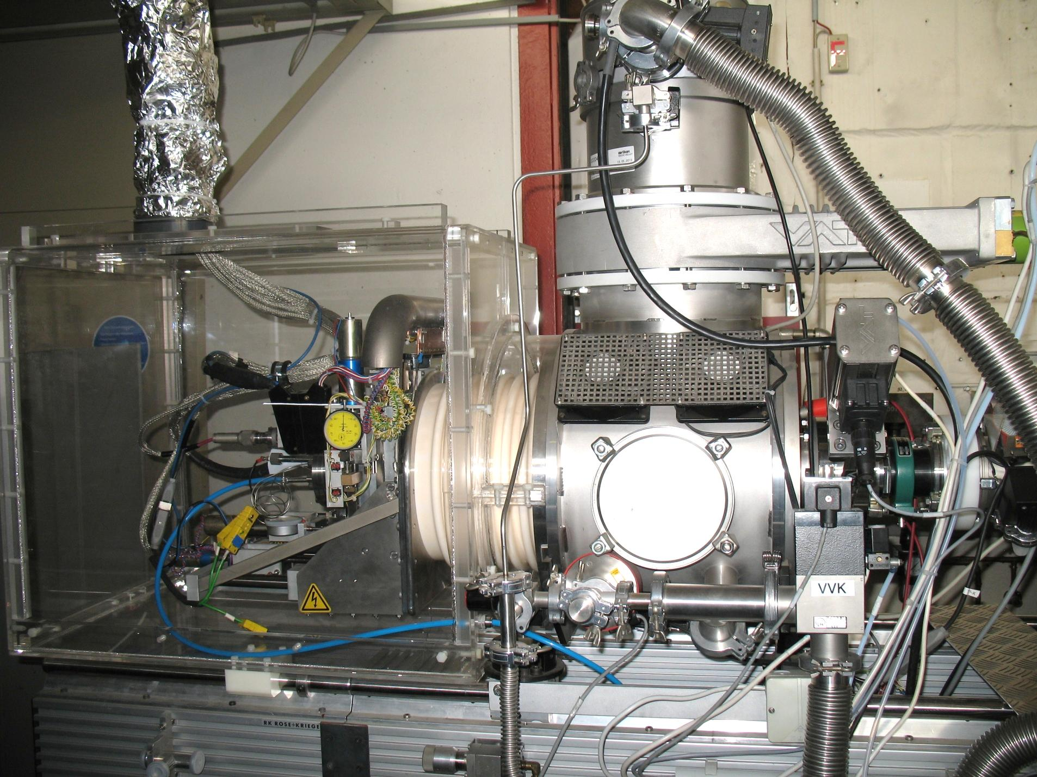
A „100 keV“ ion source at COSY
Cs⁺ source
Part of the
COSY
Pol. Ions Source
-> available
spare parts and
prototypes

Slide 15
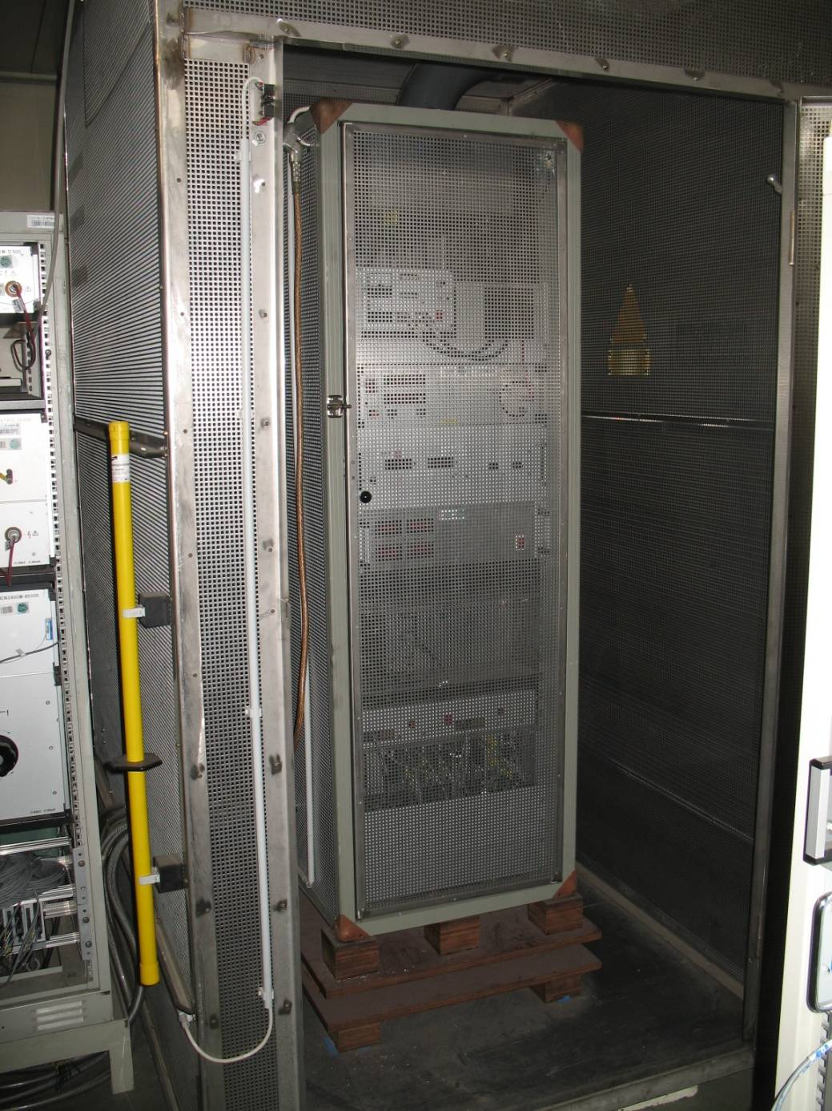
High voltage cabinet for the (Cs⁺ ) source
Faraday cage
for use at the
polarized ion source

Slide 16
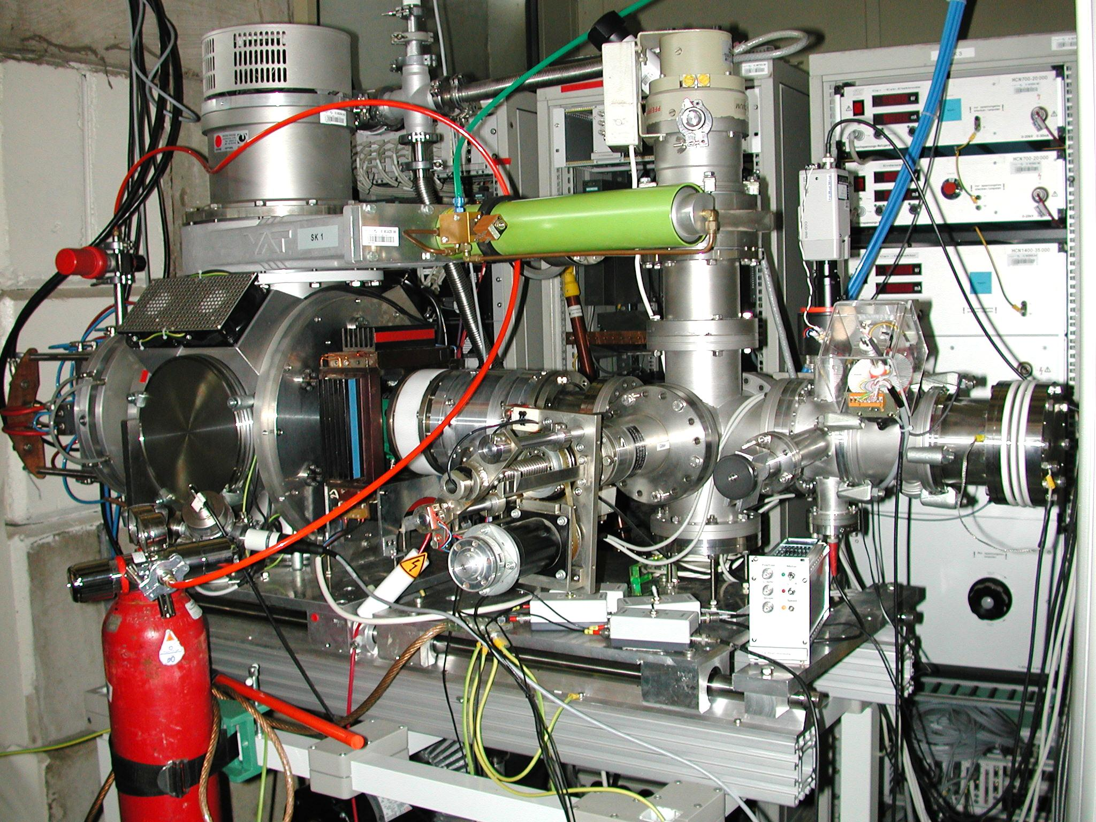
Test bench for ion sources
Vacuum system
Diagnostics for:
Current
Profiles
Viewer
-> for commissioning

Slide 17
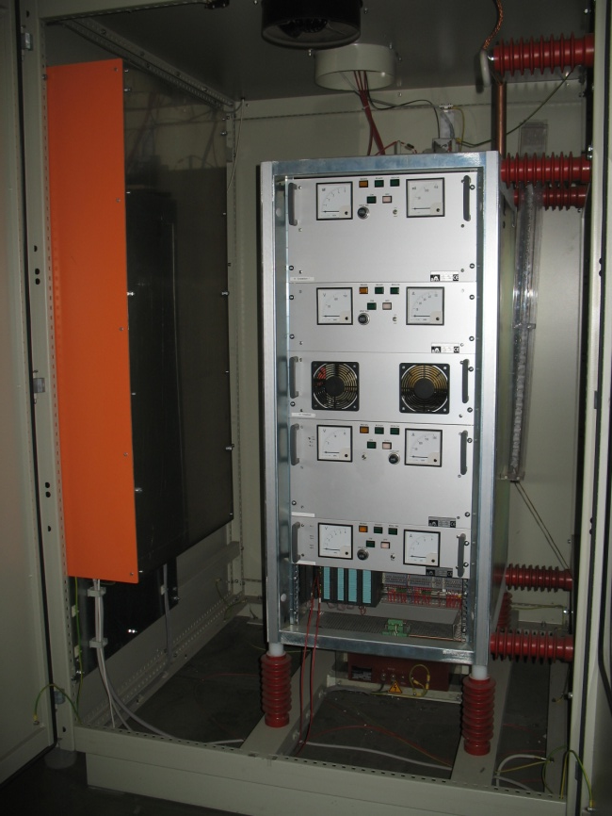
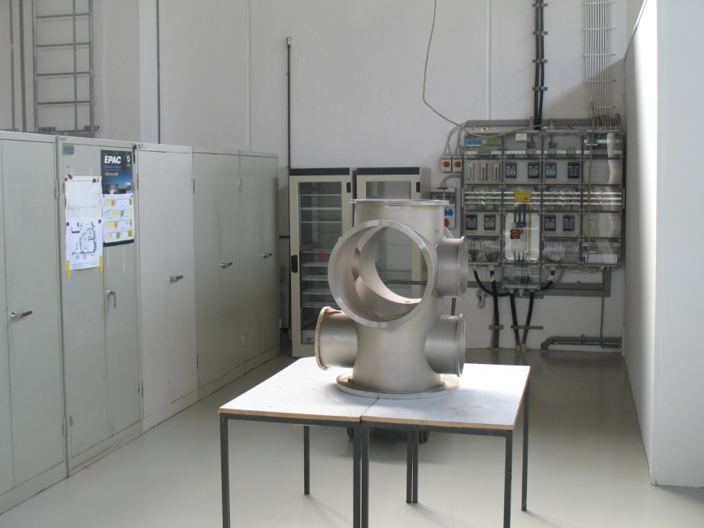
Preparation for the source
Parts and boxes #1
Vacuum chamber and floor space preparation
Transformer and power supplies

Slide 18
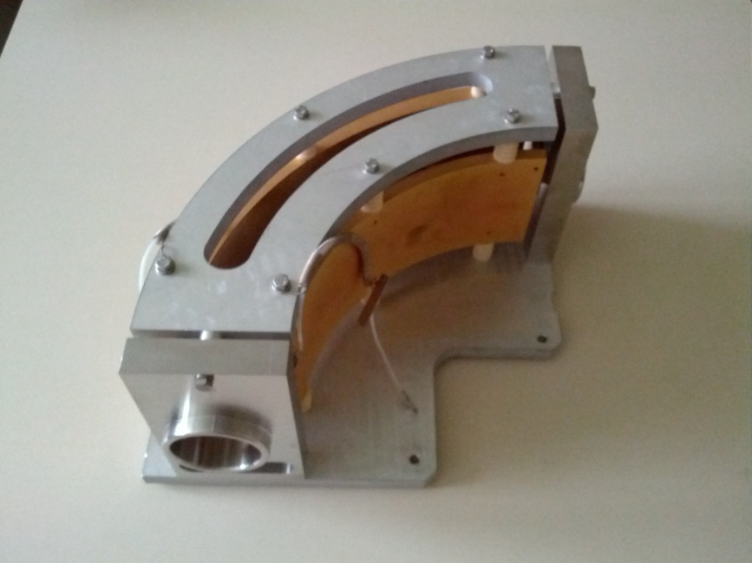
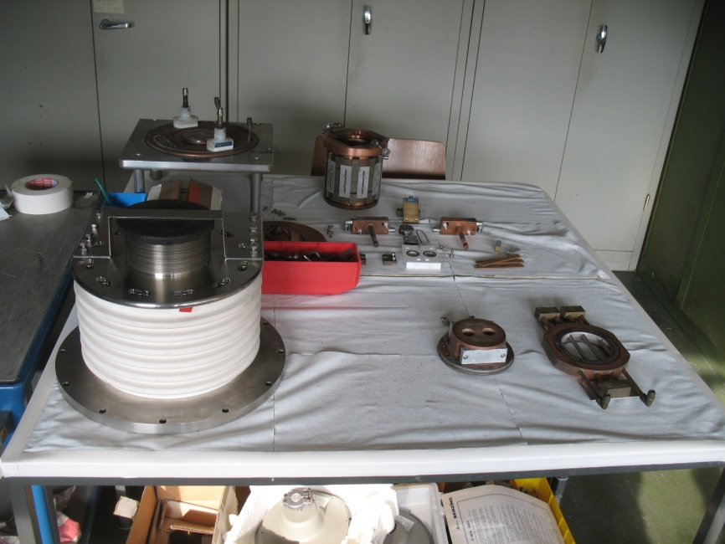
Preparation for the source
Parts and boxes #2
90° deflector
100 kV Isolator and ion source parts

Slide 19
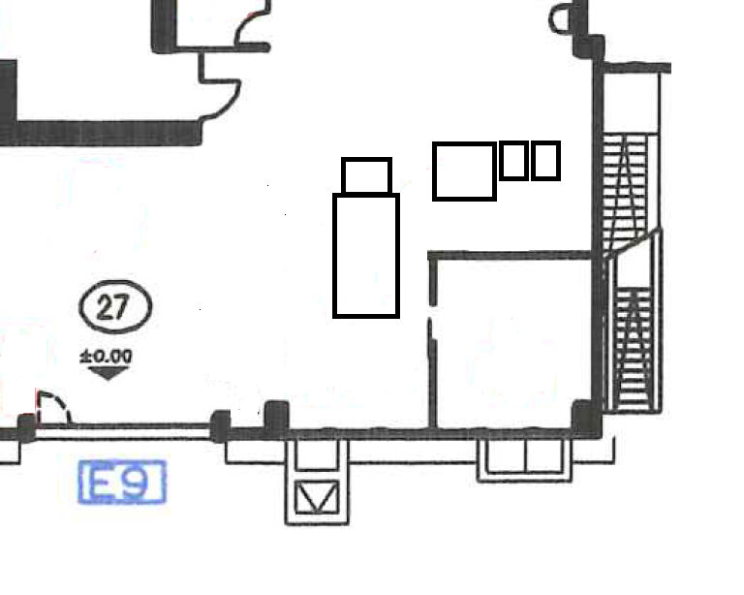
Status
Refurbishment started
Floor space and infrastructure is prepared
Identification and preparation of components
  Ion source parts
  Chambers, isolators …
  Vacuum pumps, valves ...
  Power supplies (JEMA, FuG etc. )
  Control system (Siemens PLC)
  Documentation …

Slide 20
Outlook
Fix final configuration and parameter ranges
Install refurbished source on test bench
  Check performance for pos. and neg. ions in 2012
Design and realization of the final set-up (100 keV, vert. or horiz.)

