Slide 1
Some Remarks
Konrad Elsener (CERN)

Slide 2
The early days of NBI workshops (and before that…)
Google for “Yamanoi KEK”

Slide 3
MINUTES OF E362 FRONT DETECTOR MEETING
Date: 16:00-17:00, October 20, 1995
Place: KEK meeting room (next to Library)
Present: Nishikawa (Chairman), Chikamatsu, Miyamoto (INS), Miyano(Niigata),
Sakuda(KEK), Tamura(Okayama), Nishijima,Etou(Toukai), A.Suzuki, Kohama(Kobe)
(1) Nishikawa summarizes the preceding Horn meeting (Yamanoi, Ieiri, Yoshi-
Suzuki, Miyamoto, Nishikawa, Kohama, A.Suzuki).
Yoshi-Suzuki(KEK) ordered a power supply for the Horn for ~1.2 Oku-yens.
It will be delivered next April.
A public tender for the 2nd Horn will be held in mid-November. One problem
with the horn is how to handle the thermal expansion of the structure,
which is estimated to be about 3mm. They consider the structure whose one
end is set free along the direction of the expansion.
Miyamoto/Yamanoi independently calculate the stress due to the magnetic
force. They agree.
The Horn current (I) will be monitored by either the voltage (=IR), Hall
probe or pickup coil.
(2) …
…

Slide 4
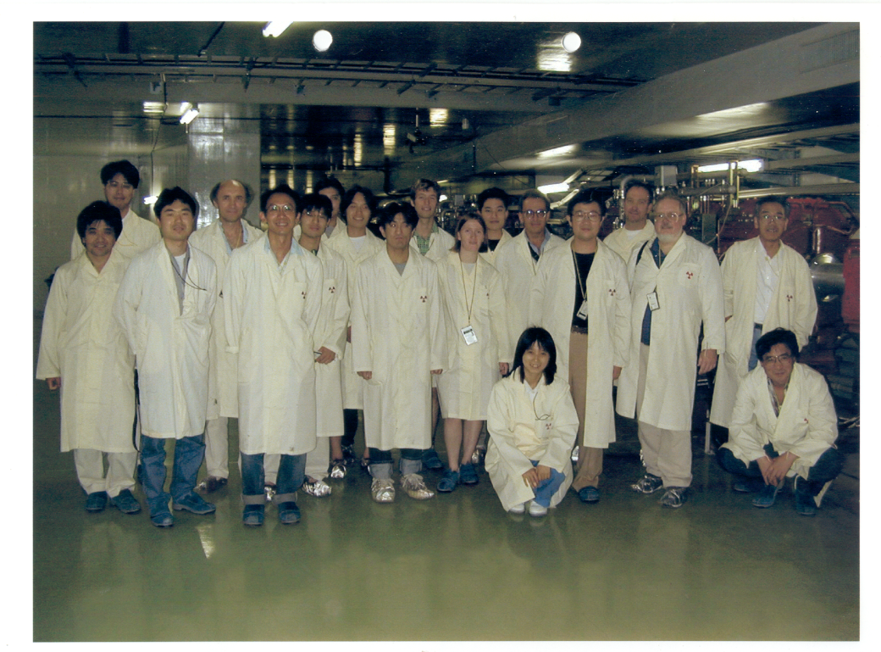
First NBI workshop - 26-29 July 1999 at KEK
CERN participants: Valeri Falaleev, K.E.
(NGS -> CNGS was not yet an approved project)
(Fermilab participants: Jim Hylen and Jorge Morfin)

Slide 5
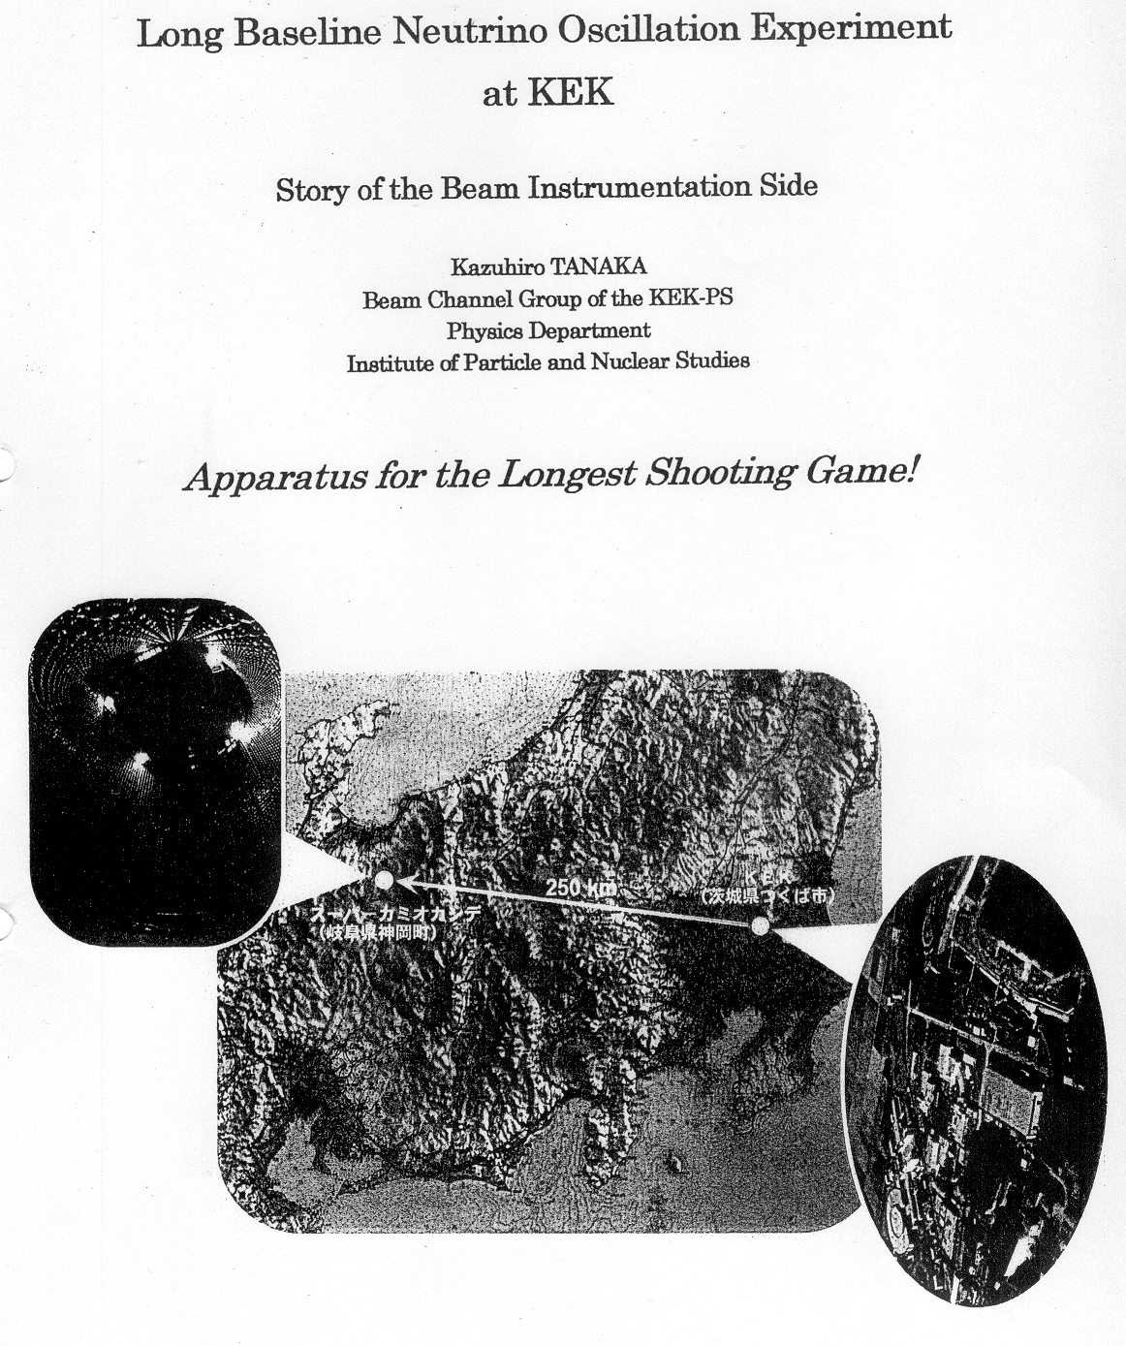
NBI 1999
“K2K”

Slide 6
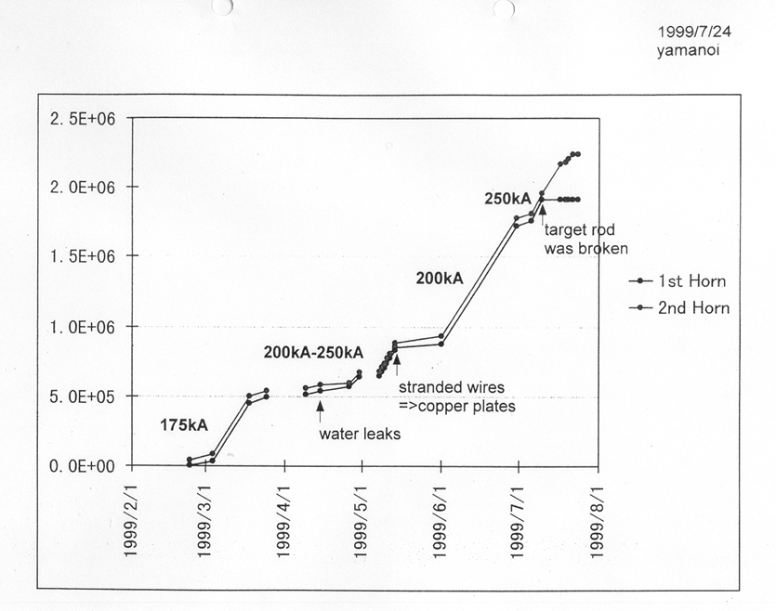
NBI 1999

Slide 7
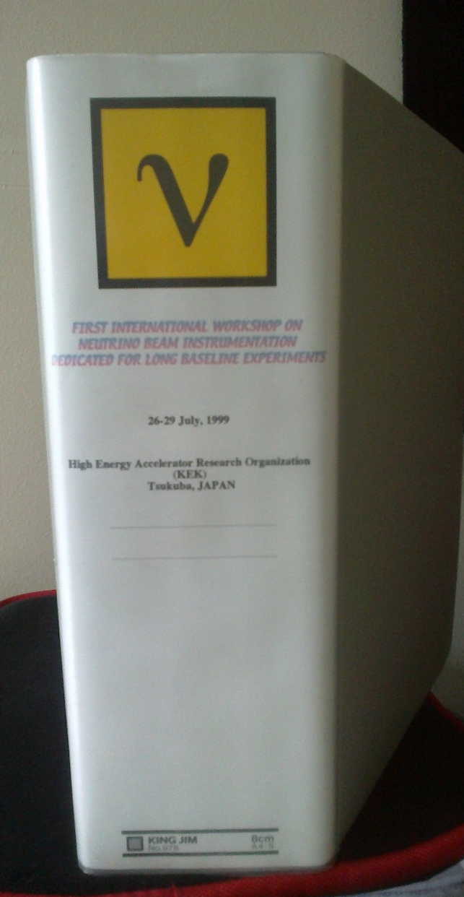
NBI 1999
Proceedings
… we then moved on to …
Fermilab (2000)
CERN (2002)
KEK (2003)
Fermilab (2005)
CERN (2006)
J-PARC (2010)
… to the web …
… and to INDICO ...

Slide 8
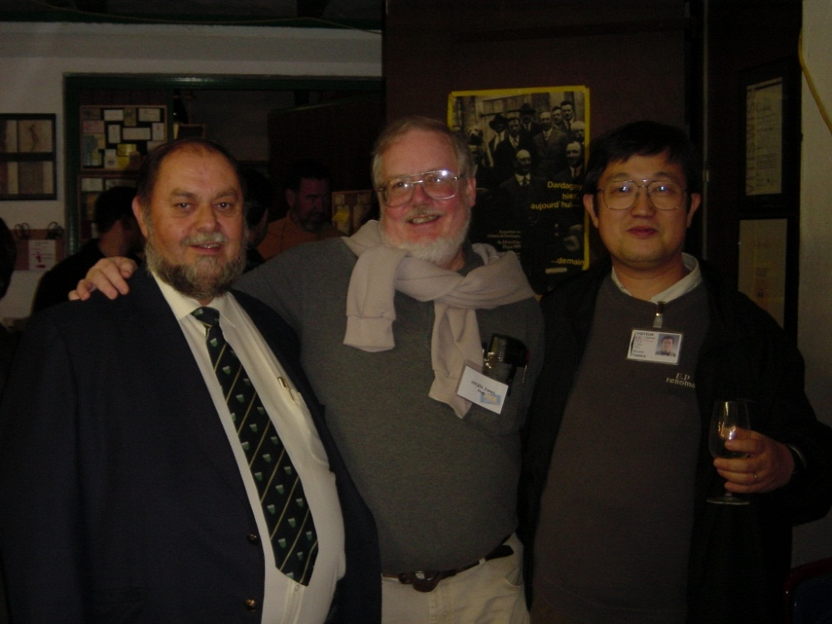
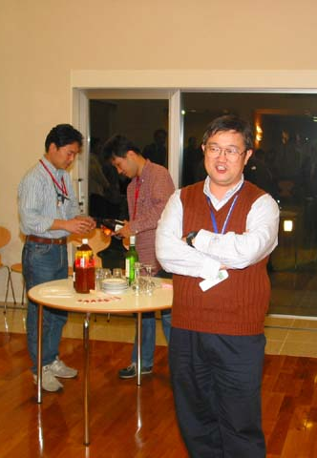
NBI 2002
NBI 2003
NBI 2005
Forbidden
You don't have permission to access /nbi2005/photos/tour/ on this server.

Slide 9
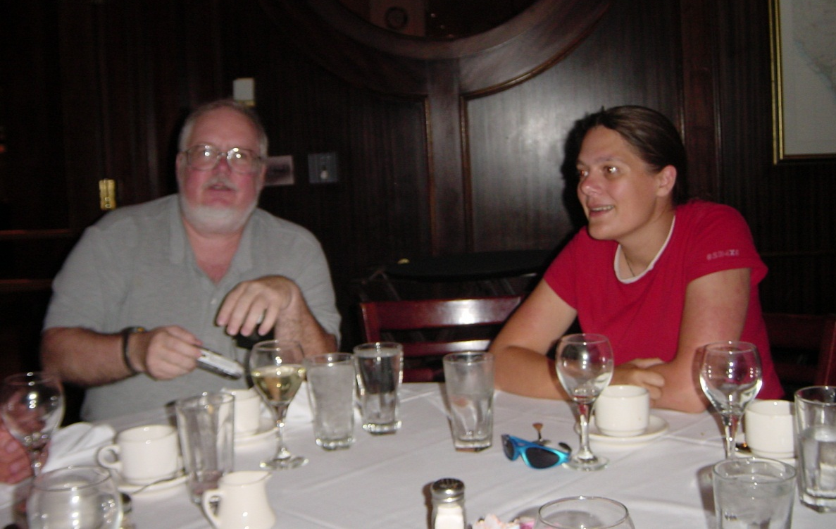
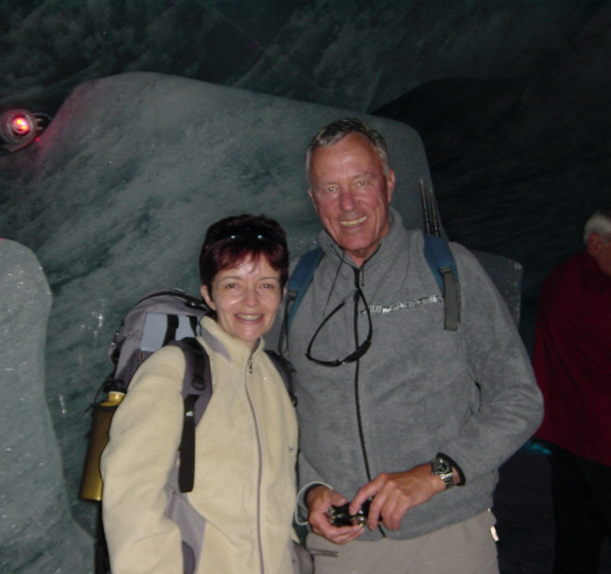
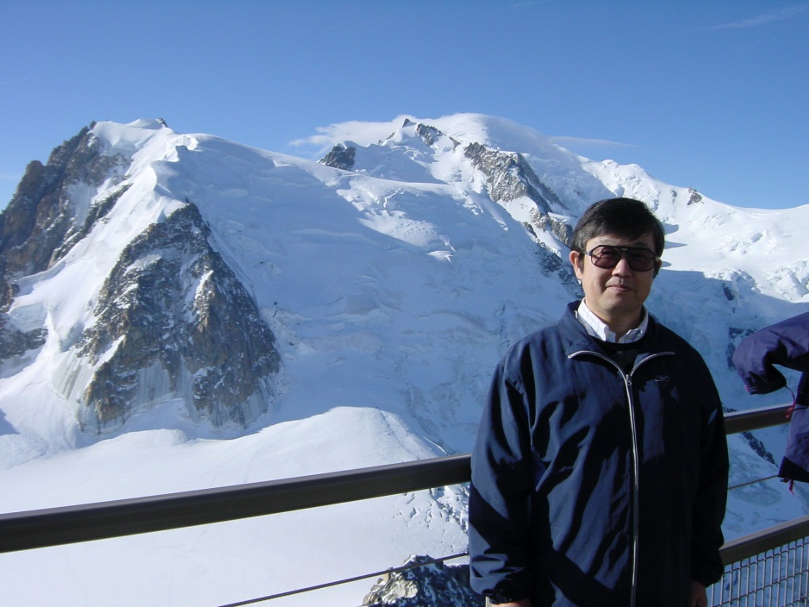
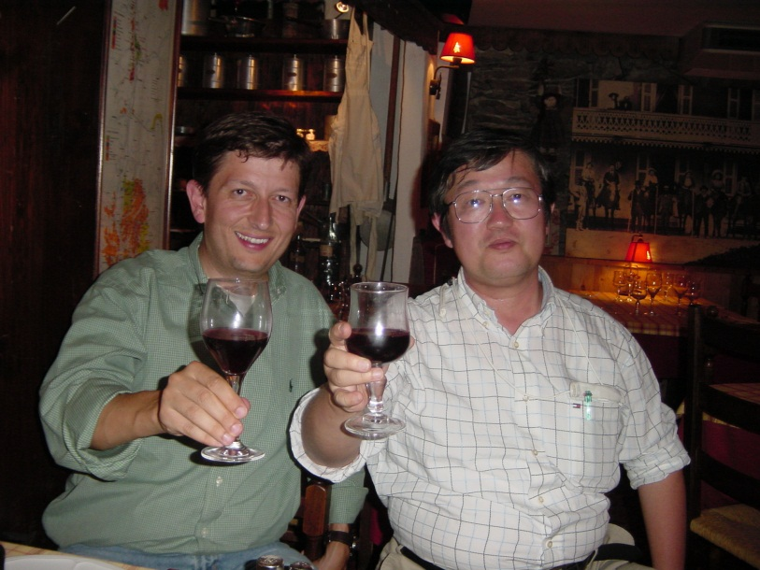
NBI 2005
NBI 2006
NBI 2006

Slide 10
Comparison Meas.-Sim. I (Preliminary)
Muon Monitors, Horizontal Pit 1
■ Measurement
■ Simulation
Fluka simulation; P. Sala et al
NBI 2006

Slide 11
What’s special about the NBI workshops (why we like them…)

Slide 12
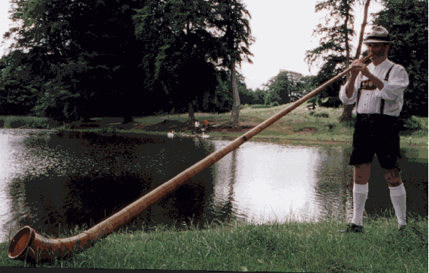
Final Horn Status of K2K
Kazuhiro TANAKA for
the KEK-PS Beam Channel Group,
& the K2K Beam Tuning Team

Slide 13
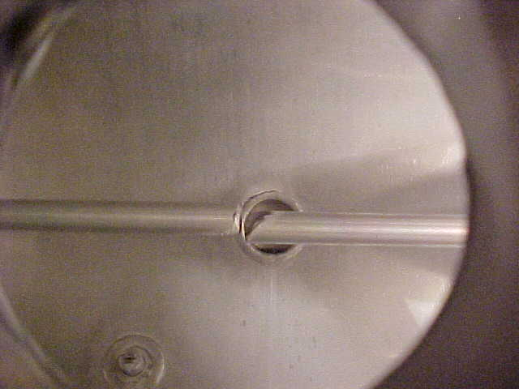
NBI 2005
1st Horn Target Rod (20mm diameter) Break
(1.9x10⁶ excitations)
from K. Tanaka

Slide 14
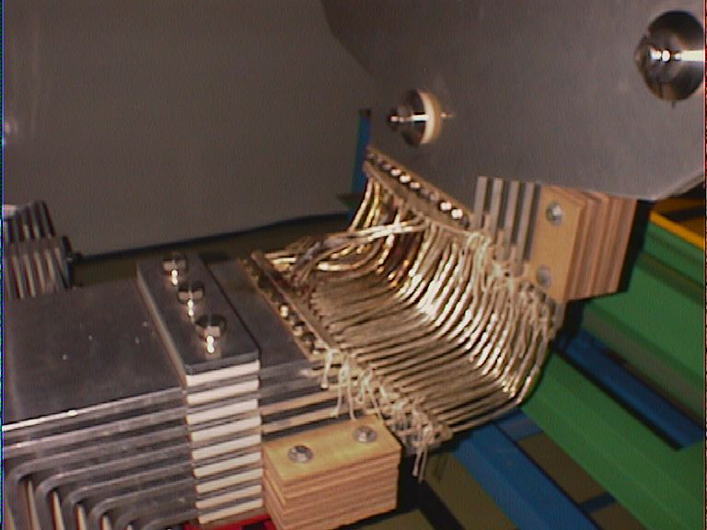
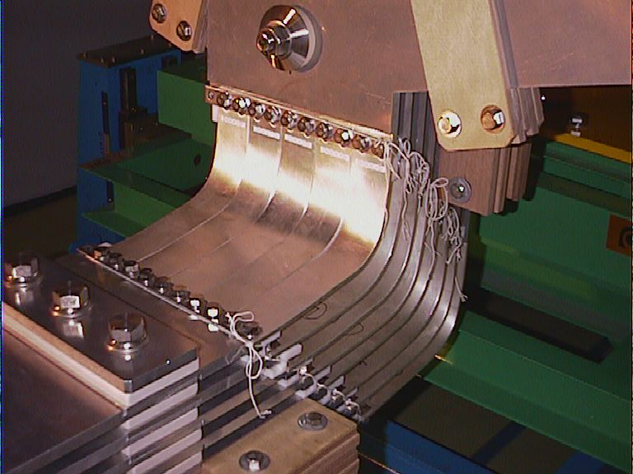
NBI 2005
Horn Flexible Feeder Trouble (8.5x10⁵ excitations)
from K. Tanaka

Slide 15
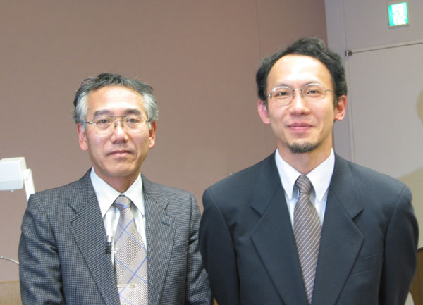
KEK Engineering Award 2003
NBI 2005
Suzuki and Yamanoi received 3rd KEK Engineering Award for their development of K2K horn system
from K. Tanaka

Slide 16
NBI 2005
Operation History of K2K Horns
from K. Tanaka

Slide 17
NBI 2005
On horns, what we learned are···
(Presented at NBI2000)
Horn can work as designed in both mechanically and electrically.
We should pay attention more and more to peripherals, which can break as designed.
Test excitation in the actual position should be as many as possible.
Never compromise with Physicists.
Sufficient time, money, manpower for R/D and for operation, maintenance.
Believe yourself.
from K. Tanaka

Slide 18
Conclusion

Slide 19
Have a great workshop !
NBI 2012
(Apologies that I can only be around part-time)

