Slide 1
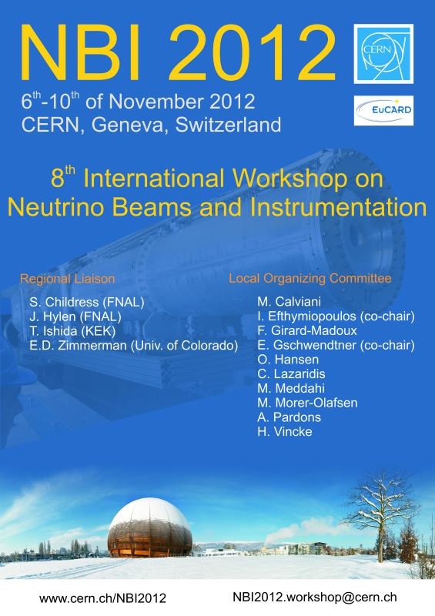

Slide 2
NBI 2012 Program
Tue, 6.11. | Wed, 7.11. | Thu, 8.11. | Fri, 9.11. | Sat, 10.11
 | Welcome
 | Project Overview | Targets | Radiation Protection Issues | Remote Handling
 | Future Projects | Targets | Radiation Protection Issues | Summary
 | Lunch | Lunch | Lunch | Lunch
 | Future Projects | Horns | Excursion
 | Primary Beam Line Instrumentation | Horns
 | Secondary Beam Line Instrumentation | CERN Tour
Reception | Social Dinner

Slide 3


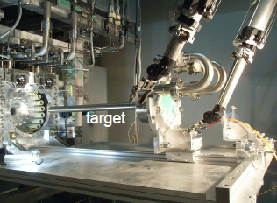
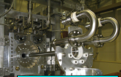


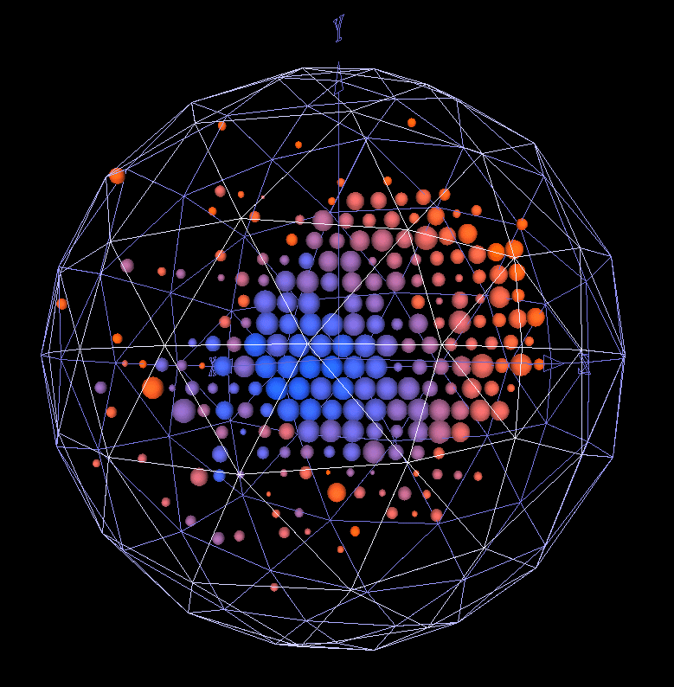
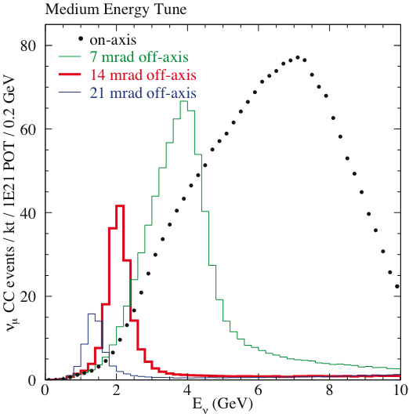
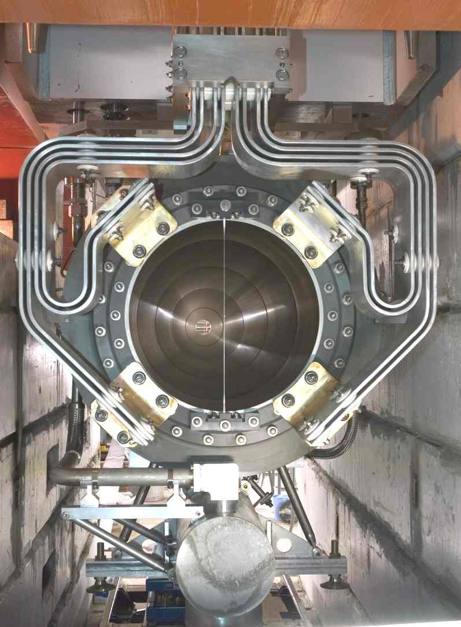


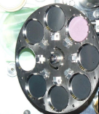

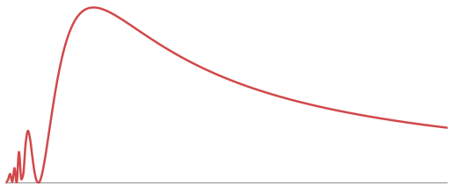
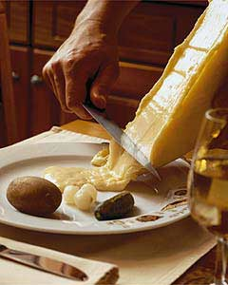
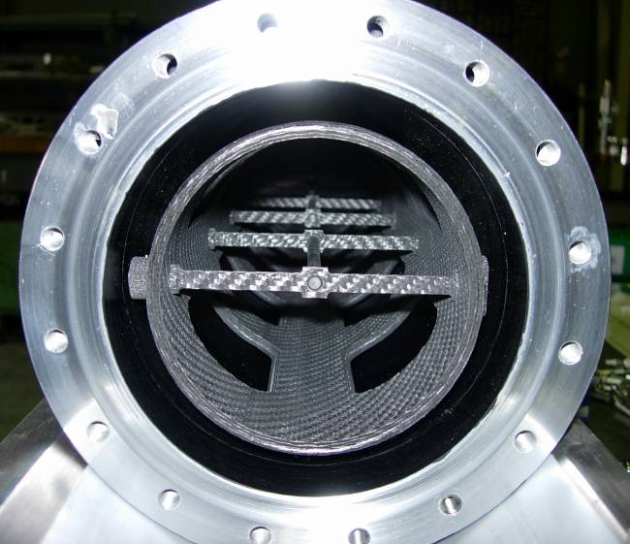

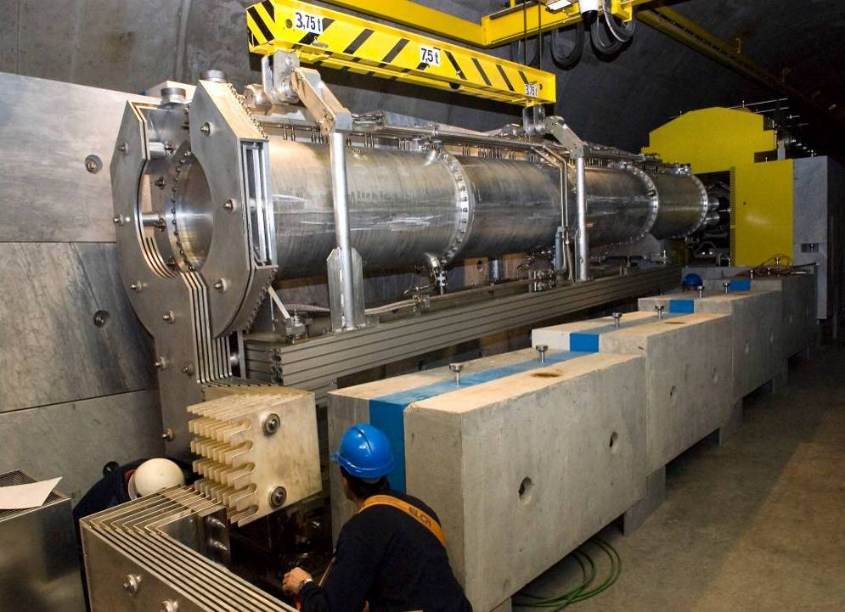
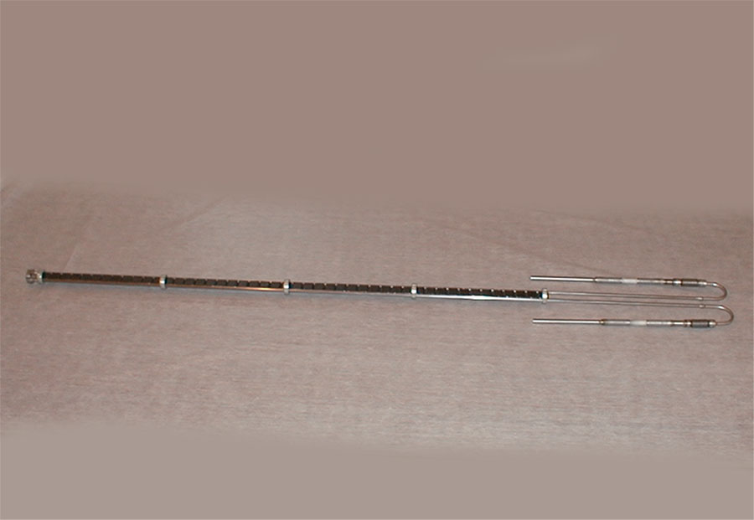
Enjoy NBI 2012 at CERN and
Looking forward to many fruitful discussion!!

