Slide 1
Magnetic Field Measurements on T2k Horns
Andrew Missert
University of Colorado, Boulder
andrew.missert@colorado.edu
NBI 2012

Slide 2
Outline
Summary of T2K horn field measurements before 2011
2011 field measurements on spare horn 1
  Azimuthal field measurement methods
  Correction for fringe effects
  Comparison with expected azimuthal field
  On-axis field measurement methods
  Anomalous on-axis field
Conclusions
Notes:
First I’ll speak briefly about some field measurements taken before 2011
I’ll move into the 2011 field measurements and discuss those in more detail
Azimuthal, nominal field, measurement methods for t2k
Correction term for fringing effects
Compareison of data with expected field
Something new: on-axis field measurements
Some surprises and anomalies we found there

Slide 3
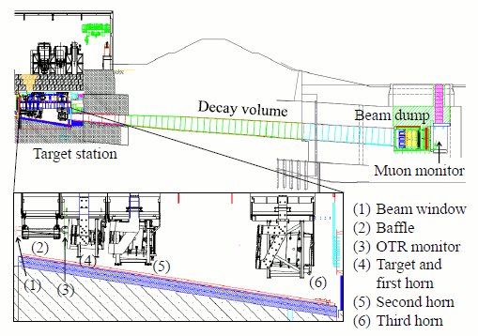
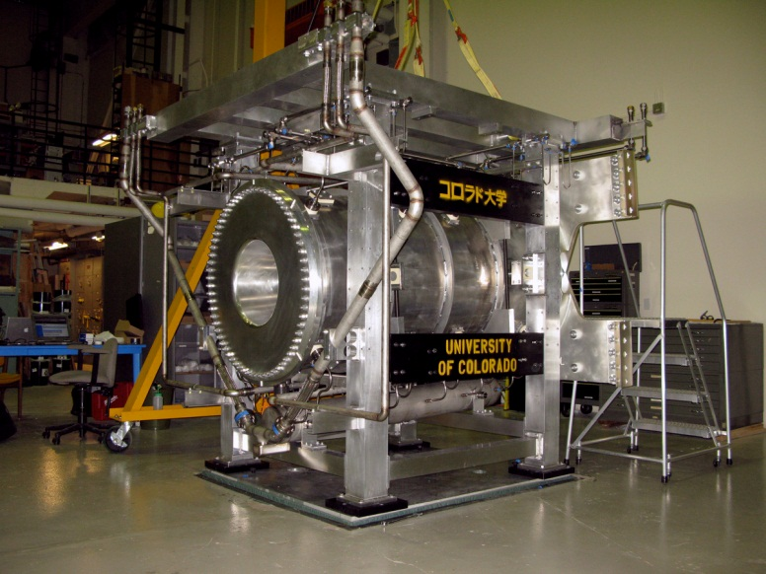
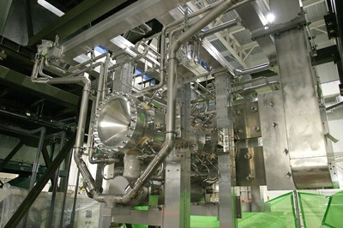
T2K Horns
T2K beamline uses 3 horns
Designed to be pulsed at up to 320kA
Each horn is equipped with instrumentation ports to permit magnetic field measurements
Notes:
As I’m sure most of you know, t2k uses 3 horns
Each is designed to handle pules of up to 320 ka
Each equipped with instrumeation ports for field measurements

Slide 4
Summary of T2K Horn Field Measurements
Date | Horn Measured | Probe Used | Measurements Taken
March 2007 | Horn 1 | 3-Axis Hall Probe | Azimuthal field
July 2007 | Horn 3 | 3-Axis Hall Probe | Azimuthal field
August 2008 | Horn 2 | 3-Axis Hall Probe | Azimuthal Field
August 2011 | Spare Horn 1 | 3-Axis Hall Probe | Azimuthal field On-axis field
September 2011 | Spare Horn 1 | 3-Axis Hall Probe | On-axis field
October 2011 | Spare Horn 1 | 3-Axis Hall Probe Pickup Coil | On-axis field, Off-centered on-axis field, Field outside horn

Slide 5
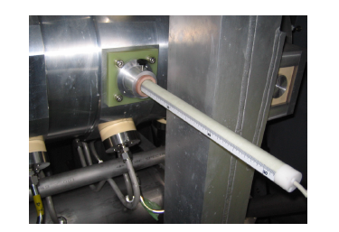
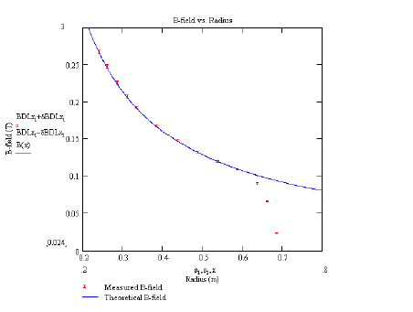
Field Measurements Prior to 2011
Fields of all horns measured with Hall probe via instrumentation ports
Verification of nominal azimuthal field for all three horns (<2% fractional deviation at most radii, outermost radii are exception.)
Horn 1
Horn 3
Notes:
Say a few words on field measurements before 2011
Important point is that nominal azimuthal field was verified on all 3 horns
We’re talking within 2% at most radii
I’d like to point out deviations at large radii, these are likely due to fringing effects near the ports
We’ll talk about how to deal with this later

Slide 6
2011 Spare Horn 1 Field Measurements
T2K Spare Horn 1 is identical to one currently in use in T2K beamline
Has four instrumentation ports for measurement of magnetic field
Goal of magnetic field measurements:
  Verify that azimuthal field agrees with expectation
  Check for horn field asymmetries
B
Downstream
Notes:
T2K spare horn 1 is identical to one currently used in t2k beamline
Goal: verify nominal field, just like the previous measurementsthis
New goal , something new, is a measurement to check for horn field asymmetries
We check for this by measuring field on axis inside inner conductor
Define coordinates

Slide 7
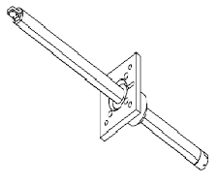
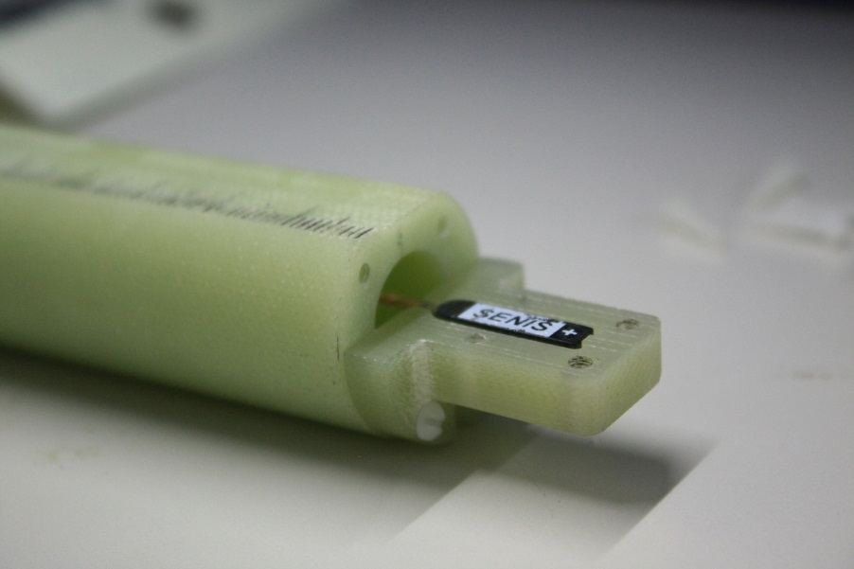
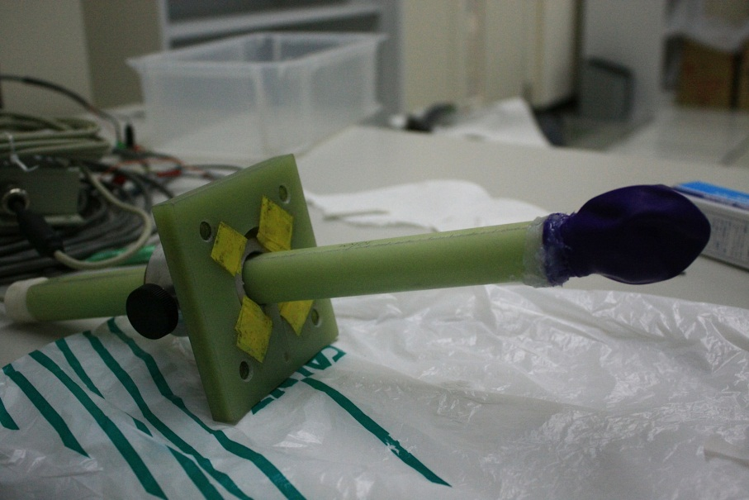
Azimuthal Field Measurements
Field measurement device: Senis integrated 3-axis hall probe
Probe placed in movable waterproof probe mount
Notes:
Field measurements were performed using a senis integerated 3-axis hall probe
Probe placed in adjustable probe mount
Mount waterproofed , tried different techniques: balloon and rubber glue

Slide 8
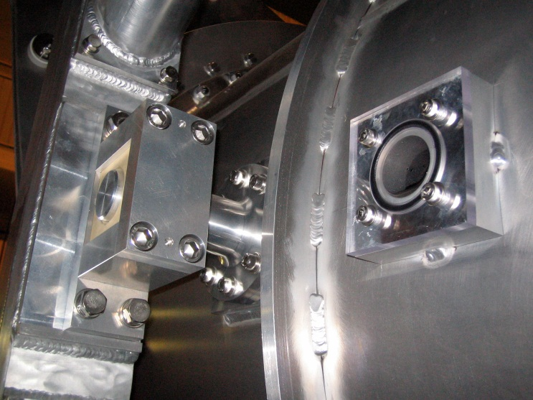
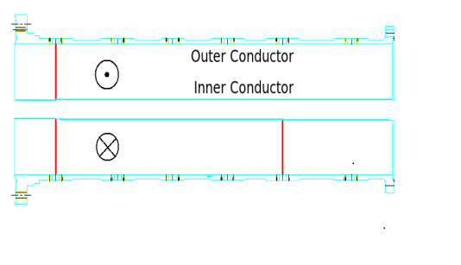
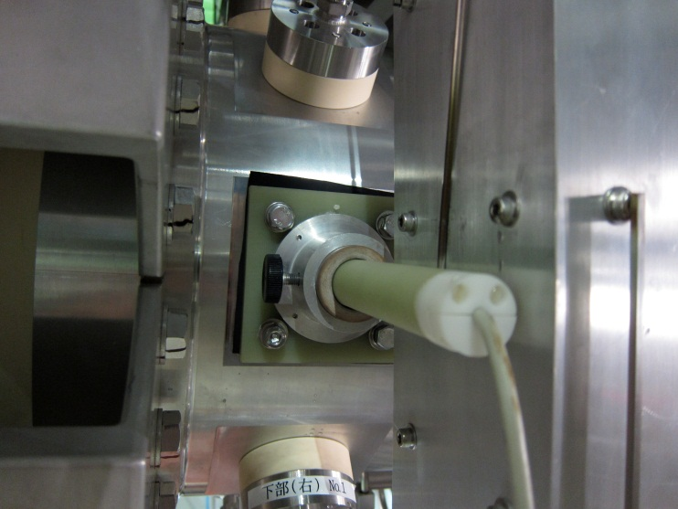
Azimuthal Field Measurements
Adjustable field probe mounted to instrumentation port holes
Ports used: left upstream, right upstream, right downstream
B
Downstream
Notes:
Probe mount placed on hole in outer conductor
Mention hole to transitioin to next slide

Slide 9
Fringe Effects in Azimuthal Field Measurements
R
Dominant magnetic field between inner and outer conductors expected to be nominal 1/R field
Some deviations from nominal are expected due to fringing effects near the instrumentation port holes.
We can estimate this deviation analytically: superimpose disk of current flowing in opposite direction
I
a
I
Notes:
Simplified diagram of horn
Use superposition
Roughly disk
Probe samples field along symmetry axis
Can solve analytically

Slide 10
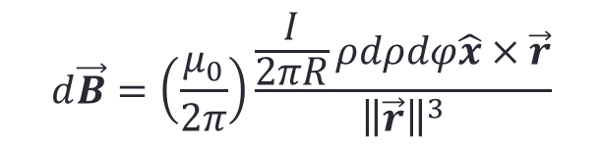
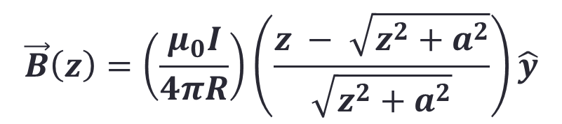
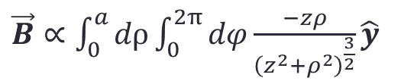

Estimation of Fringe Effect
Contribution to magnetic field along symmetry axis from disc of uniform current:
Z
$$d\vec{B}=\left(\frac{μ_{0}}{2π}\right)\frac{\frac{I}{2πR}ρdρdφ\hat{x}×\vec{r}}{{\left\|\vec{r}\right\|}^{3}}$$
r
$$d\vec{B}∝ −zρdρdφ\hat{y}+ ρ^{2}\sin{φdρdφ\hat{z}}$$
$\vec{B}∝\int_{0}^{a}{dρ\int_{0}^{2π}{dφ}\frac{−zρ}{{\left(z^{2}+ρ^{2}\right)}^{\frac{3}{2}}}\hat{y}}$
ρ
φ
X
$$\vec{B}\left(z\right)=\left(\frac{μ_{0}I}{4πR}\right)\left(\frac{z − \sqrt{z^{2}+a^{2}}}{\sqrt{z^{2}+a^{2}}}\right)\hat{y}$$
I
Notes:
Calculation is fairly straightforward
Set up differential contribution and integrate
Result is b field along the axis of the disk

Slide 11
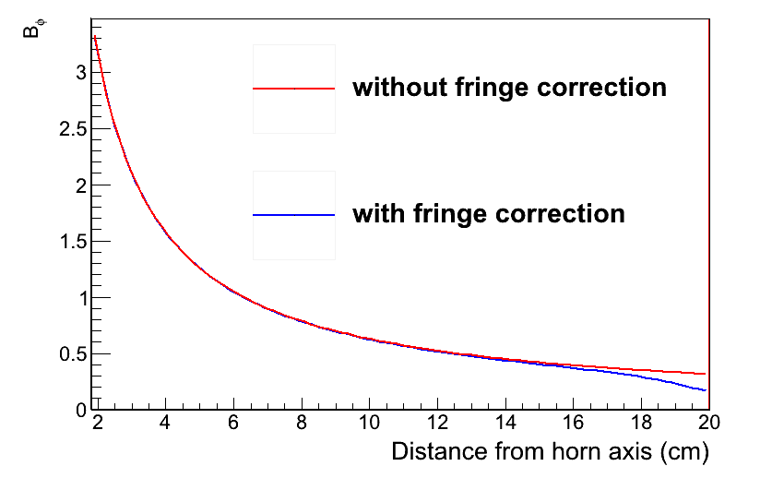
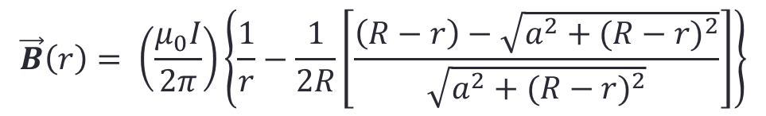
Expected Field With Fringe Correction
Prediction for the azimuthal field strength measured by probe:
$$\vec{B}\left(r\right)= \left(\frac{μ_{0}I}{2π}\right)\left\{\frac{1}{r}−\frac{1}{2R}\left[\frac{\left(R−r\right)−\sqrt{a^{2}+{(R−r)}^{2}}}{\sqrt{a^{2}+{(R−r)}^{2}}}\right]\right\}$$
r → distance from axis of horn
R → radius of outer conductor
a → radius of instrumentation port hole
I → horn current
Should be valid for a<<R
Notes:
Result of this calculation, new expectation for field strenght as measured by the probe
Recognize nominal 1/r term, addional term depends on gemetrical factors
Range of validity where you can treat the port hole as a flat disk

Slide 12
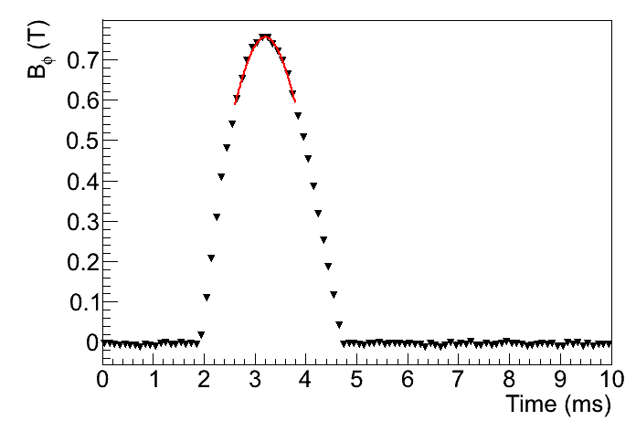
Measurements of Azimuthal Field
Field measured at several radii from beam axis or each instrumentation port studied
At each radius, data was taken for ~10 current pulses
Each peak in field data is fitted to sinusoidal curve.
Peak amplitude is averaged over all pulses
Rogowski coils used to measure current pulses (average current: 314.6 kA)
Notes:
Procedure used to analyize the probe data

Slide 13
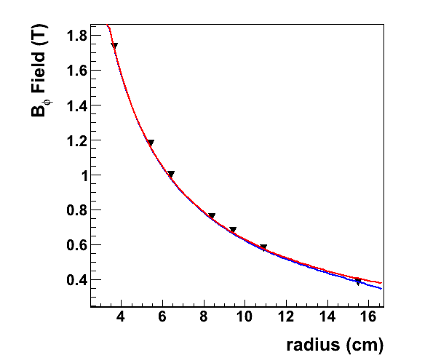
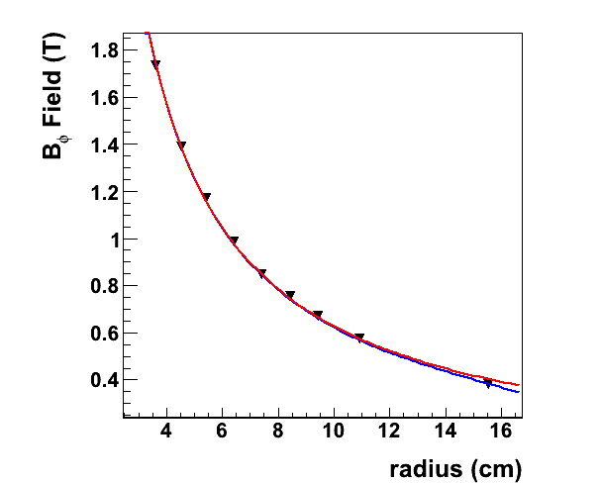

Measurements of Azimuthal Field
Left Upstream
With fringe effect accounted for, measured field agrees with expectation to within 2%
Expected field without fringe correction
Expected field with fringe correction
Right Upstream
Right Downstream
Notes:
Comparison of measured field to what we expect

Slide 14
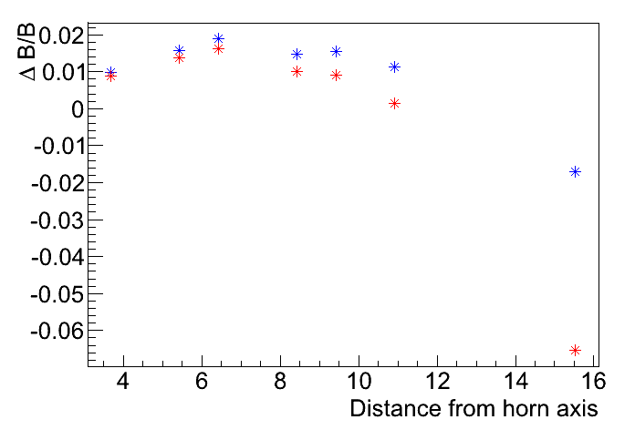
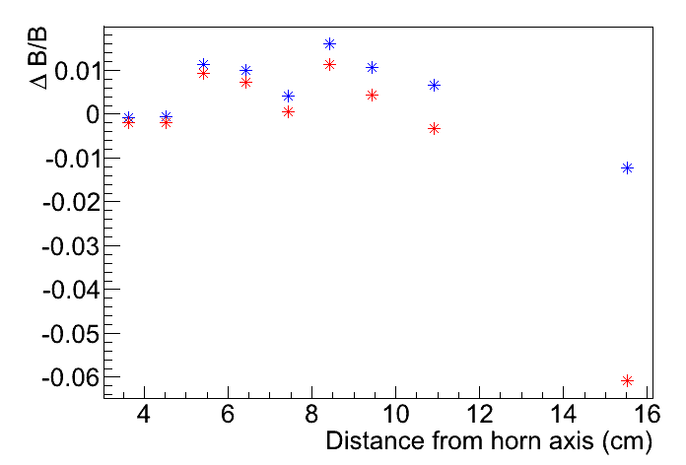
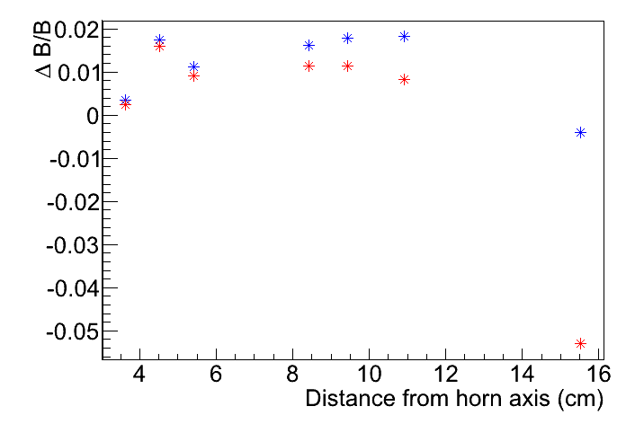
Measurements of Azimuthal Field
Left Upstream
Fractional deviation from field without fringe correction
Fractional deviation from field with fringe correction
Right Upstream
Right Downstream
Notes:
Same comparison, but now with fractional deviation makes it easier to see
Field correction is still not perfect
Assumption that oc radius is small campared to port hole radius is maybe not so strong

Slide 15
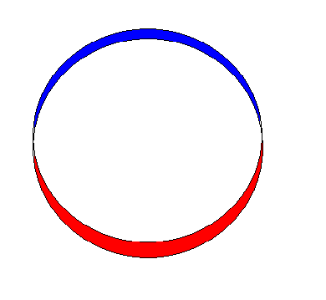
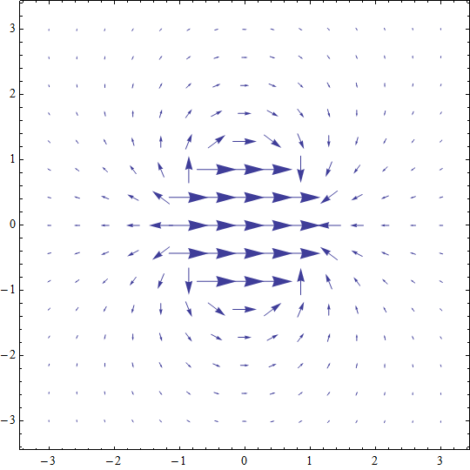
On-Axis Field Measurements
Cross-section of inner conductor:
Motivation for on-axis measurements: detection of field asymmetry
Stripline path length differences can cause current asymmetry
Assuming sinusoidal perturbation to current, field is like that of 2D dipole
Field should be proportional to current
The absence of an on-axis field is a good indication of current symmetry
Current out of page
Current into page
Notes:
Move on to on axtis field measurements
This is something new
Here is som motivation
The point here is that the absence of an on axis field can be a good indicator or current, and therfor field asymmetry

Slide 16
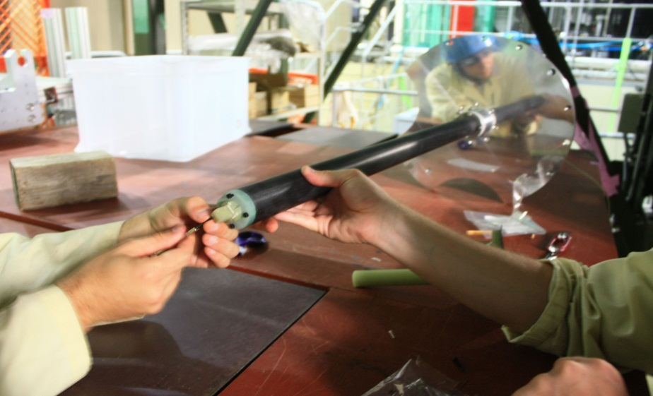
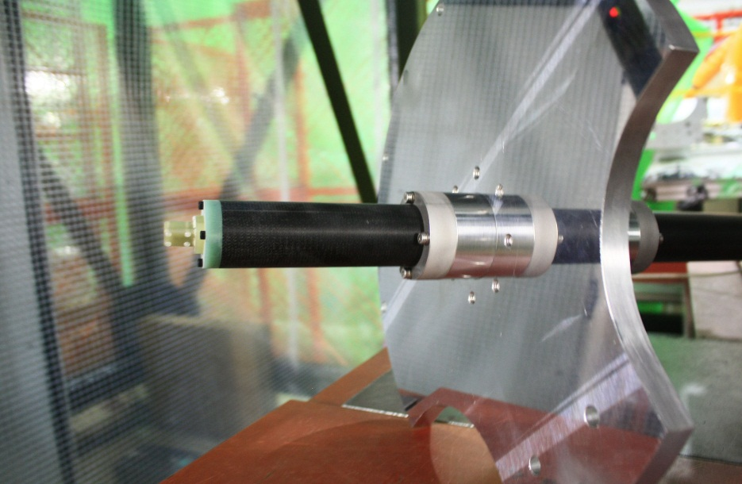
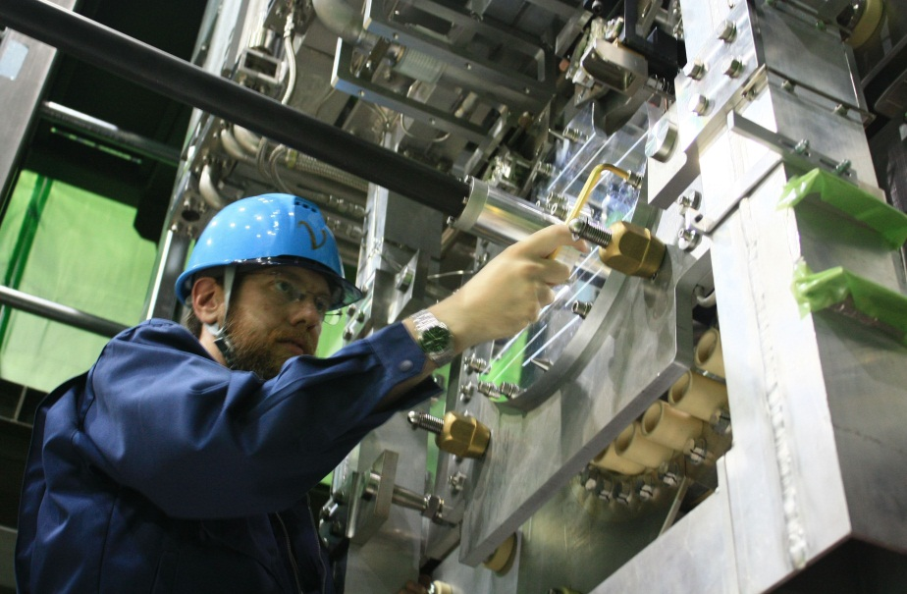
On-Axis Field Measurements
Field along horn axis measured using 1m and 2m probe mounts
Mounts designed to work with existing features used for mounting the target on the horn
Notes:
So with this motivation in mind, I’ll discuss the measurement methods

Slide 17
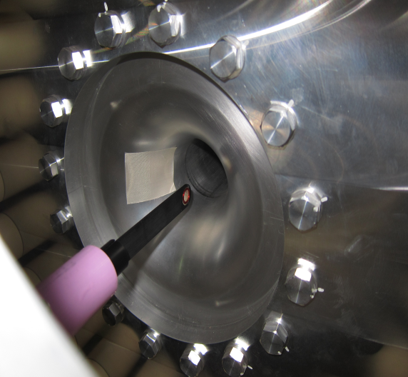
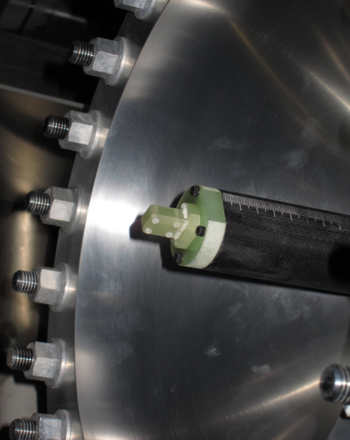
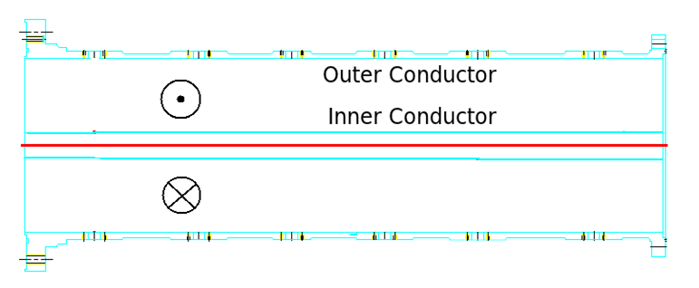
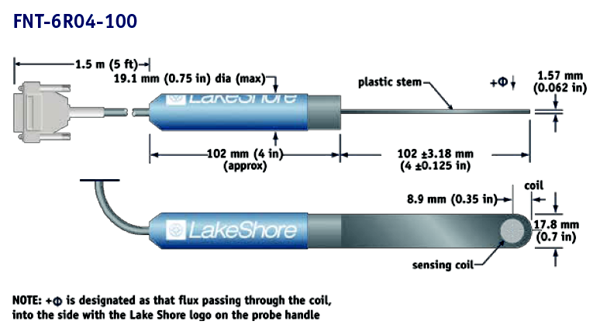
On-Axis Field Measurements
On-axis measurements taken with 3-axis Hall probe and verified with pickup coils
Notes:
Coil can be rotated to give components of field

Slide 18
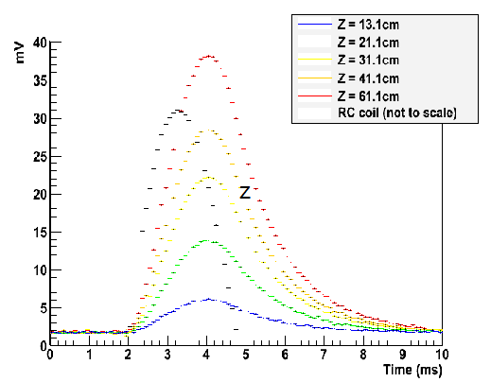
Time Dependence of On-Axis Field
Non-zero on-axis magnetic field was measured.
Measurements of on-axis field are not consistent with prior model of horn asymmetry
Delay of 0.7ms between peak current and peak field
After current pulse, exponential decay with constant of ~0.8 ms⁻¹
Physical origin of anomalous time dependence is currently unknown
Example of data:
Notes:
Resutls
So we did measure non-zero on axis field
Unfortunately, these results are not consistent with our previous assumptions on a model for horn field asymmetry
Reason is anomalous time dependance
Example of data

Slide 19
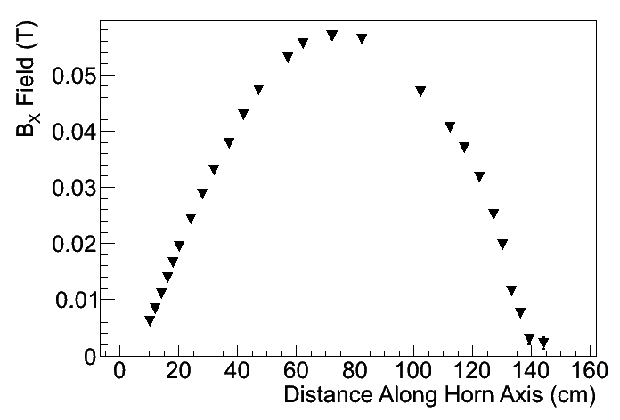
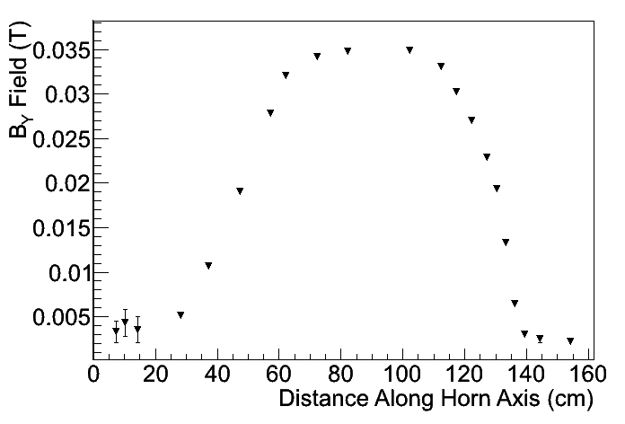
Spatial Dependence of On-Axis Field
Field measured along entirety of horn axis with both Hall probe and pickup coils on long axial probe mount.
Field reaches maximum value of (0.057,0.035,0)T near middle of horn.
Fairly weak compared to nominal field.
Y
Z
B
X
Notes:
s

Slide 20
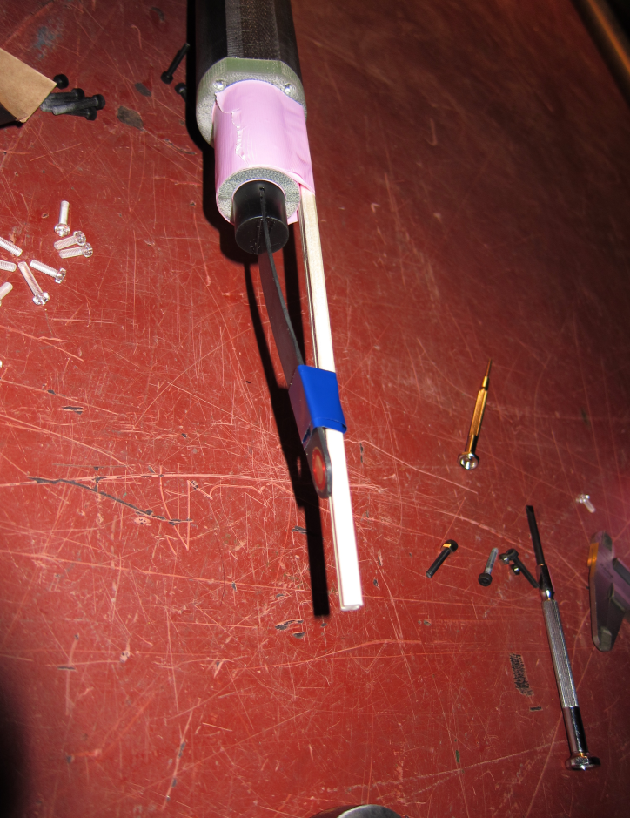
Off-Axis Field Inside Inner Conductor
Bent tip of pickup coil to take measurements 1.22cm from center of inner conductor
Rotated probe mount through successive 90 degree turns to measure B_{X} vs. X and B_{Y} vs. Y
Y
Z
X

Slide 21
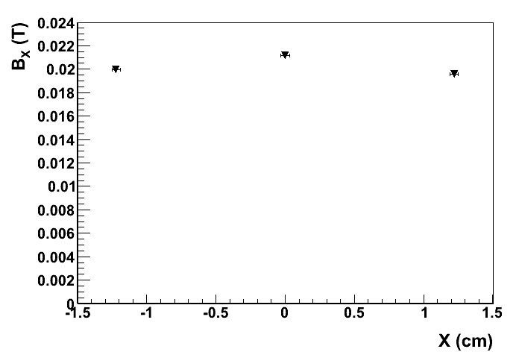
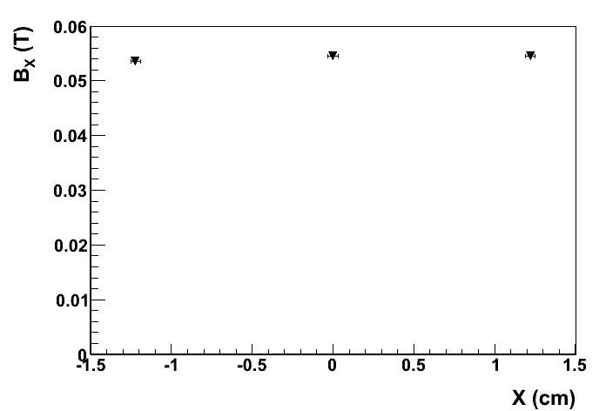
Off-Axis Field Inside Inner Conductor
Z = 21cm
Z = 41cm
Z = 71cm

Slide 22
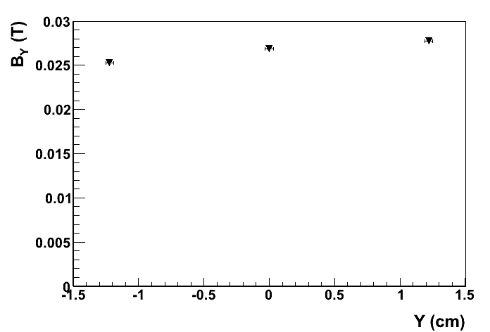
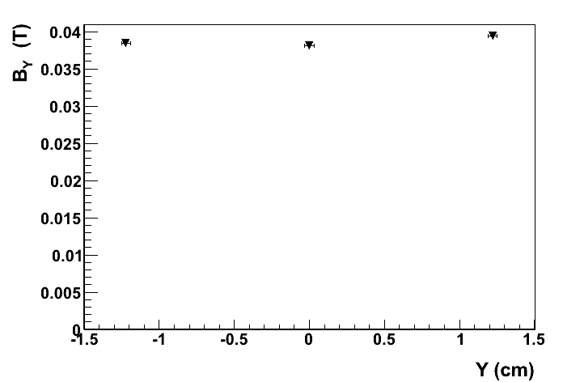
Off-Axis Field Inside Inner Conductor
Z = 21cm
Z = 41cm
Z = 71cm

Slide 23
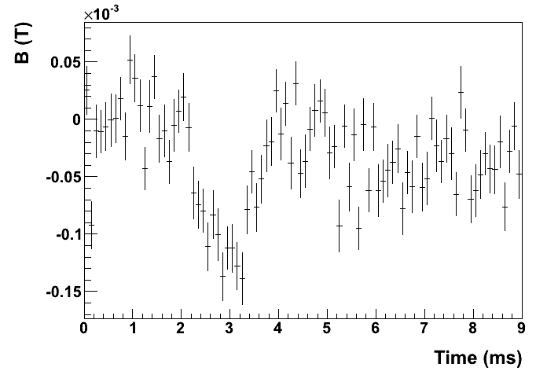
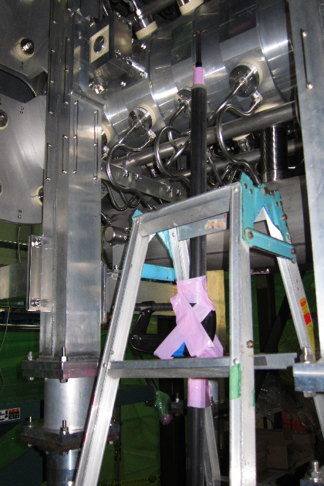
Field Outside of Horn
At most 1.5Gs (0.00015 T) outside outer conductor
Notes:
Just to show that this is not some sort of external field that is

Slide 24
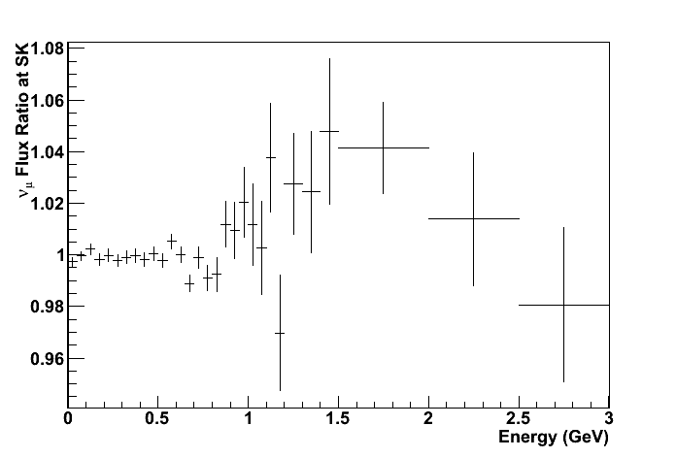
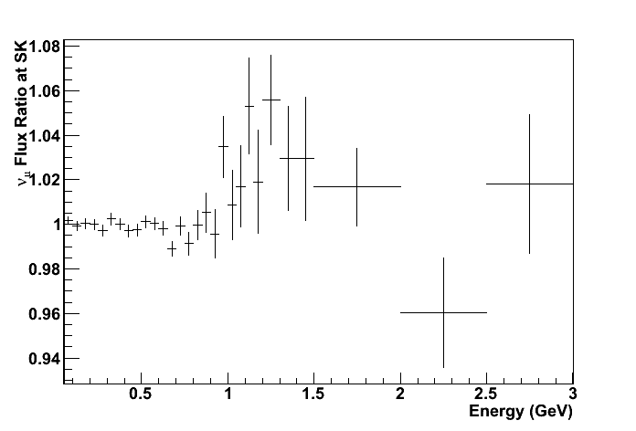
Effect On Neutrino Flux
Maximum field strength at beam timing: (0.057, 0.035,0.0)T
Upper bound on effect on neutrino flux found by implementing in beam MC maximum field inside inner conductor of just horn 1 (top) and all 3 horns (bottom)
Effect less than 2% for most energy bins.
Effect included in T2K flux prediction

Slide 25
Conclusions
Azimuthal Field
  Excellent agreement between measured field and expectation on all horns.
Spare Horn 1 On-Axis Field
  Field with anomalous time-dependence was measured
  On-axis field strongest near center of horn
  Presence of on-axis field confirmed with pickup coils
  Field magnitude small compared to nominal azimuthal field
  Effect on neutrino flux is very small
  Physical cause unknown
  Plan to continue this investigation with spare horn 2 measurements

