Slide 1


Accelerating Science and Innovation
CERN Report
R.-D. Heuer, CERN ECFA meeting, PSI, July 19, 2012
Notes:
1

Slide 2
Accelerating Science and Innovation
non - LHC
Notes:
2

Slide 3
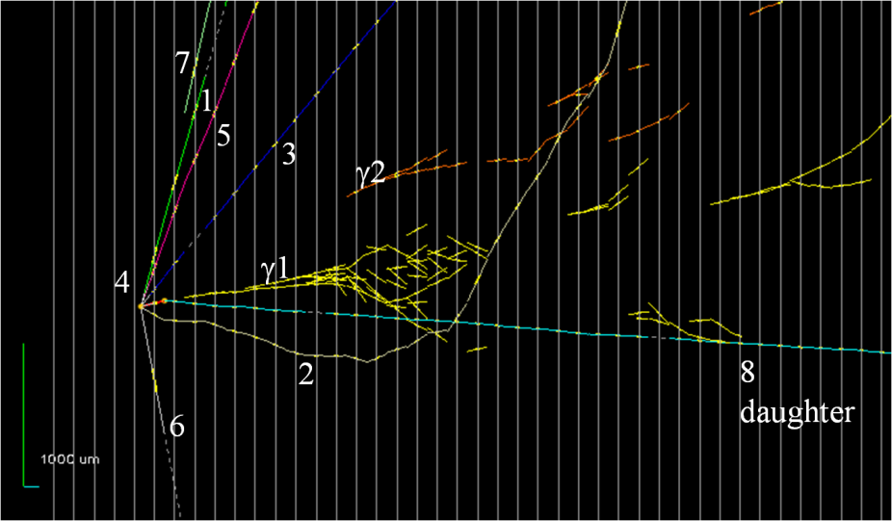
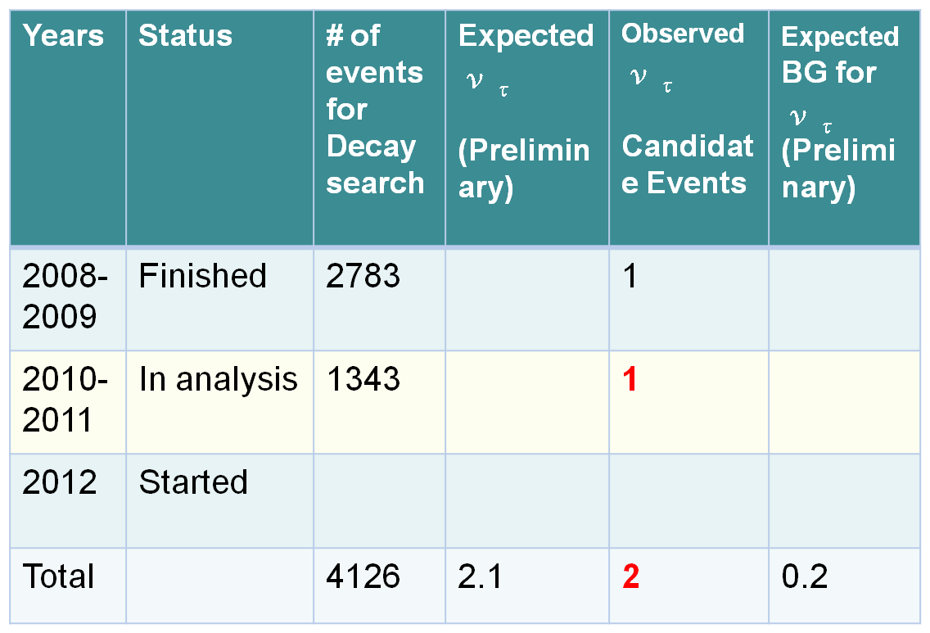
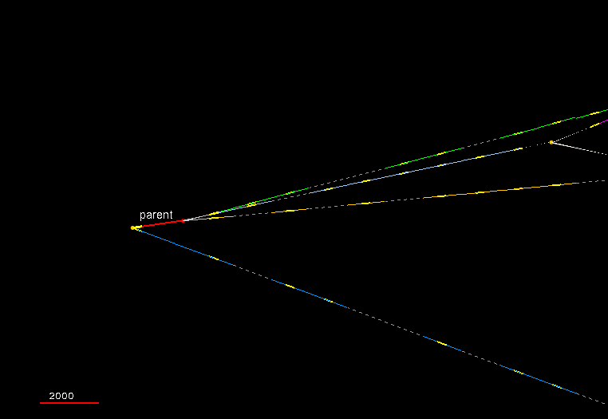
OPERA ν_{τ} appearance
Parallel talk by Marilisa De Serio
Status of the analysis
  2 candidate events so far ( expected 2.1 with 0.2 background events)
  A few more events are under study.
  Progress in estimating detection efficiency and BG.
First cand. (τ→1had kink) reported in 2010
2nd Cand (τ→3h) reported in June 2012

Slide 4
Accelerating Science and Innovation
LHC
Notes:
4

Slide 5
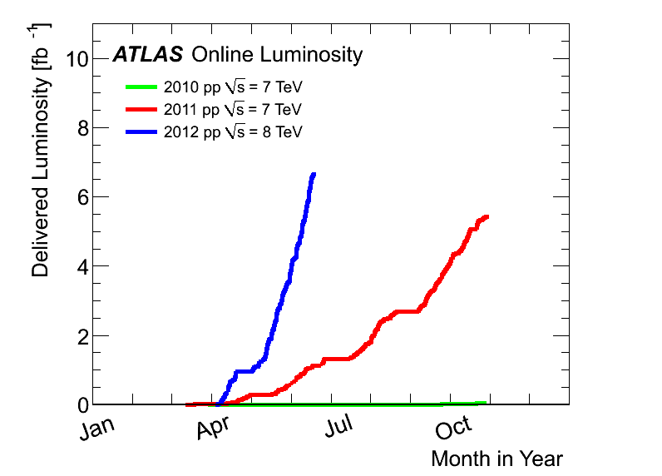


Slide 6
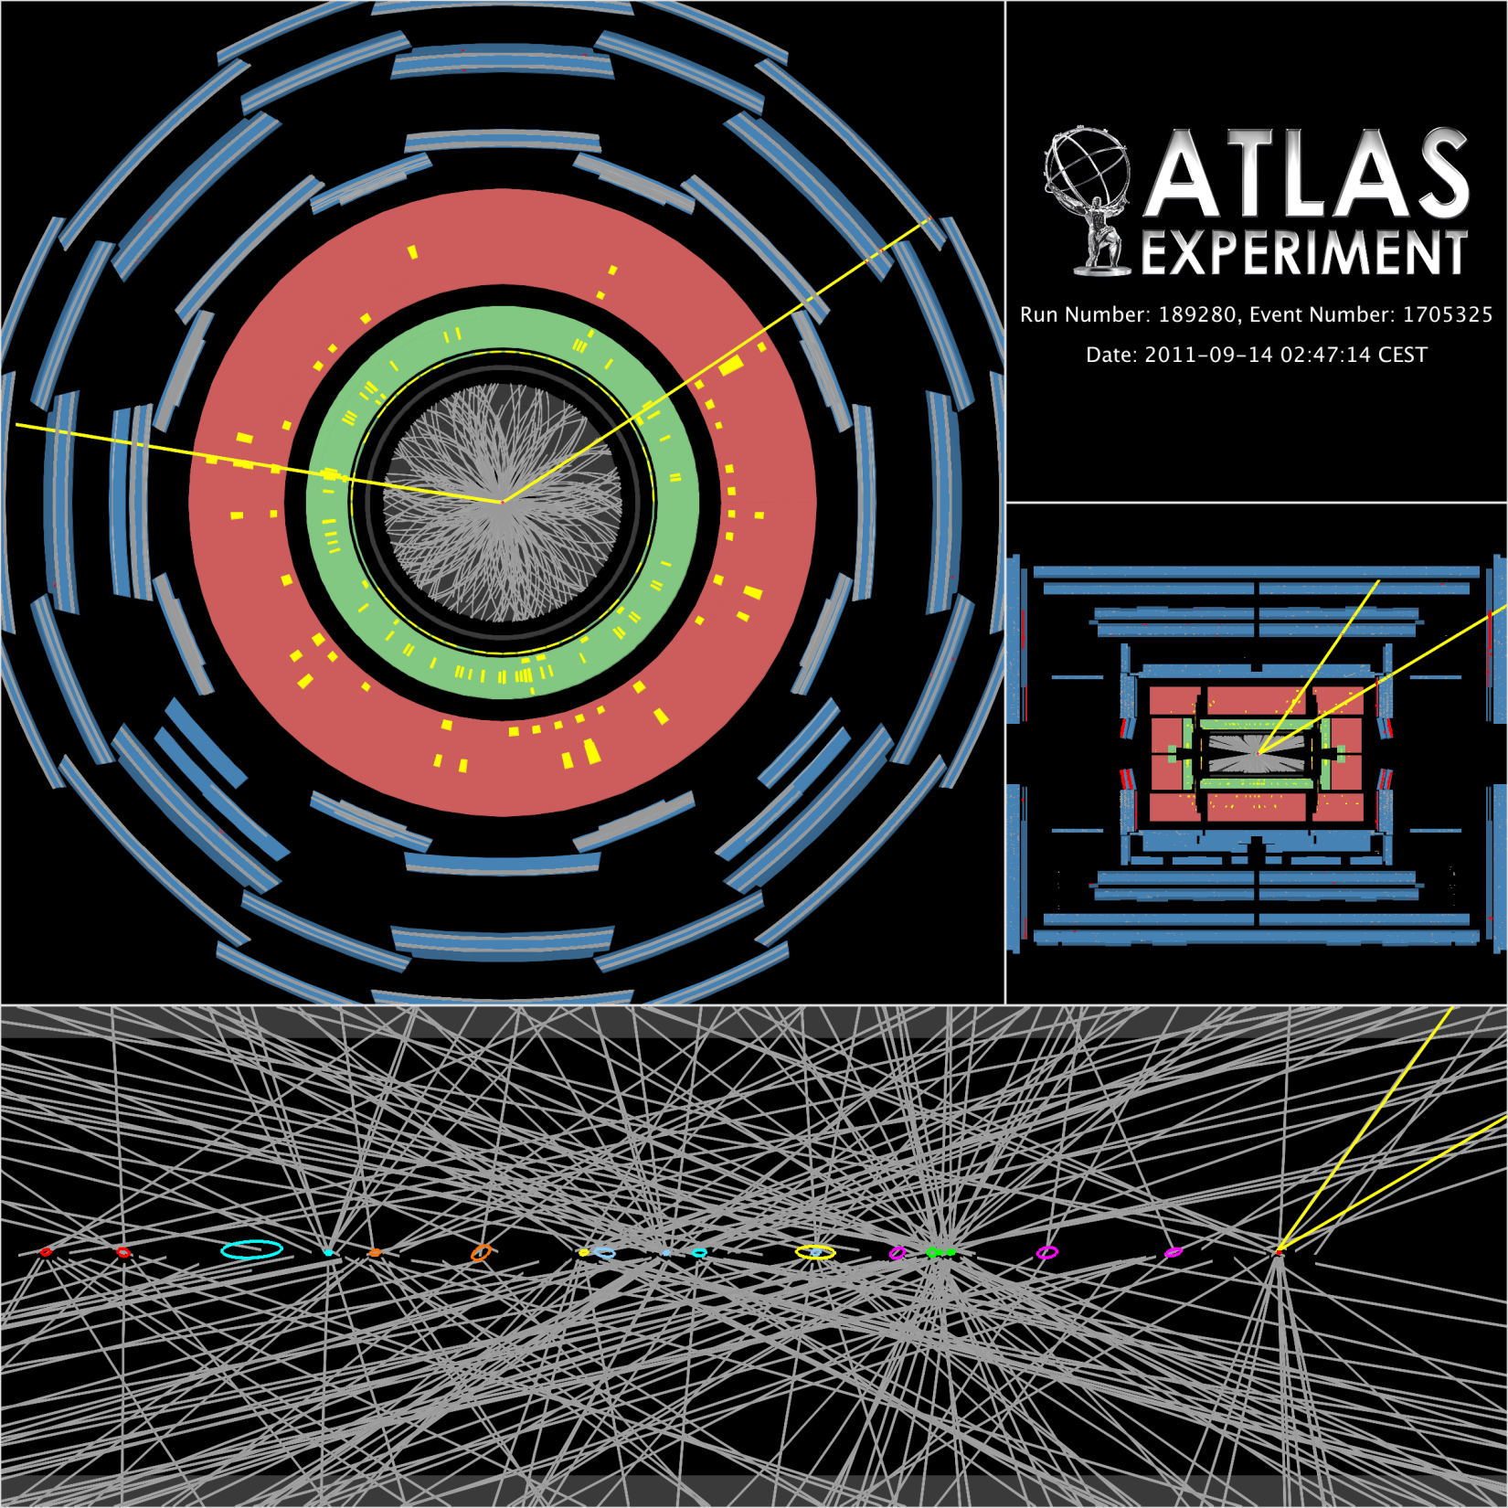
Pile-up
Experiments
record data of high quality with high efficiency at luminosities not expected at such an early stage
Z → μμ event with 20
reconstructed vertices
(ellipses have 20 σ size
for visibility reasons)

Slide 7
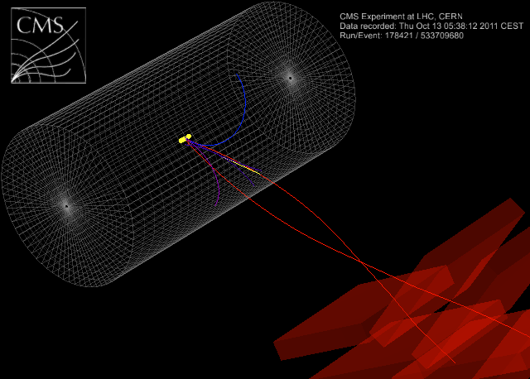
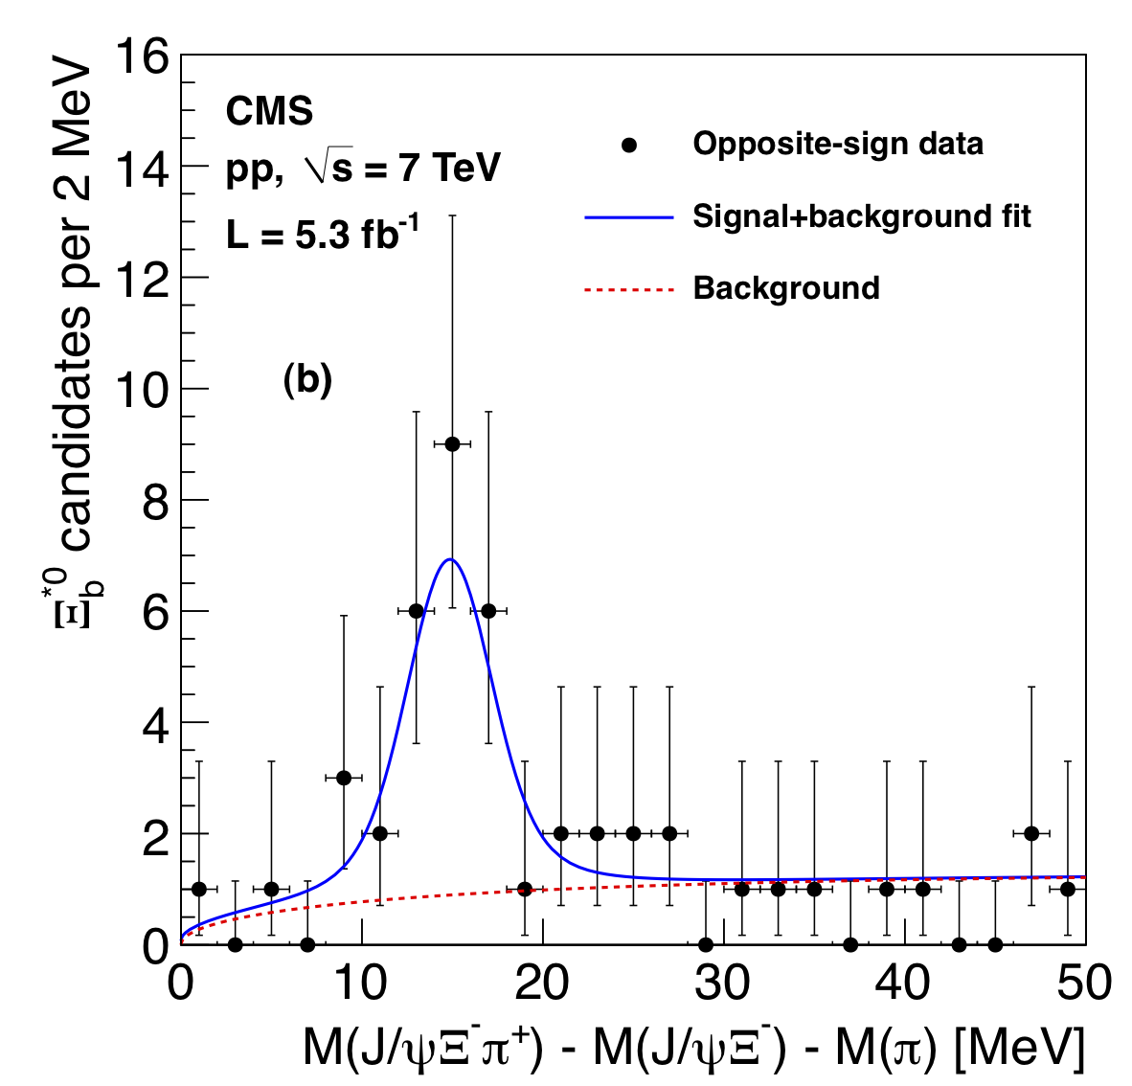
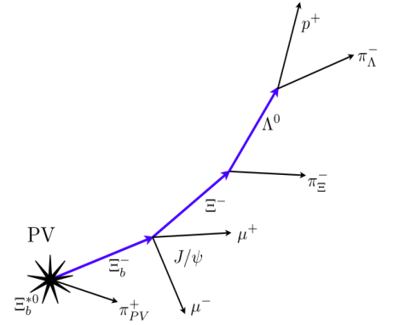
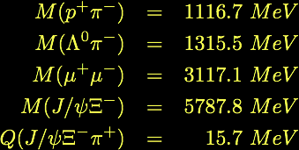
New ParticleDiscovery
The Ξ_{b}*⁰ involves elegant cascade that CMS tracker handles beautifully.
π from PV
Candidate event display
proton
Λ⁰
π from Λ⁰
π from Ξ⁻
muons
Ξ_{b}*⁰→Ξ_{b}⁻π⁺→Ξ⁻J/ψ π⁺→Λπ⁻μ⁺μ⁻π⁺→p⁺π⁻π⁻μ⁺μ⁻π⁺

Slide 8
Accelerating Science and Innovation
Search for the Higgs Boson
Notes:
8

Slide 9
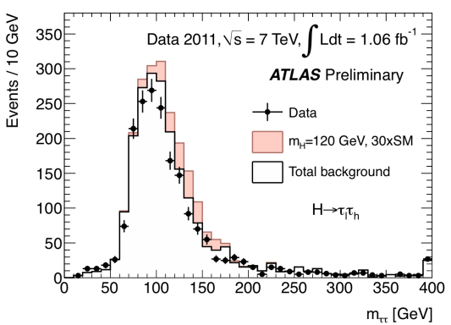
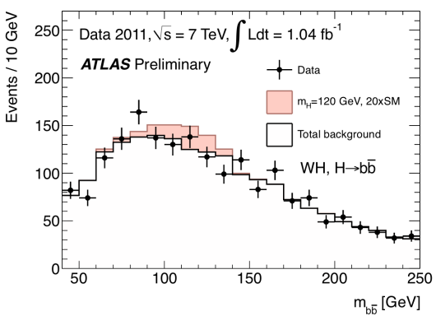
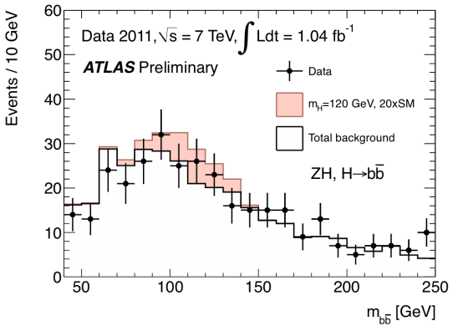
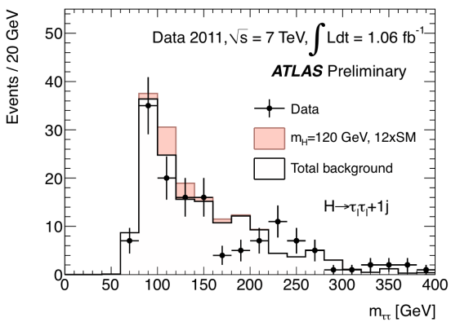
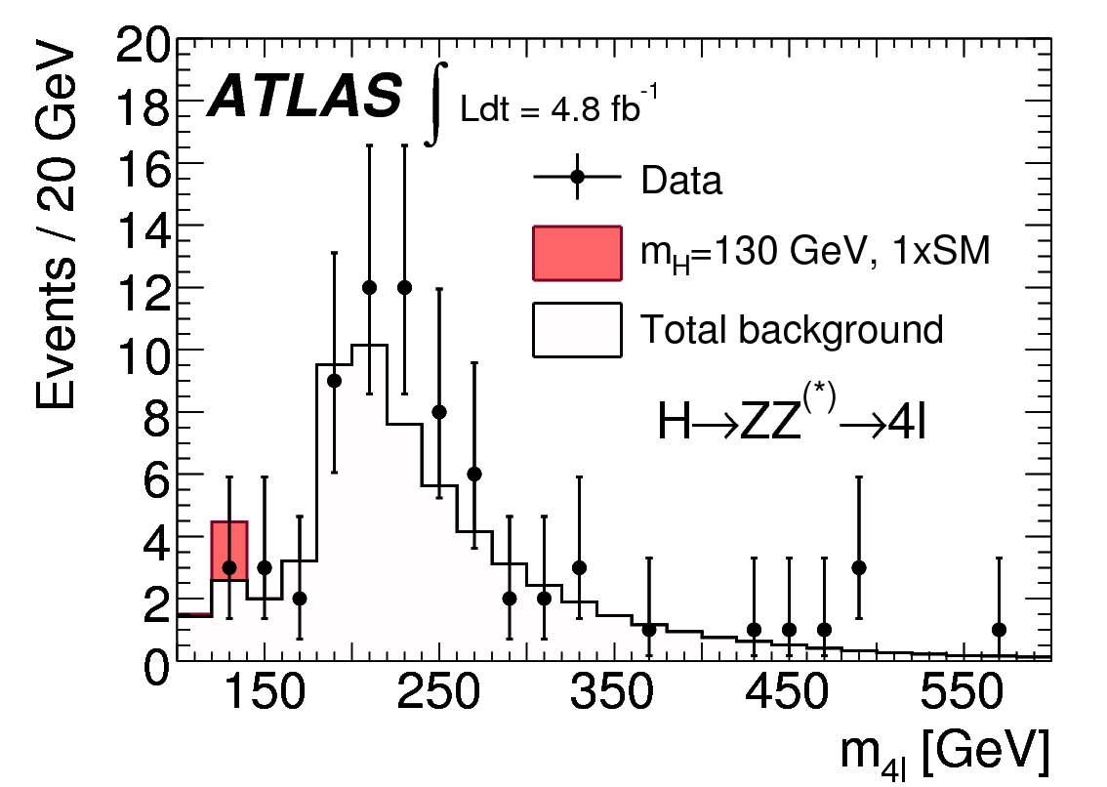
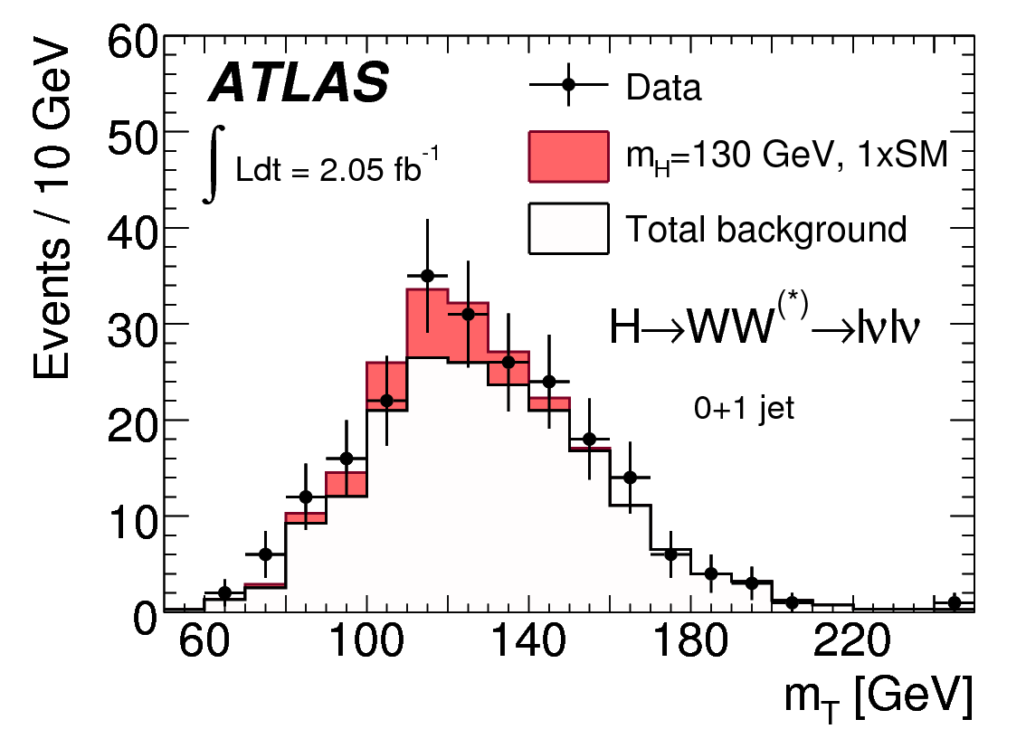
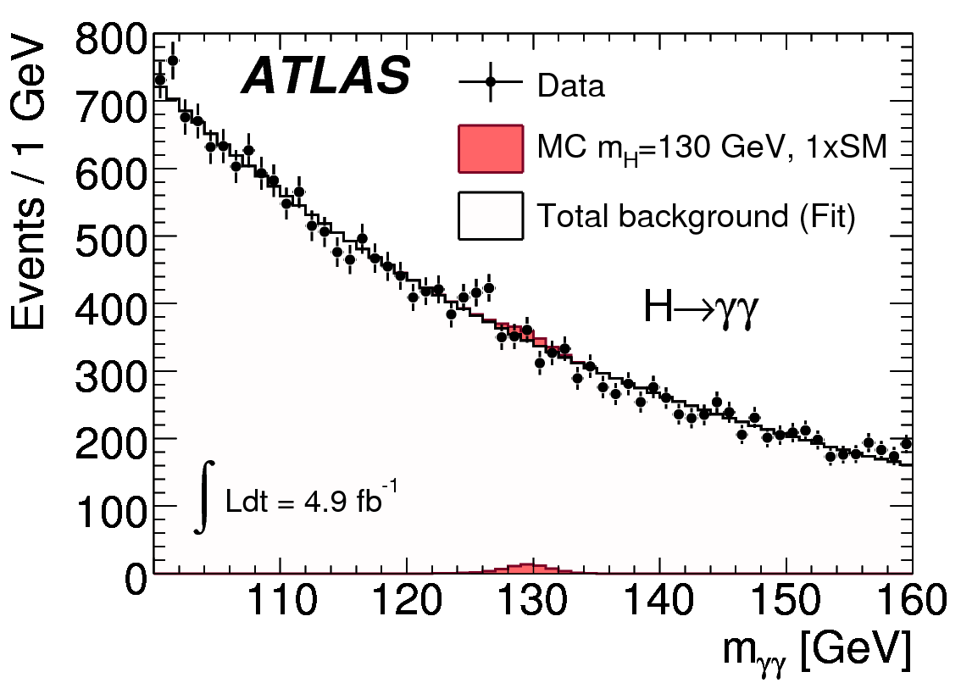
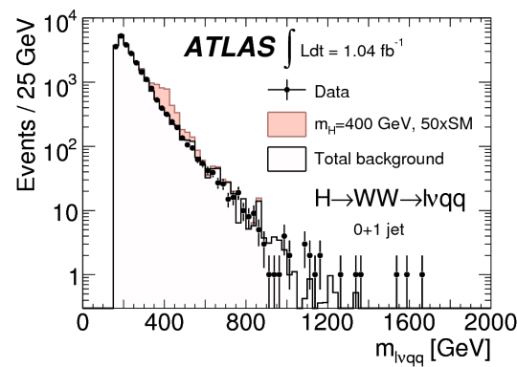
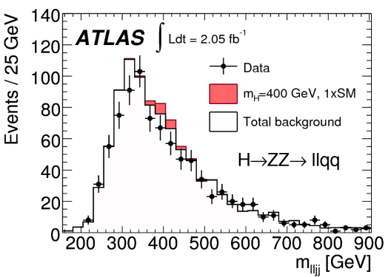
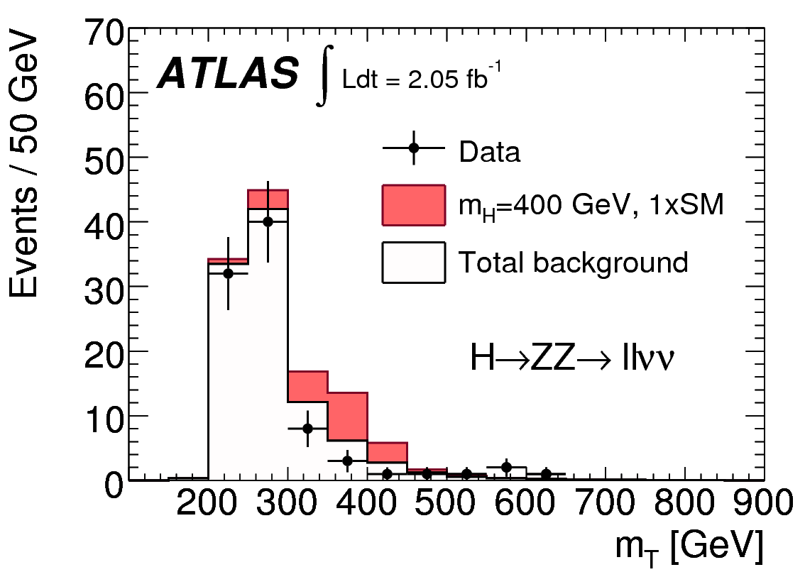
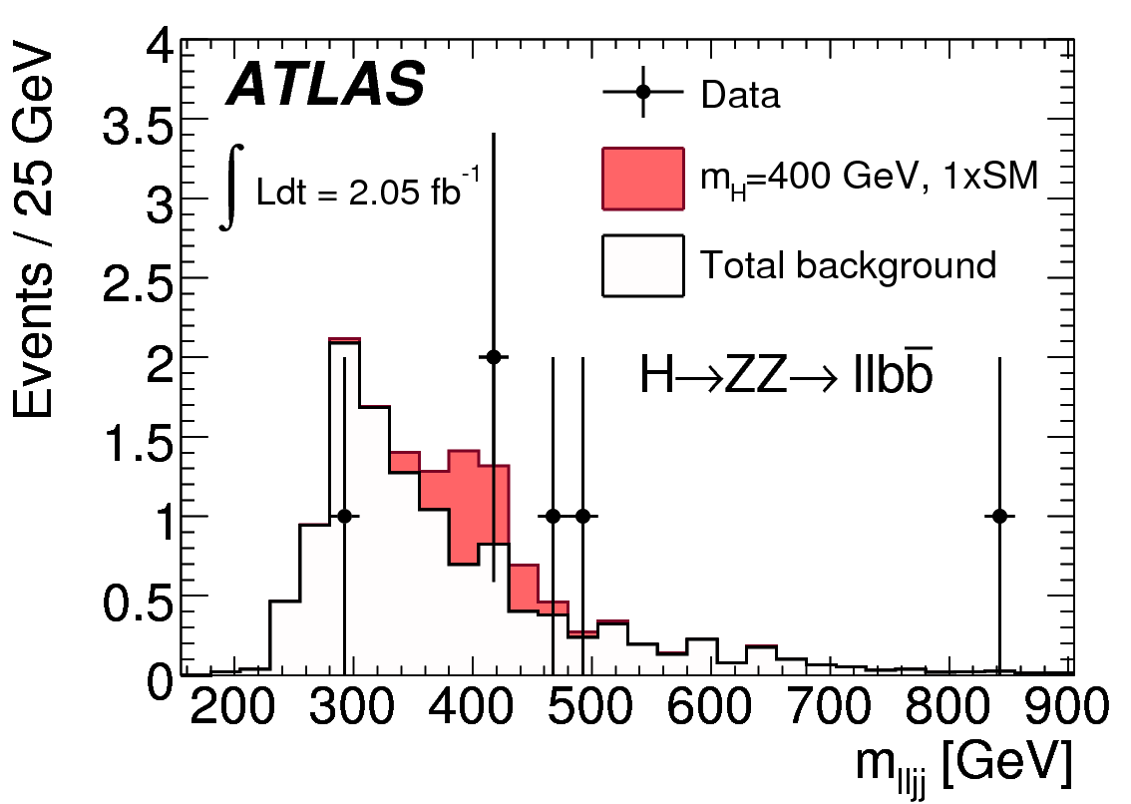
SM Higgs

Slide 10
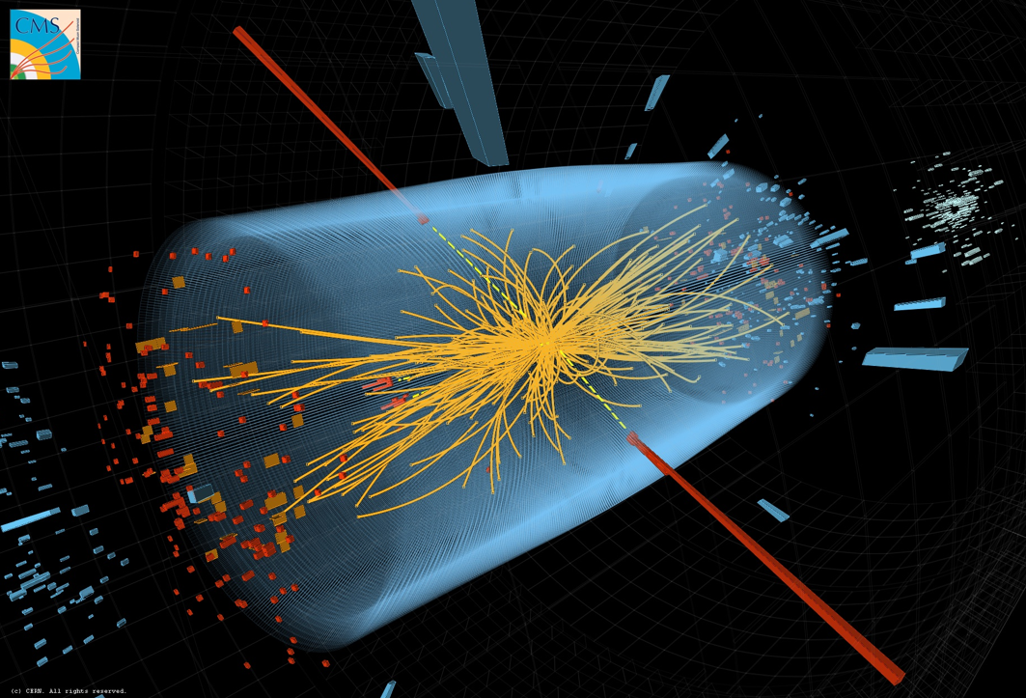
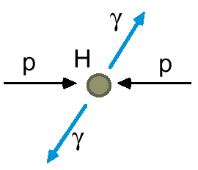
A Collision with two Photons
A Higgs or
a ‘background’
process without
a Higgs?

Slide 11
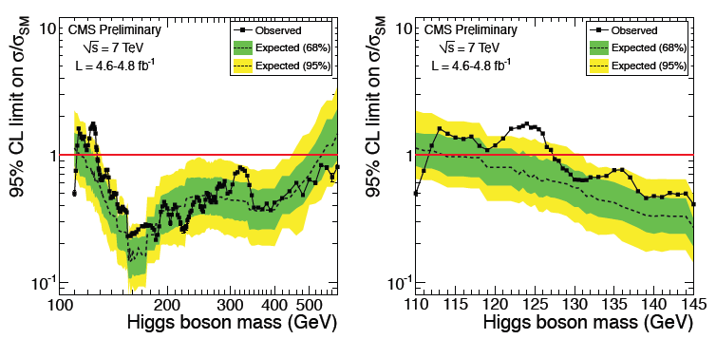
Status beginning of July 2012
It took ~30 years to experimentally restrict the SM Higgs mass to be above 114 GeV
CMS and ATLAS independently eliminated another ~475 GeV of the range in 2011

Slide 12
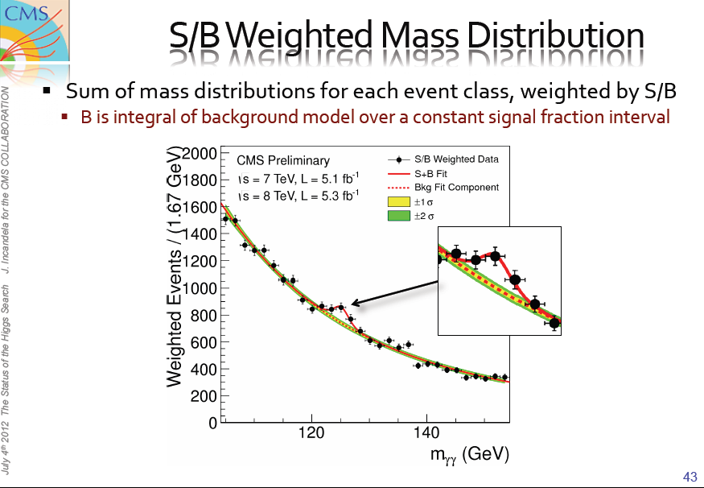

Slide 13
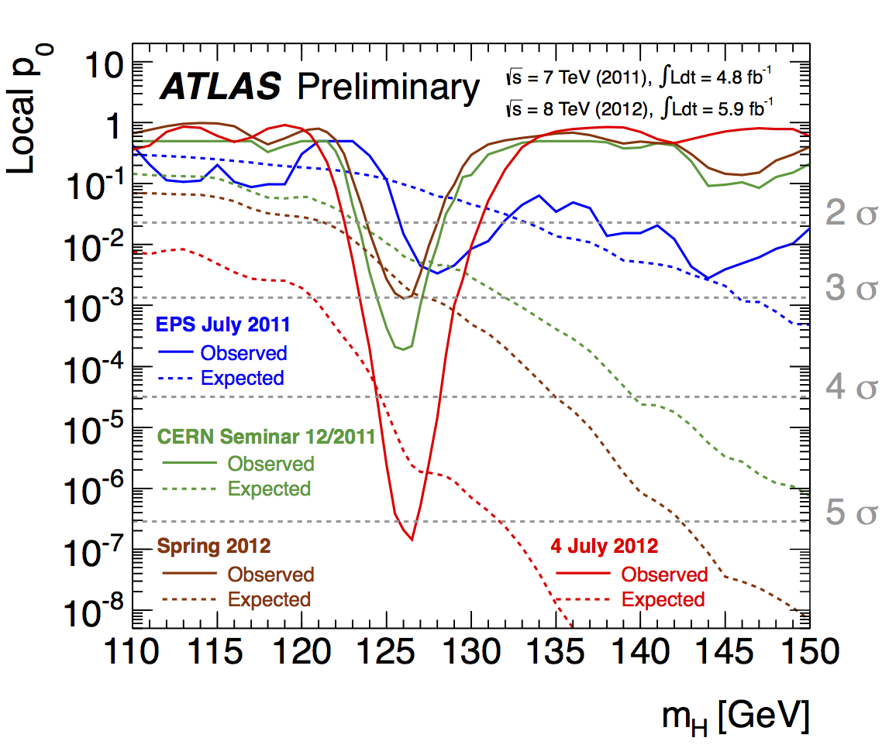
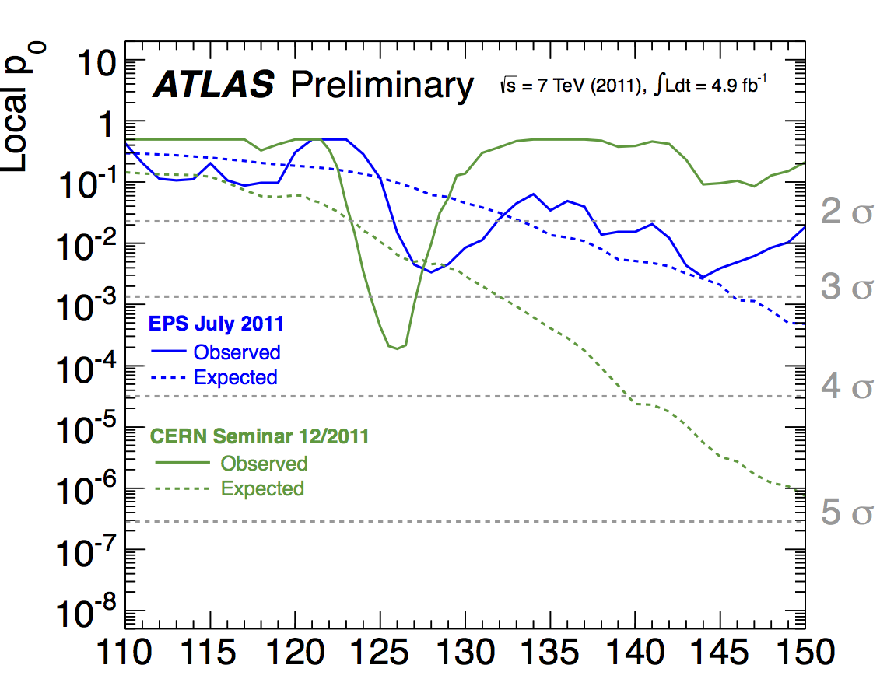
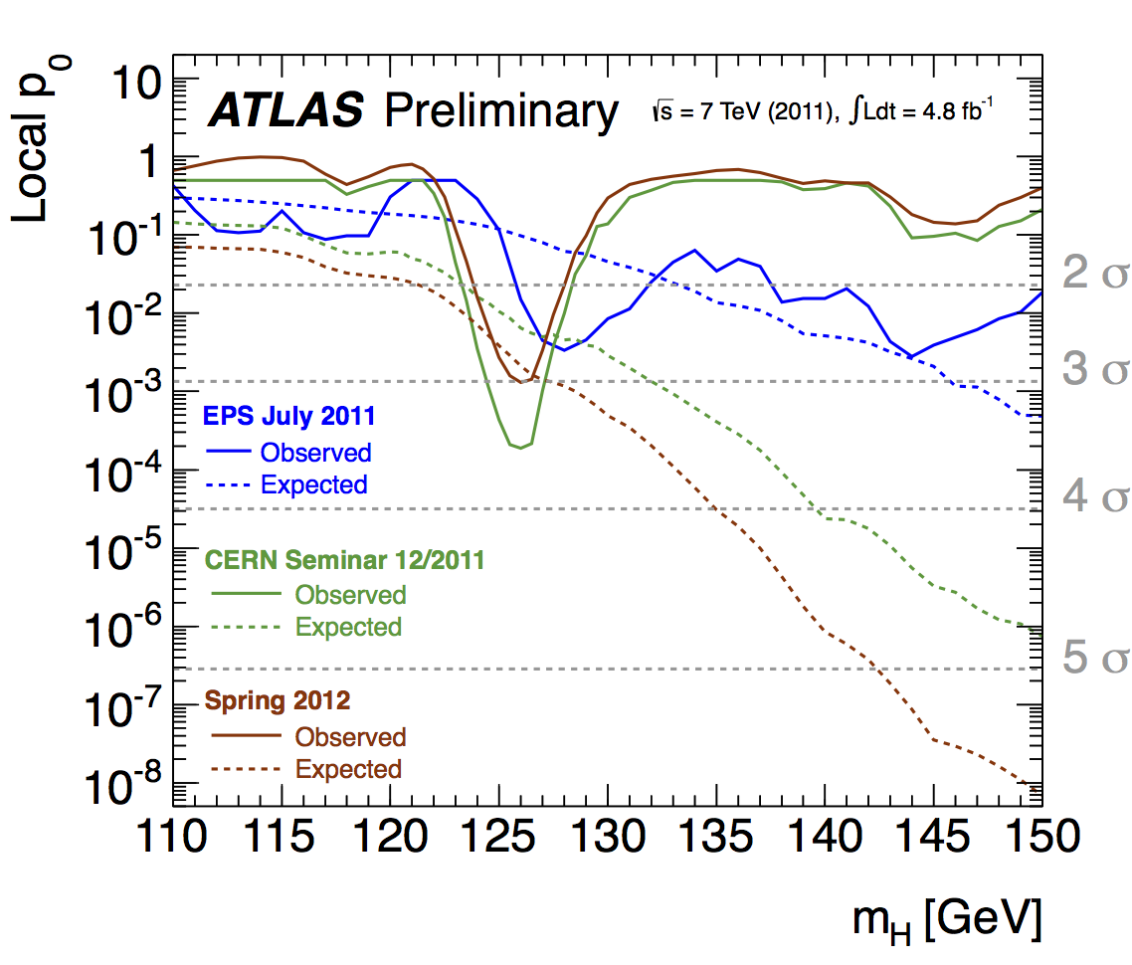
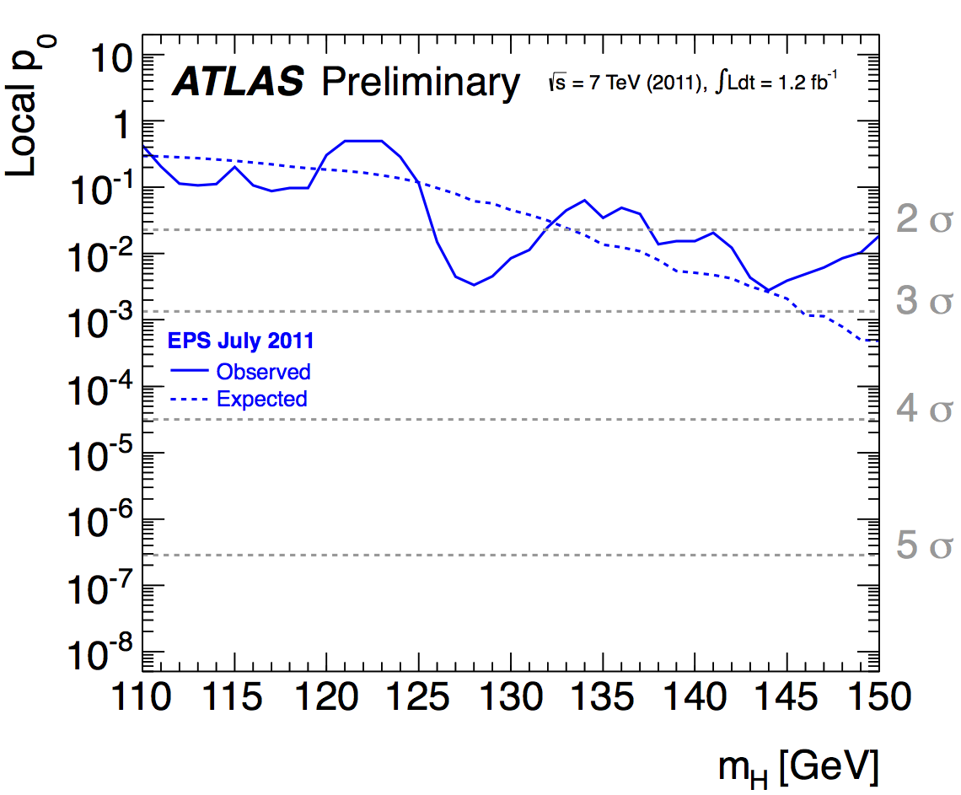
Evolution of the excess with time
Energy-scale
systematics
not included

Slide 14
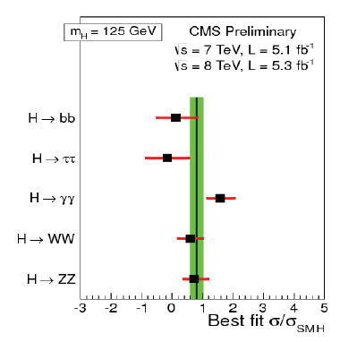
… but that’s only the beginning !
What’s next ?
Measure the properties of the new particle
with high precision

Slide 15
… is it a scalar particle ?
… is it the Higgs Boson?
or one of several?
… its properties could give information
on Dark Matter
… its properties could give first hints
on Dark Energy
Present run extended by seven weeks before going into a 20 months shutdown

Slide 16
… a few words about LHC and Higgs
at Melbourne
at ESOF2012 in Dublin

Slide 17
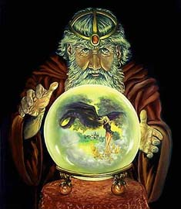
The predictable future: LHC Time-line
2009
Start of LHC
Run 1: 7 and 8 TeV centre of mass energy, luminosity ramping up to few 10³³ cm⁻² s⁻¹, few fb⁻¹ delivered
LHC shut-down to prepare machine for design energy and nominal luminosity
2013/14
Run 2: Ramp up luminosity to nominal (10³⁴ cm⁻² s⁻¹), ~50 to 100 fb⁻¹
2018
Injector and LHC Phase-I upgrades to go to ultimate luminosity
Run 3: Ramp up luminosity to 2.2 x nominal, reaching ~100 fb⁻¹ / year accumulate few hundred fb⁻¹
~2022
Phase-II: High-luminosity LHC. New focussing magnets and CRAB cavities for very high luminosity with levelling
Run 4: Collect data until > 3000 fb⁻¹
2030

Slide 18
The predictable future: Strategy
Continuously throughout the years (mainly during shutdowns):
Performance-Improving Consolidation i.e. replace (aging) components by better performing ones
2) Depending on Physics Requirements:
High Luminosity LHC (~2022) i.e. upgrade to deliver a total of some 3/ab

Slide 19

Key message
LHC
There is a program at the energy frontier with the LHC for at least 20 years:
8 TeV
14 TeV design luminosity
14 TeV high luminosity (HL-LHC)

Slide 20
Key Messages to June Council
Logical succession/continuation of previous MTP(s)
Physics (and other) Goals unchanged
All options (R&D and studies) for the future kept open (within a global scenario) until outcome of European Strategy update known, i.e. until next year’s MTP when priorities might need to be adjusted
In addition a ten years outlook (“LTP”) is presented
This MTP assumes
- no increase of contributions from Member States
- 60 MSfr/yr contribution to stabilize pension fund
- balancing the deficit by 2020
Not all projects/options are (fully) funded

Slide 21
beyond LHC ?
Notes:
21

Slide 22
R&D Projects and Studies (examples)
LC (CLIC, ILC)
HE-LHC
LHeC
all continuing as planned
Neutrino beam line
SPS area more promising than reconstruction of the PS beam line
Study of “LEP3” initiated

Slide 23
Key message
All projects need continuing accelerator and detector R&D;
All projects need continuing attention concerning a convincing physics case;
close collaboration exp-theo mandatory
so that the right decision can be made when the time comes to identify the next energy frontier accelerator (collider).
Today, we need to keep our choices open.
Update of the European Strategy
→ setting priorities

Slide 24
→ Need to present and discuss all these projects in
an international context before making choices
→ Need to present physics case(s) always taking
into account latest results at existing facilities
→ Need to present (additional) benefits to society
from the very beginning of the project
→ Need to have excellent communication and
outreach accompanying all projects

Slide 25
(Editorial)
. . .
.
.
(10bn)

Slide 26
Fixed Target Program (examples)
HIE-Isolde as approved and ongoing
AD and ELENA as approved; extension for GBAR and addition of a storage ring under consideration
n-TOF (with EAR2) as approved
Dirac at PS will terminate end 2012
Continuation of CNGS beyond 2012 unlikely but not decided yet

Slide 27
Miscellaneous
AMS
One year at ISS, all Astronauts from that flight at CERN 25 July
Open Days 2013: 27-29 September
CERN 60th anniversary 2014
Propose CERN events in member states
Summer Students 2012
269 students from 71 countries

Slide 28
CERN Membership
Membership
Serbia: ratified agreement March 2012
Cyprus: signature expected October 2012
Slovenia and Turkey: process ongoing
Associate Membership
Ukraine: Task Force report due September Council
Brazil: Application File received
Russia: official application, File in preparation

