Slide 1
LEP Beam-Beam Limit
R. Assmann
LEP3 Day, 18.6.2012, CERN

Slide 2
Introduction
The beam-beam limit in e+e- storage rings is a difficult subject, studied by many colleagues over the years. No complete overview in 10 min!
Several limits can be defined and exist.
Here: Experience at LEP.
Empirical stochastic model for the achievable beam-beam parameter versus energy and time.
Basically: Beam-beam interaction blows up vertical emittance which in turn limits achievable beam-beam parameter and luminosity.

Slide 3

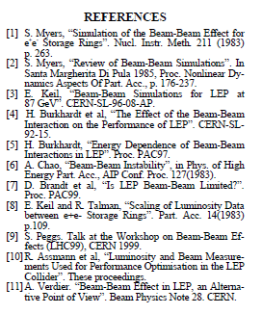
Reference
EPAC 2000

Slide 4
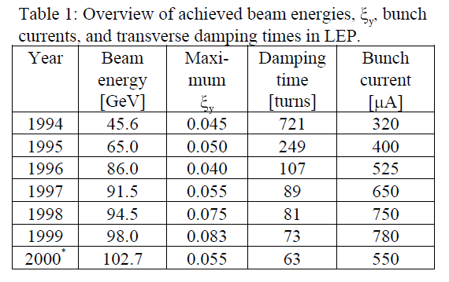
LEP Measurements

Slide 5
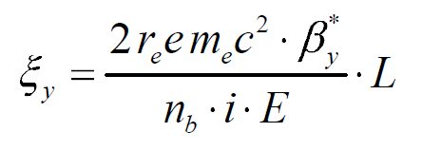
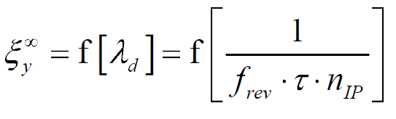
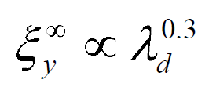
Theory I
Vertical beam-beam parameter
Prediction S. Peggs
Damping Decrement

Slide 6
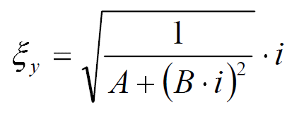
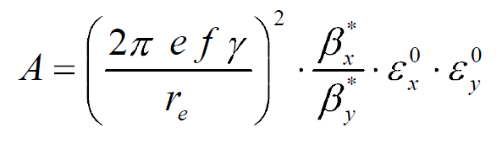
Parametric Model
simple stochastic theory of the beam-beam
interaction to derive the relationship between the vertical beam-beam parameter and bunch current i
A is a machine and optics dependent number times the zero current (unperturbed) vertical emittance (if the horizontal beam-beam blow-up is small).

Slide 7
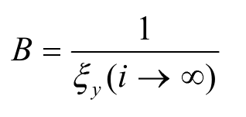
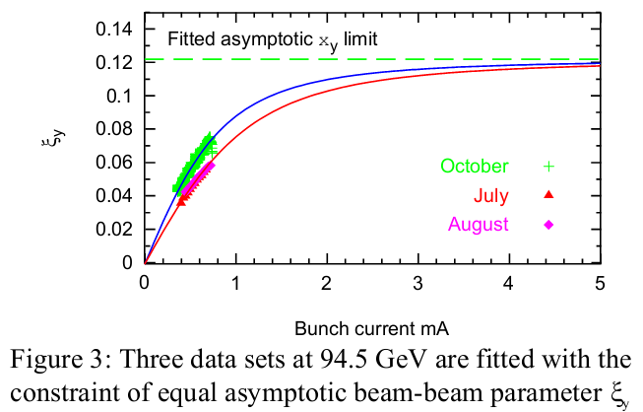
B gives the inverse asymptotic vertical beam-beam parameter

Slide 8
Unperturbed Vertical Emittance
Means: Vertical emittance unperturbed by beam-beam.
For zero vertical orbit and therefore zero vertical dispersion, it is assumed to approach zero (of course it would then be limited by other effects).
Here it is assumed that the driving blow-up will be generated by beam-beam, damped by radiation damping.

Slide 9
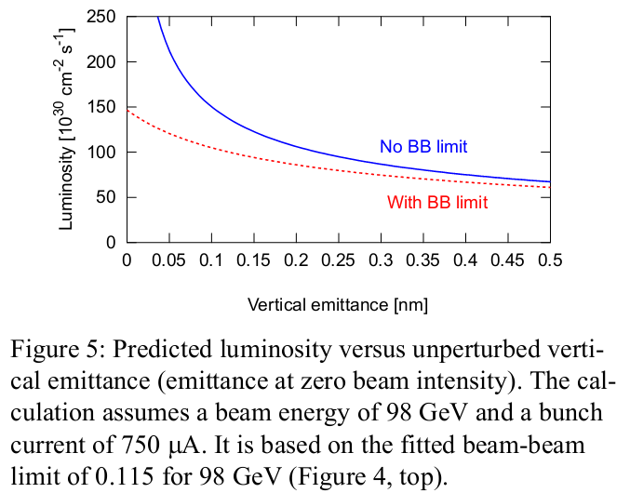
Beam-Beam Limits Luminosity
(Blowing up the Unperturbed Vertical Emittance)

Slide 10
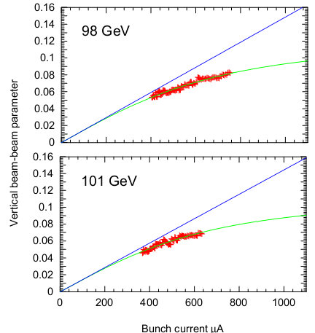
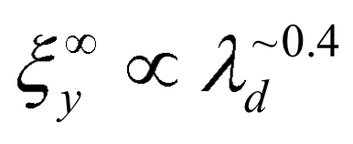
LEP Result on Scaling with Energy

Slide 11
Conclusion
Measured max. vertical beam-beam parameter:
0.083
Fitted, achievable vertical beam-beam parameter at ~100GeV:
0.11 – 0.12
Scaling with damping decrement:

