Slide 1
Fast Ramping Dipole Design and Status
Henryk Piekarz
Accelerator Physics Center, FERMILAB

Slide 2
Motivation
Several recently proposed accelerator systems (SRCS for Project X, PS2 and LHeC at CERN) as well as some industrial applications, would benefit if the synchrotrons based on the dipole magnets of:
B ≤ 2 T , and
dB/dt ≤ 10 T/s
could be built using moderately difficult technology while featuring high-level performance with low construction and operational costs.
For B ≤ 2 T , dipole field can be shaped by magnetic core and generated by a single-turn conductor – inexpensive but highly performing technology.

Slide 3
Critical Elements for Rapid Cycling Dipole Design
Superconductor choice
Magnetic core and cable design for minimized power loss
Cable radiation hardness and longevity
Core lamination and operating temperature
Low complexity of quench detection and protection system
Low complexity of magnet string power system
Low cost and complexity of magnet string cryogenic system
Low cost and complexity of magnet string and assembly work
Rapid cycling accelerator dipole powered with HTS transmission-line cable can satisfy all of the above

Slide 4
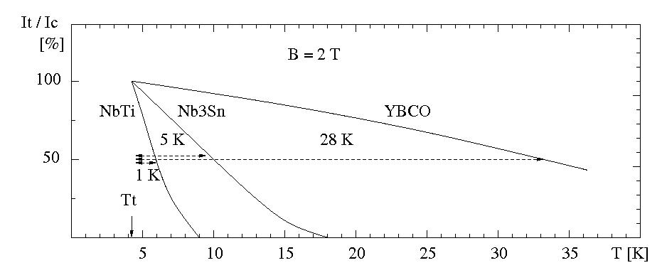
Superconductor Choice (I) Operational Temperature Margin & Radiation Hardness
Temperature margin for safe and possibly quench-free operations is make or break
parameter of superconducting power cable for rapid-cycling magnet applications.
For operation at 4.2 K, It /Ic = 50% and 2 T field, YBCO offers temperature margin
30 times wider than with NbTi, and 6 times wider than with Nb₃Sn conductors.
YBCO strand (344C-2G) has also shown strong resilience to radiation ! *)
*) R. Gupta, “Radiation Studies for HTS Magnets”, www.bnl.gov/magnets/staff/gupta/Talks/FAM08/fam-radiation.pdf

Slide 5
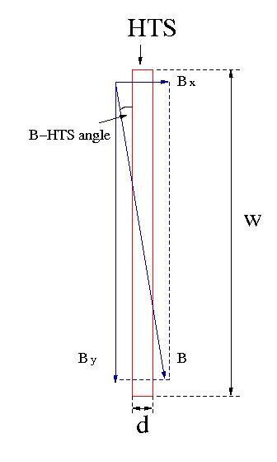
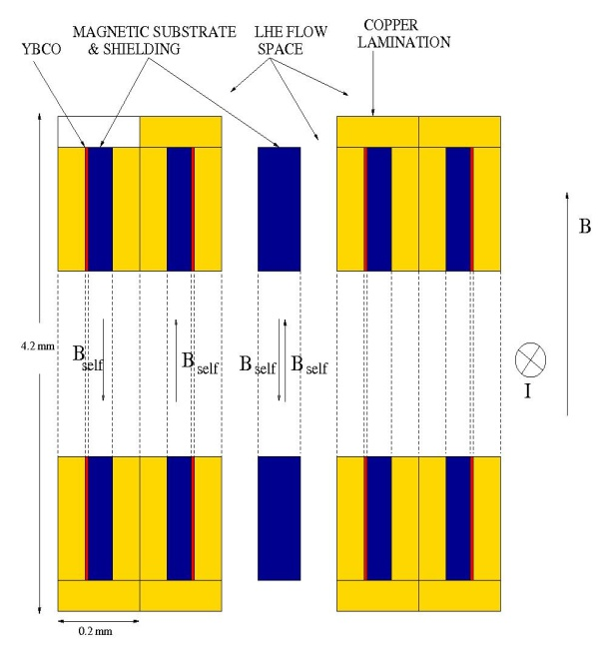
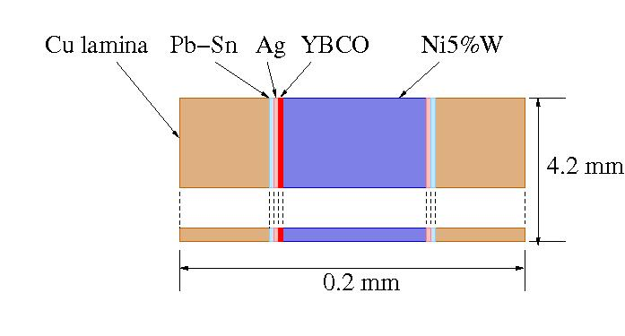
Superconductor Choice (II)
Minimization of AC Losses
(I) – If HTS tape and magnetic field in the cable cavity are parallel to each other the AC power losses are strongly minimized as only the narrow edge (2 µm) of HTS strand is exposed to the magnetic field. It is critical that B-HTS angular orientation is as parallel as possible.
(2) – As magnetic substrate (Ni5%W ) is part of the HTS tape, pairing strands with substrate sides facing each other helps to suppress the self-field coupling induced power loss.

Slide 6
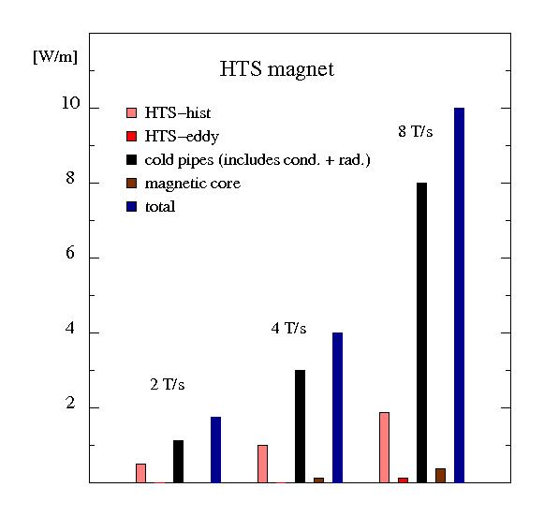
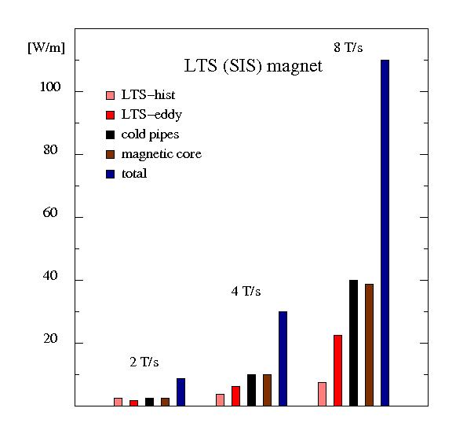
HTS Magnet Power Losses with Perfect HTS->B-field Alignment
HTS: I _{c} (5 K) = 1 x 107 kA B = 1.9 T, Core: Electrical laminated steel, 0.1 mm
I _{c} (15 K) = 1 x 96 kA, T _{oper} = 5 K, ΔT _{oper} = 10 K
LTS (SIS): I _{c} (4.7 K) = (16 x 11.9) = 190 kA B = 1.9 T, Core: Electrical laminated steel, 1 mm
I _{c} (6.7 K) = (16 x 4.5) = 72 kA T _{oper} = 4.2 K, ΔT _{oper} = 2.5 K (in practice ≤ 1 K)

Slide 7
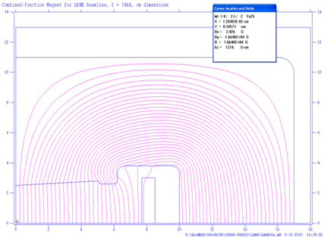
Synchrotron Magnet Design
Transmission-line power cable (single winding) facilitates magnetic design
which allows minimization of B-field -strand angular divergence , but the
placement , width and height of the current carrying HTS stack, and the
cable cavity size/shape in magnetic core must be carefully considered.
Combined function magnetic design shown above features B-field to strand angle of ~ 4⁰ when averaged over entire cable space.
Beam gap: 100 mm (H) x 50 mm ( V @ X = 0)
B =1.7 T @ I = 68 kA, dB/ dx = 4 T/m
.
B_{y} and dB_{y}/dx show no dependence on Y
in a wide range of horizontal direction

Slide 8
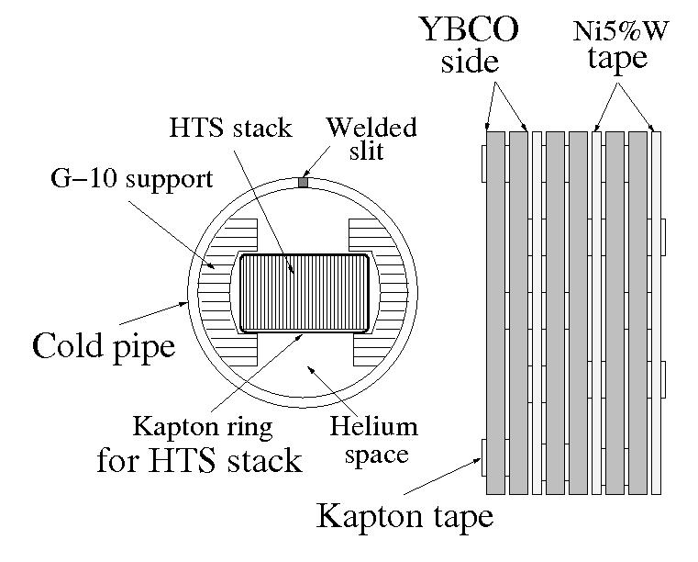
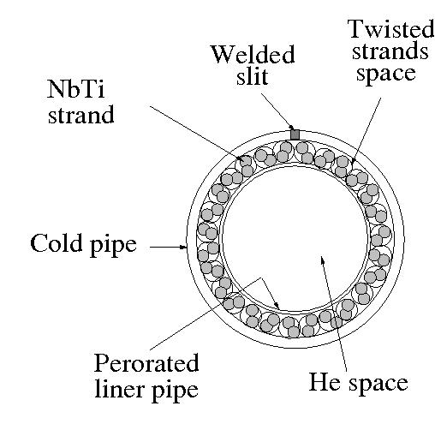
HTS & LTS Cables for Power Loss Test in Sweeping Magnetic Field
Test cables:
1.4 m long HTS and LTS cables to carry 16 kA current at 2 T
with nominal 10 K and 2 K temperature margins, respectively.
HTS cable stack consists of 10 pairs of 344C-2G strands
(4.5 mm x 0.2 mm) with 9 Ni5%W tapes (4 mm x 0.07mm)
between the strand pairs
LTS cable consists of 23 twisted pairs of 0.8 mm NbTi strands. The LHe cooling channel is 6 times that of SIS magnet cable to be about equal with the HTS cable
Top view
Cross-section
Cables were exposed to 0.5 T ramping field of up to 20 Hz rep. rate.
HTS cable was rotated in +/- 10⁰ angle range relative to B-field.
LHe coolant of 8 K, 0.23 MPa and flow rate (0.4 - 0.8) g/s was used.

Slide 9
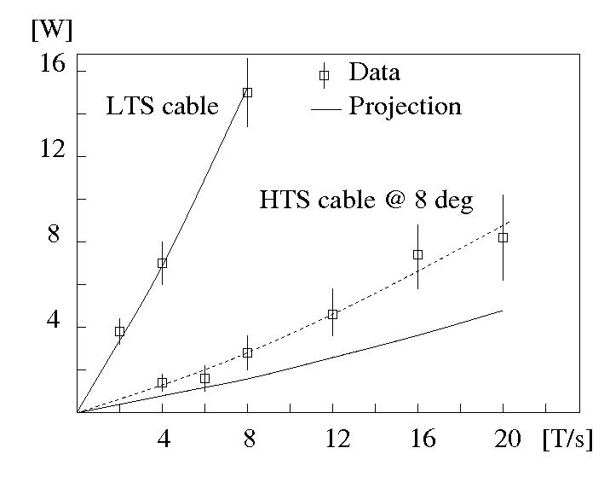
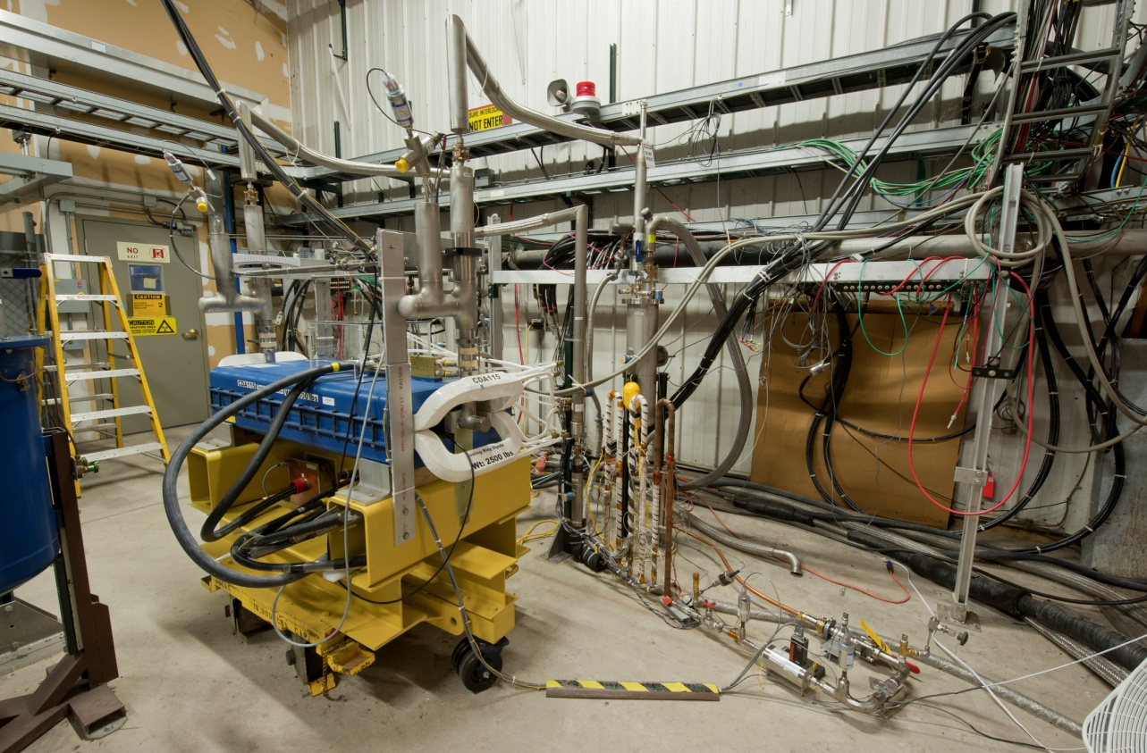
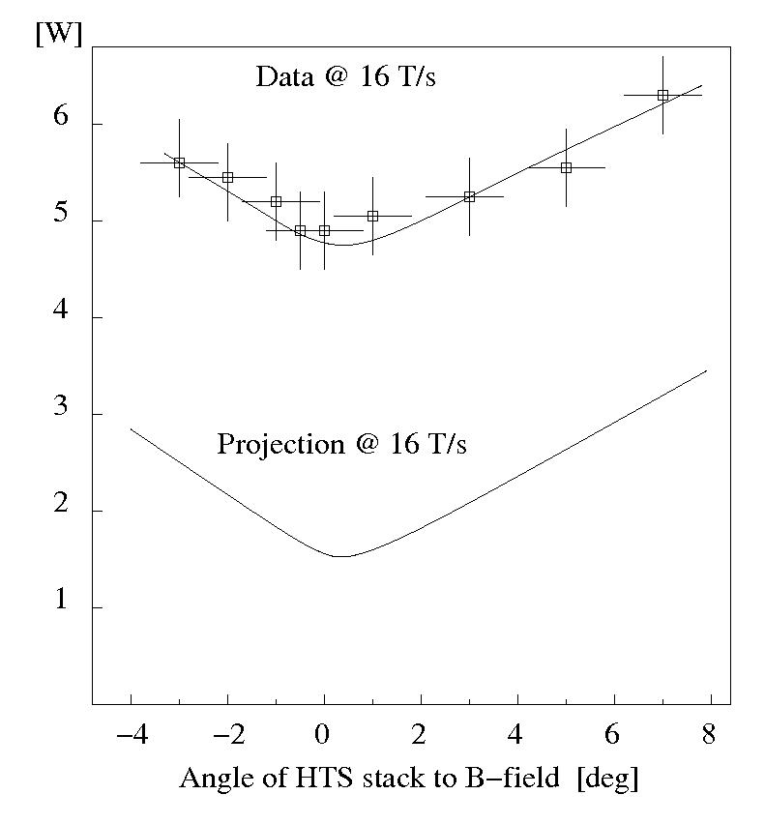
Test of HTS & LTS Cables in 0.5 T Sweeping Magnetic Field
Test results *): (1) P _{meas} (LTS) = P _{proj} (LTS)
(2) P _{meas} (LTS) = ~ 5 x P _{meas} (HTS)
(3) P _{meas} (HTS) = ~ 2 x P _{proj} (HTS) **)
**) Probable reason: cable movement in plane parallel to field, or HTS stack – B misalignment, or cable twist
*) H. Piekarz et al., IEEE, Proc. MT-22, Marseille, 2011

Slide 10
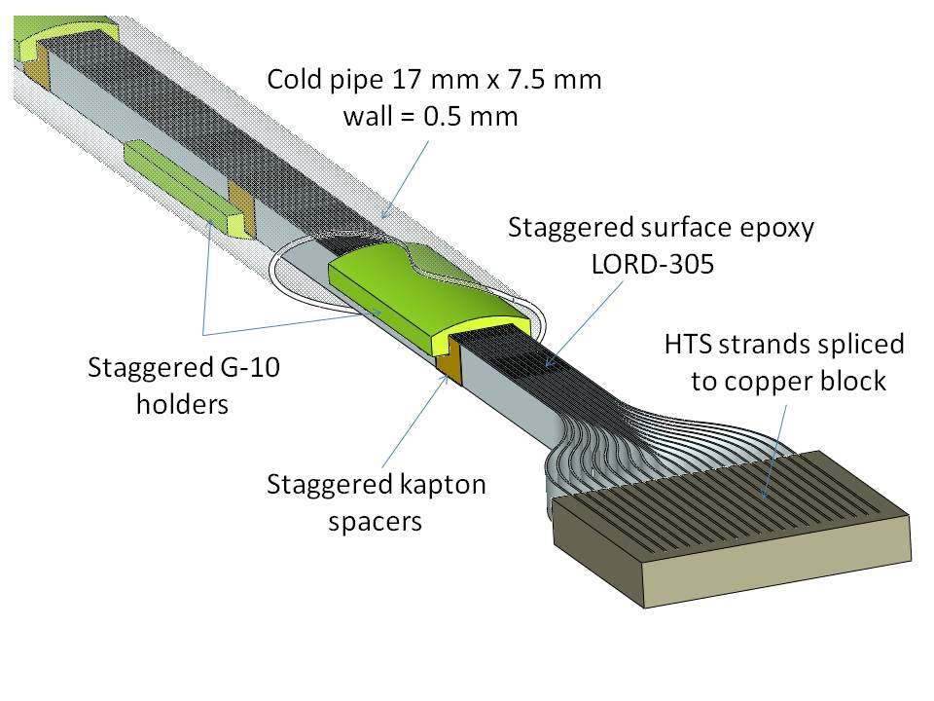
HTS Sub-Cable Design for Rapid Cycling Dipole
Sub-cable assembly shown above immobilizes HTS stack while
forcing liquid helium to flow up and down between the strands
6/19/2012

Slide 11
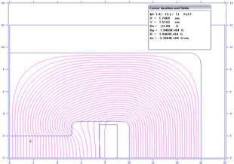
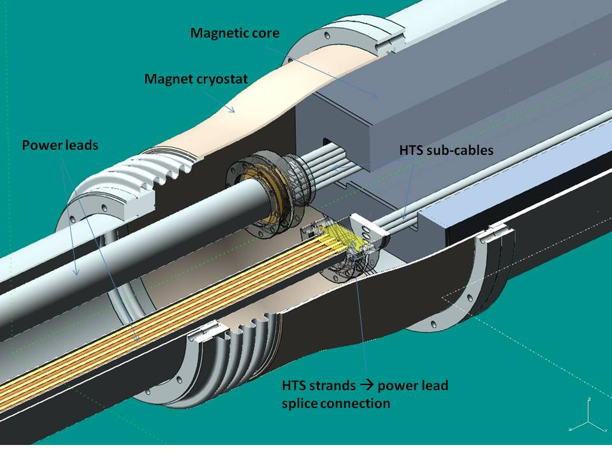
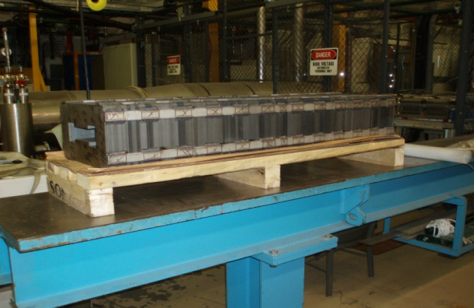
HTS Dipole Design & Fabrication Status
TEST MAGNET PROPERTIES:
Cable: Single turn of 6 parallel sub-cables connected at leads end Core: Fe3%Si, 105 µm laminations
96 344C-2G strands (~ 600 m length) L = 1200 mm, Gap = 40 mm x 100 mm
Projected <Angle _{HTS – B-FIELD} > ≈ 2⁰ Operating temp.: 80 K to RT
Instrumented : B _{max} = 1.8 T, I_{max} = 90 kA, dB/dt _{max} = 16 T/s , T _{max} = 15 K
Test: B _{max} = 0.5 T, I_{max} = 27 kA, dB/dt _{max} = 10 T/s , T _{max} ~ 25 K
Core design
Fabricated core
All HTS cable components have been fabricated
6/19/2012

Slide 12
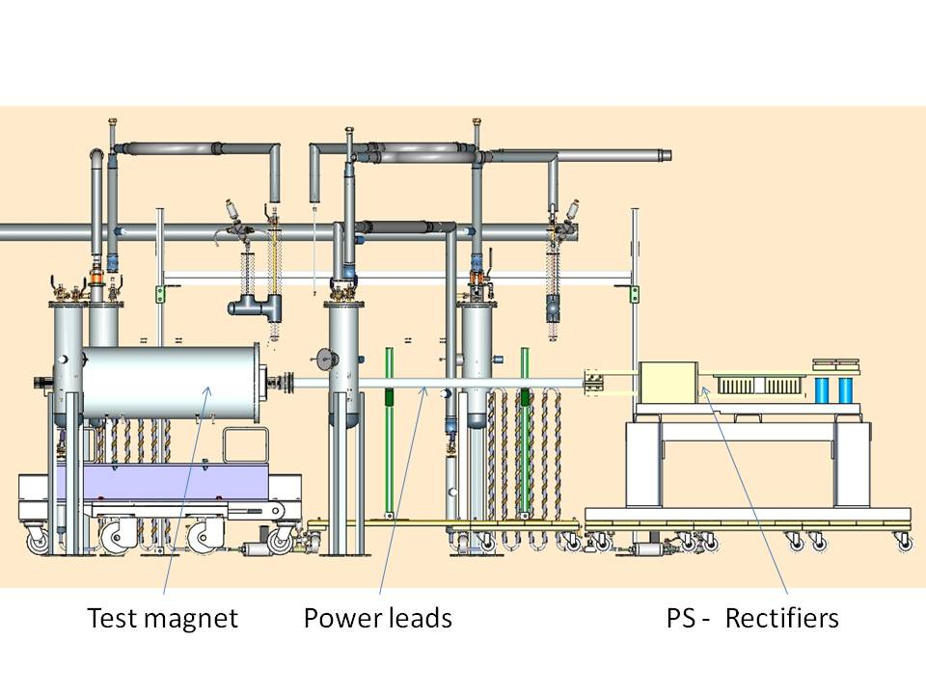
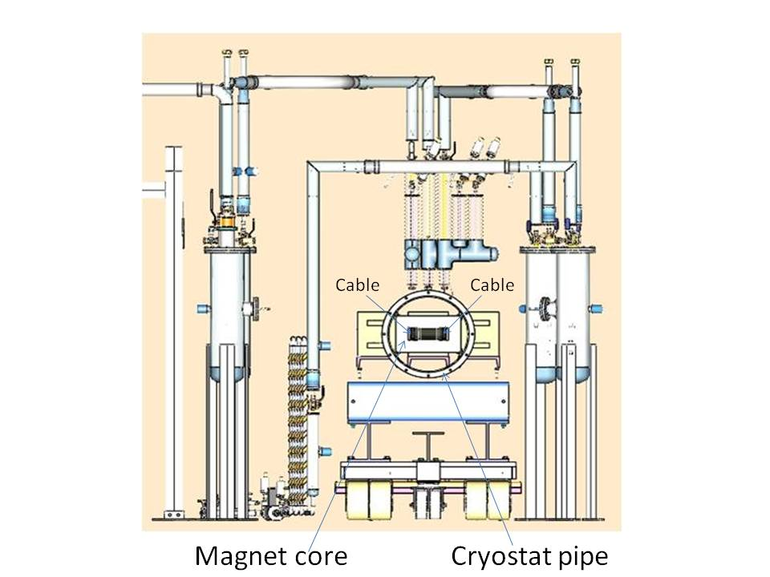
HTS Dipole Test Setup Status
Figures show test components with design complete & fabrication in progress
Side view
Front view
Component design will end in mid-August, fabrication complete by October. System assembly, safety proceedings through December.
Expected magnet tests in E4R Enclosure: December 2012 -March 2013.
6/19/2012

Slide 13
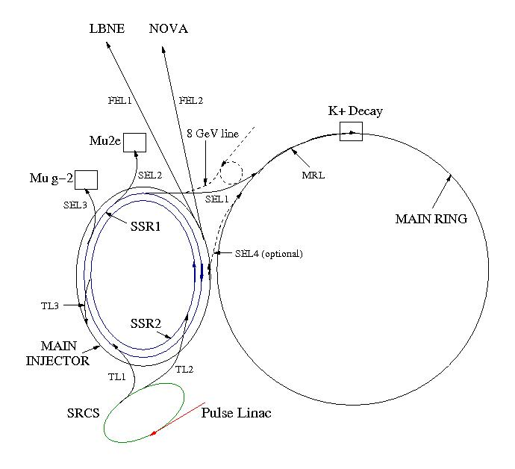
SRCS Synchrotron – Possible HTS Dipole Application for Project X
SRCS parameters versus FAIR
Parameter | SRCS | FAIR
Ring length [m] | 830 | 1100
Magnet string length [m] | 550 | 628
Magnet gap [mm] | 50 | 60
B inj / B ext [T/T] | 0.1 / 0.6 | 0.24 /2
dB/dt [T/s] | 10 | 4
Rep. rate [Hz] | 10 | 1
Superconductor | 344C 2G | NbTi
Number of strands | 124 | 496
Operational temperature [K] | 5 | 4.5
Temperature margin [K] | 25 | 1
Power loss @ 5 K [W/m] | 30 | 74
Power loss/accelerator [kW] | 16.5 | 46.5
Project X accelerator complex with SRCS *)
*) H. Piekarz, “Project X with Rapid Cycling & Dual Storage Rings Synchrotrons”, arxiv.org/pdf/1205.1527 (2012), and IPAC-12, New Orleans, May 21-25, 2012

Slide 14
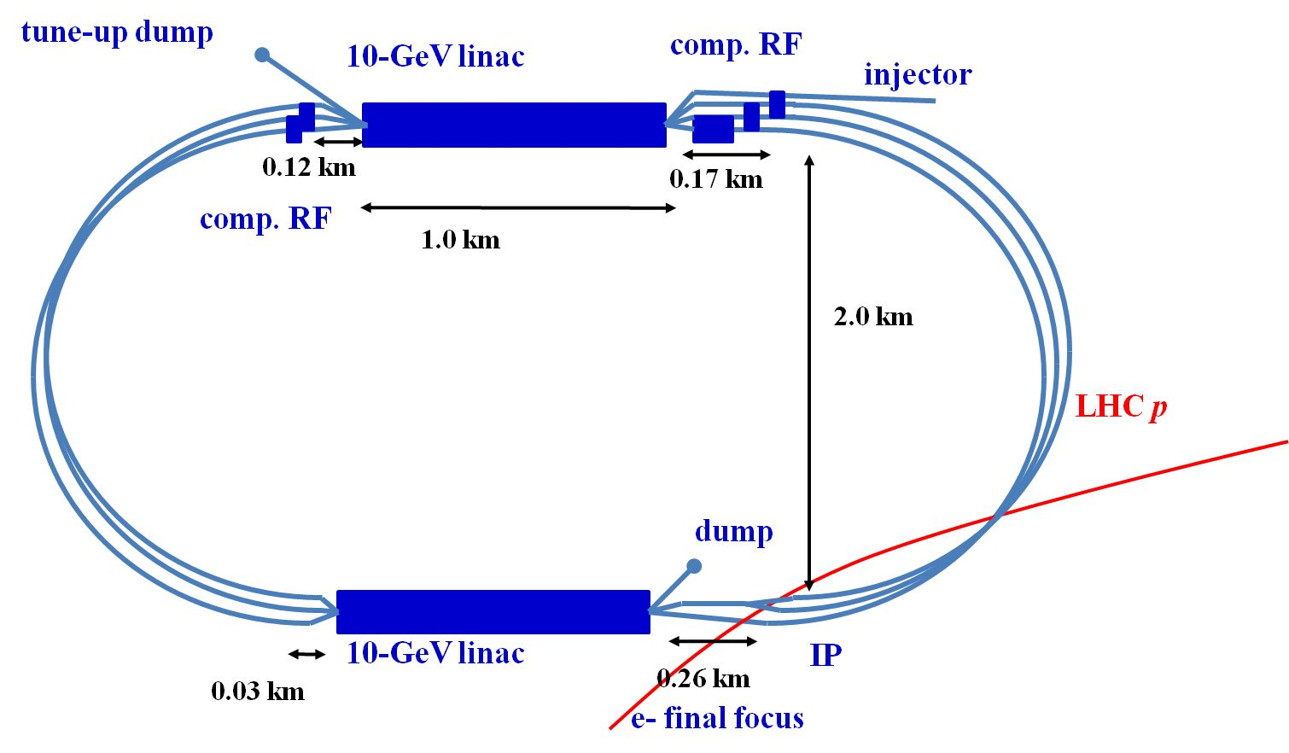
Possible HTS Dipole Application to LHeC - LR
LHeC-LR parameters versus SRCS
F. Zimmerman –
EuCARD - AccNet-RFTech Workshop, PSI, 2010
Parameter | SRCS | LHeC - LR
Ring length [m] | 830 | 2 x 3300
Magnet string length [m] | 550 | 2 x 2200
Magnet gap [mm] | 50 | 25
B inj / B ext [T/T] | 0.1 / 0.6 | 0.046 /0.264
dB/dt [T/s] | 10 | 2.2
Rep. rate [Hz] | 10 | 10
Superconductor | 344C 2G | 344C 2G
Number of strands | 124 | 60
Operational temperature [K] | 5 | 5
Temperature margin [K] | 25 | 25
Power loss @ 5 K [W/m] | 30 | 6.6
Power loss/accelerator [kW] | 16.5 | 29
Estimated SRCS cost (magnets, power system, RF system, cryogenics, civil construction) = M$ 172 *)
*) H.Piekarz, “Project X with Rapid Cycling & Dual Storage Rings Synchrotrons”, arxiv.org/pdf/1205.1527 (2012)
6/19/2012

Slide 15
Possible Application of SC Dipole Technology to LEP3
Assumption: the e⁺ and e⁻ beams are separately injected, accelerated and transferred to the LHC Collider rings so they share common accelerator to gain the required energy. As this e⁺/e⁻ synchrotron is placed in the LHC tunnel its magnets must use as little space as possible.
Due to a small size of power cable the superconducting magnets require typically 10 x less space than the normal conducting ones of the same field and gap. The magnet weight is very significantly reduced in the same time.

Slide 16
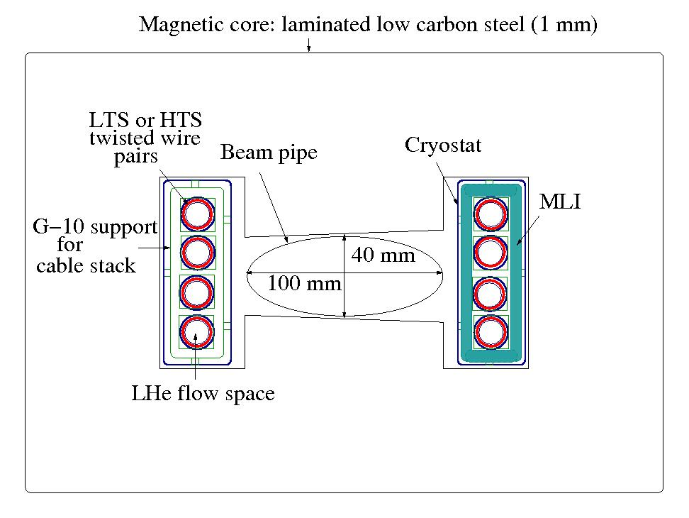
Possible SC Dipole Design for e⁺/e⁻ Synchrotron in LHC Tunnel
As the maximum projected ramping rate for the e⁺ /e⁻ synchrotron is 0.0075 T/s, dynamic power losses are expected to be very small, probably at, or below, the static ones. Consequently, both the HTS and LTS super-conductor can be considered for the magnet cable.
The length of the e⁺/e⁻ accelerator magnet should probably match the length of the LHC one (~ 14 m). For such a length the cross -section of helium cooling channels must be carefully considered. For this reason using the stacks of twisted pairs of SC wires placed over a large cooling channel (as used in LTS cable test) is a better option than using the stacks of tapes placed inside the cooling channel.
Example of magnet design with sub-cables using
LTS or HTS wires. The magnetic design is for a
combined function dipole. For synchrotron magnet
operating at low dB/dt rate standard low carbon
steel laminations at RT can be used.

Slide 17
LHeC-LR and LEP3 Synchrotron & Magnet Parameters
Some selected parameters of LHeC-LR and LEP3 dipoles using SC cables
Parameter | LEP3 | LHeC - LR
Ring length [m] | 26600 | 2 x 3300
Magnet string length [m] | 21200 | 2 x 2200
Magnet gap [mm] | 40 | 25
B inj / B ext [T/T] | 0.01 / 0.15 | 0.046 /0.264
dB/dt max [T/s] | 0.075 | 2.2
Rep. rate [Hz] | 0.05 | 10
Superconductor | NbTi | 344C 2G
Number of strands | 100 | 60
Operational temperature [K] | 4.5 | 5
Temperature margin [K] | 2.5 | 25
Power loss @ 5 K [W/m] | 0.1 | 6.6
Power loss/accelerator [kW] | 2.6 | 29

Slide 18
Summary & Conclusions
HTS Rapid Cycling Dipole design and fabrication are well advanced
Test arrangement is being constructed
Tests will proceed in late 2012 / early 2013
HTS Rapid Cycling Dipole design is suitable for application in LHeC - LR Option
Substituting HTS cable with LTS wire cable in a Rapid Cycling Dipole design makes it suitable for the LEP3 accelerator magnet
Thank you for your attention !
6/19/2012

