Slide 1

Kinetic theory,
Thermodynamics
Boltzmann
Maxwell
Newton
Particles
Fields
Universe
Technologies
1895
Electromagnetic
Weak
Strong
4
Detector
Accelerator
e⁻
Brownian motion
Photon
Radio-activity
3
1900
1905
Atom
Special relativity
1910
Nucleus
Geiger
Quantum mechanics
Wave / particle
Fermions / Bosons
Cosmic rays
General relativity
1920
p⁺
Cloud
1930
e⁺
n
Dirac Antimatter
Fermi Beta-Decay
Galaxies; expanding universe
Cyclotron
Yukawa
π exchange
1940
μ ⁻
Dark Matter
Nuclear fusion
π
Synchrotron
1950
Particle zoo
QED
P, C, CP violation
Big Bang
Nucleosynthesis
τ⁻
Bubble
p⁻
1960
νe
W bosons
Cosmic Microwave Background
e⁺e⁻ collider
Higgs
Wire chamber
νμ
u
d
s
EW unification
Beam cooling
1970
GUT
QCD
Colour
c
SUSY
Online computers
1975
τ⁻
STANDARD MODEL
1980
ντ
b
Superstrings
g
Inflation
Modern
detectors
p⁺p⁻ collider
W
Z
1990
CMB Inhomgeneities (COBE, WMAP)
3 generations
WWW
t
2000
Dark Energy (?)
ν mass
GRID
2010

Slide 2
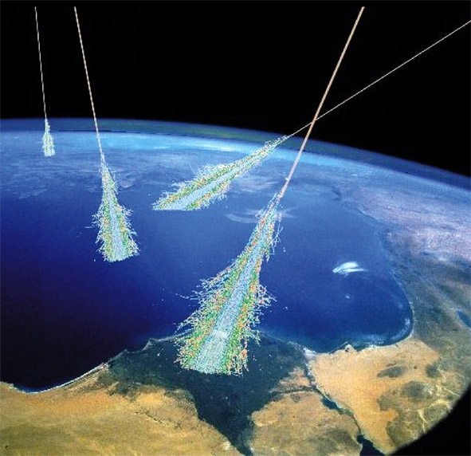
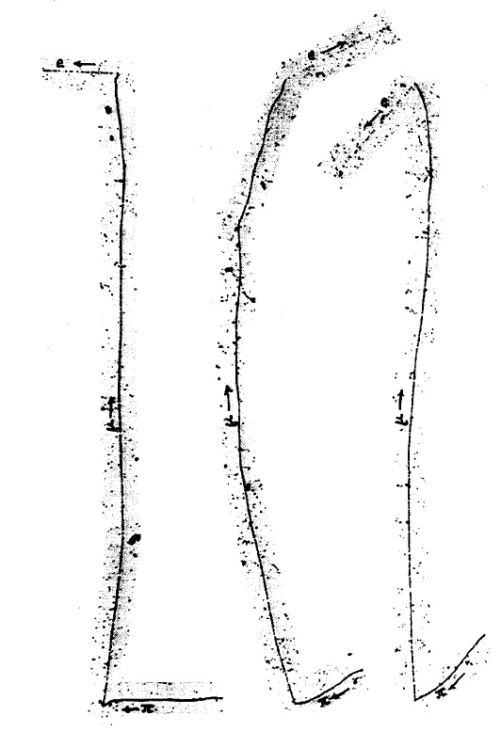
μ ⁻
1937
1913: Cosmic Rays were discovered
    Physicists went on mountain tops for experiments!
1937: New particle discovered: negative charge, ~ 200 me
    Very longe range in matter !? Not Yukawa’s “pion” !
  Muon = ‘heavy electron’
I. Rabi: “Who ordered that ?”
1948: The “pion” was finally discovered (emulsions)

Slide 3
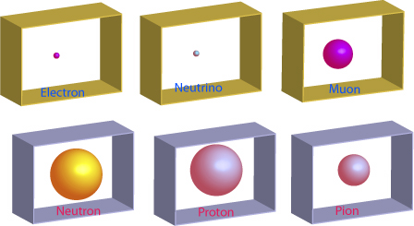
1948
In 1948, the particle spectrum started to look ugly:

Slide 4
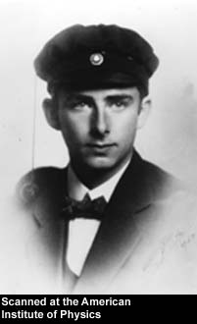
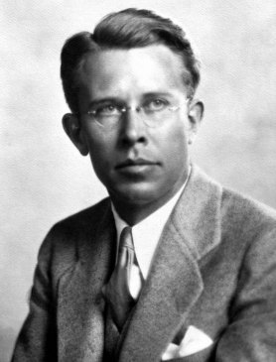
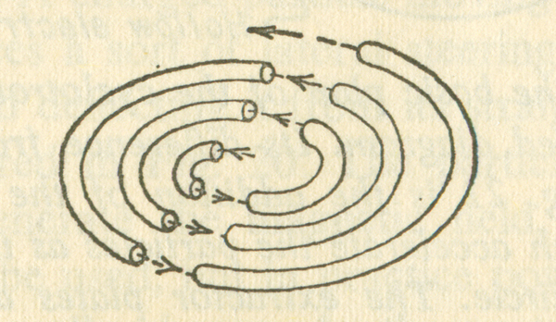

1931 - 1955
Accelerators
"Man-made cosmic rays"
Rolf Wideroe, 1928
Ernest Lawrence, 1931
Cyclotron
Linear accelerator
Use magnetic field to bend particles into circular orbit
Particles pass through same accelerating gap many times and reach higher energies
Accelerate particles between electrode gaps
Tune RF frequency to match particle motion
1931: 80 keV
1932: 1000 keV
1939: 19 MeV*
1946: 195 MeV ("synchrocyclotron")
* first limitations by relativistic mass increase

Slide 5

1931 - 1955
Accelerators (2)
1947: US constructs two 'synchrotrons'
Brookhaven (1952) - 3 GeV
Berkeley (1954) - 6.2 GeV ('antiproton')
Synchrotron
1954: Europe competes with US
Similar to cyclotron, but change magnetic field to keep particles on the same orbit
(also overcomes relativistic mass increase)
CERN (1959) - 24 GeV
Brookhaven (1960) - 30 GeV
Detectors
Geiger counters
Cloud chambers
Emulsions
Bubble chambers
Cerenkov counters
Photomultipliers
Spark chambers
After 1967:
Wire chambers
Drift chambers
Calorimeters

Slide 6
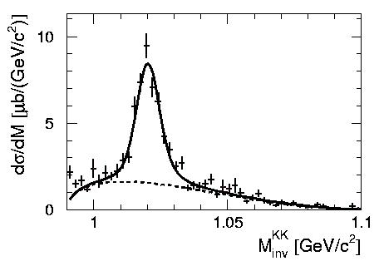
‘Resonances’ in particle collisions
4.3 MeV ~ 10⁻²² s
Resonance = ‘Peak’ in invariant mass spectrum of two or more particles
Lifetime ~ 1 / Width of resonance [~ 10⁻²¹ .. 10⁻²³ s]

Slide 7
Particle zoo
1950- 1968
With new accelerators and detectors,
the "particle zoo" grew to more than ~ 200 'elementary particles'
Mesons
BARYONS
π ⁺
π ⁻
π ⁰
Δ⁺⁺, Δ⁺, Δ⁰, Δ⁻
Pions
K⁺
K⁻
K⁰
η'
Delta
Λ⁰
Kaons
Eta-Prime
η
Σ⁺, Σ⁰, Σ⁻
Lambda (strange!)
φ
Eta
Sigma (strange!)
Phi
Ξ⁰, Ξ⁻
ρ ⁺
ρ ⁻
ρ º
Sigma(very strange!)
Rho
What was the underlying structure ?

Slide 8
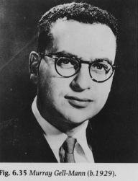
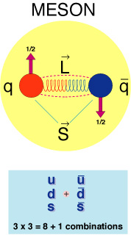
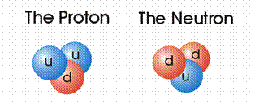
1963
SU(3) - Classification scheme based on ‘quarks’
1) 3 types of “quarks” : up, down, strange
u
d
s
2) Carry electric charges: +2/3, -1/3, -1/3
+2/3 e
-1/3 e
-1/3 e
3) Appear in combinations:
Meson = quark+antiquark
Baryon = quark(1) + quark(2) + quark(3)
Gell-Mann, 1963
(G. Zweig, 1963, CERN)

Slide 9
Some mesons (quark+antiquark):
u
u
πº
+2/3 e
-2/3 e
u
d
π⁺
u
d
s
+2/3 e
+1/3 e
+2/3 e
-1/3 e
-1/3 e
π⁻
d
u
-1/3 e
-2/3 e
u
d
s
-2/3 e
+1/3 e
+1/3 e
u
s
K⁺
+2/3 e
+1/3 e

Slide 10
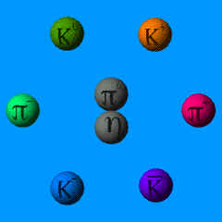
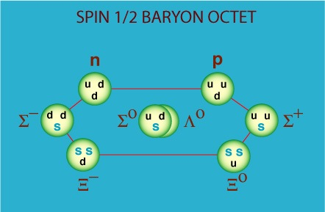
Pion, Eta-meson
Kaonen besitzen ein ‘strange’ Quark
Die leichtesten Baryonen:
Proton, Neutron;
Lambda, Sigma, Xi

Slide 11
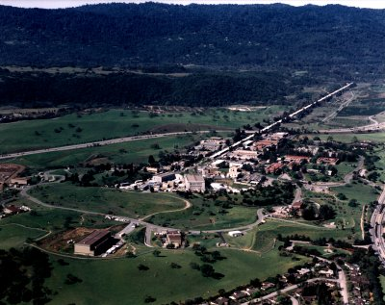
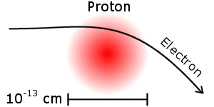
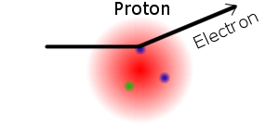
Discovery of quarks
Electron-Proton scattering
1956 Hofstadter: measured finite proton radius
Stanford Linear Accelerator Centre
1967 Friedmann, Kendall, Taylor (SLAC):
        ‘hard scattering’ of electron on three ‘point-like particles’
Measured cross-sections perfectly
compatible with presence of
2 up- and 1 down-quark in proton

Slide 12
1973
The concept of “Colour” charge
PROBLEM: three fermions are not allowed to be in
identical states (Pauli exclusion principle)
Δ⁺⁺
u
u
+2/3 e
u
+2/3 e
+2/3 e
Since the three up-quarks must have parallel spin -
there are in a symmetric state
The three quarks must be different in one quantum number: “colour”
(Bardeen, Fritzsch, Gell-Mann)

Slide 13
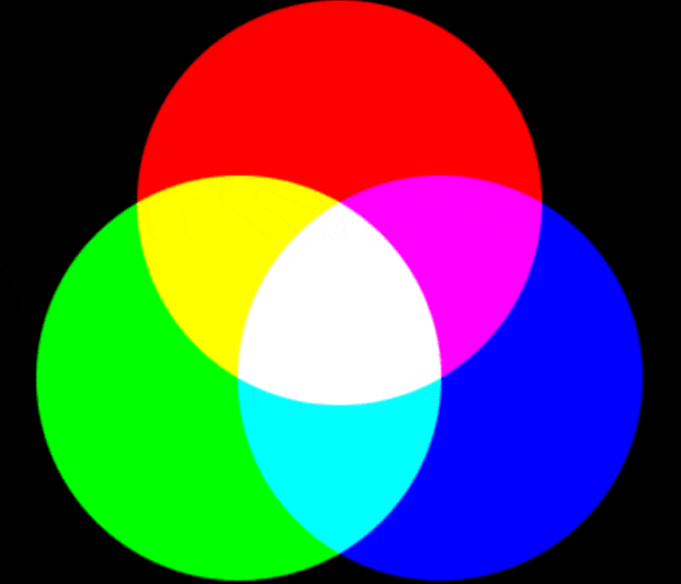
Quantum Chromo Dynamics
this has nothing to do
with our visible colours,
just an analogy
Theory constructed in analogy to QED
QCD: 3 different charges (“colour charge”) [red, green, blue]*
‘Strong force’ between quarks is transmitted by (8) gluons
Dogma of QCD: Only colour-neutral bound states are allowed, explains:
MESONS = Quark-Antiquark
BARYONS = 3-Quark states

Slide 14
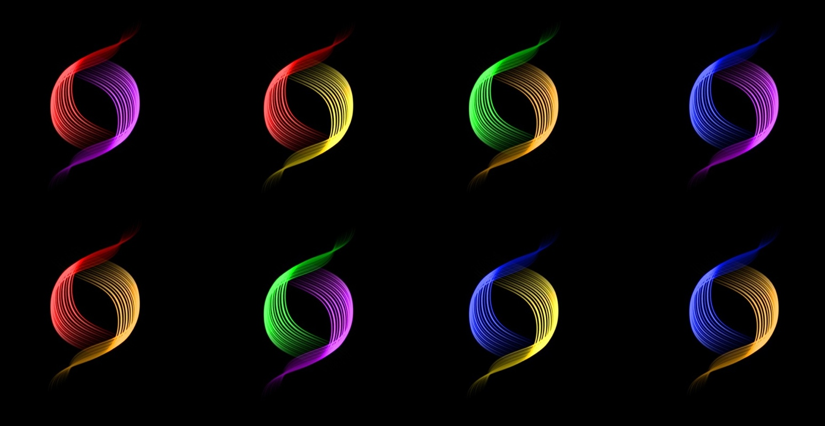
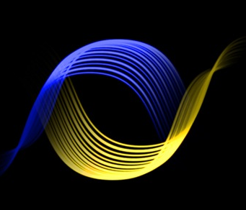
1973
Gluonen
Gluons carry a colour charge !!
Gluon-Gluon interaction
• Carrier of the strong interaction
• massless
• 3 x 3 - 1 = 8 linear independent combinations (8 gluons)
Quark : ‘Colour charge’
Anti-Quark :
‘Anti-Colour’
GLUONS:
Colour+
Anticolour

Slide 15
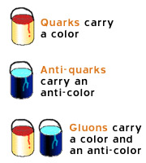
1973
GLUONS CARRY COLOUR CHARGE : SELF-INTERACTION !
At low energies, approximately:
For large distances, the force increases:
‘slavery’ : no free quarks !!
For small distances, the force decreases:
asymptotic freedom

Slide 16
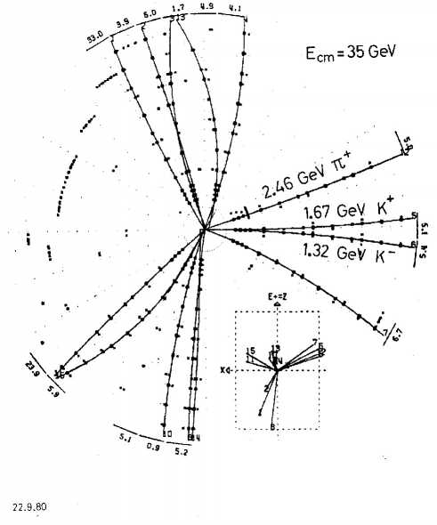
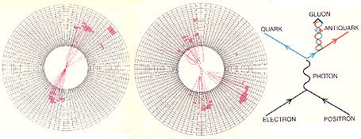
1979
Gluon discovery in 3-jet events
(DESY, 1979)
PETRA Storage Ring, 1979, DESY (Hamburg)

