Slide 1
Various points
CLIC Project Meeting June 2012
CDR volume 1 (brief), volume 3 (slightly less brief)
Space situation
Collaboration news - CB report, next meetings, new working groups and task forces
Agenda and planning for LCWS2012 in Arlington
CLIC EU projects, first ideas
Others

Slide 2
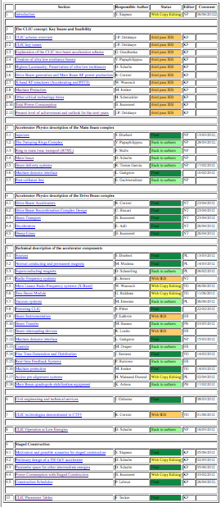
CDRs
Volume 1:
All contributions received ~20th May
Aim for ready for print by end June
Authors: be helpful to review the final versions sent back to you

Slide 3
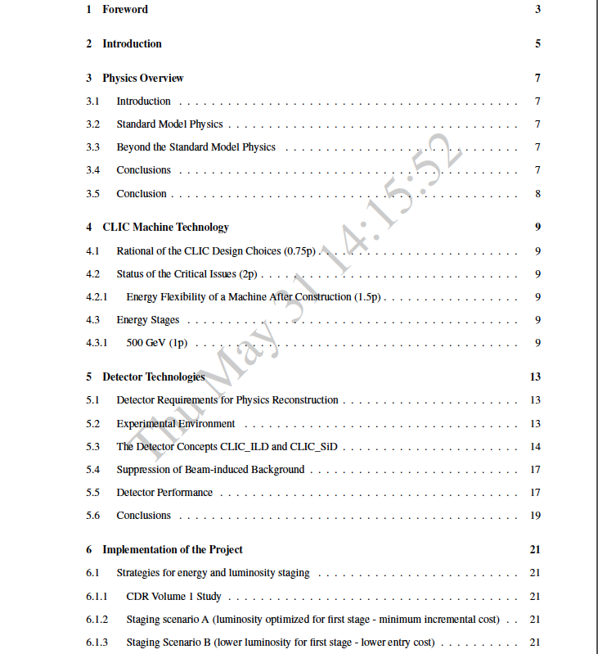
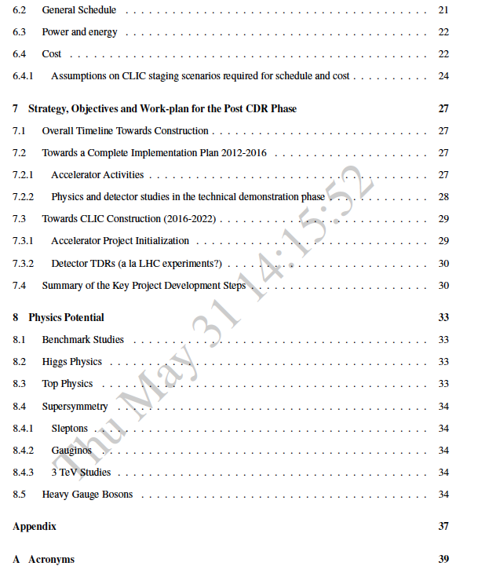
CDR volume 3

Slide 4
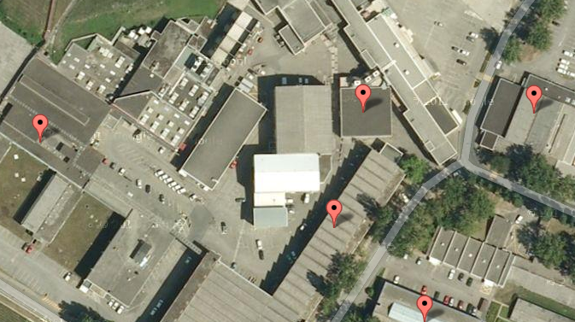
Space
Problem with x-band test stand space remains
Meeting with Thomas Petterson and Paul Collier – extended directorate agreed to continue the “extra” effort to solve space problems (so far only attacked for long-shut down (LS) activities)
Our favorite solution of bat 175 (solving also the bat 112 space problem for a furnace) difficult since the current users (ATLAS) have nowhere to go
  Other solutions will also be considered
Time is running (also increasing concerns of priority conflicts with LS work)

Slide 5
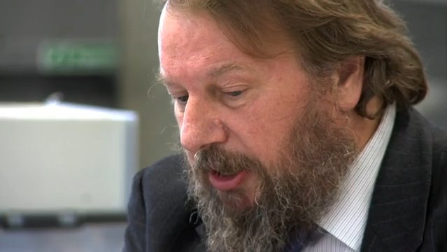
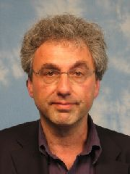
CB news
Leonid Rivkin was elected new collaboration board chair taking over from Ken Peach. The change-over is immediate as the tradition is in our collaboration.
It was agreed to set up a committee to firm up the plans for the CLIC project development beyond 2016. This will be a committee that has a wide collaboration participation and it will remain active until the European Strategy report is published to include its outcome in our future plans.
It was agreed to set up a small working group to come up with a suggestion for a future CLIC machine advisory committee, in consultations/agreement with future LC developments and CERN management.
Next collaboration meeting will be during the Arlington LCWS2012 workshop, and next CLIC collaboration meeting will be in January/February 2013 at CERN.
  Will extend to a full 4.5 day “real” workshop

Slide 6

http://www.uta.edu/physics/lcws12/
Early registration 31.8
Arrange travels as soon as you know you are going
Monday: Plenary with 3 CLIC talks (general, CTF3, staging/future programme)
Tuesday: Four topical sessions (2x2 in parallel), cost/schedule, power, system tests, emittance conservation
Wednesday: CLIC Project Meeting (starting early to overlap with European late afternoon/evening): News, CDRs, X-band/RF update, CTF3 issues, more on systemtests and working groups, some technical developments
  Try also to fit in CB meeting (difficult)
Thursday: Combined CLIC/ILC WGs:
  BDS/MDI, Damping Rings, Beam-dynamics, Sources, Civil Eng/Conv. Facilities + possibly technical systems
Friday: Summaries in plenary
Aim for wide CLIC representation
  but probably only 15-20 from CERN
  will WEBEX Project Meeting

Slide 7
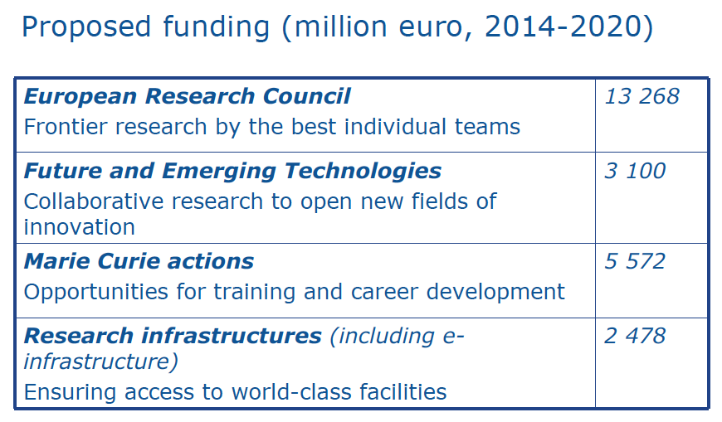
EU projects
EUCARD 2 (is being) approved – entering negotiation phase, 20% cut; major CLIC relevant activities in DR and X-band work-packages
Consider submitting Marie Curie Network application by November (~10 Ph.D student grants in inst. and industries)
Submit key ECR (including Synergy) applications – lead “CLIC scientists”), example in precision engineering, others ?
Watch development of Horizon 2020 and TIARA concerning infrastructures

Slide 8
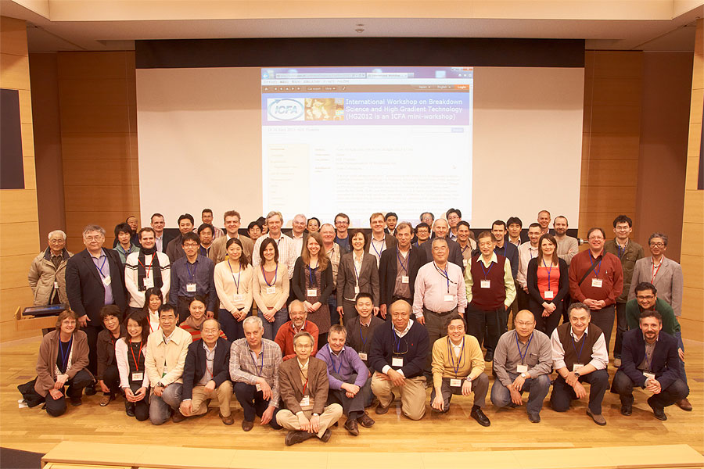
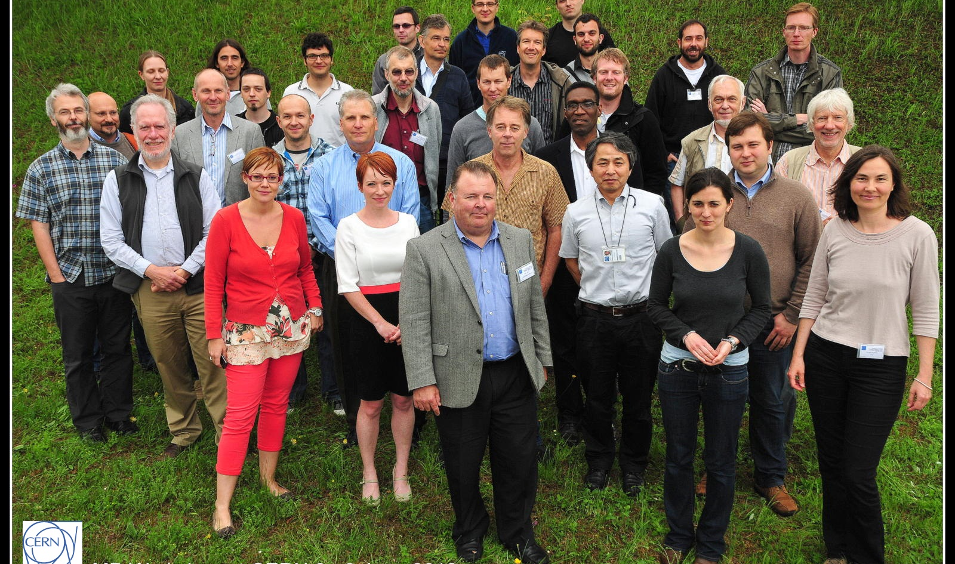
Others
Overall LC director identified, will be announced in July
Interesting links to new KEK proposal for international institute (ATF (support memo sent), X-band testing) – contact Hermann
Continue to develop further contacts with many groups concerning future programme; Minsk, Dubna, Alba-Barcelona, SLAC, Tsinghua, CEA, NCP (Pakistan) .. others
  plus many interactions during coll. week in May
Interesting workshops:
  X-band at KEK: https://indico.cern.ch/conferenceDisplay.py?confId=165513
    See also summary by Walter at:
    https://indico.cern.ch/conferenceDisplay.py?confId=191281
  Machine Protection workshop at CERN: https://indico.cern.ch/conferenceDisplay.py?confId=185561

