Slide 1
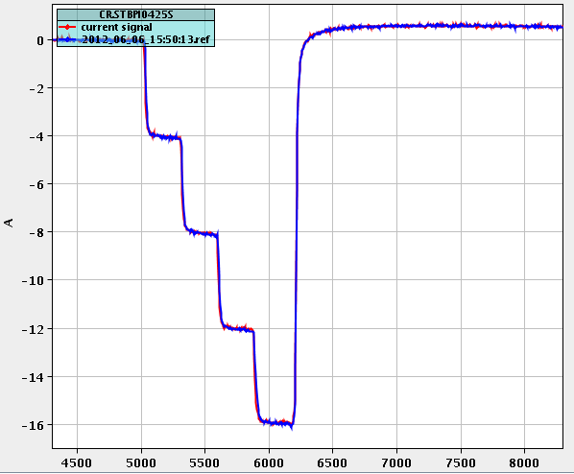
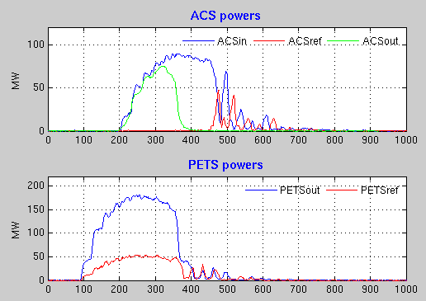
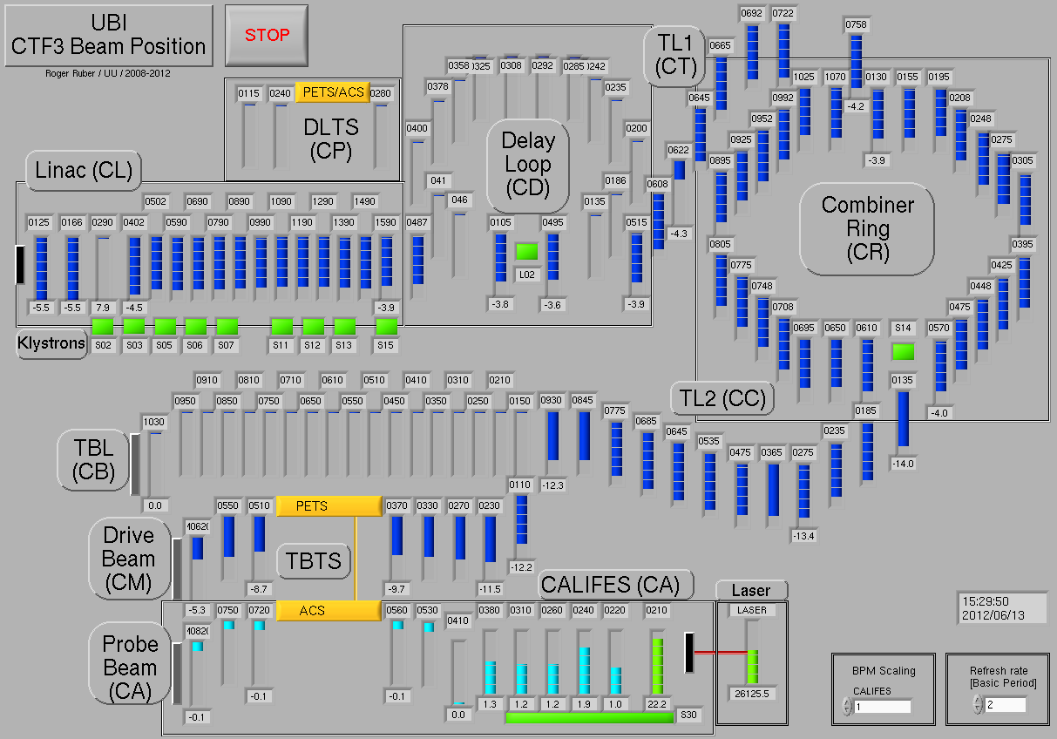
CTF3 highlights since last Project Meeting
Bumpy start due to several hardware problems (mainly modulator-klystrons) – now apparently solved.
Established and consolidated factor 4 combination, optimized transport to TBTS, started TBTS operation at nominal power level and gradient . Break-down kicks and BD statistic studies ongoing.
Completed installation of PETS loads in TBL, start next week to send beam in TBL.
New TBTS tank with two accelerating structures equipped with wake-field monitors ready for beginning of July. Planning to install it in CLEX from 8th August, in order to complete ongoing TBTS studies.
Got back one TWT from repair with a consolidated power supply. Now we have 2 fully operational and a 3rd with a slowly dying tube. Will decide next week to send it back to repair or use it still for some time.
R. Ruber, W. Farabolini, A. Palaia

Slide 2
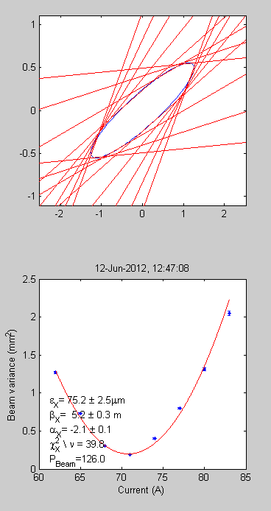
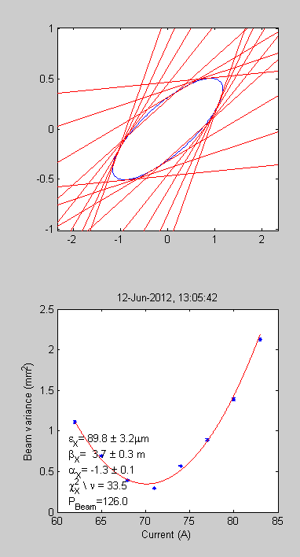
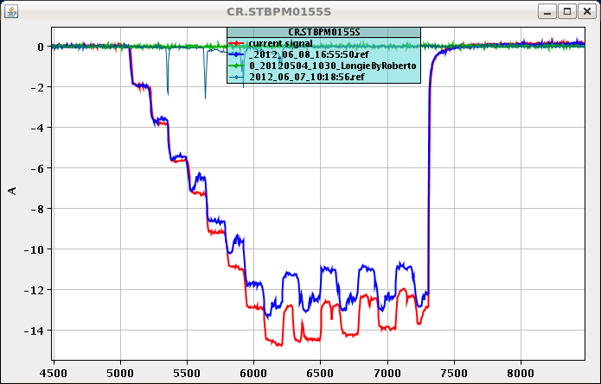
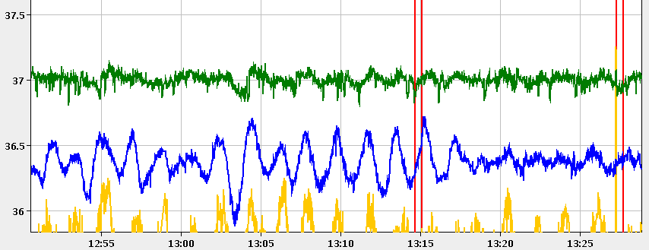
Worked on DL optics and orbit, 3 GHz beam test of split/recombination – about 20% emittance growth from DL
CRM Line, ring
Uncombined (2A)
75 um
Combined (4A)
90 um
P. Skowronski, B. Constance
new flattening feed-back
old flattening feed-back on MKS 12
MKS 11
Still improving stability
MKS 12
T. Persson,
A. Dubrowski

Slide 3
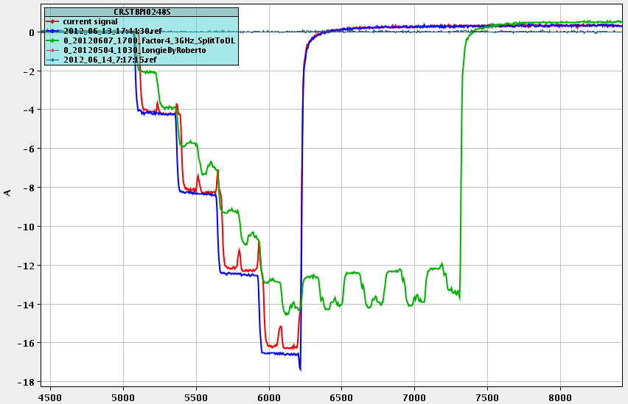
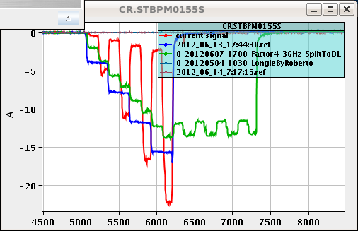
Started yesterday 1.5 GHz operation,
good progress
Factor 4
DL test
P. Skowronski
Factor 4
with 1.5 GHz beam and switches
First factor 8 in 2012 !

