Slide 1

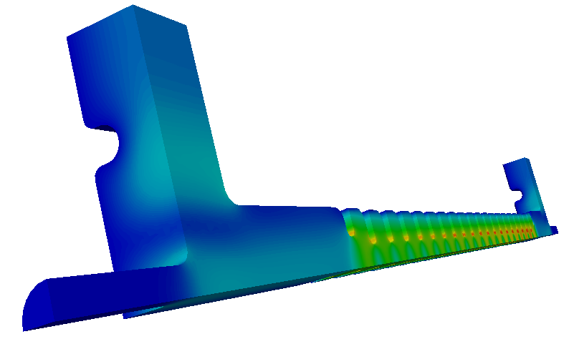
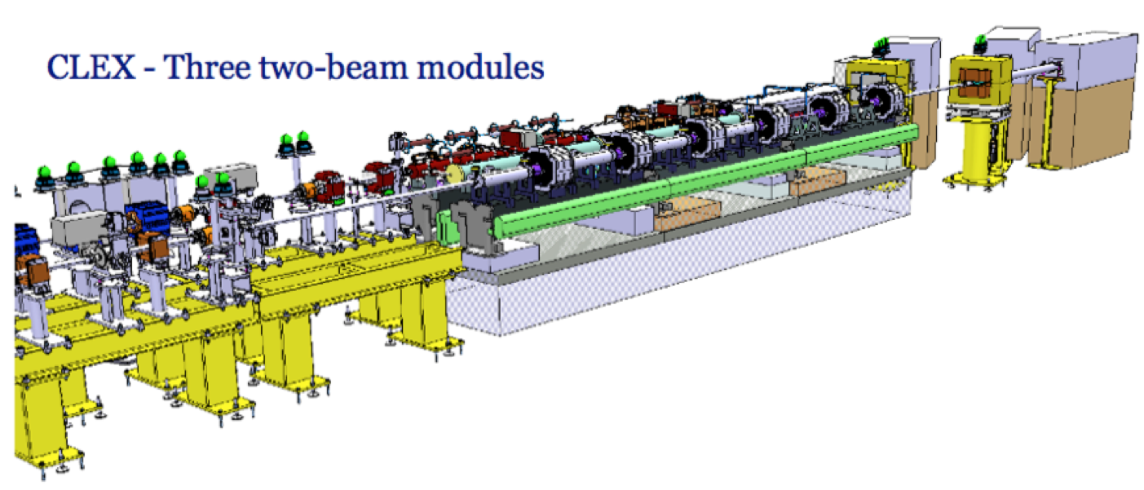
CLIC activities at the
University of Oslo, Norway
http://clic-study.org/
The Oslo group
Erik Adli, Reidar L. Lillestøl, Kyrre N. Sjøbæk
Department of Physics, University of Oslo, Norway
Friday, May 15, 2012

Slide 2
Oslo High Energy Physics Group
The CLIC activities at the University of Oslo, Norway, is within the High Energy Physics Group at the Department of Physics. The group currently has 4 professors, 1 professor II, 7 researchers/post. docs. and about 10 Ph.D. students – out of which 5 do accelerator physics. The HEP-group has strong links with the theory group, the computational physics group and electronics/instrumentation workshops at the Department of Physics. These groups have potential to contribute for future linear collider activities.
Current CLIC / linear collider personnel :
Prof. Steinar Stapnes (now at CERN)
Erik Adli, Researcher (currently Visiting Physicist at SLAC)
Kyrre N. Sjøbæk, Ph.D. student
Reidar L. Lillestøl, Ph.D. student
(The Ph.D. students are co-funded by CERN)
Future prospect:
Funding is secured to employ a project leader for accelerator science (sometime 2013). To be followed by recruitment of new students (1-2 Ph.D. students from ca. 2014)

Slide 3
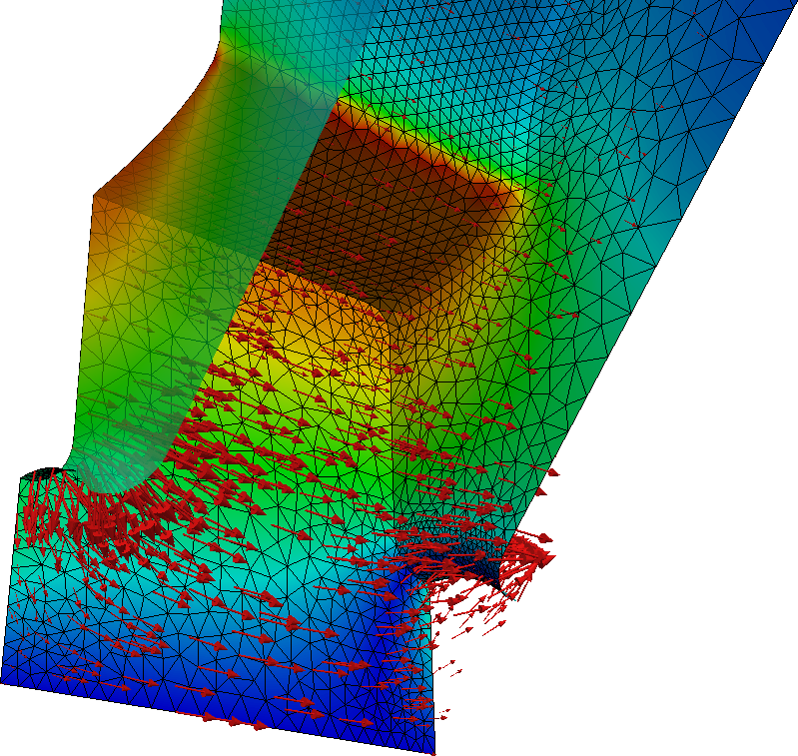
Rf design for CLIC main linac
Accelerating structure rf design using advanced parallel rf design codes (ACE3P)
We study optimization of CLIC
accelerating structures using Omega3P
Development of auxiliary ACE3P software
for rapid design parametric optimization
2012-2013 (Kyrre): Currently working on optimization of CLIC 500 GeV accelerating structure, will continue with refinement of CLIC structures and design of low-energy CLIC structures. Collaboration started with Helsinki on breakdown physics (formation of vacuum arcs), linked to DC experiments.
2013+ : We plan to continue the work on rf structures, including break down physics, possibly also including dark current studies. Potentially a subject for a new Ph.D.
Work of Kyrre N. Sjøbæk
Fields in one cell of a TD type accelerating structure

Slide 4
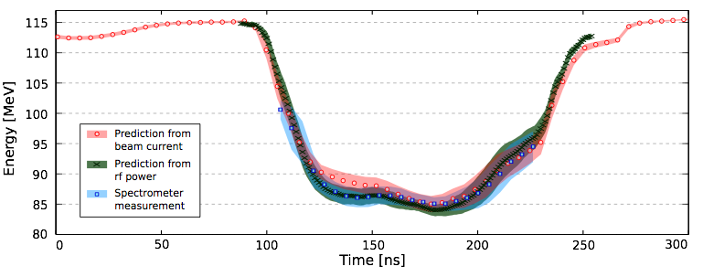
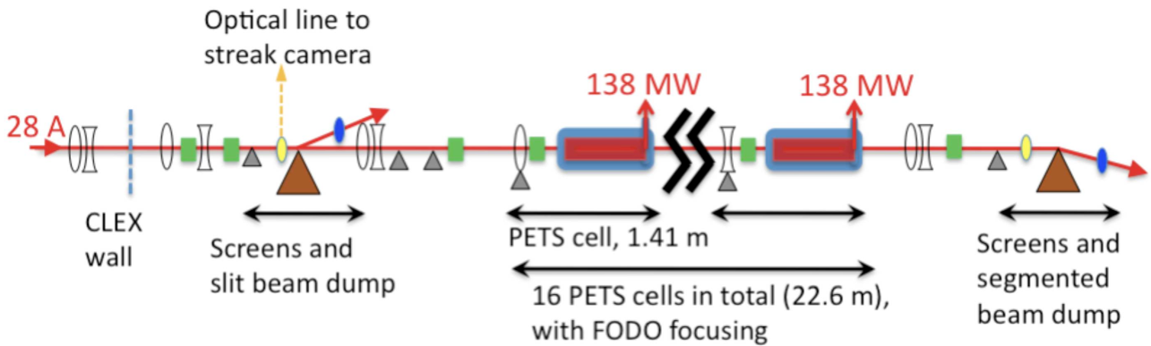
CTF3 : Decelerator TBL and TBMs
CTF3 : Decelerator Test Beam Line
We have performed extensive studies of beam physics and instability studies of heavily decelerated electron beams
2012-2013 (Reidar) :We plan to follow the experimental verification in the decelerator TBL until the completion of the program. Further experimental/simulation studies of emittance growth for decelerated beams.
2013+ : We plan to continue the work in CTF3, extending studies to the two-beam module tests. Oslo has over the last 6 years gained competence in most aspects of the two-beam acceleration scheme, and can contribute to overall system analysis of the two-beam acceleration scheme. This work can potentially be linked to a future Ph.D. study.
The Test Beam Line (TBL)
25% deceleration in the TBL
Work of Reidar L. Lillestøl

Slide 5
Importance of support from CERN
Having a project leader in place for accelerators activities at the University of Oslo will open up possibilities to apply for more funds for Norwegian contributions to CLIC from 2013/2014.
We are happy with the level of support from the CLIC management in retrieving funding. Support letter from the CLIC collaboration spokespersons has been weighted positively in earlier funding applications. For eventually future, larger applications, additional support may be useful.
We have good experience with CERN-funding and CERN co-funding of Oslo Ph.D. students. It is important for us to continue to utilize this model in order to support a healthy group of students at the Oslo group (allows at least 2 students for the price of one).
The CERN technical student program has been an excellent way to recruit Norwegian Ph.D. students in accelerator physics.
Norway also sponsors technical students at master level (3-4 months) which can be of interest

