Slide 1
12GHz test stand status
15.06.2012

Slide 2
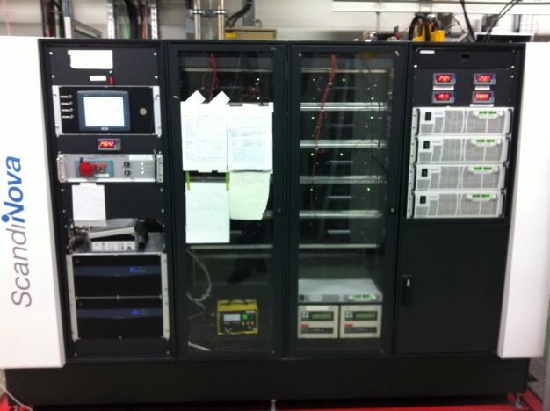
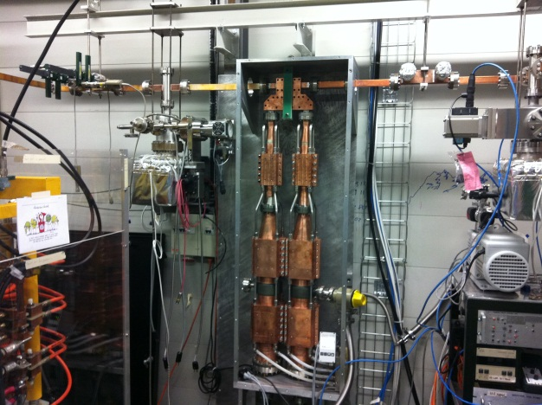
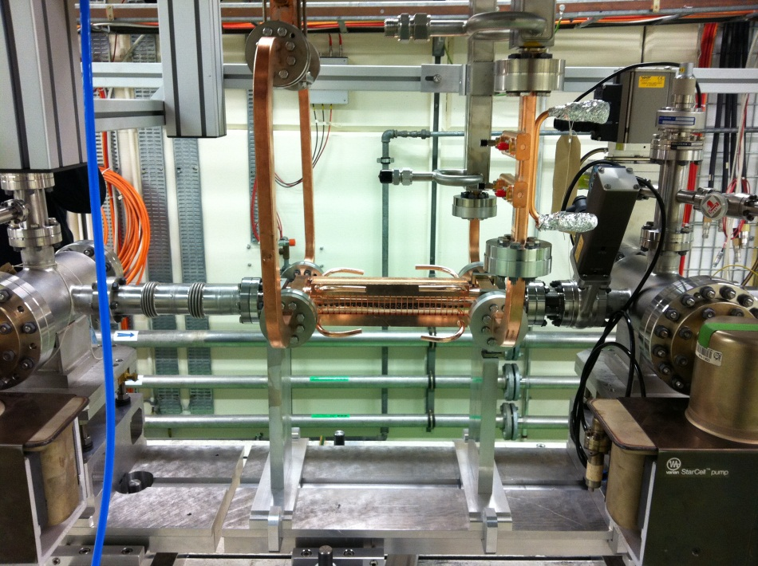
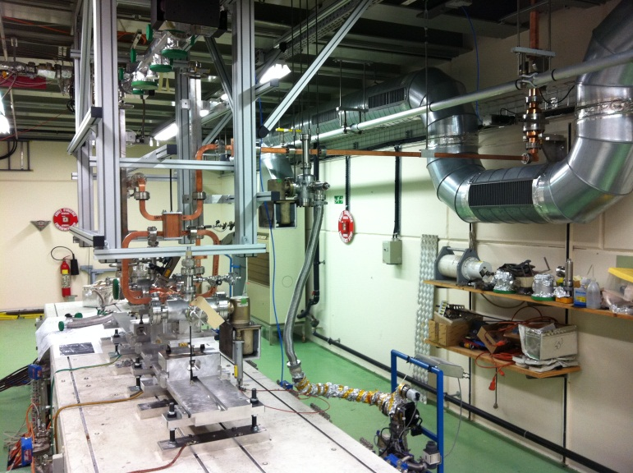
Status of the 12GHz standalone test stand
WG network and LLRF finished
Final vacuum infrastructure installation end of June
Modulator flat top tuning by Scandinova done
Klystron conditioned up to 40MW, 500ns, 50Hz with loads (50MW, 300ns, 50Hz)
Pulse compressor operation started after FAT of modulator
Gallery
Bunker

Slide 3
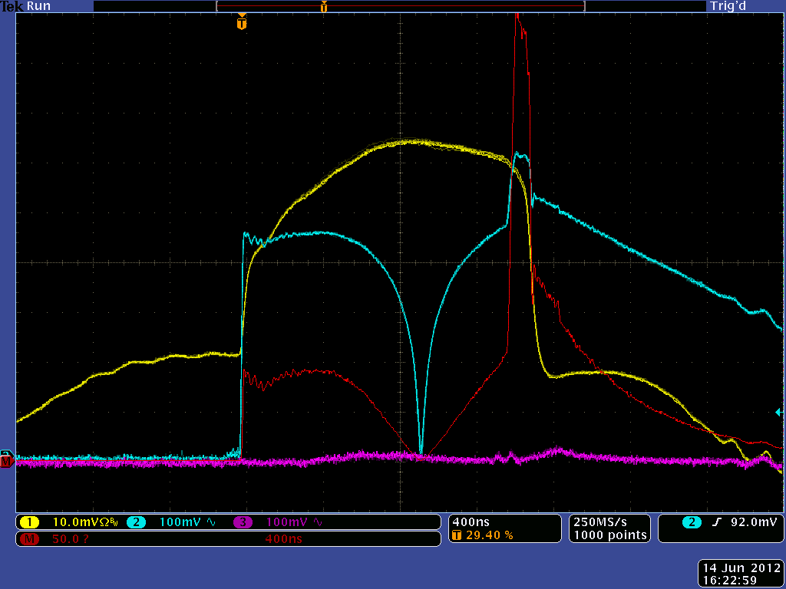
Latest status
Max power into PC: 6.9MW, 1.47us, 50Hz ➔ 507W av.
➔ Rf into structure: 17.6MW, 72ns, 50Hz
Rf power to structure (lin. Scale)
Rf power to pulse comp.
(lin. Scale)
Rf power to structure
(log. Scale)
Refl. Power from struct.
(log. Scale)

Slide 4
Plans For the future
Continue processing of pulse compressor and cavity
In parallel will commission the data acquisition system to allow automatic conditioning of cavities

Slide 5

Temperature Stabilization of Pulse Compressor
Will receive a trial chiller/heater unit in the next week or so

Slide 6
Next Test Stand
Received offer for new modulator at 2009 price
Order going out next week (hopefully) for delivery end March 2013
Klystron design ongoing with CPI, approximately 3 month delay (but we have a 6 month window)
First test foreseen September 2012, delivery still on schedule for March 2013
Waveguide network and low level components on order or under development (new pulse compressor)
Still waiting on decision as to where we will install it

Slide 7
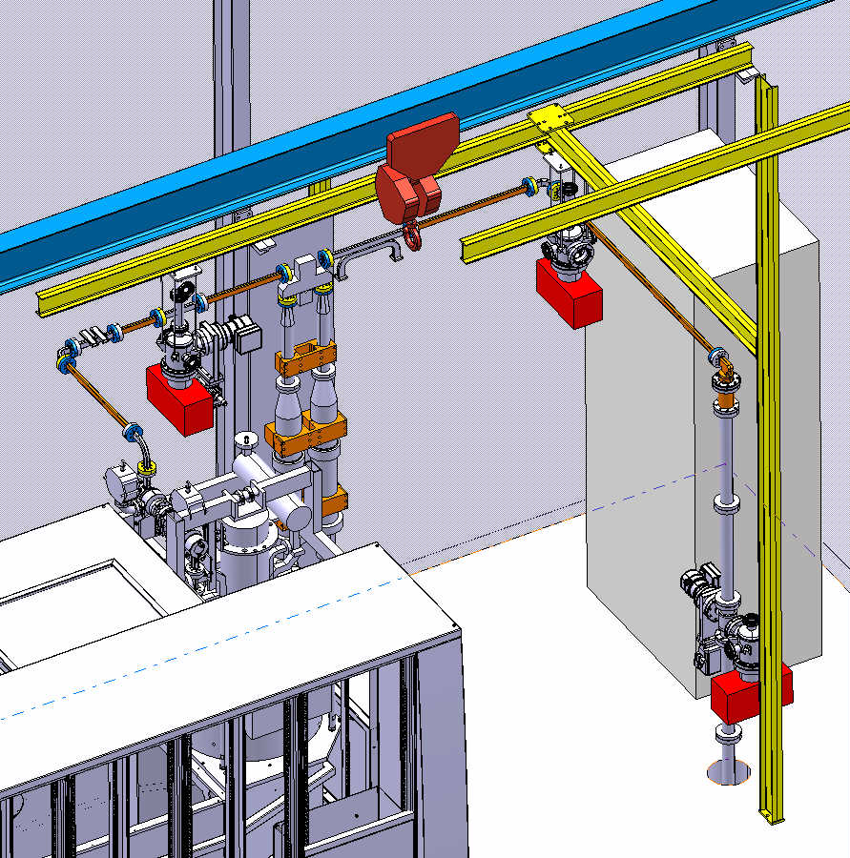
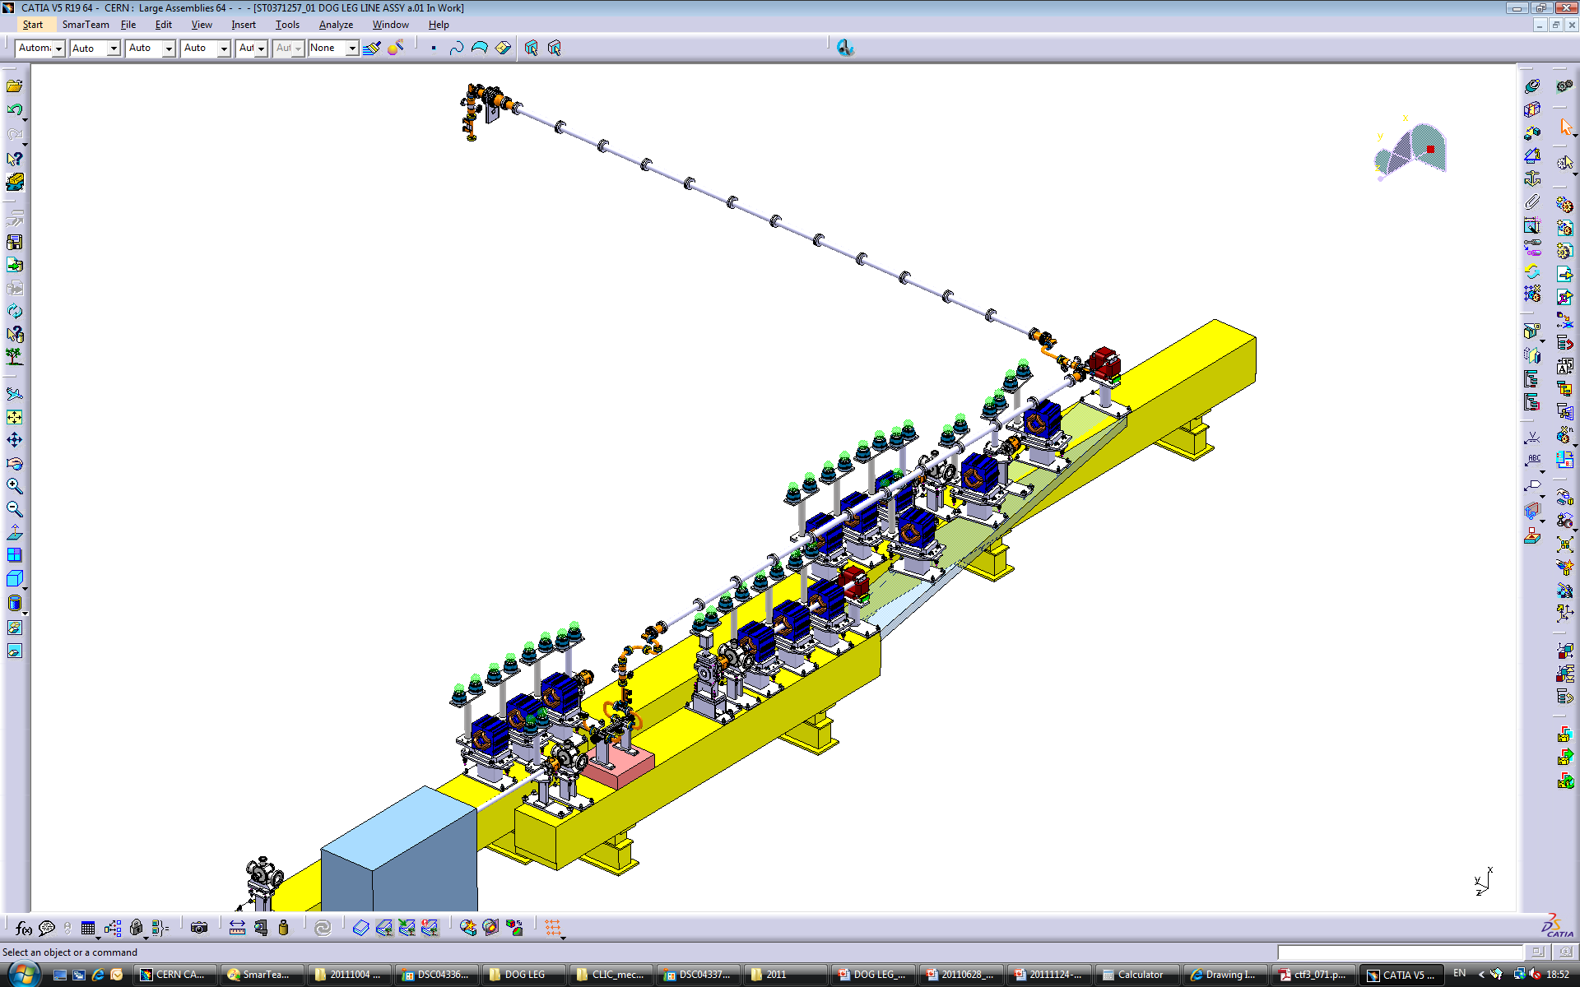
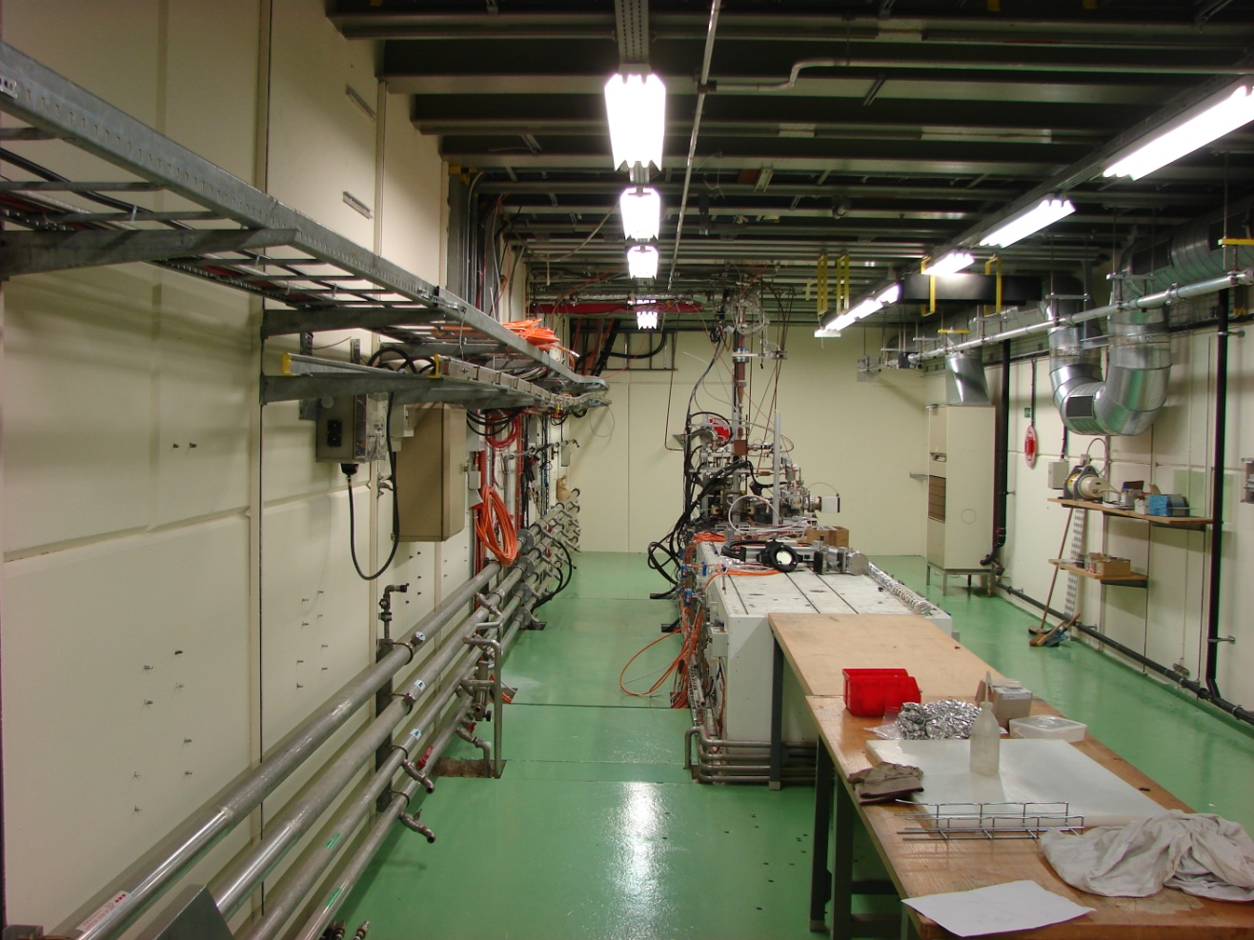
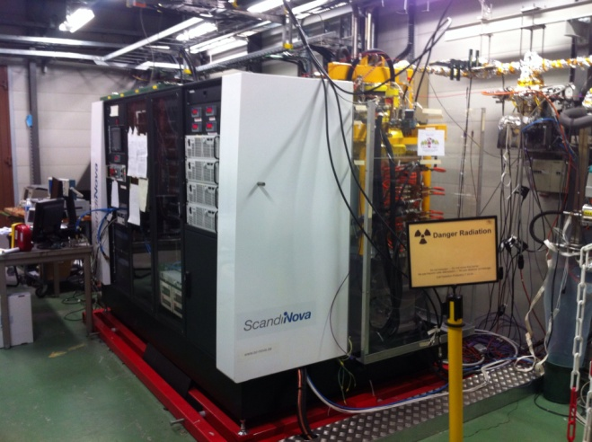
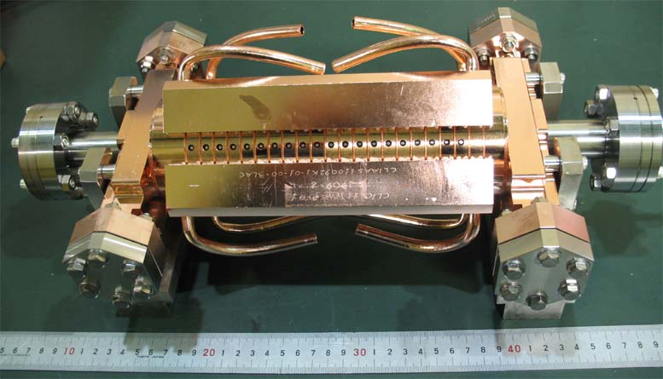
Dog leg beam Loading Experiment
Components being ordered to allow testing
CTF2
1-5 A beam
Front end of CTF3 drive beam linac
CTF3

Slide 8
“Low” Power High Rep Rate Test Stand
Market Survey with specification committee and purchasing department, ready to go out to klystron manufacturers
12 GHz (5.5 MW x 4.6 μsec x 400 Hz) x 4
PhM
PhM
AM
P_{av}/Kl.=10 kW
AM
82 MW x 240 ns
(61 MW x 400 ns)
100 Hz x 4
133 Hz x 3
200 Hz x 2
400 Hz x 1
Test bunker

Slide 9
International Unisex X Band Flange (IUX)
First meeting of international committee held at KEK in April 2012
Following consensus agreed
  Rectangular flange with 8 bolts
  Multiple iterations for gasket compression (0.2mm,0.3mm,0.4mm and 0.5mm)
  Flat knife edge width (0.5mm, 0.75mm and 1mm)
  Grooves to outside of flange for leak test
  Corners of gasket seat to be made circular for ease of gasket removal
  No guide pins, study external alignment jig
  Internal radius on corners of flange gasket knife to be made a big as reasonably possible
  Simple copper gasket 1mm thick
  Multiple models of each type to be prototype
  Heat cycle test
  High power tests
  Stress modeling of new flange assembly
Prototype drawings for approval of committee being finished at CERN by BE-RF-PM section
Approval for fabrication of prototypes within next few weeks

