Slide 1
Atlas ANALYSIS performance on the grid
monitoring and improving
First meeting

Slide 2
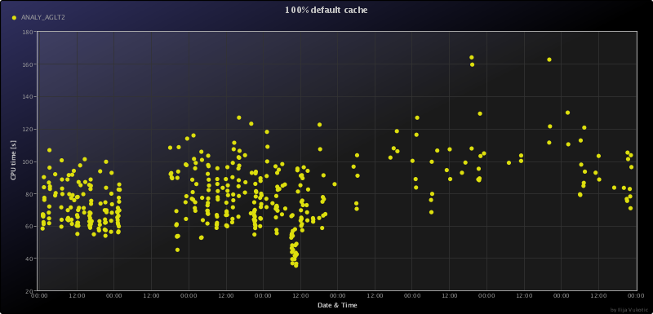
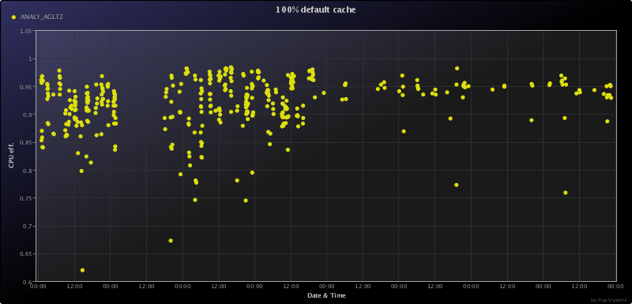
AGLT2
Something happened at 1st Jun.
CPU time went up ?! Eff. Remained good

Slide 3
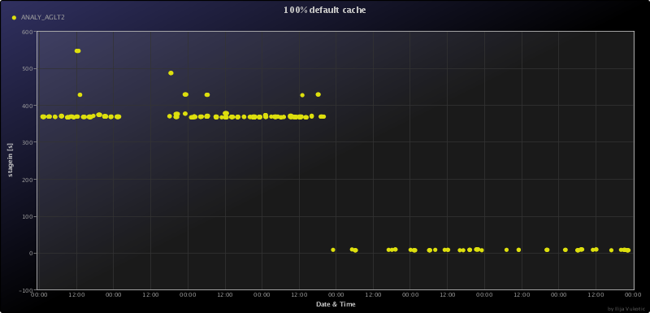
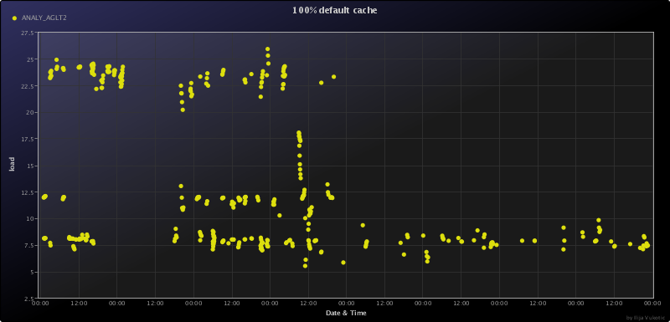
AGLT2
Stage in time decreased! Practically vanished.
24 core machines not used
  Intel(R) Xeon(R) CPU X5650 @ 2.67GHz, 24 cores HT
  Intel(R) Xeon(R) CPU X5670 @ 2.93GHz, 24 cores HT
  Intel(R) Xeon(R) CPU X5660 @ 2.80GHz, 24 cores HT

Slide 4
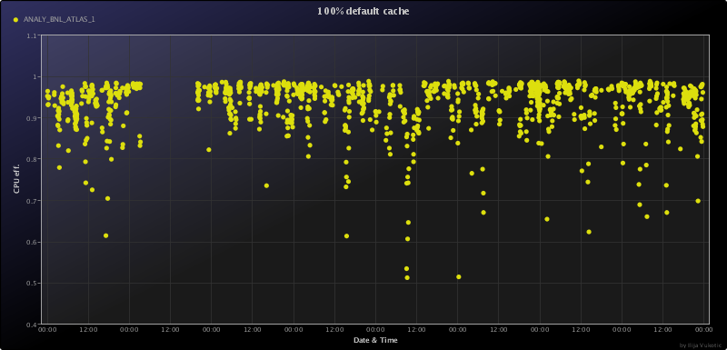
BNL
94% CPU efficiency !!!
But what are outliers?
Where dips come from?

Slide 5
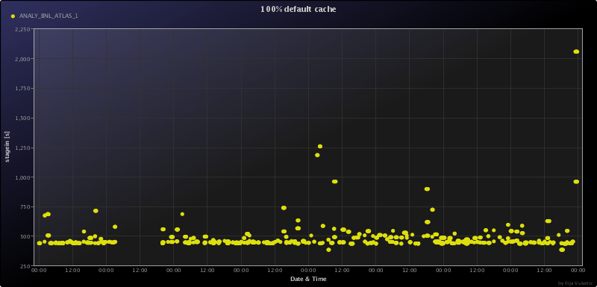
BNL
Stage in time of ~450 seconds is way too much?

Slide 6
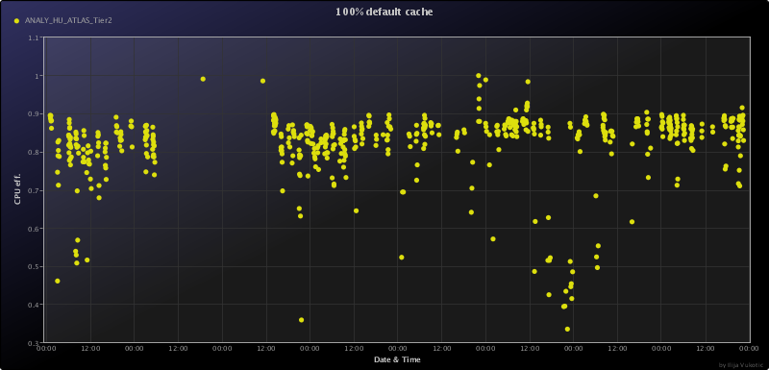
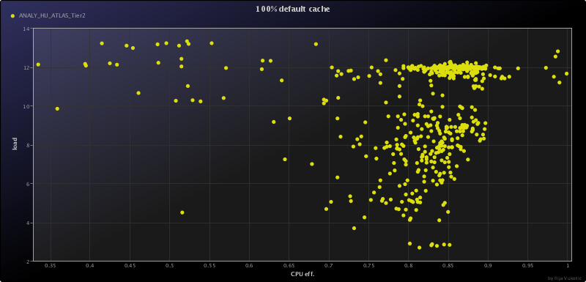
HU
Spotty efficiency
Stage in ~500s
Stage out ~ 130s ?
Setup ~100s ?
Not because of load

Slide 7
MWT2
No jobs from after 1st March?
Can’t reach results…

Slide 8
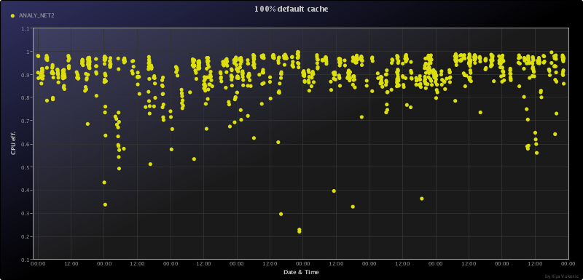
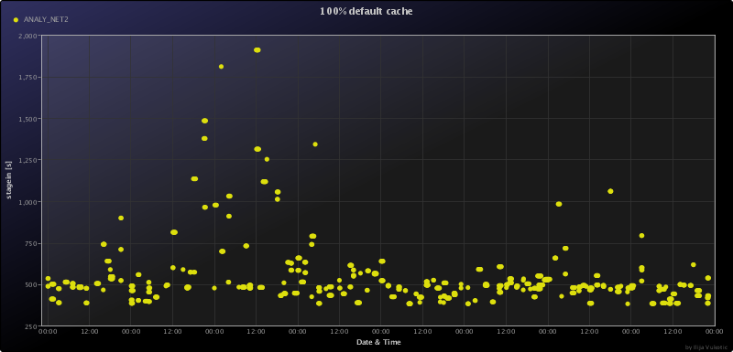
NET2
Good CPU eff. ~0.9
Stage-in ~ 542 s
But good setup: 66s

Slide 9
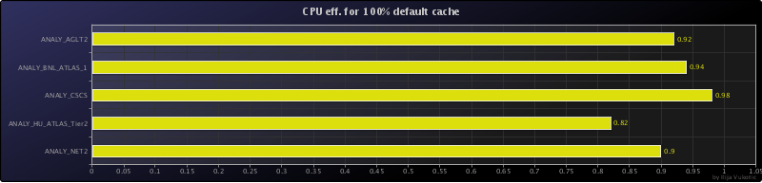
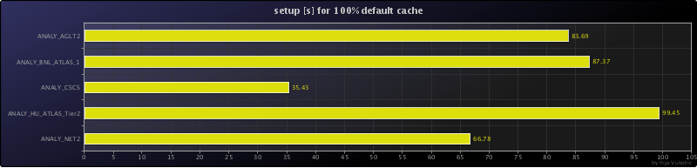
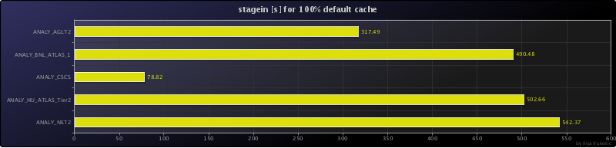
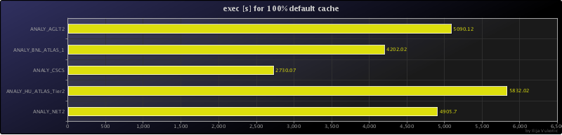
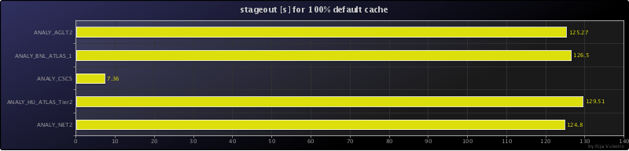
Comparisons
CSCS
  Swiss center for supercomputing

