Slide 1

ITS Upgrade Studies – Progress Report
LHCC upgrade session, CERN 12th June 2012
L. Musa
Outline
Summary of design goals and detector layout options
Update on R&D activities (selection of most relevant results)
CMOS pixel detectors
Mechanical structure and detector ladder prototypes
Conclusions

Slide 2
Design goals
1. Improve impact parameter resolution by a factor of ~3
Get closer to IP (position of first layer): 39mm 22mm
Reduce material budget: X/X₀ /layer: ~1.14%  ~ 0.3%
Reduce pixel size
currently 50μm x 425μm
monolithic pixels  O(20μm x 20μm),
hybrid pixels  O(30μm x 30μm), state-of-the-art O(50μm x 50μm)
2. High standalone tracking efficiency and p_{t} resolution
Increase granularity: 6 layers  7 layers , reduce pixel size
Increase radial extension: 39-430 mm  22– 430(500) mm
3. Fast readout
readout of Pb-Pb interactions at > 50 kHz and pp interactions at > 2MHz
4. Fast insertion/removal for yearly maintenance
possibility to replace non functioning detector modules during yearly shutdown

Slide 3
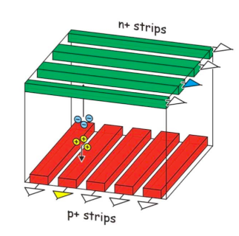
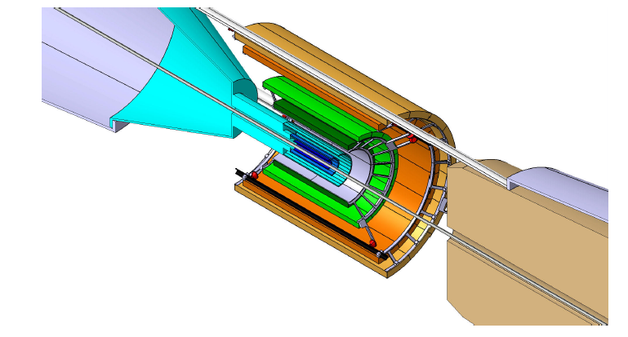
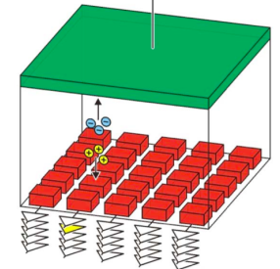
Upgrade options
Two design options are being studied
7 layers of pixel detectors
better standalone tracking efficiency and p_{t} resolution
worse PID
3 inner layers of pixel detectors and 4 outer layers of strip detectors
worse standalone tracking efficiency and momentum resolution
better PID
Option B
4 layers of strips
Option A
7 layers of pixels
3 layers of pixels
Pixels: O(20x20µm² – 50 x 50µm²)
685 krad/ 10¹³ n_{eq} per year
Includes safety factor > 4
Pixels: O( 20x20µm² – 50 x 50µm²)
Strips: 95 µm x 2 cm, double sided

Slide 4
Assumptions for physics performance studies (in ITSup CDR)
1. impact parameter resolution (at low p_{t} only 2 innermost layers are relevant)
position of first layer: 22mm
material thickness of 2 innermost layers: X/X₀ ~ 0.3% per layer
σ_{rφ} = 4-12 μm, σ_{z} = 4-12 μm for 2 innermost layers
2. tracking efficiency and p_{t} resolution (ITS + TPC)
3 inner layers: σ_{rφ} = 4-12 μm, σ_{z} = 4-12 μm
ITS – TPC high tracking matching efficiency (as current detector)
outer 4 layers could be equipped with strips (σ_{rφ} =20 μm, σ_{z} = 830 μm)
3. PID capabilities of current TPC and TOF
The implementation of silicon strips with σ_{rφ} = 20 μm, σ_{z} = 830 μm requires a new design
but its feasibility does not require a dedicated R&D programme
Motivations for using pixel detectors for all layers:
Cost
improved standalone tracking efficiency and p_{t} resolution

Slide 5
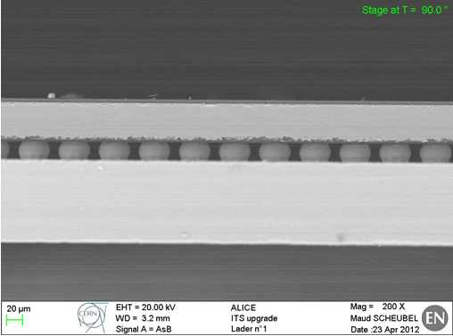
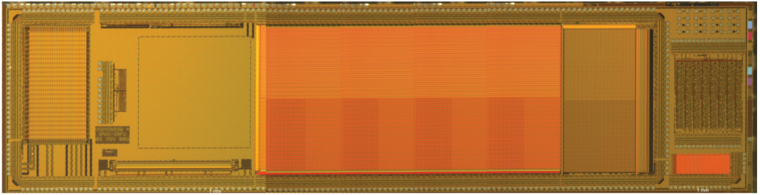
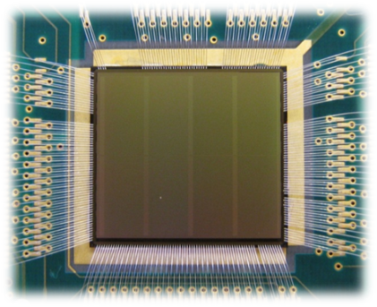
Pixel detector technologies
Several technologies are being considered
Hybrid pixel detectors
Edgeless sensors (100μm) + front-end chip (50μm) in 130 nm CMOS
Monolithic pixel detectors
MIMOSA like in 180 nm CMOS
INMAPS in 180 nm CMOS
LePix in 90nm CMOS
HYBRID (CERN)
Tower/Jazz
FEE chip
100μm
IBM
sensor
100μm
MISTRAL prototype circuit (IPHC)
INMAPS (RAL)
LePIX prototype circuit (CERN)
TPAC prototype
50 µm pixel - over 150 CMOS transistors
Matrix1
Diode
Breakdown test
Transistor test

Slide 6

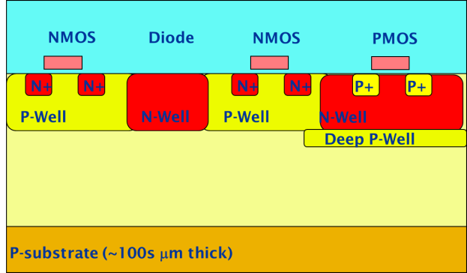
Monolithic Pixel Detectors
Development for monolithic detectors using Tower/Jazz 0.18 µm CMOS technology:
Improved TID resistance due to smaller technology node
Available with high resistivity (~1k Ω•cm) epitaxial layer up to 18 µm
Special quadruple-well available to shield PMOS transistors (allows in-pixel truly CMOS circuitry)
(R. Turchetta – RAL)
Study radiation hardness and SEU
Study charge collection
performance
Design prototype chips in
Tower/Jazz 0.18 µm
Use existing structures (RAL)

Slide 7
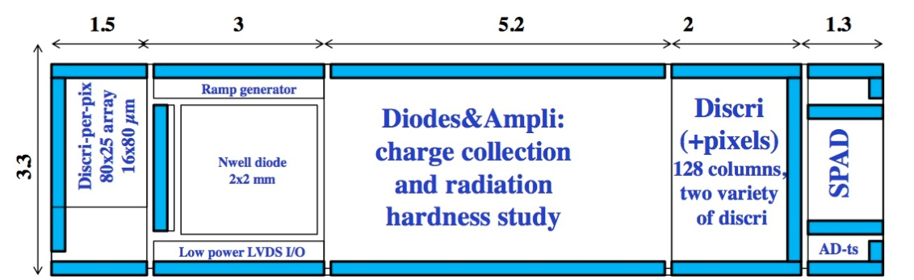
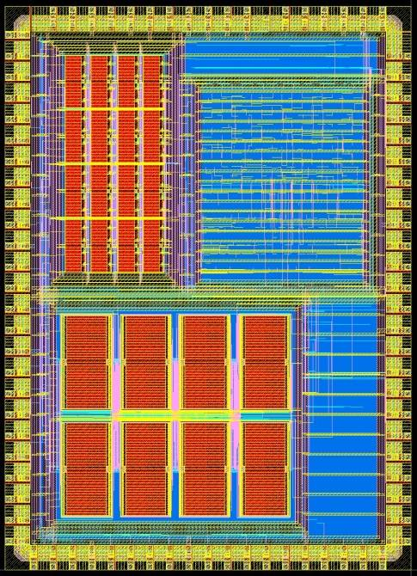
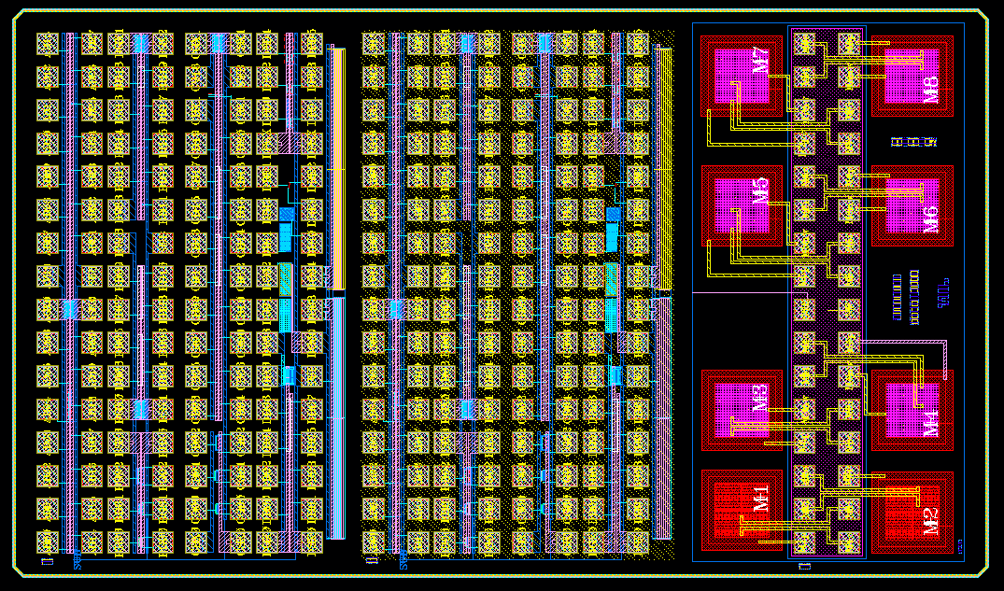
Monolithic Pixels – Evaluation of Tower/Jazz technology
MIMOSA 32 (IPHC Strasbourg)
Digital and analog blocks (2T and 3T structures with various diodes)
100 circuits delivered Jan 2012 ✓
Test with Fe⁵⁵ source ✓
Irradiation tests (X-ray, neutron) ✓
Beam-test June 6-11, 2012 ✓
First test results on pixel matrix
MONALICET1 (CERN/CCNU)
Single transistors
Breakdown structures
Memories
Digital structures
Shift register
Delivery early July 2012
5.7 mm
3.7 mm
Delivery: beginning July 2012
2.2 mm
4.1 mm
CMOS test structures
w/o deep p-well
Breakdown
diodes

Slide 8
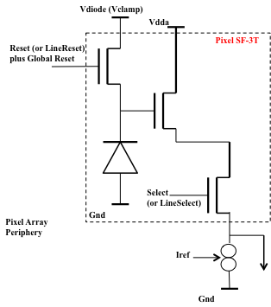
MIMOSA 32 (IPHC) – Characterization with Fe⁵⁵
3T structure
example of in-pixel circuit
➔ All pixel structures with source follower operational
Charge Collection Efficiency (CCE) for 20x20 µm² pixels
Seed pixel: ~40-50%
2x2 pixel cluster: nearly 100 %
CCE identical with/without in-pixel PMOS Trans. (i.e. deep P-well)
CCE for elongated pixels (20x40 µm²), 1 diode/pixel
Seed pixel: ~30%
+ 1st crown : ~76 % + 2nd crown : ~93%
CCE for elongated pixels (20x40 µm²), 2 diode/pixel
Seed pixel: ~44%
+ 1st crown : ~83 % + 2nd crown : ~98%
2 diodes implementation, noise increase x2
➔ High resistivity of EPI layer confirmed

Slide 9
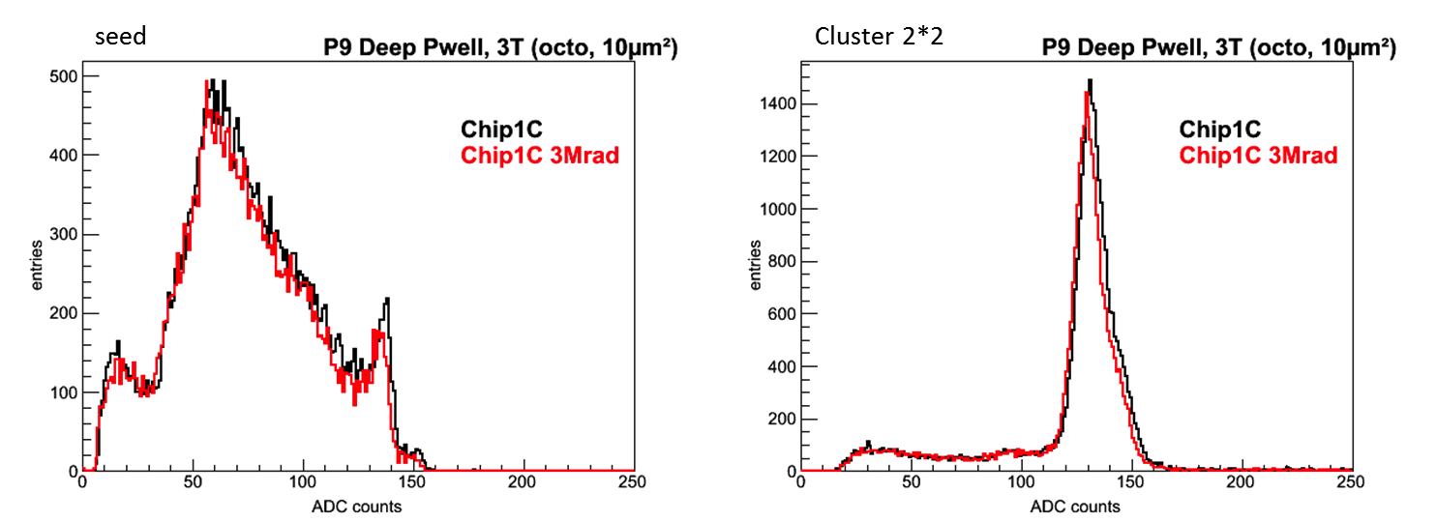
MIMOSA 32 (IPHC) – Characterization with Fe⁵⁵
Preliminary
(M. Winter et al.)
TID test: irradiation to 3 Mrad (X-ray, CERN)
Fe ⁵⁵
With deep p-well
Pixel noise ~ 15-20 e⁻ at RT (20°C) – not changed after 3 Mrad

Slide 10
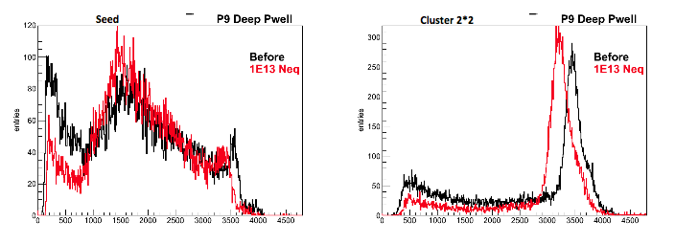
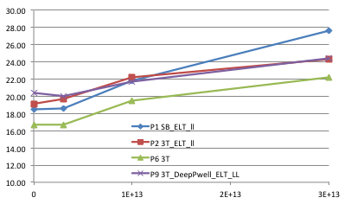
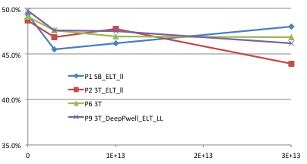
Monolithic Pixels – MIMOSA 32
Preliminary
(M. Winter et al.)
NIEL test: irradiation to 0.3E13, 1E13, 3E13 n_{eq} (neutrons, Ljublyana)
Fe ⁵⁵
Equivalent noise charge (electrons)
Fraction of charge collected on seed pixel

Slide 11
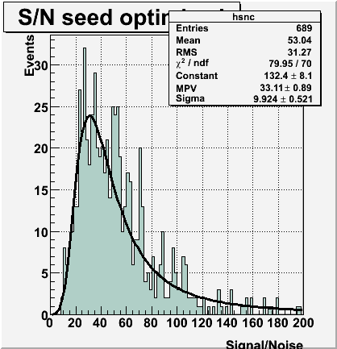
MIMOSA 32 (IPHC) – Characterization at test beam
Parasitic running on T2-H4 with ~60 GeV π⁻ beam
Data taking started June 7th  data shown collected until this morning …
Results are very preliminary!! (but consistent with lab test results)
Preliminary (M. Winter et al.)
Signal-to-Noise measured
with P1 (3T pixels) at T = 15 ⁰C
before irradiation
SNR ~ 33.1 ± 0.9

Slide 12
MIMOSA 32 (IPHC) – Characterization at test beam
Parasitic running on T2-H4 with ~60 GeV π⁻ beam
Data taking started June 7th  data shown collected until this morning …
Results are very preliminary!! (but consistent with lab test results)
Preliminary (M. Winter et al.)
Signal-to-Noise measured
with P1 (3T pixels) at T = 15 ⁰C
before irradiation
SNR ~ 33.1 ± 0.9

Slide 13
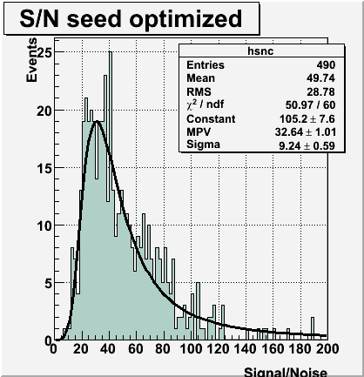
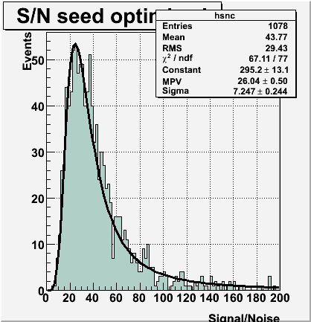
MIMOSA 32 (IPHC) – Characterization at test beam
Preliminary
(M. Winter et al.)
Signal-to-Noise measurement after irradiation
TID (10 keV X-Rays) ~ 3Mrad
10¹³ n_{eq}/cm²
Signal-to-Noise measured
with P9 (deep P-well) at T = 15 ⁰C
SNR ~ 32.6 ± 1.0
Signal-to-Noise measured
with P9 (deep P-well) at T = 30 ⁰C
SNR ~ 26.0 ± 0.5

Slide 14
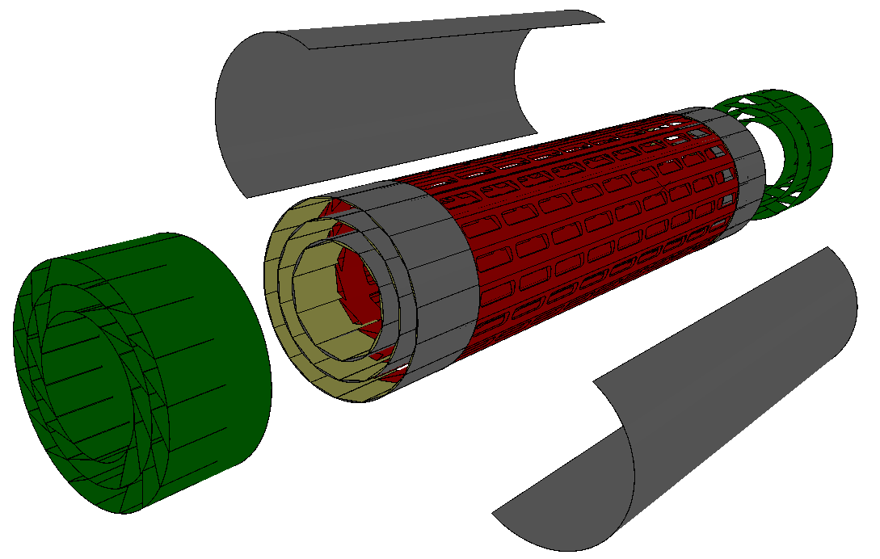
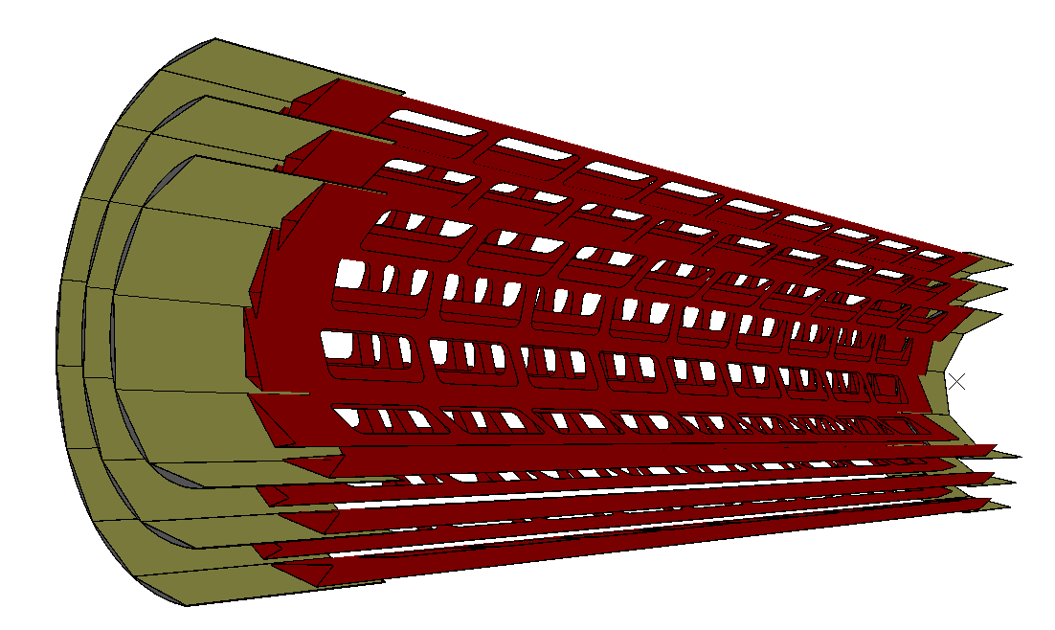
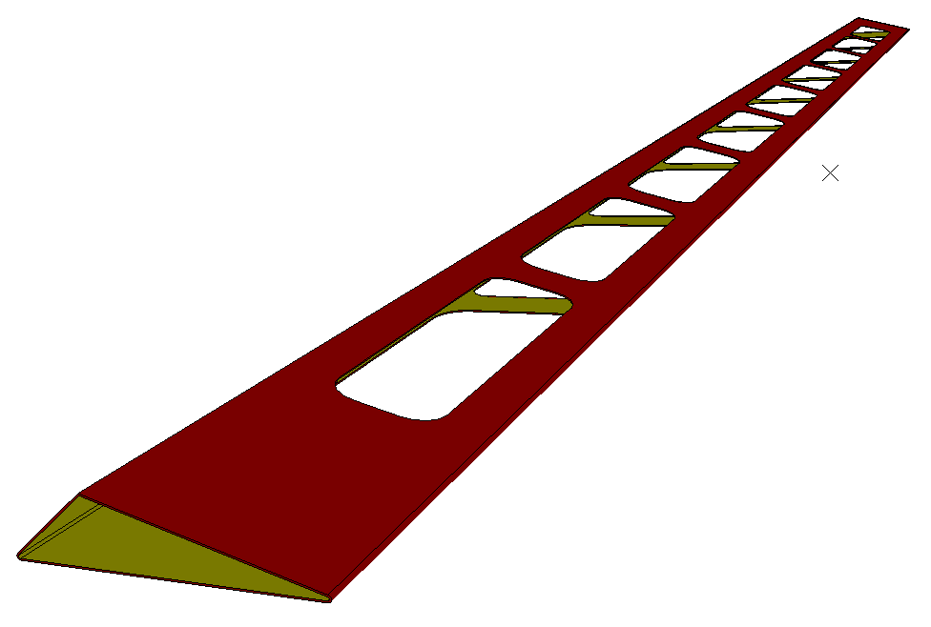

ITS mechanical structure
Stiff-end
Structural shell
barrel
layer1
290 mm
layer2
layer3
half barrel
17 mm
stave

Slide 15
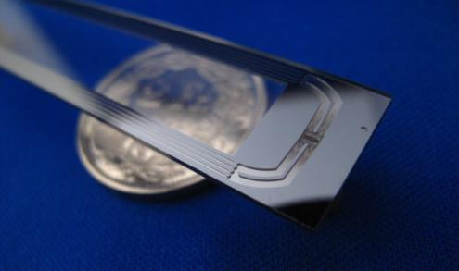
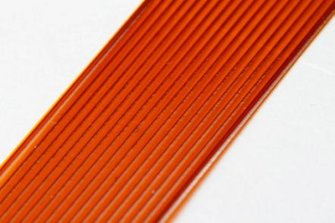
R&D on mechanical structure
The Stave Prototypes developed for ITS Layer1,2,3 can be divided in two groups that refer to two of the different cooling concepts under study
"cold plate"
Silicon micro-channel
Polyimide micro-channels
"cooling pipes"
“cooling pipes"
Polyimide tubes

Slide 16

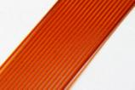
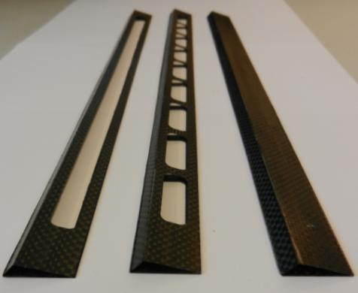
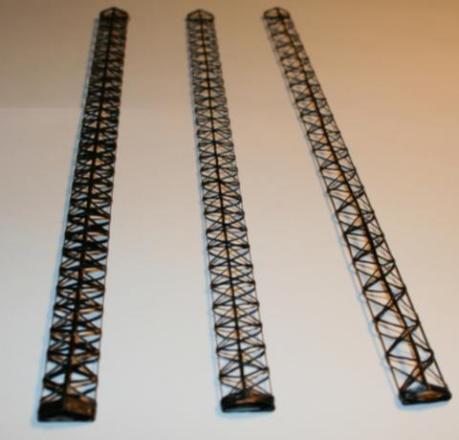
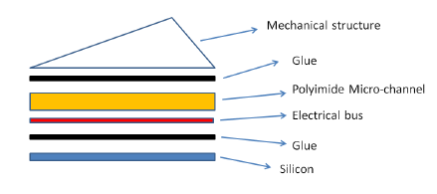
Carbon fabric
"cold plate"
T300
M55J 6k (twist)
M55J 6k
M60J 3k
Carbon roving
~1,2 gram
~1,4 gram
~2,1 gram
Fiber T300, Young modulus =250Gpa
Fiber M55JB 6k Young modulus =540Gpa
~1,3 gram
~1,0 gram
~0,6 gram
Fiber M60 -3k Young modulus =588Gpa

Slide 17
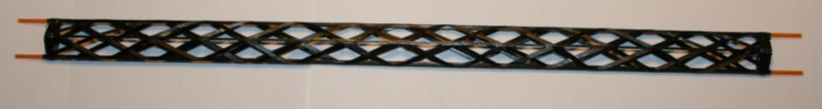
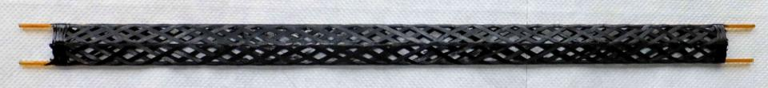
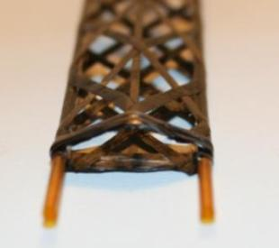
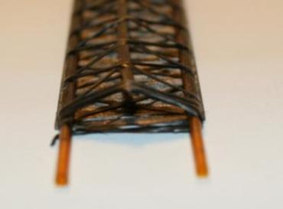
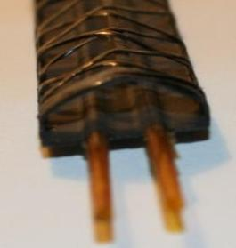
“cooling pipes"
High thermal conductivity Carbon fibers wound around polyimide tubes
~1,1 gram
Carbon fiber K13D-2U 2K, 70 µm thick : k_{Fiber} = 450 W/mK
~1,4 gram
+ High Thermal Conductivity Carbon plate*
*Carbon fiber K1100, 70 µm thick; k_{Fiber} =550 W/mK

Slide 18
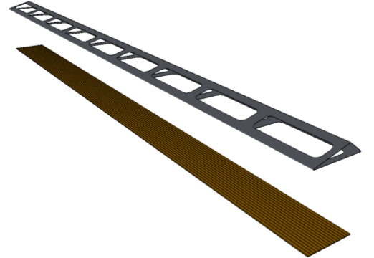
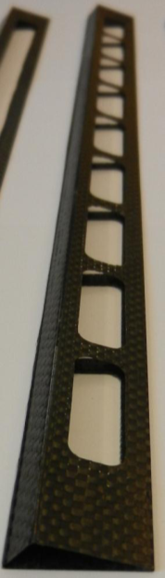
MECHANICAL STRUCTURE +
POLYIMIDE MICRO-CHANNELS
Composite: Carbon fiber fabric (0°/90°)
~1,4 gram
Polyimide micro-channels
Material | Surface (%) | Tickness (µm) | X0 (cm) | X/X0 (%)
CFRP | 22 | 120 | 25 | 0,011
CFRP | 43 | 240 | 25 | 0,041
Polyimide Micro-channels walls | 21 | 200 | 28,6 | 0,015
Polyimide Micro-channels top and bottom covers | 100 | 100 | 28,6 | 0,035
Water | 79 | 200 | 36,1 | 0,044
total |  |  |  | ~0,14

Slide 19
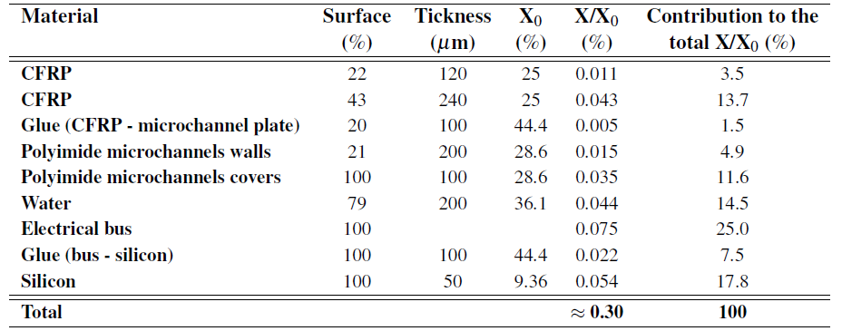
R&D on mechanical structure
Ladder prototype equipped with dummy components

Slide 20
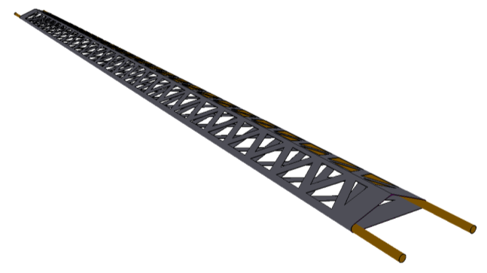
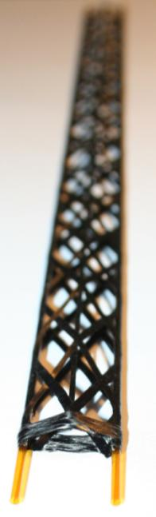

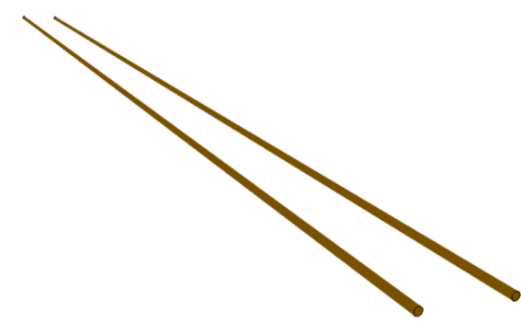
MECHANICAL STRUCTURE +
POLYIMIDE TUBES
Composite: Carbon fiber filament
Carbon Filament Section 0,190 mm²
~1,1 gram
Structure section
~1,4 gram
Polyimide tubes
(OD-15mm, wall thickness 35 µm)
Material | Surface (%) | Tickness (µm) | X0 (cm) | X/X0 (%)
CFRP filament | 53 | 190 | 25 | 0,04
Polyimide tubes | 19 | 70 | 28,6 | 0,0045
Water | 19 | 1450 | 36,1 | 0,06
total |  |  |  | ~0,11

Slide 21
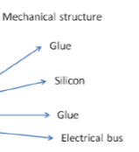

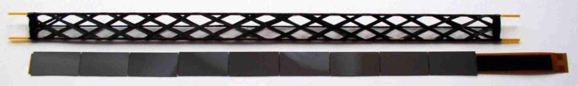
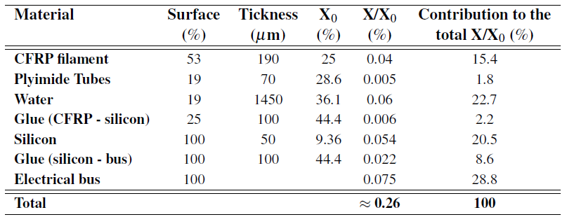
R&D on mechanical structure
Ladder prototype equipped with dummy components

Slide 22
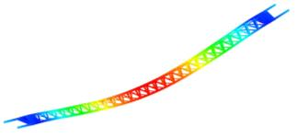
STRUCTURE
STIFFNESS
TEST
Steel tube
Aluminum tube
Wound truss + pipes
Wound truss
Open shell

Slide 23
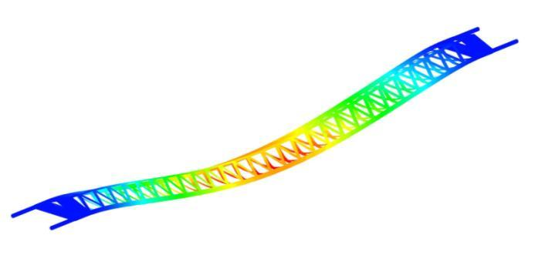

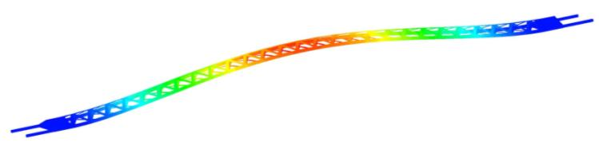
STRUCTURE STIFFNESS ANALYSIS
µm
Deformation in working condition
6
clamped
6 µm
3
clamped
5 gram = total distributed load
1
First natural frequency = 596 Hz

Slide 24
Summary
Evaluation of 0.18μmCMOS technology for MAPS  very encouraging results
Very low noise (ENC ~ 15-20 e ) and good S/N
Small cluster size (seed pixel collects ~40-50% charge)
No significant degradation when irradiated at 3Mrad, 10¹³ n_{eq}
R&D on mechanical support structure
Evaluation of different mechanical structure geometries, composite materials (CFRP) and production processes
Several ultra-light mechanical structures (ladders) for first 3 inner layers have been realized (ladder weight 0.6-1.4 g)
Stiffness tests show very high mechanical stability (natural freq. ~600Hz)
Complete ladder prototype: two mechanical structure and cooling concepts + electrical bus + glue + dummy silicon  X/X0 ≤ 0.3%

Slide 25
Improvement of impact parameter resolution
Simulations for two upgrade layouts
Option A: 7 pixel layers
Resolutions: σ_{rφ} = 4 μm, σ_{z} = 4 μm for all layers
Material budget: X/X₀ = 0.3% for all layers
Option B: 3 layers of pixels + 4 layers of strips
Resolutions: σ_{rφ} = 4 μm, σ_{z} = 4 μm for pixels σ_{rφ} = 20 μm, σ_{z} = 830 μm for strips
Material budget: X/X₀ = 0.3% for pixels X/X₀ = 0.83% for strips
radial positions (cm): 2.2, 2.8, 3.6, 20, 22, 41, 43
Same for both layouts

Slide 26
ITS standalone tracking efficiency
Central events at sqrt(s_{NN}) = 5.5 TeV
Simulations for two upgrade layouts
Option A (all pixel layers)
Resolutions: σ_{rφ} = 4 μm, σ_{z} = 4 μm for all layers
Material budget: X/X₀ = 0.3% for all layers
Option B (3 layers of pixels + 4 layers of strips)
Resolutions: σ_{rφ} = 4 μm, σ_{z} = 4 μm for pixels σ_{rφ} = 20 μm, σ_{z} = 830 μm for strips
Material budget: X/X₀ = 0.3% for pixels X/X₀ = 0.83% for strips
radial positions (cm): 2.2, 2.8, 3.6, 20, 22, 41, 43
Same for both layouts

Slide 27
Hybrid Pixel Detectors
Flip-chip bonding & thin assemblies
IZM Berlin
Hybrid pixel detector with 50 µm chip and 100 µm sensor
Tests with dummy components using ALICE SPD layout
2 ladders (5 chips + 1 sensor) and 8 singles with final thicknesses bonded
Incomplete connection on one side on 7 single chip assemblies, no problems on the ladders
50 um chip
100 um sensor

Slide 28
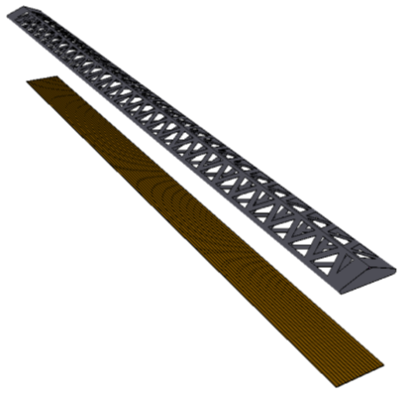

MECHANICAL STRUCTURE +
POLYIMIDE MICRO-CHANNELS
Composite: Carbon fiber filament
Carbon Filament Section 0,190 mm²
~1,3 gram
Structure section
Polyimide micro-channels
Material | Surface (%) | Tickness (µm) | X0 (cm) | X/X0 (%)
CFRP | 53 | 190 | 25 | 0,04
Polyimide Micro-channels walls | 21 | 200 | 28,6 | 0,015
Polyimide Micro-channels top and bottom covers | 100 | 100 | 28,6 | 0,035
Water | 79 | 200 | 36,1 | 0,044
total |  |  |  | ~0,14

