Slide 1

Test bench for Linac4 commissioning at 30-50-100 MeV
JB Lallement
Linac4 BCC meeting – 14/06/2012

Slide 2
L4 Commissioning
The Linac4 commissioning will be divided into several stages :
Structure | Commissioning
Ion Source | Diagnostic tank and emittance meter.
LEBT
RFQ | 3 MeV test bench – Straight and spectrometer lines.
MEBT
DTL 1
DTL 2-3 | 50-100 MeV test bench
CCDTL
PIMS | L4Z – Permanent diagnostics
TL | Permanent diagnostics – LBE/LBS

Slide 3
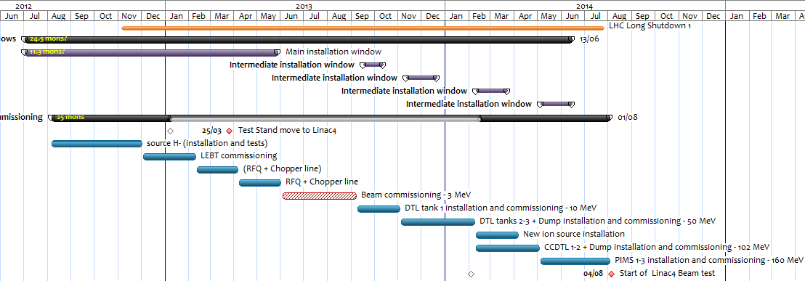
Planning
The test bench will be used for :
  Commissioning of DTL tanks 2-3
  Commissioning of CCDTL.
Test bench equipment available 3 month in advance for surface assembly, alignment & tunnel assembly !
30-50 MeV Dec 2013.
100 MeV March 2014.

Slide 4
Layout
Tank 1
Tank 2
Tank 3
Test bench
In both cases, the test bench
is located after the intertank !
CCDTL
…
CCDTL
Test bench
235.5 mm
100 mm
273 mm
563 mm
EMQ
EMQ
BSM
105 mm
105 mm
450 mm
700 mm
950 mm
Dump
Pick Up
2645.5 mm
Aperture radius :
20 mm up to 2nd EMQ
30 mm up to dump.
Steerers
SEMGrid / WS
BCT
2 EMQs (L4 spares).
2 Steerers (L4 spares).
2 Pick-ups for Time Of Flight.
1 BCT for transmission.
3 Profile monitors for emittance reconstruction.
Bunch Shape Monitor.

Slide 5
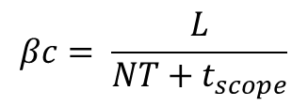
Time of flight
Not possible to install a spectrometer inside the high energy part of the tunnel.
Time of flight using 3 BPMs : 1 intertank and 2 on the test bench.
TOF measurements will be calibrated during the 3 MeV commissioning.
Will be used to set phase and voltage of the cavities.
With PUs 1&2
$$βc= \frac{L}{NT+t_{scope}}$$

Slide 6
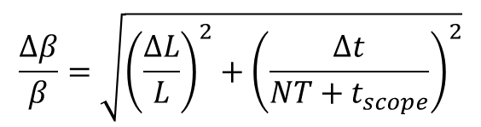
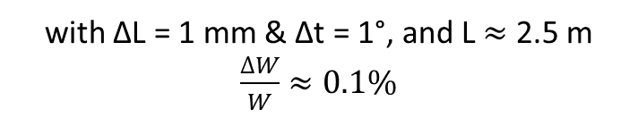
Time of flight
Not possible to install a spectrometer inside the high energy part of the tunnel.
Time of flight using 3 BPMs : 1 intertank and 2 on the test bench.
TOF measurements will be calibrated during the 3 MeV commissioning.
Will be used to set phase and voltage of the cavities.
With PUs 1&3
$$\frac{∆β}{β}=\sqrt{{\left(\frac{∆L}{L}\right)}^{2}+{\left(\frac{∆t}{NT+t_{scope}}\right)}^{2}}$$
with ΔL = 1 mm & Δt = 1°, and L $≈$ 2.5 m $\frac{∆W}{W}≈0.1\%$

Slide 7
Emittance Reconstruction (1)
Emittance reconstruction using the 3 profiles method.
3 profile monitors (WS or SG) required at appropriate location :
  60° phase advance between the monitor.
Can be confirmed with the 3 quad settings method.
Example at 30 MeV for horizontal plane.

Slide 8
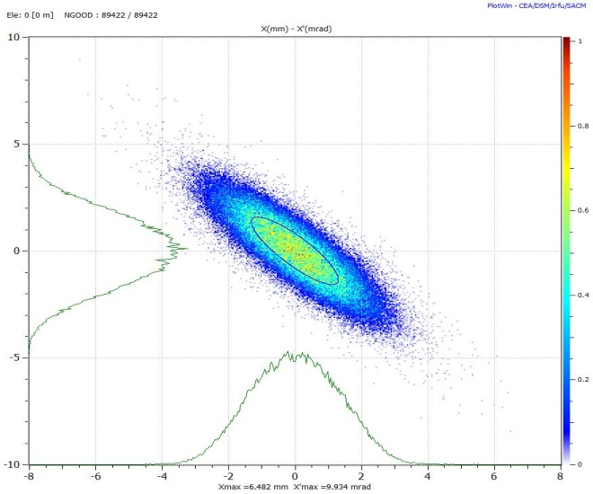
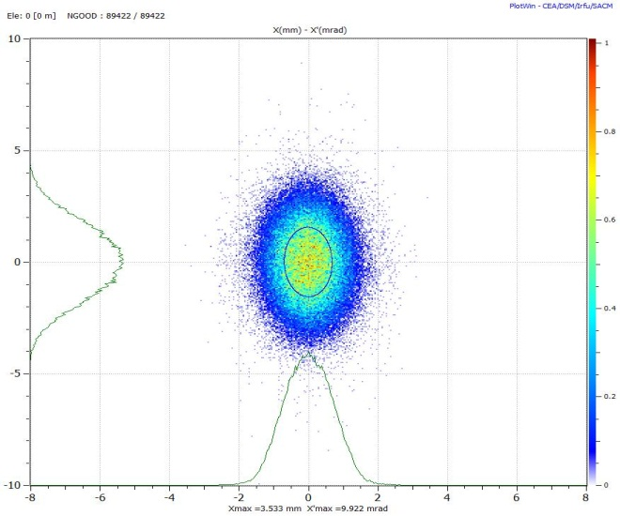
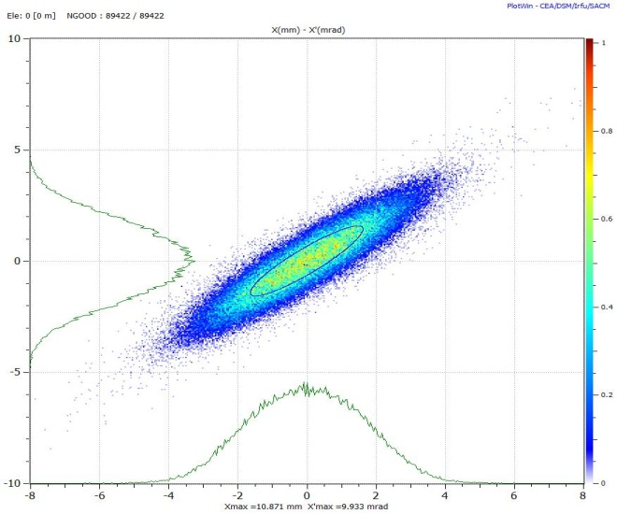
Emittance Reconstruction (2)

Slide 9
Emittance Reconstruction (3)
Forward method needed for an accurate emittance reconstruction, depending on space charge effects.
  Classic 3 monitor method.
  Iterative process with multi-particle tracking codes.
Examples : 30 and 50 MeV… @ 30 MeV, the beam is debunched…
30 MeV | Ref. Beam | Emit. Recons. | Forward Meth
Alpha X | 1.21 | 1.29 | 1.21
Beta X | 0.49 mm/mrad | 0.49 mm/mrad | 0.49 mm/mrad
ϵ X Norm. RMS | 0.28 mm.mrad | 0.28 mm.mrad | 0.28 mm.mrad
50 MeV | Ref. Beam | Emit. Recons. | Forward Meth
Alpha Y | 2.77 | 0.97 | 2.69
Beta Y | 1.69 mm/mrad | 0.67 mm/mrad | 1.62 mm/mrad
ϵ Y Norm. RMS | 0.29 mm.mrad | 0.33 mm.mrad | 0.30 mm.mrad

Slide 10
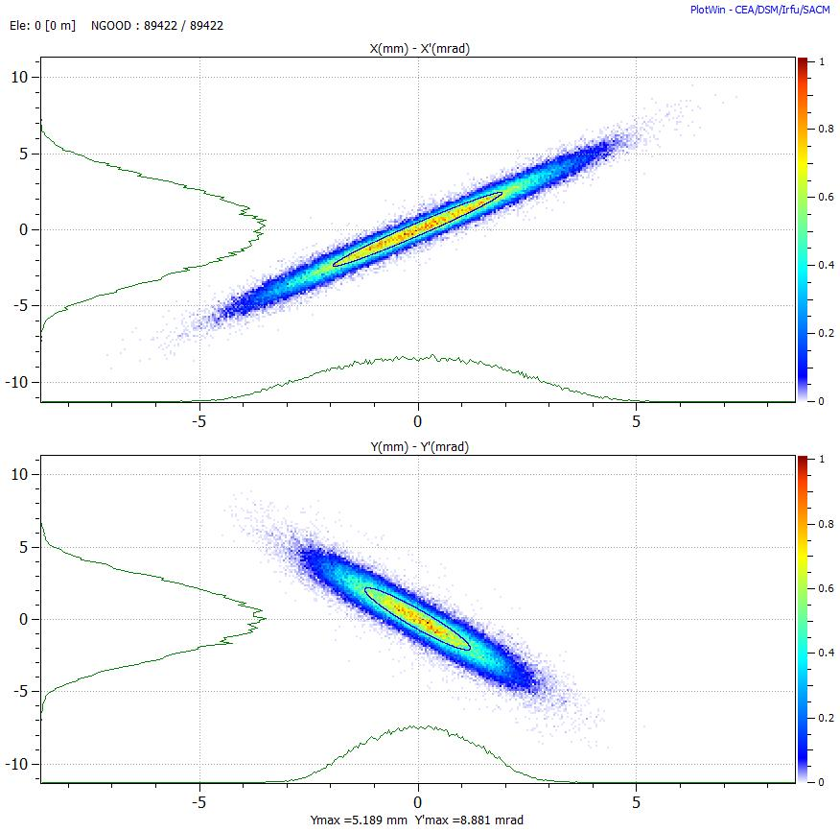
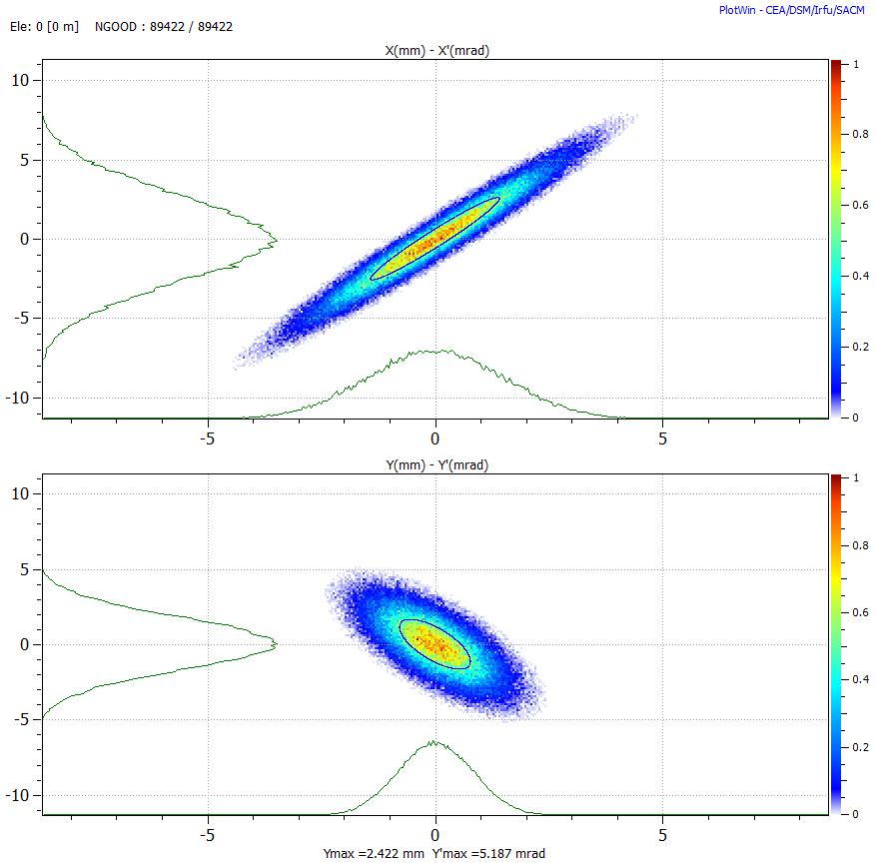

Emittance Reconstruction (4)
50 MeV | Ref. Beam | Emit. Recons. | Forward Meth
Alpha Y | 2.77 | 0.97 | 2.69
Beta Y | 1.69 mm/mrad | 0.67 mm/mrad | 1.62 mm/mrad
ϵ Y Norm. RMS | 0.29 mm.mrad | 0.33 mm.mrad | 0.30 mm.mrad

Slide 11
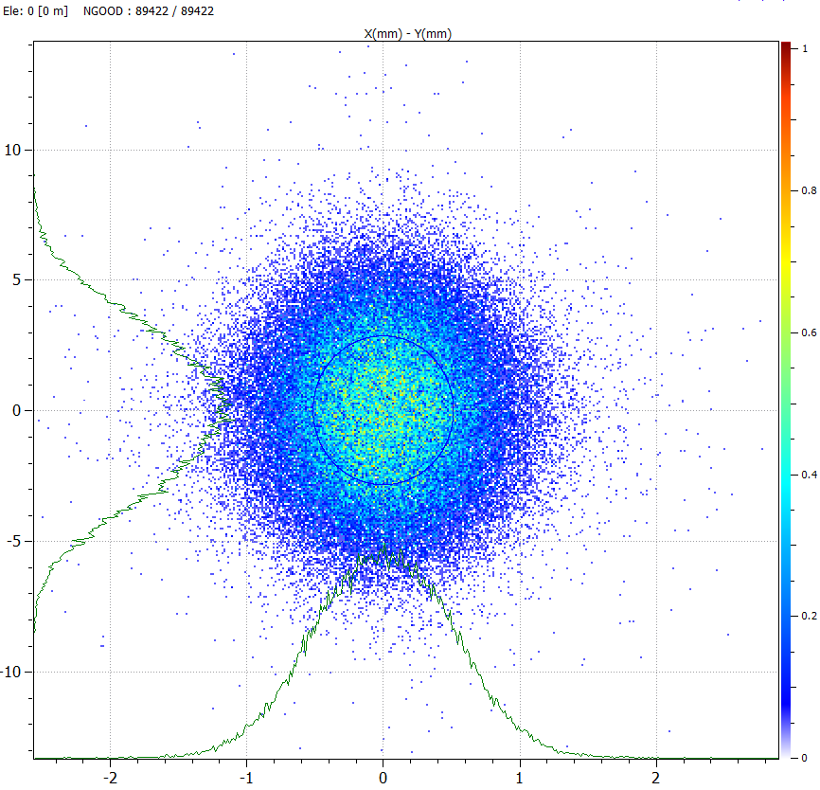
Emittance Reconstruction (4)
Beam sizes at profile monitors:
RMS Beam sizes (mm) |  | Monitor 1 |  | Monitor 2 |  | Monitor 3
30 MeV | X/y | 1.31 | 1.73 | 0.69 | 2.95 | 1.63 | 4.69
 | Y/x | 1.28 | 1.59 | 0.79 | 2.65 | 1.49 | 4.18
50 MeV | X/y | 1.37 | 1.66 | 0.51 | 2.85 | 1.78 | 4.71
 | Y/x | 1.23 | 1.26 | 0.73 | 2.00 | 1.40 | 3.37
100 MeV | X/y | 0.92 | 3.68 | 0.54 | 5.10 | 1.26 | 7.14
 | Y/x | 0.94 | 2.72 | 0.61 | 3.45 | 1.20 | 4.56
Simulations of the emit. reconstruction done with:
Wire Scanner 0.1 mm wire spacing and 40 µ width.
SEM Grids 0.4 mm wire spacing and 40 µ width.
Noise and background added

Slide 12
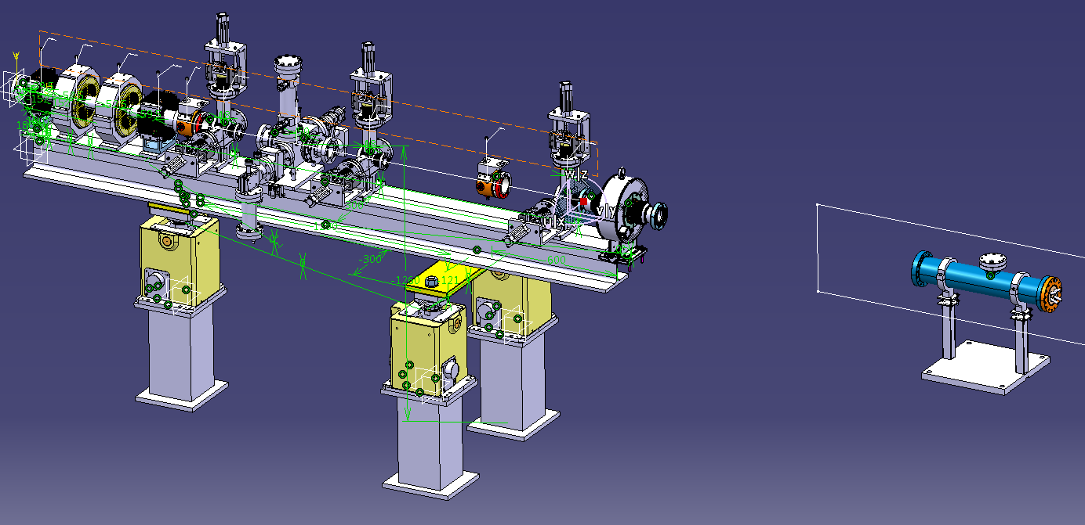
Conclusion / Discussion
All the test bench devices ready and available in Sept.- Oct. 2013.
What can be re-use from 3 MeV test bench?
Compatibility with Installation of CCDTL 3 and PIMS 4 ?
Magnets : We will use the L4 spares (2 EMQ & 2 correctors).
Diagnostic list :
  3 Profile monitors with 0.4 mm min resolution (use of the L4T ?).
  2 Pick-Ups compatible for 30-100 MeV (3 MeV spares…).
  1 BCT (the one from the 3 MeV TB…).
  The BSM.
Permanent cabling will be re-used!

Slide 14
