Slide 1
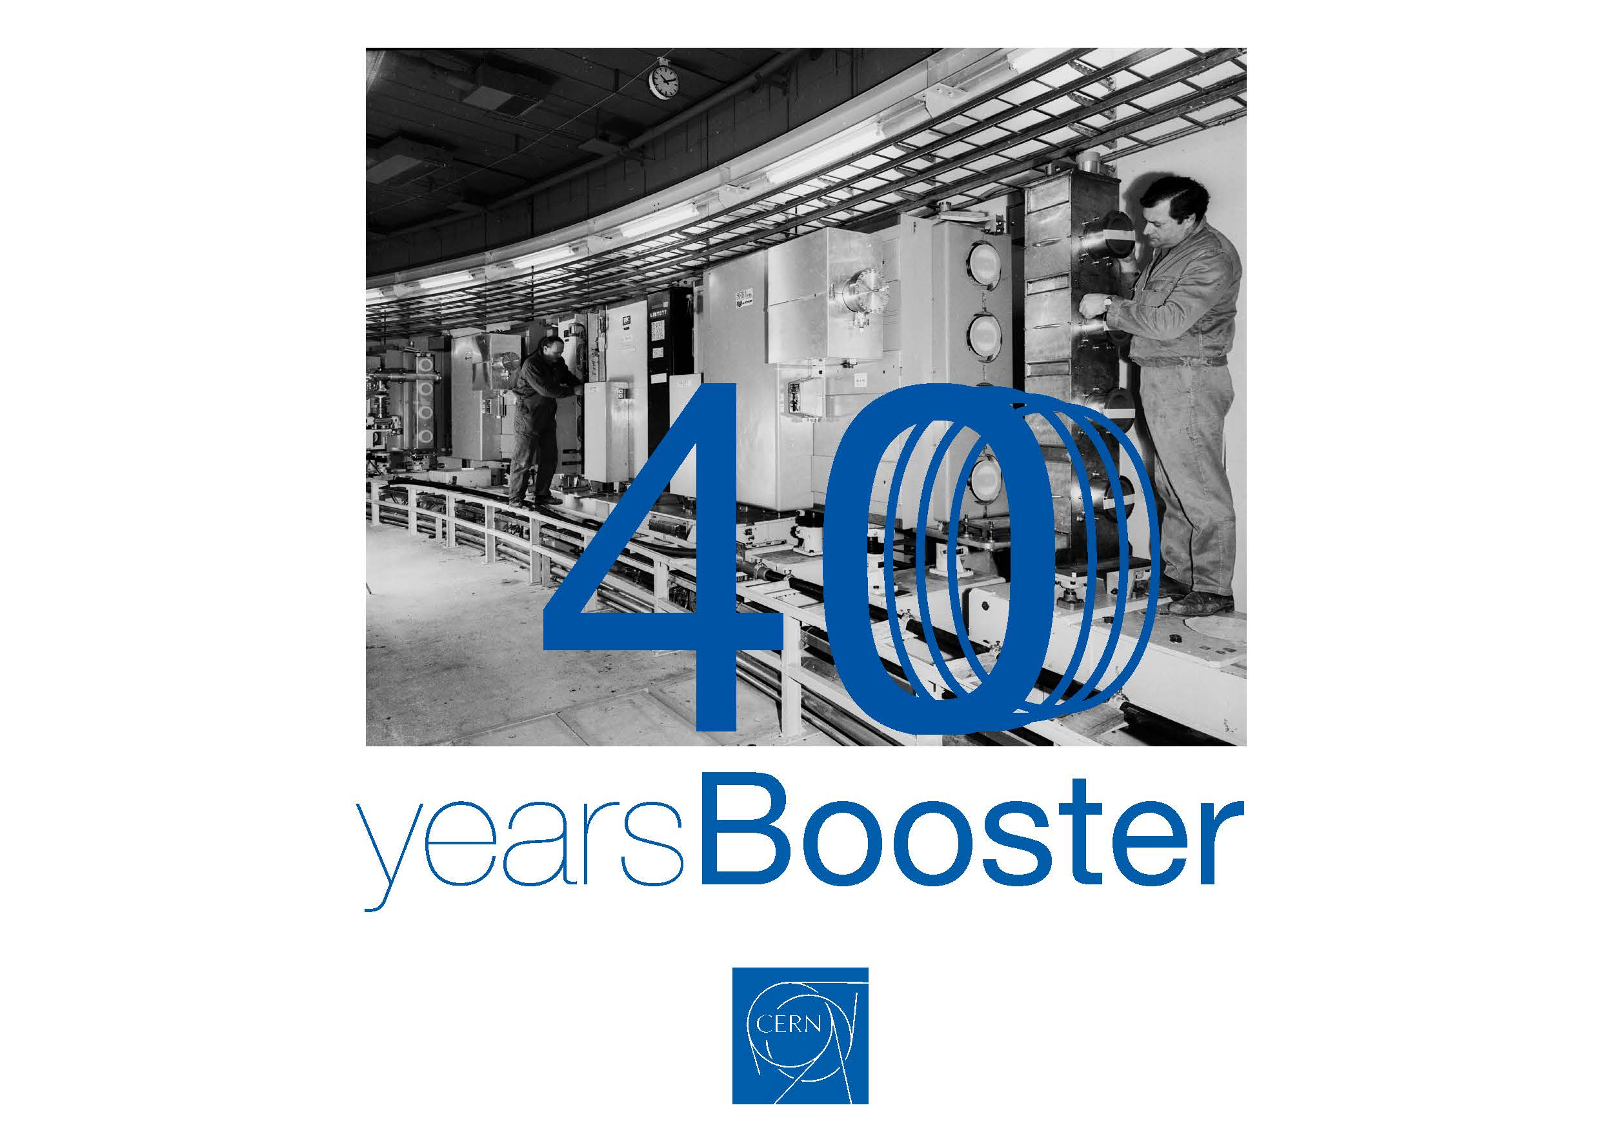
A Look into the Future
K Hanke / CERN

Slide 2
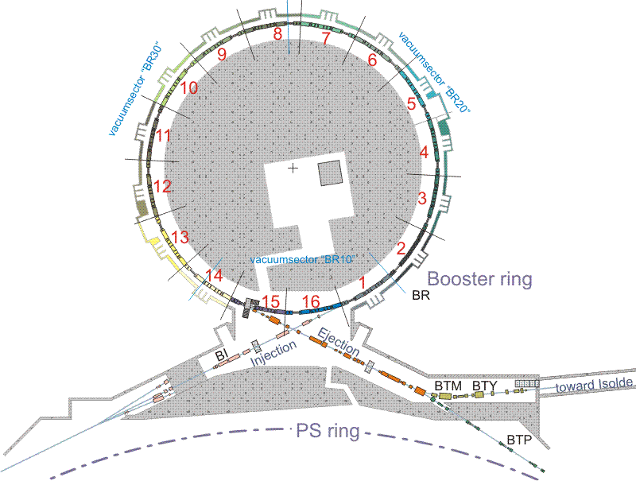
Scope of the Upgrade
upgrade of the injection
from 50 MeV protons to
160 MeV H- and increased
intensity
re-build injection line for
160 MeV
replace injection septum by
stripping foil
injection bumps
diagnostics
…
160 MeV
2 GeV
upgrade of rings and
extraction / transfer from
1.4 GeV to 2.0 GeV and
increased intensity
replace main power supply,
number of smaller power
supplies, magnets, kickers,
etc.

Slide 3
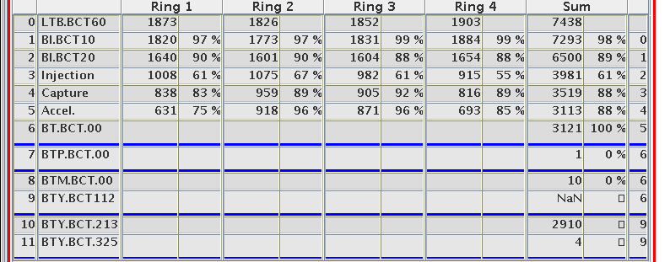
Upgrade of the Injection for Linac4
why re-building the injection region?
increased energy from 50 MeV to 160 MeV with Linac4
reduce space-charge effects at PSB injection
injection of H- ions rather than protons
significantly reduce injection losses (at the moment about 50% of the beam is lost on the injection septum!)
more flexibility in tailoring emittances by transverse phase space painting

Slide 4
Present Multiturn Injection
horiz. beam momentum
septum
closed orbit at injection (t₁)
2
1
7
3
horiz. co-ordinate
4
5
6
PSB closed orbit
as this process takes place, subsequent linac
beam “slices” are injected, with increasing
oscillation amplitude around the instantaneous
closed orbit (“horizontal stacking”)
beamlets are now “polygons”, as they
have undergone several cuts
they spiral up around the (moving)
closed orbit, leading to a density
distribution which is dense in the core
and less dense in the outer part
closed orbit
after one turn (t₂)
closed orbit after
second turn (t₃)
etc.

Slide 5
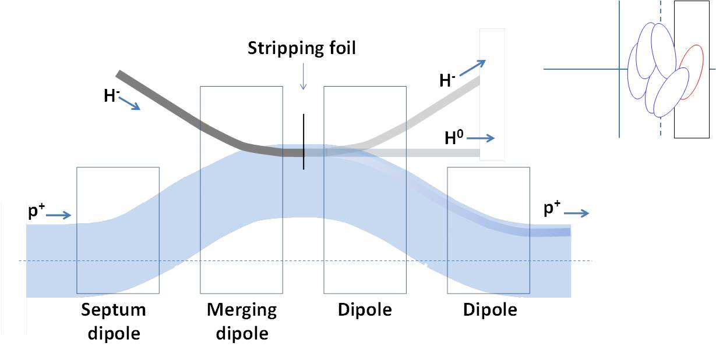
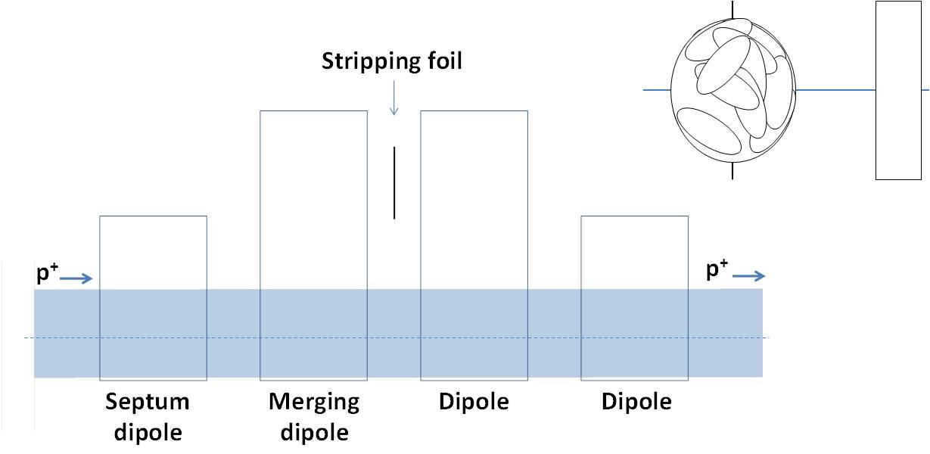
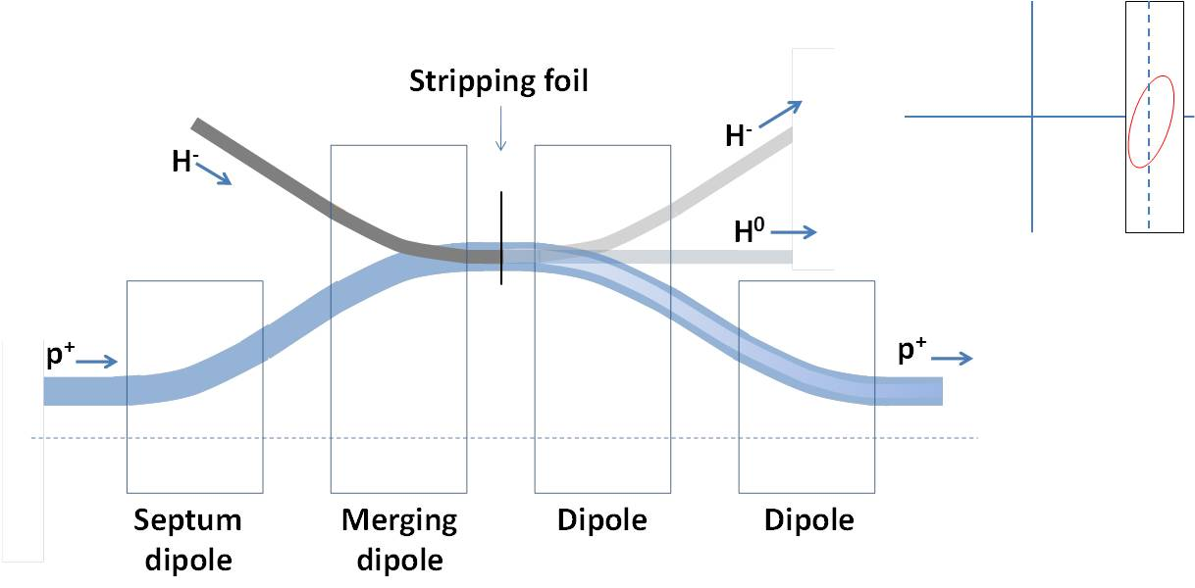
Charge Exchange Injection Principle

Slide 6
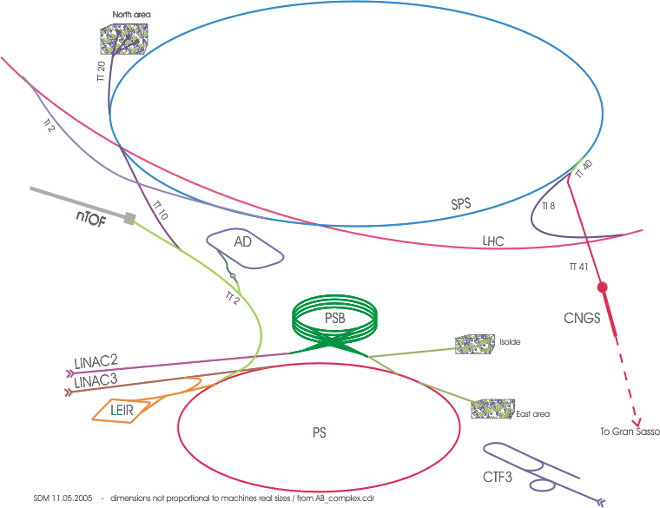
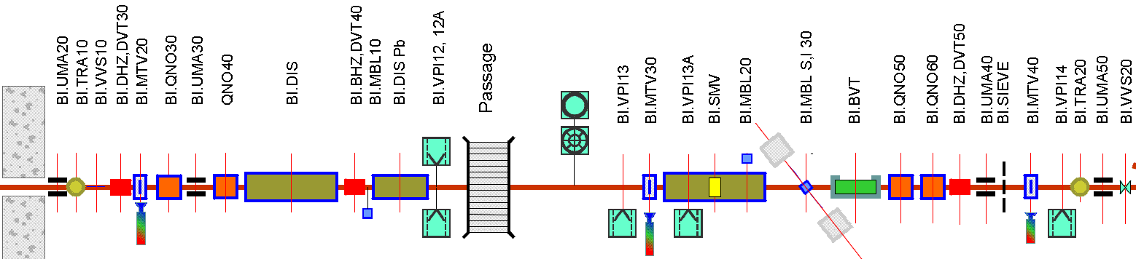
Injection Line for 160 MeV H⁻
~0.36 Tm required from BI.BVT for ~175 mrad @ 160 MeV
New BI.SMV,
4 mm thick septum and 70 mm horizontal aperture for
~165 mrad @ 160 MeV with associated new pulse generator.
Modify BI.DIS for
4.3 mrad @ 160 MeV
Performance increase of 1.9 in ∫B•dl of
BI.DVT30, BI.QNO30, BI.QNO40, BI.DVT40.
Remove obsolete BI.DIS Pb
W. Weterings

Slide 7
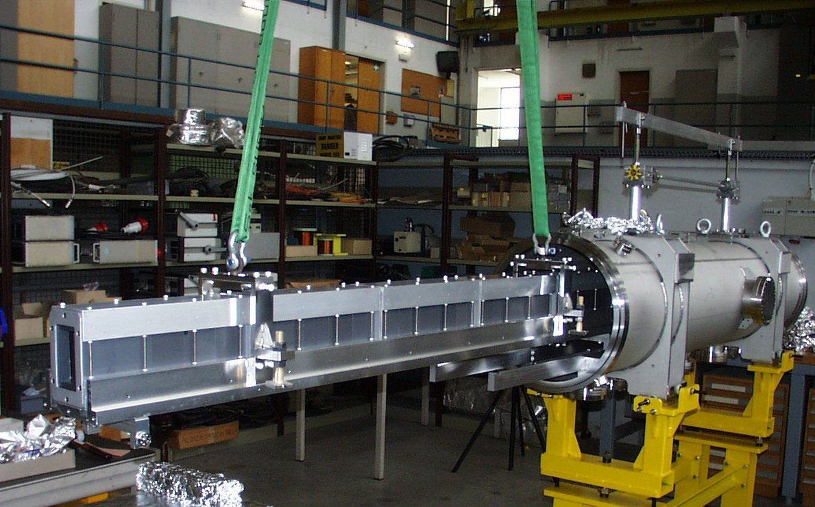
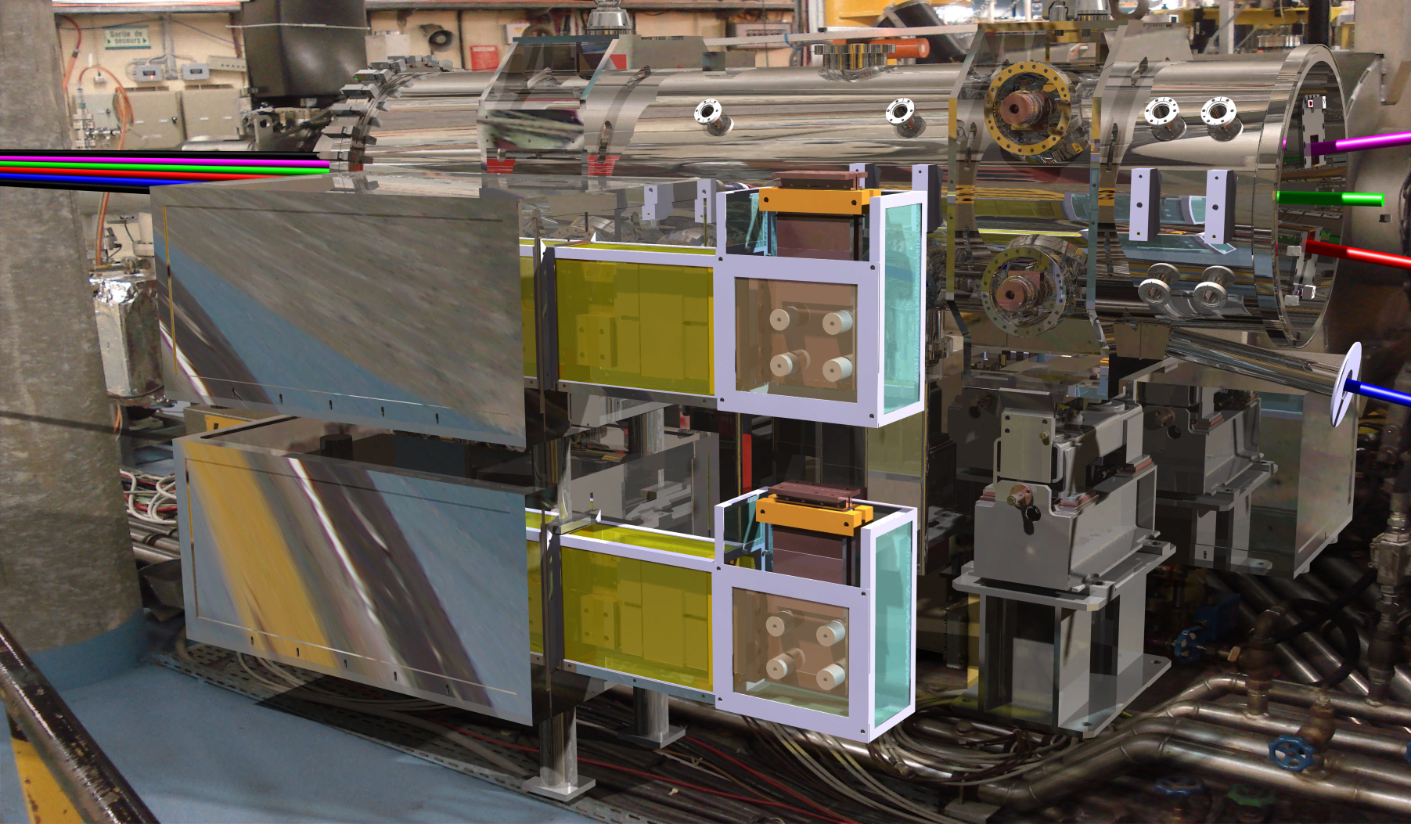
Injection Line Hardware
new distributor
new vertical septum

Slide 8
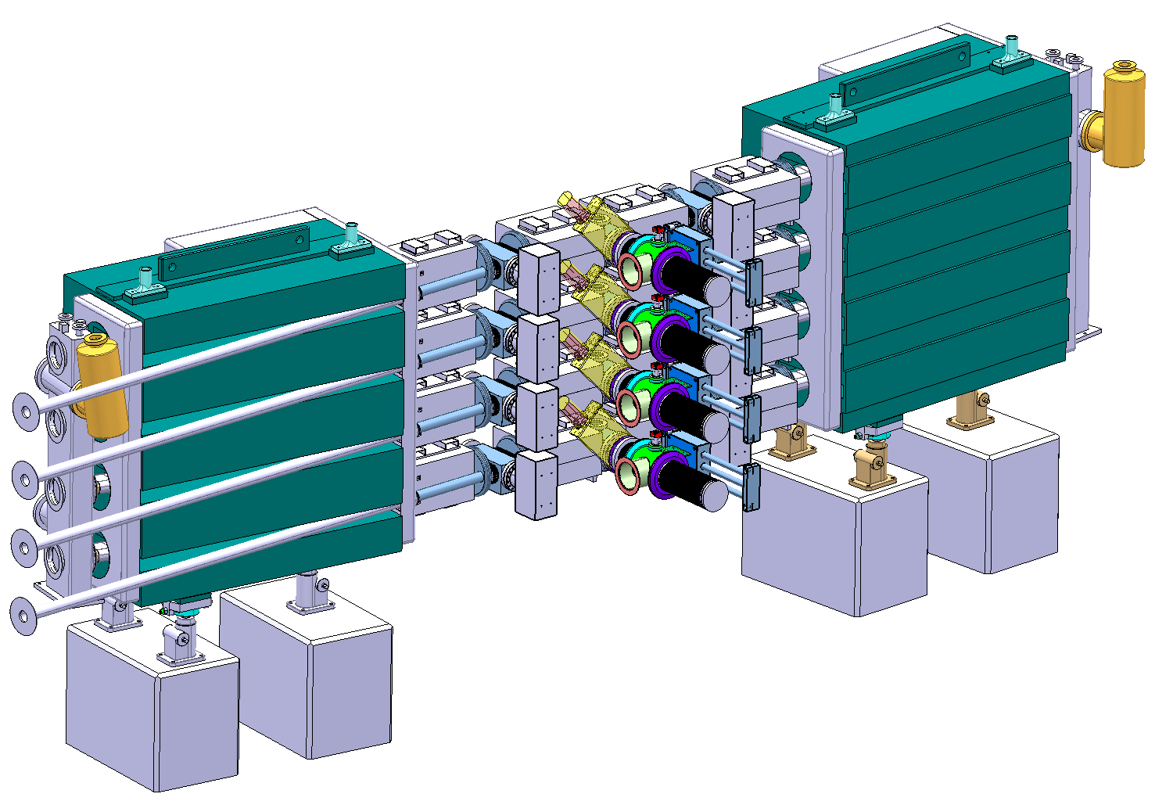
3D Layout of new Injection Region
BSW2 Merging Dipoles
BSW 3 & 4 Dipoles
BSW1 Septa
Existing PSB Dipole Magnets
Internal H⁰ Dump
Vacuum manifold
Stripping Foil System
&
Beam Observation
W. Weterings

Slide 9
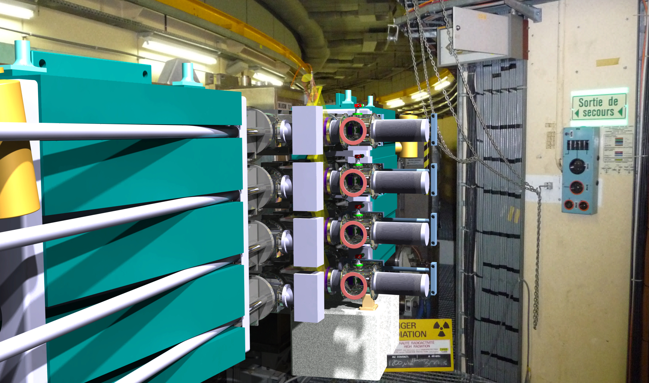
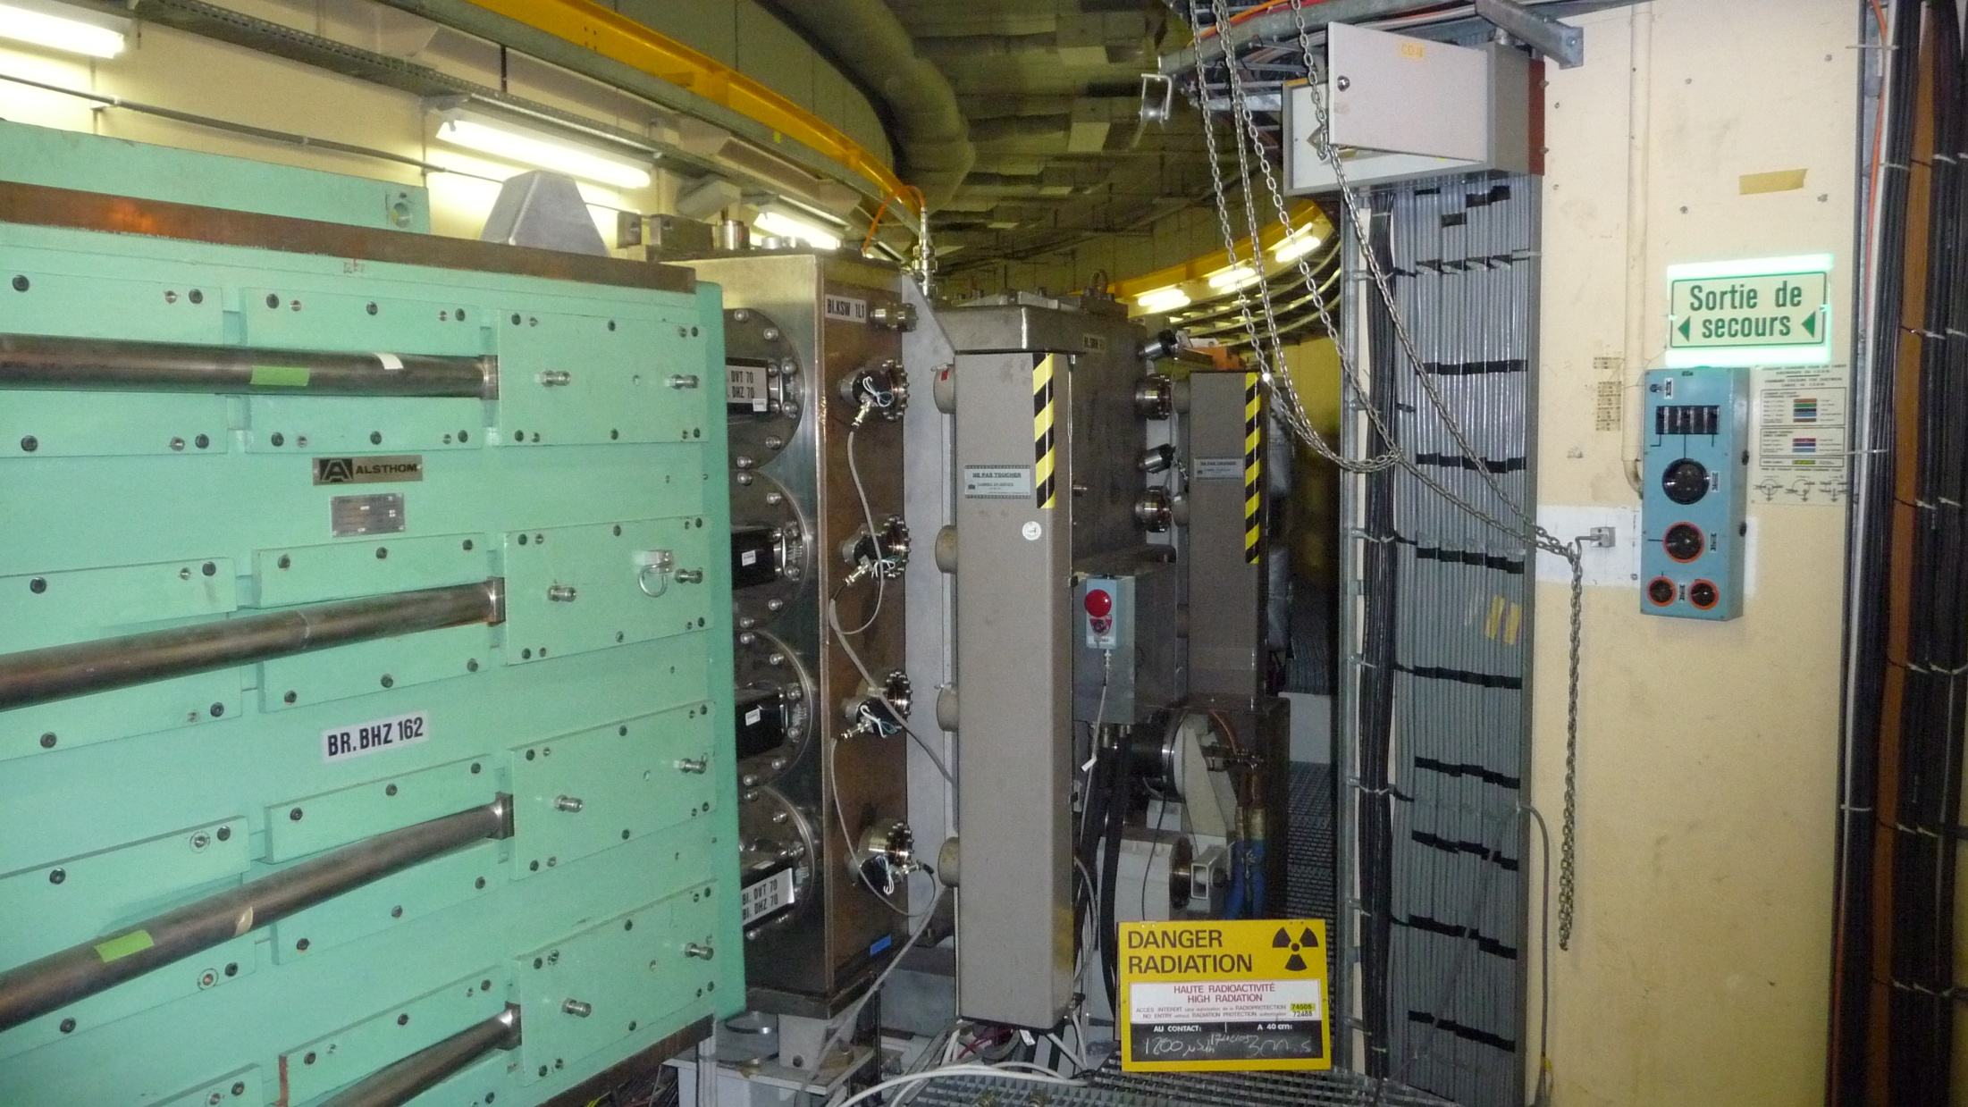
Present and Future Injection Region
B. Goddard

Slide 10
from the closing remarks of
Review on PSB 160 MeV H- Injection
9-10 November 2011
“The world’s most complex ring injection system is about to become more complex…”
“But if anyone can do it, CERN can”

Slide 11
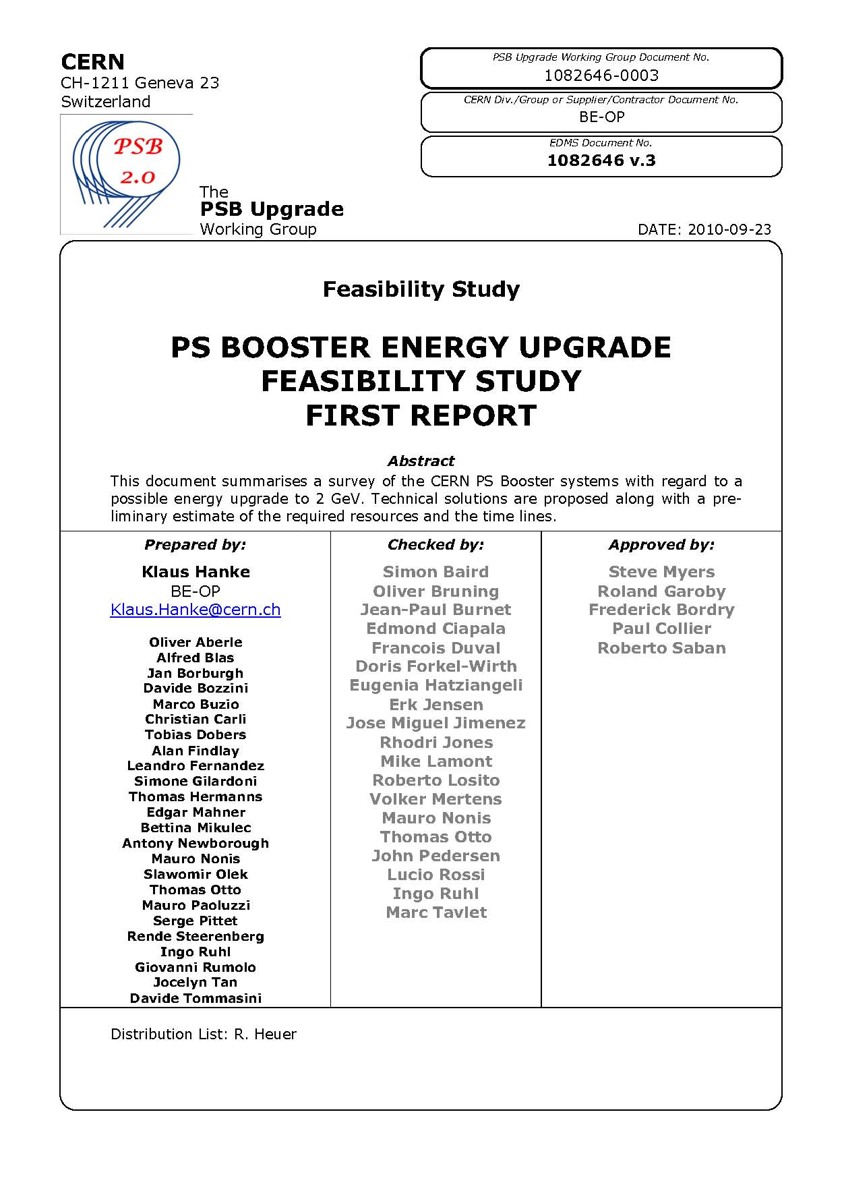
Upgrade of the Booster to 2 GeV
study launched following Chamonix 2010
→ feasibility, cost & time lines confirmed
RCS alternative studied following Chx. 2011
Booster option retained
3rd energy upgrade:
from 800 MeV to 1 GeV (1988)
from 1 GeV to 1.4 GeV (1999)
from 1.4 GeV to 2.0 GeV (LS2)
- no technical showstoppers identified
however a number of equipment and
systems need to be changed or upgraded
- high-impact items: MPS, RF, kickers, septa, …

Slide 12


Expected Performance Gain with 2 GeV
LASLETT TUNE SHIFT
if we assume that:
the optics at the PS injection remains the same
the bunch length does not change

Slide 13
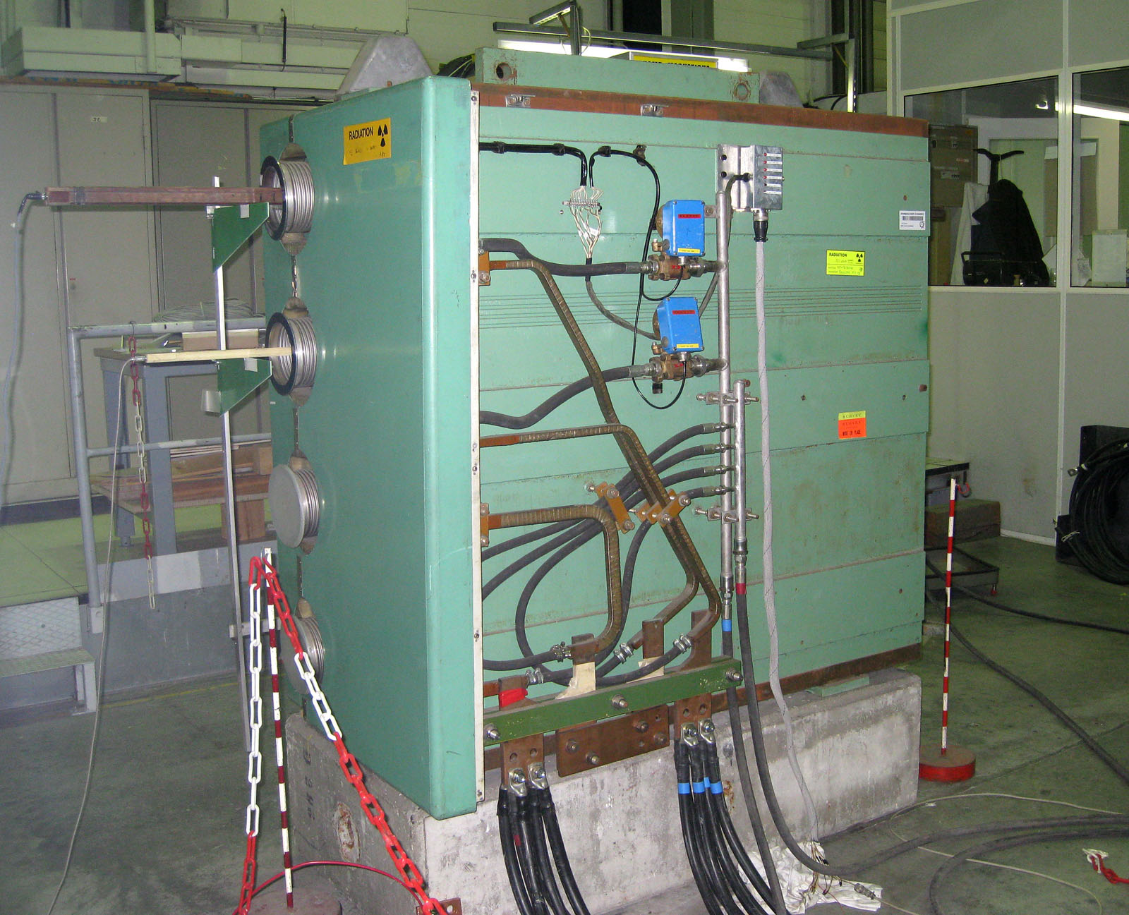
Booster 2 GeV Upgrade: Magnets
Main Magnets
main magnets can operate at field levels 30% higher than today
modifications needed:
- shimming
- retaining plates
- cooling circuits
Booster spare magnet undergoing stress tests

Slide 14
Booster 2 GeV Upgrade: Power
64 BHZ
Rings 1&4
Main Power Supply
present converter cannot deliver more than 1.4 GeV
POPS-type converter proposed (capacitor bank)
divide machine in 2 circuits (inner and outer rings)
will make R 1+4 trim power supply obsolete
new building needed
GND
MPS A
2500V
5500A
128 QFO
Rings
1,2,3&4
QFO
600V
450A
Reference
magnet
Ring 1&4
Ring 1 B-filed
measurement
Reference
magnet
Ring 2&3
Ring 2 B-filed
measurement
MPS B
2500V
5500A
QDE
600V
450A
64 QDE
Rings
1,2,3&4
GND
64 BHZ
Rings 2&3

Slide 15
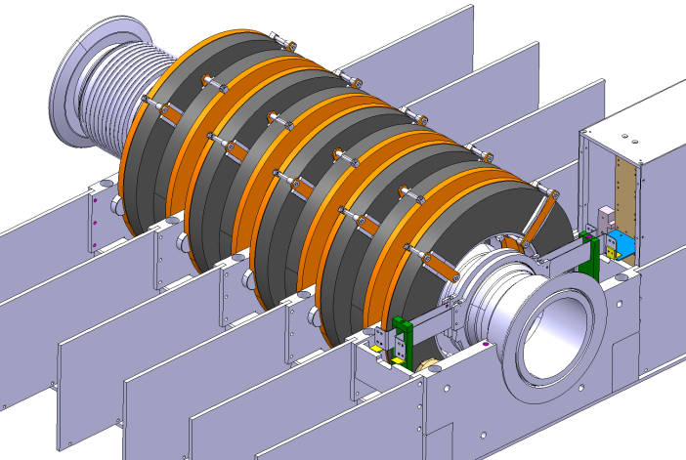
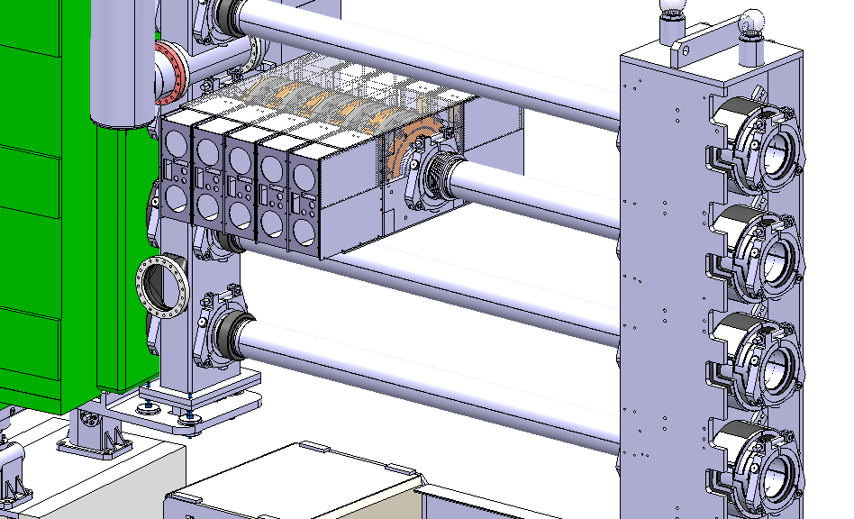
Booster 2 GeV Upgrade: RF System
complete upgrade of the Booster high-level
RF to new Finemet cavities
development of a prototype system (collaboration
with KEK-RF team)
installation of a first test cavity
in PSB during winter stop 2011-2012
upgrade program for the LL RF
Finemet cavity test installation in the PSB
M. Paoluzzi

Slide 16
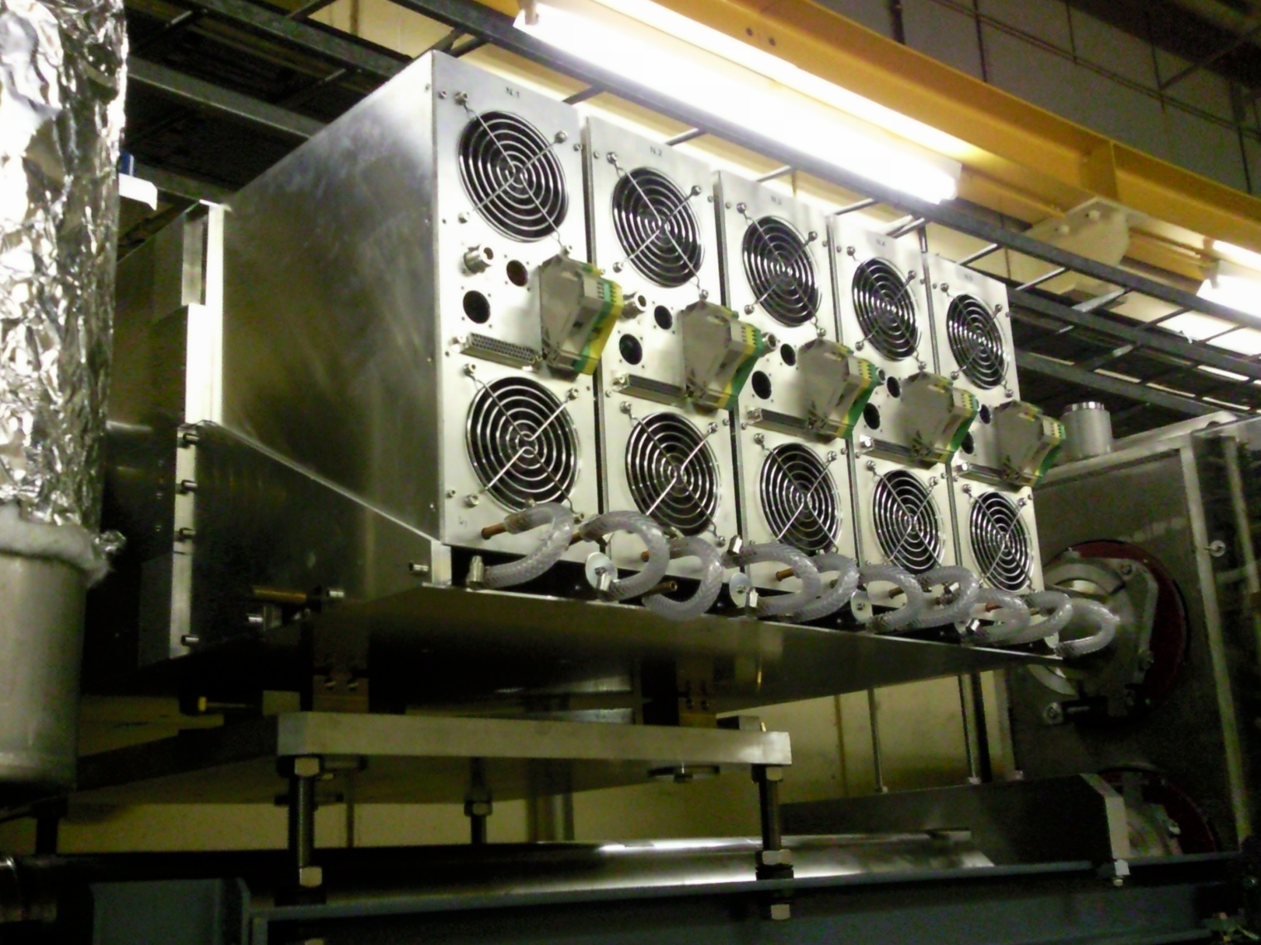
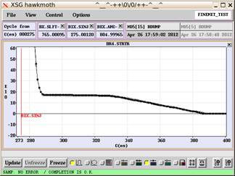
first beam captured and accelerated
26 April 2012

Slide 17
Booster 2 GeV Upgrade: Other items
instrumentation
controls
extraction and transfer to PS
beam dynamics
cooling and ventilation
electrical installations
survey
safety
interlocks
transport and handling
commissioning
vacuum
dump and beam stopper
civil engineering
radiological protection
almost a new machine

Slide 18
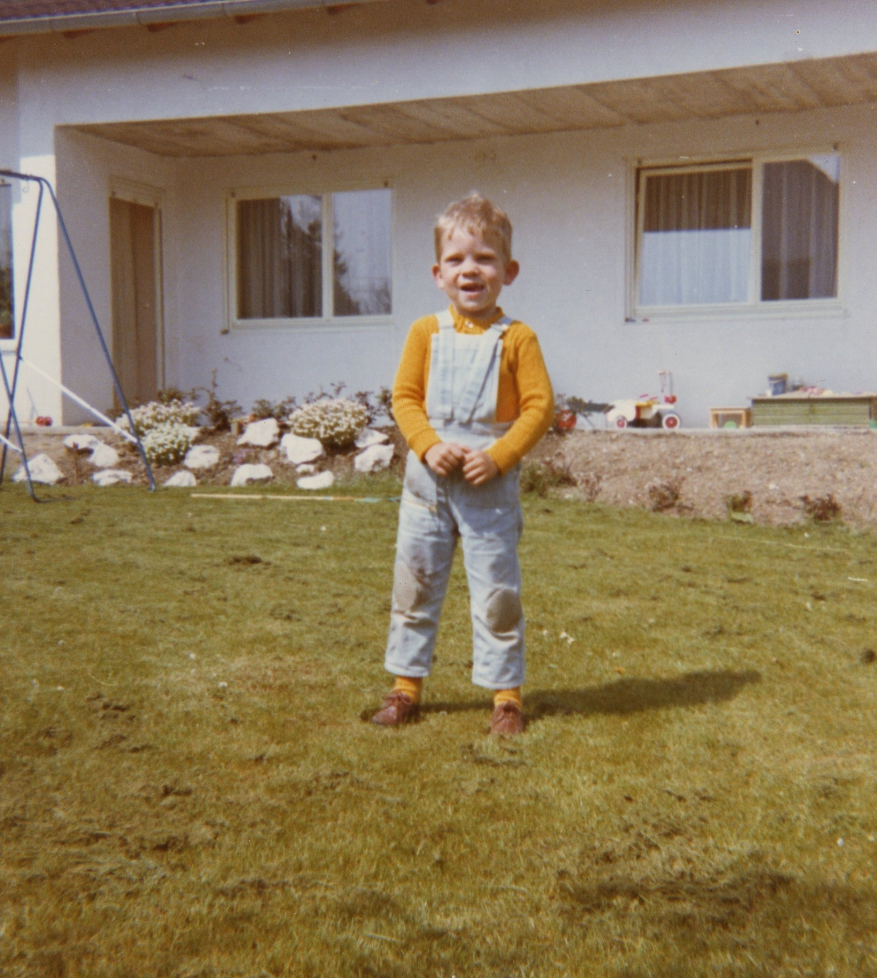
1972
Many thanks for your attention
and for your support during
the years to come!

