Slide 1
PSB PERFORMANCE OVER YEARS
M. Chanel

Slide 2
PSB in the LHC era
In the accelerator chain, the PSB is the place where the beams are prepared.
Continue the challenges of high beam density, intensity and quality.
Prepare all the beam flavours for the LHC machine and the accelerator chain.
CNGS, Isolde, Ions….

Slide 3
Impedance
Insulated flanges to avoid low freq flowing current were made originally to be low impedance above 2MHz(h=5, Fb=3MHz). Unfortunatly h=1 gives fb=600kHz
Action: suppress most of them, only 2/period (1999)
Reduce their impedance by adding electric circuit ( RMS current~2A), (2000)
Impedance reduction from 1000 to 200 and finally 20Ω in the present bunch frequency range(above 600kHz)
Reduction of common mode on cables

Slide 4
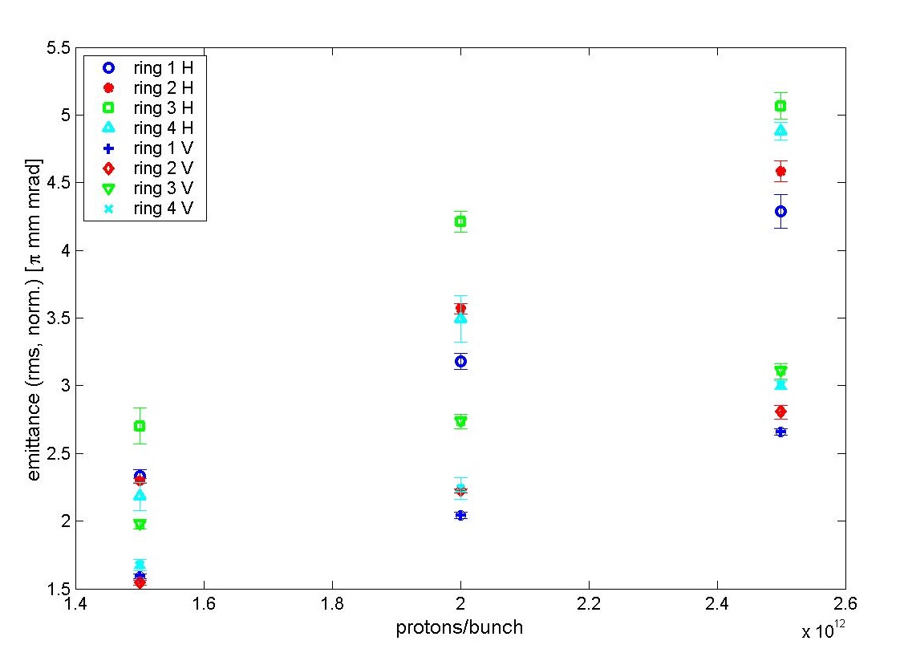
LHC Beam in PSB (2004)
1993: 10¹¹ p/b in LHC *12 gives 1,2 10¹² in PSB (no loss on chain)
2003: 1,15 10¹¹ p/b in LHC *12 gives 1,4 10¹² in PSB (15% loss on chain, crossing angle,β*=0,55)
1993: ultimate 1,7 10¹¹ p/b in LHC *12 gives 1,2 10¹² in PSB (no loss on chain)
Target 2,5µm
In PSB
2003: 2 10¹¹ p/b in LHC gives 2,5 10¹² in PSB…target not met

Slide 7
LHC test beams
To prepare the LHC commissionning (and tests in other machine in the chain) many beam flavours had to be prepared!!!
In PSB it meant, from 5 10⁹ p/b and low emitances to 2 10¹² p/b and nominal emittances (it can be only one bunch all along to LHC or one bunch cut in many in PS to have 25ns,50ns,100ns bunch separation in LHC)

Slide 8
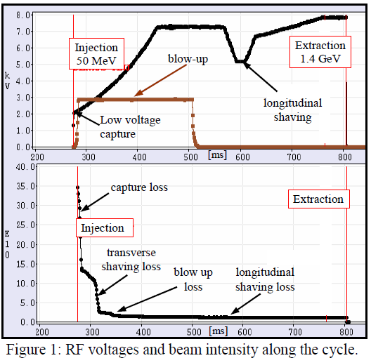
LHC test beams(2003)
Longitudinal and/or transverse scraping or/and blow up were used to produce these different flavours and have a good reproducibilty over time within 10%
Exemple: Production of the pilot beam
Finally a pilot beam of 5 10⁹ p was regularly produced.

Slide 9
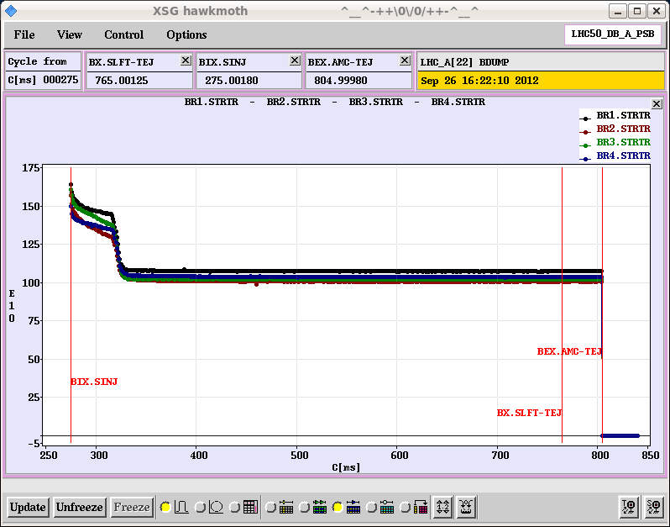
LHC today operation
Tests: use of many of the exotic beams produce by the PSB for LHC
Starting up: Use of the pilot beam, called now probe beam in PSB( 5 10⁹p/b, small emittances)
Operation: Mainly 50 ns bunch separation in LHC
PS filled with 2 batches(4+2)
PSB:1,05 10¹² p/b (cut in 6) ε_{h}= 1,25µm, ε_{v}= 1,15 µm, ε_{l}= 1,19 eVs

Slide 10
Other consequences
Linac2 regularly delivers 160mA
H=1 + h=2 with same max voltage gives more longitudinal acceptance and a better bunching factor ( essential to limit space charge effects). Immediatly, the record of accelerated protons increased by 20%.
Laminated magnets in the transfer line allow 1 and 1,4 GeV operation for Isolde
Kickers and pulsed septa allow different bunch separation for the PS.

Slide 11
Other modifications and operations in 2000’s

Slide 12
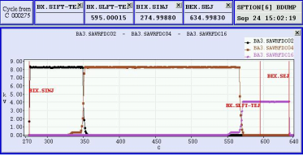
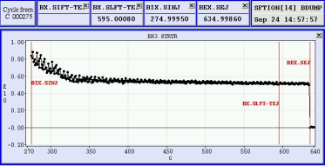
Indium ions ₁₁₅In³⁷⁺
-15% B field at injection
Acceleration with h=4(C02 then C04) and finally h=8(1 bucket filled every 2 with C16)
More than 5 10⁹ ions sent to PS

Slide 13
Linac2 PSB transfer Line
Since long we looked to have zero dispersion at the end of PSB injection line and then, limit the large dispersion excursion.
Finally the problem was found and was a great improvement and allow better injection efficiency

Slide 14
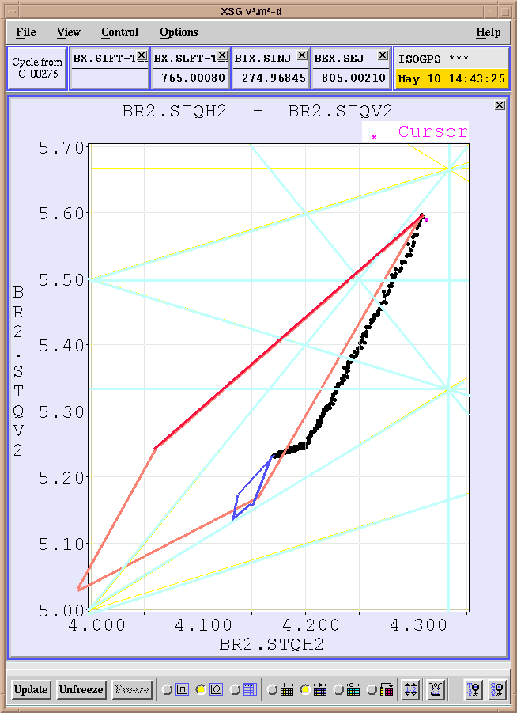
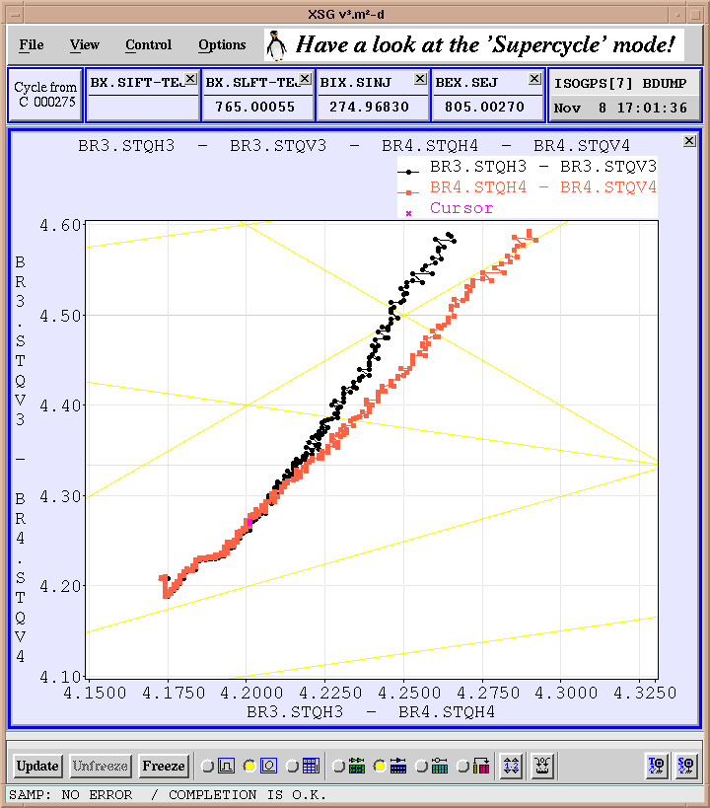
tunes
Low WP 4,17 4,23
High WP 4,17 5,23
2Qv=11
2 Qv=9
Systematic 3Qv=16
All 3rd order resonances,
No syst.
Qh-Qv=-1
2(Qh-Qv)=0

Slide 15
HWP versus LWP
HWP: a champion, Ring2 ; two bad: R1 and R4
LWP: quasi all equal ! Then 5% more intensity
LWP: orbit correction needed and done, change vertical shaving dipole and Transfer line matching.
Strentgh and effects of resonances are much smaller especially for outer rings
Limitation: Montaigue resonance
The Vertical emittance of the LHC beam is a bit larger.

Slide 16
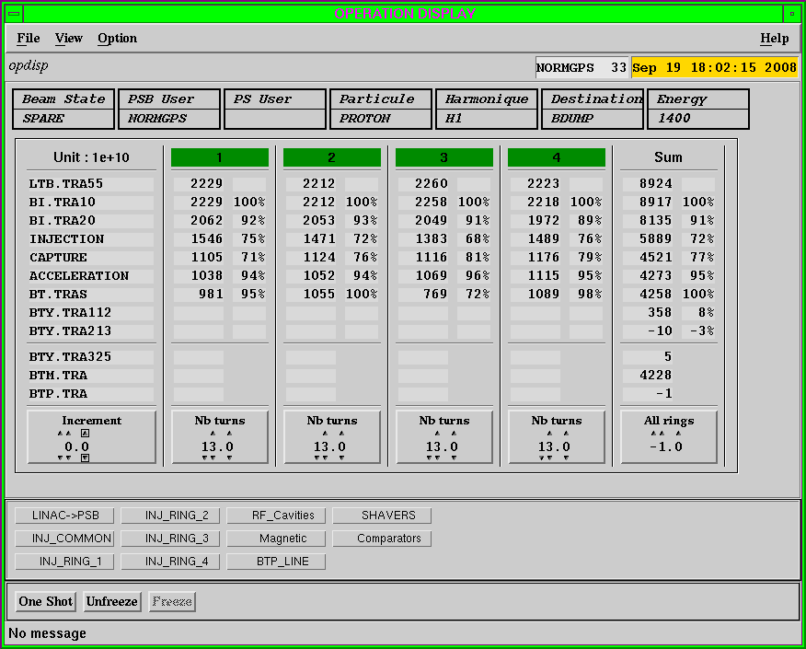

Slide 18
PSB VERSATILITY
Four different rings but so much flexibility for operation
A large spread of intensity, density, emittances
Different distances between bunches at transfer and even superposed
Different bunch numbers( 1 to 20max and later 8 max)
Many users with so different requests, thanks to ppm
PSB have also accelerated many ions species
From 800MeV to 1GeV to 1,4GeV and…

Slide 19
Merci de votre attention

