Slide 1
Simulations of a proton FFAG with space charge
FFAG’12, Osaka, Japan

Slide 2
Overview
Motivation
4-cell 1GeV FFAG
  Single energy simulations
  Serpentine acceleration with SC
6-cell 1GeV FFAG simulations
  Single energy simulations
  Serpentine acceleration with SC
Two discussion points:
  Cost to build an FFAG vs linac
  Terminology
Summary

Slide 3
Motivation
For ADS & other high power beam applications a CW beam offers many advantages
  Lower peak current (lower space charge forces)
  Flexible beam structure depending on injector (can leave ‘gaps’ if you want to)
  Implies fixed RF & fixed field – less to go wrong?
Would harness full potential of the FFAG
  We’ve been promising “improved performance” with FFAGs but have we delivered it?

Slide 4
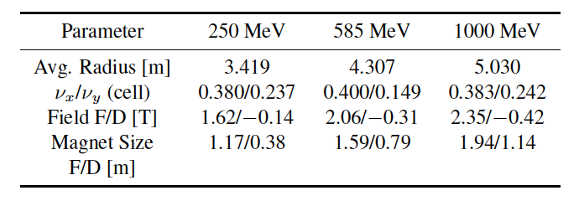
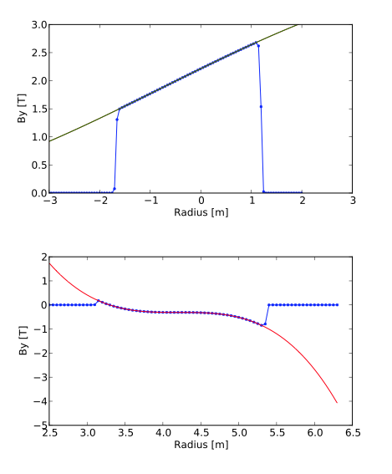
4-cell Lattice design
F
Total tune variation = 0.12 (H) / 0.56 (V)
D
C. Johnstone et al, AIP conference proceedings 1299, 1, 682-687 (2010)

Slide 5
Serpentine channel acceleration
Using Carol’s 4-cell 1 GeV FFAG ring
330MeV-1GeV
Serpentine acceleration is possible due to 3% time of flight variation
Using single particle tracking:
10 MV/turn
12 MV/turn
15 MV/turn
From IPAC’11, S. L. Sheehy, WEPS088

Slide 6
Motivation continued…
Serpentine channel acceleration was not something I was going to pursue, until…
Discussions with Mori-san and others at HB2012 in Beijing led me to consider whether ‘almost’ isochronous is good enough if we have small chromaticity.
  (Ref. Yamakawa et al. HB2012 paper also suggests using serpentine channel in FFAG.)
But… I have concerns over achievable RF voltage…
  (h=1 needs voltage of 20 MV/turn in racetrack ring)
Mori suggests possibility of superconducting large horizontal aperture cavities?
  have these ever been designed?
  (Or should we think about finding someone to design one?)
I concluded that regardless of the issue of large V/turn, it would be interesting to know what happens in the serpentine channel with space charge…

Slide 7
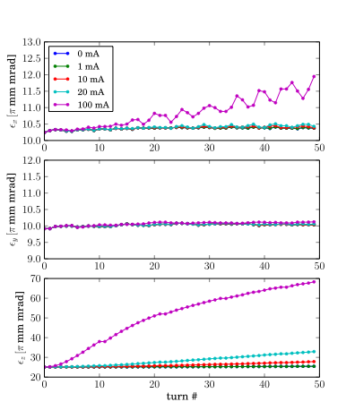
Setting up the simulation in OPAL
Beam matching at 300 MeV
Single energy tracking at realistic intensities shows no emittance growth.
At very high intensities emittance grows, as expected.
  (See HB2012 MOP258)
Single bunch
10 π mm mrad in horiz/vertical
Length ~ 4% of ring circumference
50 turns at 300 MeV with no acceleration
Current is average of full turn

Slide 8
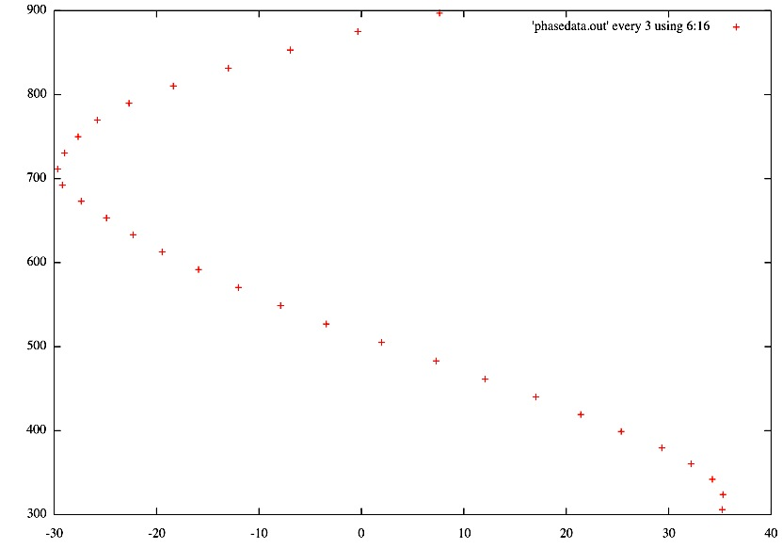
Setting up the simulation
Harmonic number = 1 (for now)
Space charge ‘off’ – track bunch of 2000 particles with parabolic profile
Energy (MeV)
Cavity phase (deg)
Issue: OPAL outputs after set num of tracking steps NOT azimuthal position ie. not a full ‘turn’ if not perfectly on phase! In the newer version of OPAL (1.1.9) I can use ‘probe’ element to get ‘screen-like’ physical position readout (in process of updating on SCARF).
For now – the following simulations were run overnight on my quad core desktop!

Slide 9
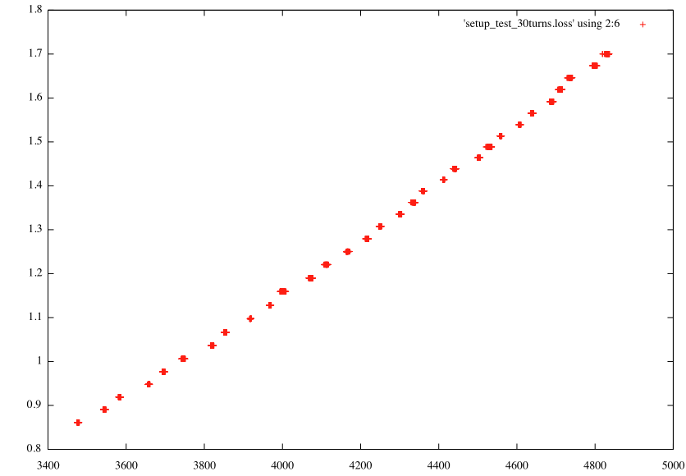
Turn-by-turn orbit with bunch
Try a short & small 1 π mm mrad beam to see what happens
Using ‘probe’ element to get turn-by-turn at 0 degree position, 200 particles
Momentum [βγ]
Acceleration!
With V_{RF}/turn= 22 MV
X Position [mm]

Slide 10
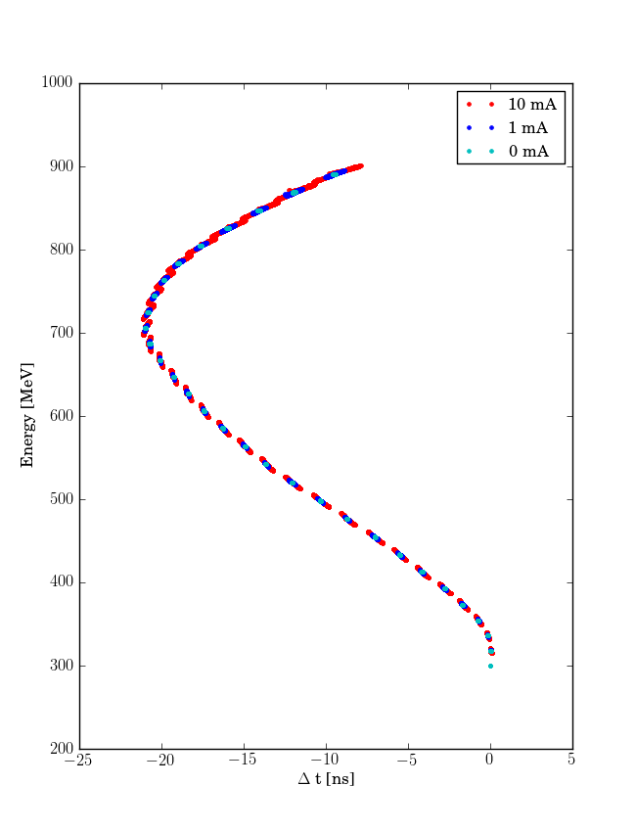
With space charge ‘on’
1 pi mm mrad bunch
Tracked for 30 turns in serpentine channel
Vary (average) beam current up to 10 mA
10 MW beam at 1 GeV
NOTE: VERY SHORT BEAM!
Total beam length approx. 1cm so peak current = 22A!
Lots of space charge!!
Acceleration with 3 cavities
V_{RF}/turn= 22 MV

Slide 11
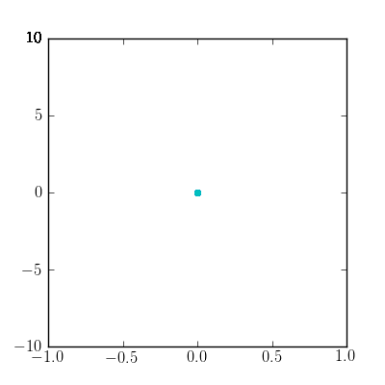
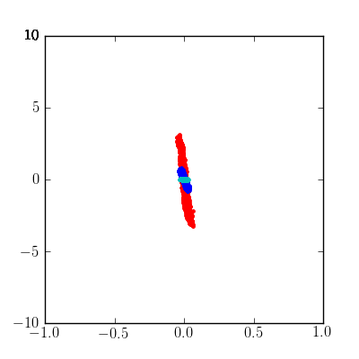
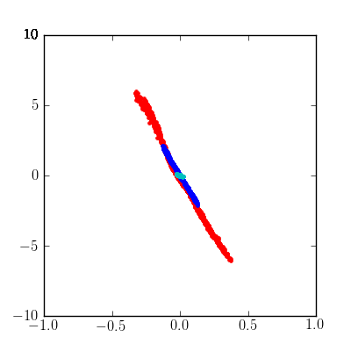
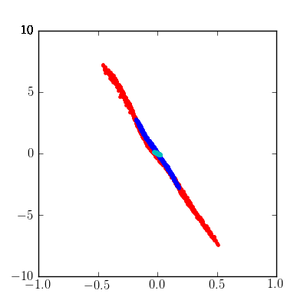
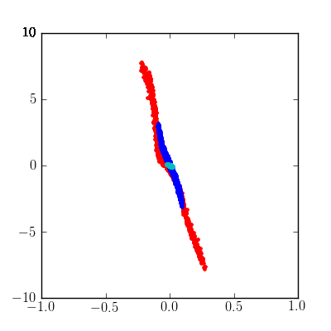
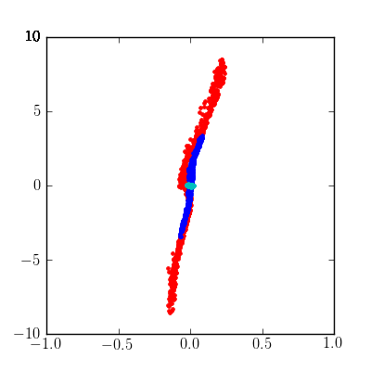
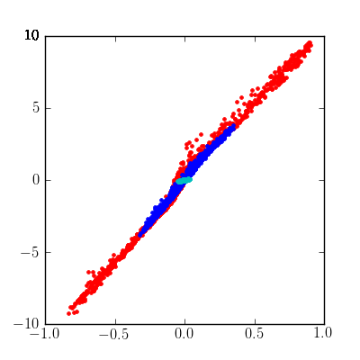
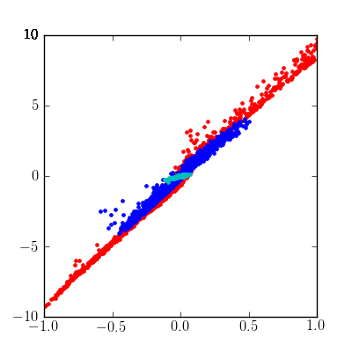
Longitudinal evolution
ΔE [MeV]
1
2
5
10
15
20
25
28
Δt [ns]

Slide 12
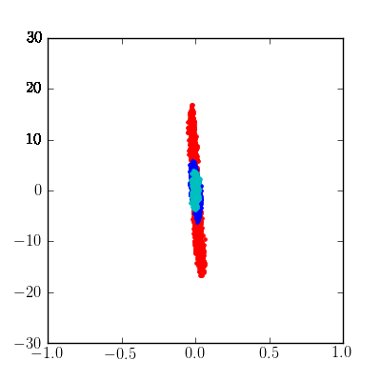
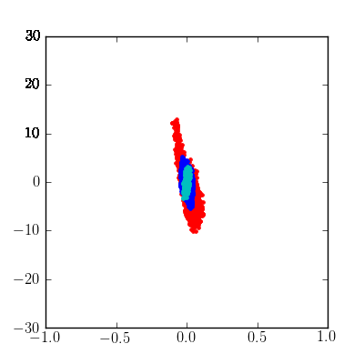
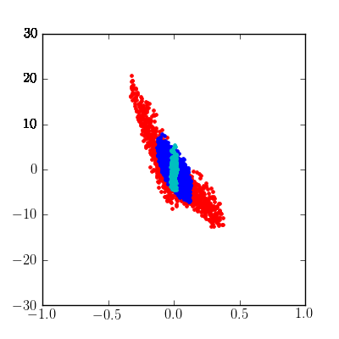
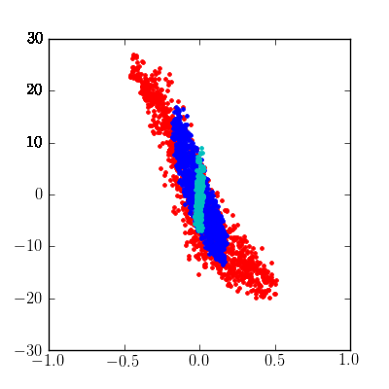
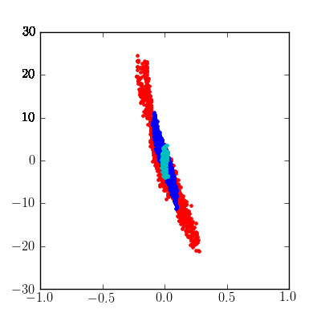
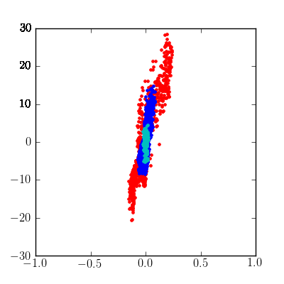
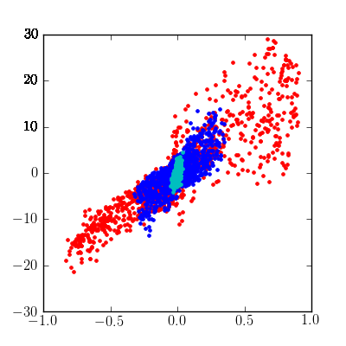
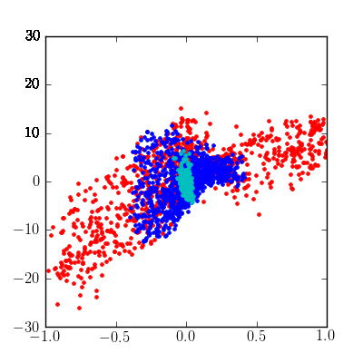
Horizontal pos vs time
Δx [mm]
1
2
5
10
15
20
25
26
Δt [ns]

Slide 13
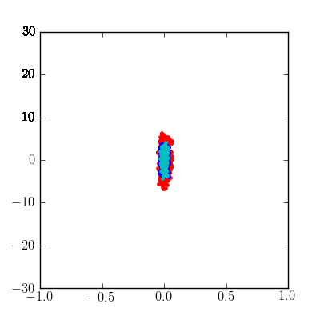
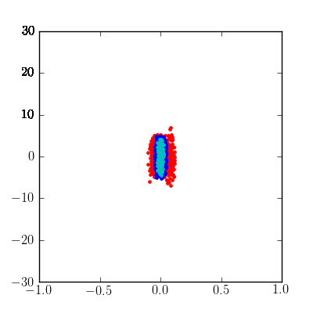
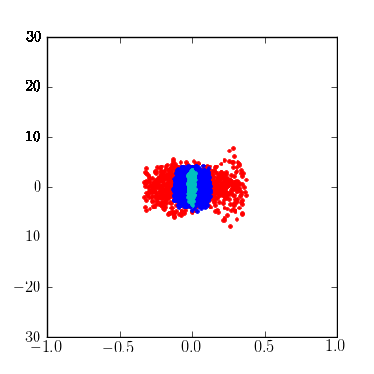
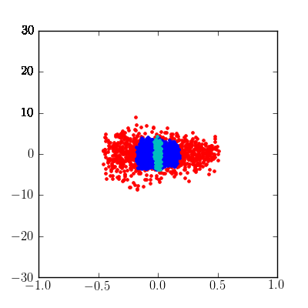
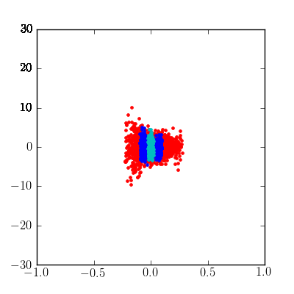
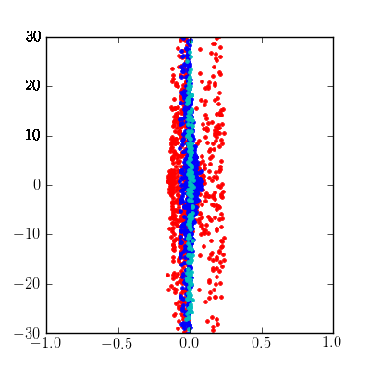
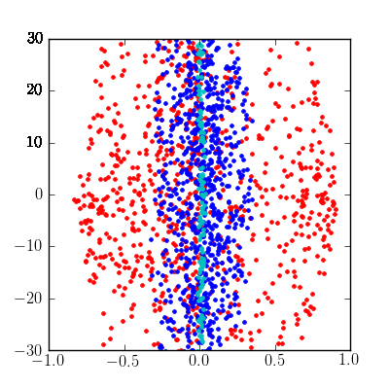
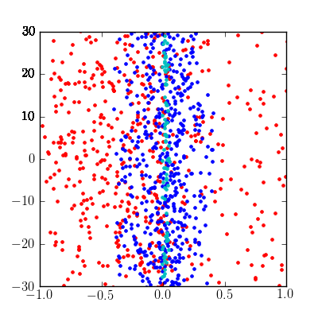
Vertical pos vs time
Δz [mm]
1
2
5
10
15
20
25
26
Δt [ns]

Slide 14
Emittance evolution
(NB as discussed before these are per ‘turn’ wrt time so not ‘real’ turns)
NOTE DIFFERENT SCALES!!
300 MeV – 30 turn serp. Accel.
300 MeV – no acceleration
horizontal
Question: why does vertical emit grow even with no space charge?
vertical
longitudinal

Slide 15
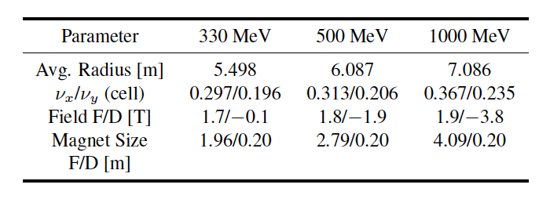
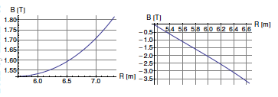
6-cell 1GeV Ring
Initially I had issues modeling this ring as short magnets were not well-reproduced with the interpolation in OPAL
I now have a much finer field map! (thanks to K. Makino)
The main driver behind this design was to achieve better isochronicity but the vertical tune variation also improved.
Total tune variation = 0.42 (H) / 0.234 (V)
Lower B field (cf 2.35T in 4-cell design)
Larger radius
Field profiles from C. Johnstone, IPAC’12, THPPR063

Slide 16
6-cell 1 GeV Ring
Single energy closed orbits separation & TOF in 20 MeV steps

Slide 17
Single energy with space charge
No acceleration, 10 pi beam
50 turns with space charge
Short beam (0.04% ring)
No acceleration, 10 pi beam
50 turns with space charge
Longer beam (4% ring)

Slide 18
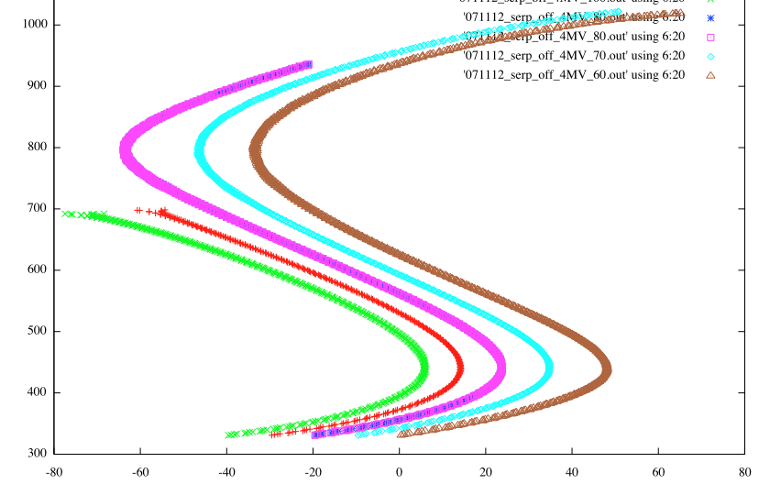
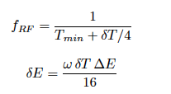
Serpentine channel
Much smaller TOF variation than 4-cell version
Required RF frequency & energy gain per turn to open up the serpentine channel (δE) can be estimated by
total energy gain required is ΔE and ω =2πF_{RF}
In this case, we expect δE ~ 3.7 MV/turn.
(A few quick simulations confirm this)
4MV/turn !
If we make it ‘isochronous enough’, perhaps we can use the serpentine channel without superconducting cavities?
Notes:
Note this IS the serpentine channel, when I tried it with 2MV/turn I couldn’t reach the full energy.

Slide 19
Acceleration & space charge
Use ‘reasonable’ 8MV/turn (equiv. 4 PSI-type cavities)
Beam matched at 330 MeV
Same emittance & length beam as in 6-cell simulations

Slide 20
Summary so far…
The two rings are comparable in terms of emittance growth with single energy tracking.
The 6-cell ring has a serpentine channel at a much lower voltage/turn due to improved isochronicity
A small emittance/length beam is transmitted fine using the serpentine channel – 4-cell design seemed to grow in vertical, waiting to see for 6-cell design.
Still need to try a more realistic beam.
Some interesting beam distribution shaping effects in serpentine channel with space charge.

Slide 21
How much would it cost?
Argument for FFAGs has been: ‘smaller than a linac, so must be cheaper to build!’ but I would like some evidence to support this…
Email discussion with S. Holmes & V. Lebedev:
  2-8 GeV RCS total = $150M
  Technical Components $84M
  Conventional Construction $67M
Pulsed Linac total = $210M
  Technical Components $134M
  Conventional Construction $76M

Slide 22
Aside… terminology
I’m going to call this an “FFAG Cyclotron”
We should use terminology familiar to those outside of our sub-field.
Radial sector cyclotron with reverse bends… ?
FFAG is a blanket term for a wide range of machines. ‘Scaling’ and ‘non-scaling’, ‘linear’ and ‘non-linear’ tends to confuse others
Some are more similar to cyclotrons, some to synchrotrons. Yet outside of FFAG workshop, no-one knows the difference.
They are mostly pitched for applications - no-one will take the risk on a completely new technology, but this isn’t completely new!
In Australia we have a tendency to call a spade a spade. In the FFAG field we have the tendency to call a spade a ‘non-linear non-scaling quasi-isochronous earth removal device’. Who wants one of those? No-one. They just want a spade.
Notes:
Outside of the FFAG workshop, no-one knows the difference between the different types of FFAG. Many people learned about them a few years back and heard about one type (scaling or non-scaling) and assume that all future machines are the same. This is not unreasonable – it’s pretty true for synchrotrons, cyclotrons & linacs. They don’t come up with new names for their ‘type’ of machine all the time, they are just synchrotrons, cyclotrons and linacs. That is where we have difficulty.

Slide 23
References
Lattice design:
C. Johnstone, P. Snopok, F. Meot, In Proc. IPAC’12, pp. 4118 (THPPR063).
C. Johnstone et al, AIP conference proceedings 1299, 1, 682-687 (2010)
C. Johnstone, Proc. Cyclotrons (2010)
Serpentine channel (for practical formulae):
S. Koscielniak, C. Johnstone, Nucl. Instrum. Meth. Phys. Res. A (523), pp. 25-49, 2004.
Radial sector ‘FFAG cyclotron’:
M. K. Craddock and Y-N. Rao, ‘FFAGs and cyclotrons with reverse bends’, in PAC (2009) Vancouver.
M. K. Craddock, talk at FFAG’08, Manchester.

