Slide 1

Development of new FFAG RF Cavity at KURRI
Fukui University
Tomoya Minamikawa

Slide 2
Contents
・Background
・Introduction
・Flow of my work
・considering shape
・the processing new magnetic core
・Experiment
・Summary

Slide 3
Background
・Analyze properties of materials using neutron beam
・Accelerator Driven Subcritical Reactor
・(Cancer therapy with neutron beam)
FFAG at KURRI
ADSR
Proton Beam strikes the neutron target
→Neutron breaks out
Ion source
Linac
・Stop reactor safely
・Recycle spent nuclear fuel by radiation of neutron beams.
・Disposal of long life radio nuclide.
RFCavity
FFAG
(Main Ring)
ADSR
For cancer therapy
Extract the Proton Beam
Notes:
１、開発が進めば、小型で大強度な中性子源として期待できる。
２、実際に、げんざいはこのような用途で使われている
３、加速器はこんな感じ、私はRFをやってるよ
４、じゃあRFってどんな物なのか説明します。

Slide 4
Typical of the RF Cavity
Capacitor resonates with Toroidal Core
Magnetic
Field
Magnetic
Field
Installing Troidal Core,
It can apply acceleration Gap
to Voltage efficiency.
Capacitor
・Impedance depends
mostly on Magnetic Alloy
Troidal Core
Troidal Core
Beam duct
Electric
Field
Installing Troidal Core,
standing wave length
become shorter.
・We don’t use any capacitor.
・We deal with the gap and the plate
as a capacitor.
Amp.
Amp.
Notes:
１、ビームが通過
２、電場（加速電圧）を感じて加速
３、外側から、電流を送ってる 磁性体が電流を感じて磁場を発生。LCの共振構造。
４、空胴の性能はほとんど磁性体で決まり、インピーダンスが高いほど加速電圧を大きく出来る。
５、加速電圧が大きくなるとどういうメリットがあるのか、見て行きます。

Slide 5
Introduction
We want to get more acceleration voltage to get High power beam.
If the acceleration voltage is more higher, we can increase repetition rate.
It means,
・we can increase Average output beam current
・The beam can avoid the foil quickly. Beam doesn’t lost particles.
We should Install another cavity.
Present spec
We try to get High power Beam
reusing J-PARC RCS Core .
Energy (MeV) | 100
Accelerating Voltage (KV/turn) | 4
Repetition rate (Hz) | 20
Cavity Impedance (Ω) | 500
Number of cores | 2
BUT
Horizontal aperture is not enough.

Slide 6
Flow of my work
Consider the shape
Examination of the shape.
Process the Core
Making ”Ribbon Core”.
Investigate the property of the Core
To determine the Impedance.
verify the effect of the cutting Core.
Construct New Cavity
Determine the Impedance to confirm the boundary
(put it in the New cavity)
Input high power and do the thermal test
Install New Cavity
Notes:
１、加速電圧を高く出来ると短時間でこうエネルギーまで加速可能になります。
２、だから、空胴の性能を左右する磁性体の開発が必要です、
３、（フローの説明）

Slide 7
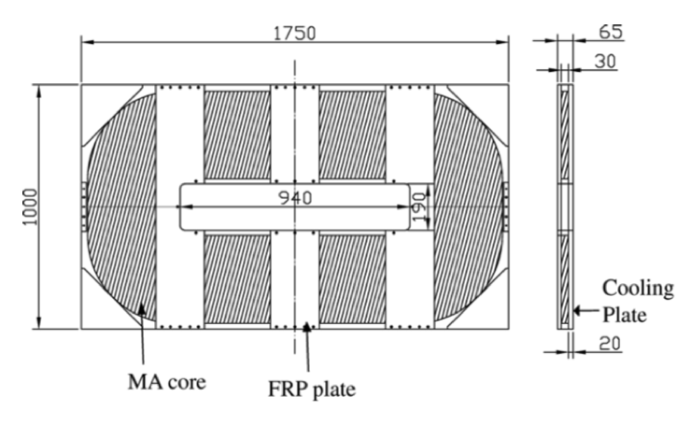
Consider the shape(1)
RF Cavity has rectangular beam duct.
Beam
▷We should make
the large aperture core.
Beam duct
Accelerating
electric field
Present core
If the new core can be made from RCS core,
We don’t have to use a large oven.
It is too hard to make.
We need too much cost.
It is useful technique
to make the core from piece.

Slide 8
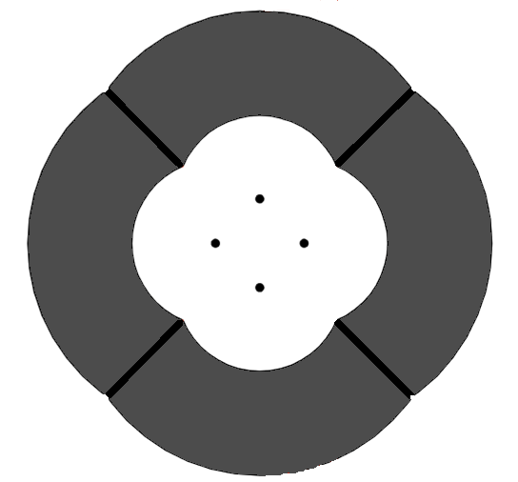
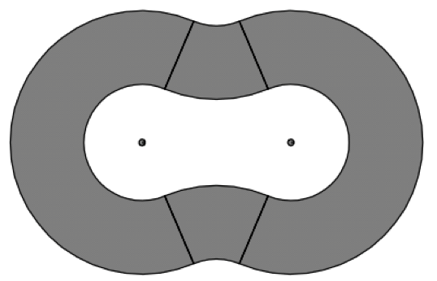
Consider the shape(2)
Flower core
:The factor depends on the shape of MA core
N²
×density
Outer circumference(mm) : 3238.68
Inner circumference(mm) : 1758.13
ln(OC/IC) :0.265
Compare with RCS L₀ :0.74
Ribbon core
Outer circumference(mm) : 3656.79
Inner circumference(mm) : 2164.53
ln(OC/IC) :0.227
Compare with RCS L₀ : 0.57

Slide 9
Consider the shape(2)
Flower core
:The factor depends on the shape of MA core
N²
×density
Outer circumference(mm) : 3238.68
Inner circumference(mm) : 1758.13
ln(OC/IC) :0.265
Compare with RCS L₀ :0.74
Ribbon core
Outer circumference(mm) : 3656.79
Inner circumference(mm) : 2164.53
ln(OC/IC) :0.227
Compare with RCS L₀ : 0.57

Slide 10
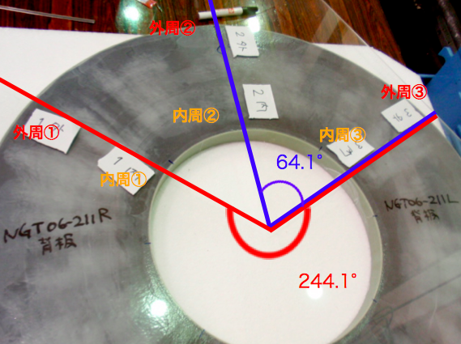
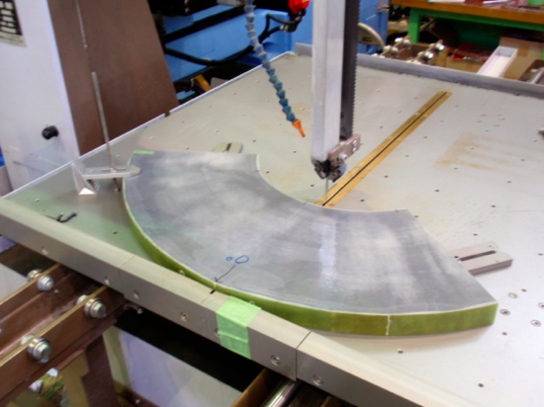
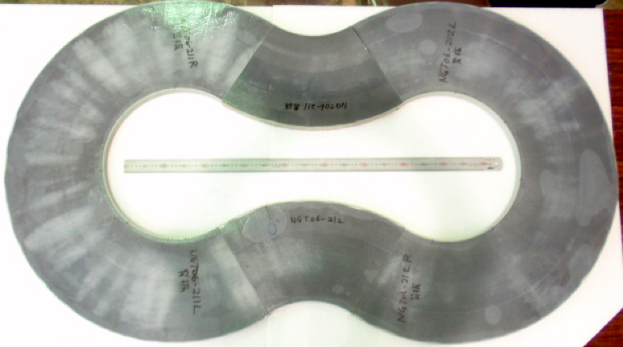
Cutting core
How to make Ribbon Core
Manage how to cut
using Diamond cutter
Cut troidal core
Polish the cut surface
and shape the flower cavity
Notes:
これが花弁型コアだよ
制作費が浮く
次に、カットした事による影響について考えます

Slide 11
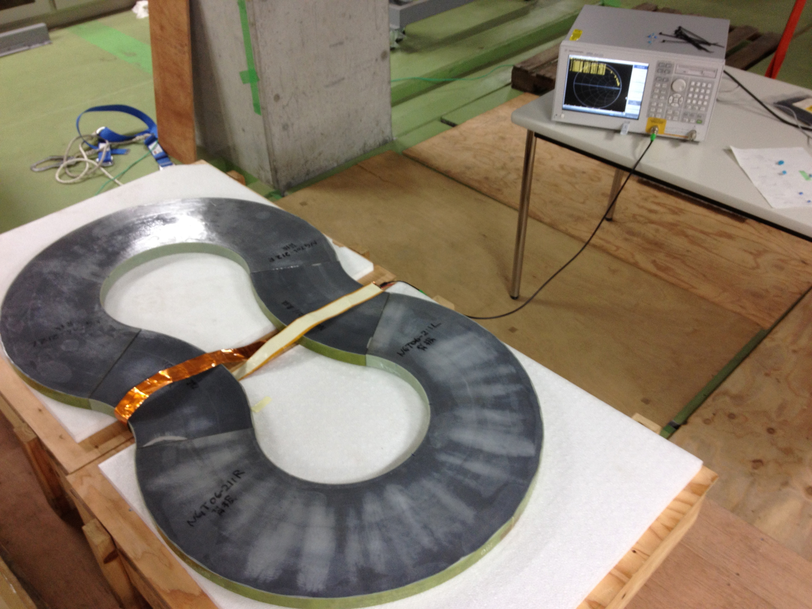
Exp1-Impedance
Network Analyzer
Cut surface
Change the gap of the cut surface : 0mm , 1mm

Slide 12

Result - Exp1,：Impedance-
・The form of the Impedance doesn’t change almost.
・RCS Inductance is larger than Flower core’s.
・”Flower Core 0mm L” is larger than “Flower Core 1mm L”.
▷Inductance depends on the gap of the cut surface.
Decreasing Inductance means
Impedance may not be so broad(Q is higher) → should check if it can be used on the whole frequency range
Flower Core 0mm
Flower Core 1mm
*L,R of the J-parcRCS are normalized by L,R of Flower Core

Slide 13
Result - Exp1,：Impedance-
・The form of the Impedance doesn’t change almost.
・RCS Inductance is larger than Flower core’s.
・”Flower Core 0mm L” is larger than “Flower Core 1mm L”.
▷Inductance depends on the gap of the cut surface.
Decreasing Inductance means
Impedance may not be so broad(Q is higher) → should check if it can be used on the whole frequency range
Flower Core 0mm
Flower Core 1mm
*L,R of the J-parcRCS are normalized by L,R of Flower Core

Slide 14
Result - Exp1,：Impedance-
・The form of the Impedance doesn’t change almost.
・RCS Inductance is larger than Flower core’s.
・”Flower Core 0mm L” is larger than “Flower Core 1mm L”.
▷Inductance depends on the gap of the cut surface.
Decreasing Inductance means
Impedance may not be so broad(Q is higher) → should check if it can be used on the whole frequency range
Flower Core 0mm
Flower Core 1mm
*L,R of the J-parcRCS are normalized by L,R of Flower Core

Slide 15
Result - Exp1,：Impedance-
Decrease about
3.0×10⁻⁶ (H)
If we make the gap 1mm,
▷Inductance decrease
about 3.0×10⁻⁶(H)
▷Q_{blue} is 1.6 times Q_{green .}
If the core has more large gap, Q value is increased quickly.
I must not to make the gap as possible.

Slide 16
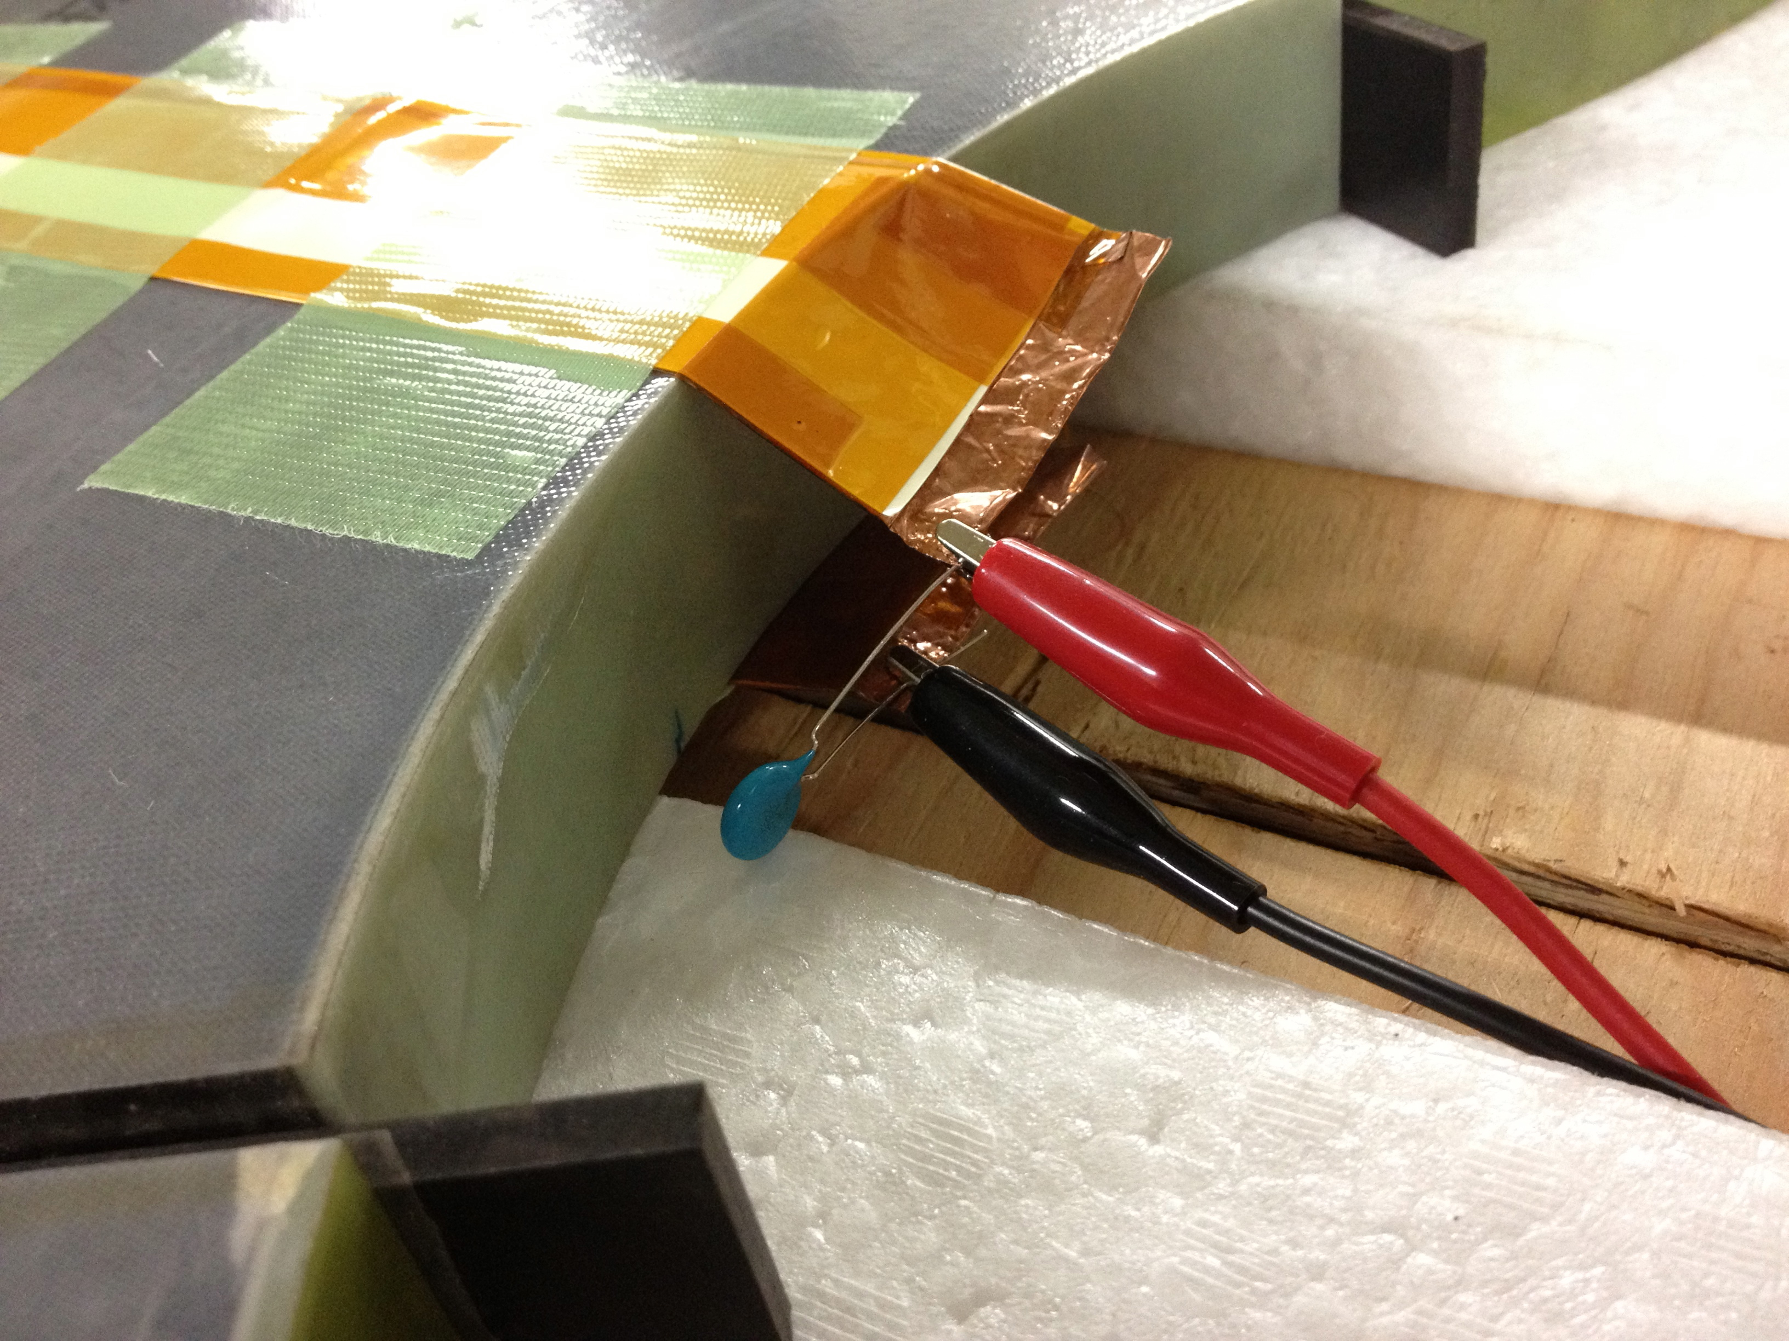
Exp2-Impedance with Capacitor
Set the resonance point at ２MHz using capacitor (1,200pF)

Slide 17
Result - Exp2,：Impedance with Capacitor-
150MeV Extraction 4.4MHz
Set the resonance point at
２MHz using capacitor
100MeV Extraction 4MHz
Accelerating Freq：
1.5MHz ~ 4.4MHz
Impedance is broad. We can get High Accelerating voltage constantly.

Slide 18
Result - Exp2,：Impedance with Capacitor-
We can get the Impedance 130~140 Ω at whole frequency range.
If we install 4 cores on the new RF cavity and input *14~15 kW,
we can get 4kV per turn.
We will be able to make The New Cavity Reusing RCS Cores.
Impedance par a core(Ω) | How many cores can we install | Aim of the Acc Vol ”V_{RF}”(kV) | Input Power we need (kW)
130〜140 | 4 | 4kV | 14~15

Slide 19
Summary
【Summary】 We will Install New RF Cavity to get high power beam
・Cut J-PARC RCS core and make new core “Ribbon core”
・Measure the Impedance R and Inductance L”
which concern performance of the cavity.
・Effect of the L₀
Flower Core is 0.57 times the RCS Core
・Effect of the cut surface
Impedance almost doesn’t change, Inductance decreased
→Impedance may not be so broad(Q is higher)
・Impedance with Capacitor
Broadband Impedance
On the cavity, we install 4 cores and input 15kW.
▷Get 4kV of the Accelerating Voltage.
【Future plan】
・Put the core in the new cavity and measure the Impedance.
・Input high power
・Thermal test

Slide 20
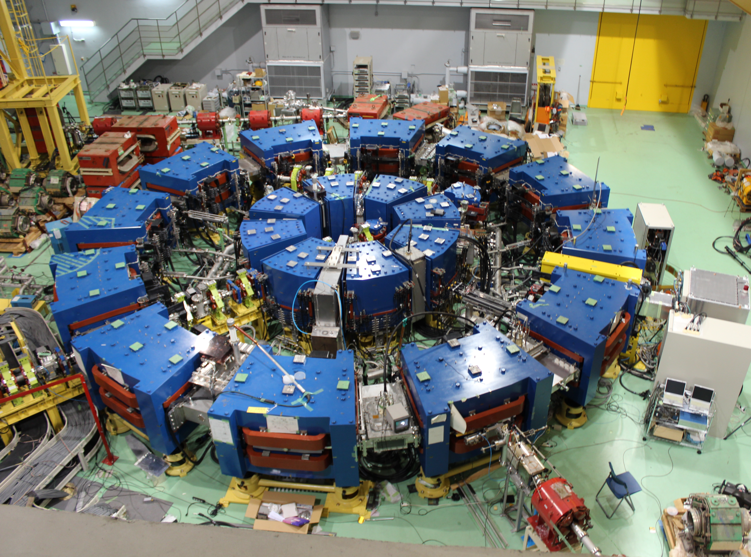
Thank you for your attention

Slide 21
Impedance
Effect of the Flower cavity
*Input Power is
①Shape(Form factor : L₀）
Impedance：
:The factor depends on the shape of MA core
N²
×density
Ribbon Core is 0.57 times the RCS Core
②Effect of the cut surface
Decrease Magnetic field at cut surface → Decrease L
▷We may not get the Impedance which is broadband.
Notes:
１、形状因子の話
Aとbで決まる、サイズに起因するよ
２、測定器側では、インピーダンスのデータはこのように（RとX）アウトプットしてくれます。
３、変換計算して指標RpLpを出します。
では実験方法について見て行きます。

