Slide 1
Beam commissioning of
150 MeV FFAG accelerator at Kyushu University
Yujiro Yonemura
Kyushu University
November 13, 2012

Slide 2
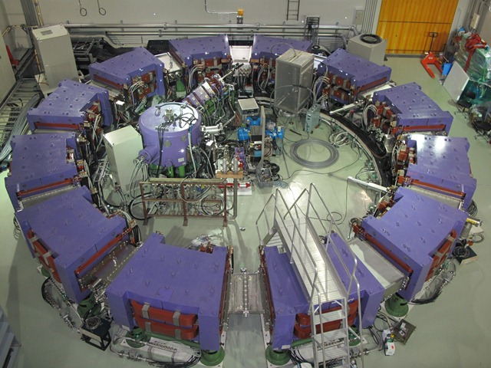
Contents
Current status of 150 MeV FFAG accelerator
Overview of 150 MeV FFAG Accelerator
Experimental results of beam commissioning
Upgrade ion source of injector cyclotron
Power test of RF acceleration system
summary

Slide 3
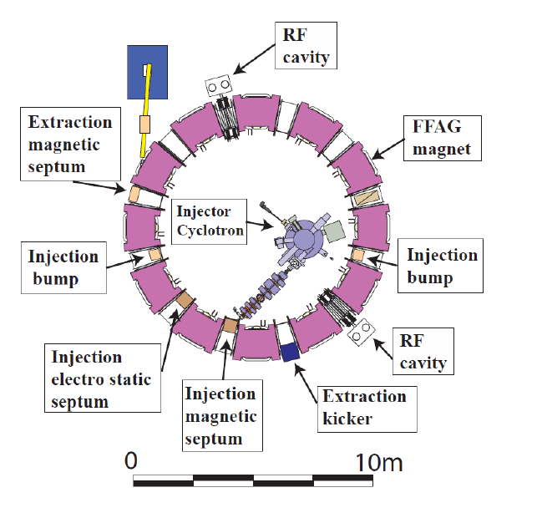
1-1. 150 MeV FFAG Accelerator
magnet | Radial sector type (DFD-triplet)
Cell | 12
K-value | 7.62
Beam energy | 10 ⇒125 MeV ( 12 ⇒ 150 MeV)
Radius | 4.47 ⇒ 5.20 m
Betatron tune | H: 3.69～3.80 V: 1.14～1.30
Max. field | F-field: 1.63 T
(along orbit) | D-field: 0.78 T
Circ. freq. | 1.55～4.56 MHz
Repetition | 100 Hz
Mean current | 1.5 nA

Slide 4
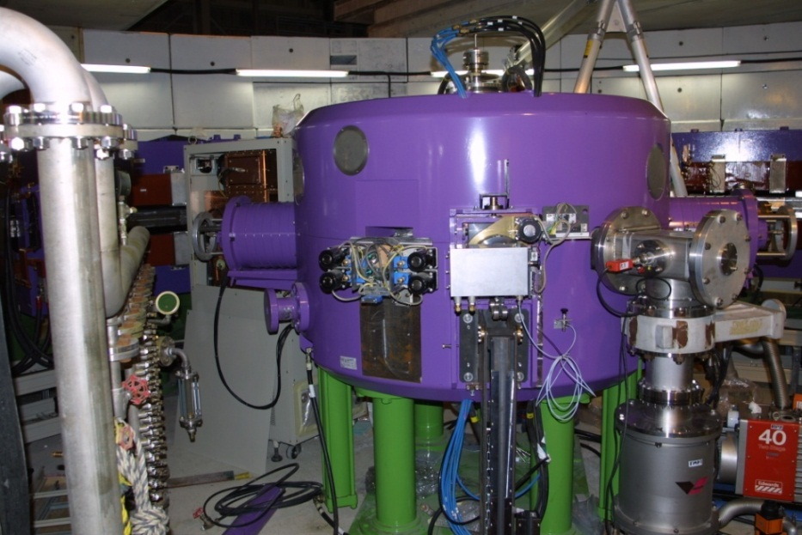
1-2. Injector cyclotron
Design parameters of Baby-Cyclotron
Energy | 10 MeV (proton)
Type | AVF Cyclotron
Ion Source | Internal PIG ( LaB6 cathode)
RF Dee Voltage | 40 kV
Extraction Radius | 300 mm
Magnetic field | Max. 1.54 T
RF Frequency | 47 MHz (2nd harmonic)
Beam Current | 15 μA
JSW Baby-Cyclotron

Slide 5
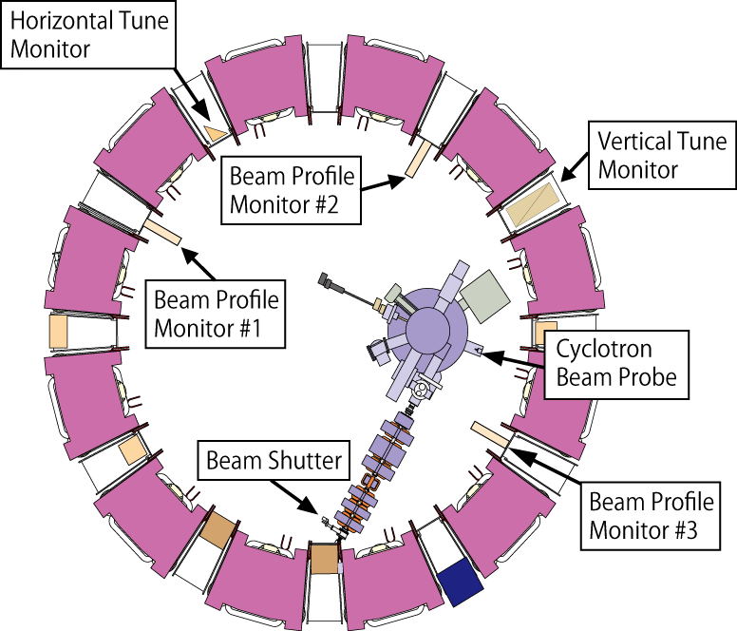
1-3. Layout of beam monitors

Slide 6
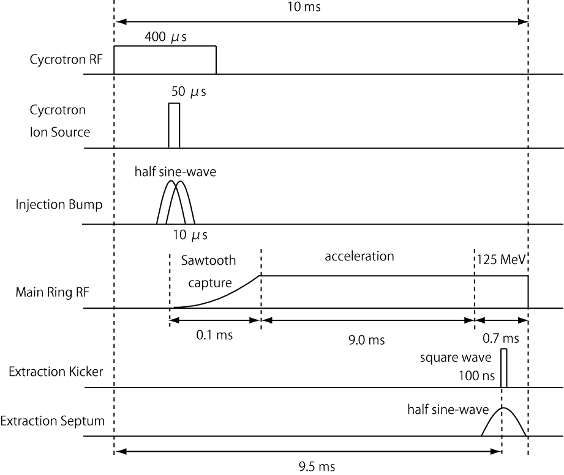
1-4. Timing chart

Slide 7
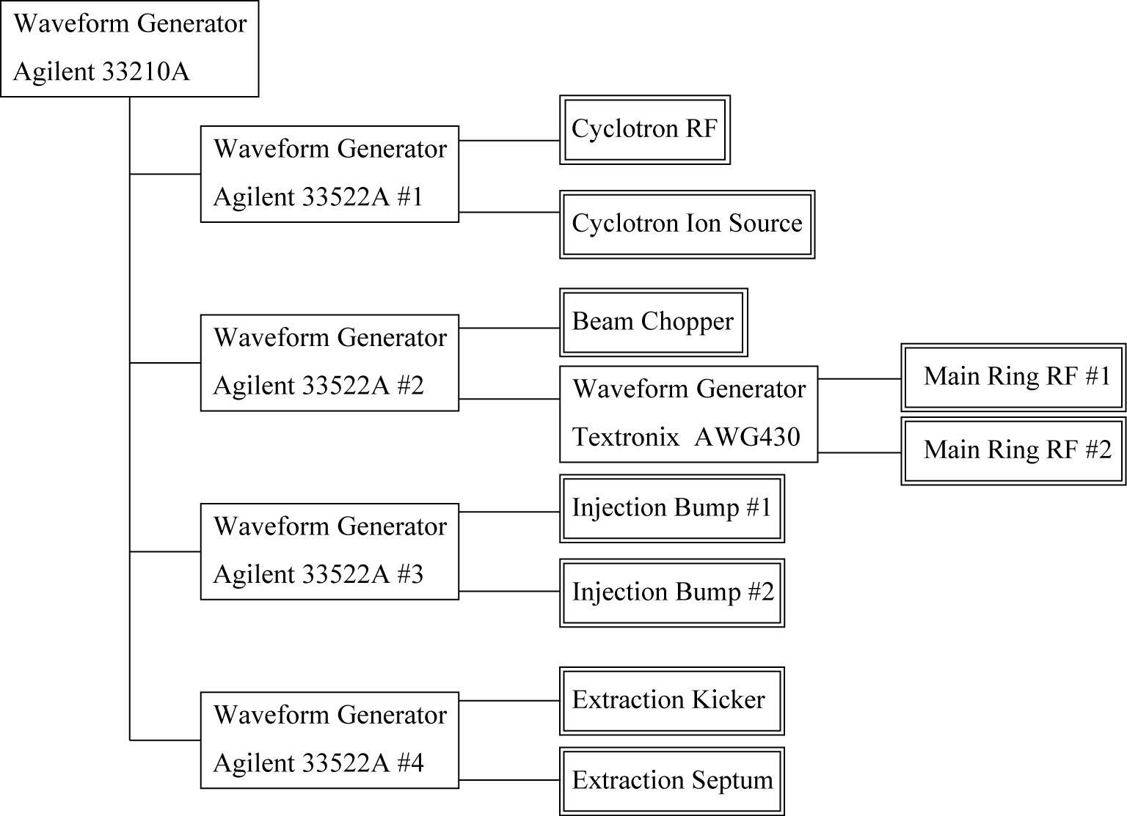
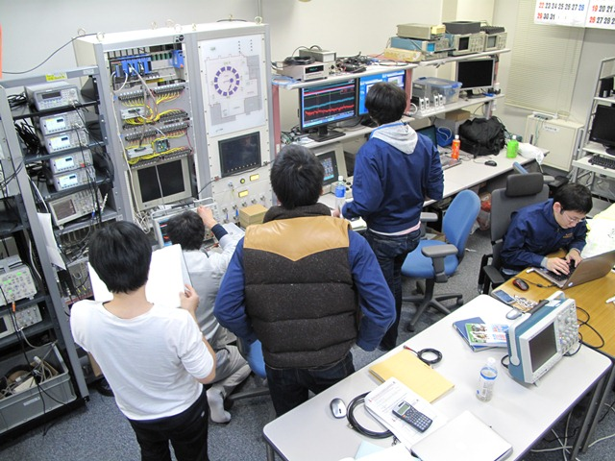
1-5. Block diagram of timing system
Timing system
Control room

Slide 8
Contents
Current status of 150 MeV FFAG accelerator
Overview of 150 MeV FFAG Accelerator
Experimental results of beam commissioning
Upgrade ion source of injector cyclotron
Power test of RF acceleration system
summary

Slide 9
2-1. Beam commissioning log
Oct. Injector cyclotron (Ion source)
Nov. Commissioning of power source of the main ring
Dec. Beam injection into the main ring
2011
Jan. The 1st turn was observed
Feb. Circulating beam was observed
Apr. – Jun. Maintenance period (Saving electricity and budget)
Jul. – Aug. Construction and power test of RF cavity
Sep. Beam study of beam injection
2012

Slide 10
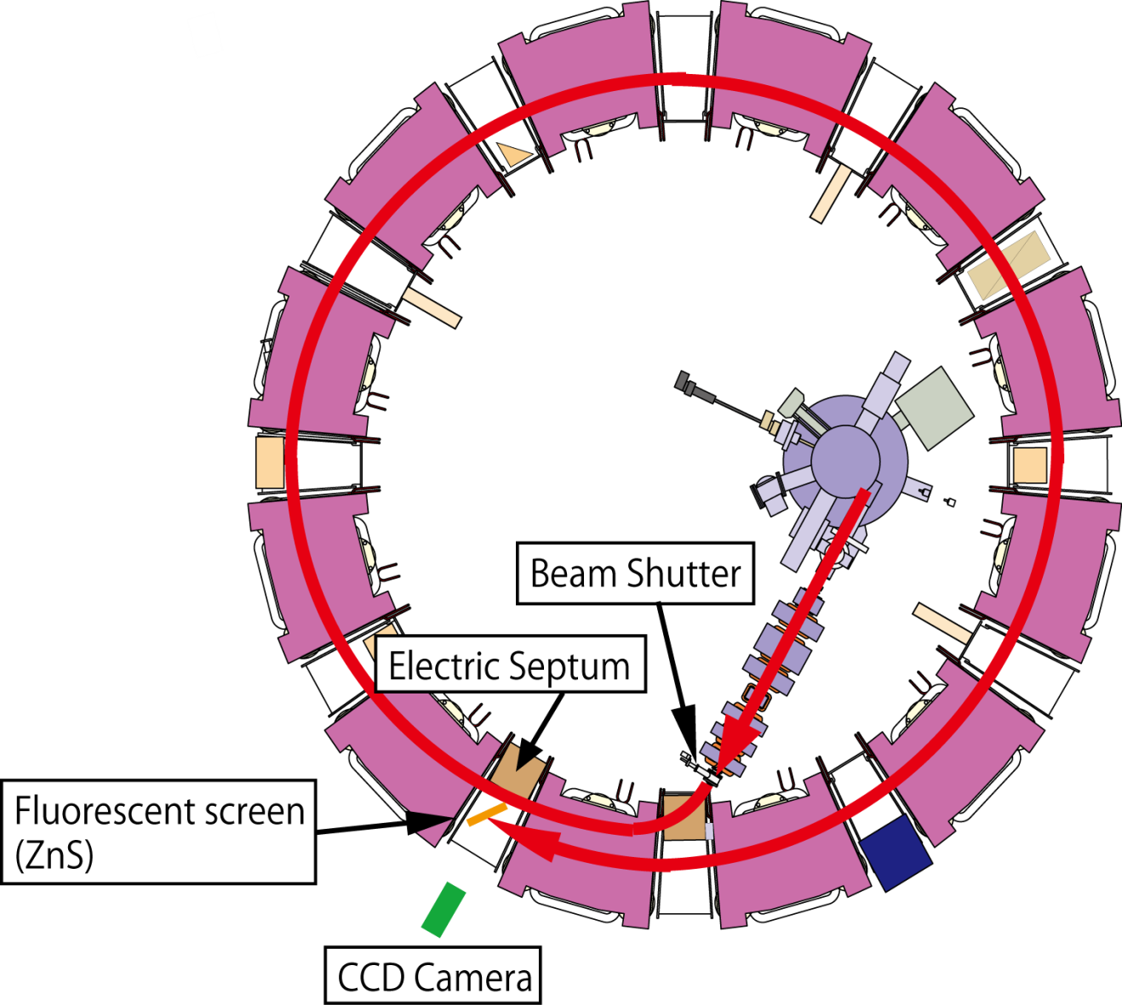
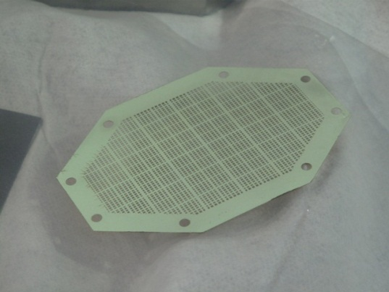
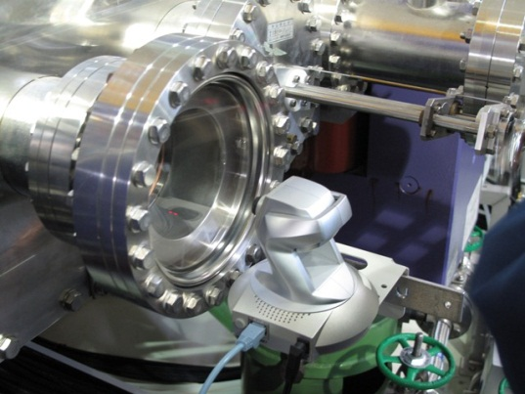
2-2. Beam injection (single-turn injection)
Fluorescent screen
(provided by RCNP)
CCD Camera

Slide 11
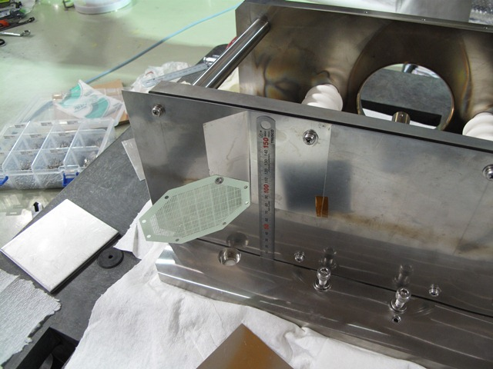
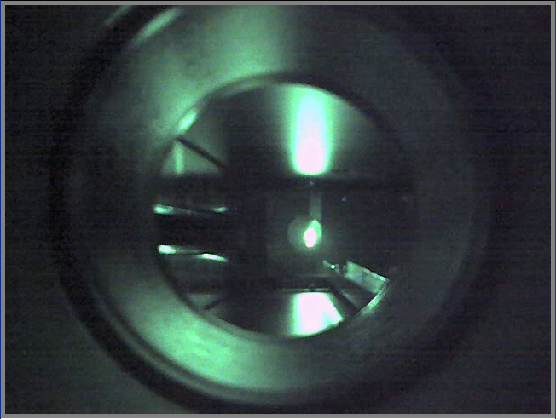
2-2. Beam injection (single-turn injection)
Electric septum
screen
Beam
CCD Camera

Slide 12
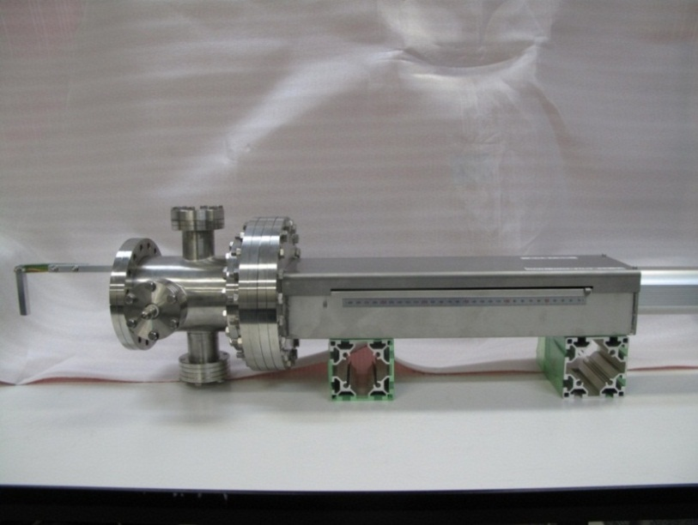
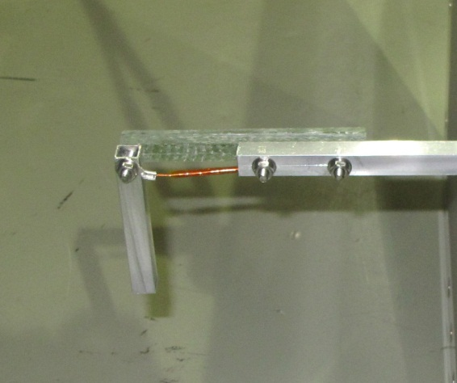
2-3. Measurements of beam position
FRP rod
Motorized cylinder
Electrode
(w=10mm)
Range of motion: 300 mm
Accuracy: 0.2 mm
Control system: PLC + LabView

Slide 13
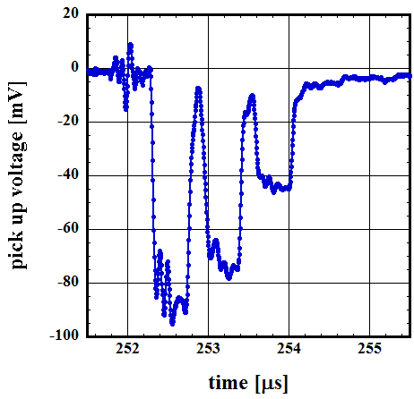
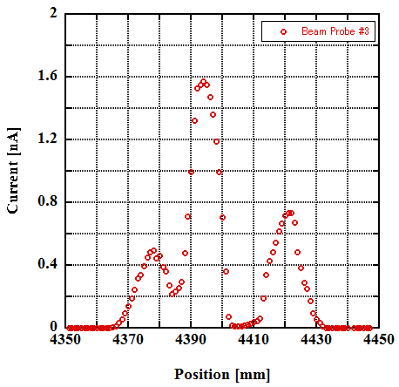
2-3. Measurements of beam position
Closed orbit
~ 4400 mm
①
③
②
①
②
③

Slide 14
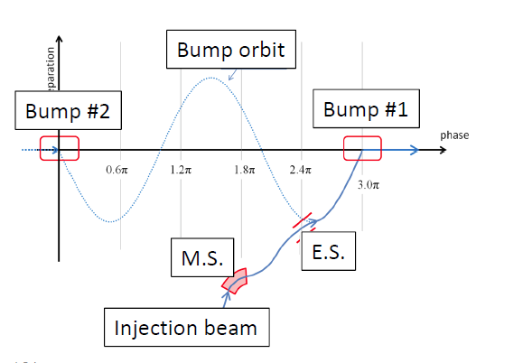
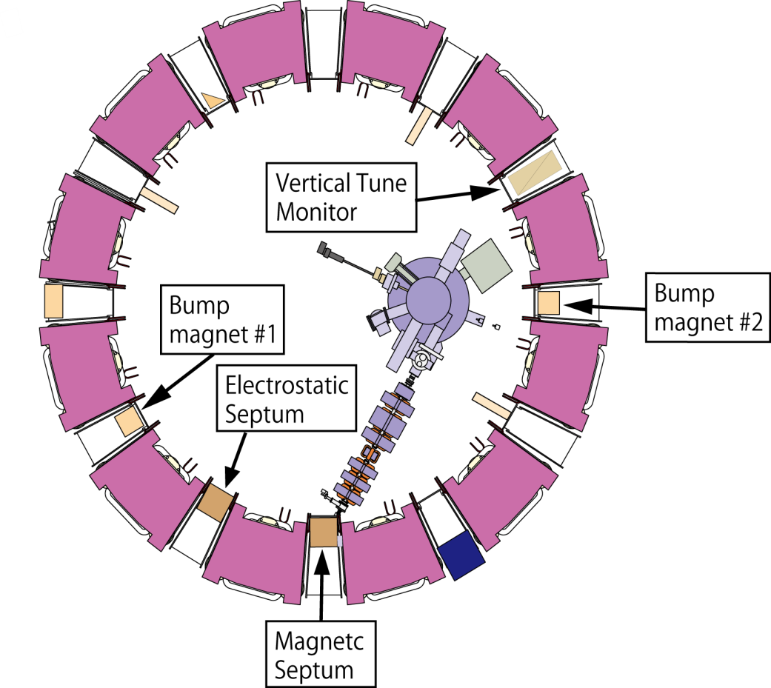
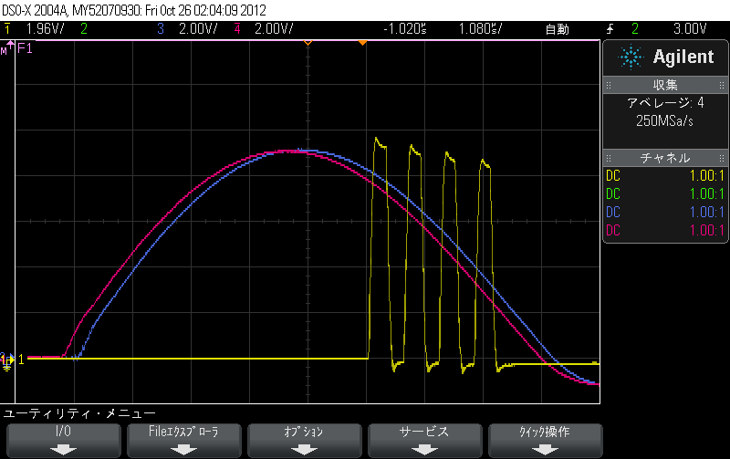
2-4. Beam injection (multi-turn injection)
Details will be described in Mr. Kuratomi’s presentation.

Slide 15
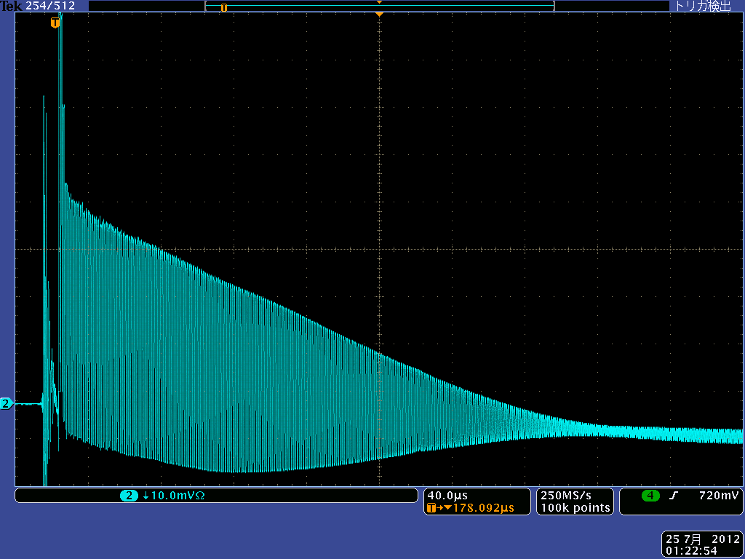
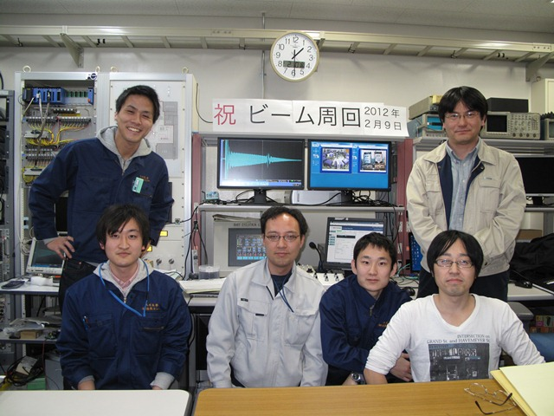
2-4. Beam Injection (multi-turn injection)
9th February 2012
The first circulating beam was observed.

Slide 16
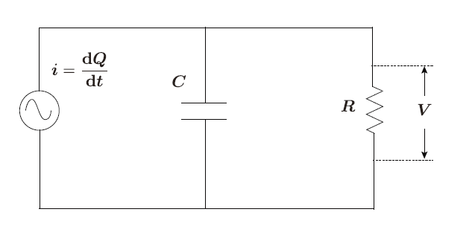
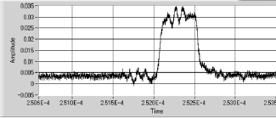
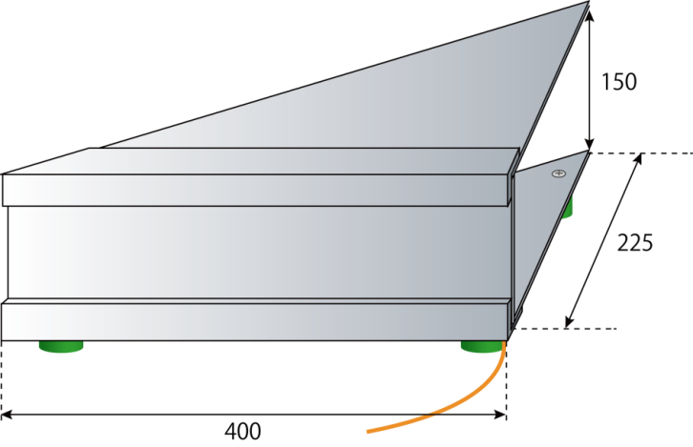
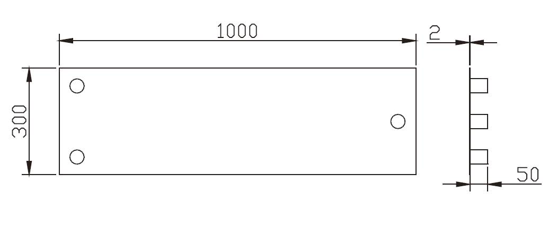
2-5. Tune measurements
Capacitive pickup monitor
R: Resistance 1 MΩ
C: 540 pF (horizontal monitor)
125 pF (Vertical monitor)
Equivalent circuit
Horizontal tune monitor
Vertical tune monitor

Slide 17
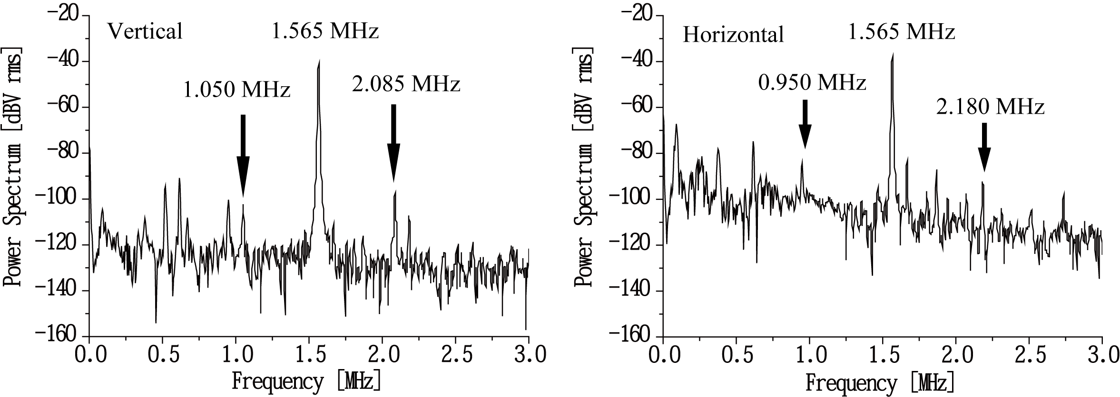


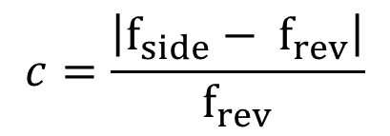

2-5. Tune measurements
$$c=\frac{\left|f_{side}− f_{rev}\right|}{f_{rev}}$$
$$v_{v}=1.331$$
$$f_{rev}=1.565 MHz$$
$$v_{h}=3.607$$

Slide 18
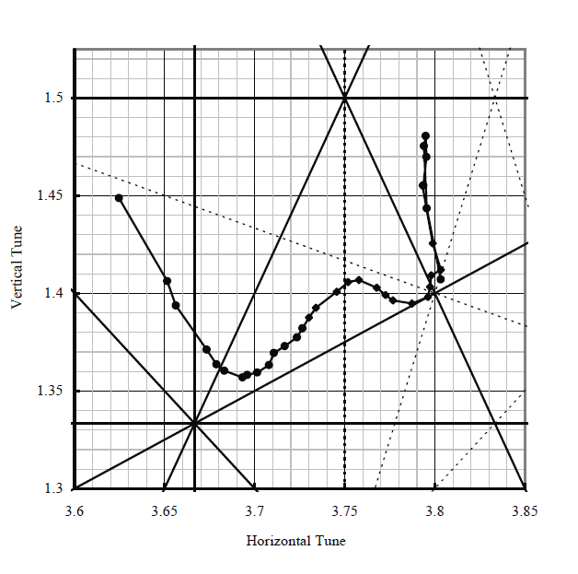

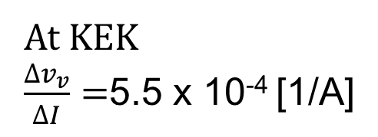
2-5. Tune measurements
Measured tune at KEK
D ~ 1000 A
$$v_{h}−2v_{v}=1$$
At KEK
$\frac{∆v_{v}}{∆I}=$5.5 x 10⁻⁴ [1/A]
D = 780A

Slide 19
Contents
Current status of 150 MeV FFAG accelerator
Overview of 150 MeV FFAG Accelerator
Experimental results of beam commissioning
Upgrade ion source of injector cyclotron
Power test of RF acceleration system
summary

Slide 20
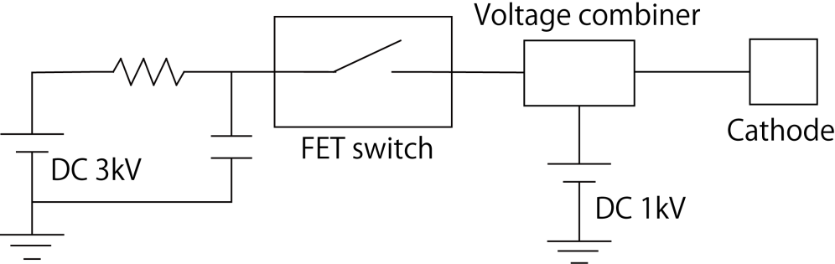
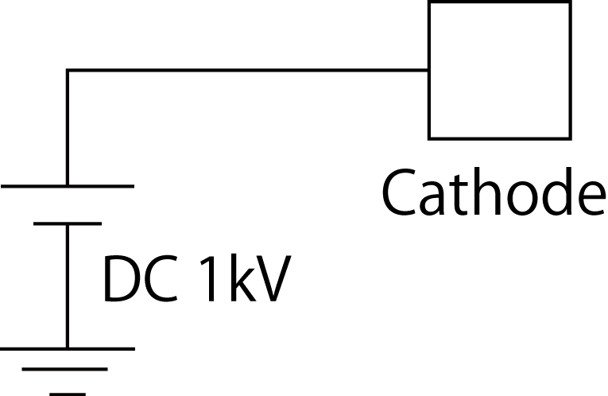
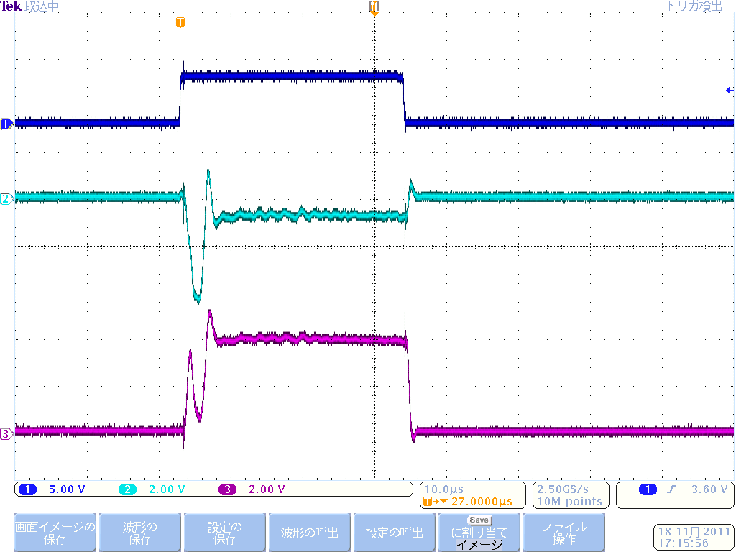

3. Upgrade ion source of the cyclotron
Trigger signal
Arc voltage (1kV/div)
Peak arc current = 20 A
50 $μ$s
Arc current: 0.5 A -> 20 A
Measured beam signal -> about 3 times larger

Slide 21
Contents
Current status of 150 MeV FFAG accelerator
Overview of 150 MeV FFAG Accelerator
Experimental results of beam commissioning
Upgrade ion source of injector cyclotron
Power test of RF acceleration system
summary

Slide 22
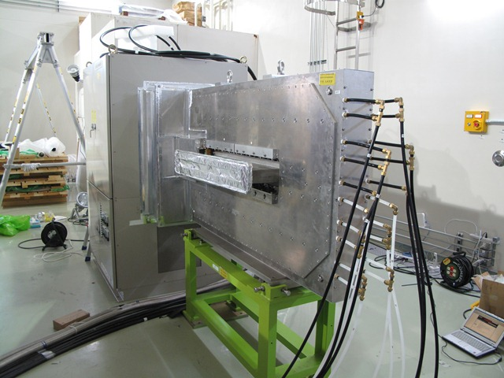
4-1. Power test of RF system
Transistor
Power Amplifier
Function Generator
Main RF Amplifier
MA Cavity
Gap Voltage | 4 .0 kV/cavity
RF frequency | 1.5 – 4.2 MHz
Power tube | 4CW15000E × 2
Class | B class, Push-pull
Core material | FINEMET (FT-3M)
RF output power | 200 kW
Details will be described in Mr. Inaoka’s presentation.

Slide 23
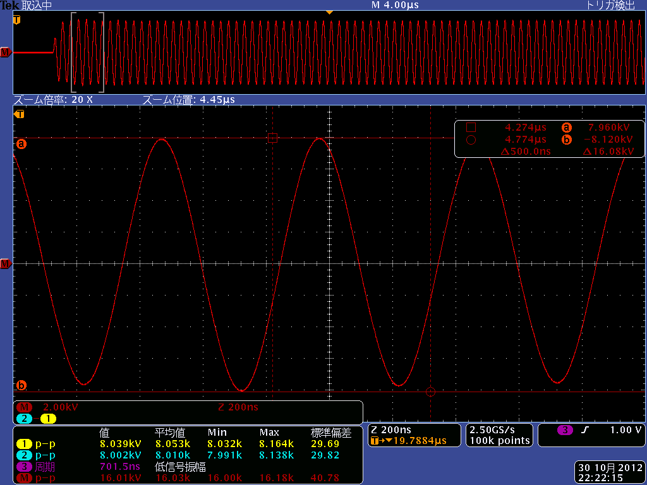
4-2. Power test of RF system
4 kV
Impedance of the RF cavity
Measured RF voltage
Output RF voltage: 4.0 kVp.
We are now in preparation for installing the RF cavity

Slide 24
Summary
The beam commissioning of 150 MeV FFAG
has gone smoothly.
We are now in preparation for installing the RF cavity.
Beam acceleration will be carried out in 2012.

Slide 25
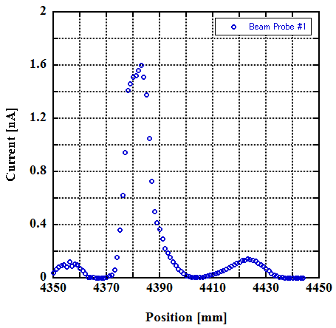
Measurements of beam position

