Slide 1
Response Matrix measurements & COD correction
David Kelliher
On behalf of the EMMA group,
ASTeC/STFC Rutherford Appleton Laboratory,
FFAG12, Osaka University
13-16, November 2012

Slide 2
Contents
Closed orbit measurements.
Response matrix measurements.
COD correction.

Slide 3
introduction

Slide 4
EMMA COD status
A large COD (~10mm peak-to-peak) is measured in EMMA.
The main source in the horizontal plane is the septum stray field (0.5 mTm). In the vertical plane the source is unidentified.
Response matrices have been measured due to quadrupole shifts and vertical correctors. As well as improving correction, the measurements may yield information about the machine.

Slide 5
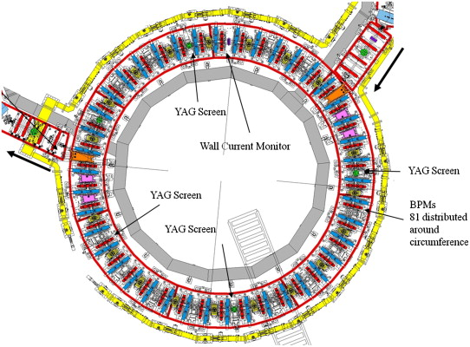
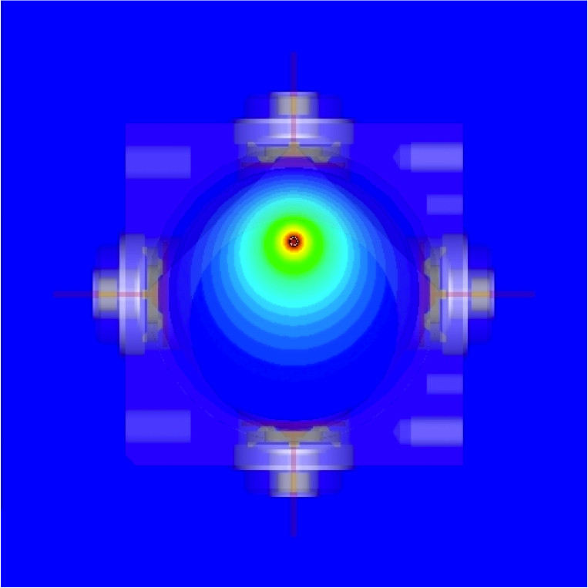
Diagnostics
In general, 2 BPMs per cell. One in between every quadrupole pair and two at either end of every other long drift.
There is also a WCM in the ring.
BPM data now read by EPICS shot-by-shot and stored on a server for later retrieval.
Due to the beam traversal of the BPM aperture, mapping voltages to coordinates is non-trivial. A CST model was used to work out the mapping.

Slide 6
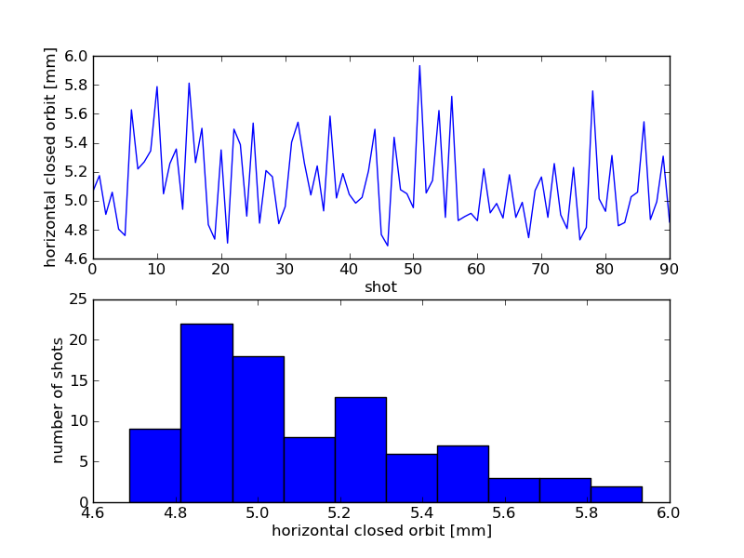
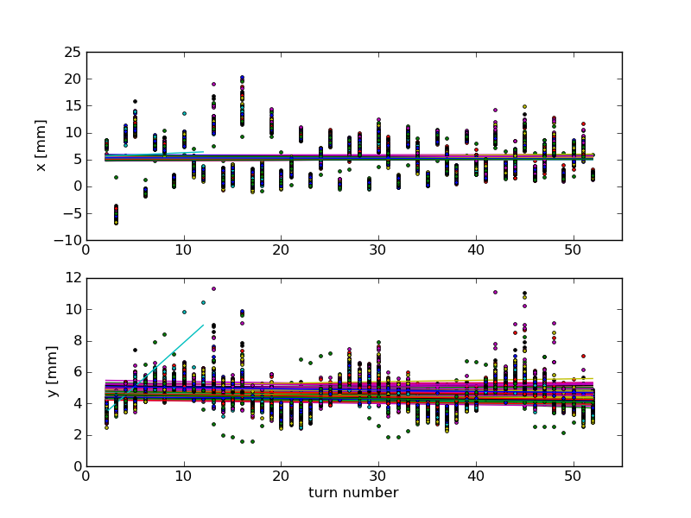
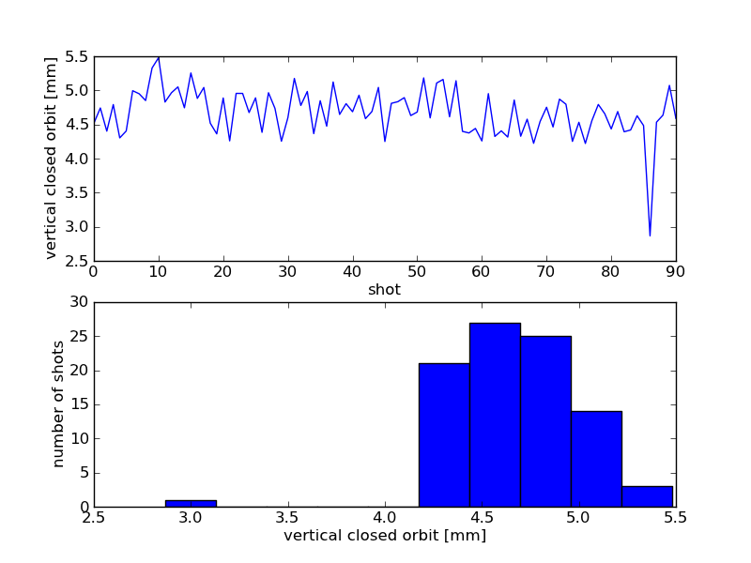
Closed orbit calculation (1)
Calculate closed orbit for each BPM and for each shot.

Slide 7
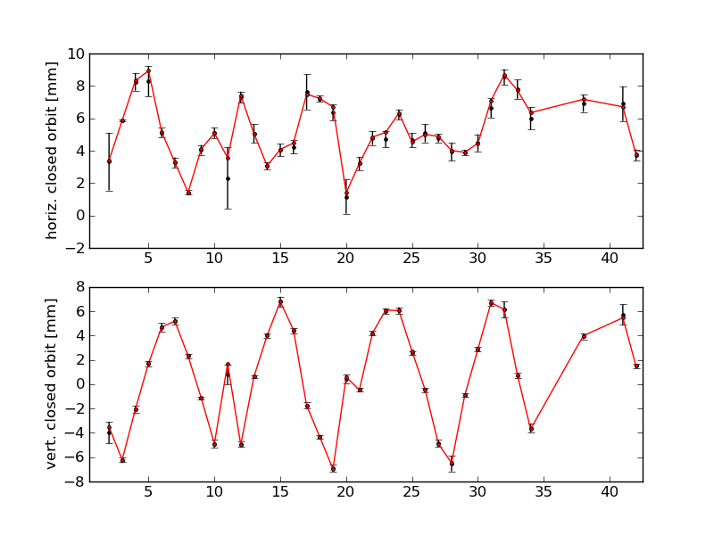
Closed orbit calculation (2)
Calculate closed orbit at each BPM for each shot. Error bar is the standard deviation of the set of closed orbits calculated for all shots.
Horizontal and vertical closed orbits at 18 MeV/c

Slide 8
Apparent closed orbit variation (1)
Fit to coordinate versus turn implies a slow COD variation with turn.
Is the variation due to a change in beam momentum, drift in BPM electronics or a time-varying error source?
Establishing the cause of the drift should allow us to calculate the closed orbit with more confidence.

Slide 9
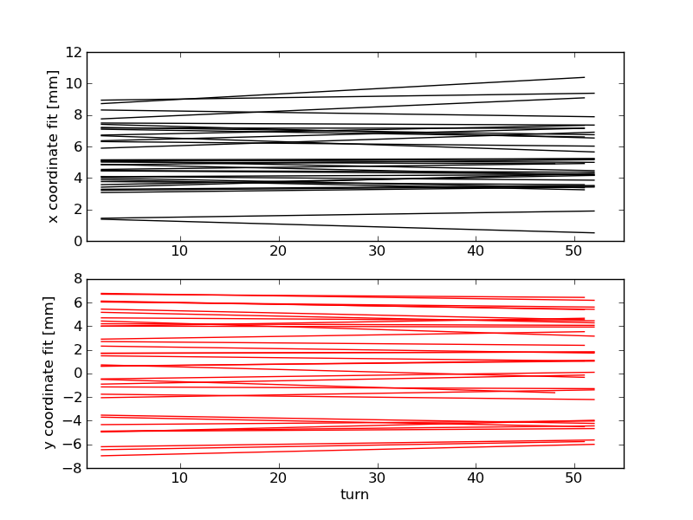
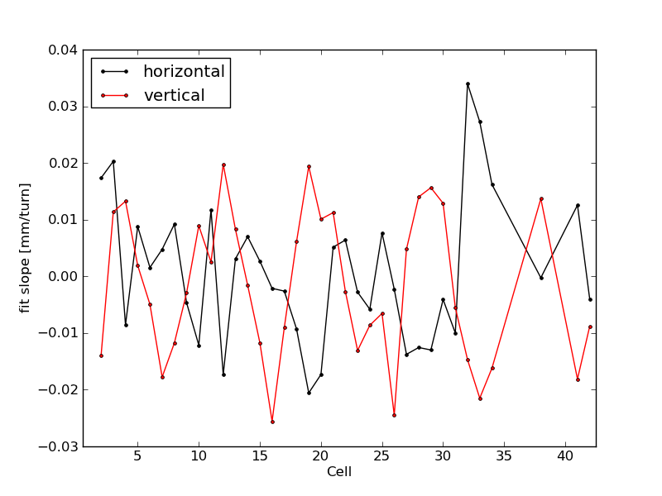
Apparent closed orbit variation (2)
In general, slope of fitted line depends on amplitude of COD at each BPM.
This indicates that the trend is probably not something solely to do with the BPMs themselves but is related to some property of the beam.
Fit for each BPM
Slope of fitted line

Slide 10
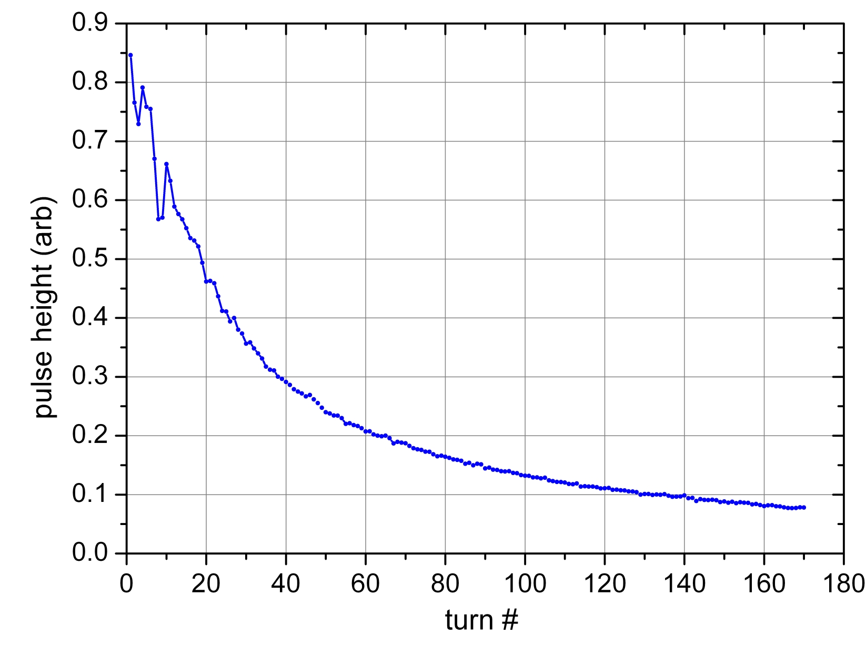
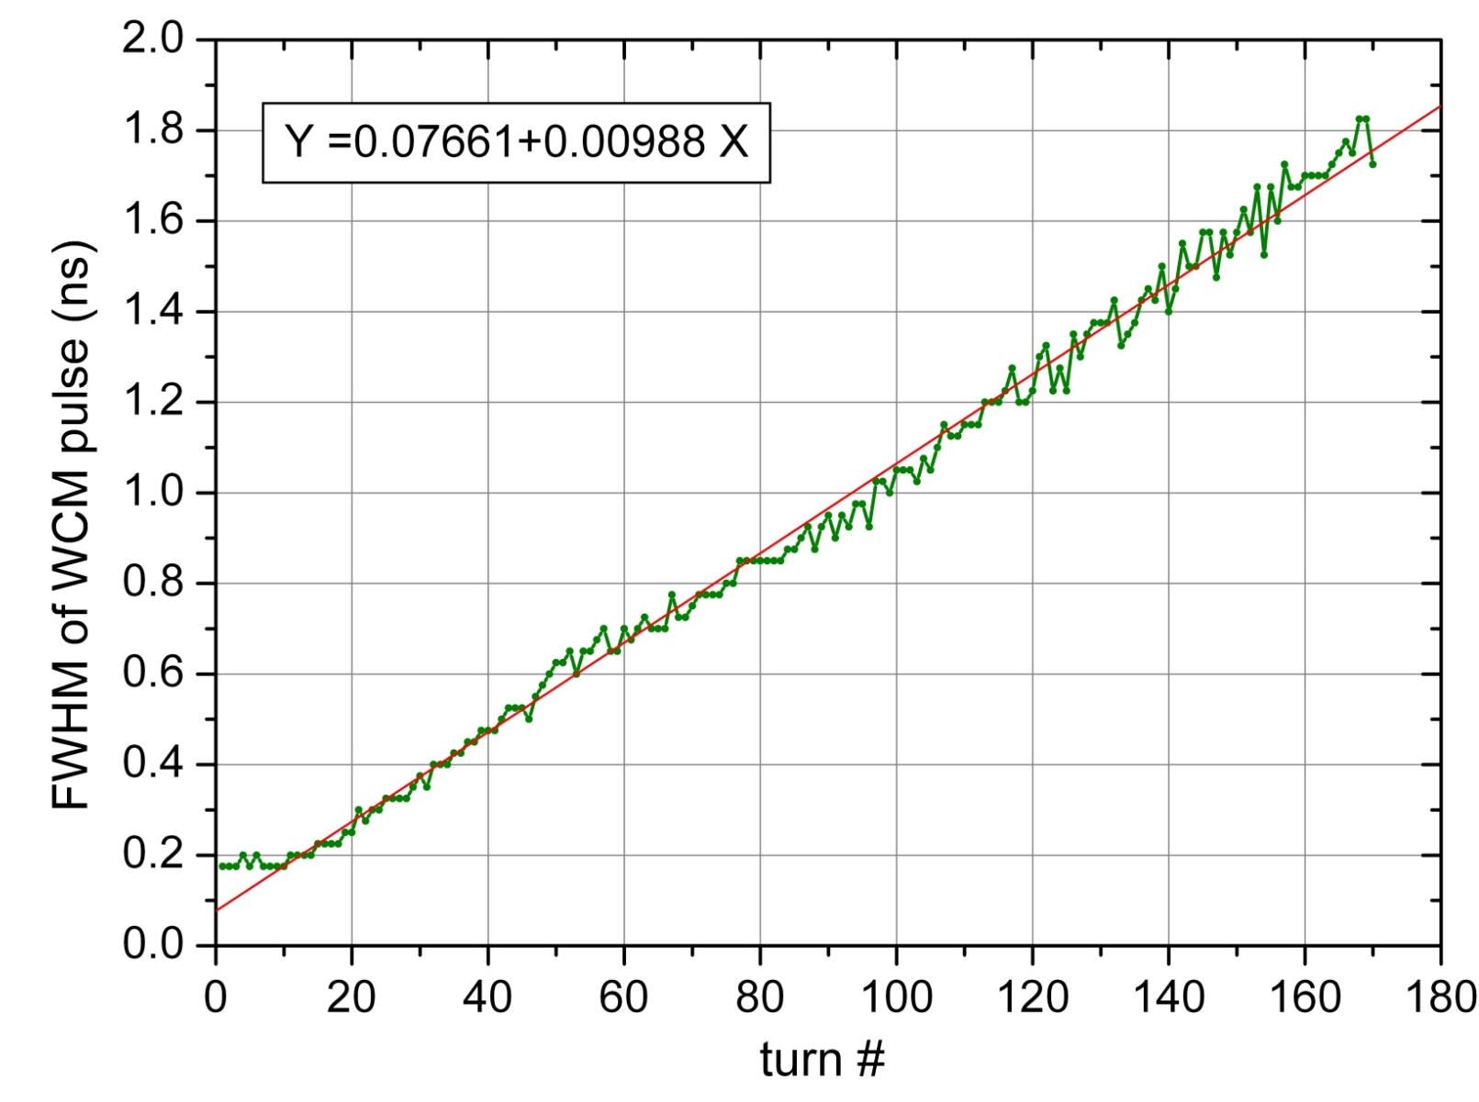
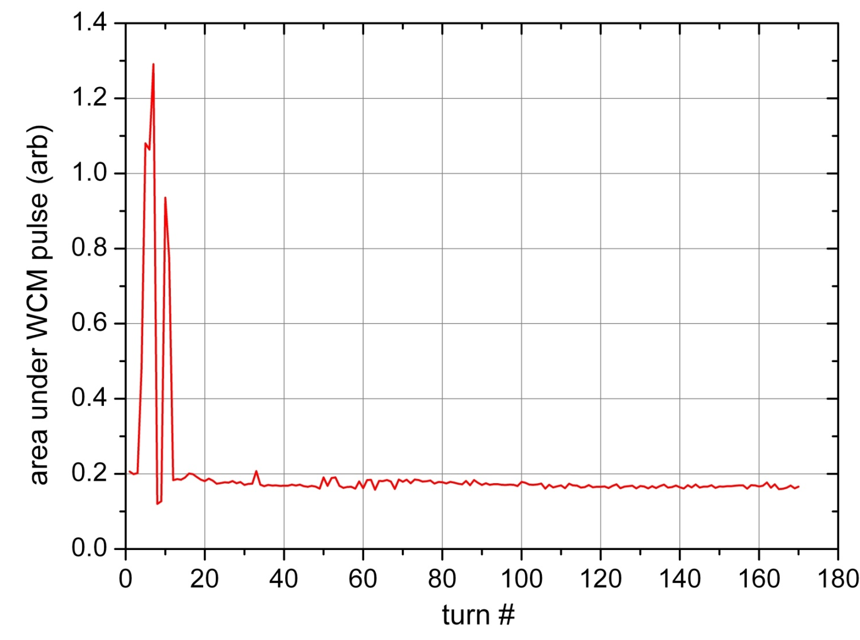
Debunching measured by WCM
(Ian Kirkman)

Slide 11
Response matrix

Slide 12
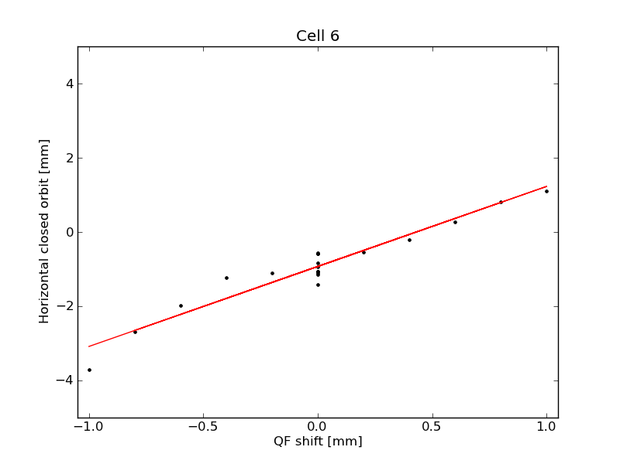
Response matrix measurement
Decided on a +/- 0.5 mm magnet shift & +/- 0.2 V on vertical corrector to measure response matrices.

Slide 13
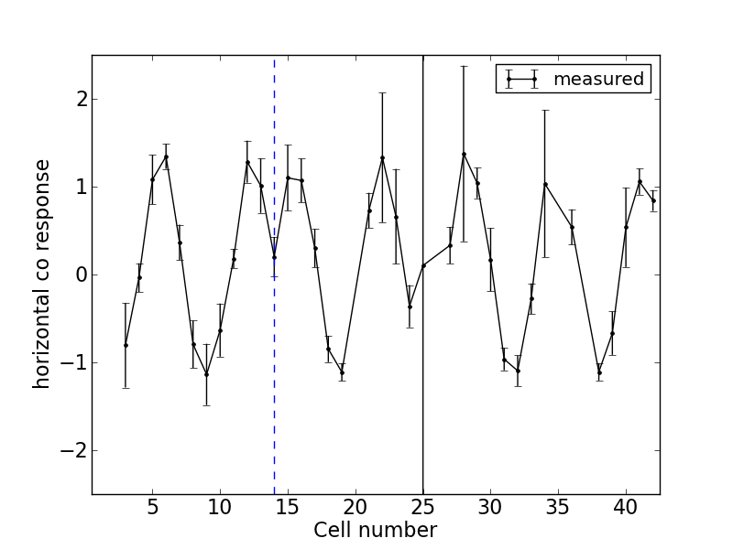
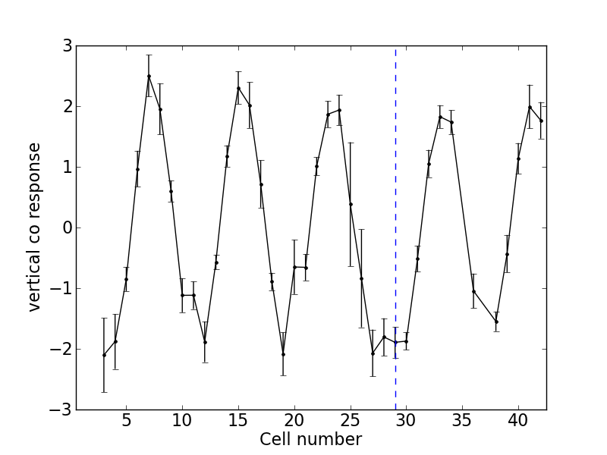
Response at 18MeV/c
Look at response at each BPM due to a single magnet shift.
Can see characteristic “dip” at the corrector location.
Error bars obtained by adding in quadrature the closed orbit standard deviation over shots.
D-14 response
VC-29 response
Horizontal co response to D in cell 14 shift
Vertical co response to VC in cell 29

Slide 14
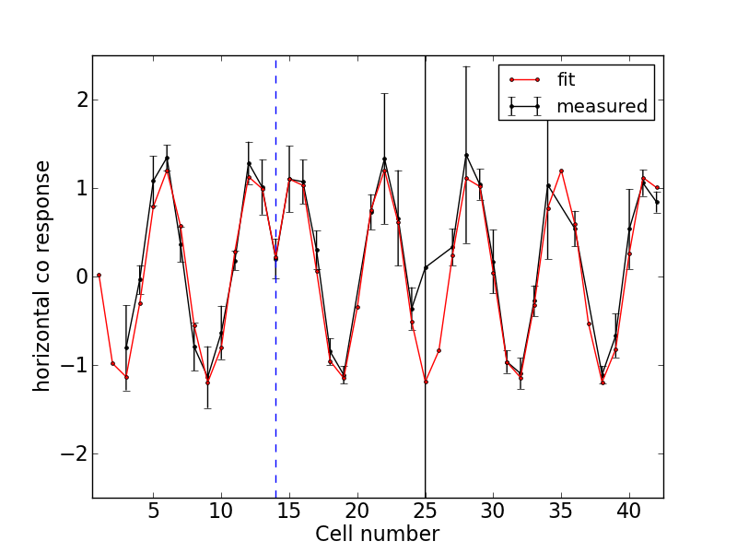
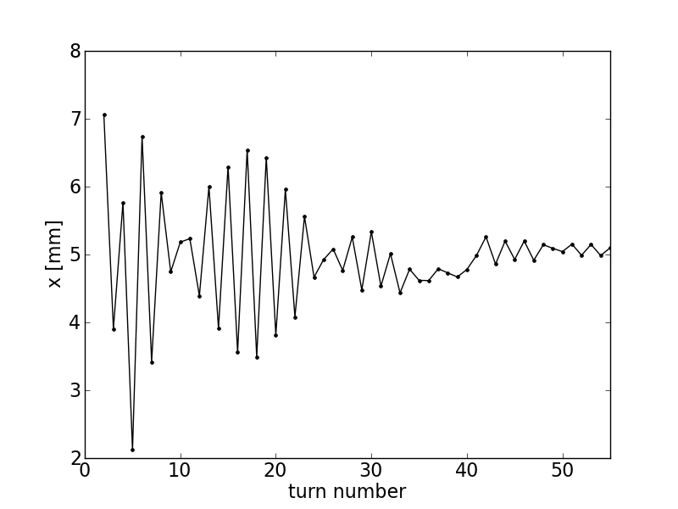
Lattice parameters from response matrix
Use downhill simplex algorithm to find β at corrector and BPM and cell tune.
D-14 response
D-14 x(turn)
υ_{x}= 0.155, β_{D,}β_{BPM}= 0.302, 0.484 m
Fractional part of tune, 0.5, is consistent with turn-by-turn coordinate

Slide 15
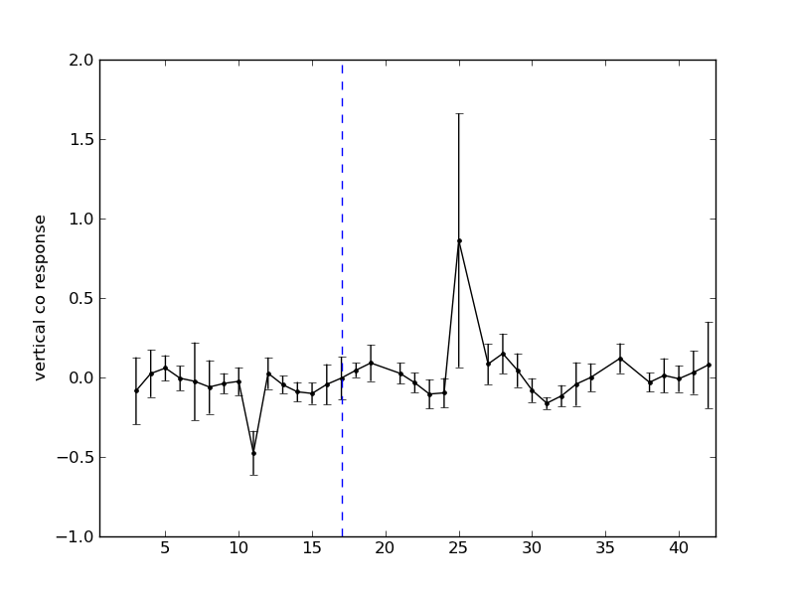
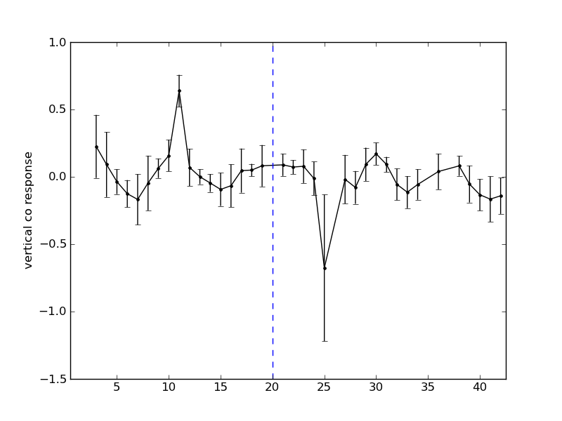
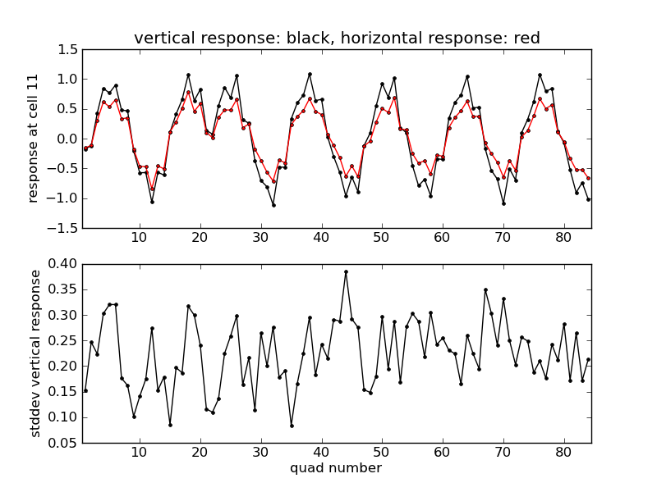
Vertical response to quad shift?
Vertical co response to D in cell 17 shift (left) and D in cell 20 shift (right).
Vertical response in cell 11 BPM seems to correlate with horizontal response in same BPM.
Need larger shift and more data to see if there is any real effect.

Slide 16
Response Matrix measurements to date
Equivalent momentum (MeV/c) | Components measured
11.66 | D, F, VC
14.3 | D. F, VC
16.1 | D, F, VC
17.8 | D, F, VC
18.0 | D, F, VC
18.2 | F, VC
18.4 | F
18.6 | D, F, VC

Slide 17
CoD Correction

Slide 18
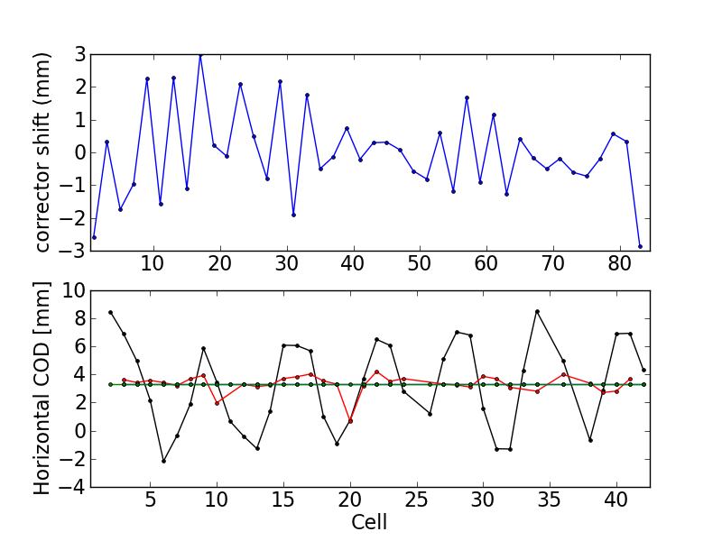
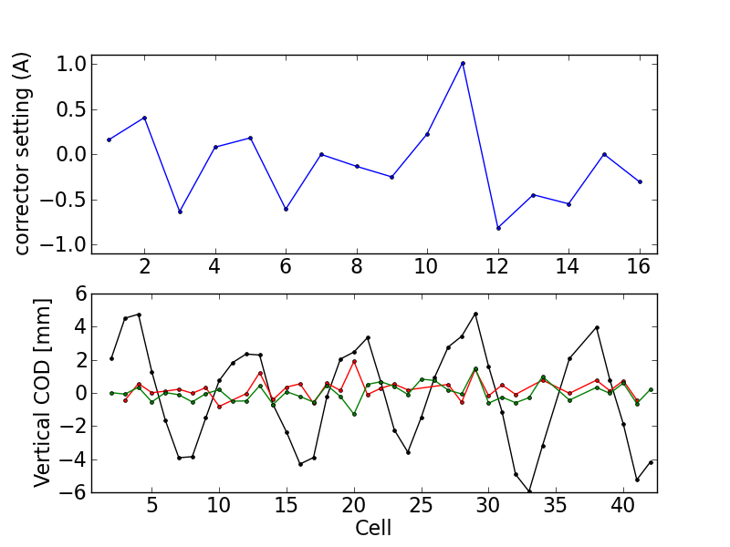
COD correction at single momentum
Correction using fit to measured response matrix and least squares.
COD reduced but room for improvement.
Example at 17.9 MeV/c, data from 5/11/12 and 30/8/12.
Horizontal
Vertical

Slide 19
COD correction at multiple momenta (simulation)
Can expand the response matrix to cover multiple momenta and find optimal correction settings.

Slide 20
COD correction at multiple momenta (verification)

Slide 21
Conclusions
Can measure response matrix. Have demonstrated COD correction using fitted response matrix.
The response matrix provides a measure of tune and beta at corrector and measurement locations.

