Slide 1
Slow Integer Tune Crossing Experiment
FFAG ‘12
Jimmy Garland
The University of Manchester
The Cockcroft Institute

Slide 2
Outline and Motivation
Rapid acceleration has been demonstrated in EMMA without amplitude growth¹.
Many practical applications of non-scaling FFAGs involve accelerating much heavier particles and therefore acceleration may be slower than in EMMA. Investigating slow acceleration and the subsequent beam behavior is therefore of importance.
Cross tune space in EMMA by acceleration in an RF bucket with a range of slower than nominal acceleration rates.
Determine if there is any transverse amplitude growth due to lattice errors.
Compare with Zgoubi simulations to determine agreement.
Draw some conclusions about possible emittance and amplitude growth.
[1] S. Machida et al, Nature Physics 8, 243–247 (2012)

Slide 3
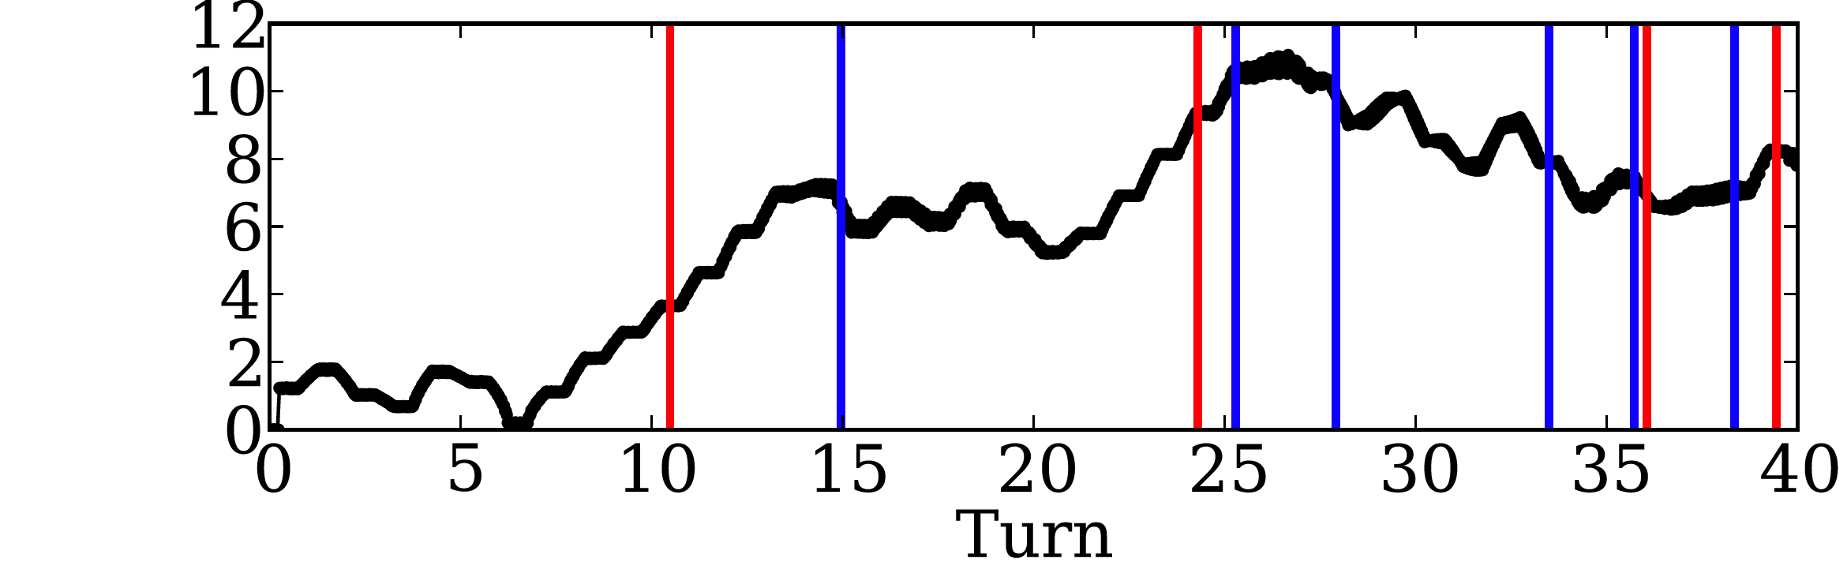
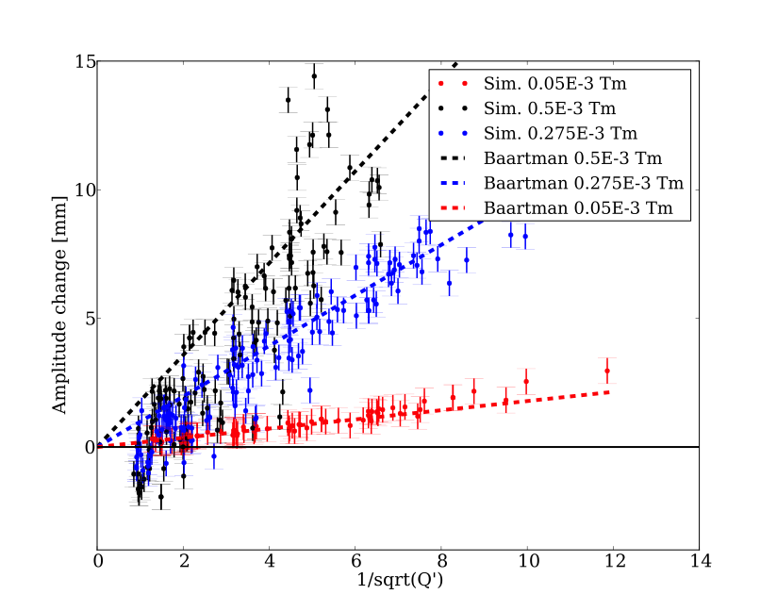
Single Particle
Simulation in Zgoubi
Can only measure charge centre in EMMA therefore single particle simulations. Measure sliding value of standard deviation of transverse coordinate.
Stand. dev. [mm]
A horizontal bending field error is used in the simulation to represent the believed septum stray field in EMMA. This provides a driving term for possible horizontal integer resonance excitation.
Results here are compared to R. Baartman’s formulation of amplitude growth from resonance crossing as a function of crossing speed and error magnitude.

Slide 4
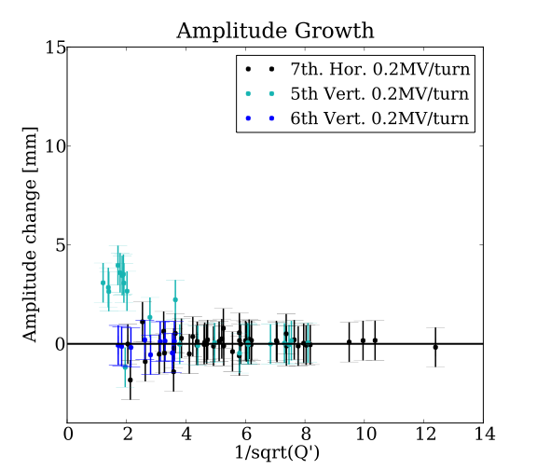
Single tune crossing amplitude growth analysis in EMMA
Some EMMA experimental results of the same amplitude growth analysis technique used for single particle simulations.
No growth can be concluded form single integer tune crossings when analysing the standard deviation of a horizontal coordinate for EMMA data.

Slide 5
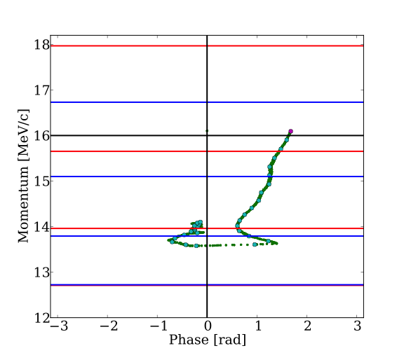
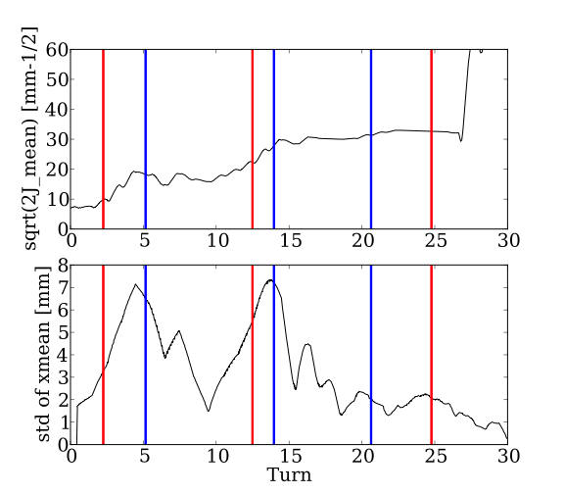
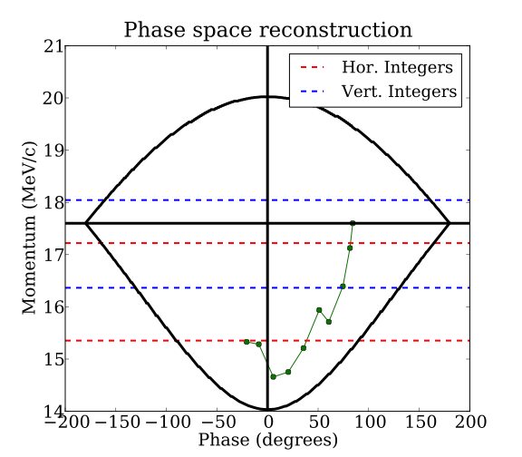
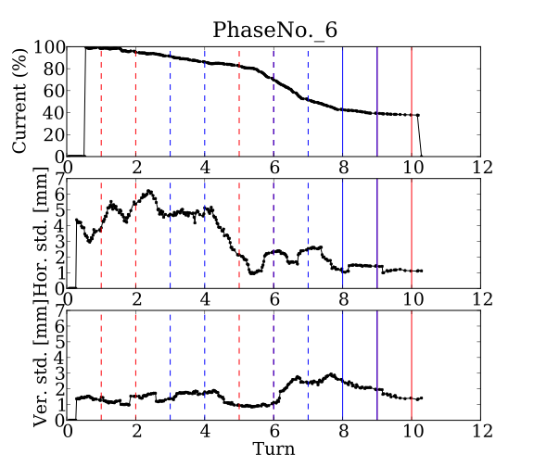
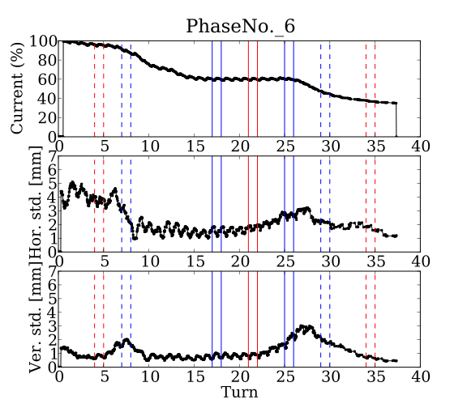
Multi-particle simulation sin Zgoubi and EMMA experimental results.
Zgoubi
Similar behavior can be seen when comparing the standard deviation of the horizontal coordinate for both cases.
Experiment

Slide 6
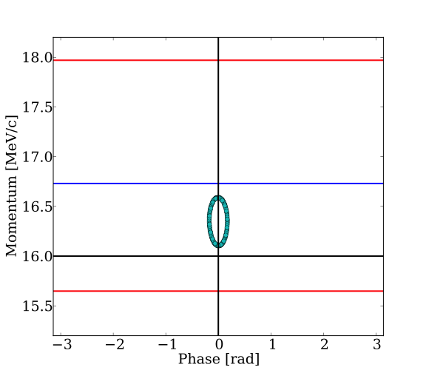
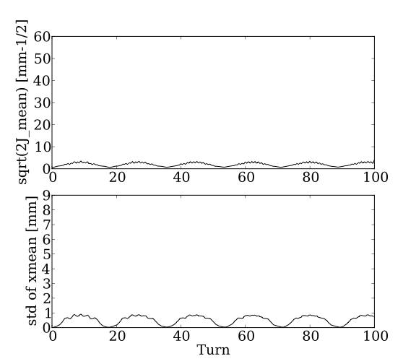
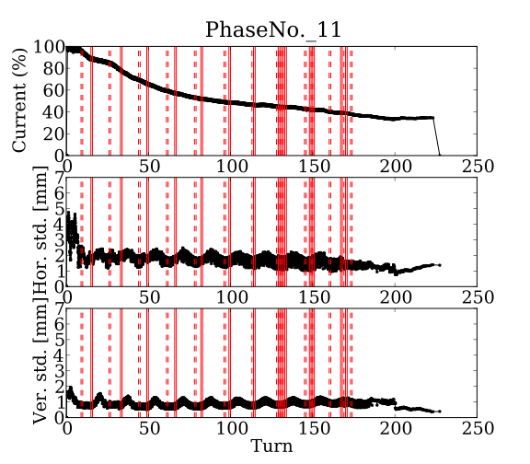
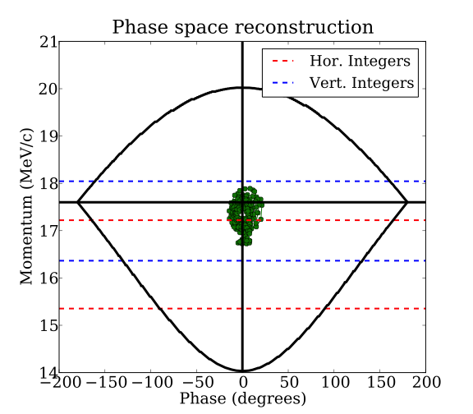
Multi-particle simulation sin Zgoubi and EMMA experimental results.
Zgoubi
Experiment

Slide 7
Multi-particle simulation sin Zgoubi and EMMA experimental results.
Analysis of Zgoubi results may provide us with some insight into the behavior in EMMA if there is good agreement.
The animation shows how some particles are boosted to a higher amplitude when crossing an integer tune but subsequently there is some decoherence effect and the standard deviation of the coordinate decreases, however the action or emittance is increased.

