Slide 1
S-POD Experiment at Hiroshima University
Hiromi Okamoto (Hiroshima Univ.)

Slide 2
Background
Stable Transport
of High-Power or Low-Emittance Hadron Beams
Detailed Information on “Space-Charge Effects”
Accelerator-Based Experiments
Expensive
Need lots of manpower
Poor flexibility
Difficulty in measurements
Radio-activation
Mathematical Theories
Too complex equations
Simplifying models
Numerical Simulations
At present, probably the most popular approach
toward various space-charge effects
BUT
Often very time-consuming…
Standard Approaches
Large-scale experiments
Mathematical theories
Computer simulations

Slide 3
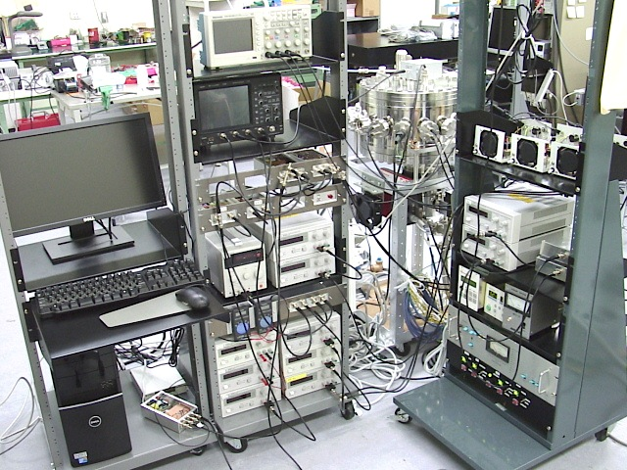
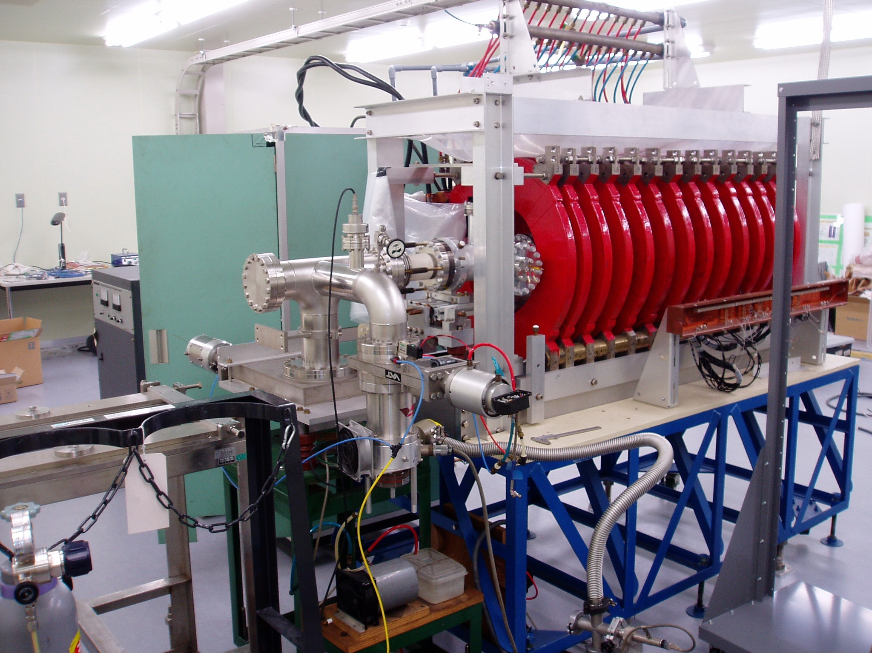
Plasma Trap Experiment
Use a compact, low-cost model that provides
a dynamical system equivalent to charged-particle beams !
S-POD III
S-POD (Simulator for Particle Orbit Dynamics)
RF Trap
Magnetic Trap

Slide 4
Principle
Charged-particle beams
in an AG focusing channel
Non-neutral plasmas
in a trap system
Charged-particle beams
in an AG focusing channel
Non-neutral plasmas
in a trap system
Both interacting many-body systems obey the following equations:
Poisson equation
Vlasov equation
Two systems are physically equivalent
if governed by similar Hamiltonians.
Use this simple fact to study various collective effects in space-charge-dominated beams !

Slide 5
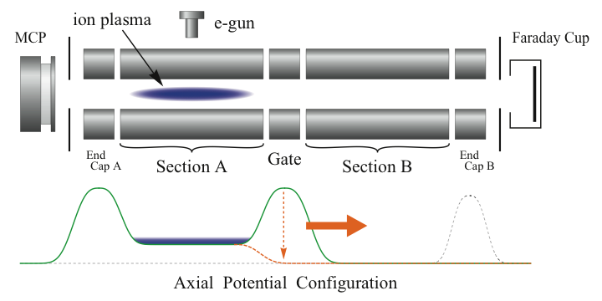
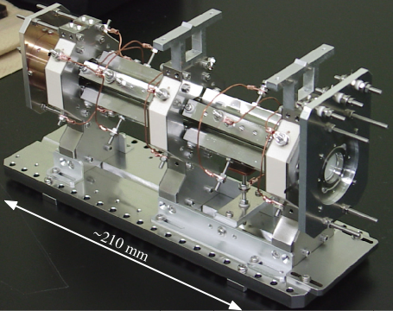
RF Ion Trap
Linear Paul Trap
* Operating frequency : 1 MHz
* Particle species : Ar⁺, Ca⁺, N⁺, etc.
* Plasma lifetime : order of seconds
(dependent on plasma conditions)
* Tune depression : > 0.8
(without cooling)
* Cost : a few thousand USD !
Transverse confinement :
rf quadrupole
Longitudinal confinement :
rf or electrostatic potential

Slide 6
Typical S-POD Experiments
Collective resonance excitation (Ar⁺)
Lattice dependence of stop bands (Ar⁺)
Resonance crossing (Ar⁺)
Halo formation (e⁻)
Ultralow-emittance beam stability (Ca⁺)

Slide 7
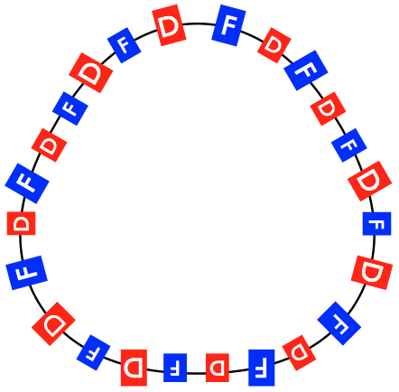
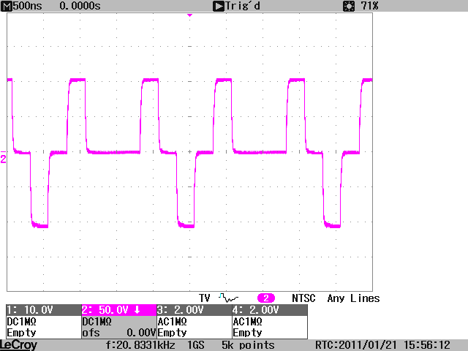
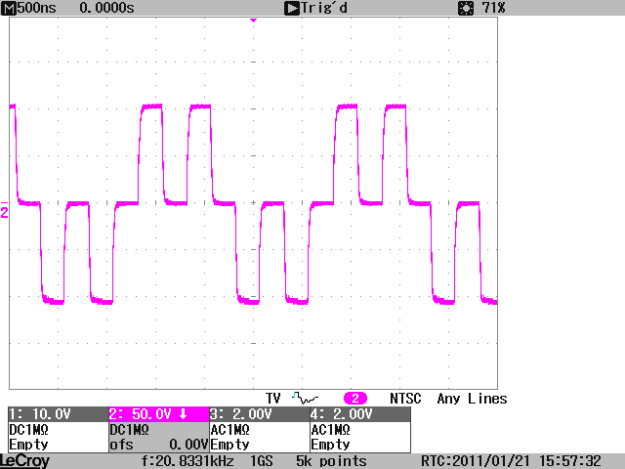
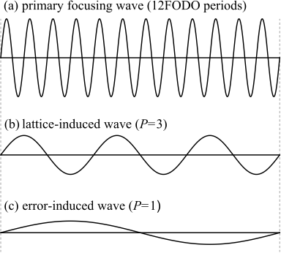
Driving Force
Sinusoidal Wave Model
Charged-particle beams
in an AG focusing channel
Non-neutral plasmas
in a trap system
When the focusing potential is periodic, we can expand K_{RF} into Fourier series:
where L is the length of unit lattice structure, and .
Periodic functions depending on a lattice design :
We choose only a few Fourier components that approximately express the
essence of the external driving force !
This approximation makes it much easier to design and construct an RF power
supply system for S-POD.
Triplet
FFDD

Slide 8
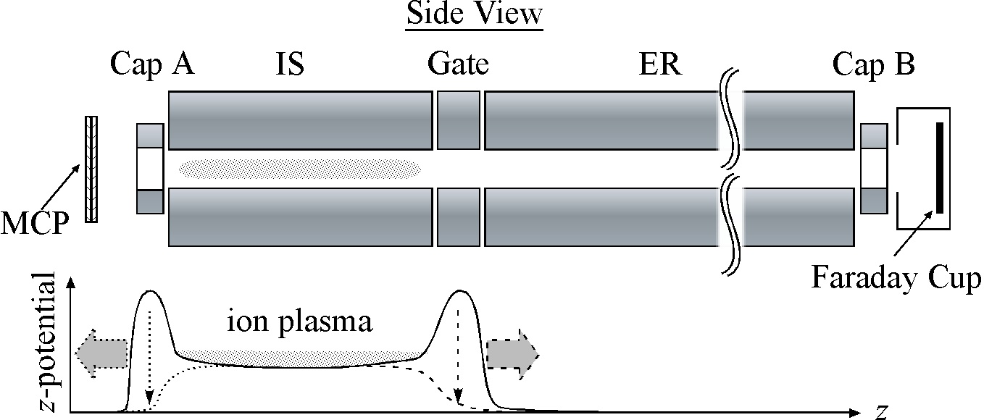
Basic Measurement Cycle
⁴⁰Ar⁺ ions have been used
for resonance experiments.
Add specific DC bias voltages to Cap A and Gate.
Ionize neutral Ar gas in the IS region (typically for 1 second).
After a short storage (typically for 1 msec to 10 msec), switch off the bias on Gate (or Cap A).
Measure the ion number with the Faraday cup (or MCP).
Transfer the data to a personal computer and save it.
Change slightly the amplitude of the rf voltage on the quadrupole electrodes.

Slide 9
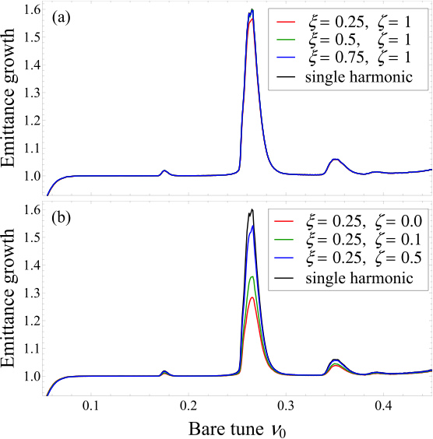
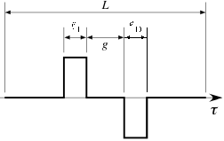
Stop Bands in Doublets
WARP
S-POD
Filling Factor :
Collective Resonance Condition
Drift Ratio :
For
Linear (m = 2) :
Third-order (m = 3) :

Slide 10
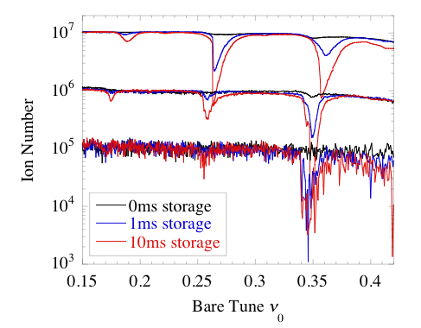
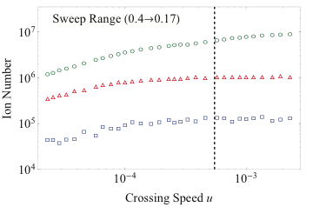
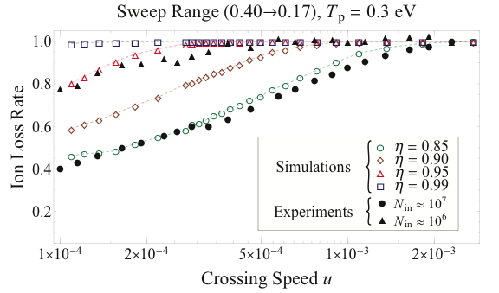
Resonance-Crossing Experiment
10 x 42 RF periods
: 10 turn extraction
from EMMA
Crossing Speed
: tune-sweep width
: rf period for tune sweep
n_{rf}

Slide 11
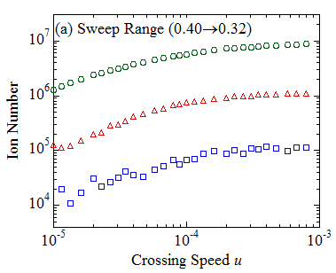
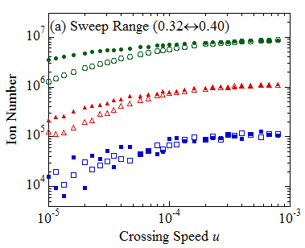
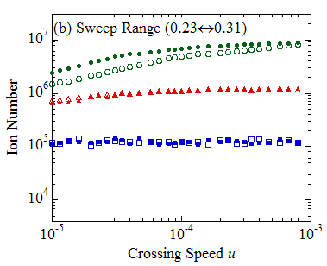
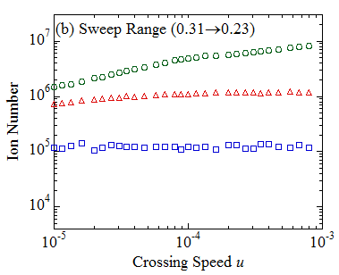
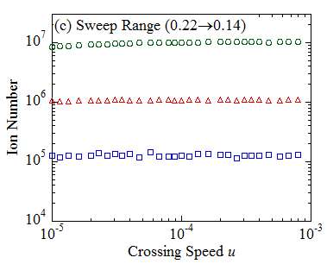
Single Resonance-Crossing Experiment

Slide 12
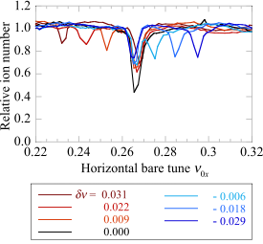
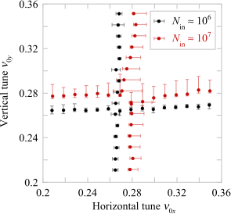
Stop-Band Splitting : S-POD Experiments
When , all stop bands split !
Tune Diagram
Linear stop band

Slide 13
Preparation for Integer-Resonance Crossing Experiments at S-POD

Slide 14
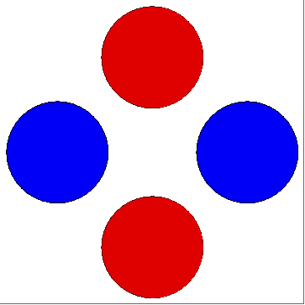
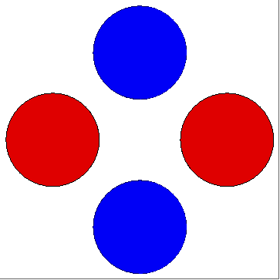
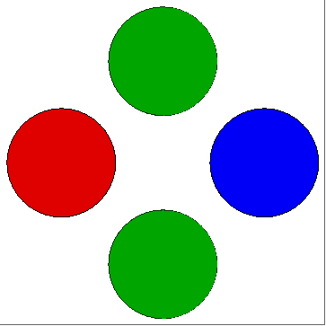
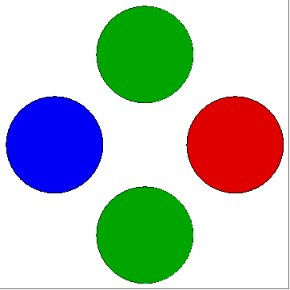
Excitation of the Dipole Mode
Quadrupole mode
Dipole mode

Slide 15
Hamiltonian Correspondence
Storage ring
Paul trap
Note that the D-function
is particle-independent.
This determines the periodicity of
the dipole driving force. In the EMMA
case, the most dominant dipole
perturbation is produced by a leakage
field from the septum magnet.
The RF dipole-field function
Let us assume a delta-function
kick, considering the fact that
the septum leakage field is well
localized in EMMA.

Slide 16
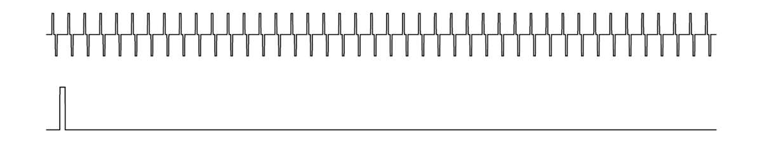
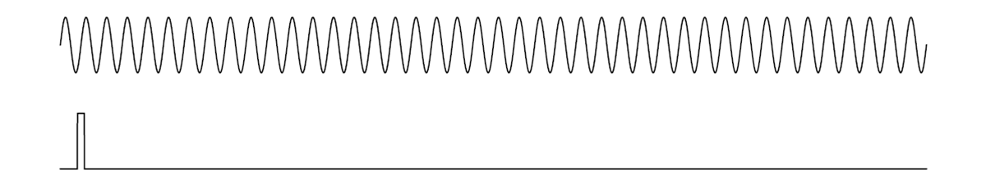
RF Waveforms
An ideal superperiod
Quadrupole
(42 doublets)
Dipole kick
A model superperiod
Quadrupole
(42 sine waves)
Dipole kick

Slide 17
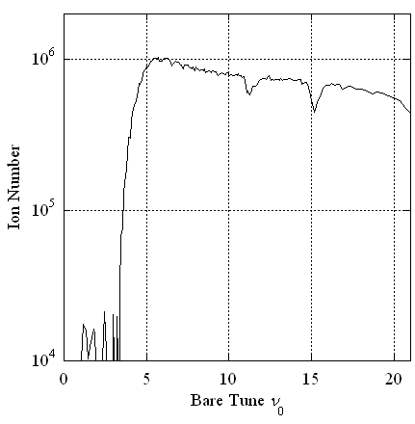
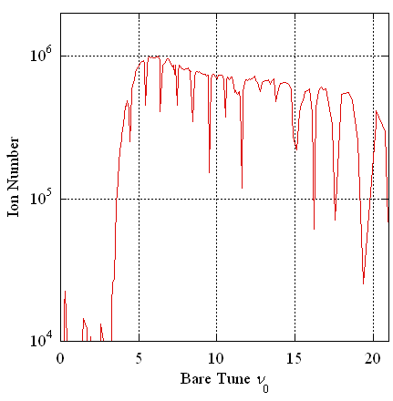
S-POD Data (Preliminary)
Storage period = 1 msec ; Dipole amplitude = 1 % of quadrupole
Without dipole perturbation
Dipole perturbation applied !

Slide 18
Plans on Resonance Crossing Experiments
Concentrate upon Integer-Resonance Crossing
Dependence on dipole-perturbation strength
Dependence on resonance crossing speed
Dependence on beam density
0% to ~10% of the quadrupole amplitude is possible.
We can ramp the dipole strength during resonance crossing.
The minimum sweep time of the RF quadrupol amplitude is
100 micro-sec corresponding to ~ 2 turns in EMMA
(dQ/dT ~ 10).
An arbitrarily slow crossing is possible (dQ/dT ~ 0).
The possible maximum space-charge-induced tune shift is
~15 % of the bare tune (without plasma cooling).
Technical Issues
Strange shifts of integer stop bands
Dipole noise
Preparation for MCP and phosphor measurements
Emittance estimation

Slide 19
Acknowlegements
Past and Present Contributors to the S-POD Project
Hiroshima University
Hiroyuki Higaki, Kiyokazu Ito
(Students)
M. Endo, S. Fujimoto, M. Fujioka, K. Fukata, K. Fukushima, H. Hitomi, K. Homma, M. Kano, Y. Mizuno, K. Moriya, K. Nakayama, S. Ohtsubo, K. Okabe, S. Sakao, H. Sugimoto, H. Takeuchi, K. Tanaka, R. Takai, G. Uchimura, S. Yamaguchi
Kyoto University
Akihiro Mohri
Osaka University
Kenji Toyoda
LBNL & LLNL
Steven M. Lund, Andrew M. Sessler, Peter Seidl, David Grote, Jean-Luc Vay

Slide 20
Some Technical Issues

Slide 21
Observed Stop-Band Shifts
The stop bands generated by the
dipole perturbation are not located
at integers but slightly shifted.

Slide 22
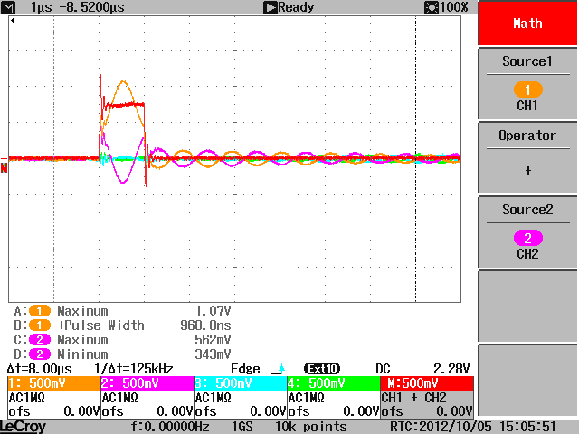

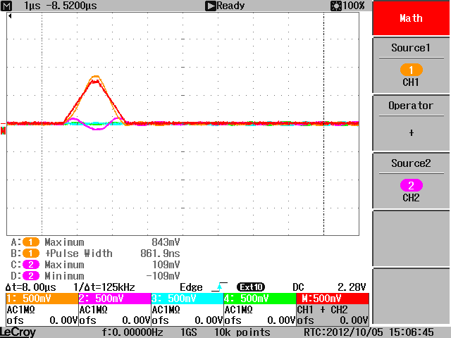
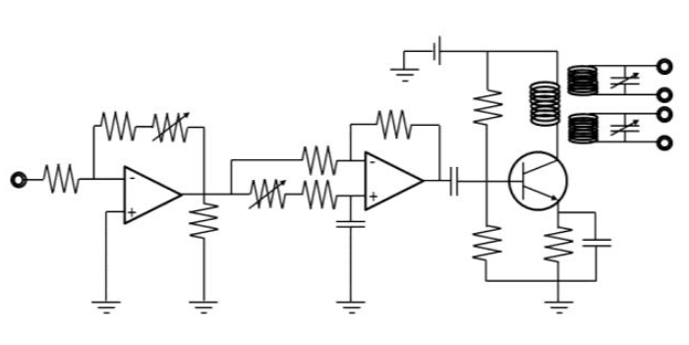
Dipole Noise
We modified the original RF circuit
to produce a dipole perturbing field.
This modification has caused a noise
problem.
Amp
Amp

