Slide 1
Non-scaling linear FFAG
proton racetrack accelerator
Dejan Trbojevic

Slide 2
Non-scaling linear FFAG racetrack accelerator
1. Introduction
2. Permanent magnets - Halbach
6. Acceleration
4. NS-FFAG ring with permanent magnets
3. FFAG straight section solution P. Meads
5. Matching of the ring to the straight section
Normalized phase space, dispersion

Slide 3
Range of momentum = range kinetic energy
ΔE_{k proton}=250-30.967 MeV
E² =(p/c)²+E_{o}²

Slide 4
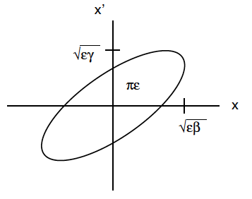
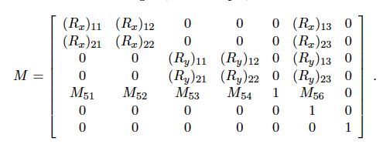



Betatron and dispersion functions
X_{out}=M X_{in} X=(x, x’, y, y’, -ds, dp/p, 1)
x’√β+xα/√β
φ
x/√β
√ε
α,β,γ=(1+α²)/β

Slide 5
Particle motion in an accelerator
s
x/√β
ξ=D/√β
φ_{2,3}
φ_{3,4}
φ
φ_{1,2}
x’√β+xα/√β
χ=D’ √β+Dα/√β
ΔD’ √β=θ√β
√ε

Slide 6
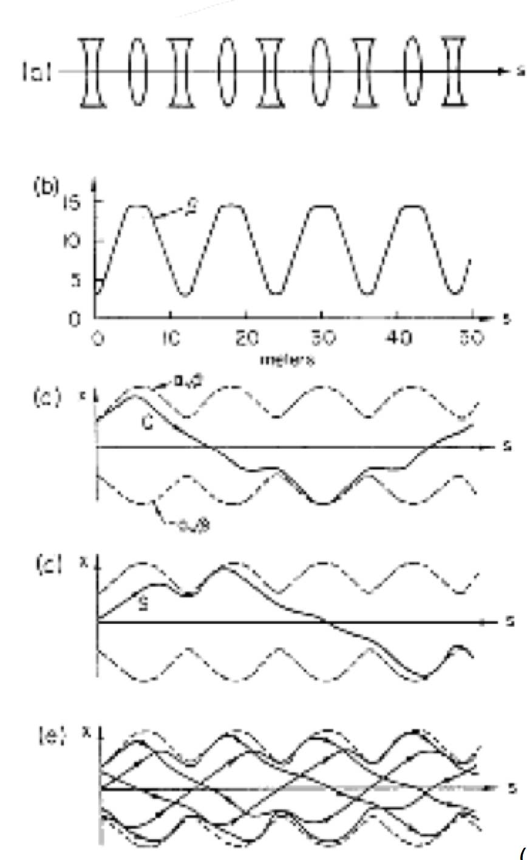
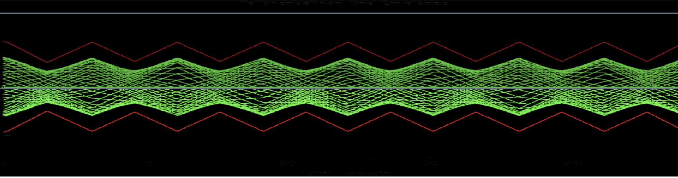
TRANSVERSE MOTION OF PARTICLES
IN THE FODO STRUCTURE

Slide 7
Dispersion function - momentum
Let’s assume that:
p₂=0.65p_{o}
Δx=D dp/p
θ_{o}=l_{o} /ρ
ρ_{o}=0.65ρ₂
p_{o}
l₂
Δx
D=Δx/(dp/p)
θ₂
p₂
θ_{o}

Slide 8
Non-scaling FFAG concept
Orbit offsets are proportional to the dispersion function:
Δx = D_{x} ∗ δp/p
To reduce the orbit offsets to ±20 mm range, for momentum range of δp/p ~ ± 50 % the dispersion function D_{x} has to be of the order of:
D_{x} ~ 2 cm / 0.5 ≤ 4 cm
The size and dependence of the dispersion function is best presented in the normalized space and by the H function:
δp/p ~ ± 50 % →E_{k} [30.1 , 250 MeV]

Slide 9
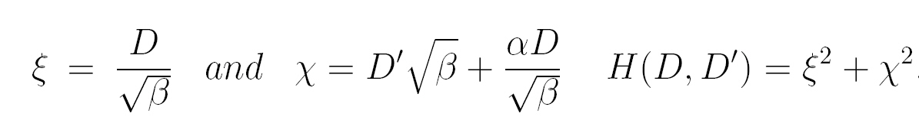
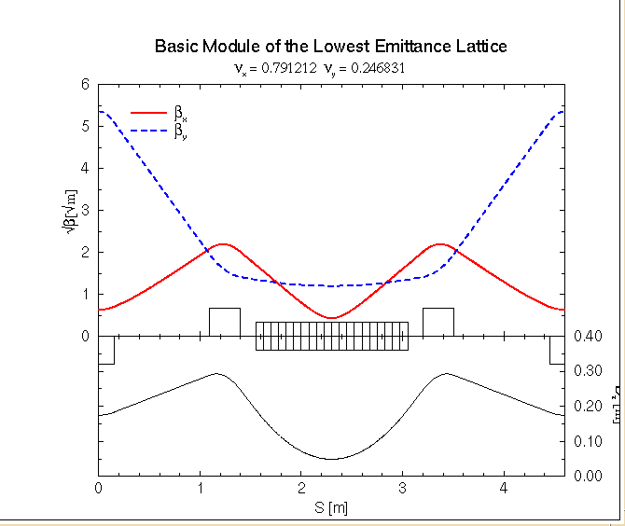


Minimizing H function
D/2
D/2

Slide 10
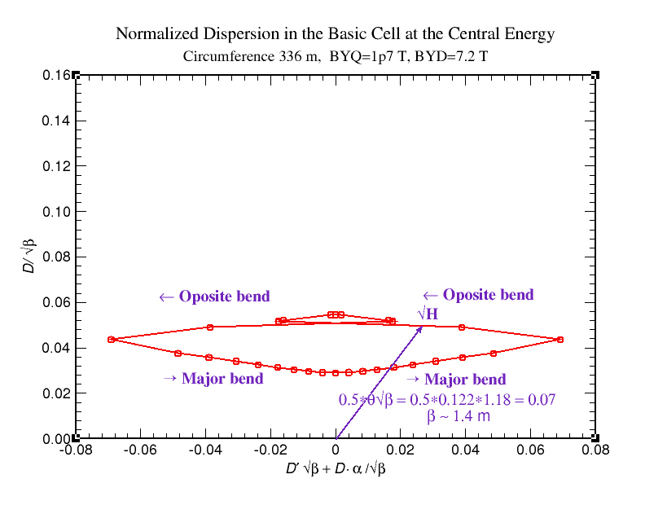
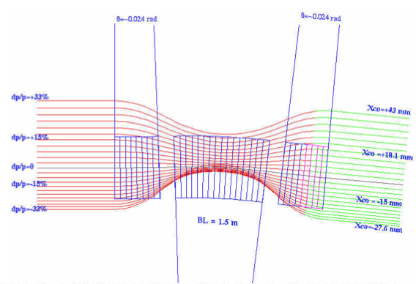
Optimizing H function – Normalized dispersion
FODO
Minimization of the H function applied for the FFAG design

Slide 11
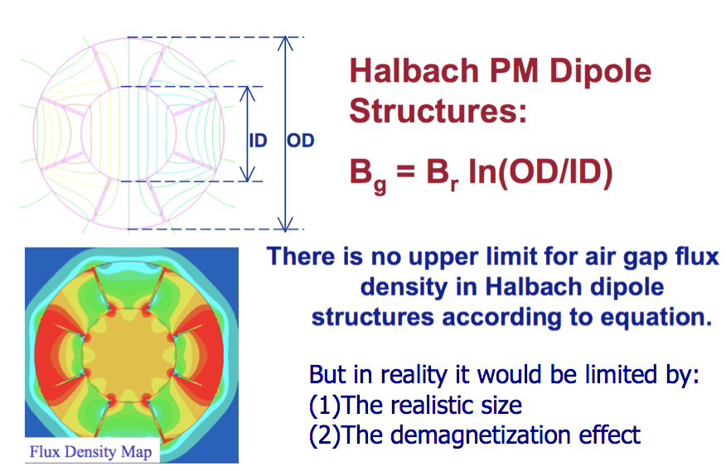
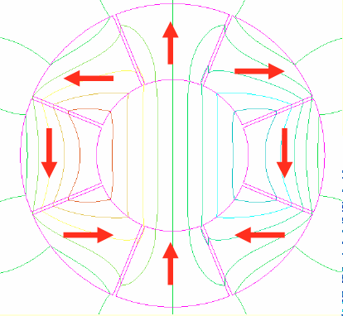
Permanent magnets – Halbach structure

Slide 12
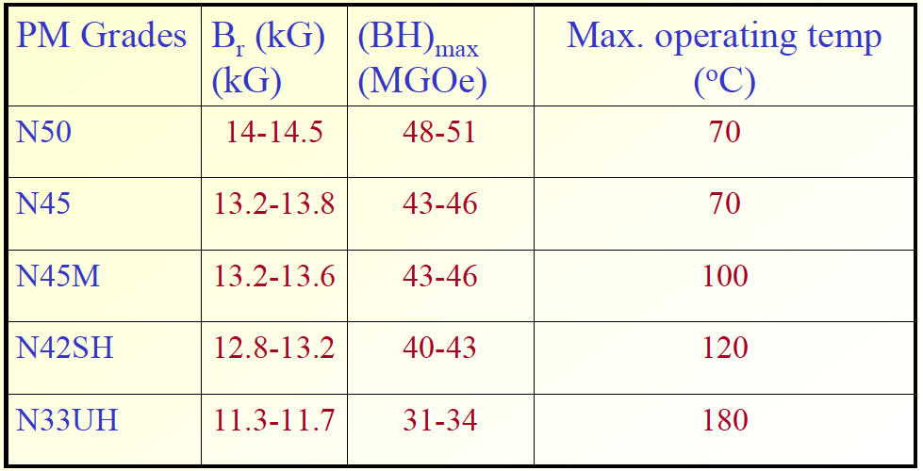
Permanent magnet materials
Electron Energy Corporation - courtesy of : Jinfang Liu and Peter Dent
924 Links Ave. Landisville PA 17538
Nd-Fe-B Type Rare Earth Magnets
B_{r} = 1.35 T

Slide 13
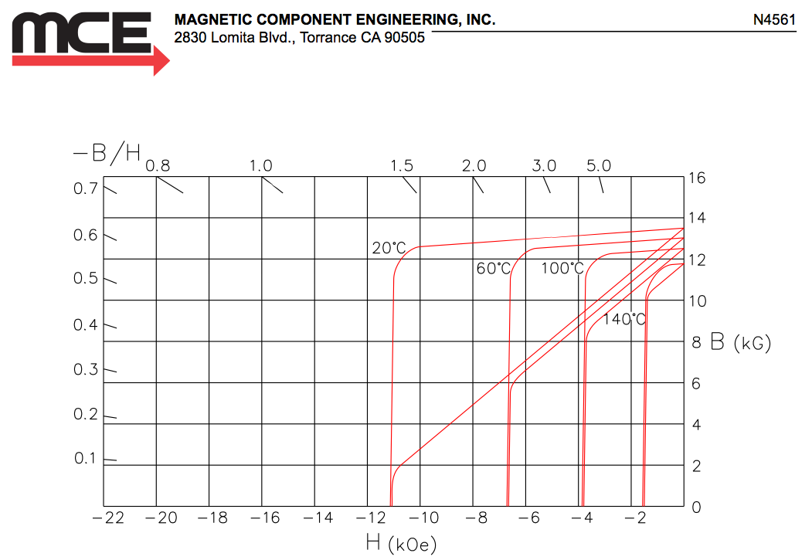
Permanent magnet material
N4561
1.35 T

Slide 14
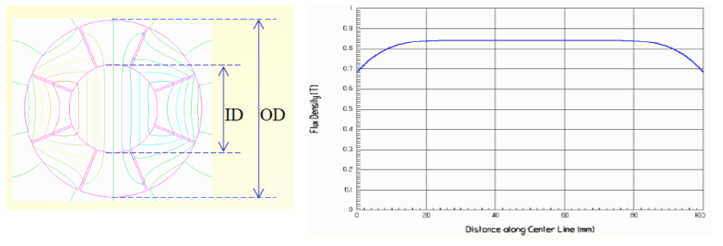
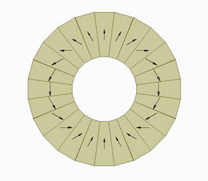
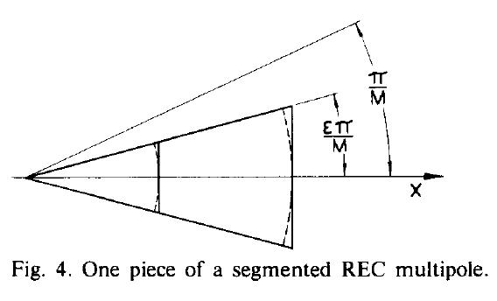
Halbach permanent magnets

Slide 15
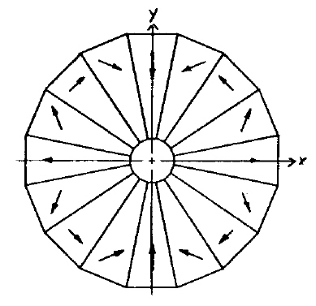
Halbach magnet–from his original publication
B_{g}= B_{r} ln(OD/ID)
B_{r}=1.35 T
OD=21.0 cm
ID =3.5 cm
ln(OD/ID)=1.79
B_{g}=2.4 T
QLD=8.0 cm
BL= 4.8 cm
QLF=11 cm
GF = 2.2 T/0.015 m = 150.0 T/m
GD= -2.2 T/0.013 m=-170.0 T/m
3.5 cm
21.0 cm
15

Slide 16
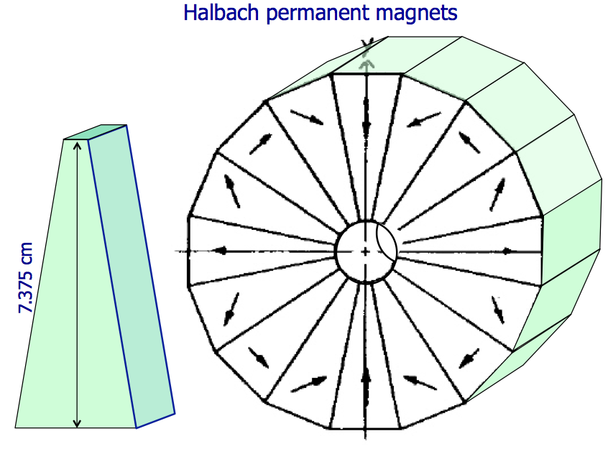

Slide 17
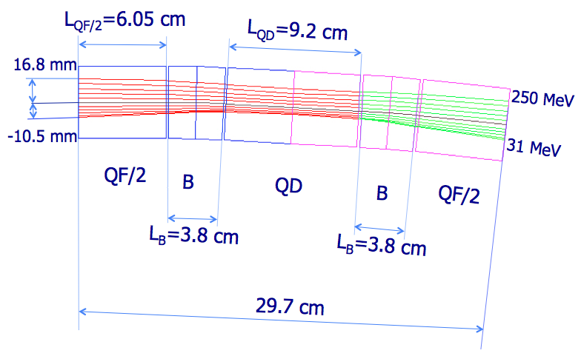
Initial conditions:
α_{x} = 0,α_{y} = 0
D’_{x}= 0, x_{off}’= 0
16.3 mm

Slide 18
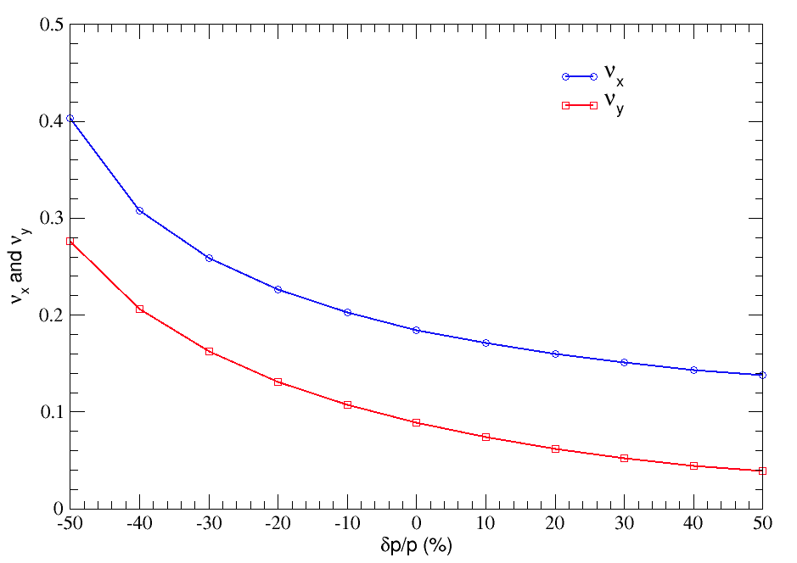
Arc design NS-FFAG: Tunes vs. momentum

Slide 19
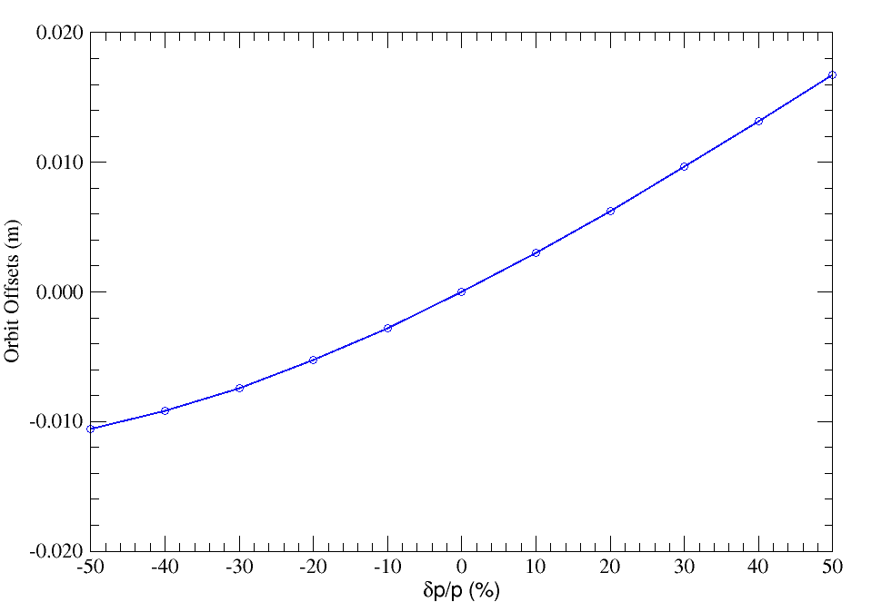
Maximum orbit offsets vs. momentum

Slide 20
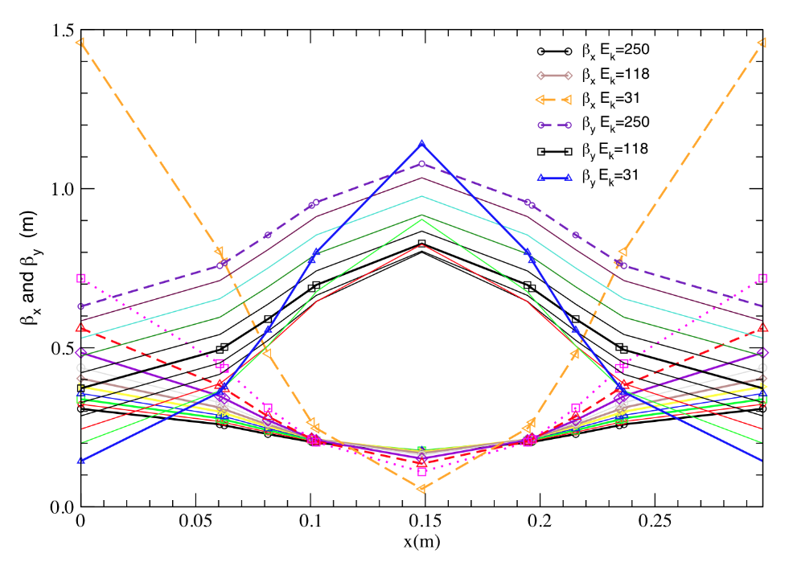
β_{X} and β_{y} vs. momentum

Slide 21
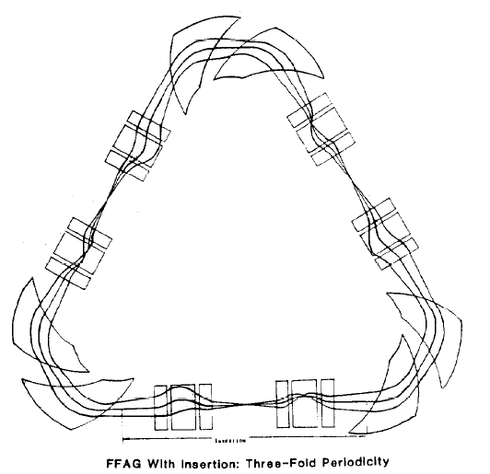
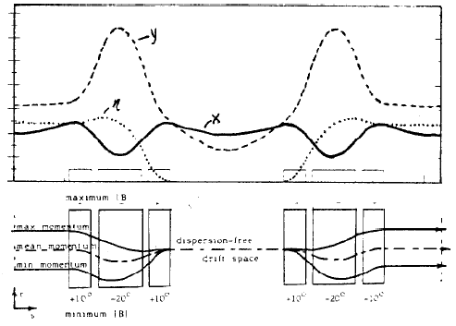
Previous solution for the FFAG straight section
P.F. Meads Jr., IEEE Transactions on Nuclear Science, Vol. NS-30, No. 4. (1983) pp. 2448-2450.

Slide 22
Sending here three energies:
250 , 118, 31 MeV
φ_{2max}
B_{D} = B_{o1} + G_{D} x
ρ_{2max}
β₂
G_{D}
a₂
β₁
x_{max1}
x₂/a₂ = sin φ_{2o}
x₂/ρ_{2max} = sin φ_{2max}
a₂=ρ_{2max}*(sin φ_{2max}/sin φ_{2o})
y₂/b₂ = sin φ_{2o}
y₂/ρ_{2min} = sin φ_{2min}
b₂=ρ_{2min}*(sin φ_{2min}/sin φ_{2o})
φ_{2ο}
b₂
ρ_{2o}
x₂
β₁
x>0
x₁
ρ_{2min}
LS
x<0
x_{max}
x_{max2}
x_{min1}
y₁
x_{max2}=a₂-ρ_{1o}
x_{min2}=ρ_{2o}-b₂
x<0
y₂
α₁
_{Xo}
x_{min}
x>0
x_{min2}
ρ_{1min}
φ_{2min}
α₂
φ_{1min}
x₁/a₁ = sin φ_{1o}
x₁/ρ_{1max} = sin φ_{1max}
a₁=ρ_{1max}*(sin φ_{1max}/sin φ_{1o})
y₁/b₁ = sin φ_{1o}
y₁/ρ_{1min} = sin φ_{1min}
b₁=ρ_{1min}*(sin φ_{1min}/sin φ_{1o})
G_{F}
B_{F}=B_{o2}+G_{F} x
α₁
ρ_{1o}
β₁
x_{max1}=a₁-ρ_{1o}
x_{min1}=ρ_{1o}-b₁
We know the offsets
16.3 mm, -10.5 mm
a₁
φ_{1ο}
b₁
ρ_{1max}
We know the
energies
Inputs are:
x_{max}, x_{min}
p_{min}
p_{max}
P_{o}
B_{o}
L_{D1}
LS
L_{D2}
Unknowns:
G_{F},G_{D}
α₁ = φ_{1min} - φ_{1o}
α₂ = φ_{2min} - φ_{2o}
β₁ = φ_{1o} - φ_{1max}
φ_{1max}
β₂ = φ_{2o} - φ_{2max}

Slide 23
x₂/a₂ = sin φ_{2o}
x₂/ρ_{2max} = sin φ_{2max}
a₂=ρ_{2max}*(sin φ_{2max}/sin φ_{2o})
φ_{2max}
x_{max2}=a₂-ρ_{1o}
B_{F} = B_{o2} + G_{F} x
ρ_{2max}
a₂
y₂/b₂ = sin φ_{2o}
y₂/ρ_{2min} = sin φ_{2min}
b₂=ρ_{2min}*(sin φ_{2min}/sin φ_{2o})
x_{max}
x_{min}
b₂
φ_{2ο}
ρ_{2o}
x_{min2}=ρ_{2o}-b₂
x₂
ρ_{2min}
Δx_{max}
x_{max2}
x<0
x_{min2}
x_{max}
y₂
_{Xo}
x_{min}
x>0
Δx_{min}
φ_{2min}
B_{F} = B_{o2} + G_{F} x

Slide 24
Initial Conditions for the straights
x/√β
(D/√β)
x√β+x’α/√β
(D√β+D’α/√β)
-3. 5 mm

Slide 25
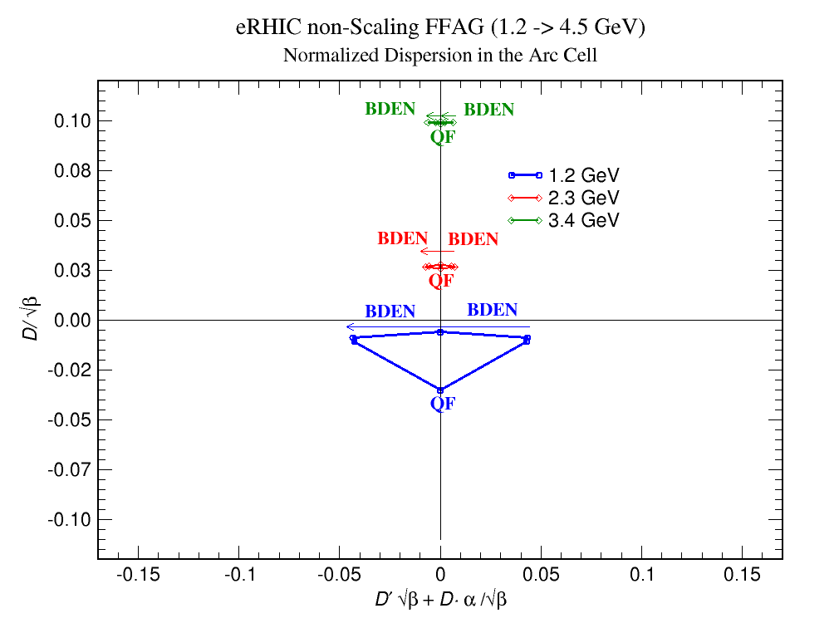
Normalized dispersion space for three energies in the NS-FFAG racetrack

Slide 26
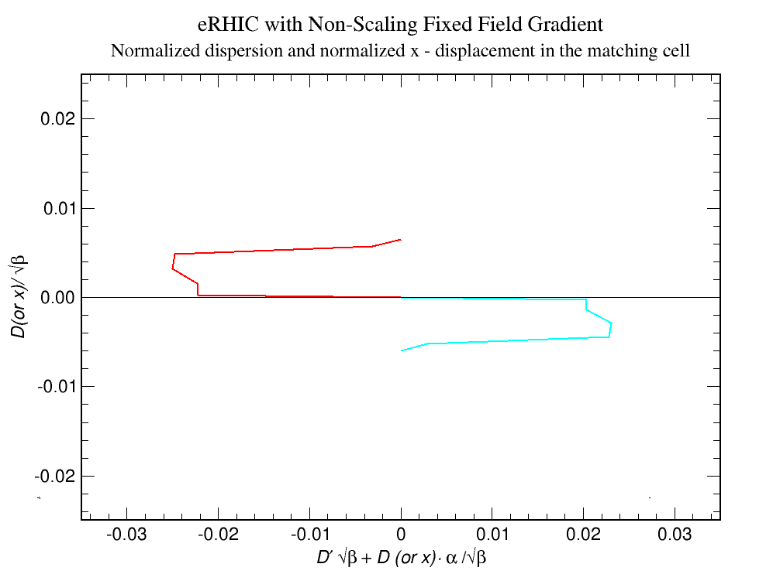
Normalized dispersion space

Slide 27
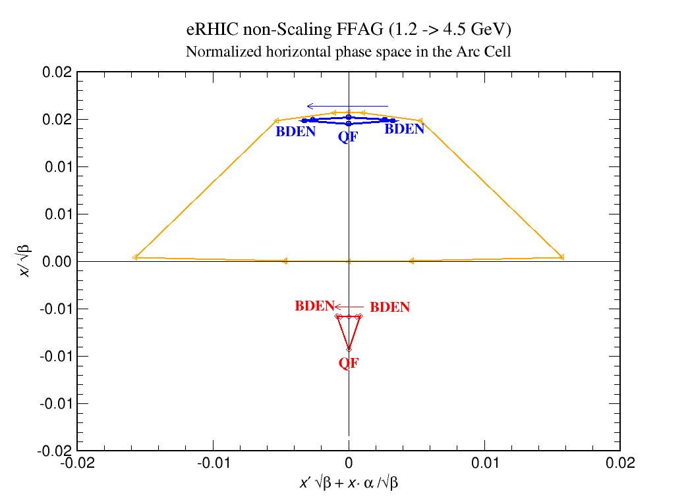
Normalized phase space – matching cell at minimum, central and maximum momentum

Slide 28
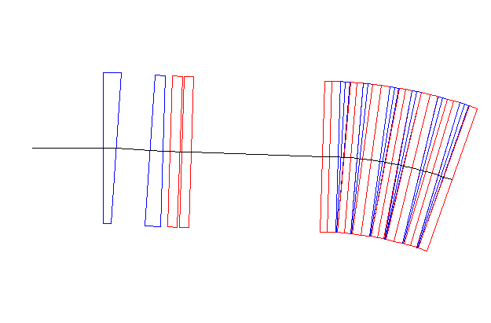
Matching arcs to the straight section
What are the variables and what are the constraints?
@ all Δp/p
QFX3
QDX2
OPI
OC₄
QFX1
QD8
OC₁
QF1
GFX1
GF1
GD8
GDX2
GFX3
OC1P
OC2P
OC3P
OC4P
OPIP
θ_{BDX1}
θ_{BDX2}
α_{X} = 0
α_{Y} = 0
β_{X} ≈ 1
β_{Y} ≈ 1
D_{X} = 0
D’_{X} = 0
x’_{off} = 0
x_{off} = 0
ν_{X} = 0.25
ν_{Y} = 0.25
BDX₂
BDX₁
OC₃
VARIABLES
CONSTRAINTS

Slide 29
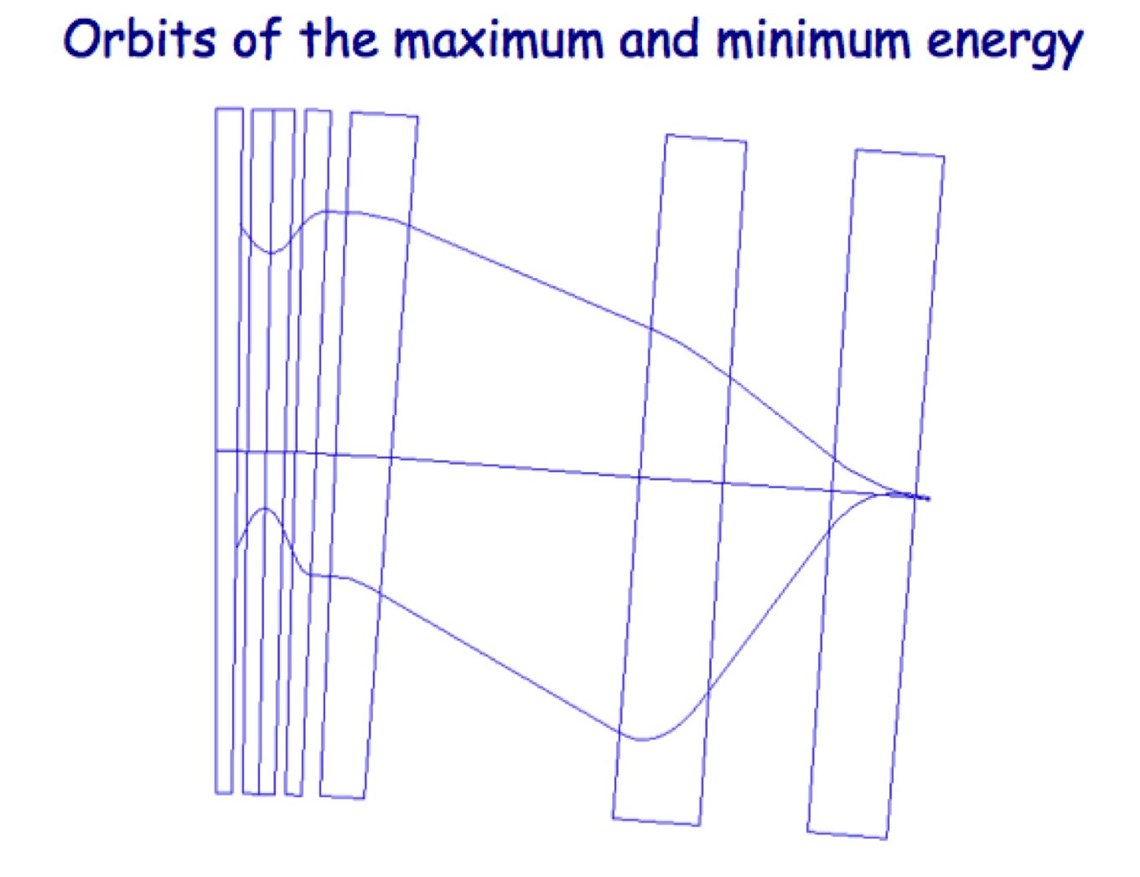
Matching arcs to the straight section
At the beginning a total number of constraints for momentum values of:
-50%, -40%, -30%, -20%, -10%, +10%, +20%, +30%, +40%,+50%,
10 x 10=100 !
a total number of variables could be:
30 cells x 2 = 60 different gradients +2θ+3 straight section gradients=65!
α_{X} = 0, α_{Y} = 0, β_{X} ≈ 1, β_{Y}≈ 1, D_{X}= 0, D’_{X} = 0, x’_{off} = 0, x_{off}= 0, ν_{X} = 0.25, ν_{Y} = 0.25
It happen to be that if one succeeds to match it @dp/p=+50% and @dp/p=-50%
It is enough.

Slide 30
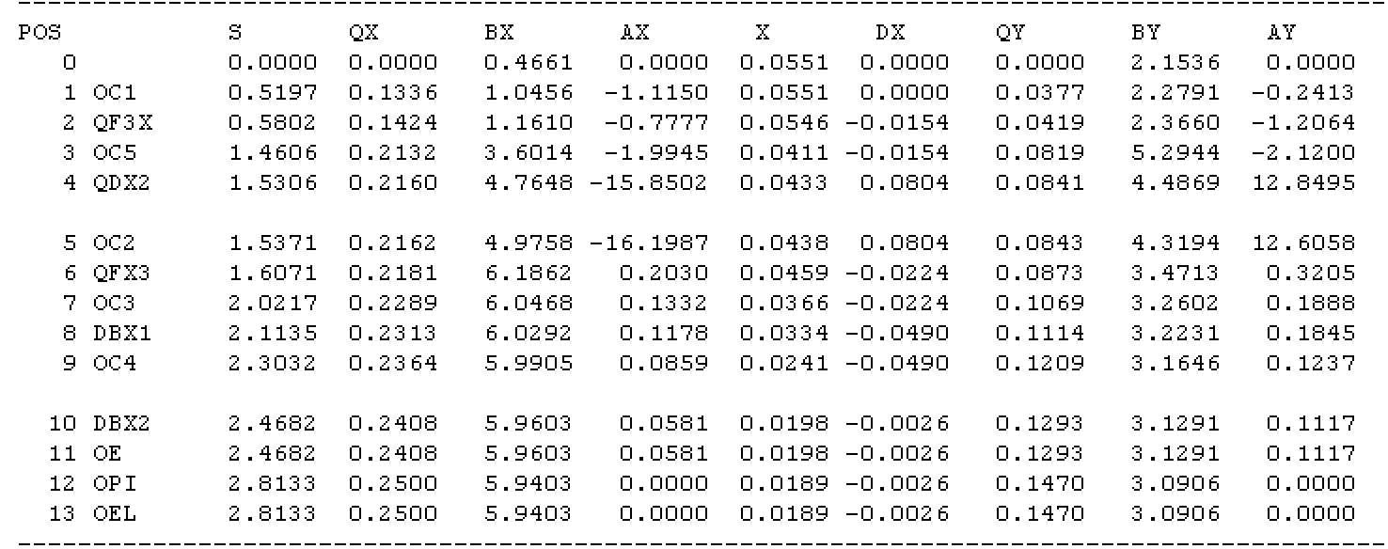
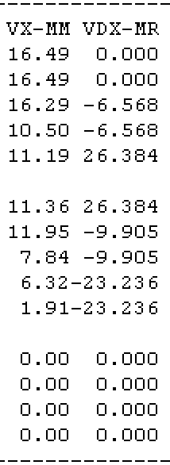
Matching arcs to the straight section

Slide 31
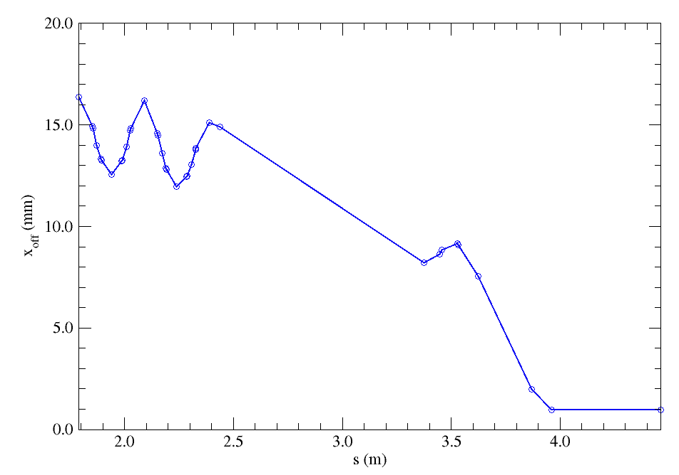
Matching orbit offsets @ dp/p=±50 %
to the straight section

Slide 32
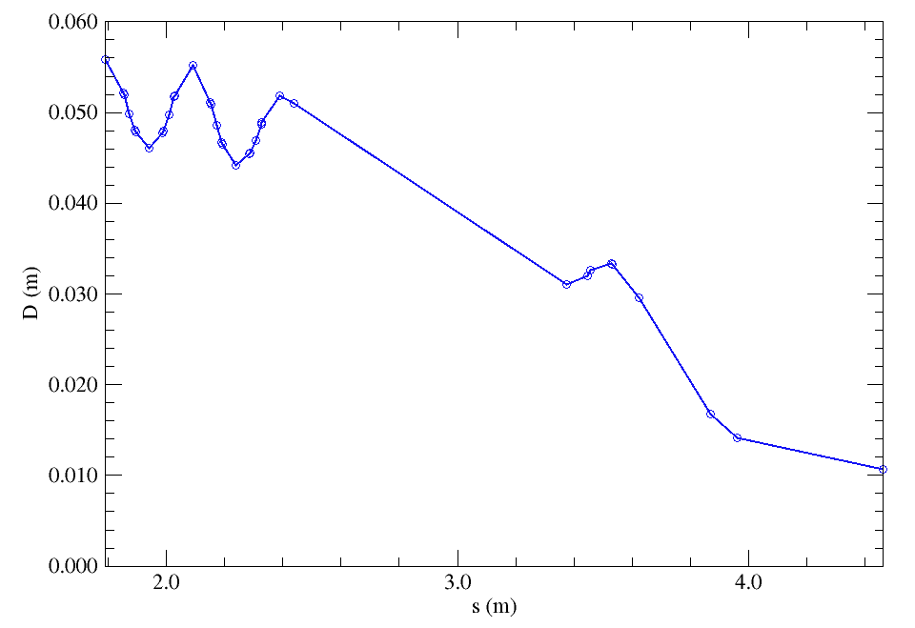
Matching dispersion @ dp/p=50 %
to the straight section

Slide 33
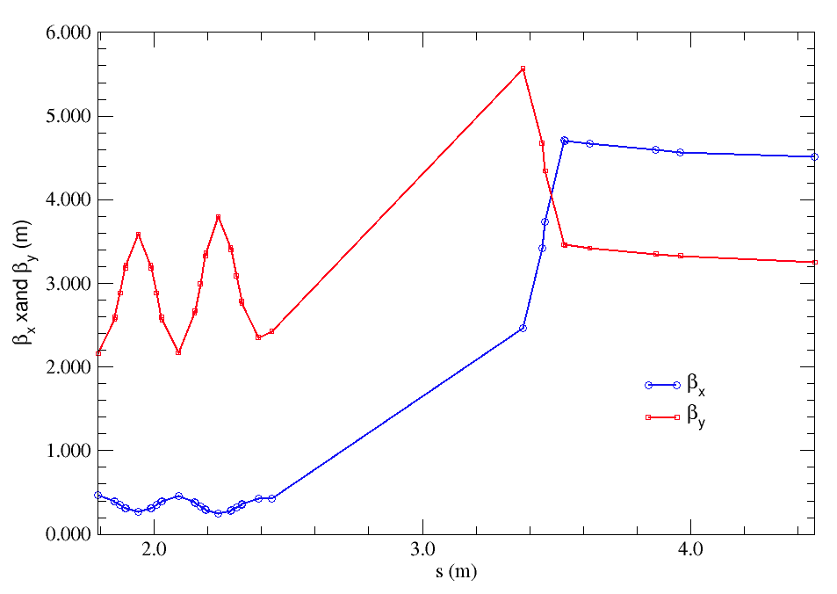
Matching β_{x} and β_{y} @ dp/p=50 %
to the straight section

Slide 34
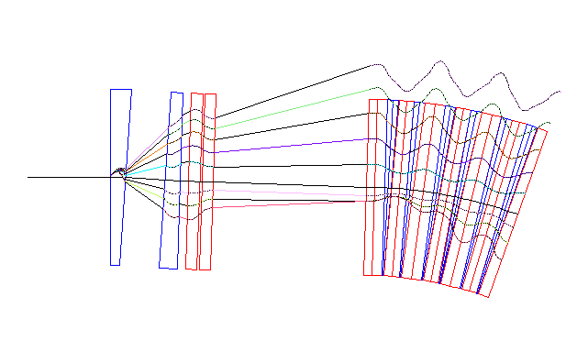
Matching arcs to the straight section

Slide 35
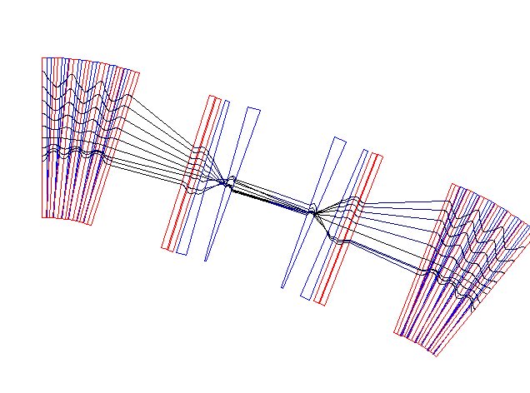
Matching arcs to the straight section

Slide 36
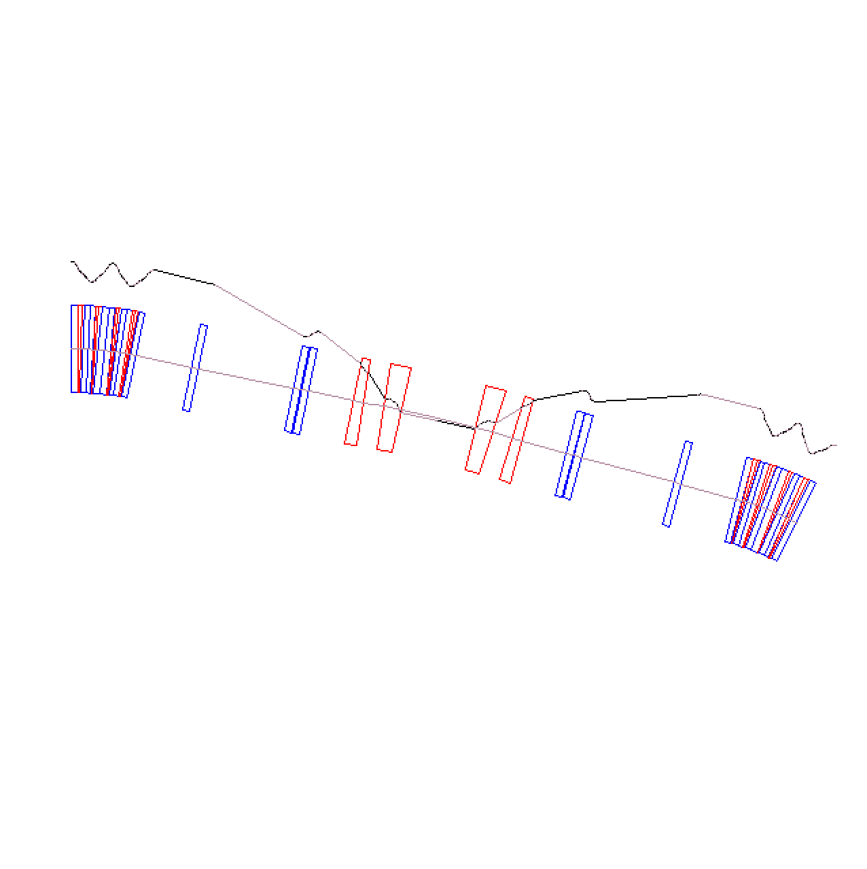
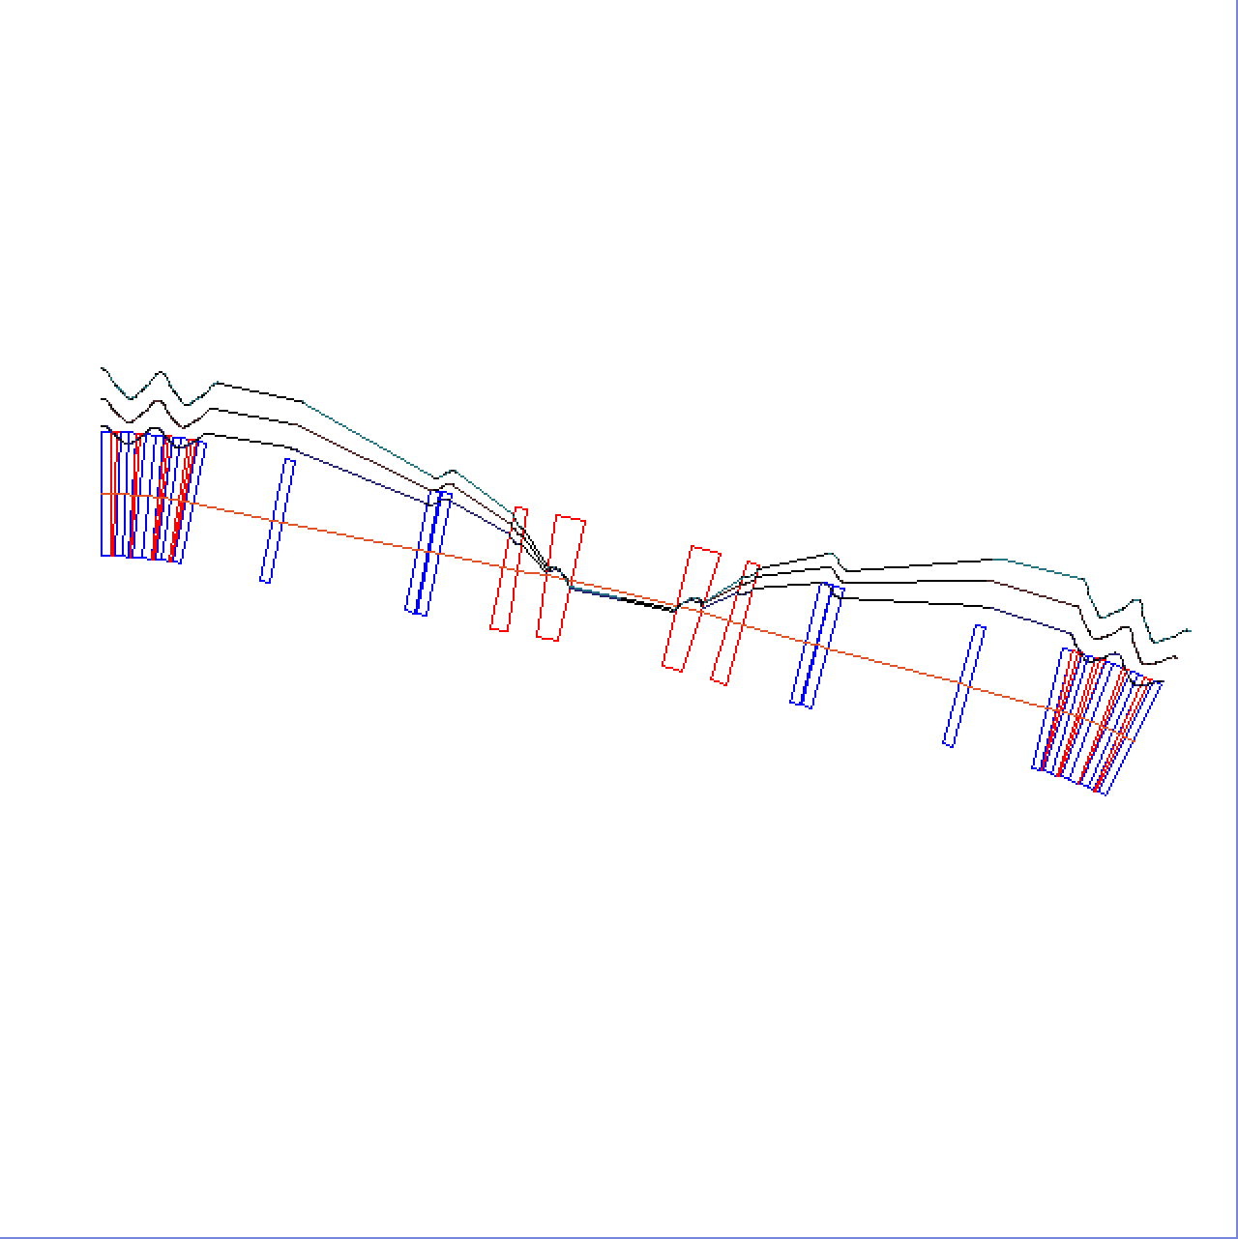
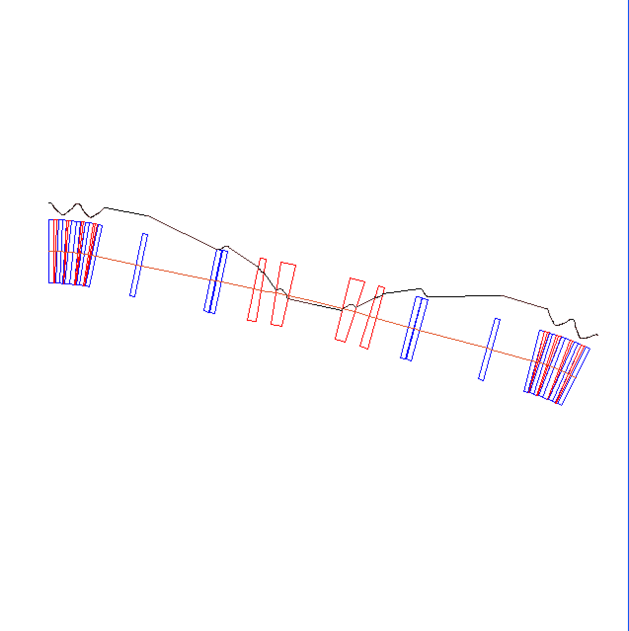
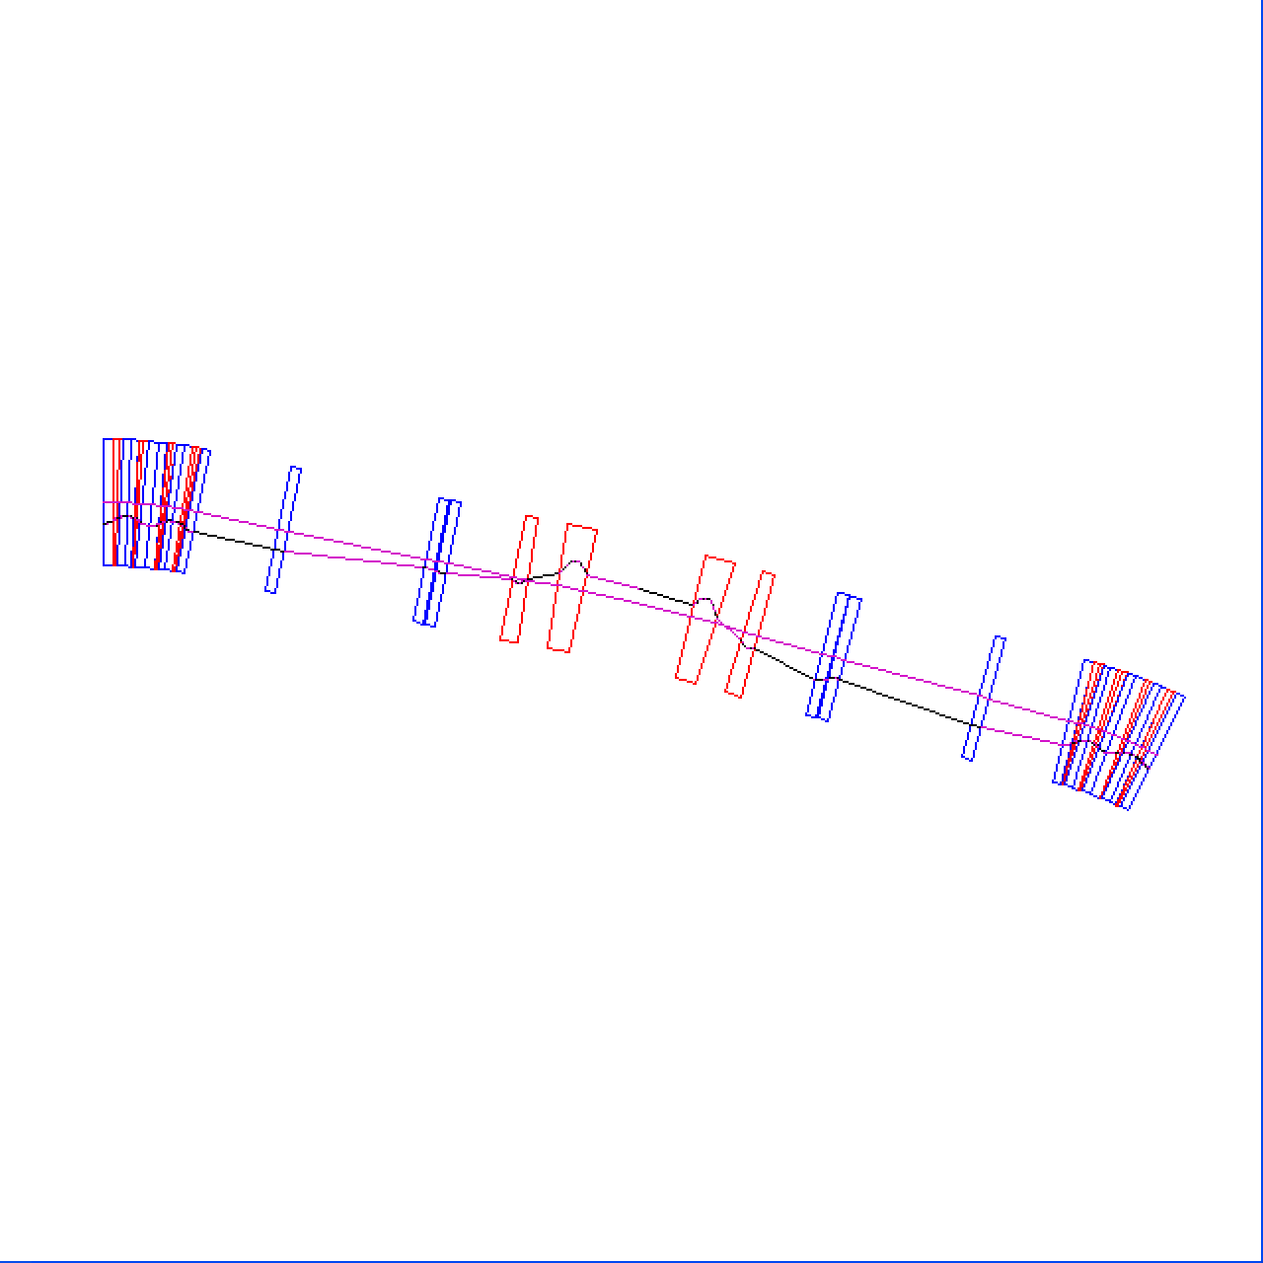
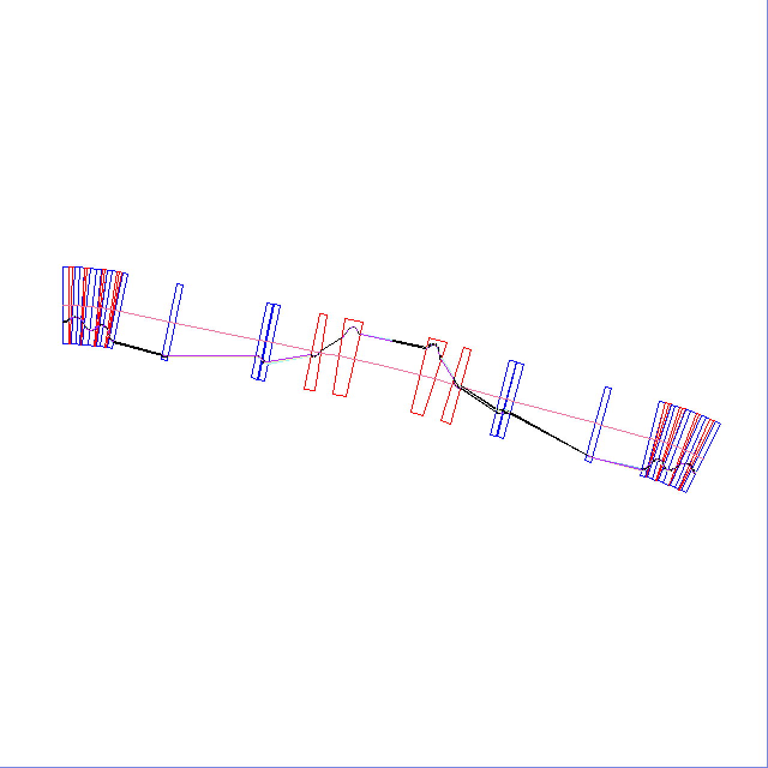
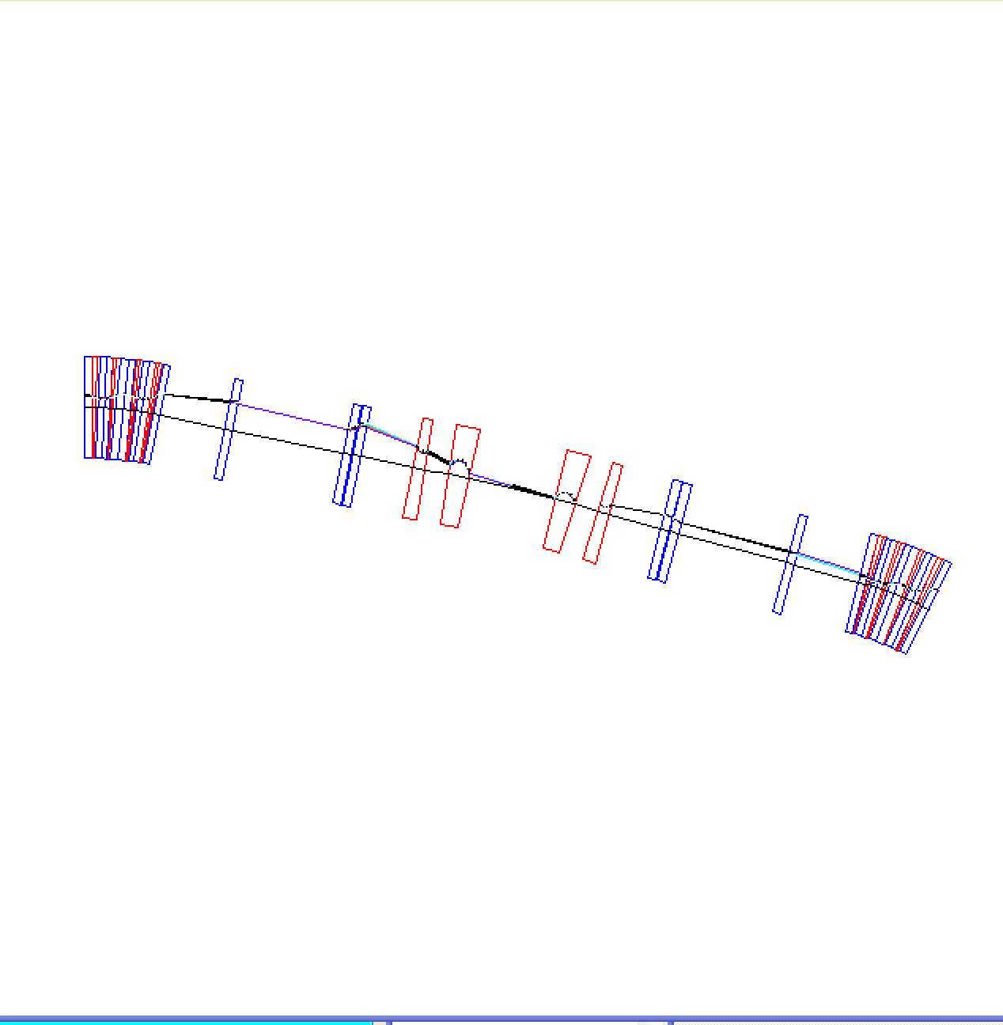
NS-FFAG racetrack straight section
250 MeV
16.3 mm
31 MeV
-10.57 mm

Slide 37
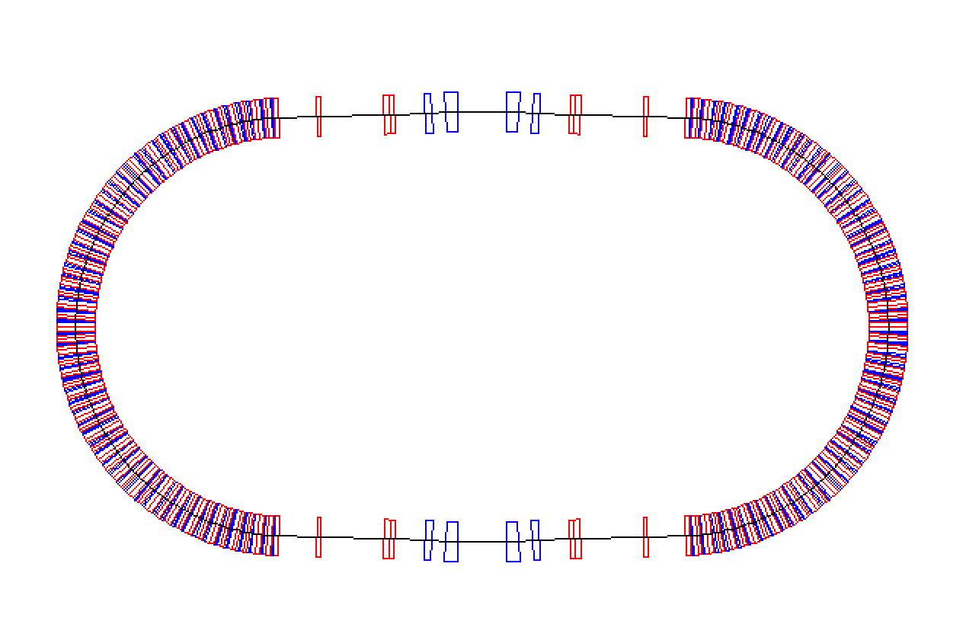
Racetrack NS-FFAG

Slide 38
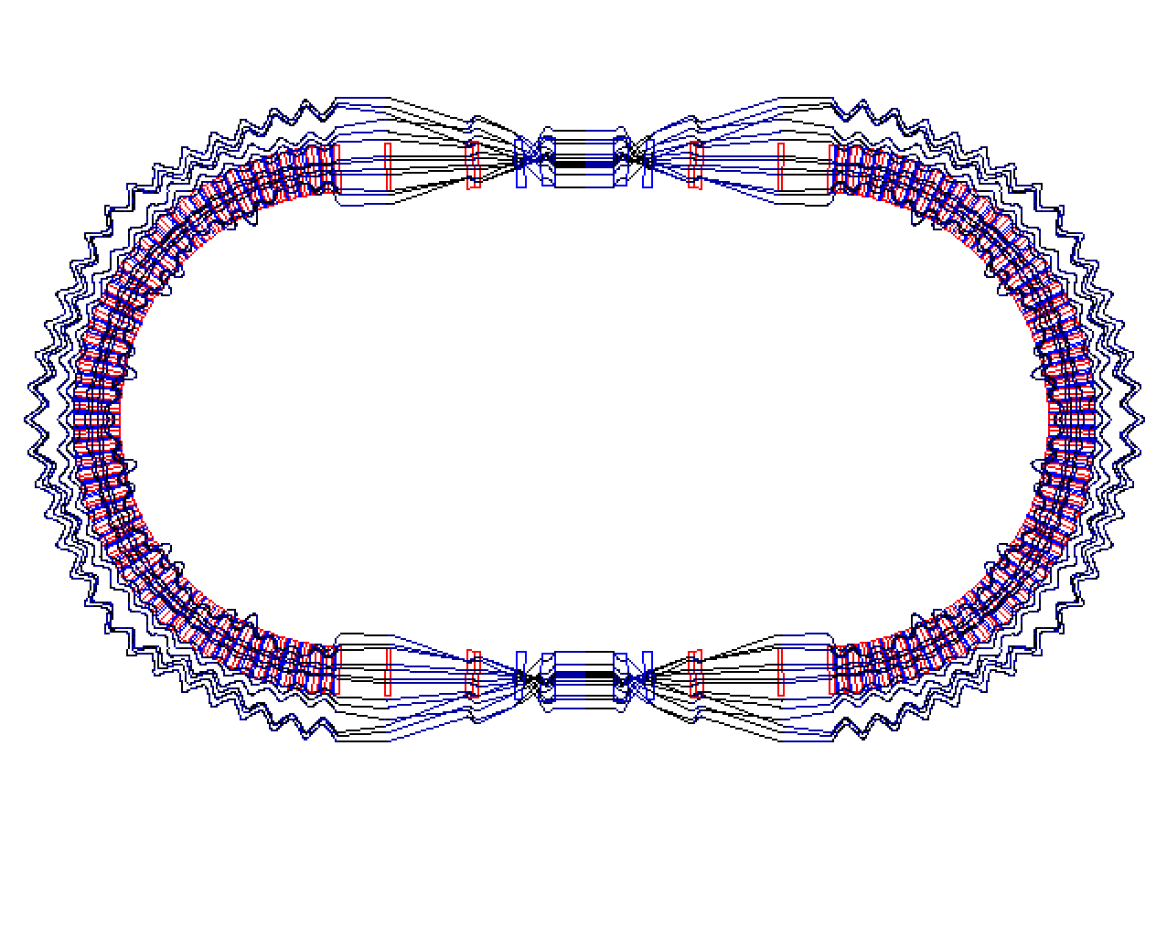
Orbits in 31-250 MeV racetrack NS-FFAG magnified 50x
250 MeV
16.3 mm

Slide 39
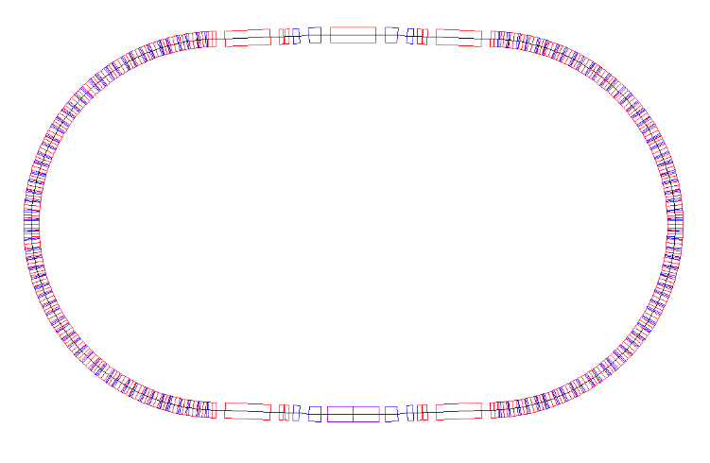
Layout of the Racetrack with the RF cavity
and kickers for extraction and injection

Slide 40
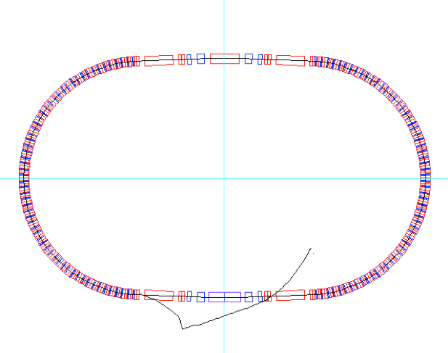
RF cavity
Injection kicker2
Injection septum

Slide 41
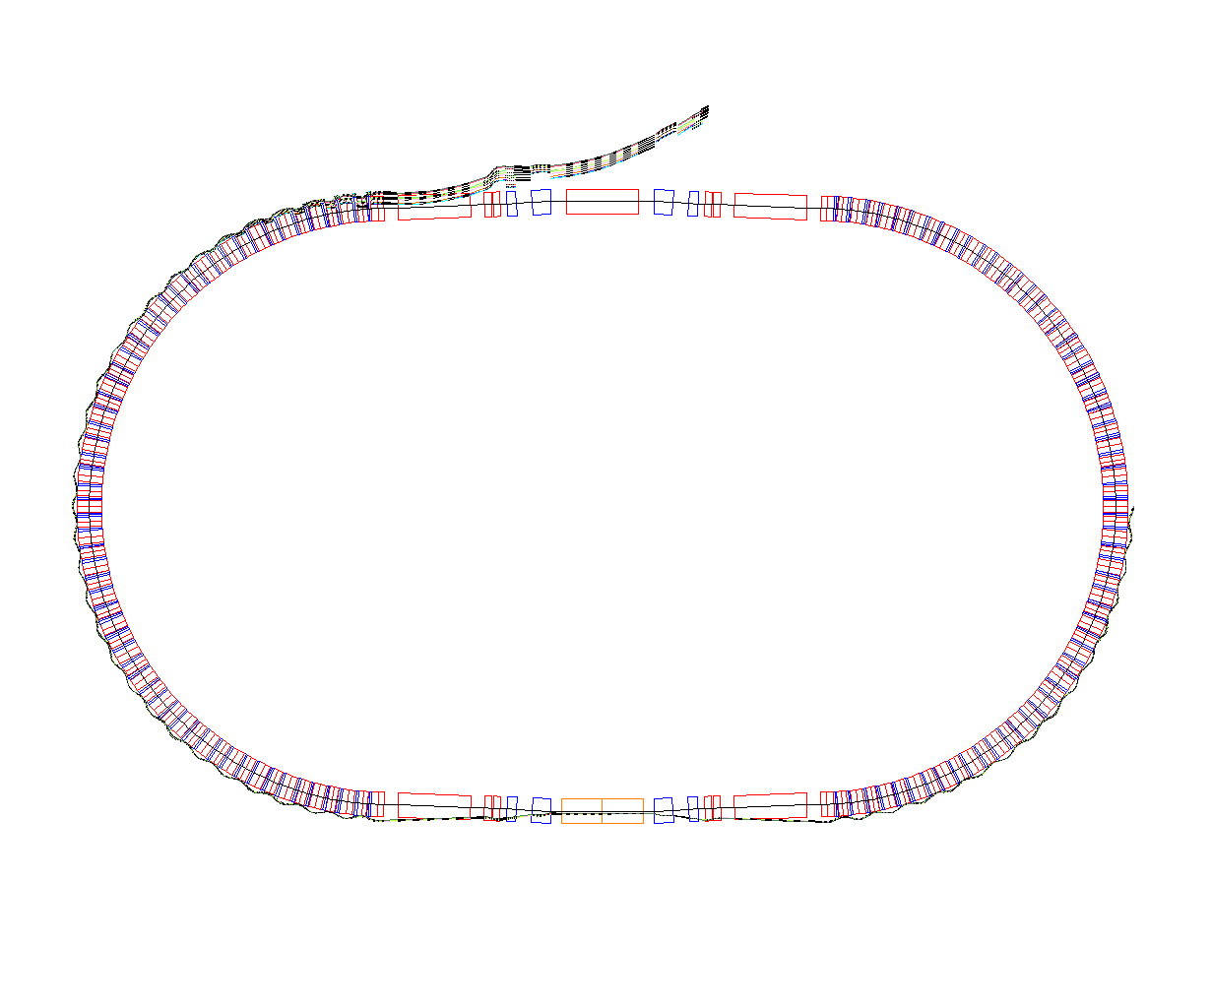
Extraction Septum
Extraction kickers

Slide 42
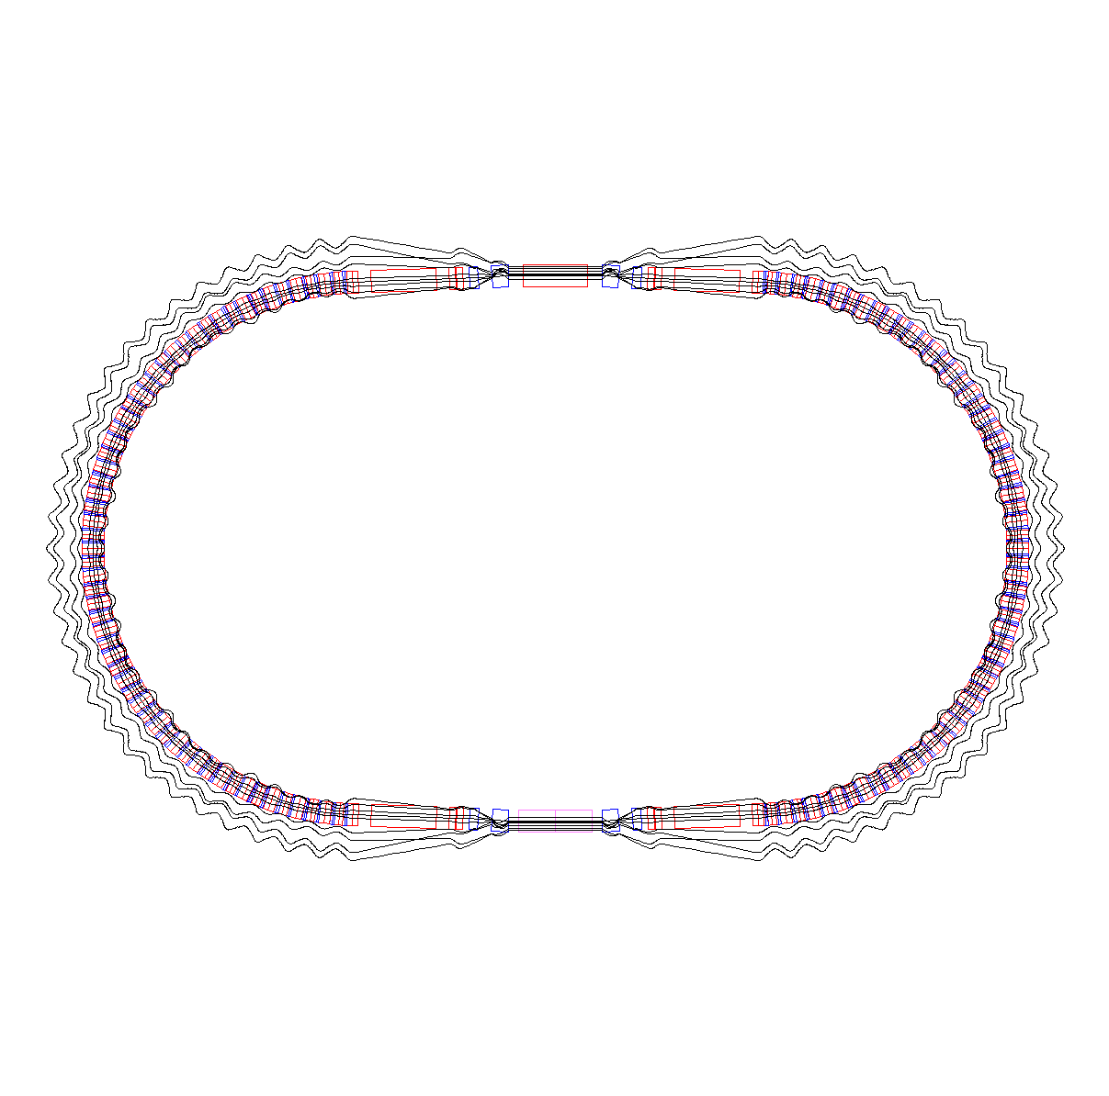

Slide 43
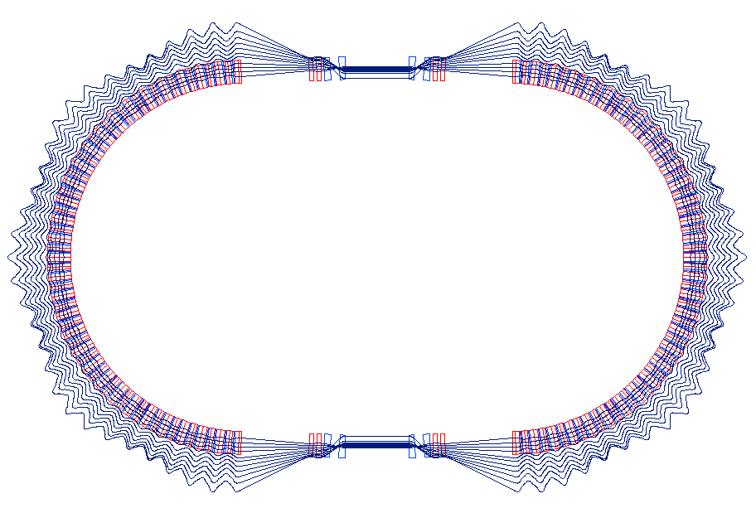
Race track NS-FFAG
4.48 m
r=2.84 m

Slide 44
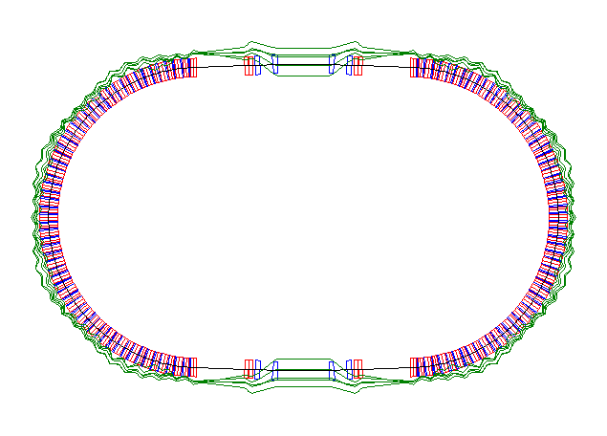
Racetrack ddispersion -50%<dp/p<50%

Slide 45
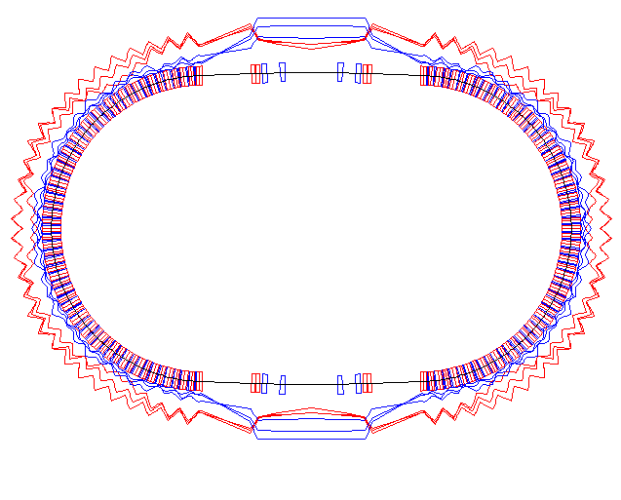
Racetrack βx and βy -50%<dp/p<50%

Slide 46
Summary
Today most of the proton cancer therapy accelerators are cyclotrons or slow extraction synchrotrons.
An example of racetrack NS-FFAG was described were fast acceleration is assumed with a total number of turns less then 800 as the integer resonance crossing can be a problem.
To simplify the solution the permanent separated function magnets of the Halbach structure are proposed.
The orbit offsets in the example presented are within 11mm<Δx<17 mm. This allows use of an aperture of 35 mm. With the outside diameter of 21 cm from the available Nd-Fe-B (for temperatures less than 70 C) materials a bending dipole field of 2.4 T could be obtained.
Advantage of the accelerator is very small magnets and simplified operation, as the magnets are permanent. Acceleration is assumed to be with a fast phase jump scheme where the voltage on the cavities is changed within one turn of the circulating bunch.

Slide 47


Slide 48


Slide 49


Slide 50


Slide 51


