Slide 1
Non-Scaling Linear Smallest
Carbon Cancer Therapy Gantry
Dejan Trbojevic

Slide 2
NS-FFAG GANTRIES:
INTRODUCTION
NS-FFAG
CARBON GANTRY
MAGNETS
PROTON GANTRY
PERMANENT MAGNETS

Slide 3
Dispersion function - momentum
Let’s assume that:
p₂=0.65p_{o}
θ_{o}=l_{o} /ρ
ρ_{o}=0.65ρ₂
p_{o}
l₂
Δx
D=Δx/(dp/p)
θ₂
p₂
θ_{o}

Slide 4
Range of momentum = range kinetic energy
ΔE_{k carbon}=400-195.4 MeV/u [27.3-8.2 cm]
ΔE_{k carbon}=195.4-91.5 MeV/u [8.2–2.2 cm]
ΔE_{k proton}=250-118.81 MeV [37.8-10.4 cm]
ΔE_{k proton}=118.81-54.6 MeV [10.4-2.6 cm]

Slide 5
Why the non-scaling FFAG for the gantries?
Orbit offsets are proportional to the dispersion function:
Δx = D_{x} ∗ δp/p
To reduce the orbit offsets to ±20 mm range, for momentum range of δp/p ~ ± 50 % the dispersion function D_{x} has to be of the order of:
D_{x} ~ 2 cm / 0.5 ≤ 4 cm
The small aperture, the small magnet, less weight, easier to build easier to operate.
δp/p ~ ± 50 % →E_{k} [52 , 400 MeV/u]

Slide 6
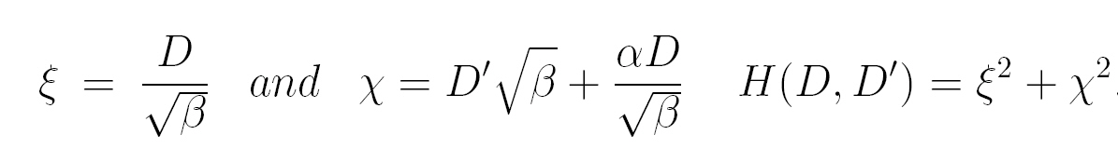
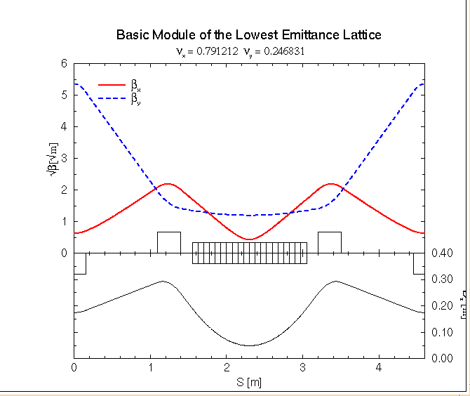


Minimizing H function
D/2
D/2

Slide 7
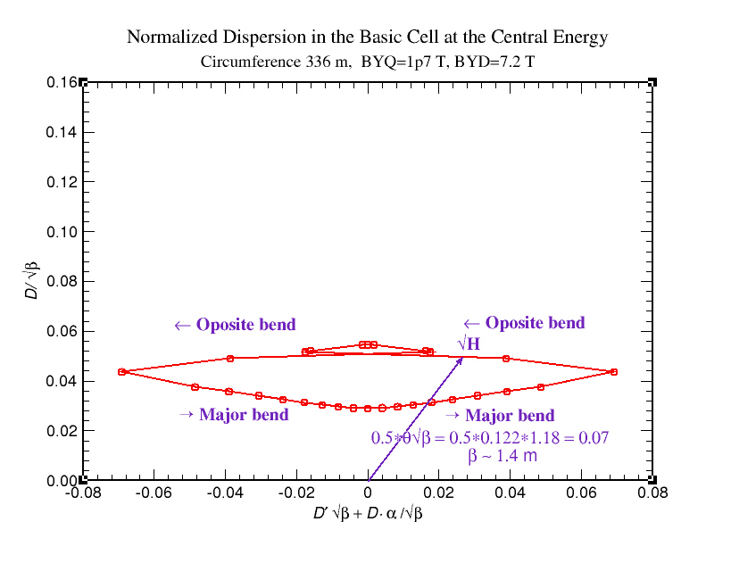
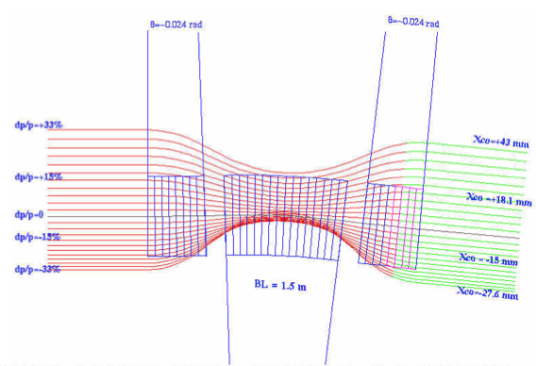
Optimizing H function – Normalized dispersion
FODO
Minimization of the H function applied for the FFAG design

Slide 8
NS-FFAG GANTRIES
1. Introduction
3. SAD definition
4. NS-FFAG gantry with adjustable fields
5. NS-FFAG gantry with fixed fields
Motives-reduction of cost by using method- simpler is better
Small size for carbon – superconducting combined function magnets
Spot scanning, simplify operation, large energy acceptance
CYCLOTRON application, TERA LINAC application

Slide 9
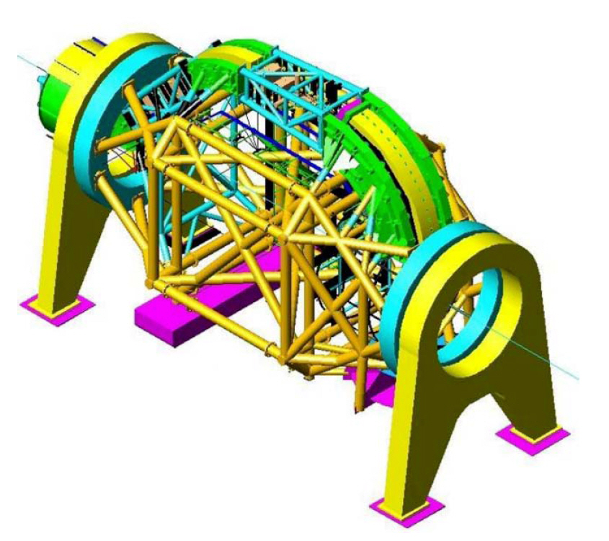
Motivation for the NS-FFAG gantries
Motivation
Reduce a major cost for the hadron therapy
Magnetic field is the same for all energies
Present solutions use large magnets (carbon ions especially)
Carbon E_{k}=400 MeV/u
Bρ = 6.35 Tm ( θ= Bl/Bρ )
If: B=1.6 T then ρ ~ 4.0 m
If: B=3.2 T then ρ ~ 2.0 m
Weight of the transport
components – 135 tons
Total weight = 630 tons
Length of the rotating part 19 m long.
Heidelberg gantry

Slide 10
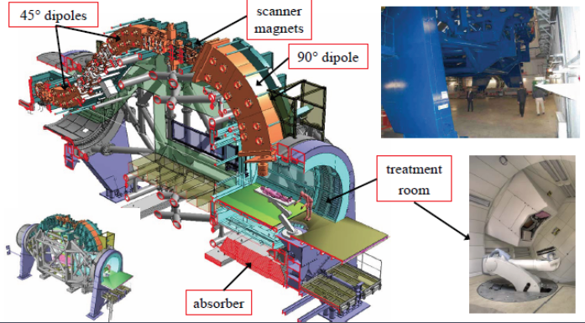
State of the Art Gantry at Heidelberg
Weight of the transport components – 135 tons
Total weight = 630 tons - 19 m long. WEIGHT and SIZE
Carbon E_{k}=400 MeV/u → Bρ = 6.35 Tm ( θ= Bl/Bρ )
Warm iron magnets: B=1.6 T then ρ ~ 4.0 m
Superconducting magnets B=3.2 T then ρ ~ 2.0 m

Slide 11
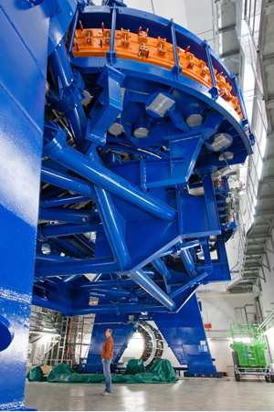
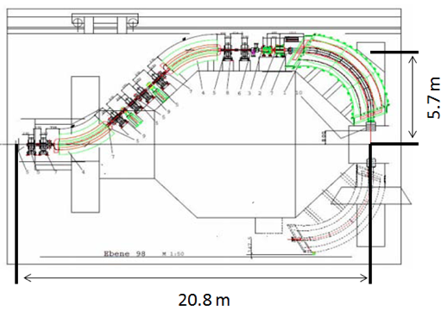
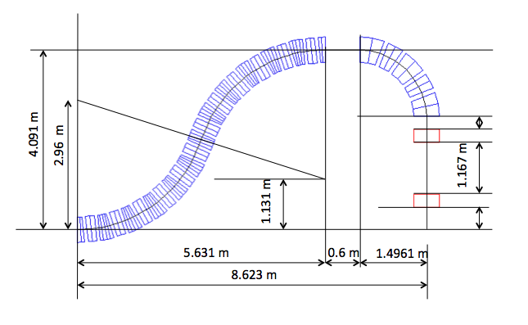
Why Superconducting Gantry?

Slide 12
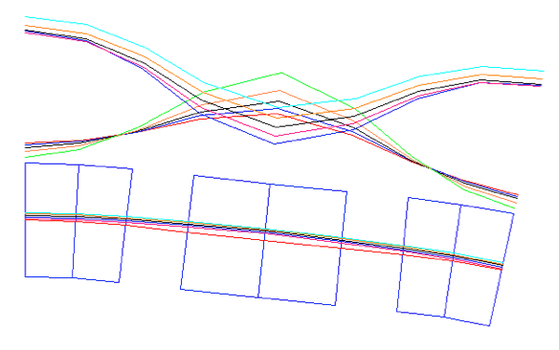
Amplitude functions in the carbon gantry
√β_{x}, √β_{y} (m^{1/2}), D_{x} (m)
1.45 (2.1 m)
√β_{y}
√β_{x}
D_{x}
D_{max}<8 cm

Slide 13
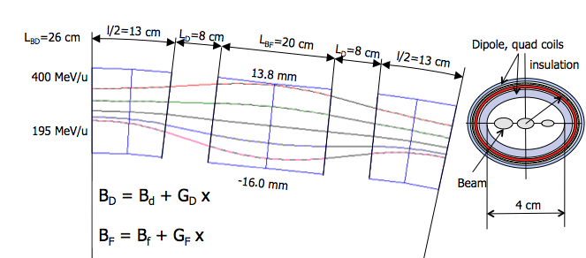
Orbit offsets in the carbon NS-FFAG gantry
ANGD | ANGF | B _{D} (T) | B _{F} (T) | G_{D}(T/m) | G_{F}(T/m)
0.112 | -0.0146 | 4.557 | -0.3851 | -90.8 | 151.1

Slide 14
Magnetic field required in the pipe and estimated maximum field in the coils
9.7 mm
3.67 T
Dipole, quad coils
B_{D max} = B_{d} + G_{D} x = 4.56 - 90.8 ∗
B_{F max} = B_{f} + G_{F} x =-0.385 + 151.1∗
insulation
-6.75 mm
5.17 T
r
13.96 mm
1.72 T
Beam
-13.75 mm
1.69 T
4 cm
Beam size : σ_{T}=√σ² + (D dp/p)²
r=2.15 cm
r=2.3 cm

Slide 15
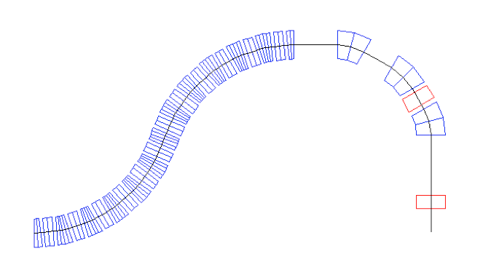
NS-FFAG superconducting gantry with scanning through the last quadrupole

Slide 16
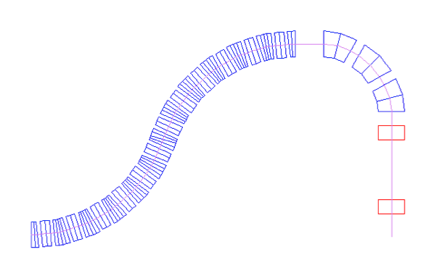
NS-FFAG superconducting carbon gantry protected by the patent number: US 2007/0262269 A1
0.612 m
2.9585 m
4.091 m
0.3 m
72º
θ=0.063 rad
B_{max}=1.334 T
1.586 m
2.6586 m
2.2086 m
0.3 m
0.5m

Slide 17
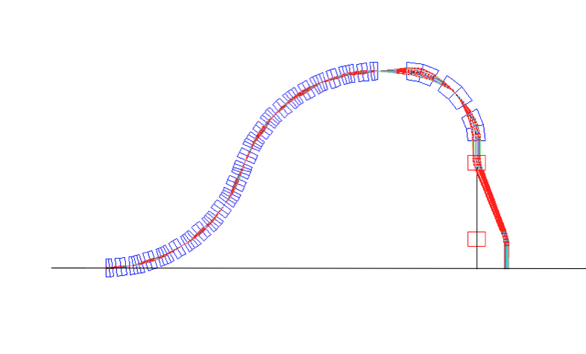
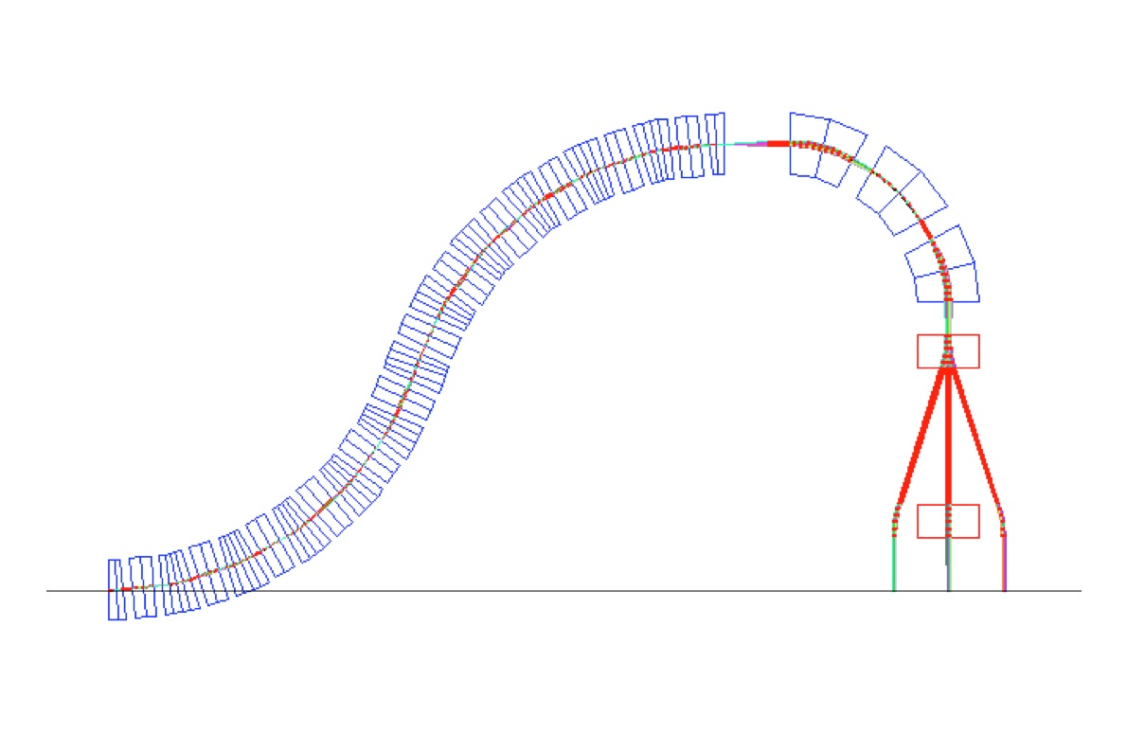
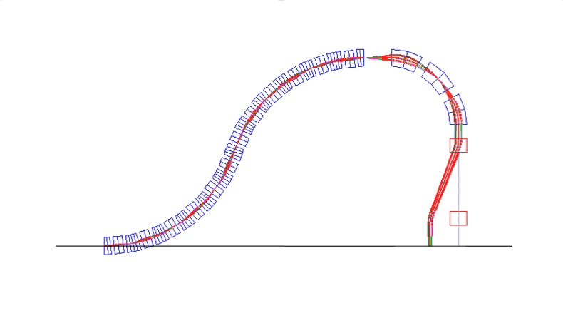
CARBON GANTRY height 4.091m
5X magnification, scanning ±10 cm

Slide 18
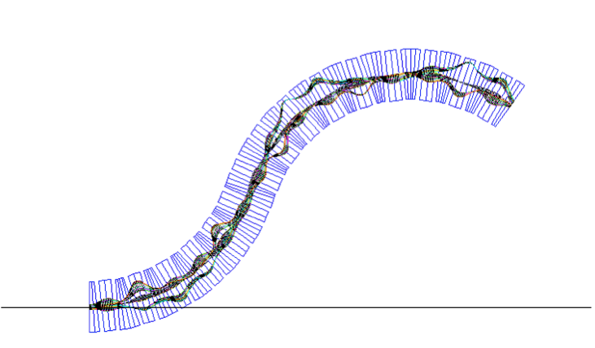
Tracking particles in the carbon gantry for the energy range of 190-400 MeV/u collaboration with Vasily Morozov-Jefferson Lab for the six gradients adjustment

Slide 19
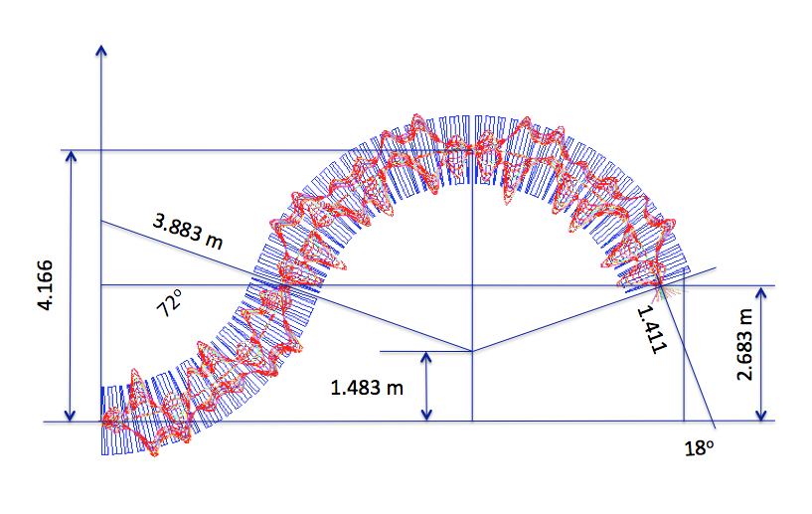
All at once: Fixed field & fixed focusing
Magnification 30 TIMES
9 mm
400 MeV/u
200 MeV/u
2 mm

Slide 20
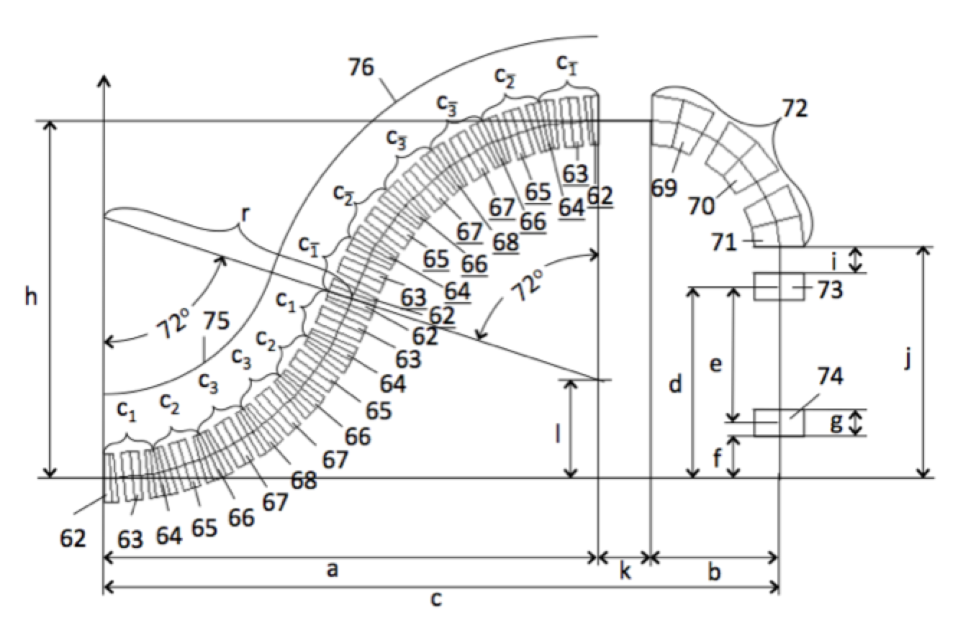
Data from the PTC gantry program:
SUPER CELL
SUPER CELL GRADIENTS
KBF1=166.08366D0/BRHO;
KBD1=-86.418383D0/BRHO;
KBF2=167.26062D0/BRHO;
KBD2=-78.352246D0/BRHO;
KBF3=138.44318D0/BRHO;
KBD3=-93.449917D0/BRHO;
KBD4=-87.353011D0/BRHO;
SUPER CELL

Slide 21
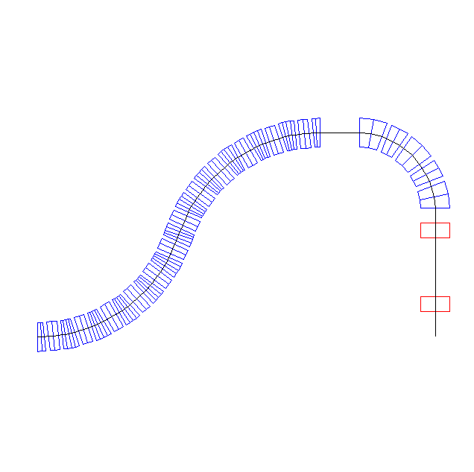
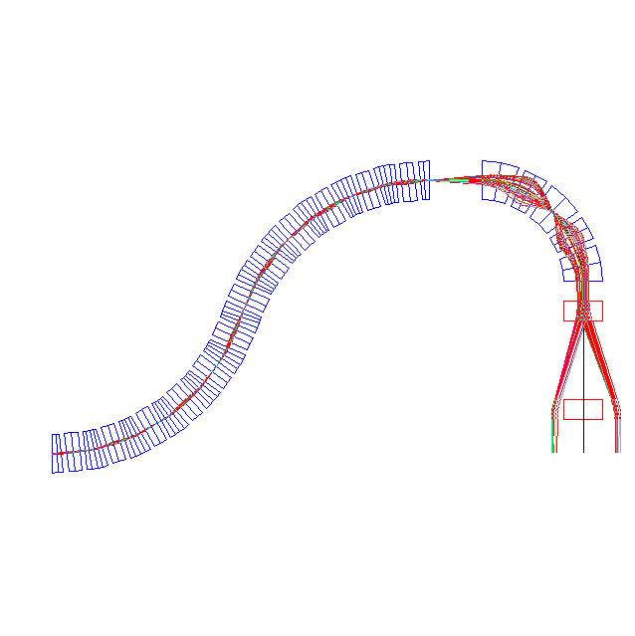
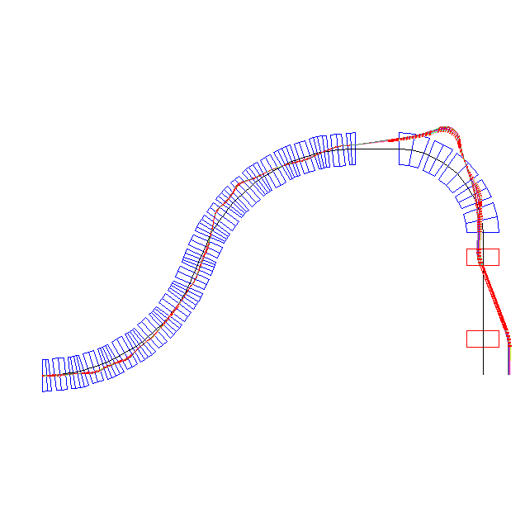
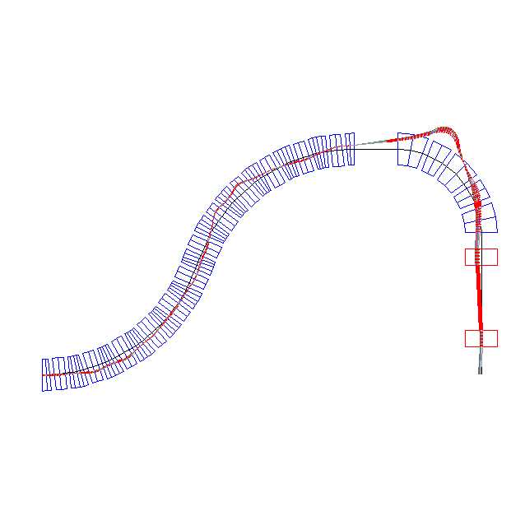
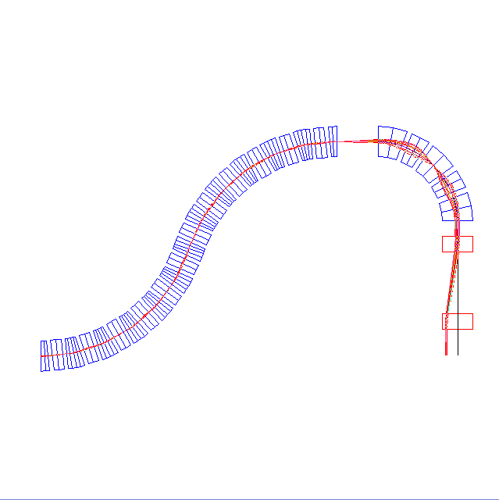
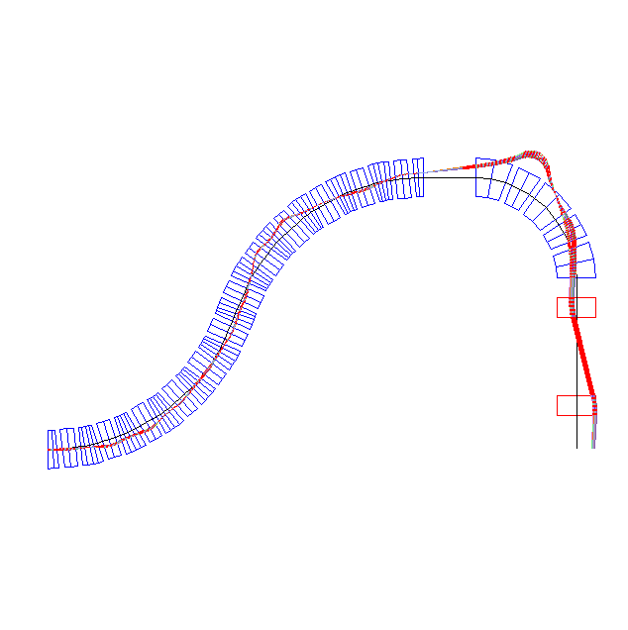
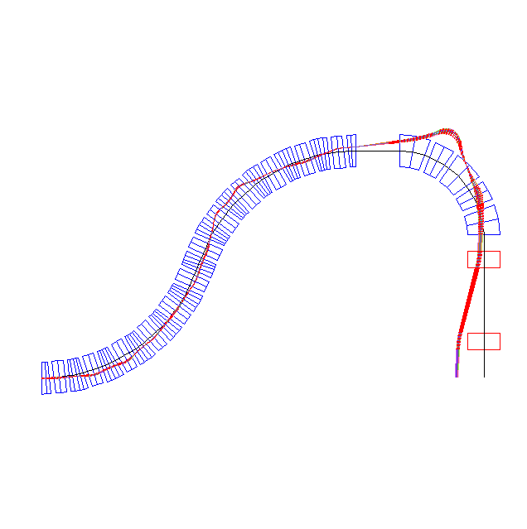

Slide 22

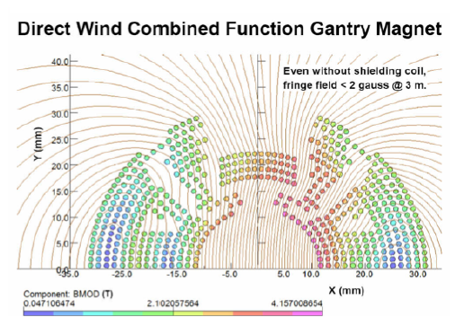
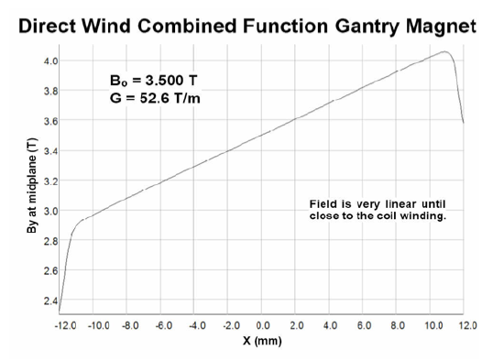
BNL-preliminary combined function magnet design

Slide 23
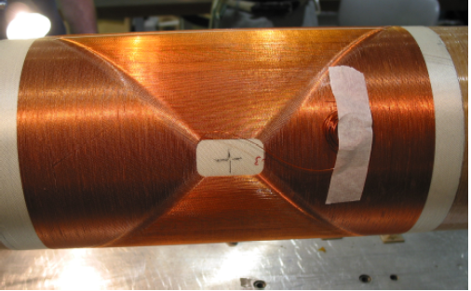
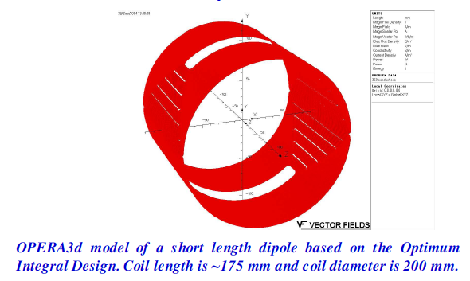
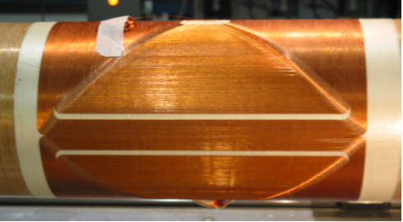
Magnet design
In a quadrupole, the coil length limits the fill factor in the cross-section when it becomes less than one fourth of the circumference. We used six spacers (wedges) in the cross-section to make the first six allowed harmonics nearly zero. Once again, a large integral transfer function is obtained since the mid-plane turns span the entire end-to-end coil length. The design has a coil diameter of 200 mm and coil length of 90 mm (less than half the radius). Quad with Coil Length Less Than Coil Radius Sextupole with Coil Length 2/3 Coil Radius We carried out a similar exercise for a 200 mm aperture sextupole having an end-to-end coil length of 66 mm. This is ~1/3 of diameter. We were again able to get a design with low harmonics and a good
integral transfer function.

Slide 24
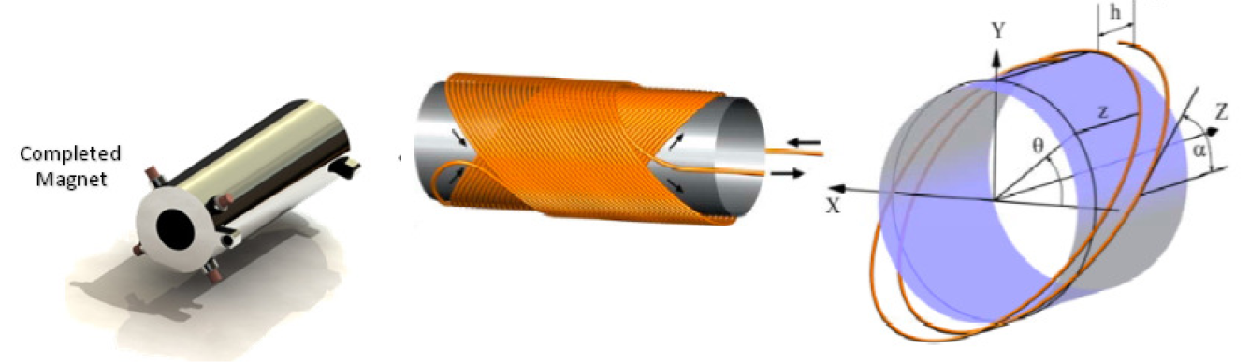
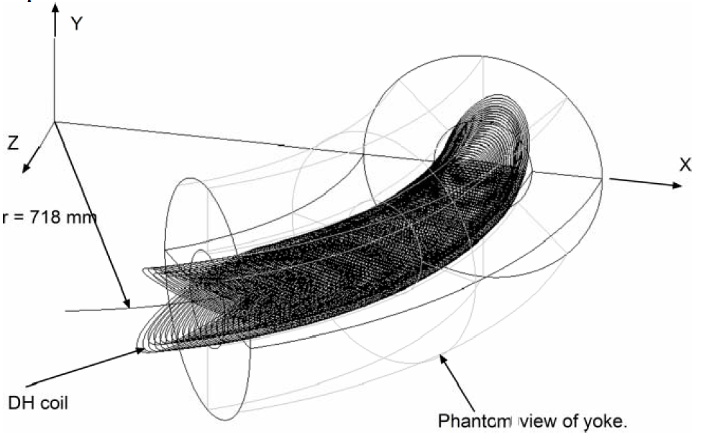

Slide 25
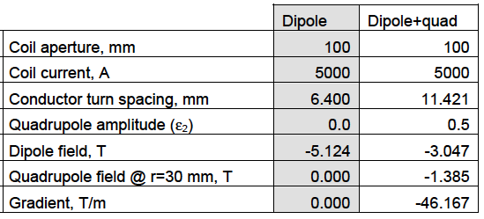
AML combined function magnet design
A = 4 cm

Slide 26
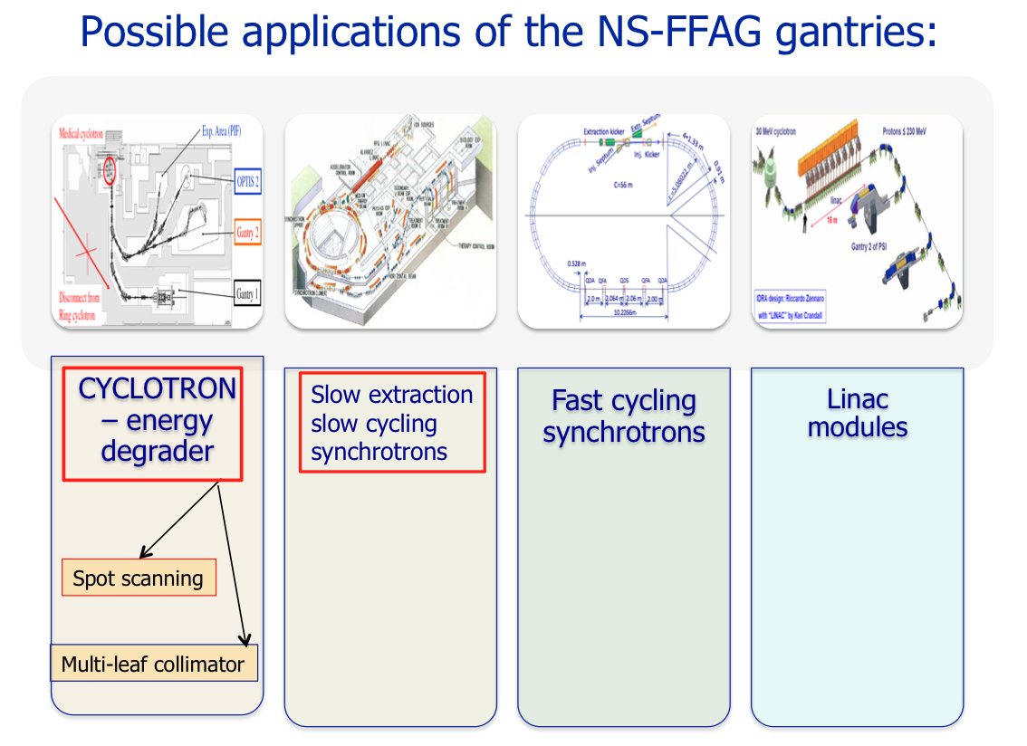

Slide 27
SAD – SOURCE-TO-AXIS-DISTANCE
Scanning system: applied for patent by BNL
The maximum dose to the patient surface relative to the dose in the SOBP
increases as the effective source-to-axis distance (SAD) decreases. For a fixed,
horizontal beam, large SAD's are easy to achieve; but not for gantry beam lines. A smaller gantry with a physical outer diameter of less than 2 meters may have important cost implications. Such a gantry would require magnetic optics to ensure that the effective source-to-axis distance is large enough to provide adequate skin sparing.
S
S
Axis
Axis

Slide 28
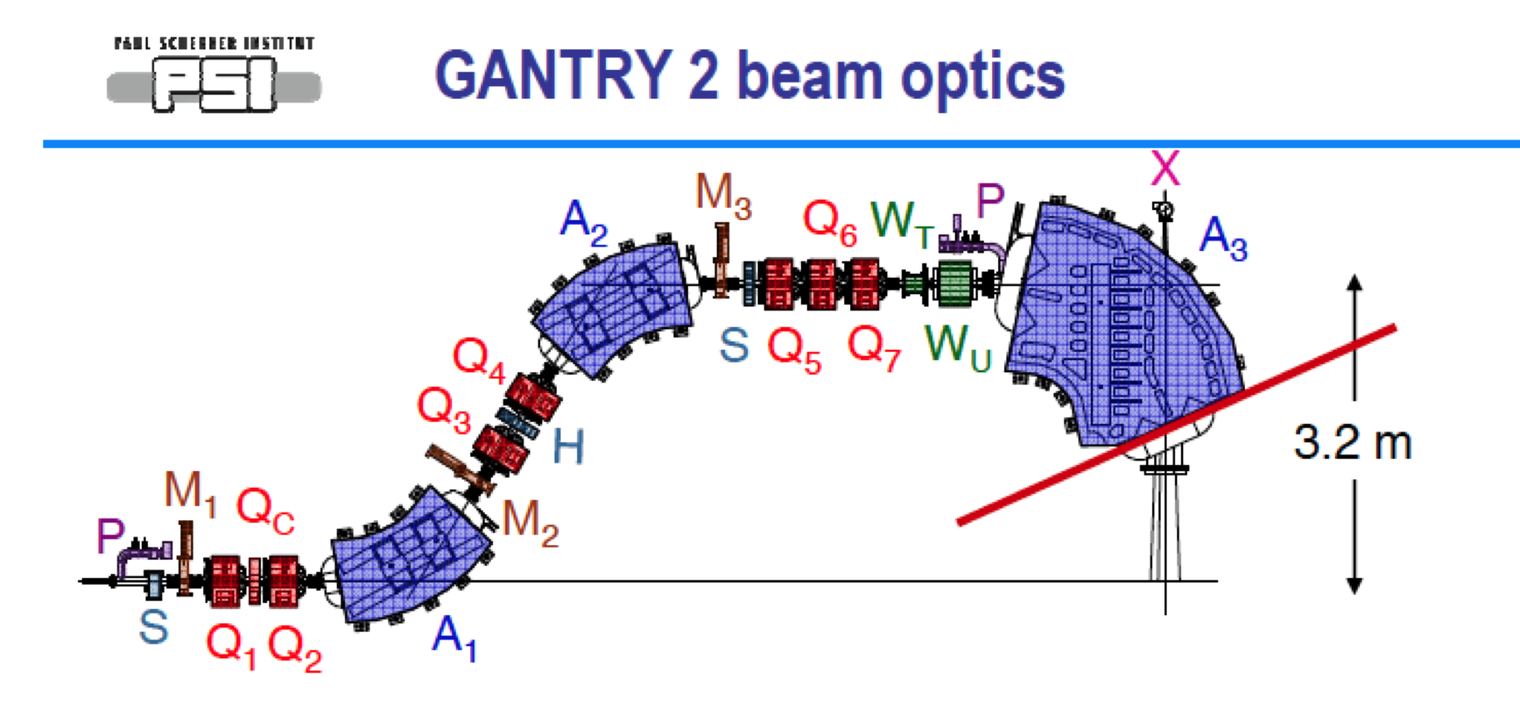
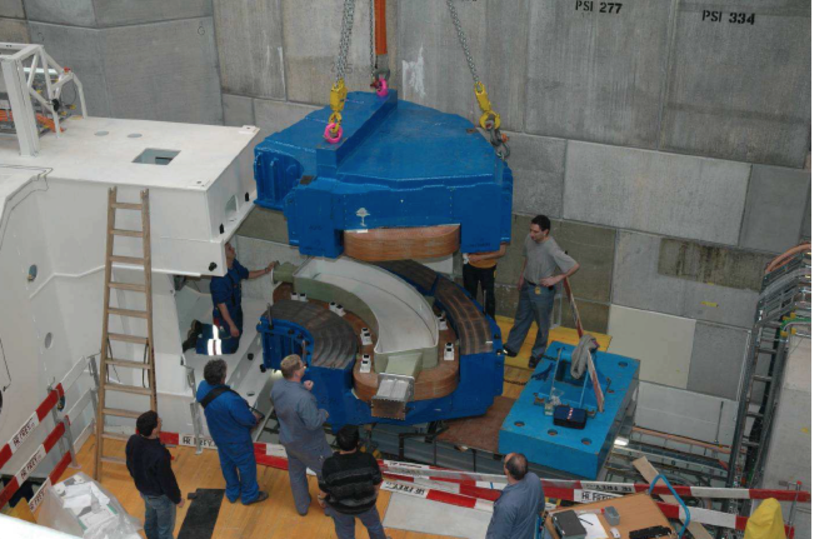
The state of the art proton gantry at PSI
3.2 m
3.2 m

Slide 29
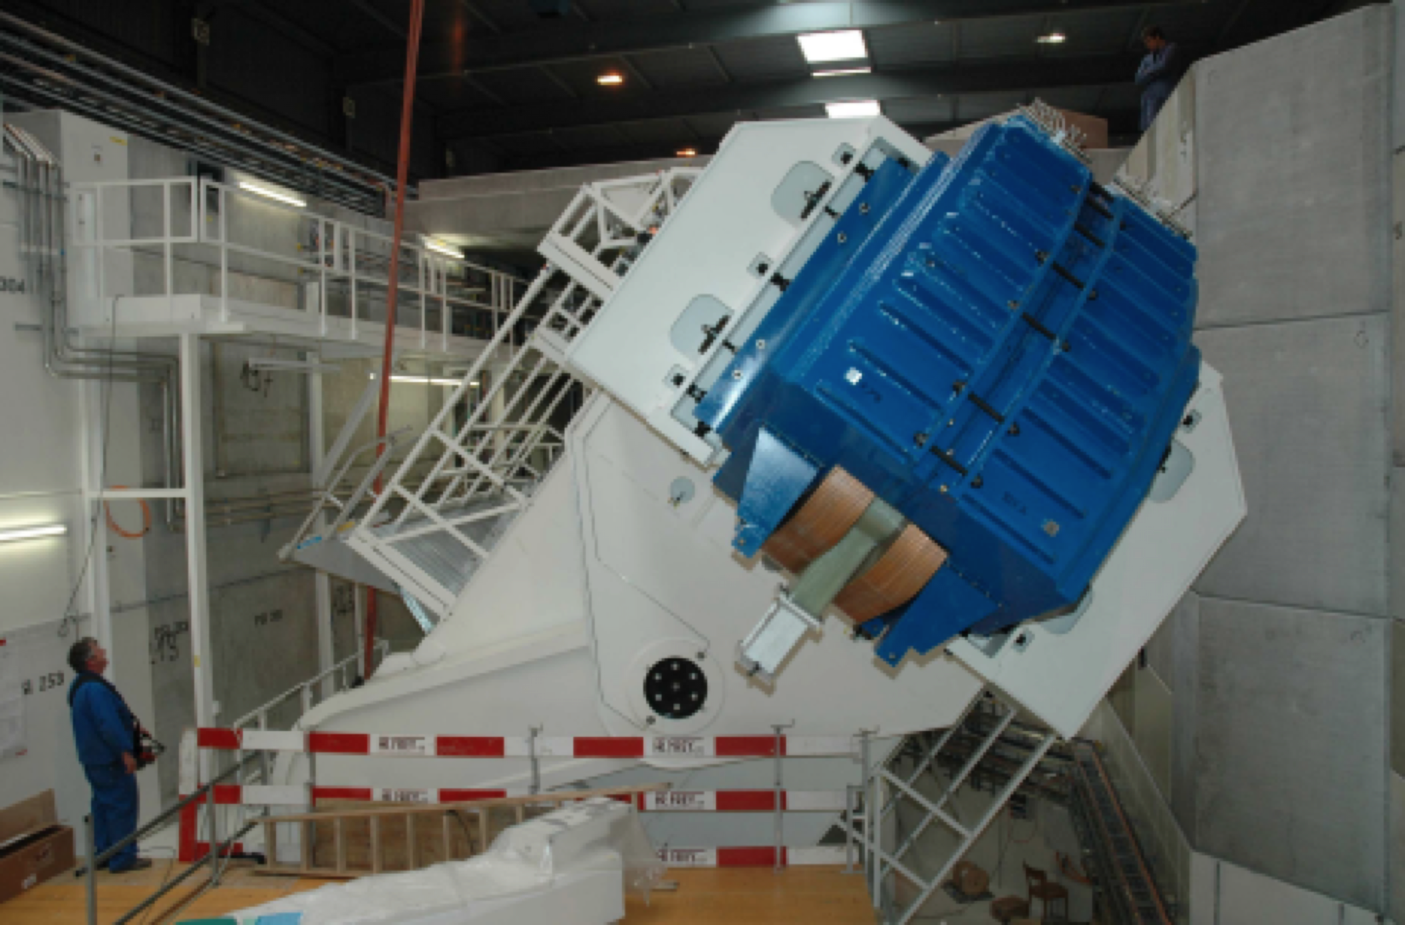
The state of the art proton gantry at PSI

Slide 30
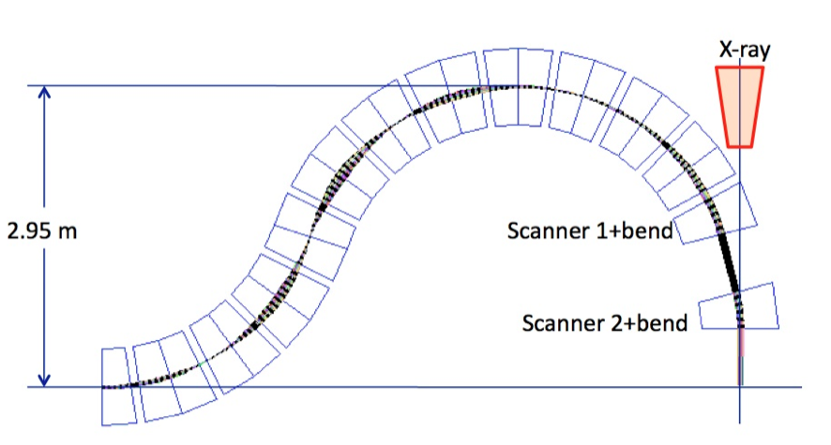

Slide 31
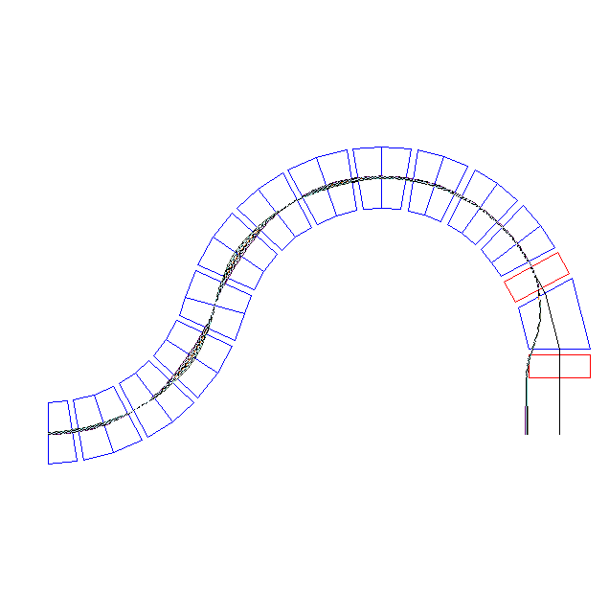
9.375º
l=6.15
52º
(L=2.61 m)
l=7.85
R=1.99389
1.848
l=8.51
0.897
28.625º
2.9556681
75º
0.66
Dipole
1.477835
0.9617781
10 cm
Magnification x10

Slide 32
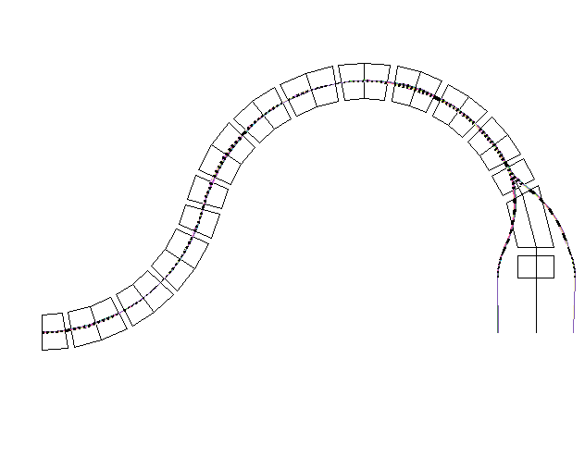

Slide 33
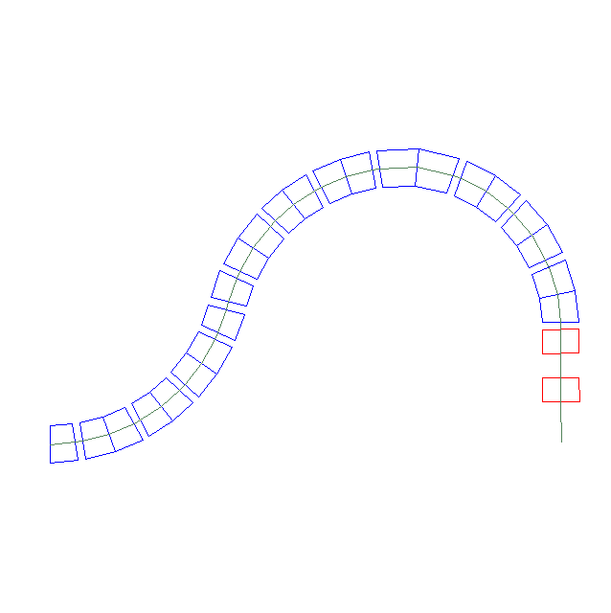
99.375º
65.625º
3.456
75º
0.585 m
15º
2.26127 m
1.327
1.09 m

Slide 34
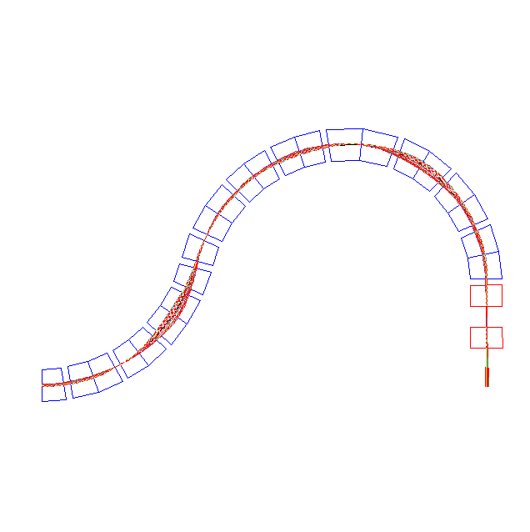
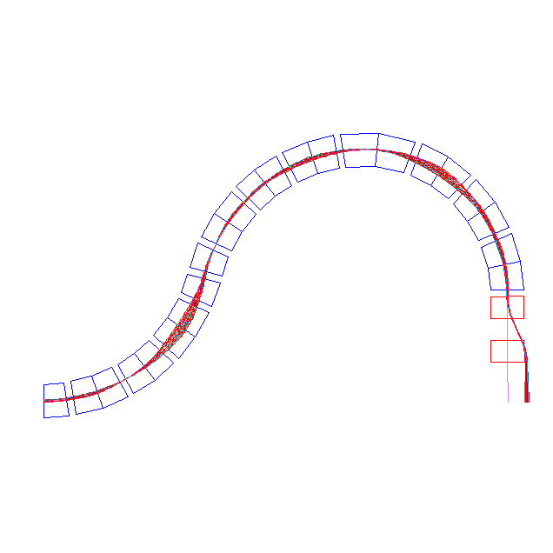
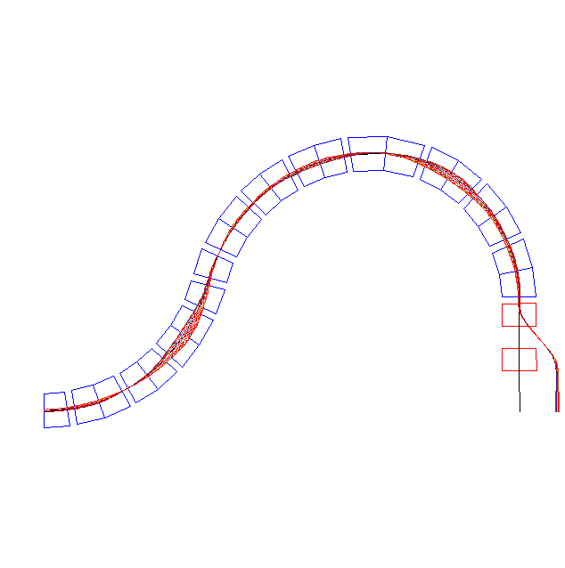
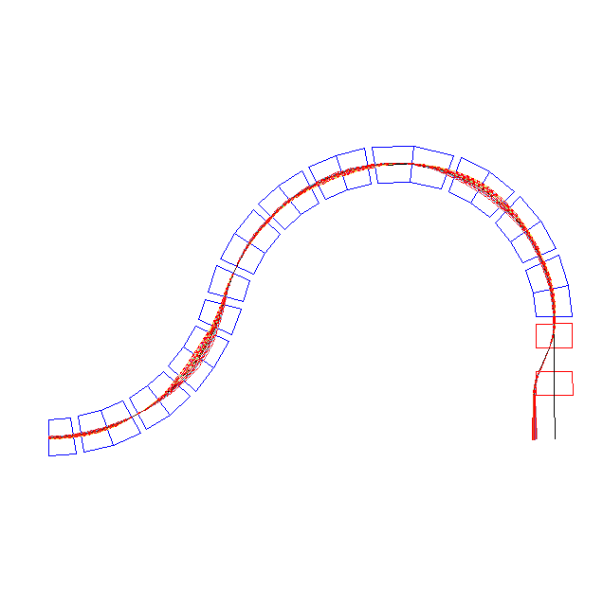

Scanning – proton isocentric gantry
±10 cm
Magnification 5X

Slide 35
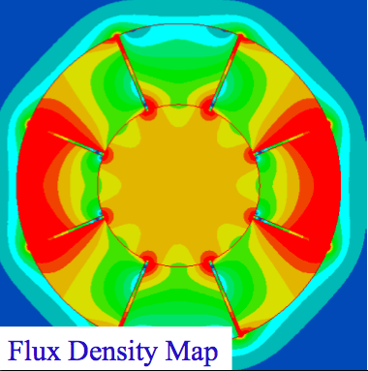
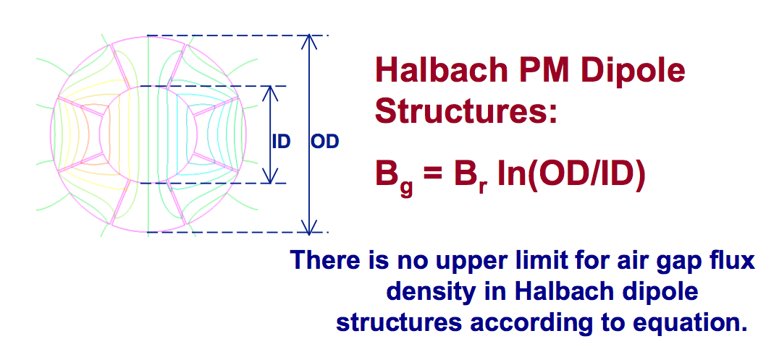
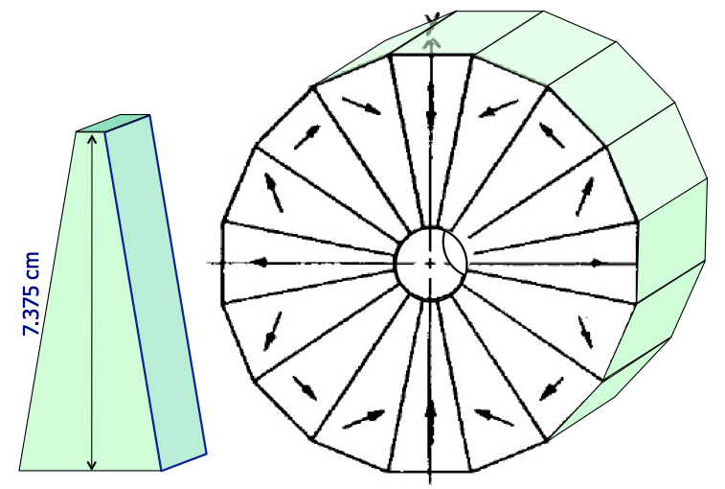
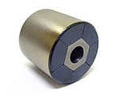
NS-FFAG gantry with permanent magnets

Slide 36

NS-FFAG ring
with permanent
Halbach magnets
Accelerates
protons from
31-250 MeV
r=2.84 m
60 cells, C=17.82 m
Orbits are magnified 20 times

Slide 37

What is innovative: extreme focusing
L_{QF/2}=6.05 cm
L_{QD}=9.2 cm
16 mm
250 MeV
-10.2 mm
QF/2
31 MeV
B
QD
B
QF/2
L_{B}=3.8 cm
L_{B}=3.8 cm
29.7 cm

Slide 38

Permanent Halbach magnet NS-FFAG gantry
14 cells-27 cells
r=2.71 m
162º
84º
h₂=3.172 m
h₁=2.61 m
BRHO = 1.7372345376900 Tm ANG=2π/120 = 0.05235987755982988
BYD= 2.0214 T KF =160.0 T/m KD= -175.0 T/m
L_{CELL}=0.285081466313463

Slide 39
SUMMARY:
NS-FFAG gantries transfer carbon ions with Δp/p=±20%
Weight is reduced for one or two orders of magnitude.
Size of NS-FFAG the carbon gantry is of PSI proton one.
Operation is simplified as the magnetic field is fixed.
Scanning system is with SAD=∞.
Beam size is adjustable with the triplet magnets.
It is possible to transfer in one pass beam with all energies after the multi-leaf collimator.
Triplet magnets do not need to be superconducting

