Slide 1
Resonance crossing in proton FFAGs: a proposed experiment
Thanks to Hiromi Okamoto & Shinji Machida for prompting this discussion!
Dr. Suzie Sheehy
STFC/ASTeC Intense Beam Group
FFAG’12 workshop, Osaka, Japan

Slide 2
Background
Around the time that EMMA was being built & the PAMELA project was starting, many people said:
  “can we build a proton accelerator like EMMA”?
Answer was “NO!” with two main arguments against:
  Very sharp injection/extraction angle
  Resonance crossing would blow up the beam
So both Johnstone & Machida decided to ‘flatten’ the tunes and create long straight sections in different ways.
But… the question of resonance crossing was never ‘fully’ answered, and still has not been answered experimentally.

Slide 3
“Can an EMMA-like FFAG work for protons?”
Or more specifically…
“Given a certain linear ns-FFAG proton lattice configuration with reasonable alignment errors, how quickly do we need to sweep the tune to accelerate with less than 10% emittance growth?”
(NB: 10% is arbitrary, could choose any reasonable number)

Slide 4
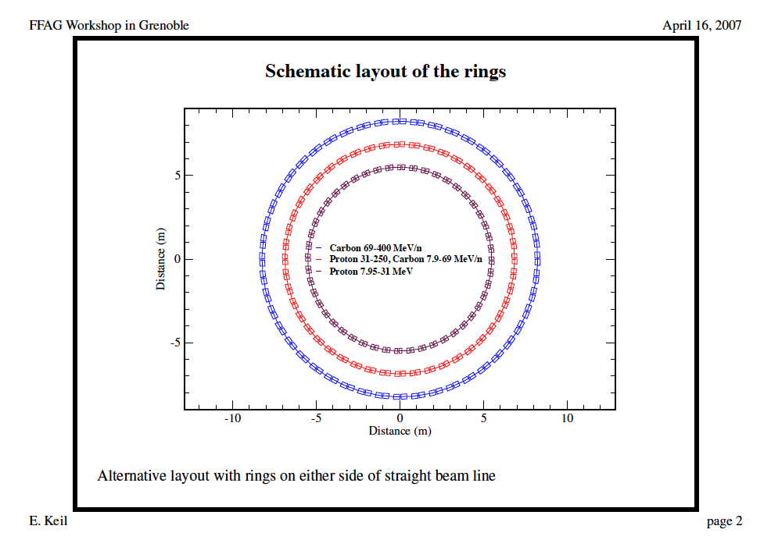
Keil-Sessler-Trbojevic cancer therapy design

Slide 5
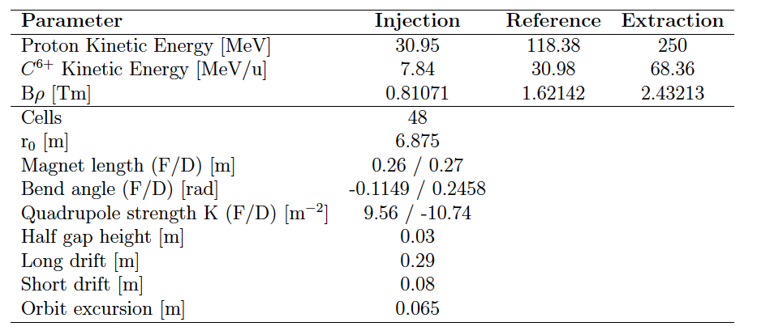
Ring 2 Parameters

Slide 6
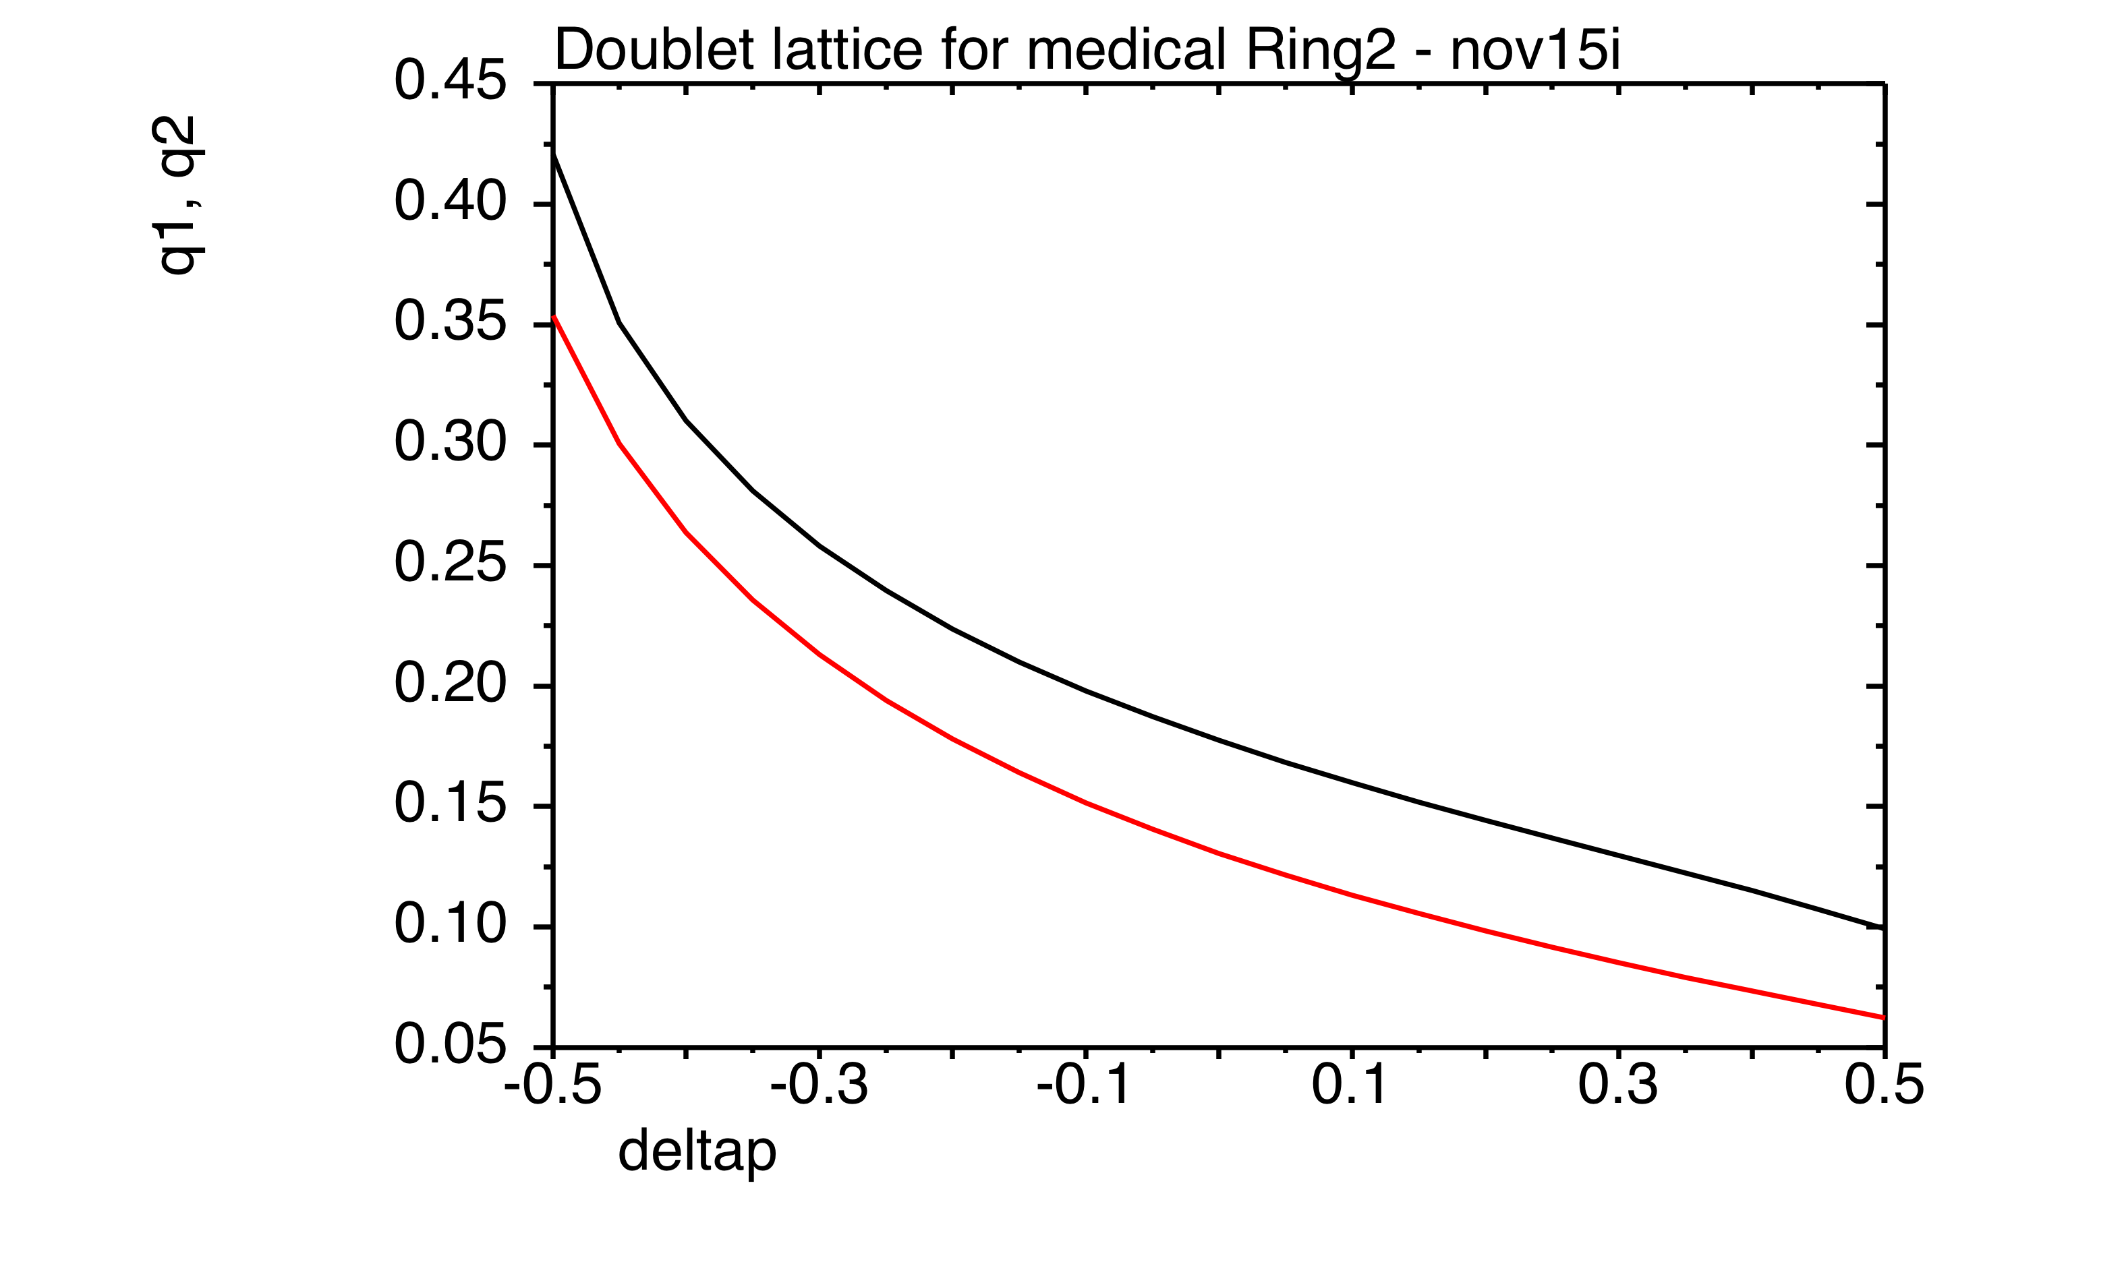
Ring 2 tune variation
21.6
19.2
16.8
Horiz.
Cell tunes
Total tunes
Vert.
14.4
12.0
9.6
7.2
4.8
2.4
Δp/p

Slide 7
Previous error studies
Each FD doublet given random alignment error
Track particle over 1000 turns to extraction
Orbit shape changes throughout acceleration
Orbit distortion: max deviation of tracked particle from closed orbit of zero-error lattice
From S. L. Sheehy, Dphil thesis, University of Oxford, 2010

Slide 8
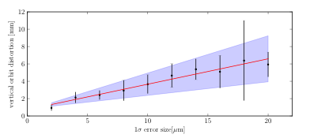
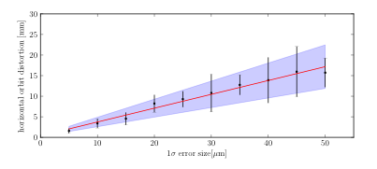
Orbit distortion
Horiz. Amplification factor = 336 +/- 104
Vert. Amplification factor = 293 +/- 136
From S. L. Sheehy, Dphil thesis, University of Oxford, 2010

Slide 9
Emittance increase
36 particles on 10 pi mm mrad normalised emittance ellipse tracked through first 40 turns of acceleration
Random horiz. Alignment errors of 50 micron (realistic)
A beam would not survive!
A few comments:
I’m not quite sure I know why it grows between integers, but assume because particles are getting lost – out of dynamic aperture?
I remember this being quite hard to simulate accurately – the beam did NOT want to stay in! Would need a bit more work…
From S. L. Sheehy, Dphil thesis, University of Oxford, 2010

Slide 10
Other lattices?
Comparison done for FFAG’09 proceedings with D.Trbojevic lattice (& PAMELA non-linear lattice)
Difference due to 24 doublet cells, sector shaped magnets, crosses less integer resonances
Note this is only for horizontal alignment errors & in reality vertical, rotational & field errors also!
Reference: S. L. Sheehy, Effects of alignment errors in proton non-scaling FFAGs, Int. J. Mod. Phys. A, Vol. 26, No.10n11, 2011.

Slide 11
S-Pod experiment?
HYPOTHESIS:
That a proton beam in a ns-FFAG of the type described earlier cannot realistically be accelerated to extraction in pulsed mode without excessive emittance growth due to slow resonance crossing.
AIM:
To determine the tune sweep rate (and thus acceleration rate) which would result in less than 10% emittance growth over the whole acceleration cycle in a medium-energy proton ns-FFAG.
METHOD:
Use ‘low current’ equivalent S-Pod setup
Set the correct primary focusing wave according to number of cells
Set a secondary ‘perturbation’ wave for alignment errors (How do we do random errors? Is this possible? Or we could do just ‘one’ misalignment in ring instead of a random set, but this would need the comparable simulations)
Determine emittance with & without errors (how?)
Change tune ramp rate & repeat
Ie. run similarly to Shinji’s experiment!

Slide 12
Relevant parameters
48 FD doublet cells consisting of quadrupoles with an offset
In the design the horizontal tune goes from 0.4->0.2 (19.2-9.6) in 3000 turns so dQ/dT=0.0032, for the vertical it's dQ/dT=0.004.
Acceleration could conceivably be done a bit faster in say 1000 turns, making dQ/dT roughly 0.01.
I guess this would be considered very slow resonance crossing, which puts it in a different regime to the proposed EMMA-like PT experiments.

Slide 13
A few questions & concerns
Comment on p.2 of the recent PR-STAB (2012) paper which says the LPT is "physically equivalent to a charged particle beam travelling through a linear transport channel at relativistic speed". Should I take that to mean 'ultra-relativistic' or simply 'fast'? (ie. is this beam ‘relativistic’ enough for the assumptions to hold true?)
Should we be concerned about effects of dispersion (alignment error kick distorts orbit – but with dispersion it then sees different field?) Will this have an effect?
How do we set up the ‘perturbation’ wave?
Diagnostics etc…

