Slide 1


Optics issues for Phase 1 and Phase 2 upgrades
Massimo Giovannozzi, CERN
Outline:
  Option for Phase 1 and 2 upgrades.
  Development and issues of Phase 1 upgrade studies.
  Issues of Phase 2 upgrade studies.
  Conclusions and outlook.
  Acknowledgements: AB and AT colleagues contributing to the upgrade studies

Slide 2
LHC IR Upgrade options - I
Phase 1: consolidation of ‘ultimate’ performance with L > 10³⁴cm⁻²s⁻¹
  Large aperture NbTi triplet magnets using existing spare dipole cables.
  The goal is also of introducing additional margins for the LHC operation.
  No modifications of the experiment interface and cryogenic infrastructure.
  Opening the option for operation with β* = 0.25 m and the LHC ‘ultimate’ beam.

Slide 3
LHC IR Upgrade options - II
Phase 2: ambitious upgrade of luminosity with L ~ 10³⁵cm⁻²s⁻¹
  Aims at operation beyond ultimate luminosity (the goal is integrated L).
  Implies operation in extremely radiation hard environment (35 MGy/year).
  Less than 1 year lifetime for magnets with nominal triplet layout!
  New magnet technology and /or special protection / absorber elements.

Slide 4
The path to Phase 1 layout - I
Technological challenge of large aperture quadrupoles (see presentation of E. Todesco): where are the limits of gradient vs. aperture?
From E. Todesco, J.-P. Koutchouk, LUMI’ 06 Proceedings

Slide 5
The path to Phase 1 layout - II
Huge parameter space: semi-analytical approaches and fitting to determine
Twiss parameters vs. free parameters
From E. Todesco, J.-P. Koutchouk, LUMI’ 06 Proceedings.

Slide 6
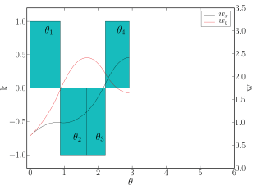
The path to Phase 1 layout - III
Huge parameter space: analytical approaches applied to a slightly simplified system to fix the overall optical parameters prior to detailed analysis are needed.
R. De Maria, LHC Project Report 1051.

Slide 7
The path to Phase 1 layout - IV
Guidelines for the optical design:
  Aperture is the first requirement. General criterion:
    33 σ + 12 mm needed in the triplets
    Open question: how much aperture margin do we need? And what is the best use of it, e.g.
      Mitigation of energy deposition issues (still to be studied in details, see presentation by E. Wildner).
      Mitigation (but not solution!!!) of impedance issues due to collimators.
  Keep βmax under control (impact on chromaticity, off-momentum beta-beating and single-particle dynamic aperture).

Slide 8
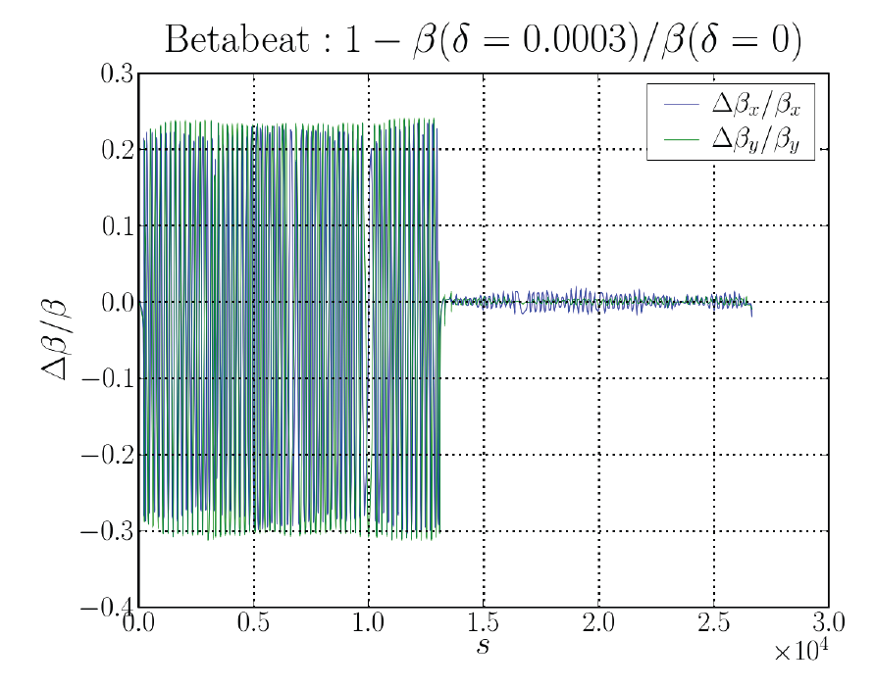
The path to Phase 1 layout - V
A word on off-momentum beta-beating:
  Nominal LHC:
    3/8 10⁻⁴ Δp/p -> 10%/30%
    Correction means (see S. Fartoukh LHC Project Report 308)
      Phasing IPs
      Chromatic sextupoles (32 families/beam)
    NB: off-momentum beta-beating can be corrected only in one half of the machine.
Example from an upgrade optics

Slide 9
The path to Phase 1 layout - VI
Apart on aperture, off-momentum beta-beating has an impact on collimation performance.
How to chose in which half of the machine the beating has to be corrected?
    Driving criterion: avoid that a secondary collimator becomes a primary one.
    FOR the nominal LHC the correction should be made between IR5 and IR1.
Betatron cleaning IR
Momentum cleaning IR

Slide 10

The path to Phase 1 layout - VII
Concerning field quality issues, it is worth mentioning that:
  Recently a useful result was obtained concerning the dependence of the triplets field quality on aperture (E. Todesco et al. LHC Project report 1010).
  The impact of these scaling laws on dynamic aperture clearly observed (see presentation by R. Tomás).
  Hardware constraints such as modularity (optimize the tooling and the spares) have to be considered.

Slide 11
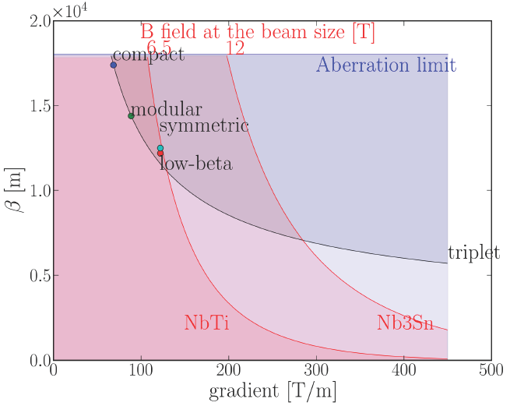
The path to Phase 1 layout - VIII
Putting everything together:
Detailed discussion of the four optics under consideration for the Phase 1 upgrade by R. de Maria.
From R. de Maria LIUWG presentation 18/10/07

Slide 12
The path to Phase 1 layout - IX
Usually the focus is always on the triplets, but the long straight section needs also revision and detailed analysis (see S. Fartoukh LIUWG presentation 27/09/07):
  D1 (warm design): its aperture has to be increased!
    Modification to the current design proposed (J.-P. Koutchouk and D. Tommasini): very cost-effective.
    Should a cold D1 be considered?
  D2, Q4, Q5: a rotation of the beam screens should fix the aperture issues. Possibility of designing a two-aperture Q4 with increased aperture assessed (E. Todesco).
  The rest of the long straight section is essentially compatible with Phase 1 upgrade requirements.

Slide 13
The path to Phase 1 layout - X
Next steps:
  Convergence to a smaller number of optics candidates (two). Each should be studied in terms of:
    Overcome the observed limitations in the optics.
    Provide a complete solution compatible with the hardware constraints (cryostats parameters, instrumentation).
    Study tunability of the optics.
    Study injection optics.
    Study squeeze sequence.
    Evaluate the performance of a flat beam option.
    Beam-beam simulations.
    Collimation performance.

Slide 14
The beneficial effect of flat beams - I

Slide 15
The beneficial effect of flat beams - II

Slide 16
Phase 2: introduction - I
Current studies look for a 10-fold increase in the peak luminosity. Two options (doubling the bunch number not possible):
  ES (25 ns): Low β* (11 cm – 14 cm) with ‘ultimate’ beam parameters requiring significant hardware modifications in the IR & detector regions.
  LPA (50 ns): operation with larger than ‘ultimate’ beam intensities and ‘flat bunches’ but without modifications in the detector regions.

Slide 17
Phase 2: introduction - II
Additional measured required for a Phase 2 upgrade:
  Upgrade of the cryogenic plants for IR1 and IR5 (additional new plants).
  Improved shielding and protection of triplet magnets.
  Both Phase 2 options require additional measures that go beyond magnet.
  R&D and that could benefit already the Phase 1 upgrade.

Slide 18
Phase 2: optics concept
R. De Maria, LHC Project Report 1051
J.-P. Koutchouk et al., PAC07.
Additional changes in the long straight section (see S. Fartoukh LIUWG presentation 27/09/07):
Beam screen rotation in D2, Q4, Q5.
Q4, Q5 must be replaced with large aperture magnets.
120-130 mm gap requested for D1 (cold D1 might be the only possible option).
95-100 mm aperture requested for D2 (Warm D2, e.g. MBW type, might be the only possible option).

Slide 19
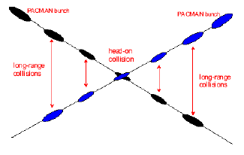
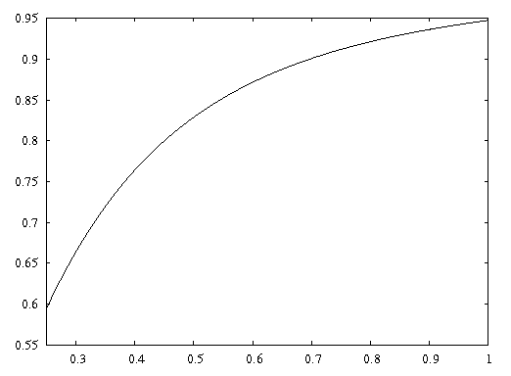
Additional measures for Phase 2 - I
Minimizing the luminosity loss due to the crossing angle:
F
The crossing angle results at the IP in an increase of the effective cross section and thus a reduction of the luminosity.
Assuming a constant normalized beam separation the reduction factor decreases with decreasing β*!
β*
Piwinski angle

Slide 20
Additional measures for Phase 2 - II
Minimizing the luminosity loss due to the crossing angle at the IP:
Compensate the long range beam-beam effects, thus allowing a smaller angle
wire
compensator
New proposal and technology, requiring MDs (USLARP & CERN@)
Could potentially reduce the required crossing angle
Similar proposal for head-on collisions: electron lens

Slide 21
Additional measures for Phase 2 - III
Minimizing the luminosity loss due to the crossing angle at the IP:
Reduce the crossing angle at the IP via dipole magnets deep inside the detectors (slim dipole option)
Q0 quad’s
stronger triplet magnets
D0 dipole
Requires magnet integration inside the detectors.
Impact on detector performance and physics reach.
Requires new magnet technology.
Implies beam-beam studies (numerical and experimental).

Slide 22
Additional measures for Phase 2 - IV
Minimizing the luminosity loss due to the crossing angle at the IP:
Bunch rotation via crab cavities. It implies a new technology for protons.
Requires high precision RF technology and control.
Currently used in KEK B-factory.
No experience with operation in proton machines (noise).
Requires prototyping and machine studies (lead time and resources).

Slide 23
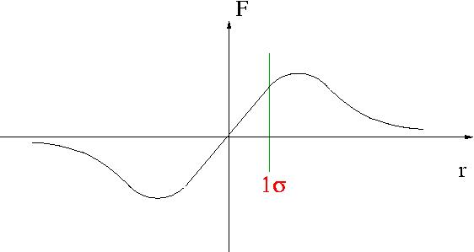
Additional measures for Phase 2 - V
Minimizing the luminosity loss due to the crossing angle at the IP:
Bunch rotation via crab cavities. It implies a new technology for protons.
Compensate the head-on beam-beam force by additional e⁻/p⁺ interactions (opposite sign of the p⁺/p⁺ beam-beam force).
Development of a prototype ‘electron lens’ at FNAL.
This new tool is currently studied / tested in Tevatron (and RHIC in 2008).
Still open issues: Tevatron observes significant operation improvements (lens as a fast quadrupole), but no successful operation as beam-beam lens.

Slide 24
Additional measures for Phase 2 - VI
Operation with large Piwinski angle:
40% higher luminosity for flat bunch profile.
  Increased luminosity lifetime.
  Does the flat bunch remain flat (proved in injectors for short times)?
Luminosity leveling (see talks by J.-P. Koutchouk and G. Sterbini):
Can it be performed in real operation?

Slide 25
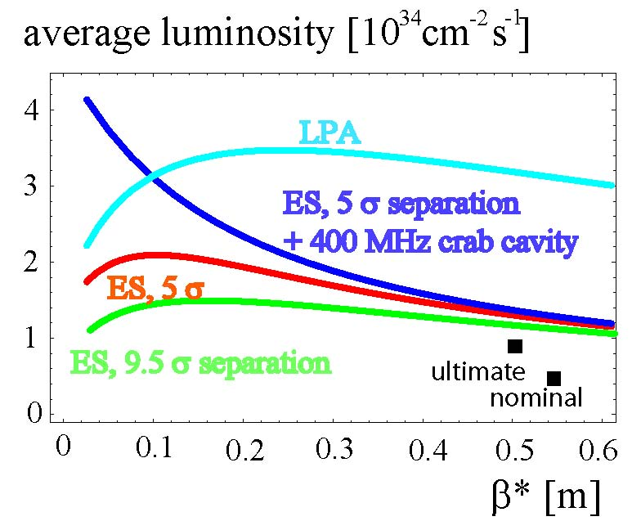
Phase 2 luminosity potential reach
Average luminosity over one physics run assuming optimum run length.
Estimates done without luminosity leveling.
Phase 2 might provide average luminosity increase by a factor 3 to 4 in most optimistic scenario.
F. Zimmermann at Beam07

Slide 26
Conclusions and outlook
Phase 1:
  Essentially new magnets are required, only.
Phase 2:
  New magnets are required and (not all together):
    Wire compensators
    Integrated dipole magnets
    Crab cavities
    Electron lens
    Longitudinal flat beam operation
    Luminosity leveling
    Magnets TAS, absorbers, and masks
    All additional measures for the Phase 2 upgrade could benefit the Phase 1 upgrade. They should be launched before Phase 2!

