Slide 1
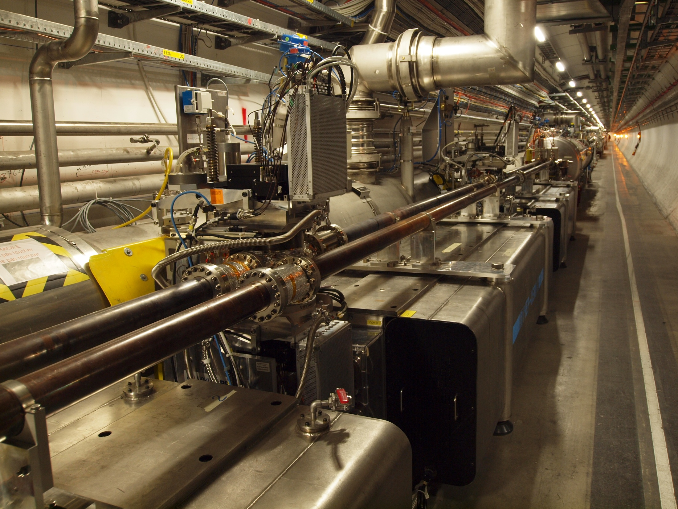


Measurement of elastic scattering with ALFA
– and the many steps before
Sune Jakobsen
On behalf of the ATLAS collaboration
Low-X 2012

Slide 2


ALFA Installation Triggering Beam based alignment β* = 90 m campaign 2011 Summary and plans for 2012
Agenda
ALFA detector system
Installation of ALFA in 2011
Triggering of ATLAS by ALFA
Beam based alignment (scraping)
β* = 90 m campaign 2011- determination of total cross section
Summary and plans for 2012
Low-X 2012
NIELS BOHR INSTITUTE
UNIVERSITY OF COPENHAGEN
2/18
Measurement of elastic scattering with ALFA
Sune Jakobsen

Slide 3
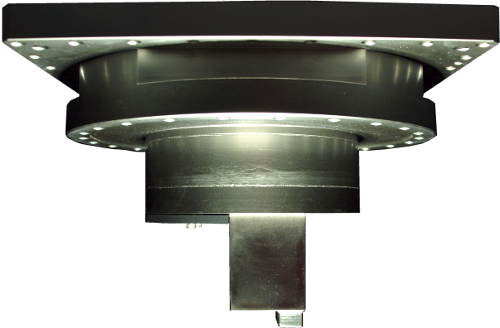
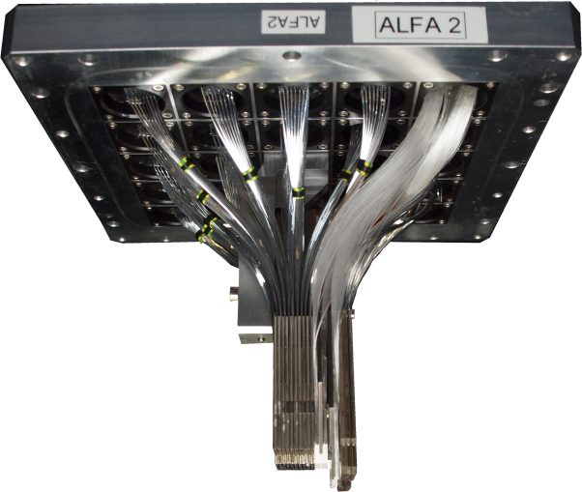
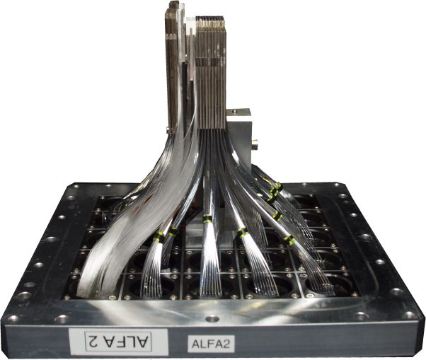
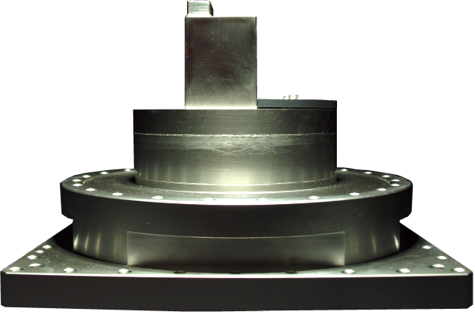
ALFA Installation Triggering Beam based alignment β* = 90 m campaign 2011 Summary and plans for 2012
Absolute Luminosity For ATLAS - ALFA
Approach the beam to few mm with Roman Pot
Beam pipe
Beam pipe
Only used in dedicated high β* runs
Low-X 2012
NIELS BOHR INSTITUTE
UNIVERSITY OF COPENHAGEN
3/18
Sune Jakobsen
Measurement of elastic scattering with ALFA

Slide 4
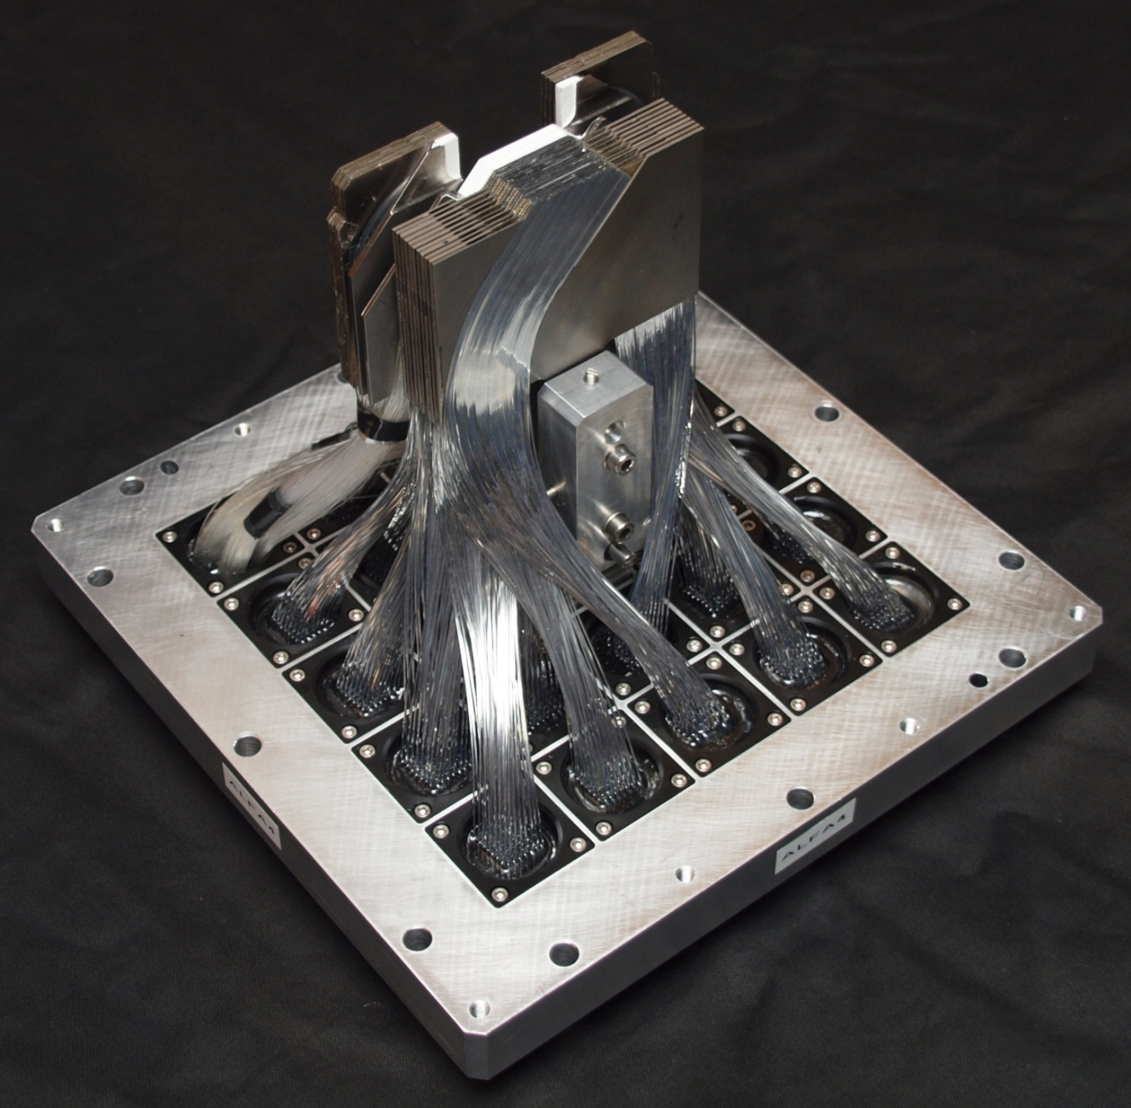
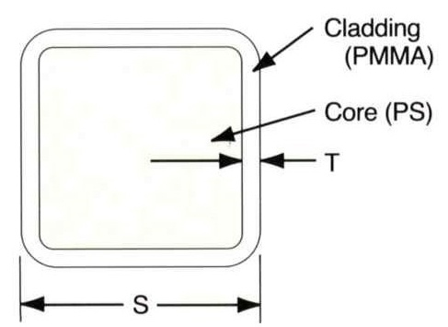
ALFA Installation Triggering Beam based alignment β* = 90 m campaign 2011 Summary and plans for 2012
ALFA detector
500 µm scintillating fibers
Aluminum coating
Low-X 2012
NIELS BOHR INSTITUTE
UNIVERSITY OF COPENHAGEN
4/18
Measurement of elastic scattering with ALFA
Sune Jakobsen

Slide 5
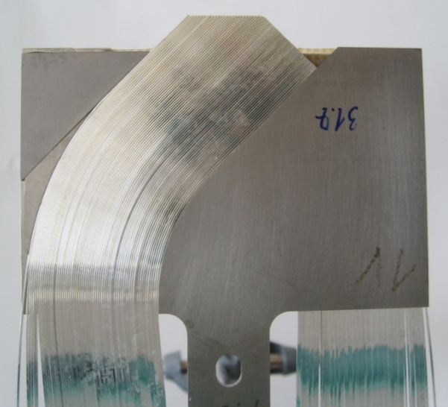
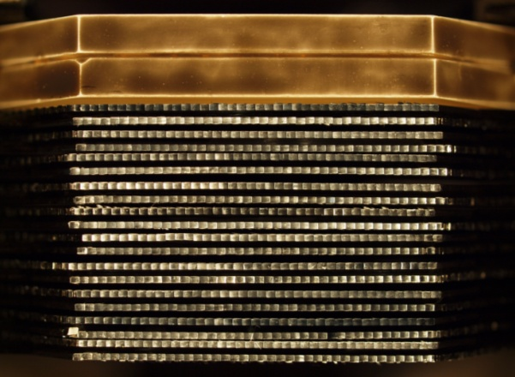
ALFA Installation Triggering Beam based alignment β* = 90 m campaign 2011 Summary and plans for 2012
ALFA detector
Main detector plan
Main detector
Staggering of plans
Low-X 2012
NIELS BOHR INSTITUTE
UNIVERSITY OF COPENHAGEN
4/18
Measurement of elastic scattering with ALFA
Sune Jakobsen

Slide 6
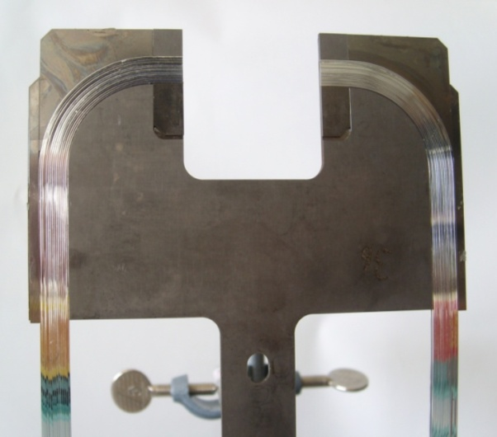
ALFA Installation Triggering Beam based alignment β* = 90 m campaign 2011 Summary and plans for 2012
ALFA detector
Overlap detector plan
Overlap detector
Main detector
Overlap detector principle on slide 15
Low-X 2012
NIELS BOHR INSTITUTE
UNIVERSITY OF COPENHAGEN
4/18
Measurement of elastic scattering with ALFA
Sune Jakobsen

Slide 7
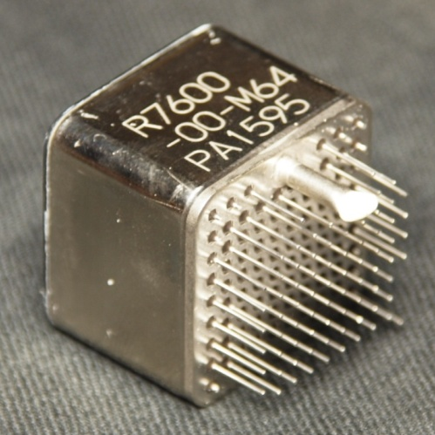
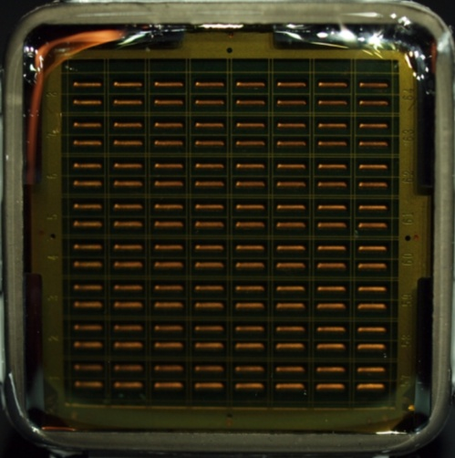
ALFA Installation Triggering Beam based alignment β* = 90 m campaign 2011 Summary and plans for 2012
ALFA detector
MultiAnode PhotoMultiplier Tube (MAPMT)
Overlap detector
Main detector
64 individual channels
MAPMT channel
Fiber connector
Low-X 2012
NIELS BOHR INSTITUTE
UNIVERSITY OF COPENHAGEN
4/18
Measurement of elastic scattering with ALFA
Sune Jakobsen

Slide 8
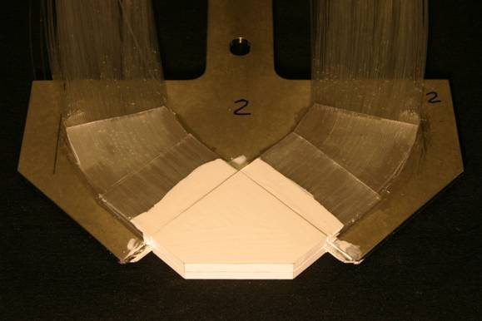
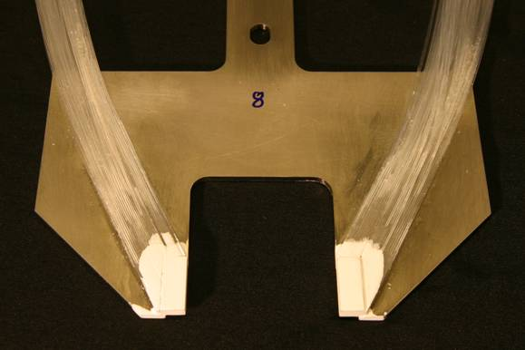
ALFA Installation Triggering Beam based alignment β* = 90 m campaign 2011 Summary and plans for 2012
ALFA detector
Overlap trigger tiles
Main trigger tiles
Main trigger scintillator tile
Overlap detector
Main detector
Overlap trigger scintillator tiles
Fiber connector
Low-X 2012
NIELS BOHR INSTITUTE
UNIVERSITY OF COPENHAGEN
4/18
Measurement of elastic scattering with ALFA
Sune Jakobsen

Slide 9
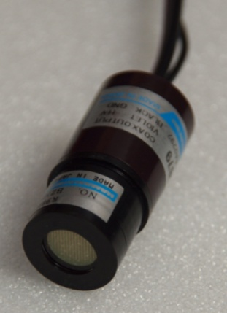
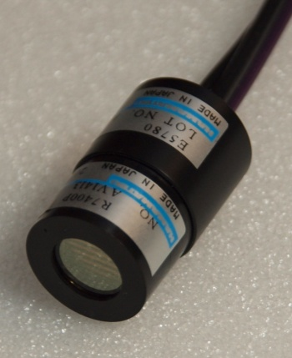
ALFA Installation Triggering Beam based alignment β* = 90 m campaign 2011 Summary and plans for 2012
ALFA detector
Overlap trigger tiles
Main trigger tiles
Main trigger scintillator tile
Overlap detector
Main detector
Trigger fiber connector
Overlap trigger scintillator tiles
Fiber connector
Low-X 2012
NIELS BOHR INSTITUTE
UNIVERSITY OF COPENHAGEN
4/18
Measurement of elastic scattering with ALFA
Sune Jakobsen

Slide 10
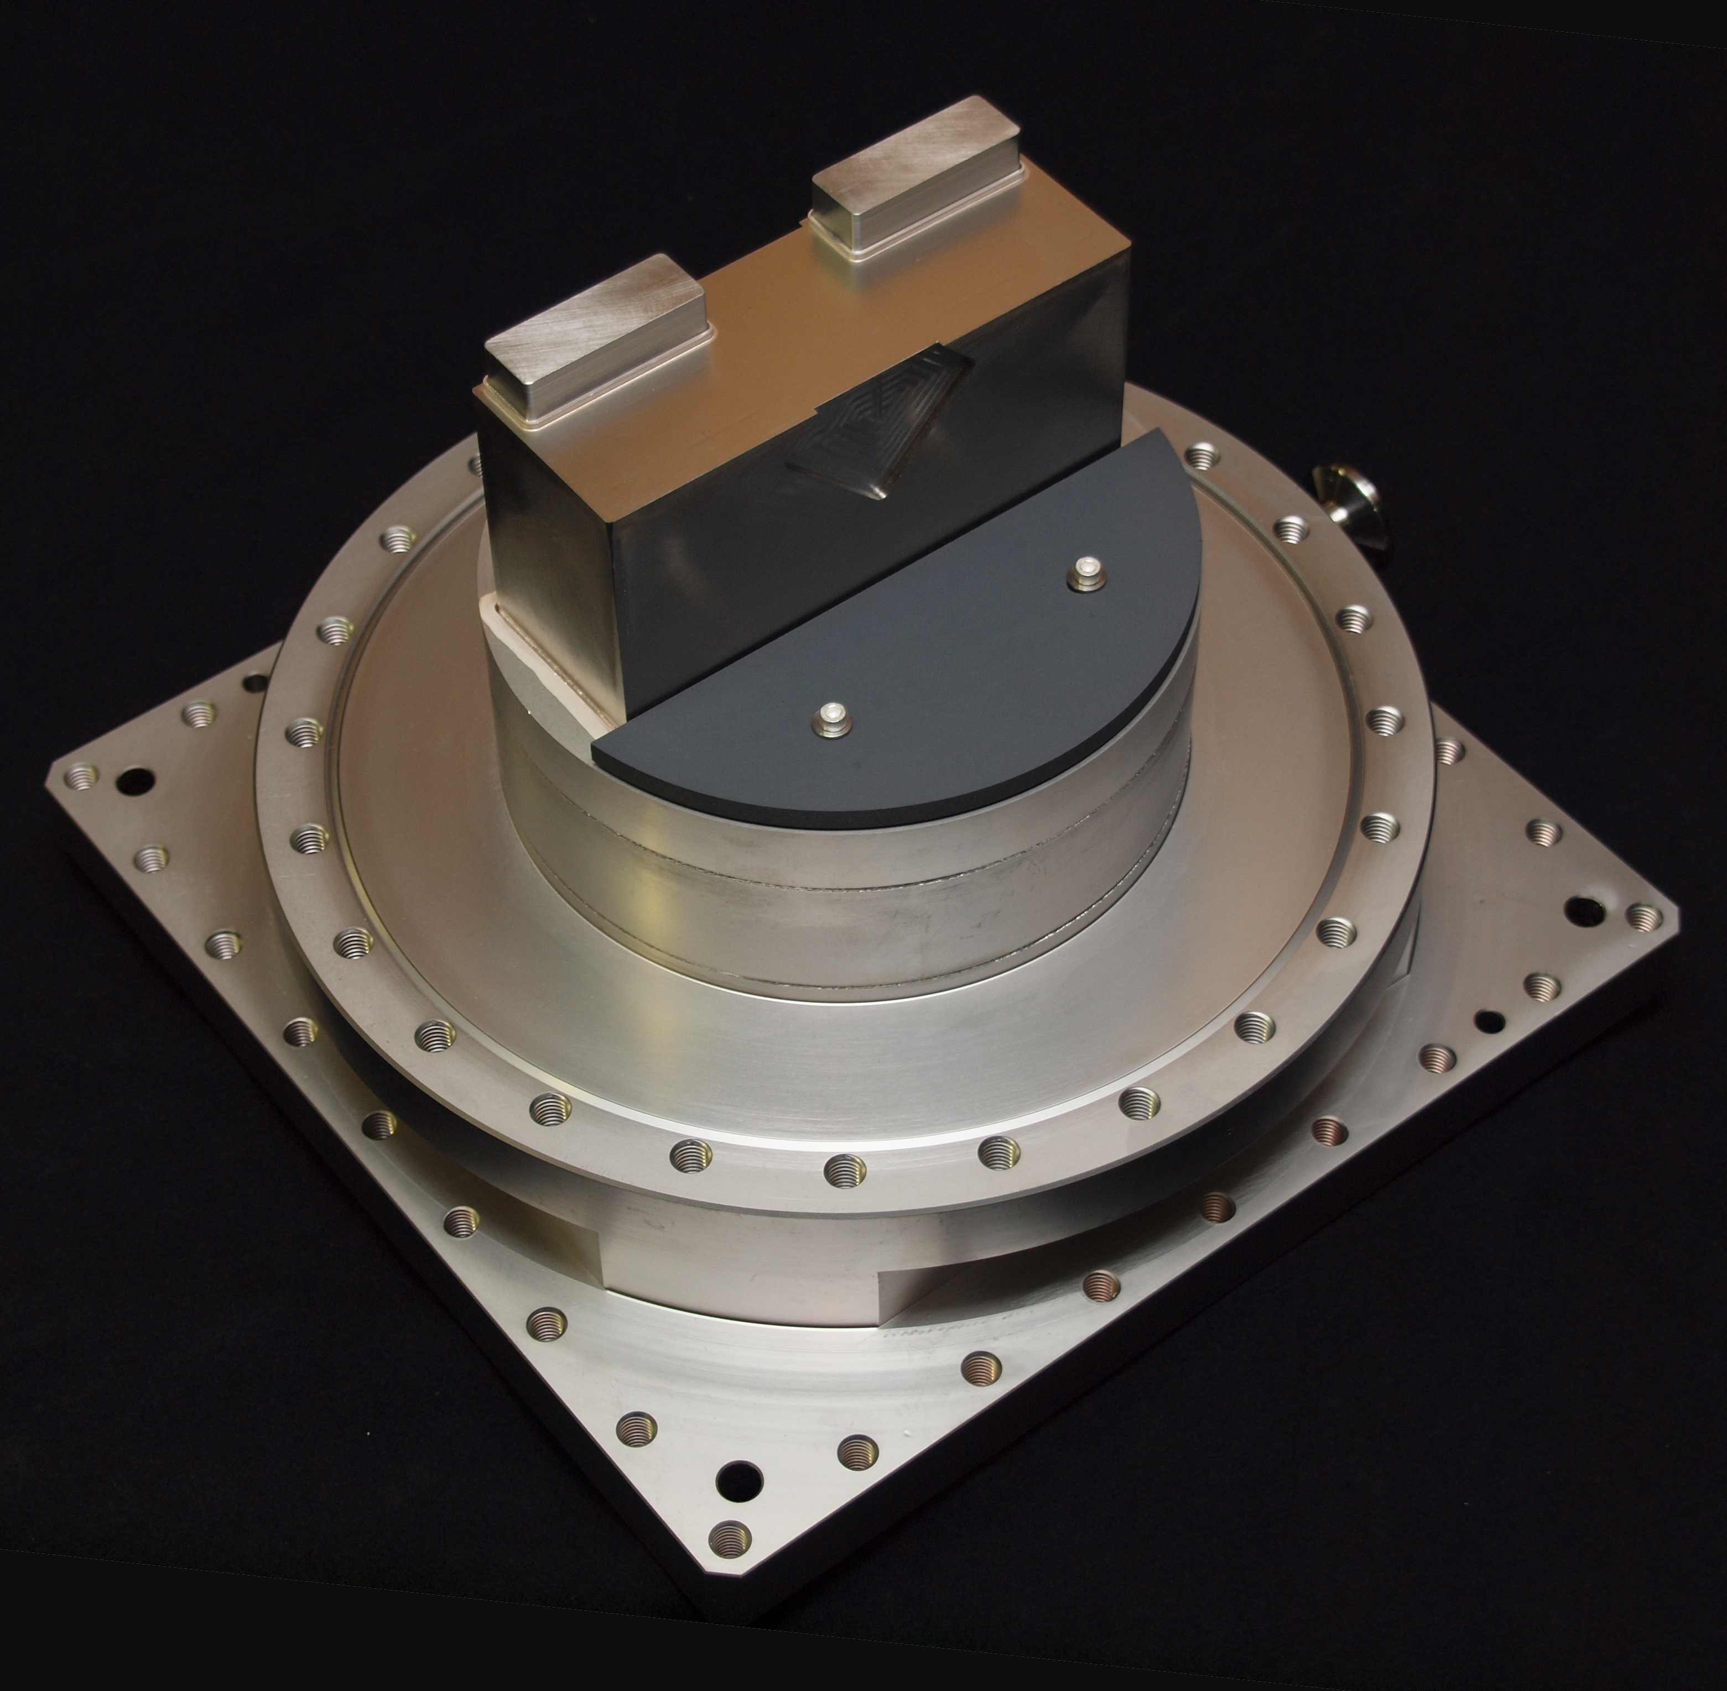
ALFA Installation Triggering Beam based alignment β* = 90 m campaign 2011 Summary and plans for 2012
ALFA Roman Pot
Room for overlap detectors + trigger
Separates the detector from the ultra high beam vacuum
Wall in front of the main detector
Roman Pot window
Ferrite
Window thickness 200 µm
Secondary vacuum inside (detector side) to keep window flat
Low-X 2012
NIELS BOHR INSTITUTE
UNIVERSITY OF COPENHAGEN
5/18
Measurement of elastic scattering with ALFA
Sune Jakobsen

Slide 11
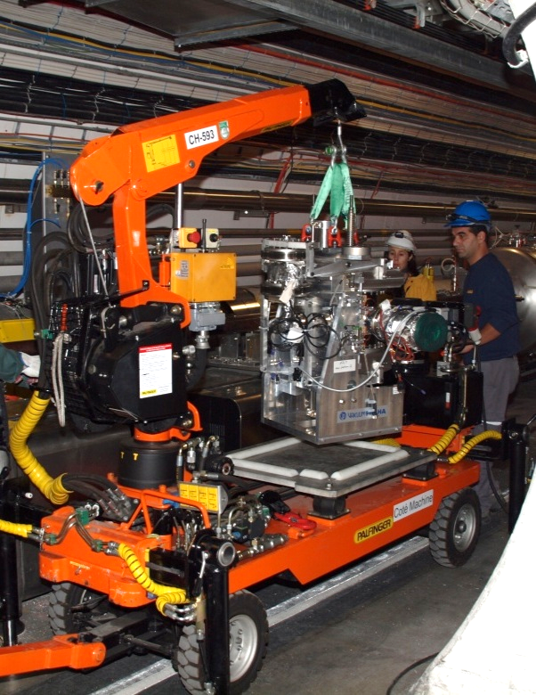
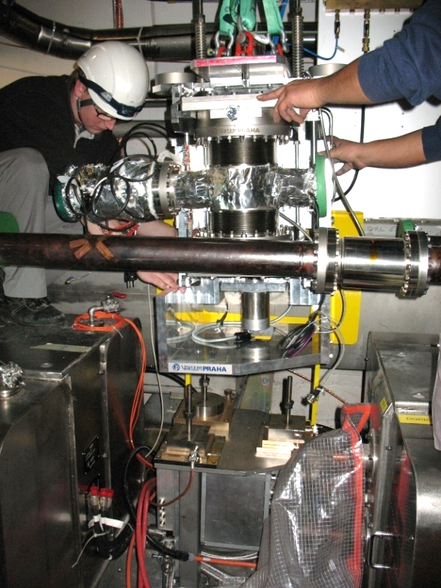
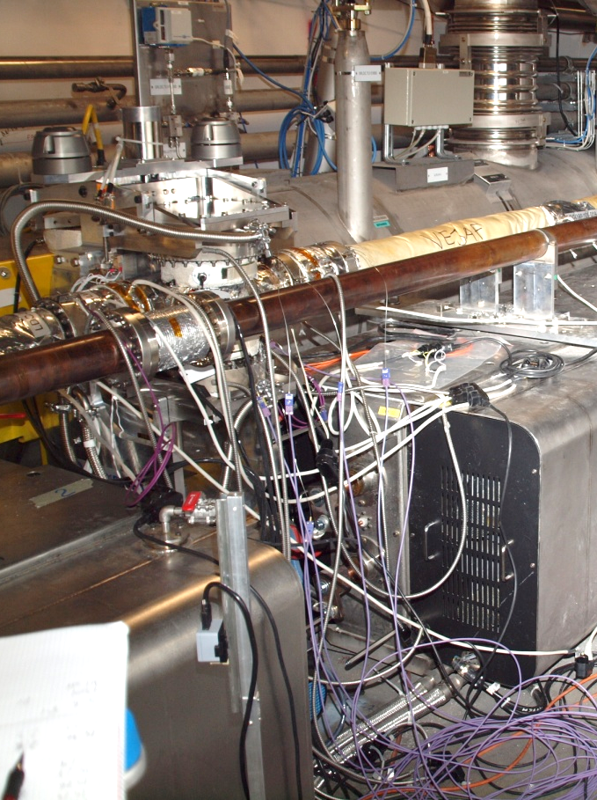
ALFA Installation Triggering Beam based alignment β* = 90 m campaign 2011 Summary and plans for 2012
Station installation in LHC
Palfinger with ALFA station
Positioning of the station on the foot
Bake out equipment installed on the ALFA stations and the beam pipe
Low-X 2012
NIELS BOHR INSTITUTE
UNIVERSITY OF COPENHAGEN
6/18
Sune Jakobsen
Measurement of elastic scattering with ALFA

Slide 12
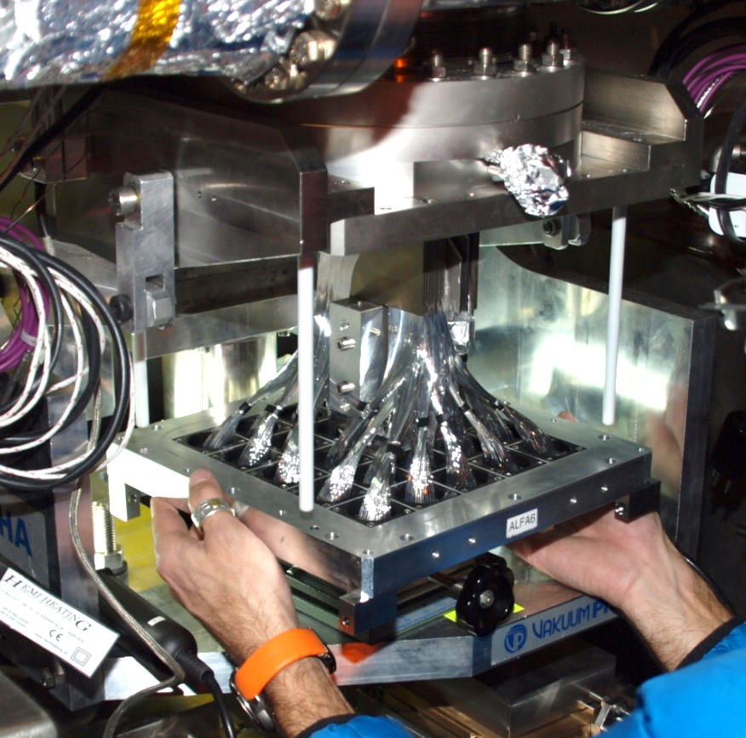
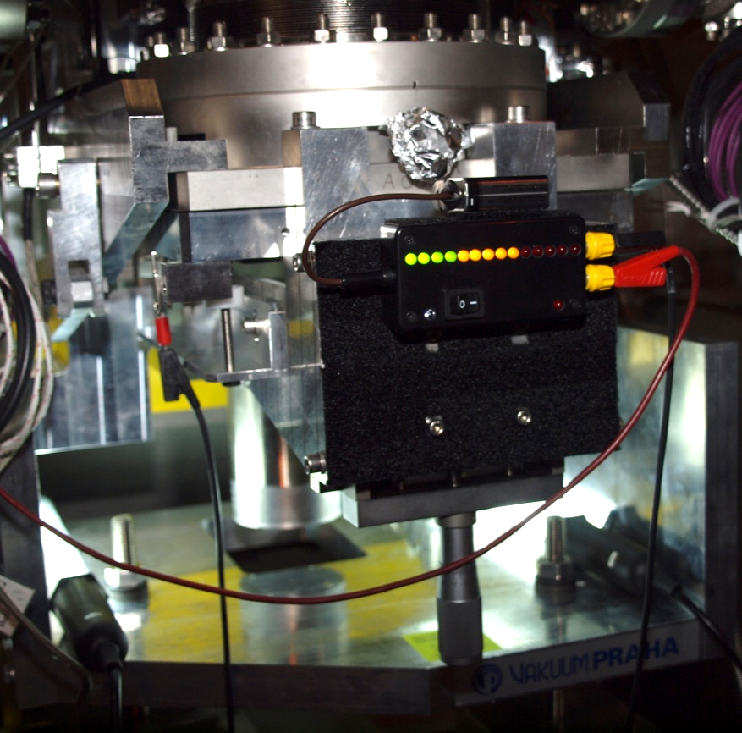
ALFA Installation Triggering Beam based alignment β* = 90 m campaign 2011 Summary and plans for 2012
Detector installation
Very delicate due to gaps between detector and Roman Pots of about 100-200 µm
Detector on lifting table
Custom made tools used
All detectors installed without problems
Low-X 2012
NIELS BOHR INSTITUTE
UNIVERSITY OF COPENHAGEN
7/18
Sune Jakobsen
Measurement of elastic scattering with ALFA

Slide 13
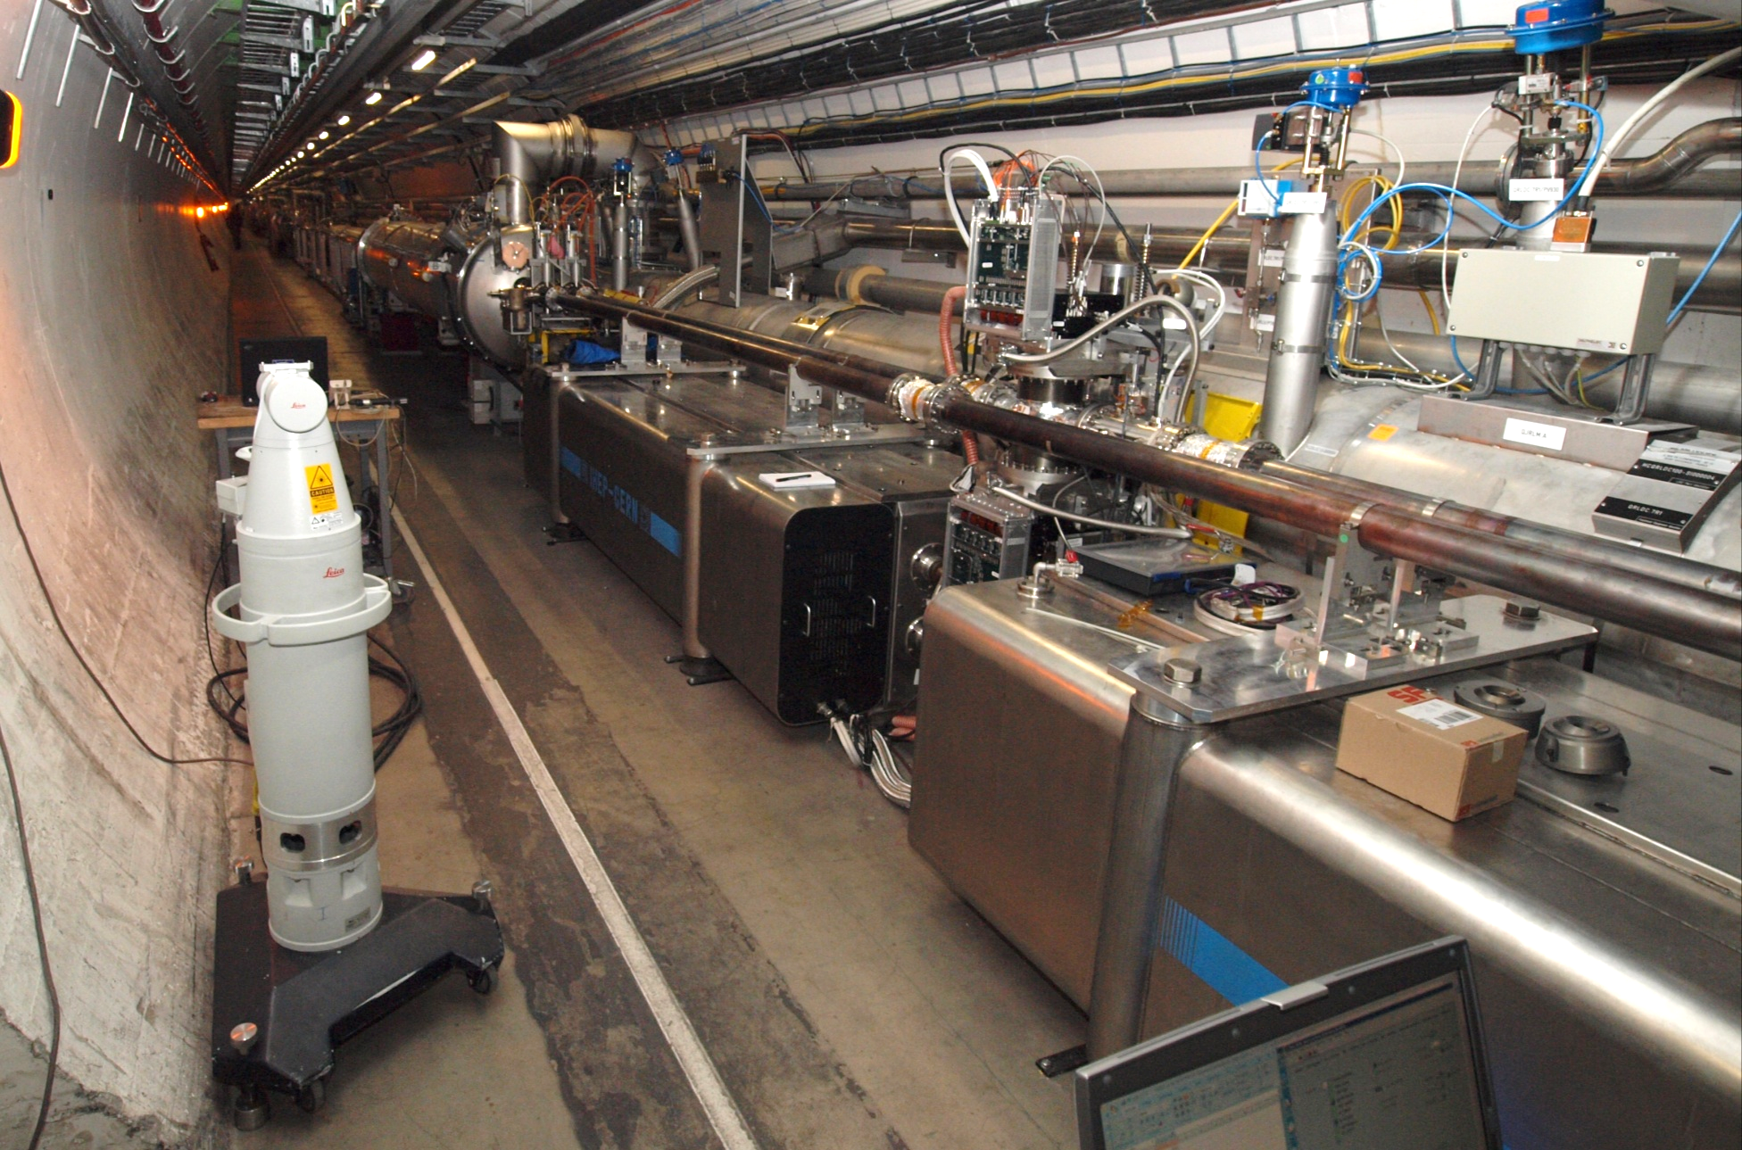
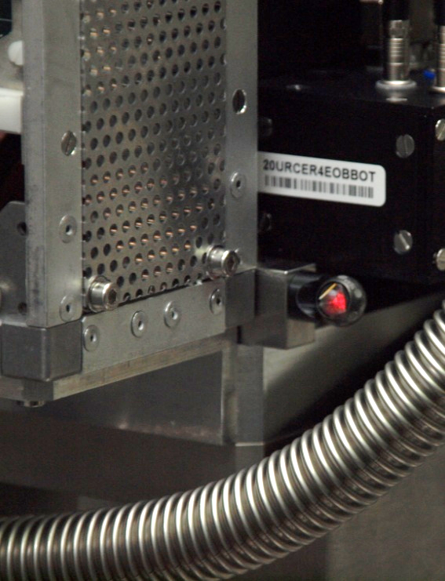
ALFA Installation Triggering Beam based alignment β* = 90 m campaign 2011 Summary and plans for 2012
Survey in LHC to calibrate movement system
Low-X 2012
NIELS BOHR INSTITUTE
UNIVERSITY OF COPENHAGEN
8/18
Sune Jakobsen
Measurement of elastic scattering with ALFA

Slide 14
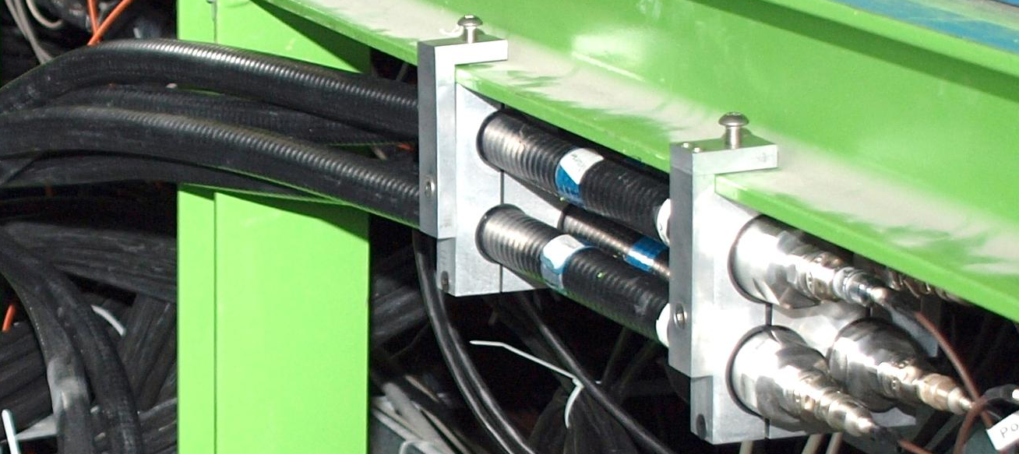
ALFA Installation Triggering Beam based alignment β* = 90 m campaign 2011 Summary and plans for 2012
Delay of ALFA trigger signals
The particles have to travel 240 m (~800 ns) from the interaction point before reaching ALFA.
The trigger signals has to travel back to ATLAS.
Air-core cable
Special air-core cables used with signal speed of 91 % c.
Lemo cable
Signals arrives 500 ns later the normal ATLAS triggers, so a special latency/buffer setting has to be used when ALFA is included in the global ATLAS trigger.
Low-X 2012
NIELS BOHR INSTITUTE
UNIVERSITY OF COPENHAGEN
9/18
Sune Jakobsen
Measurement of elastic scattering with ALFA

Slide 15
ALFA Installation Triggering Beam based alignment β* = 90 m campaign 2011 Summary and plans for 2012
Current logic for main triggers
Low-X 2012
NIELS BOHR INSTITUTE
UNIVERSITY OF COPENHAGEN
10/18
Sune Jakobsen
Measurement of elastic scattering with ALFA

Slide 16
ALFA Installation Triggering Beam based alignment β* = 90 m campaign 2011 Summary and plans for 2012
Current logic for main triggers
Low-X 2012
NIELS BOHR INSTITUTE
UNIVERSITY OF COPENHAGEN
10/18
Sune Jakobsen
Measurement of elastic scattering with ALFA

Slide 17
ALFA Installation Triggering Beam based alignment β* = 90 m campaign 2011 Summary and plans for 2012
Examples of Look-Up-Tables
B7L1U
A7L1U
A7R1U
B7R1U
or
IP
Beam pipe
or
B7L1L
A7L1L
A7R1L
B7R1L
Elastics15 (B7L1U or A7L1U) and (A7R1L or B7R1L)
Elastics18 (B7L1L or A7L1L) and (A7R1U or B7R1U)
Single_Diffraction5 B7L1U and A7L1U
Single_Diffraction6 A7R1L and B7R1L
Single_Diffraction7 B7L1L and A7L1L
Single_Diffraction8 A7R1U and B7R1U
Low-X 2012
NIELS BOHR INSTITUTE
UNIVERSITY OF COPENHAGEN
11/18
Sune Jakobsen
Measurement of elastic scattering with ALFA

Slide 18
ALFA Installation Triggering Beam based alignment β* = 90 m campaign 2011 Summary and plans for 2012
Examples of Look-Up-Tables
B7L1U
A7L1U
A7R1U
B7R1U
or
IP
or
Beam pipe
B7L1L
A7L1L
A7R1L
B7R1L
Elastics15 (B7L1U or A7L1U) and (A7R1L or B7R1L)
Elastics18 (B7L1L or A7L1L) and (A7R1U or B7R1U)
Single_Diffraction5 B7L1U and A7L1U
Single_Diffraction6 A7R1L and B7R1L
Single_Diffraction7 B7L1L and A7L1L
Single_Diffraction8 A7R1U and B7R1U
Low-X 2012
NIELS BOHR INSTITUTE
UNIVERSITY OF COPENHAGEN
11/18
Sune Jakobsen
Measurement of elastic scattering with ALFA

Slide 19
ALFA Installation Triggering Beam based alignment β* = 90 m campaign 2011 Summary and plans for 2012
Examples of Look-Up-Tables
B7L1U
A7L1U
A7R1U
B7R1U
IP
Beam pipe
B7L1L
A7L1L
A7R1L
B7R1L
Elastics15 (B7L1U or A7L1U) and (A7R1L or B7R1L)
Elastics18 (B7L1L or A7L1L) and (A7R1U or B7R1U)
Single_Diffraction5 B7L1U and A7L1U
Single_Diffraction6 A7R1L and B7R1L
Single_Diffraction7 B7L1L and A7L1L
Single_Diffraction8 A7R1U and B7R1U
Low-X 2012
NIELS BOHR INSTITUTE
UNIVERSITY OF COPENHAGEN
11/18
Sune Jakobsen
Measurement of elastic scattering with ALFA

Slide 20
ALFA Installation Triggering Beam based alignment β* = 90 m campaign 2011 Summary and plans for 2012
Examples of Look-Up-Tables
B7L1U
A7L1U
A7R1U
B7R1U
IP
Beam pipe
B7L1L
A7L1L
A7R1L
B7R1L
Elastics15 (B7L1U or A7L1U) and (A7R1L or B7R1L)
Elastics18 (B7L1L or A7L1L) and (A7R1U or B7R1U)
Single_Diffraction5 B7L1U and A7L1U
Single_Diffraction6 A7R1L and B7R1L
Single_Diffraction7 B7L1L and A7L1L
Single_Diffraction8 A7R1U and B7R1U
Low-X 2012
NIELS BOHR INSTITUTE
UNIVERSITY OF COPENHAGEN
11/18
Sune Jakobsen
Measurement of elastic scattering with ALFA

Slide 21
ALFA Installation Triggering Beam based alignment β* = 90 m campaign 2011 Summary and plans for 2012
Examples of Look-Up-Tables
B7L1U
A7L1U
A7R1U
B7R1U
IP
Beam pipe
B7L1L
A7L1L
A7R1L
B7R1L
Elastics15 (B7L1U or A7L1U) and (A7R1L or B7R1L)
Elastics18 (B7L1L or A7L1L) and (A7R1U or B7R1U)
Single_Diffraction5 B7L1U and A7L1U
Single_Diffraction6 A7R1L and B7R1L
Single_Diffraction7 B7L1L and A7L1L
Single_Diffraction8 A7R1U and B7R1U
Low-X 2012
NIELS BOHR INSTITUTE
UNIVERSITY OF COPENHAGEN
11/18
Sune Jakobsen
Measurement of elastic scattering with ALFA

Slide 22
ALFA Installation Triggering Beam based alignment β* = 90 m campaign 2011 Summary and plans for 2012
Examples of Look-Up-Tables
B7L1U
A7L1U
A7R1U
B7R1U
IP
Beam pipe
B7L1L
A7L1L
A7R1L
B7R1L
Elastics15 (B7L1U or A7L1U) and (A7R1L or B7R1L)
Elastics18 (B7L1L or A7L1L) and (A7R1U or B7R1U)
Single_Diffraction5 B7L1U and A7L1U
Single_Diffraction6 A7R1L and B7R1L
Single_Diffraction7 B7L1L and A7L1L
Single_Diffraction8 A7R1U and B7R1U
Low-X 2012
NIELS BOHR INSTITUTE
UNIVERSITY OF COPENHAGEN
11/18
Sune Jakobsen
Measurement of elastic scattering with ALFA

Slide 23
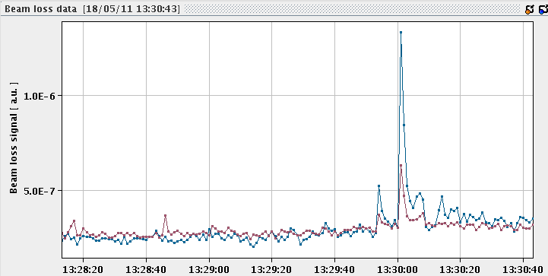
ALFA Installation Triggering Beam based alignment β* = 90 m campaign 2011 Summary and plans for 2012
Beam based alignment (scraping)
Goal: Find accurately the beam center relative to the Roman Pots. This allows positioning of the Roman Pots very close to and symmetric around the beam center.
Position primary collimators at a well-defined position around 4 sigma.
ALFA Roman Pot
Primary collimator
Halo
Beam loss monitor
Beam pipe
Move in very slowly Roman Pots until they touch the beam.
Stop by BLM signal (or very high trigger rate).
Low-X 2012
NIELS BOHR INSTITUTE
UNIVERSITY OF COPENHAGEN
12/18
Sune Jakobsen
Measurement of elastic scattering with ALFA

Slide 24
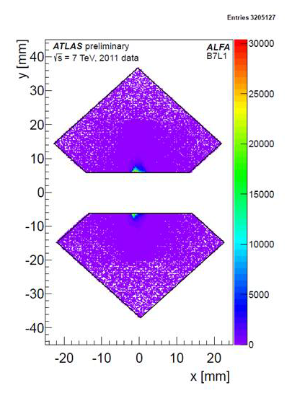
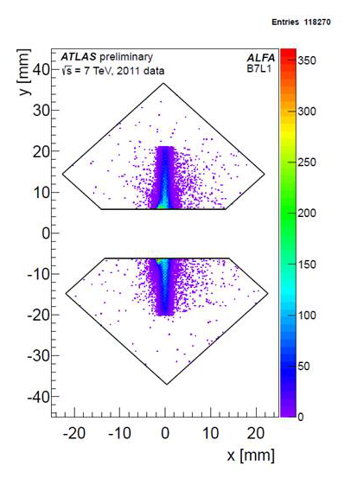
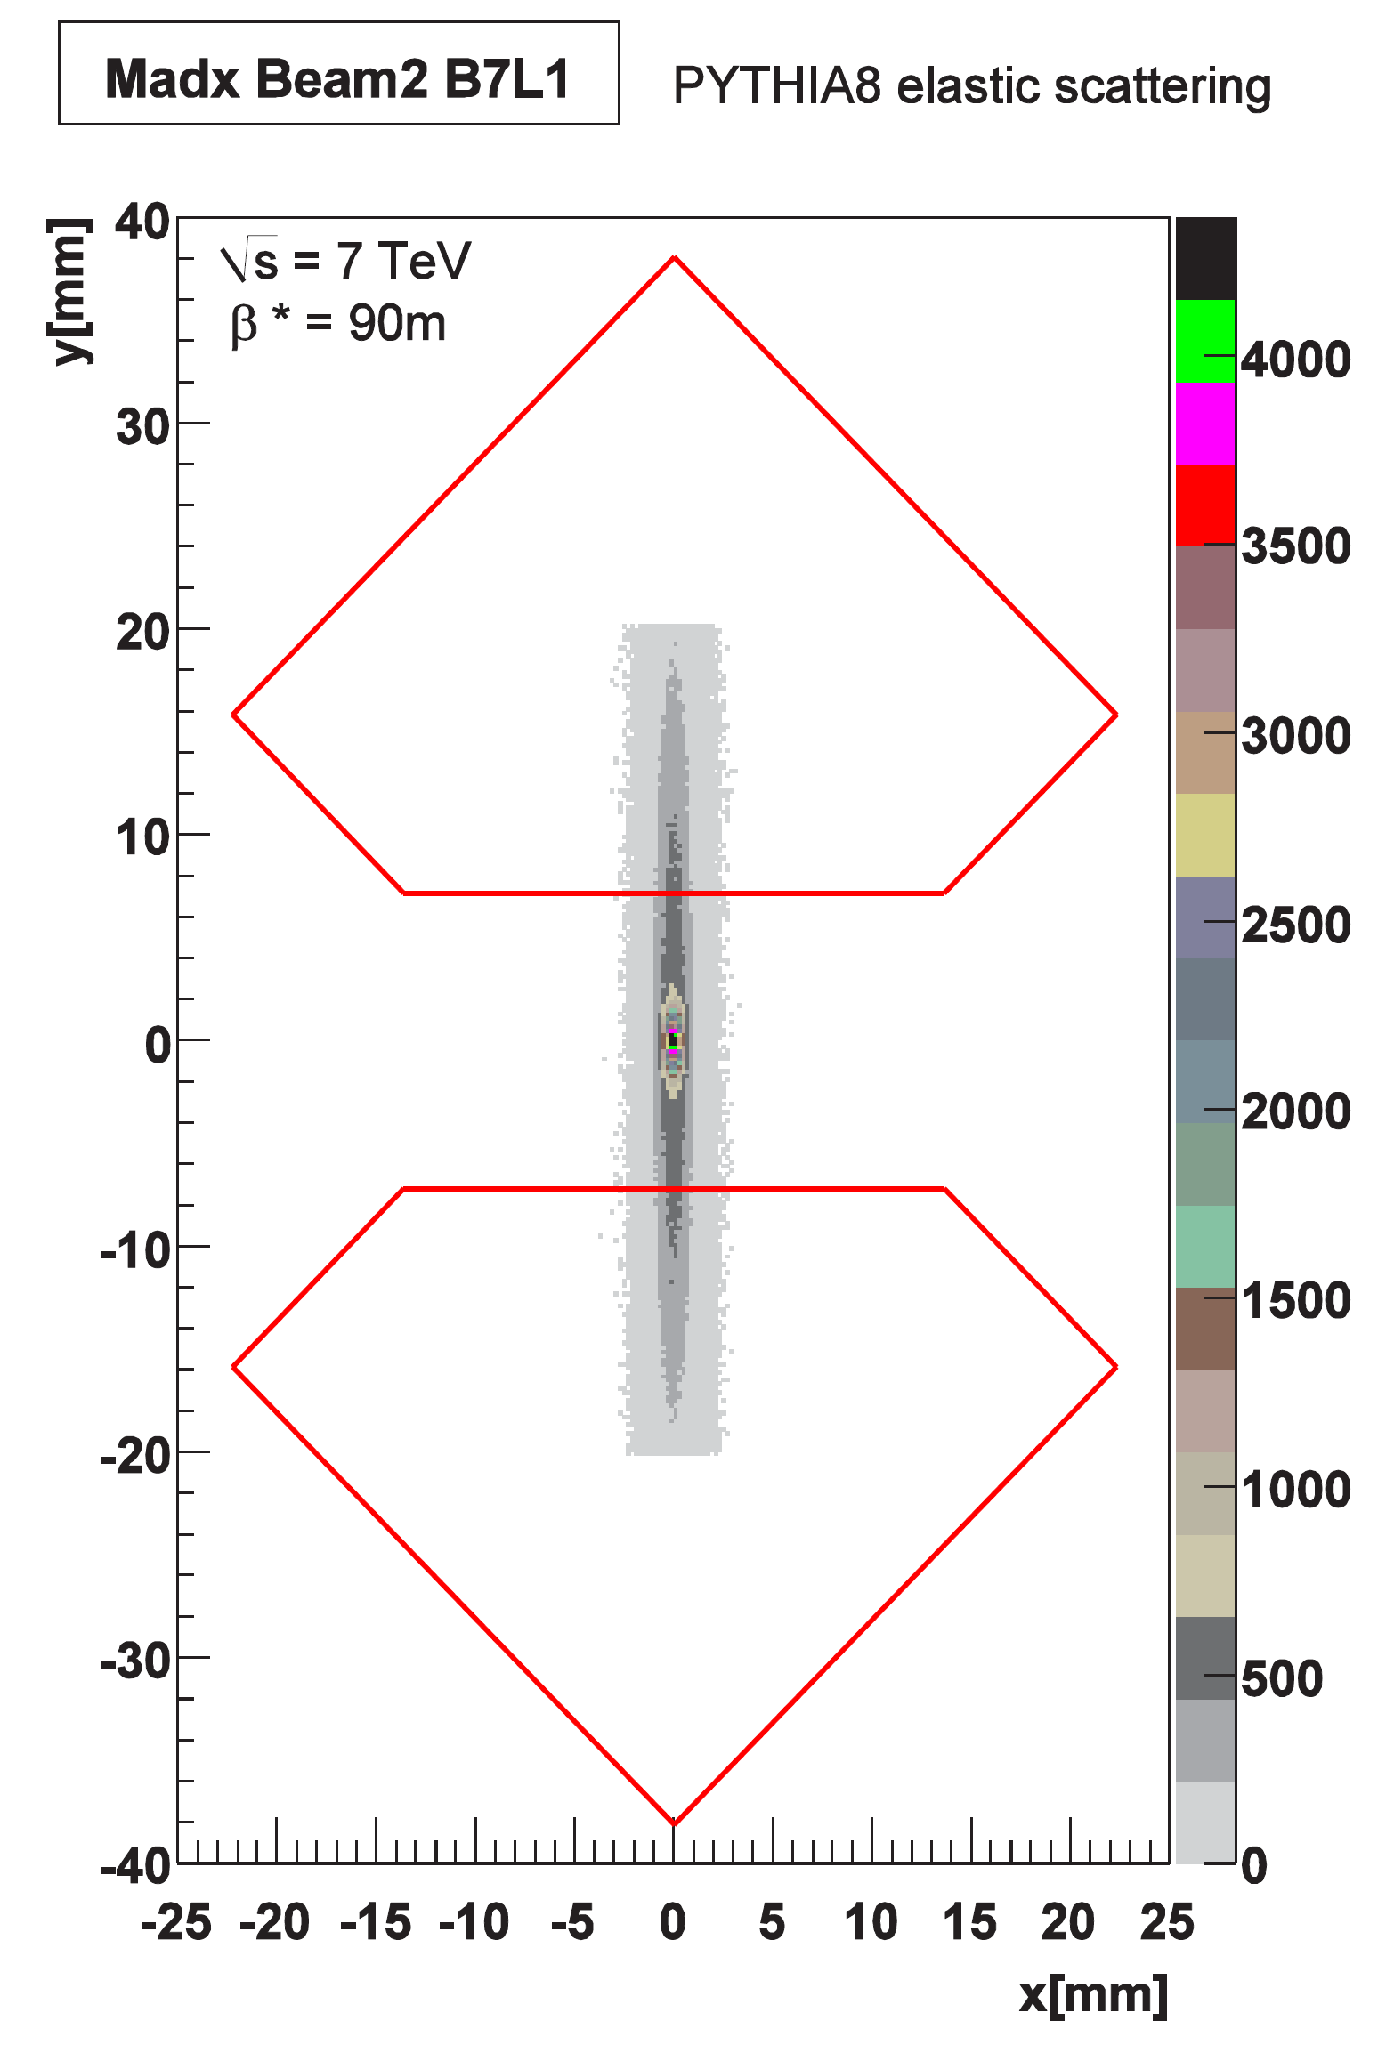
ALFA Installation Triggering Beam based alignment β* = 90 m campaign 2011 Summary and plans for 2012
Data taking at 90 m beta* optics
Goal:
Physics data to determine total cross section.
Roman Pot position:
6.5 nominal sigma (about 9 real sigma to detector edge).
Beam intensity:
1 bunch of 7E10 colliding.
13 bunches of 1E10 colliding.
1 bunch of 7E10 none-colliding.
Track pattern before cuts
Track pattern for only elastic candidates
Simulated track pattern for elastic
Low-X 2012
NIELS BOHR INSTITUTE
UNIVERSITY OF COPENHAGEN
13/18
Sune Jakobsen
Measurement of elastic scattering with ALFA

Slide 25
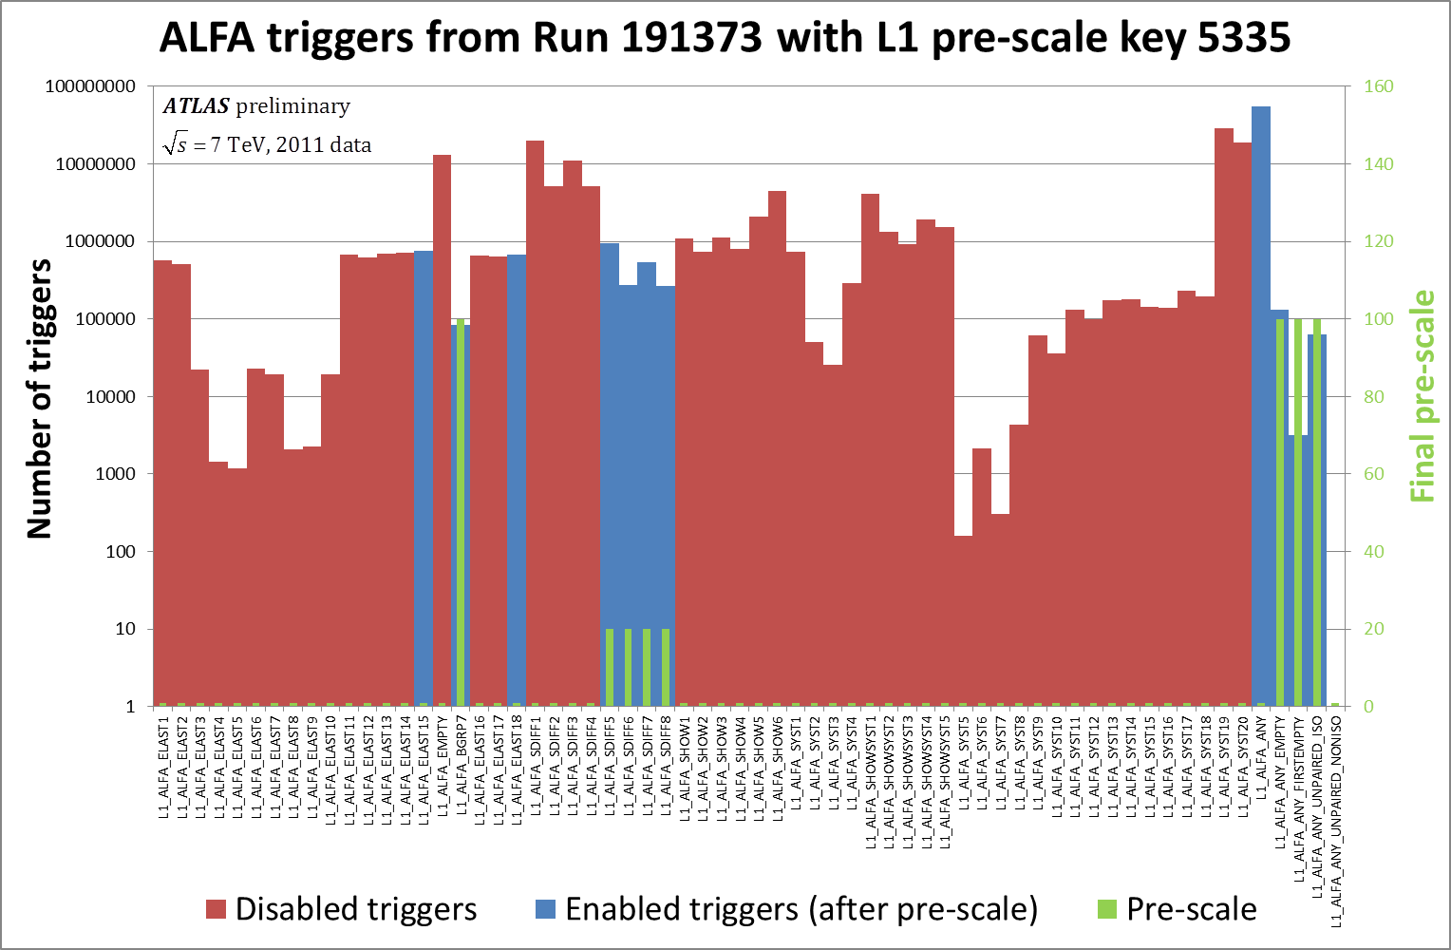
ALFA Installation Triggering Beam based alignment β* = 90 m campaign 2011 Summary and plans for 2012
Observations on beam quality from ALFA triggers
About 1.4 M elastic like triggers.
Any ALFA trigger from colliding bunches
Any ALFA trigger not from any bunches (after 5 BC)
Any ALFA triggers from BC1 (large colliding bunch)
Any ALFA trigger up to 5 BC after a bunch
Any ALFA trigger from none colliding bunches
About 2 M single diffractive like triggers (after pre-scale).
Only about 15 % of the “Any ALFA” triggers is from the large colliding bunch.
Elastic triggers
About 18 % of the “Any ALFA” triggers is not associated with any bunch.
Single diffraction triggers
About 12 % of “Any ALFA” triggers is from none colliding bunches.
Low-X 2012
NIELS BOHR INSTITUTE
UNIVERSITY OF COPENHAGEN
14/18
Sune Jakobsen
Measurement of elastic scattering with ALFA

Slide 26
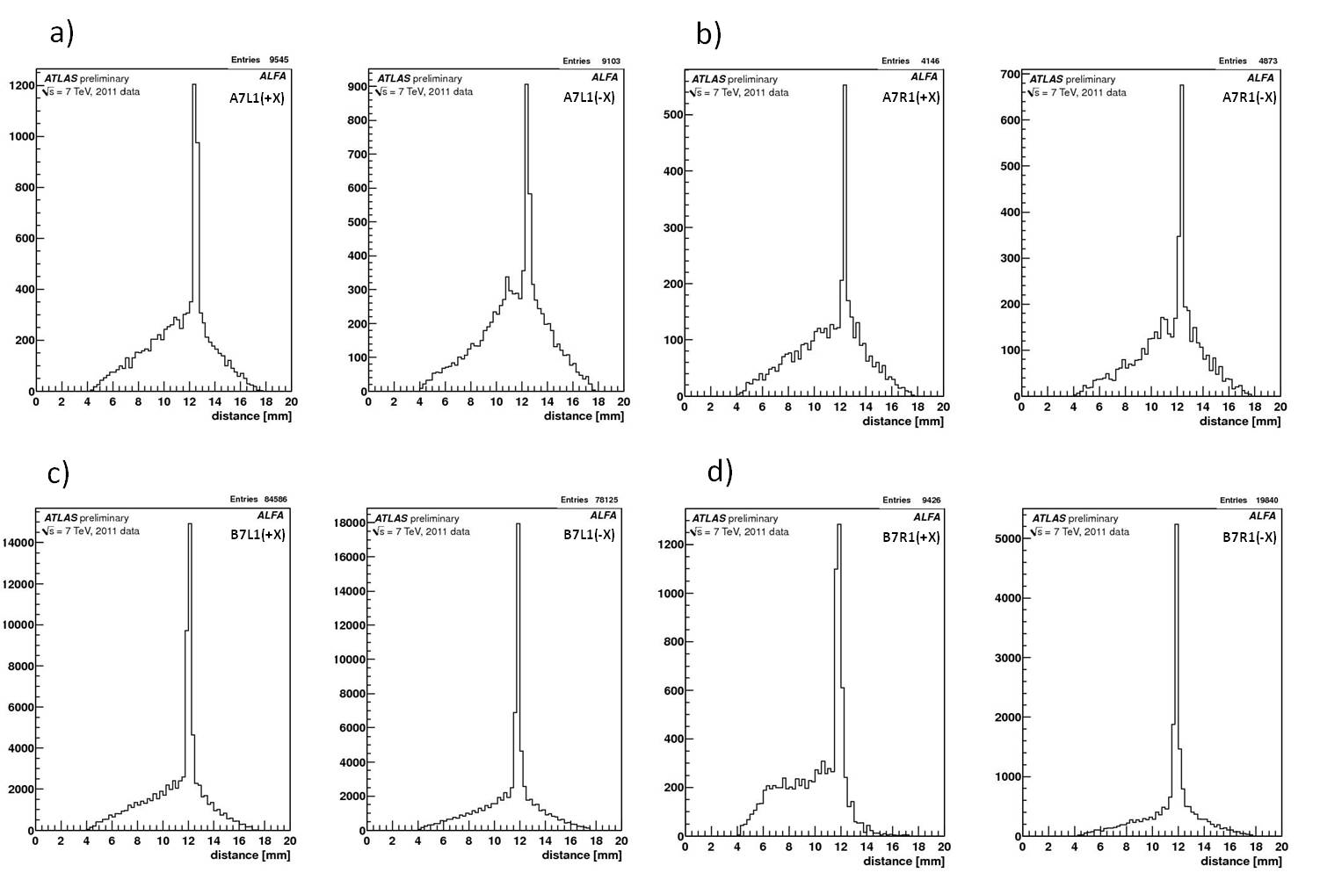
ALFA Installation Triggering Beam based alignment β* = 90 m campaign 2011 Summary and plans for 2012
Detector alignment
Relative distance of the upper and lower Roman Pot is determined using particles passing both the upper an lower “overlap detector”
Reconstructed distance for (left) the first station from the IP and (right) the second station from the IP.
Halo
Beam
The global alignment of the all detectors is made using the distribution of elastic tracks in each detector.
Low-X 2012
NIELS BOHR INSTITUTE
UNIVERSITY OF COPENHAGEN
15/18
Sune Jakobsen
Measurement of elastic scattering with ALFA

Slide 27
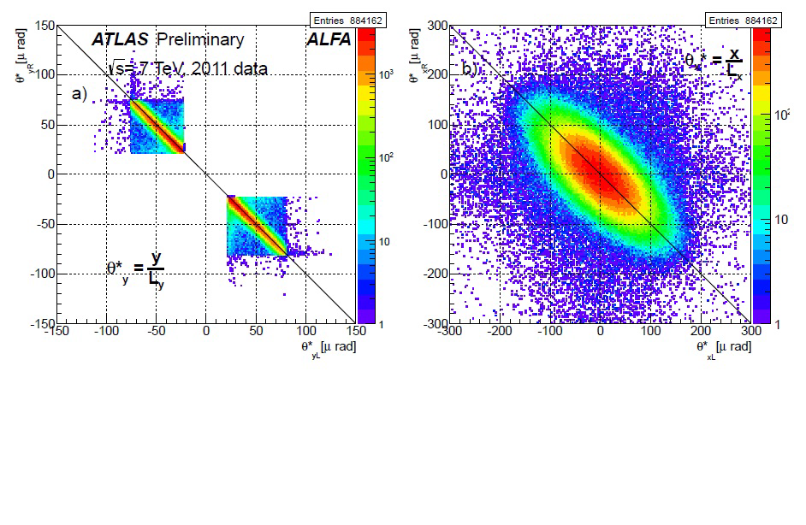
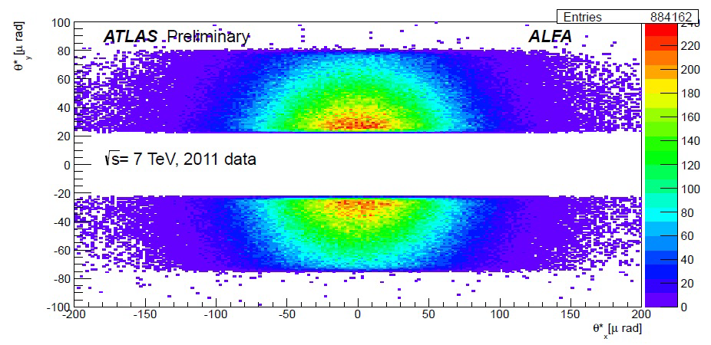
ALFA Installation Triggering Beam based alignment β* = 90 m campaign 2011 Summary and plans for 2012
90 m β* optics - correlations – evidence of elastic events
<=
Reconstructed scattering angle correlation between left and right side for elastic candidates - Vertical
=>
Reconstructed scattering angle correlation between left and right side for elastic candidates - Horizontal
<=
Reconstructed scattering angle correlation between vertical and horizontal planes combining the left and right arm of ALFA
Analysis still ongoing to publish t-spectrum and total cross section.
Low-X 2012
NIELS BOHR INSTITUTE
UNIVERSITY OF COPENHAGEN
16/18
Sune Jakobsen
Measurement of elastic scattering with ALFA

Slide 28
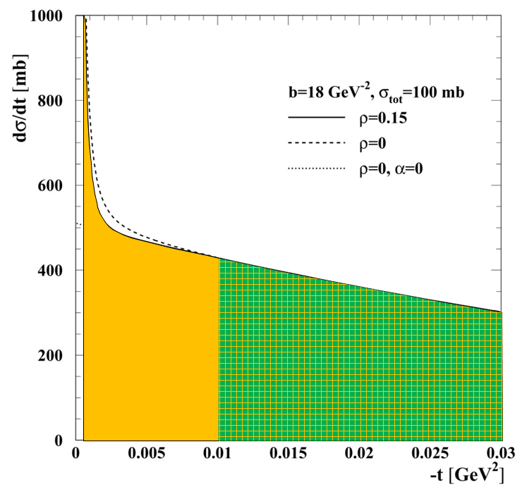
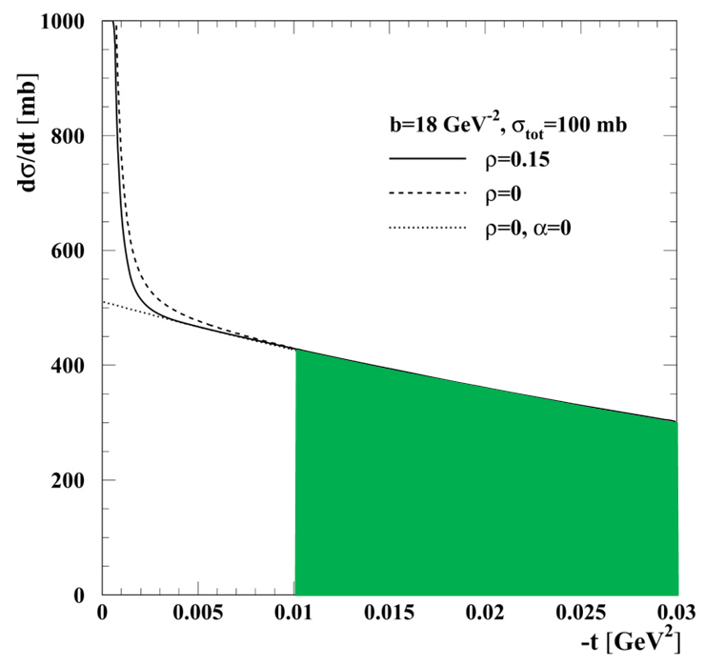
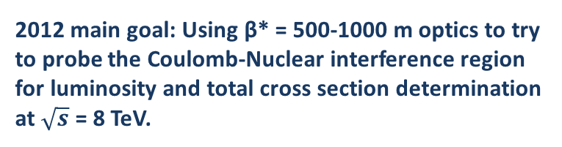
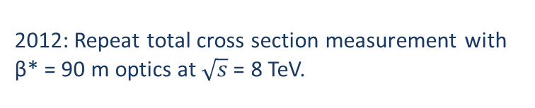
ALFA Installation Triggering Beam based alignment β* = 90 m campaign 2011 Summary and plans for 2012
Summary and plans for 2012
The ALFA detector system was installed in the winter shutdown 2010-2011 and is now fully integrated in ATLAS including common triggering (with special latency setting).
Elastic event data for determination of the total cross section was successfully taking with a special β* = 90 m optics .
The Roman Pots has been aligned online with beam based alignment and offline using the distribution of elastic events and the measured relative distance of the detectors.
Simulated spectrum
Correlations of scattering angles shown – Analysis to get t-spectrum and total cross section on-going.
2012: Repeat total cross section measurement with β* = 90 m optics at $\sqrt{s}$= 8 TeV.
2012: Use the ALFA detectors for diffractive physics measurements at β* = 90 m.
2012 main goal: Using β* = 500-1000 m optics to try to probe the Coulomb-Nuclear interference region for luminosity and total cross section determination at $\sqrt{s}$ = 8 TeV.
Hope for β* = 500-1000 m in 2012
β* = 90 m in 2011
Low-X 2012
NIELS BOHR INSTITUTE
UNIVERSITY OF COPENHAGEN
17/18
Sune Jakobsen
Measurement of elastic scattering with ALFA

Slide 29
ALFA Installation Triggering Beam based alignment β* = 90 m campaign 2011 Summary and plans for 2012
Thanks for your attention
Low-X 2012
NIELS BOHR INSTITUTE
UNIVERSITY OF COPENHAGEN
18/18
Sune Jakobsen
Measurement of elastic scattering with ALFA

