Slide 1

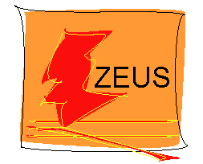
HERAPDF
Low-x meeting 2012
A M Cooper-Sarkar
on behalf of ZEUS and H1 collaborations
HERAPDF NLO uses the combined H1 and ZEUS data on:
Inclusive Neutral and Charged Current processes for e⁺p and e⁻p scattering at 820,920 GeV proton beam energy from HERA-I (HERAPDF1.0) and HERA I+II (HERAPDF1.5)
There are also studies adding data from the lower energy runs at 460, 575 proton beam energy and from adding combined HERA data on F2charm
There are also fits adding separate H1 and ZEUS data on inclusive jet production to the inclusive cross section data (HERAPDF1.6)
Finally HERAPDF1.7 uses ALL of these data sets
HERAPDF NNLO uses just the inclusive cross-section data because of incomplete NNLO calculations for jet data and for charm production

Slide 2
Furthermore the HERAPDF uses purely proton data
No need for deuterium corrections--- arXiv:1102.3686- uncertainties in deuterium corrections can feed through to the gluon PDF in global fits including jet data
No need for dubious corrections for FL when extracting F2 –arXiv:1101.5261
No need for neutrino data heavy target corrections.
No assumption on strong isospin needed to get the d-quark
A very well understood consistent data set JHEP 1001 (2010) 109 +updates
The HERA data combination gives us a well understood ,consistent and accurate data set with systematic errors which are smaller than the statistical errors across most of the kinematic plane. The total errors are ~1% for Q² 20-100 GeV² and less than 2% for most of the rest of kinematic plane.
This allows us to use the χ2 tolerance Δχ2 =1 to set 68% limits on the PDFs from experimental sources

Slide 3
This page shows NC e+ combined data
Above : Results of the combination compared to the separate data sets
Right: the full NC e+ data

Slide 4
Where does the information on parton distributions come from?
CC e-p
CC e+p
d²σ(e⁻p) = G_{F}² M⁴_{W} [x (u+c) + (1-y)²x (d+s)]
d²σ(e⁺p) = G_{F}² M⁴_{W} [x (u+c) + (1-y)²x (d+s)]
dxdy
2πx(Q²+M²_{W})²
dxdy
2πx(Q²+M²_{W})²
The charged currents give us flavour information for high-x valence PDFs
NC e+ and e-
d²σ(e±N) = Y+ [ F₂(x,Q²) - y² F_{L}(x,Q²) ± Y_xF₃(x,Q²)], Y± = 1 ± (1-y)²
dxdy
Y+
Y+
F₂ = F₂^{γ} –v_{e} P_{Z} F₂^{γZ} + (v_{e}²+a_{e}²)P_{Z}² F₂^{Z}
xF₃ = - a_{e} P_{Z} xF₃^{γZ} + 2v_{e}a_{e} P_{Z}² xF₃^{Z}
Where P_{Z}² = Q²/(Q² + M²_{Z}) 1/sin²θ_{W ,} and at LO
[F_{2 ,,}F₂^{γZ}, F₂^{Z}] = Σ_{i} [e_{i}²,2e_{i}v_{i},v_{i}²+a_{i}²][xq_{i}(x,Q²) + xq_{i}(x,Q²)]
[xF₃^{γZ}, xF₃^{Z} ] = Σ_{i} 2[e_{i}a_{i},v_{i}a_{i}] [xq_{i}(x,Q²) - xq_{i}(x,Q²)]
So that xF₃^{γZ} = 2x[e_{u}a_{u}u_{v} + e_{d}a_{d}d_{v}] = x/3 (2u_{v}+d_{v})
Where xF₃^{γZ} is the dominant term in xF₃
The neutral current F2 gives the low-x Sea
The difference between e- and e+ also gives a valence PDF for x>0.01- not just at high-x
And of course the scaling violations give the gluon PDF

Slide 5
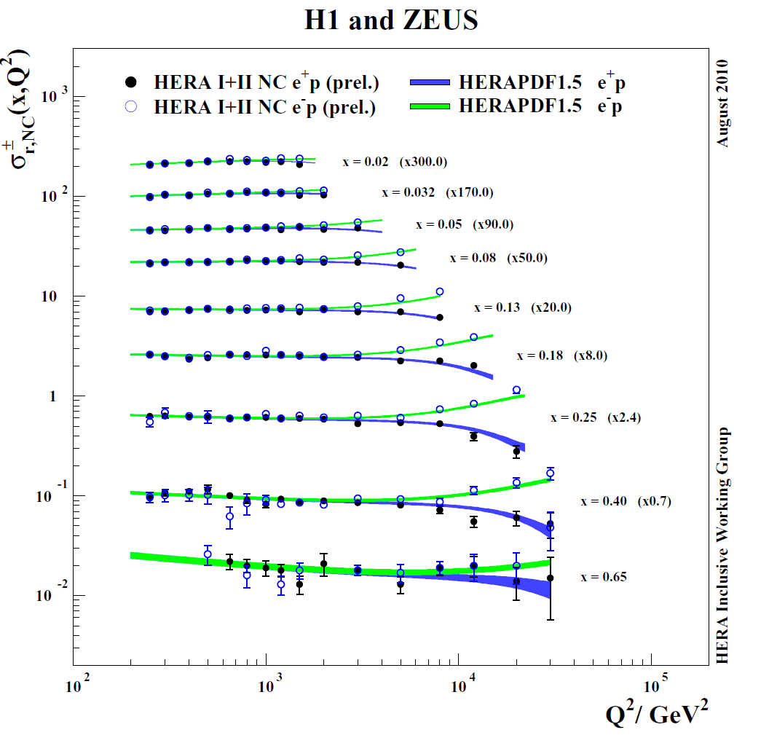
HERAPDF1.0 at NLO is already published (JHEP 1001 -109) and we have updated to HERAPDF1.5 NLO and NNLO : this is an update of data AND fit
Uses preliminary HERA I+II data combination
(ZEUS-prel 10-018,
H1prelim-10-042) in addition to the published HERA-1 combined data
Gives increased precision at high-x
HERAPDF1.5 NLO is on LHAPDF5.8.6 with eigenvector PDFsets and model and parametrisation uncertainties and for a series of α_{S}(M_{Z}) values
However as we include more data sets and move to NNLO we have extended our central parametrisation.
5

Slide 6
A reminder of the PDF parametrization: u_valence, d_valence, U and D type Sea and the gluon are parametrised by the form
² + ε√x)
 | A | B | C | D | E ε
uv | Sum rule | free | free | free | free var
dv | Sum rule | free | free | var | var var
UBar | =(1-fs)ADbar | =BDbar | free | var | var var
DBar | free | free | free | var | var var
glue | Sum rule | free | free | var | var var
A’g | B’g
free | free
extended gluon parametrisation Ag x^{Bg} (1-x)^{Cg} (1+Dx+Ex²) – A’g x^{B’g} (1-x) ^{Cg}
The table summarises our extended parametrization choices and the parametrization variations that we consider in our uncertainty estimates (and we also vary the starting scale Q²₀). NOTE we have made the gluon more flexible and we have freed low-x d-valence from u-valence
We also consider model uncertainties on the PDFs by varying m_{c},m_{b},f_{s},Q²_{min}
PDFs are also supplied for a range of α_{s}(M_{Z}) values
6

Slide 7
How does the extended parametrisation affect the NLO PDFs?- not much
HERAPDF1.5 HERAPDF1.5f
The level of total uncertainty is similar- but we swap parametrisation uncertainty for experimental uncertainty- and there is slightly more uncertainty on low-x gluon
The central values have shifted such that the flexible parametrisation has a softer high-x Sea and a suppressed low-x d-valence- but these changes are within our error bands
7

Slide 8
Using this extended parametrization we added HERA jet data (as yet uncombined) to the fit ( ZEUS-prel-11-001 ,H1prelim-11-034)
Without jets
With jets
There is little difference in the size of the uncertainties after adding the jet data –but there is a marginal reduction in high-x gluon uncertainty.

Slide 9
However, the jet data allow us to make a competitive measurement of α_{S}(M_{Z})
The χ2 scan of HERAPDF1.5f (no jets) and HERAPDF1.6 (with jets) vs α_{S}(M_{Z})
α_{S}(M_{Z}) =0.1202 ± 0.0013 (exp) ± 0.0007(model/param) ± 0.0012(hadronisation)
+0.0045/-0.0036 (scale)
α_{S}(M_{Z}) = 0.1202 ± 0.0019 ± scale error

Slide 10
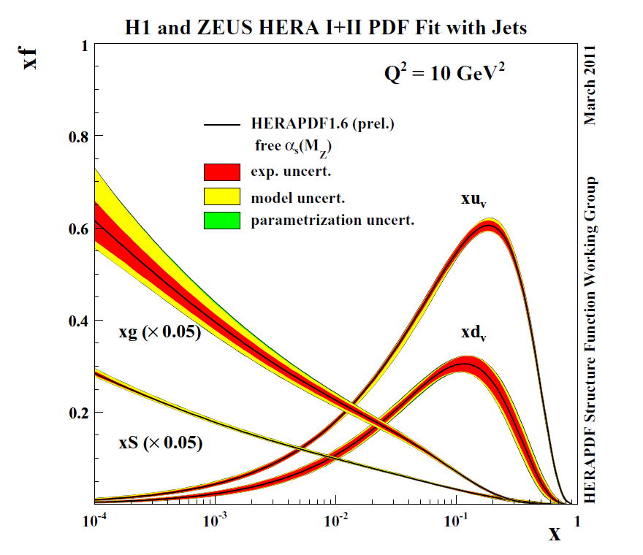
Free α_{S}(M_{Z}) no jets
Free α_{S}(M_{Z}) with jets
PDFs with freeα_{S}(M_{Z}) with and without jet data included in the fit
The addition of the jet data ensure that the PDF uncertainty on the gluon due to the uncertainty on α_{S}(M_{Z}) is not very large
10
10

Slide 11
We have also made specific studies of the addition of the HERA combined F2charm data (ZEUS prel 10- 009,H1prelim 10 -045 )
In HERAPDF1.0,1.5 we present a model uncertainty of mc 1.35 to 1.65 GeV on the charm mass . The inclusive data have no sensitivity to mc (left). The combined charm data do (middle). However the value depends on the scheme chosen to calculate the heavy quark contributions (right). All schemes bar the Zero Mass Variable Flavour Number have equally acceptable χ2
The use of the optimal charm mass for the chosen scheme has consequences for the predictions of LHC W, Z cross sections.
The charm data will help to reduce uncertainties

Slide 12
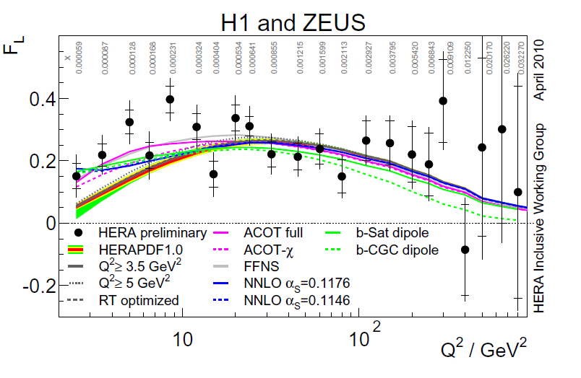
H1 and ZEUS have also combined the e+p NC inclusive data from the lower proton beam energy runs (P_{P} = 460 and 575) and produced a common FL measurement (ZEUS prel 10-001 , H1prelim 10-043 )
In HERAPDF1.0,1.5 we also present a model uncertainty from the variation of the minimum Q² cut on the data The low energy data are more sensitive to this cut.
If low Q² -and hence low x - data are cut -the resulting gluon is somewhat steeper.
This level of uncertainty is now covered by the extended parametrization

Slide 13
We have now put together all the data sets:
HERA –I +II high energy inclusive, HERA-II low energy inclusive , F2charm and the separate H1 and ZEUS jet data to make HERAPDF1.7 NLO using the extended parametrization.(ZEUS prel-11-010)
All the data sets are very compatible and
the addition of charm motivates us to change our standard VFN to the RT optimised version, with its preferred value of the charm mass parameter mc=1.5 GeV,
whereas the jet data motivate us to raise our standard NLO α_{S}(M_{Z}) value to
α_{S}(M_{Z}) = 0.119
HERAPDF1.7 has a steeper gluon at low-x than our previous PDFS. This is because of the use of the RT optimized GMVFN scherme

Slide 14
LHC at 7 TeV parton-parton luminosity plots for HERAPDF in ratio to MSTW2008
From Graeme Watt
You can see that HERAPDF1.5 has a softer high-x sea than 1.0 but very similar gluon.

Slide 15
Comparing HERAPDF1.5, 1.6, 1.7
α_{S}(M_{Z})=0.1176, 0.1202,0.119
The hard high-x sea is softest for 1.7 – relaxing the parametrisation, adding jets, adding more data sets.
We also see that the low-x distributions are a bit steeper for 1.7 for gluon and quark
This is because the shape of the low-x gluon is steeper for RTOPT mc=1.5 (and this is a bit mitigated by the higher alphas value).
But the soft high-x gluon is rather similar for 1.7 and 1.5. the hardest high-x gluon is for 1.6 with larger α_{S}(M_{Z}) .

Slide 16
And so to NNLO: ZEUS-prel-11-002/H1prelim-11-042. For these fits only HERA I+II high energy inclusive data are used
First compare HERAPDF1.5 NLO and NNLO both with extended parametrization
NLO
NNLO
What are the differences?
Valence not much
Sea a little steeper
Gluon more valence like
The low-x gluon has greater uncertainty NNLO DGLAP is NOT a better fit than NLO to low-x,Q² data
On these plots both NLO and NNLO have α_{s}(M_{Z}) =0.1176

Slide 17
Now compare HERAPDF1.5NNLO to HERAPDF1.0 NNLO
Previously we did not issue an error band on the 1.0 NNLO fits – the errors were in fact asymmetric and this is what led us to the extended parametrisation. Here we compare at α_{S}(M_{Z})=0.1176, which is our recommended central value for NNLO
The HERAPDF1.5 NNLO is available for a series of α_{S}(M_{Z}) values and with model and parametrisation uncertainties on LHAPDF5.8.6
HERAPDF1.5 NNL0 has a harder high-x gluon than HERAPDF1.0.

Slide 18
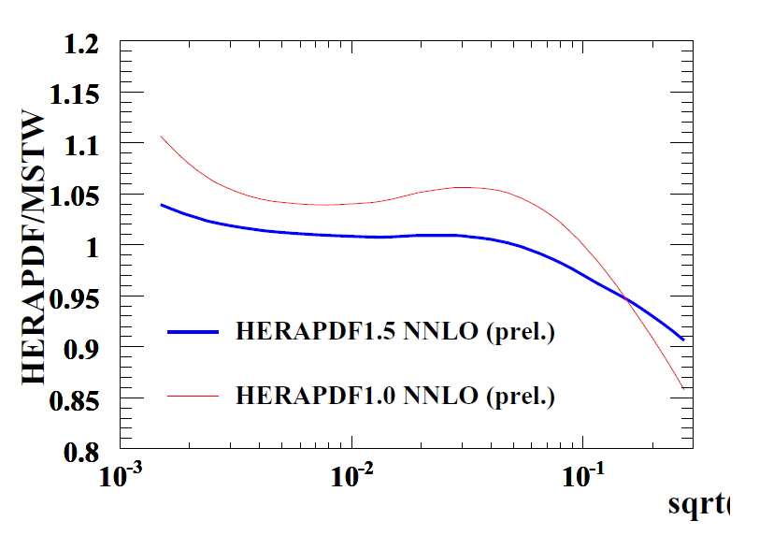
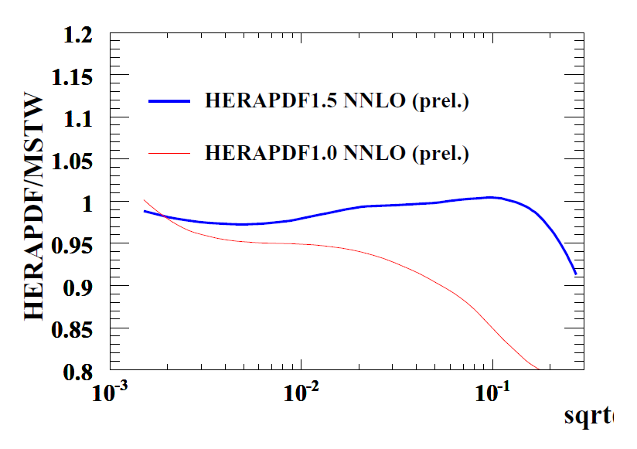
Watt’s NNLO luminosity plots- the upper error on HERAPDF1.5NNLO high-x g-g is quite large

Slide 19
FInally how does HERAPDF measure up to Tevatron data
χ2=27/28
χ2=16/28
χ2=19/13
χ2=25/11
Pretty well for Tevatron W and Z data – even before fitting –and if these data are fit (χ2 given after fit) the resulting PDFs lie within the HERAPDF1.5 error bands
Descriptions for HERAPDF 1.6,1.7 are similar
19

Slide 20
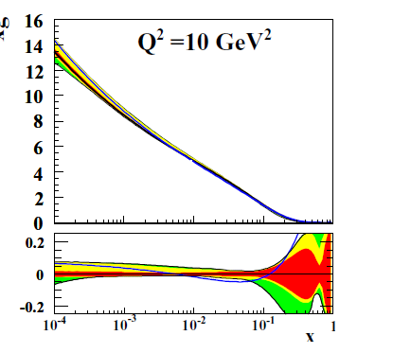
What about Tevatron jet data?– it ‘looks’ OK
But it is not sufficent for it to ‘look’ OK. The correlations are so large that one needs to do a fit including correlations. For HERAPDF 1.5 central settings
χ2/dp = 176/76 for CDF jets
However this ignores the error band of the fit. If these data are included in an NLO fit we get χ2/dp = 113/76 and The resulting PDF is still within the error bands- although at the edge of (68%CL) error bands
Making the χ2 calculation again for recent HERAPDFs:
At NLO HERAPDF1.6 α_{S}(M_{Z}) =0.1202 gives the best fit for its central settings χ2/dp = 122/76 for CDF jets- it has the hardest high-x gluon
At NNLO HERAPDF1.5 gives χ2/dp=72/76 already a very good description even before the data are input to the fit
(and yes it has a relatively hard high-x gluon

Slide 21
FInally how does HERAPDF measure up to LHC data
HERAPDF1.7(1.6,1.5) vs ATLAS 2010 muon and electron data combined data
HERAPDF1.5 vs CMS 2010+11 data and HERAPDF1.0 vs ATLAS,CMS and LHCb data
ATLAS and CMS Z0 data compared to HERAPDf1.7

Slide 22
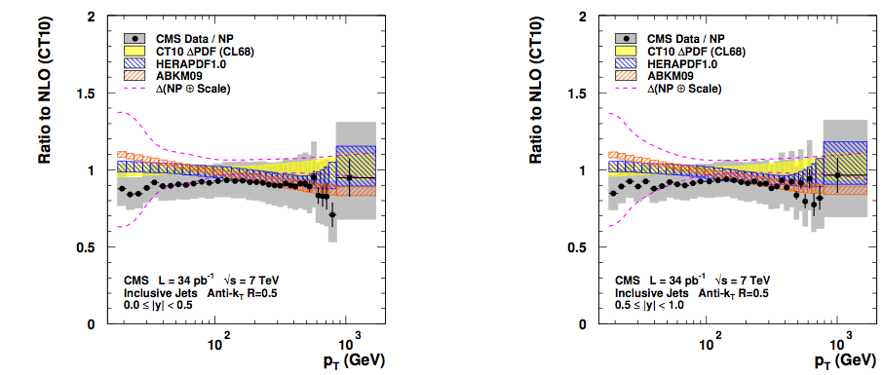
And how well is LHC jet data described?
As usual I looks quite good but we must fit it. ATLAS data come with correlations
HERAPDF1.5 χ2/dp = 58/90
HERAPDF1.6 α_{s}(M_{Z})=0.1202 χ2/dp = 52/90
HERAPDF1.7 χ2/dp = 56/90
HERAPDF1.5 NNLO χ2/dp = 44/90
All good fits, not much discrimination

Slide 23
Summary
The HERA inclusive data provide precision for the low-x Sea and gluon PDFs, the u-valence is also well measured, and the d-valence is measured without assumptions about nuclear corrections or strong isospin.
Adding HERA jet data allows a measurement of α_{S}(M_{Z}) and the high-x gluon
Adding charm data allows a reduction in model uncertainties concerning the charm mass and scheme.
Adding low energy data will allow us to investigate non-DGLAP behaviour at low x,Q²
HERAPDF gives a good description of Tevatron W, Z data and jet data (within its error bands) and a good description of LHC W ,Z and jet data

Slide 24
extras

Slide 25
LHC at 7 TeV parton-parton luminosity plots for HERAPDF1.5 in ratio to MSTW2008
q-qbar
g-g
The q-qbar luminosity at NLO
HERAPDF1.5 is softer than 1.0 at high-x and 1.5f is even softer
Adding the jets to make it 1.6 makes the high-x sea even softer
Letting alphas be free so that α_{S}(M_{Z})=0.1202 rather than 0.1176 hardens the high-x quark distribution marginally
An HERAPDF1.7 is softest of all
The g-g luminosity at NLO
HERAPDF1.5 is on top of 1.0 and 1.5f is very similar
Adding the jets to make it 1.6 makes little difference, similarly for 1.7
But letting alphas be free so that α_{S}(M_{Z})=0.1202 rather than 0.1176 also reduces the low-x gluon and hardens the high-x gluon

Slide 26
LHC at 7 TeV parton-parton luminosity plots for HERAPDF1.0/1.5 in ratio to MSTW2008 at NNLO
q-qbar
g-g
Mention alphas value choice of 0.1176 not 0.1145
NNLO -- NNPDF2.1
Compare MSTW Compare HERAPDF1.5
26

Slide 27
This consistency of the HERAPDFs for W,Z predictions is also the case for Tevatron energies. Here we see CDF Z0 data, CDF direct W-asymmetry data and D0 lepton asymmetry data compared to HERAPDF1.5,1.6(alphas=0.1202) and 1.7.
(Sorry that I have a bug when the D0 lepton asymmetry goes negative– but the point that the new PDFs remain similar to the publically available 1.5NLO stands.

Slide 28
So how about the other HERAPDFs. Again using central settings: HERAPDF1.5 χ2/dp = 176/76
HERAPDF1.5f χ2/dp = 169/76
HERAPDF1.6 χ2/dp = 167/76
HERAPDF1.6 () χ2/dp = 122/76
HERAPDF1.7 χ2/dp = 160/76
HERAPDF1.5NNLO χ2/dp=72/76
(Of course NNLO is not strictly correct for the jets but other PDF fitters do this)
Going back to NLO PDFs:
Only 1.6 with free larger αs(=0.1202) is actually a significantly better fit than 1.5.
Of course one can fit the CDF jet data in a fit like 1.6 with HERAjets and αs=0.1202. Such a fit gives χ2/dp = 74/76, but the high-x gluon PDF has gone outside the error band!
Conclusion CDF jets do want out NLO PDFs to have harder high-x gluon
But 1.5NNLO is as good as any NNLO PDF

Slide 29
How does HERAPDf measure up to LHC data?
LHCb
χ2=8/5
χ2=4/12
χ2=16/11
χ2=16/35
Early ATLAS W and Z data are described fairlly well and if these data are fit (χ2 given after fit) the resulting PDFs lie within the HERAPDF1.5 error bands
29

Slide 30
Comparison of ATLAS W+, W- lepton, Z0 and W-lepton asymmetry with HERAPDF1.5NNLO

Slide 31
Last year I showed HERAPDF1.5 vs early ATLAS muon asymmetry data. Here I show HERAPDF1.7 vs these data and you can see it does not differ much from 1.5 (or 1.6)
And here I show HERAPDF1.7 vs ATLAS 2010 muon and electron data combined (phew!) and CMS 2010+11 vs HERAPDF1.5
And the bottom two plots are ATLAS and CMS Z0 data compared to HERAPDf1.7

Slide 32
Just to re-inforce the point that HERAPDF1.7,1.6 and 1.5 are not very different for W,Z predictions here are some plots of predictions for rapidity distributions of ratios and W+,W-,Z0 differential cross-sections with the error bands shown so you can see the differences in the PDFS better.
It is basically all at high rapidity and is within error bands.

Slide 33
Various HERAPDFs central PDF only fits to ATLAS jet data:
HERAPDF1.5 χ2/dp = 58/90
HERAPDF1.5f χ2/dp = 57/90
HERAPDF1.6 χ2/dp = 56/90
HERAPDF1.6 free αs=0.1202 χ2/dp = 52/90
HERAPDF1.7 χ2/dp = 56/90
HERAPDF1.5 NNLO χ2/dp = 44/90
ATLAS jets are well fit by ALL HERAPDFs
If we input the ATLAS jet data to the HERAPDF1.5f fit (ie no extra HERA data) with α_{S}(M_{Z}) free we get
χ2/dp = 52/90
α_{S}(M_{Z})=0.1201 ±0.0019 HERA+ATLAS α_{S}(M_{Z})=0.1164 ±0.0031 just HERA
Experimental errors only
And the high-x gluon would like to be harder

Slide 34
Summary
Only HERAPDF1.5 NLO and NNLO are public
But 1.7,1.6 give very similar predictions for W and Z production for both LHC and Tevatron
There are some differences for LHC and CDF jet production.
Our NNLO PDF HERAPDF1.5 NNLO does well but we may still doubt the use of an NNLO PDF for jets (though other PDF fitters use them)
Amongst our NLO PDFs HERAPDF1.6 (alphas=0.1202), which included HERA jets, gives the best predictions for CDF jet production but CDF data would still like a harder high-x gluon.
ATLAS jet data is not so discriminating- all our PDFs fit well, although it is still true that chisq improve if we move to the hardest high-x gluon end of our error bands.
HERAPDF1.7 is not as good for fitting Tevatron jet data as 1.6 because
The RTopt and higher mc value work against having a hard high-x gluon
The extra low energy data and charm data seem to ‘dilute’ the effect of the jets a bit?
However 1.7 does have a less hard high-x quark distribution

