Slide 1
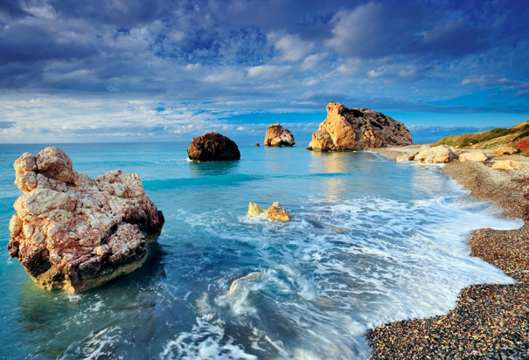


Resonance and low-mass vector meson production in ALICE
A. Badalà – INFN Sezione di Catania for the ALICE collaboration
Introduction and ALICE performances
Resonances identified by their hadronic decay channel in pp collisions (√s_{NN}= 0.9 and 7 TeV)
Resonances identified by their leptonic decay channel in pp collisions (√s_{NN}=2.76 and 7 TeV)
Resonance results in Pb-Pb (√s_{NN} =2.76 TeV)
Conclusions and Prospects
LowX meeting – Paphos (Cyprus) 27 June-1 July 2012
1

Slide 2
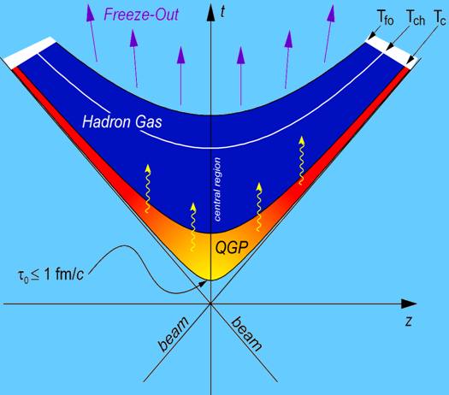
Resonances in heavy-ion collisions
Resonances have lifetimes of about a few tens fm/c →τ_{resonance} ~ τ_{fireball}
 | Mass (MeV/c²) | Width (MeV/c²) | cτ(fm) | Decay
ρ(770) | 770 | 150.7 | 1.3 | ππ/μμ
φ(1020) | 1019 | 4.26 | 46 | K K/μμ
Σ(1385)± | 1385 | ∼33 | 6 | Λ π
Ξ(1530)⁰ | 1530 | 9 | 22 | Ξ π
t~10 fm/c
Resonances may give informations on the nuclear matter dynamics and chiral properties
Regeneration and rescattering effects→Timescale chemical-kinetic freeze-out
Modification of width, mass and branching ratio
Space-time evolution of ultrarelativistic heavy ion collision
A. Badalà- LowX meeting – Paphos (Cyprus) 27 June-1 July 2012
2

Slide 3
Resonances and chiral symmetry
To study chiral symmetry restoration in terms of mass shift and width broadening, resonance decays from the early stage of the medium need to be extracted
The best probes are resonances reconstructed by their leptonic decay channel since leptons are less likely to rescatter in the hadronic medium. However regenerated resonances from the late hadronic phase feed down into this signal
π⁻
⁺
⁻
π⁺
⁻
π⁻
ρ⁰
ρ⁰
ρ⁰
⁺
π⁺
ρ⁰
π⁻
⁻
ρ⁰
π⁺
⁺
Hadronic decay channel probes late stages of the collision
Leptonic decay channel probes all stages of the collision
A. Badalà- LowX meeting – Paphos (Cyprus) 27 June-1 July 2012
3

Slide 4
Resonances in pp collisions
Decay of resonances →large fraction of the final-state particles→ early step in understanding pp collisions at LHC, i.e. opportunity to test QCD in a new energy domain
In general, resonance production in pp collisions helps in
establishing the underlying event structure and the baseline for heavy-ion collisions
constraining QCD-inspired models (PYTHIA, PHOJET,etc…)
understanding hadronic production processes
strangeness production is accessed via strange resonance production
A. Badalà- LowX meeting – Paphos (Cyprus) 27 June-1 July 2012
4

Slide 5
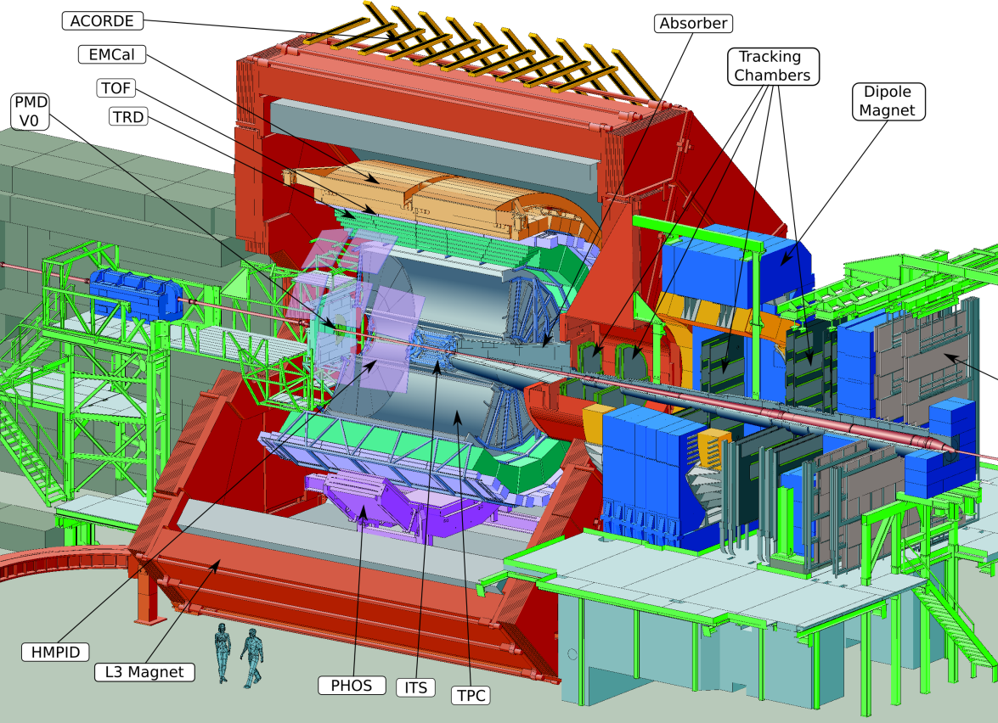

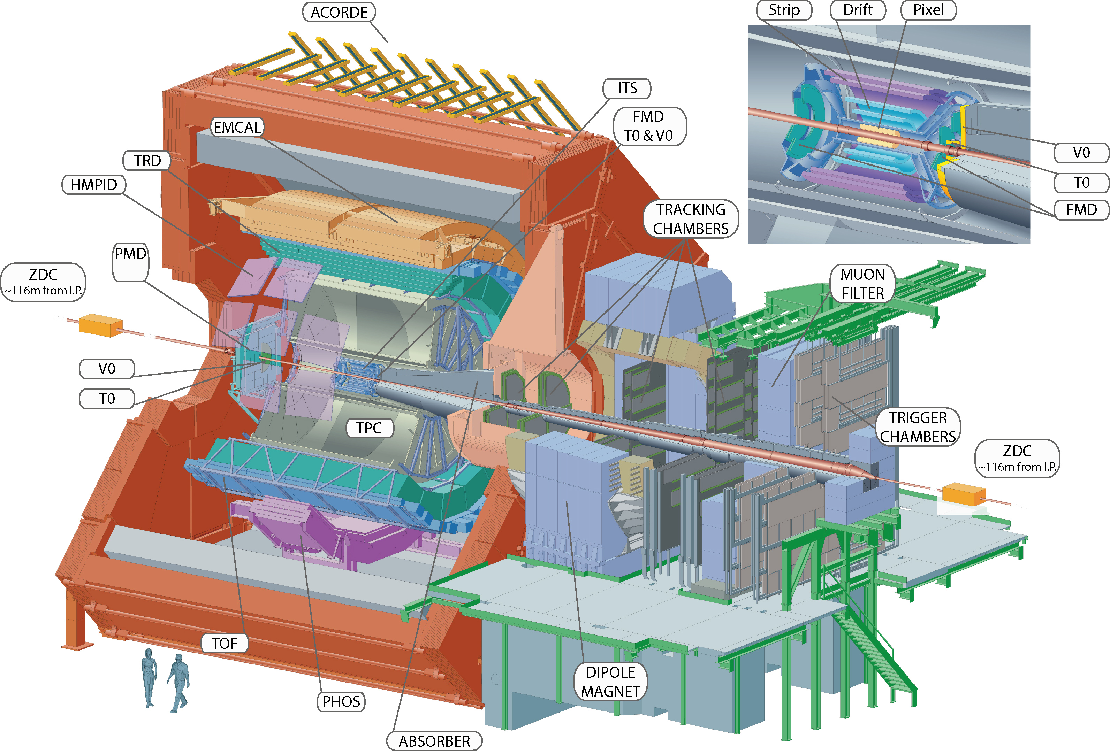

ALICE
Muon Spectrometer
Detector:
Size: 16 x 26 meters
Weight: 10,000 tons
5

Slide 6
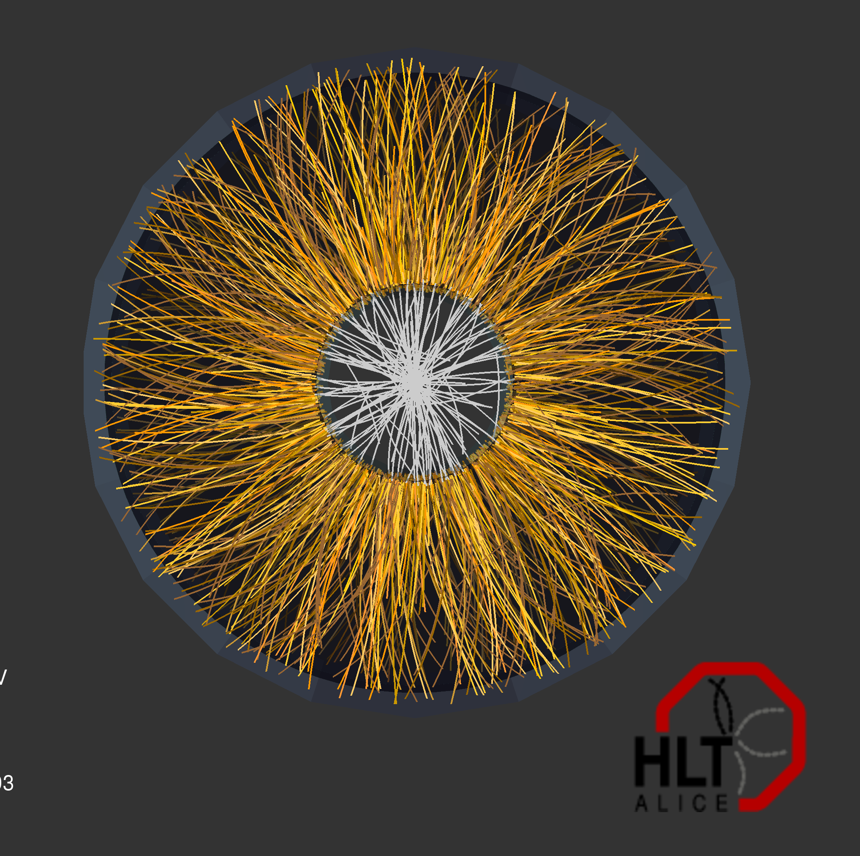
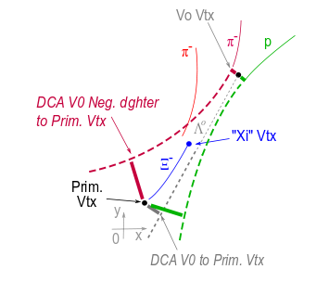
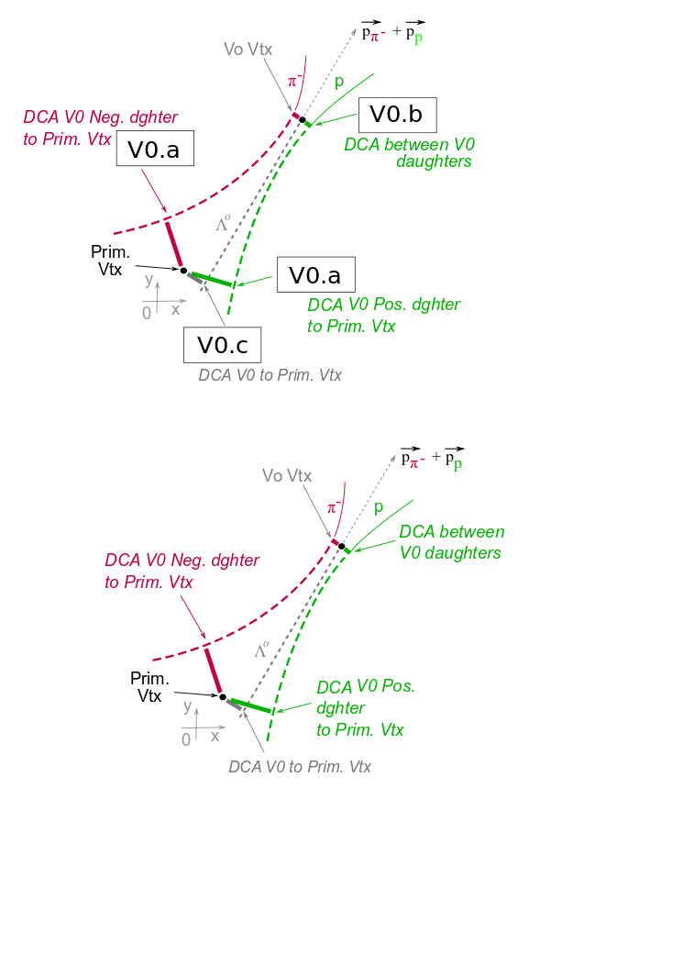
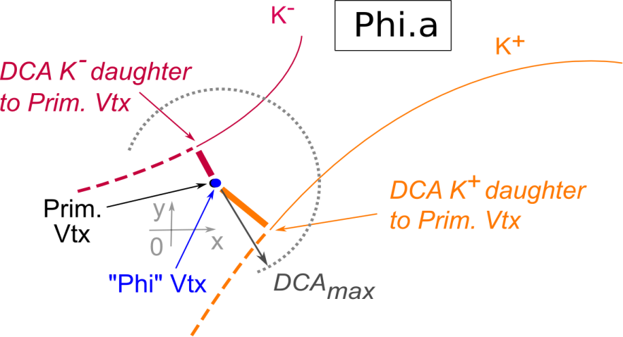
Resonance reconstruction
Reconstruction based on primary tracks or particles (cut on DCA)
π, K, p identified via PID detectors (ITS,TPC,TOF)
K(892)⁰ → π⁻ + K⁺
(1020) → K⁺ + K⁻
Σ(1385)± → Λ⁰ + π±
Ξ(1530)⁰ → Ξ⁻ + π⁺
Λ identified by secondary tracks, with opposite charges, within a fiducial volume,
+ “V0 topology”
K⁺
K*
Ξ identified by three secondary tracks, within a fiducial volume,
+ “Cascade topology”
π⁻
φ(1020)
Ξ⁻
Λ⁰
6
A. Badalà- LowX meeting – Paphos (Cyprus) 27 June-1 July 2012

Slide 7
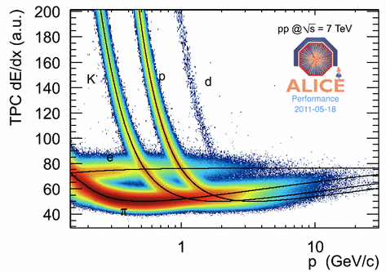
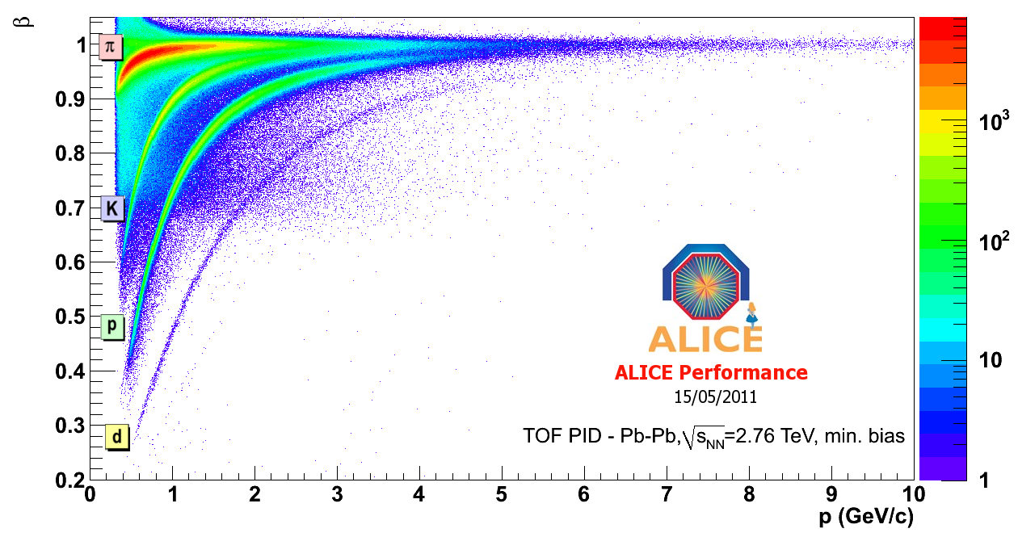
Particle identification
:
Basic identification strategy: fit response function in p_{T} bin
TOF σ ≈ 90 ps
TPC dE/dx
≈5-6%
p_{T} range of separation
within 3σ (GeV/c)
For resonances, V0 and cascade analysis PID by a cut (3-5 σ) on the relative difference between:
 | TPC | TOF
π | 0.2 ÷ 0.7 | 0.5 ÷ 2.0
K | 0.3 ÷ 0.6 | 0.5 ÷ 2.0
p | 0.5 ÷ 1.0 | 0.5 ÷ 2.5
TPC signal and Bethe-Bloch function
TOF signal and integrated time
A. Badalà- LowX meeting – Paphos (Cyprus) 27 June-1 July 2012
7

Slide 8
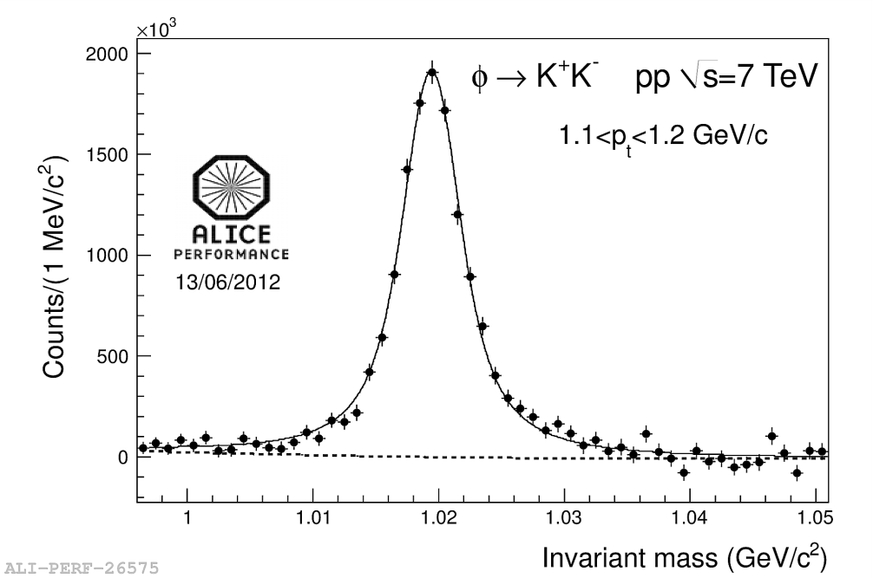
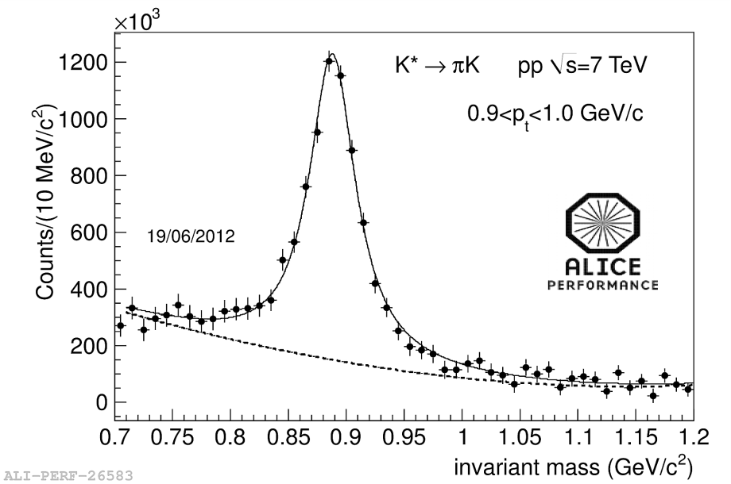
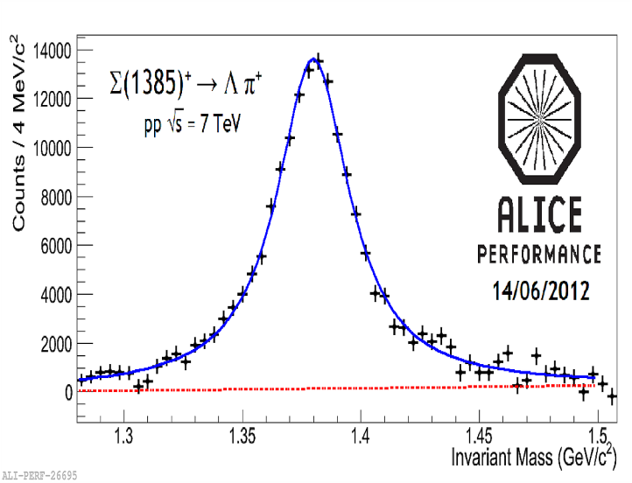
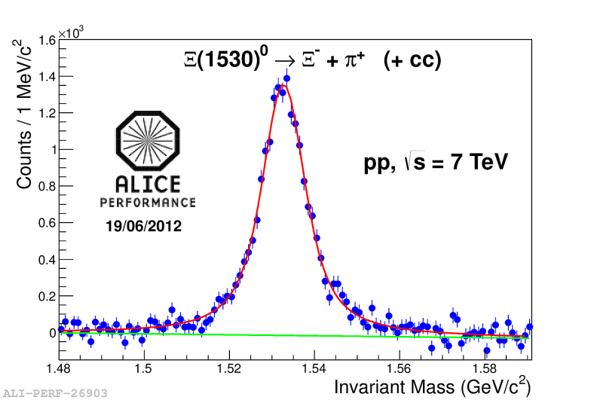
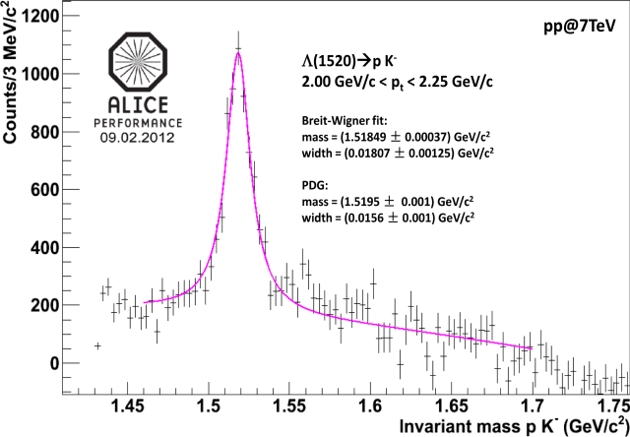
Invariant mass signal pp 7 TeV
K*(892)
60-155 M MB events
ϕ(1020)
Σ*(1385)⁺
Λ*(1520)
Ξ*(1530)
A. Badalà- LowX meeting – Paphos (Cyprus) 27 June-1 July 2012
8

Slide 9
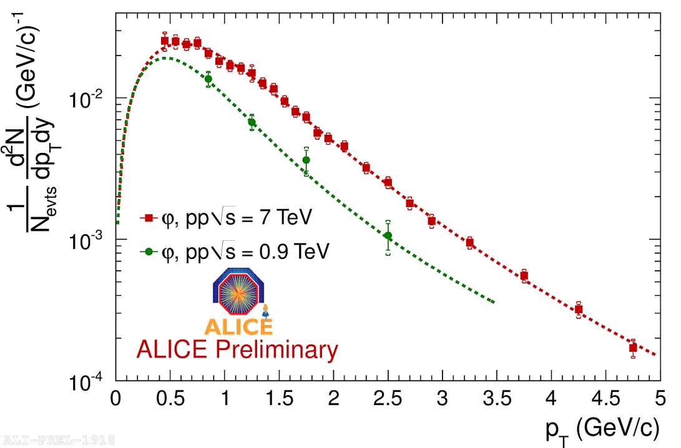
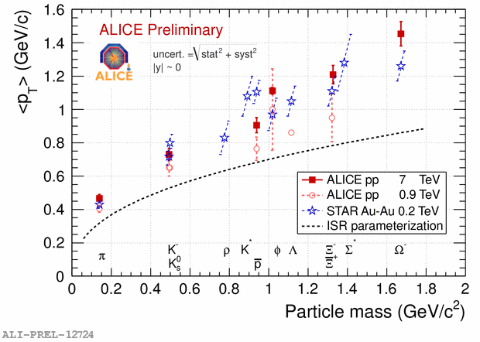
ϕ @ 0.9 and 7 TeV pp, yield and <p_{T}>
φ @ 0.9 TeV : ALICE Collaboration, Eur. Phys. J. C71 (2011), 1594
uncert = √(stat²+syst²)
Levy fit
√s | dN/dy | T | n
0.9 TeV | 0.021 ± 0.005 | 164 ± 91 | 4.2 ± 2.5
7 TeV | 0.0334 ± 0.0008 | 286 ± 14 | 7.0 ± 0.6
A rise in the mean p_{T} with collision energy is observed!
ISR ((√s)_{pp} = 62 GeV ) parameterization doesn’t describe pp data at LHC energies, while it describes RHIC pp data
dN_{φ}/dy increases proportionally to dN_{ch}/dy from 0.9 TeV to 7 TeV
Charged multiplicity ALICE Collaboration, Eur. Phys. Journal C 68 (2010), 345
A. Badalà- LowX meeting – Paphos (Cyprus) 27 June-1 July 2012
9

Slide 10
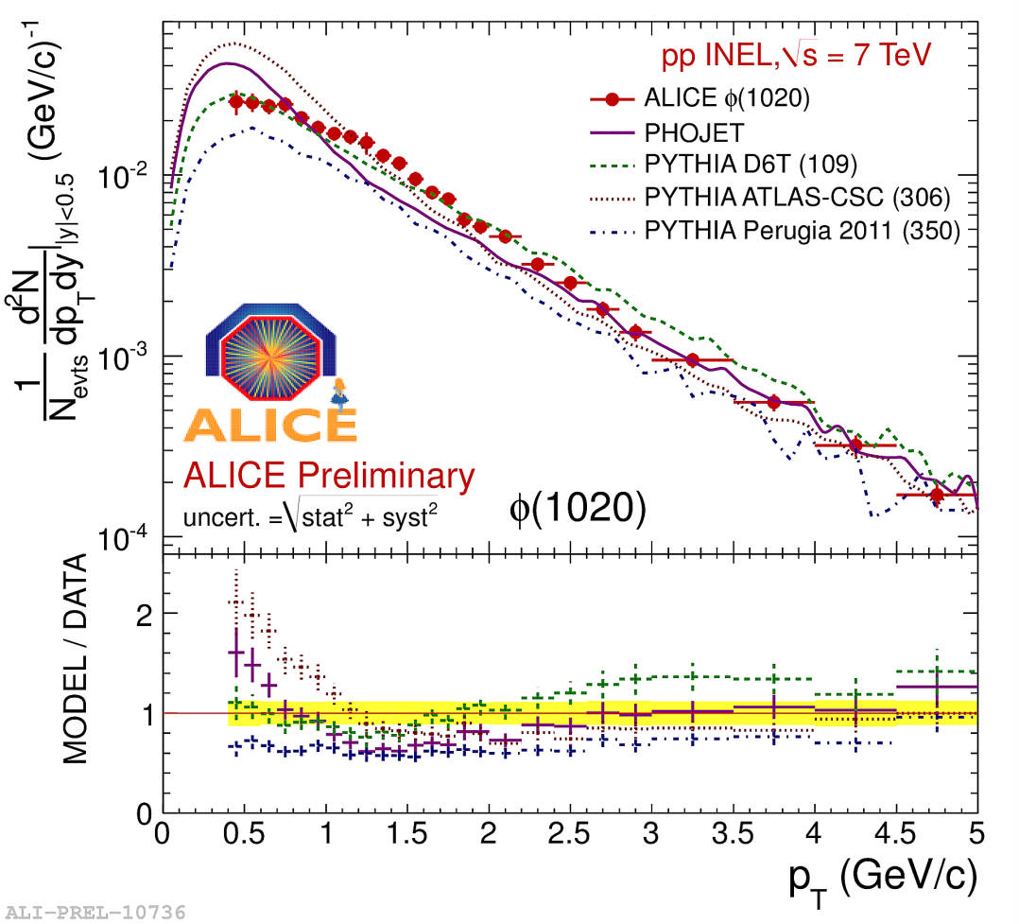
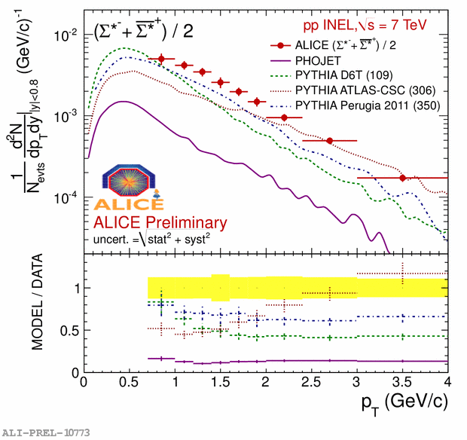
Comparison with MC @ 7 TeV
p_{T} ≤ 2 GeV/c: good agreement with PYTHIA D6T
p_{T} ≥ 2 GeV/c: good agreement with PHOJET
PYTHIA tunes describe better the ϕ(1020) than Σ(1385) resonance
Yellow band:
data systematics
A. Badalà- LowX meeting – Paphos (Cyprus) 27 June-1 July 2012
10

Slide 11
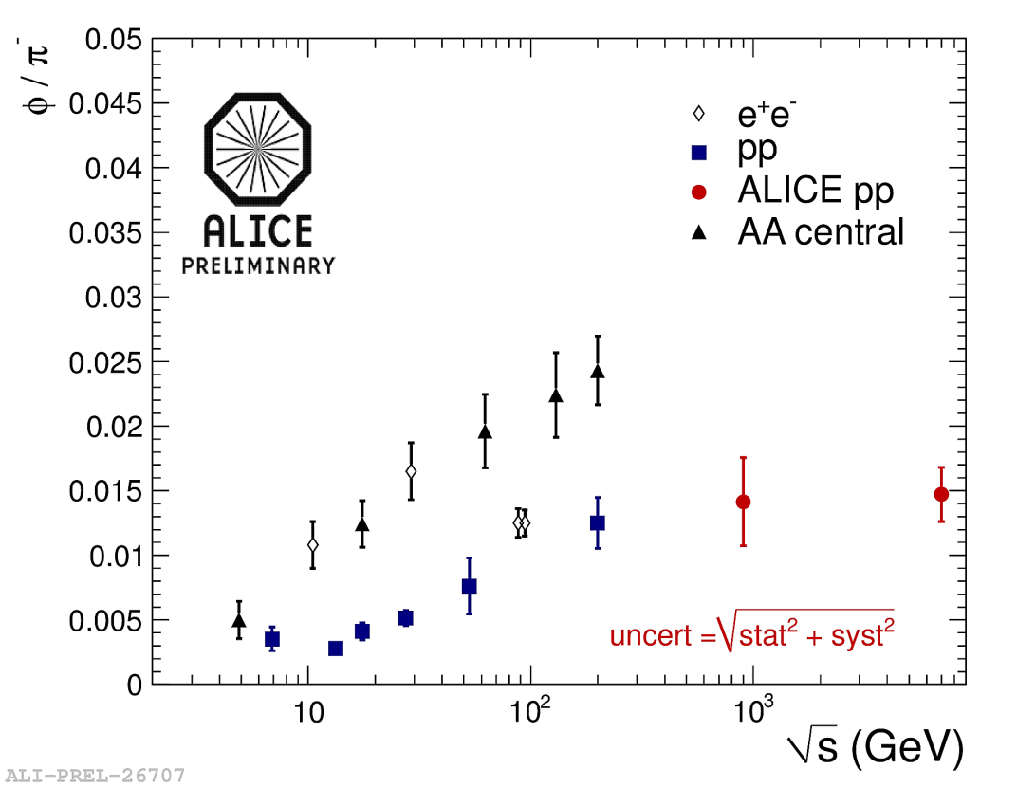
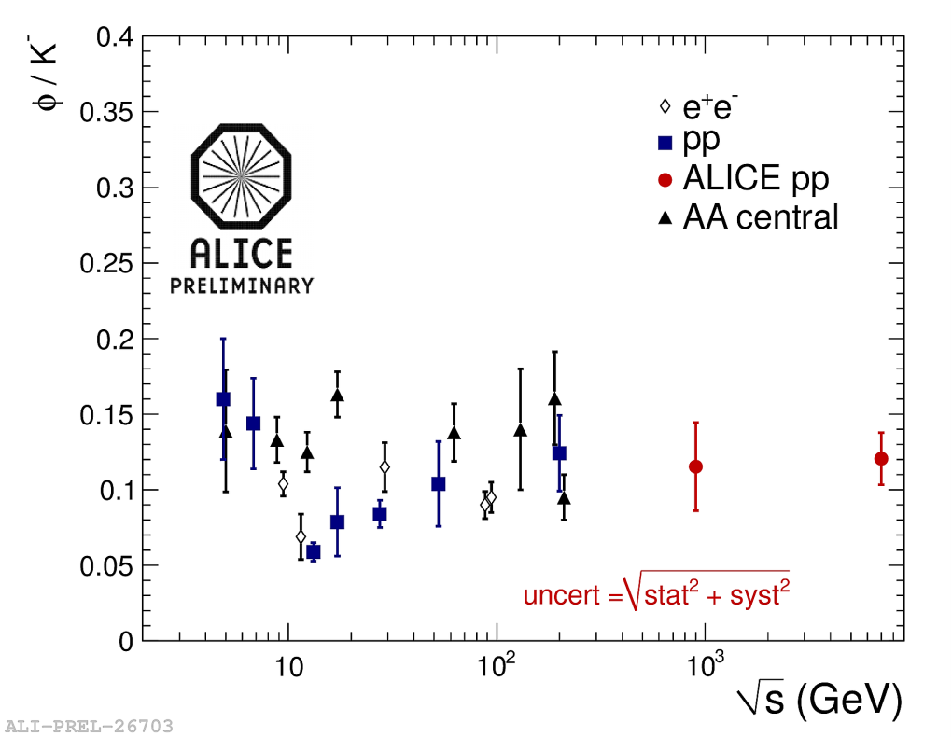
ϕ/π and ϕ/K ratio
?
The ϕ/π ratio increases with energy both in heavy-ion and in pp collisions. Will the value at LHC energy confirm this trend?
At 200 GeV in pp collisions we observe a saturation.
The ϕ/K ratio doesn’t increase with energy.
Same in all system sizes.
A. Badalà- LowX meeting – Paphos (Cyprus) 27 June-1 July 2012
11

Slide 12
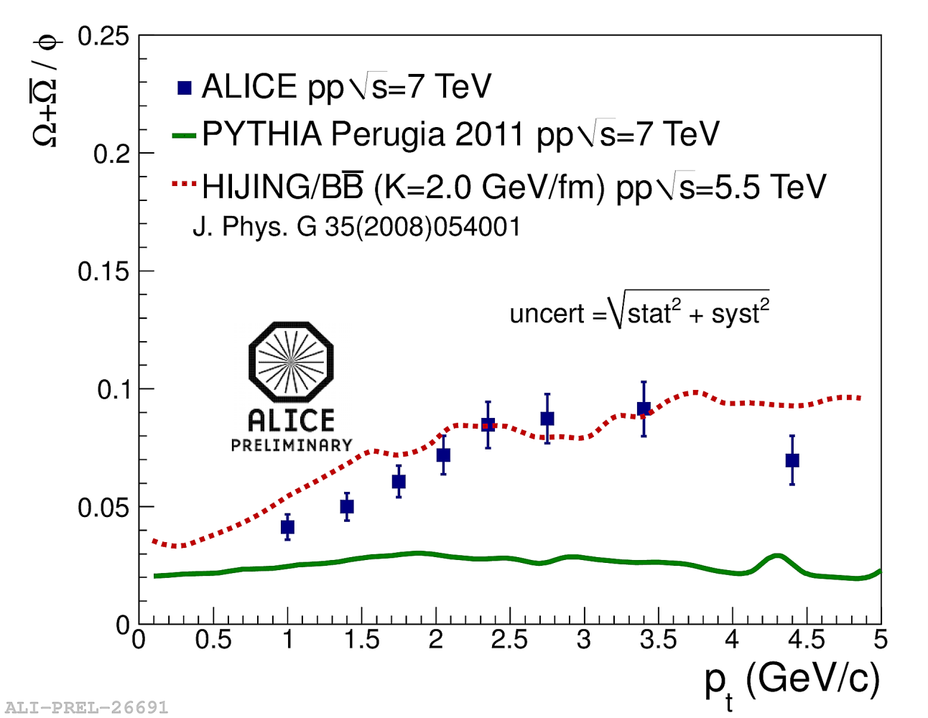
Ω+anti-Ω/ϕ ratio at 7 TeV
HIJING (K=2 GeV/fm) rescale factor
Pythia Perugia 2011 is a factor 1.5-5 below data. It underpredicts multistrange baryon yield.
Predictions of HIJING/BB with a Strong Color Field modeled by an increased string tension are in agreement with the data.
A. Badalà- LowX meeting – Paphos (Cyprus) 27 June-1 July 2012
12

Slide 13
Low-mass dimuon results
A. Badalà- LowX meeting – Paphos (Cyprus) 27 June-1 July 2012
13

Slide 14
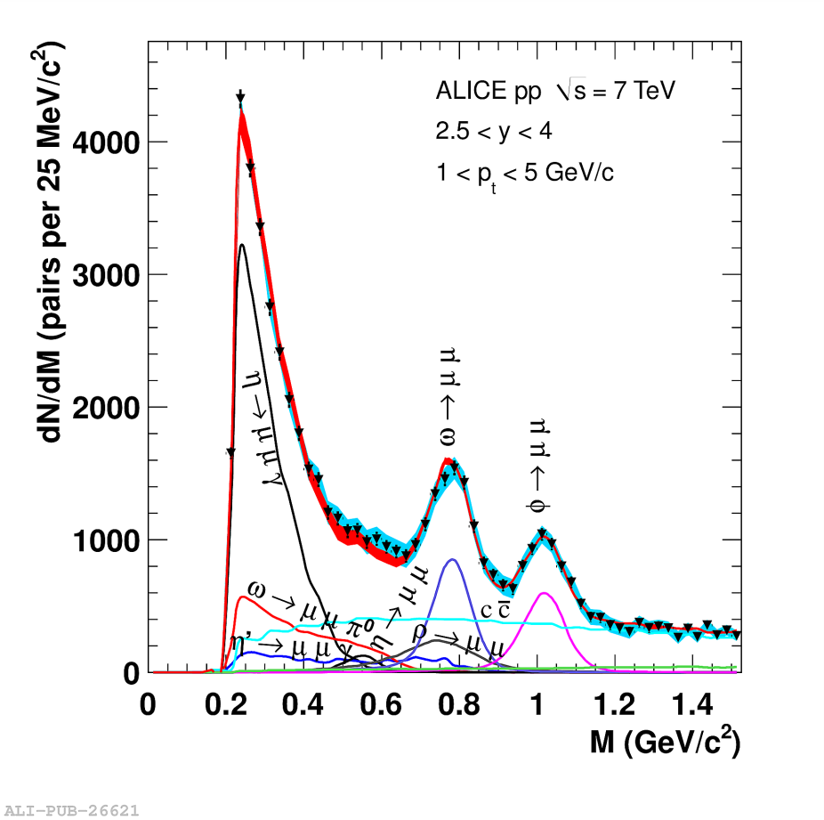
Low mass dimuon spectrum in pp collisions at 7 TeV
ALICE coll. Phys. Lett. B 710 (2012) 557
Processes contributing to the dimuon mass spectrum are the light meson (η,ρ,ω,η′,ϕ) decays into muons and the correlated semi-leptonic open charm and beauty decay
Fit of the dimuon mass spectrum after
background subtraction:
● free parameters of the fit are the
normalization of η, ω, ϕ and open charm
● other processes normalized with ratios
between cross sections or branching
ratios
Blue band: syst. uncertainty from bck. subtraction
Red band: Sum of all simulated contributions
A. Badalà- LowX meeting – Paphos (Cyprus) 27 June-1 July 2012
14

Slide 15
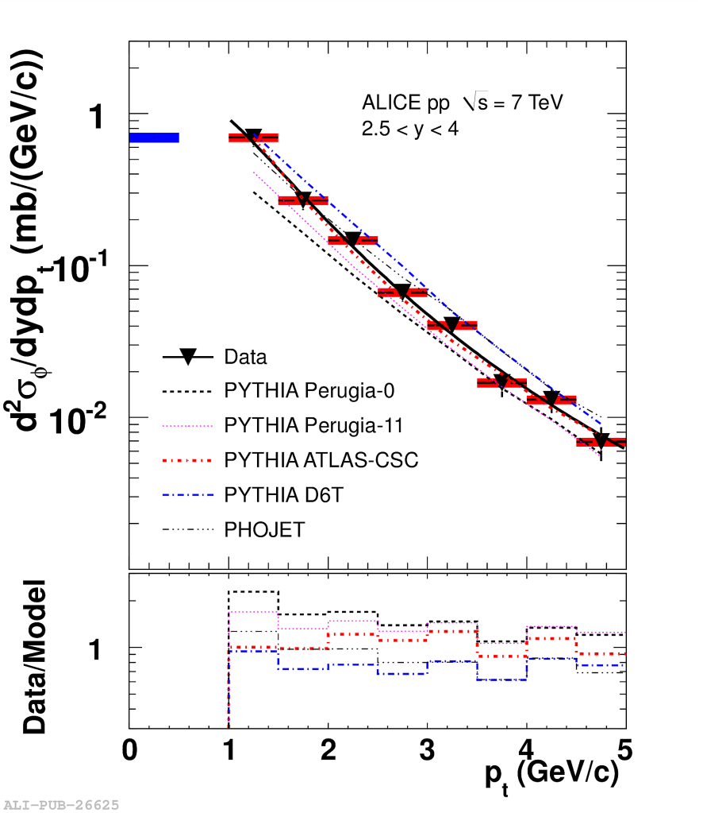
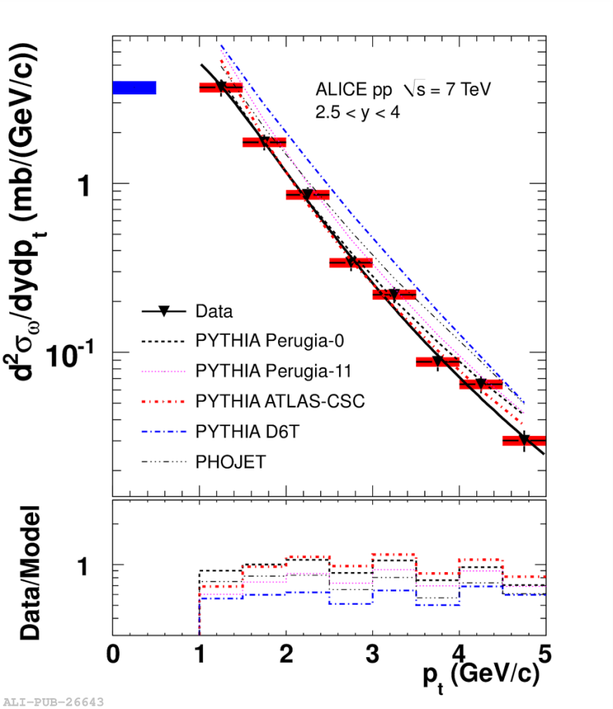
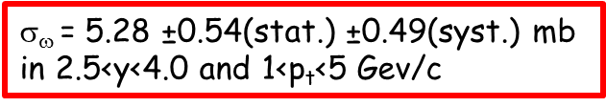
ϕ and ω cross section @ 7 TeV
ALICE coll. Phys. Lett. B 710 (2012) 557
ALICE coll. Phys. Lett. B 710 (2012) 557
L_{INT}=55.7 nb⁻¹
L_{INT}=55.7 nb⁻¹
ϕ values
p₀= 1.16±0.023GeV/c
n=2.7±0.2
ω values
p₀= 1.44±0.09 GeV/c
n=3.2±0.1
σ_{ϕ} = 0.940 ±0.084(stat.) ±0.076(syst.) mb
in 2.5<y<4.0 and 1<p_{t}<5 Gev/c
σ$$ = 5.28 ±0.54(stat.) ±0.49(syst.) mb
in 2.5<y<4.0 and 1<p_{t}<5 Gev/c
σ_{ϕ} is reproduced by PHOJET and ATLAS-CSC and D6T PYTHIA tunes, underestimated by Perugia-0 and 2011 tunes
σ_{ω} overestimated by all models except PYTHIA-Perugia0
A. Badalà- LowX meeting – Paphos (Cyprus) 27 June-1 July 2012
15

Slide 16
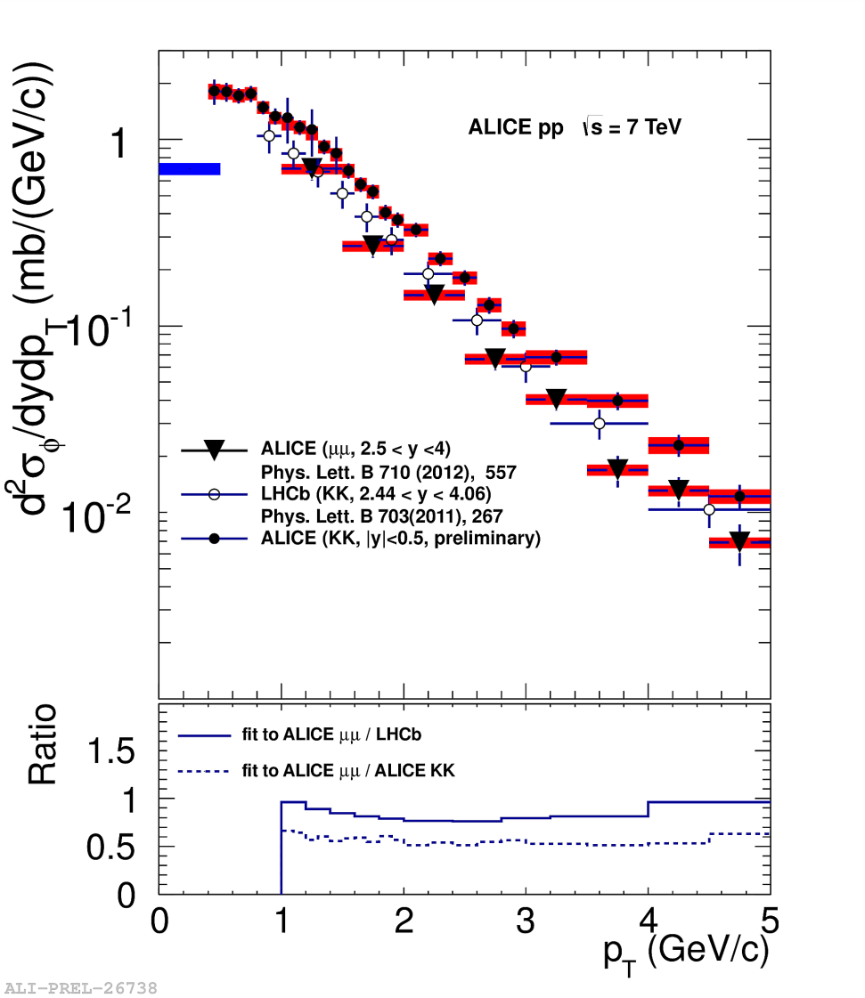
ϕ →KK and ϕ→μμ @ 7 TeV
ALICE results, ϕ→μμ Phys. Lett. B710 (2012)557.
Slope ϕ→KK consistent with slope ϕ→μμ (2.5<y<4.0, 1<p_{t}<5 GeV/c)
Difference between forward and mid-central rapidity yield as expected from D6T PYTHIA tune
σ_{ϕ} = 0.940 ±0.084(stat.) ±0.076(syst.) mb in 2.5<y<4.0 and 1<p_{t}<5 Gev/c
σ(LHCb) in ALICE range = 1.07±0.15(stat.+syst.) mb
LHCb results, ϕ→KK (2.44<y<4.06, 0.8<p_{T}<5 GeV/c)
Phys. Lett. B703(2011)267.
A. Badalà- LowX meeting – Paphos (Cyprus) 27 June-1 July 2012
16

Slide 17
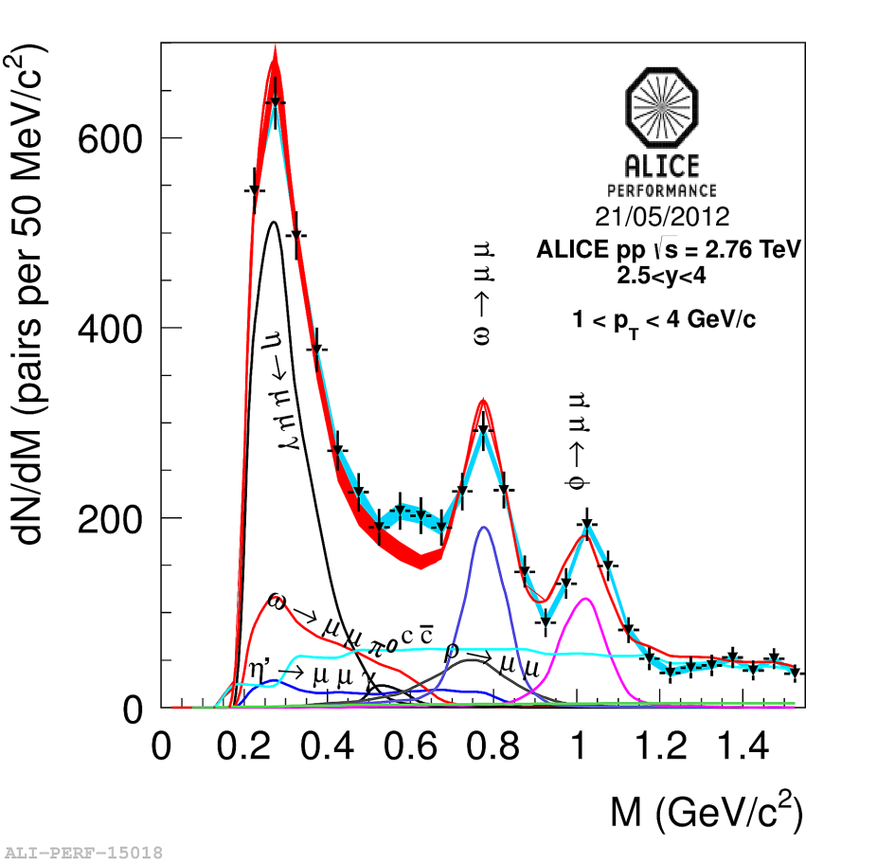
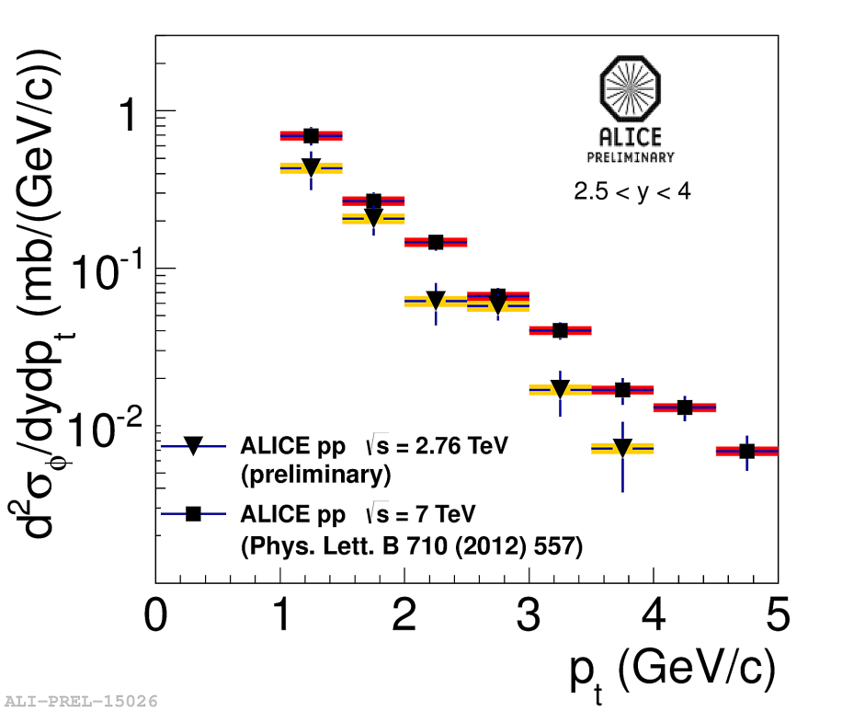
Comparison ϕ@ 2.76 and 7 TeV
Blue band: syst. uncertainty from bck. subtraction
Red band: Sum of all simulated contributions
σ_{ϕ} =0.587 ±0.070(stat.) ± 0.045 (mb)
in 2.5<y<4.0 and 1<p_{t}<4 Gev/c and L_{INT}=17.6 nb⁻¹
PHOJET and PYTHIA with ATLAS-CSC and D6T tunes reproduce σ_{ϕ}
A. Badalà- LowX meeting – Paphos (Cyprus) 27 June-1 July 2012
17

Slide 18
Pb- Pb results
A. Badalà- LowX meeting – Paphos (Cyprus) 27 June-1 July 2012
18

Slide 19
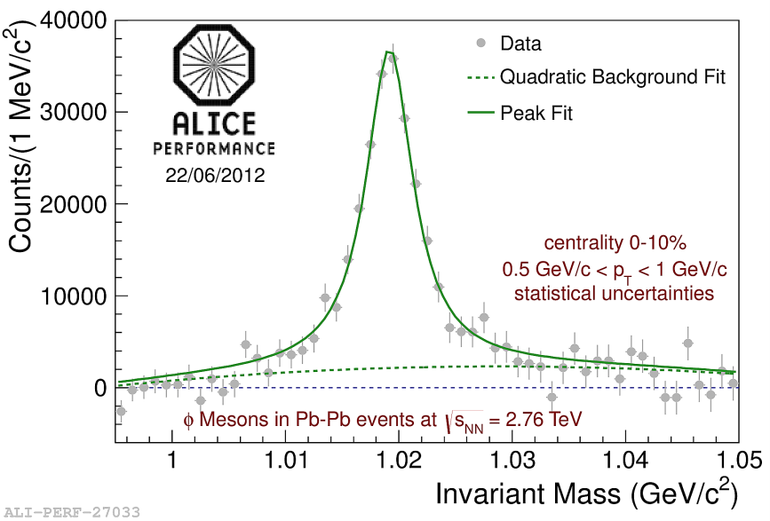
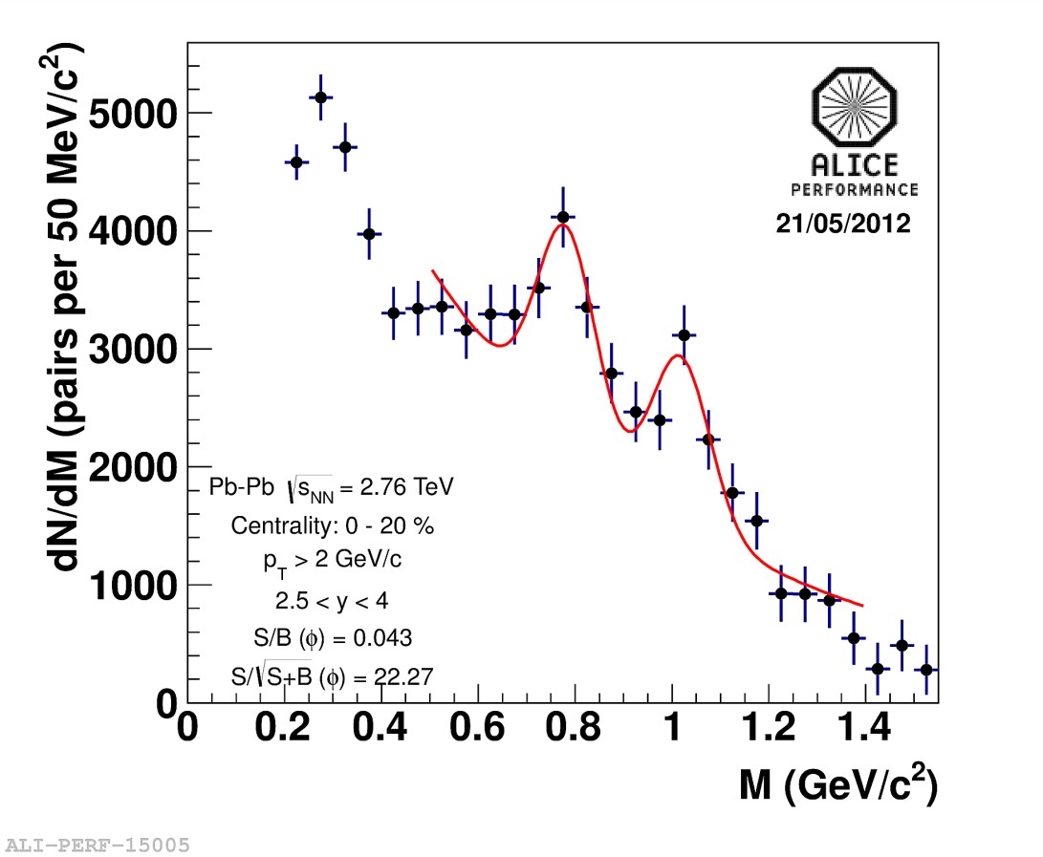
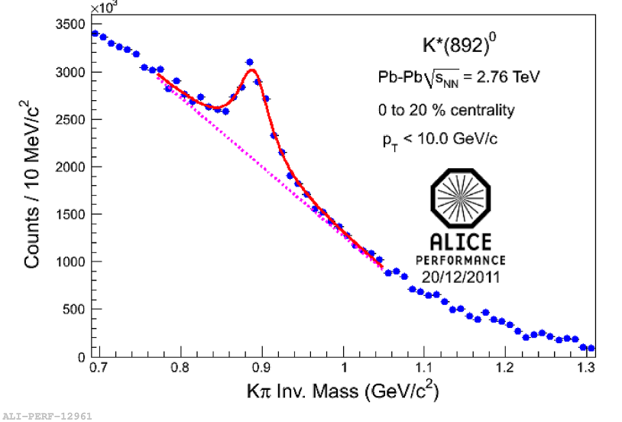
Invariant mass signals Pb-Pb @2.76 TeV
Hadronic channel
Dimuon channel
2.5<y<4.0
|y|<0.5
|y|<0.5
Combinatorial background estimated by event-mixing
A. Badalà- LowX meeting – Paphos (Cyprus) 27 June-1 July 2012
19

Slide 20
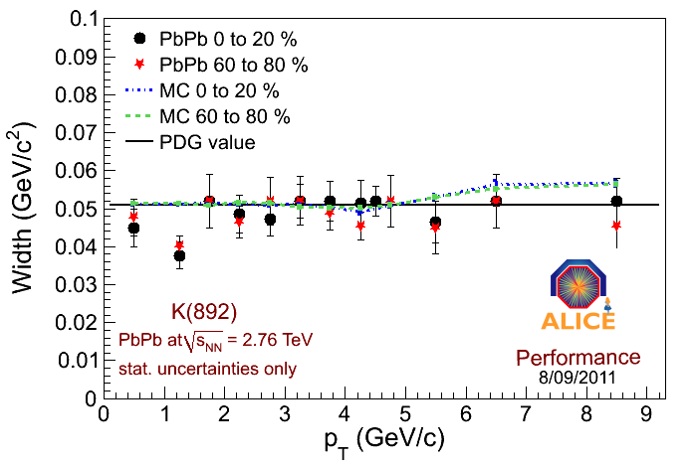
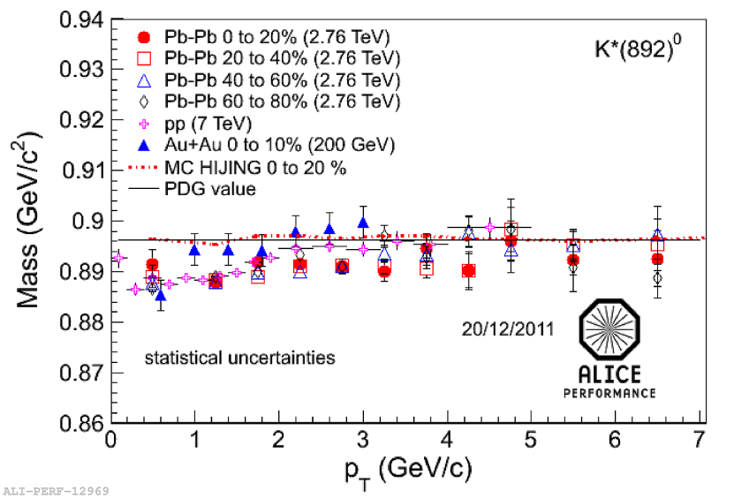
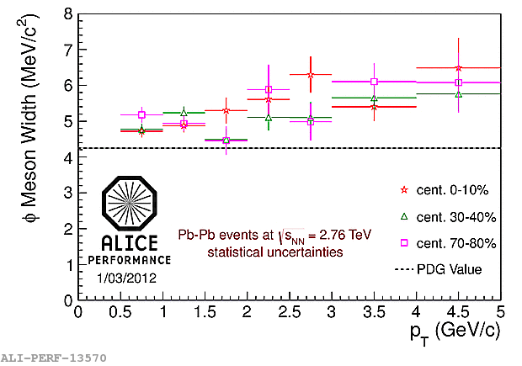
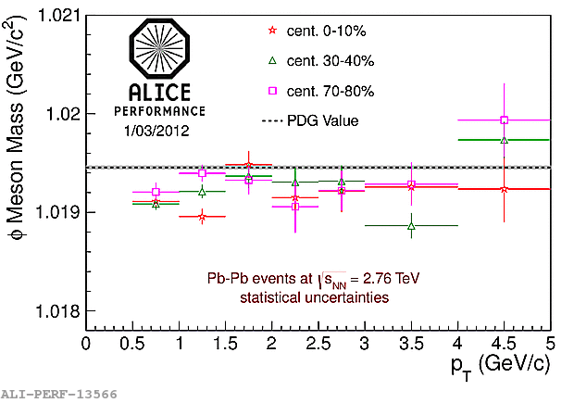
K* and ϕ mass and width
K* →No width broadening. Mass shift: the same in pp and Pb-Pb collisions→No medium effect.
ϕ →No mass shift or width broadening in Pb-Pb collisions
A. Badalà- LowX meeting – Paphos (Cyprus) 27 June-1 July 2012
20

Slide 21
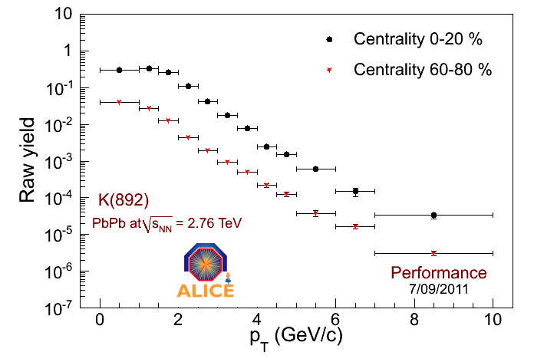
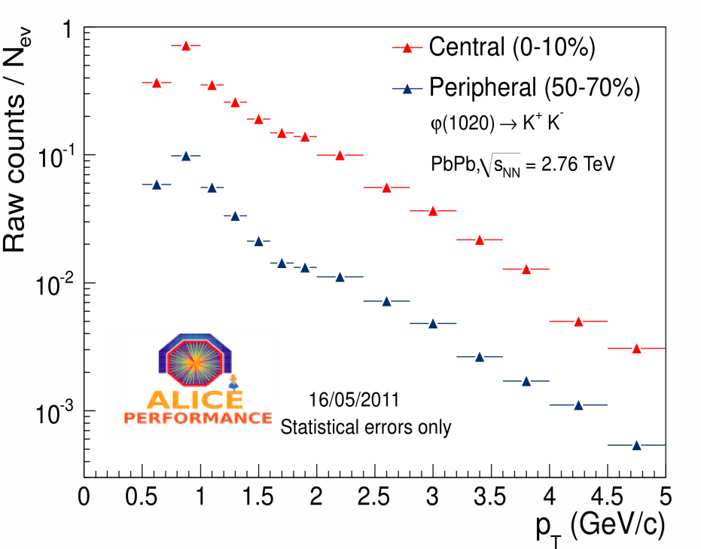
K*(892) and ϕ(1020) raw spectra in Pb-Pb
Corrected spectra will come soon.
A. Badalà- LowX meeting – Paphos (Cyprus) 27 June-1 July 2012
21

Slide 22
Summary pp results
Yield and transverse momentum spectrum of (ϕ(1020), Σ*(1385)±) at mid-rapidity and ω(782) and ϕ(1020) at forward rapidity have been measured in 7 TeV pp collisions and 2.76 and 7 TeV pp collisions, respectively, by their hadronic and leptonic decay channel.
In pp collisions ϕ/K is indipendent of energy, ϕ/π saturates at the energy above 200 GeV.
Forward-(μμ channel) and mid-rapidity (KK channel) ϕ spectra in 7 TeV pp collisions are in agreement considering the different rapidity range.
None of PHOJET and PYTHIA tunes give a full satisfactory description of the spectra at mid-rapidity. In particular they underestimate strange baryon resonances yield.
PHOJET and ATLAS-CSC and D6T PYTHIA tunes reproduce σ_{ϕ} (2.5<y<4.0 , 1<p_{t}<5 Gev/c) in pp collisions at 2.76 and 7 TeV. σ_{ω} at 7 TeV is equal to Perugia-0 PYTHIA value.
The Ω+anti-Ω/ϕ ratio at |y|<0.5, not reproduced by Pythia Perugia 2011, is in good agreement with a prediction of HIJING/BB model with a SCF modeled with a string tension of 2 GeV/fm.
A. Badalà- LowX meeting – Paphos (Cyprus) 27 June-1 July 2012
22

Slide 23
Summary PbPb results
The widths of K*(892) and ϕ(1020) are in agreement with the PDG value including the detector effects. Masses of K* are lower in low p_{t} region for all collision systems. (→ no medium effect).
Yield of resonances will be soon available.
A. Badalà- LowX meeting – Paphos (Cyprus) 27 June-1 July 2012
23

Slide 24
THANKS

Slide 25
Backup slides
A. Badalà- LowX meeting – Paphos (Cyprus) 27 June-1 July 2012

Slide 26
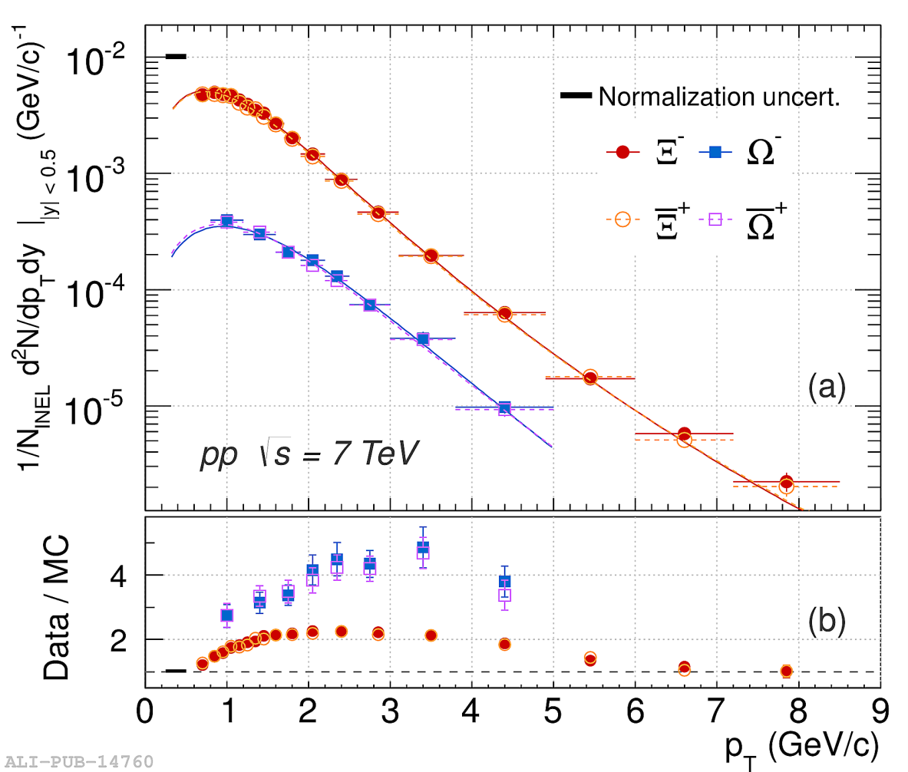
A. Badalà- LowX meeting – Paphos (Cyprus) 27 June-1 July 2012

Slide 27
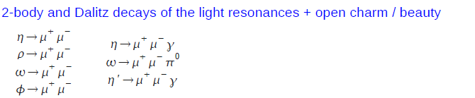
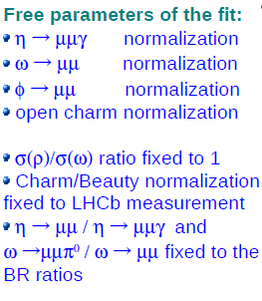
Processes contributing to the mass spectrum
Resonances are simulated with an hadronic cocktail generator.
Open charm/beauty simulated via a parametrization of PYTHIA.
The p_{t} distribution of ρ, ω and ϕ is described by a power-law function (HERA-B parametrization). The parameter p₀ and n were tuned iteratively to the results of the analysis.
p_{t} distribution of η from measured distribution via two photon decay channel (ALICE coll.).
A. Badalà- LowX meeting – Paphos (Cyprus) 27 June-1 July 2012

Slide 28
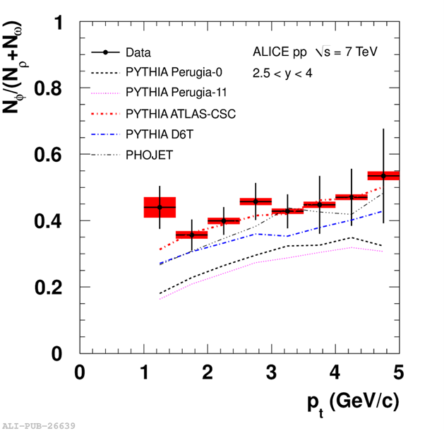
A. Badalà- LowX meeting – Paphos (Cyprus) 27 June-1 July 2012
2

Slide 29
A. Badalà- LowX meeting – Paphos (Cyprus) 27 June-1 July 2012
2

