Slide 1


Measurement of the t dependence in exclusive photoproduction of
Upsilon (1S) mesons at HERA
Janusz Tomasz Malka (DESY)
on behalf of the ZEUS Collaboration

Slide 2
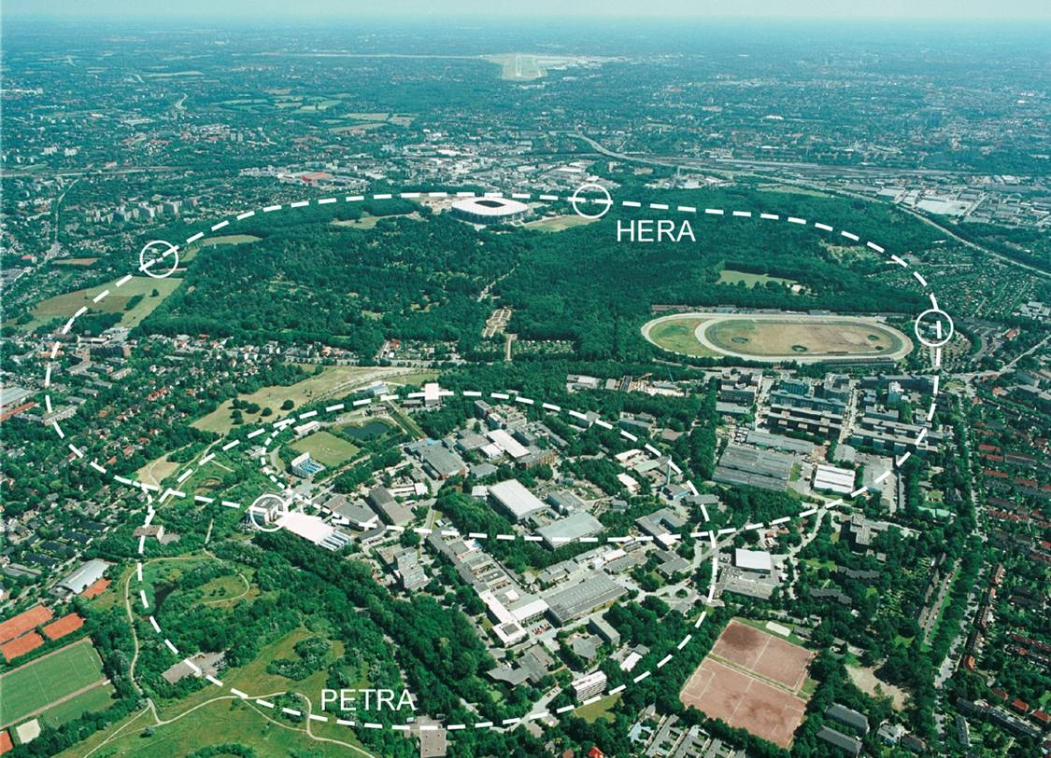




HERA and ZEUS
HERA was an ep collider, (27.5GeV electrons/positrons , 920GeV protons beam ,CMS energy 318 GeV) running ended mid 2007

Slide 3
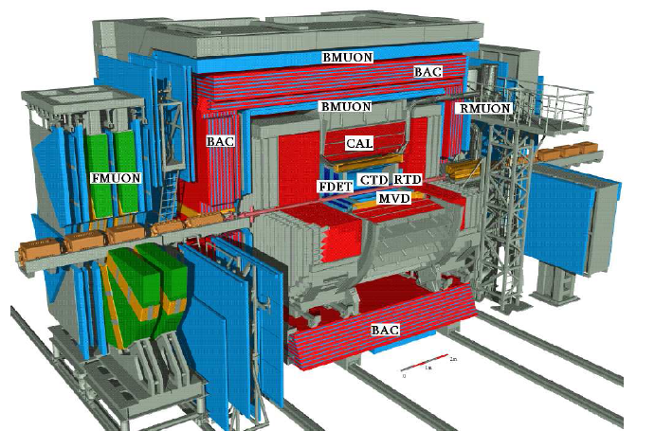
HERA and ZEUS
ZEUS was a large multipurpose experiment, integrating all the data taken since 1996: 11 years of activity and 468 pb⁻¹ of integrated luminosity

Slide 4
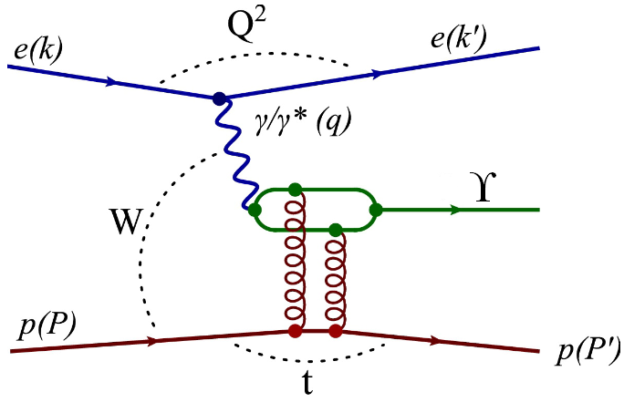
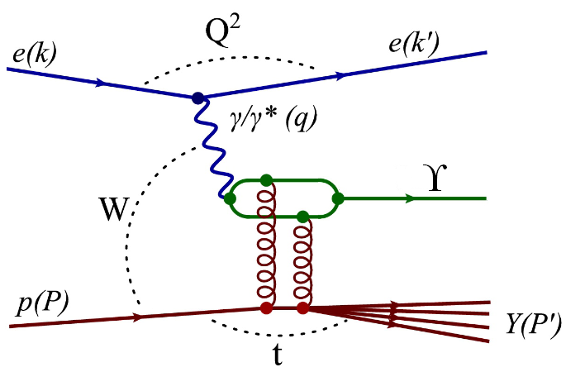
Diffractive ϒ production
exclusive
proton-dissociative
Q² - photon virtuality Q²=-q²=-(k-k’)²
(Q²≈ 0 – photoproduction , Q²> 0 – electroproduction)
W - c.m. energy of γp system W=(q+p)²
t - (4-mom. transfer)² at p-vertex t = (P - P’)²
The proton can stay intact p(P’) or dissociate Y(P’)

Slide 5
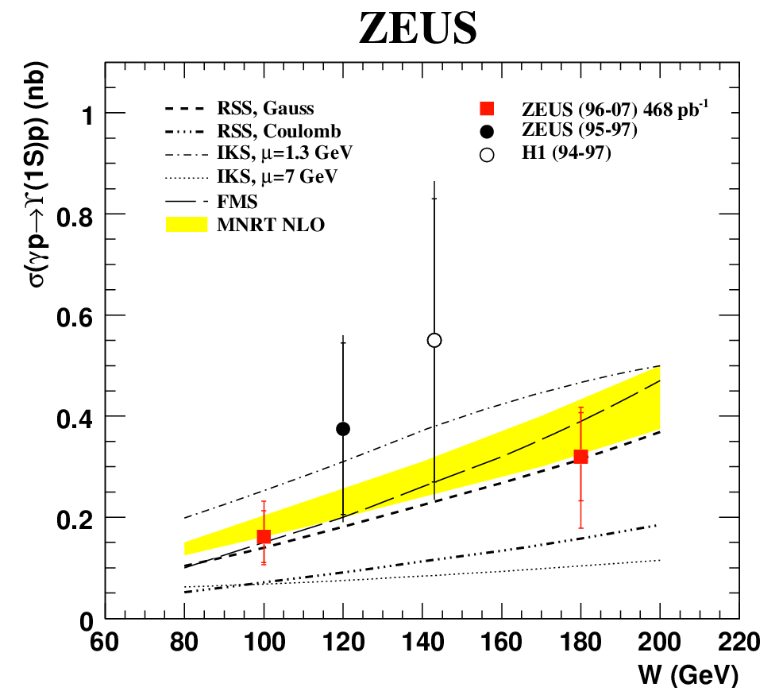
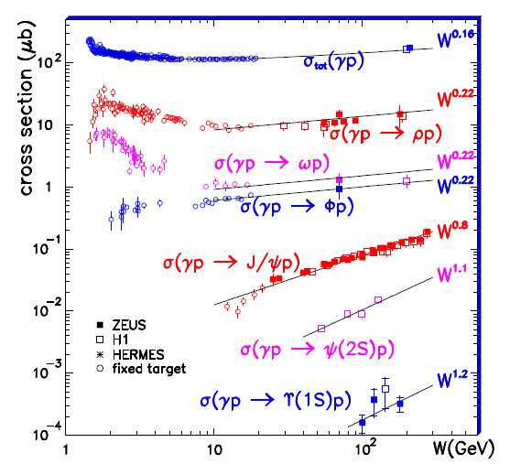
W – dependence
Upsilon PHP
Compilation PHP
σ(γp) ∼ W^{δ}
δ =1.2±0.8
δ increases with the mass of vector meson

Slide 6
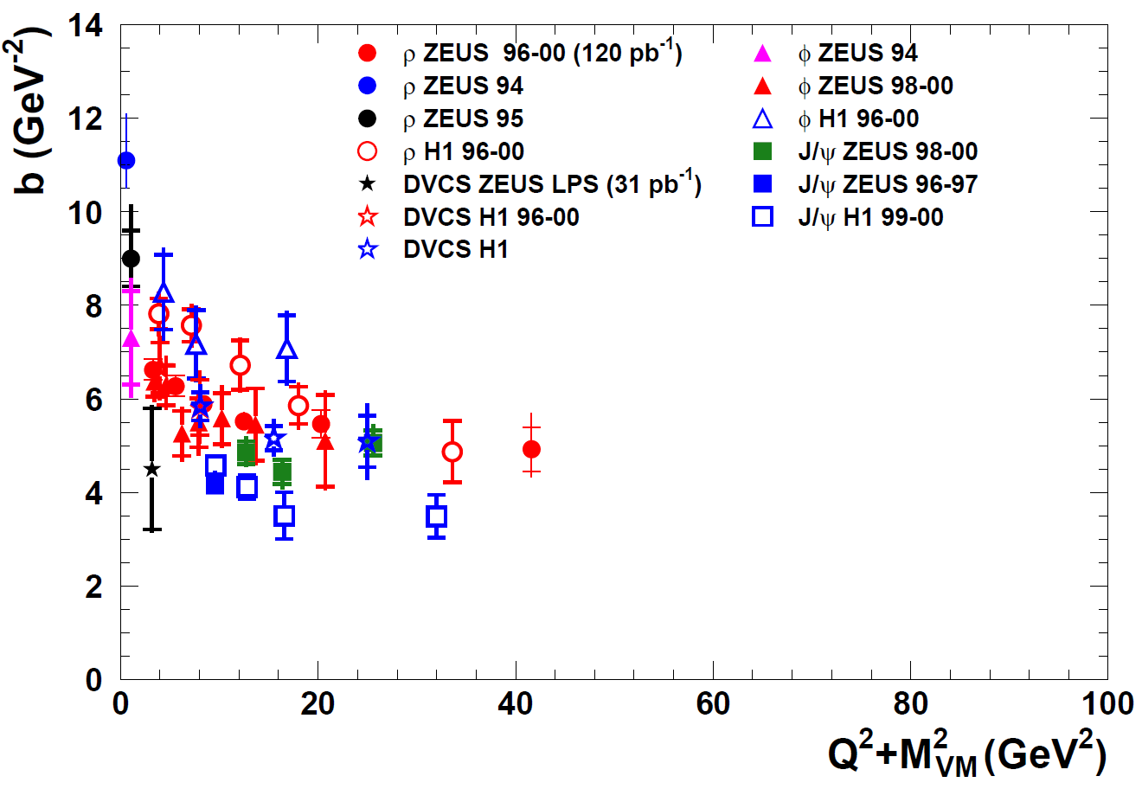
Motivation for t-dependence (exponential slope)
dσ/d|t| ∼ exp(-b |t|)
b = b_{V} + b_{p}
b_{V} ∼ 1/(Q²+M_{VM}²) ~ 0
→ b ∼ b_{p} ∼ 5 GeV⁻²
Relation to transverse
size of the interaction
region, R_{T}:
b_{p}= R_{T}²/2
→ R_{T} ∼ 0.6 fm
Gluon radius of the proton
b_{V}
b_{p}

Slide 7
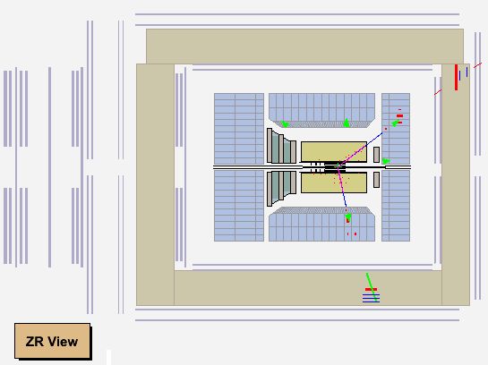
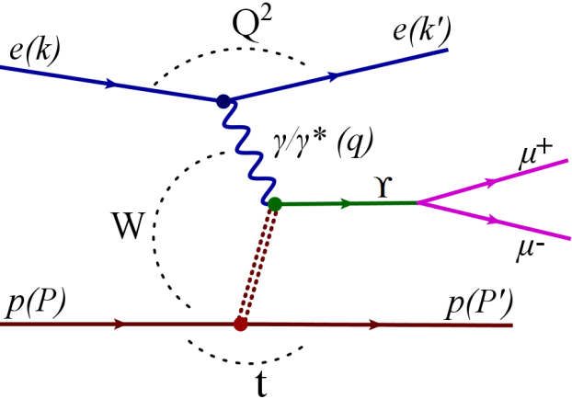
Elastic ϒ event as seen in the ZEUS detector
e
p
e

Slide 8
Elastic ϒ event as seen in the ZEUS detector
μ⁻
e
p
e
μ⁺

Slide 9
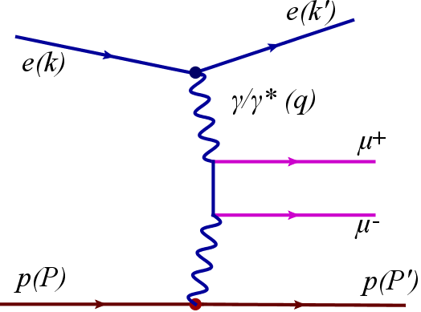
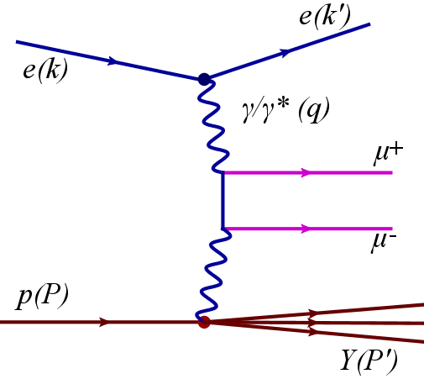
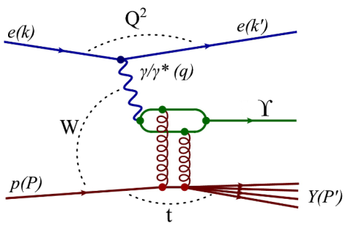
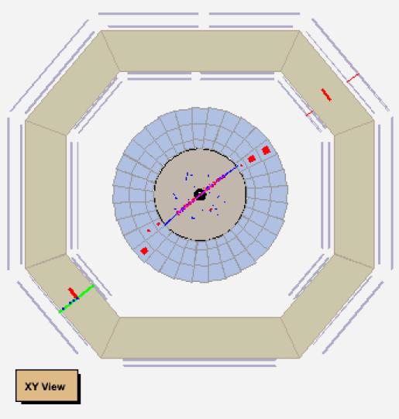
Background processes
Bethe-Heitler γγ → μ+ μ-
Upsilon production with proton dissociation
Cosmic muons passing
near to the interaction point

Slide 10
Monte Carlo
γp→ϒp elastic and pdiss DIFFVM 2.0 (Regge+ VDM)
pdiss + JETSET 7.3
SCHC (s-channel helicity conservation) assumed
dσ/d|t| ~exp(-b |t|) b=4.5 GeV⁻² (as for J/ψ);
σ(γp) ~ W ^{1.2}
Radiative corrections O(1%) not included
Bethe-Heitler μ+μ-GRAPE v1.1k

Slide 11

Proton dissociation contribution
Definition of the fraction:
fpdiss= Npdiss/(Nelastic+ Npdiss)
Small statistics for a standalone
measurement of fpdiss in this analysis
Earlier measurements show: fpdiss similar for all VM
Justified to assume: fpdiss= 0.25 ±0.05 (result for J/ψ)
dσ/d|t| ~exp( -b |t|) contains elastic and proton diss. contributions
Assume for pdiss: bpdiss = 0.65±0.1 GeV⁻² (result for J/ψ)

Slide 12
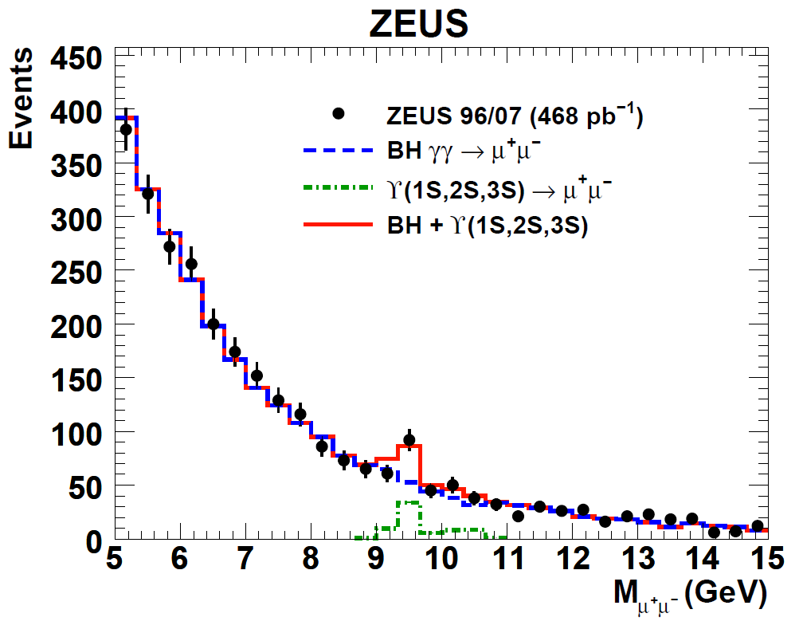
Invariant mass distribution
mass range: 5-15 GeV
BH normalised excluding 9-11 GeV mass range
Signal mass window: 9.33-9.66 GeV
(scanned–no cosmic)
Upsilon 1S:2S:3S ratios
from CDF: 0.73 : 0.19 : 0.08

Slide 13
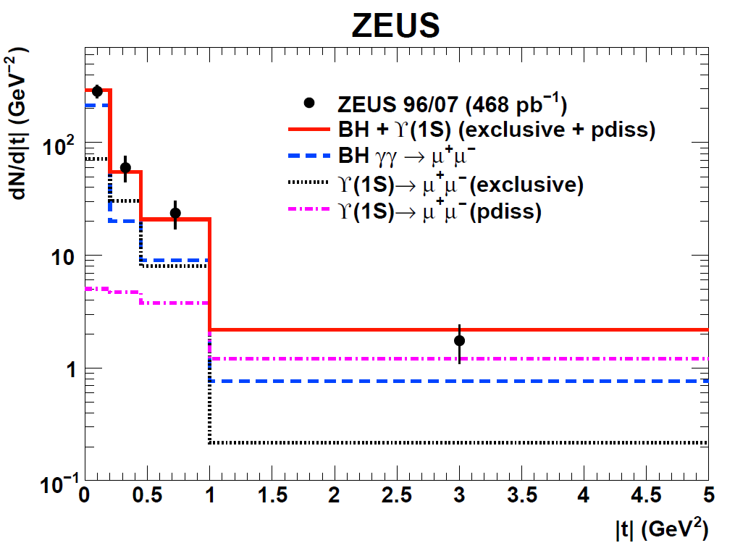
dN/d|t| and slope measurement
Binned Poissonian
maximum log-likelihood
fit → elastic b, N(1S)
N(1S)= 41 ±10
events(44% of all events
in the mass window)
ZEUS RESULT:
b = 4.3 ^{+2.0}_{-1.2}^{+0.5} _{-0.6} GeV⁻²

Slide 14
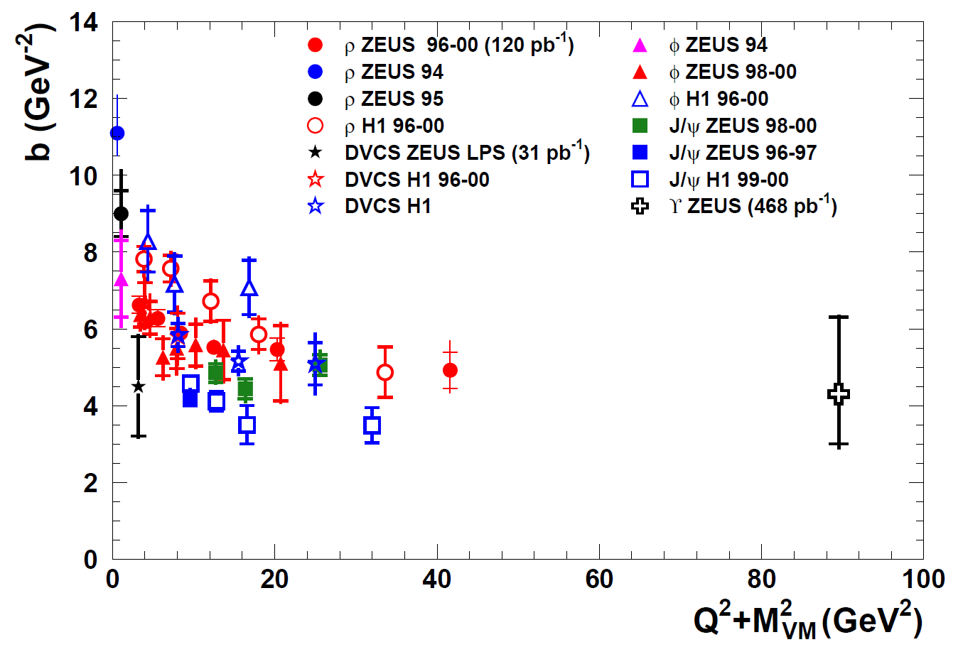
Compilation for elastic b slope
Universal behaviour observed

Slide 15
Summary
ϒ (1S) t-slope measured for the first time
Doubles the range of the Q²+M² scale
In agreement with asymptotic behaviour
• Consistent with expectations from the proton radius and QCD

