Slide 1
LOFT Project Introduction
P. Azzarello, E. Bozzo, F. Cadoux,
Y. Favre, M. Pohl

Slide 2
LOFT
ESA M-class mission candidate
Science: X-ray transients (BH etc.)
Currently in assessment phase
Study lead: SRON (NL), CAP Genève
Downselection mid 2013
Phase A/B 2013-15
Phase C/D 2015-20
Flight ~2022

Slide 3
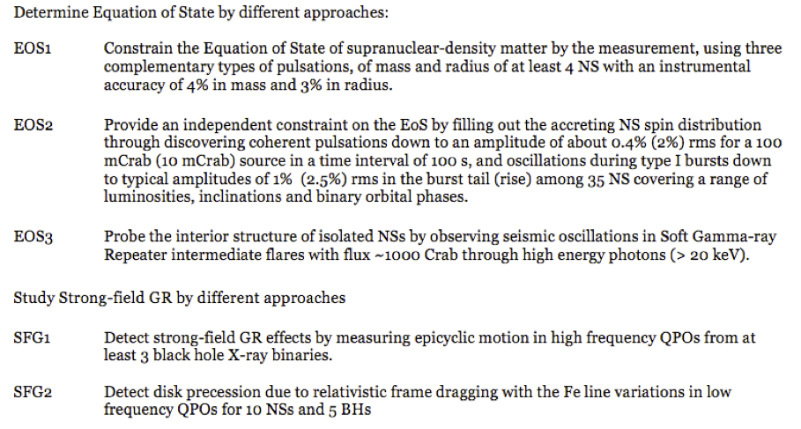
Top level science goals

Slide 4
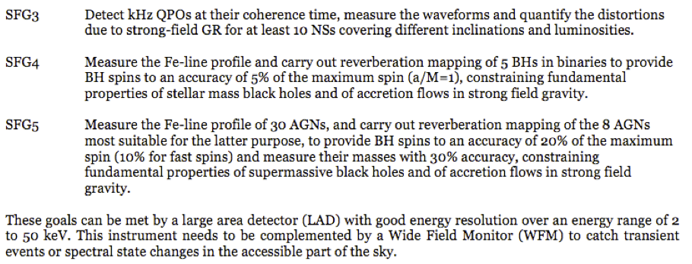
Top level science goals (2)

Slide 5
LAD panel and module
LAD contains 6 panels, 90×343 cm² each
Panel contains 21 modules, 29×49 cm² each
Module contains 16 × (silicon drift detector + FEE) + n collimators + 1 MBEE
Notes:
Module: 29x49 cm2
Panel: 90x343 cm2

Slide 6
Silicon Drift Detector
Few channels/surface
3D readout, HV along sensor
Low input C, low noise
Design property of INFN for ALICE
Manufacturers:
  Canberra (for LHC)
  FBK Trento
  CSEM

Slide 7
Some numbers
SDD dimensions: 120.84 × 72.50 × 0.45 mm³
Active area: 108.52 × 70 mm²
Pitch: 970 µm
16 channels/ASIC
7×2 ASICs/sensor
112×2 readout channels per sensor
LAD = 15 m², ~2000 sensors
Industrial collaboration mandatory

Slide 8
Electronic noise
Total noise requirement:
<260 eV @ 6 keV for 2-anode events at EOL
<200 eV @ 6 keV for 1-anode events at EOL
<2 keV @ 30 keV for 2-anode events at EOL
Goal:
<200 eV @ 6 keV for 2-anode events at EOL
<160 eV @ 6 keV for 1-anode events at EOL
Implies electronic noise ~17 e⁻ shared between SDD and ASIC

Slide 9
FEE Functionality and AIV
Interface with SDD
  SDD Anode readout (ASIC): bond length
  SDD power supply (HV, MV), wrap-around cable
Interface with MBEE:
  Interface with HV, MV, digital voltage
  Digital lines
  Temperature sensor
  …

Slide 10
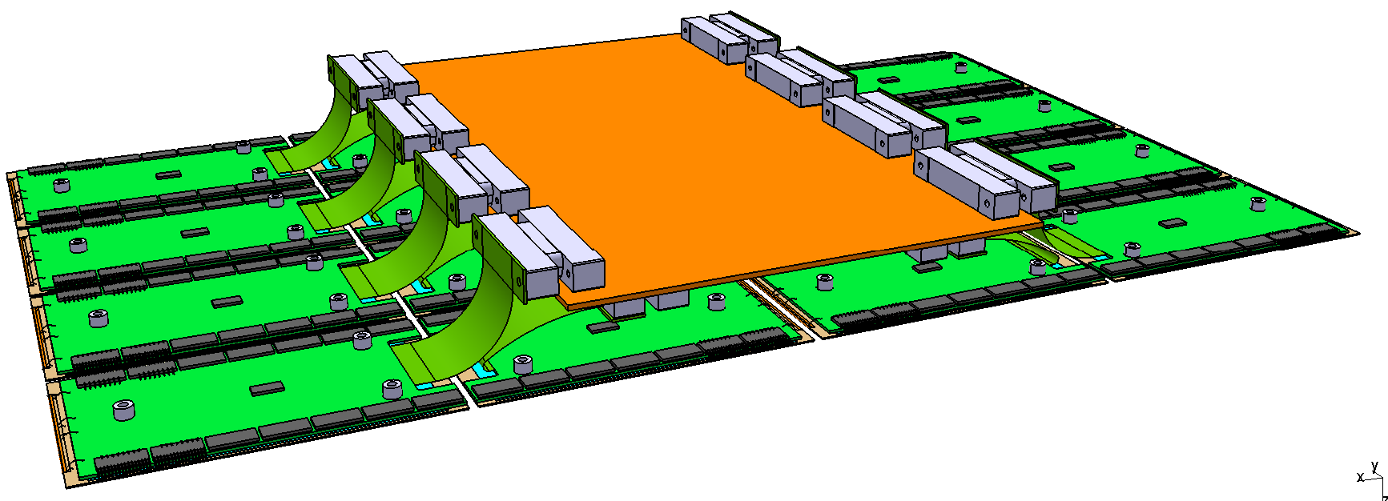
Design study (FEE / MBEE)
F. Cadoux
In this design MBEE is 183mm × 297mm Alternative: split MBEE

Slide 11
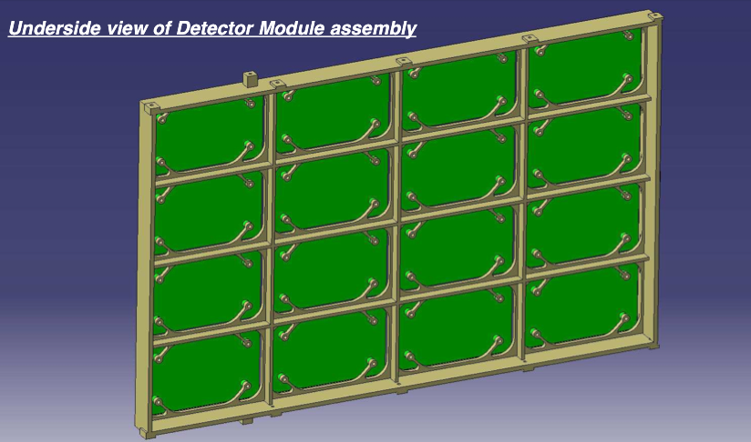
LAD module: lower side
(proposal from MSSL)

Slide 12
FEE Prototyping
Mechanical model FEE+SDD, for thermal and vibration tests (F. Cadoux):
  Low temperature conditions (operating temperature from -60°C to -30°C), while the assembly will be done at 20°C.
  Board material, glue
FEE hybrid (Y. Favre):
  Bread board 1 using existing material, XDXL ASIC under study in Italy: test board enabling sensor readout, with the right mechanical design.
  Bread board 2 using the same board geometry, with the real LAD ASIC, produced by CNES: accommodate and evaluate final ASIC
To test the board design, thermal and vibration tests are foreseen.

Slide 13
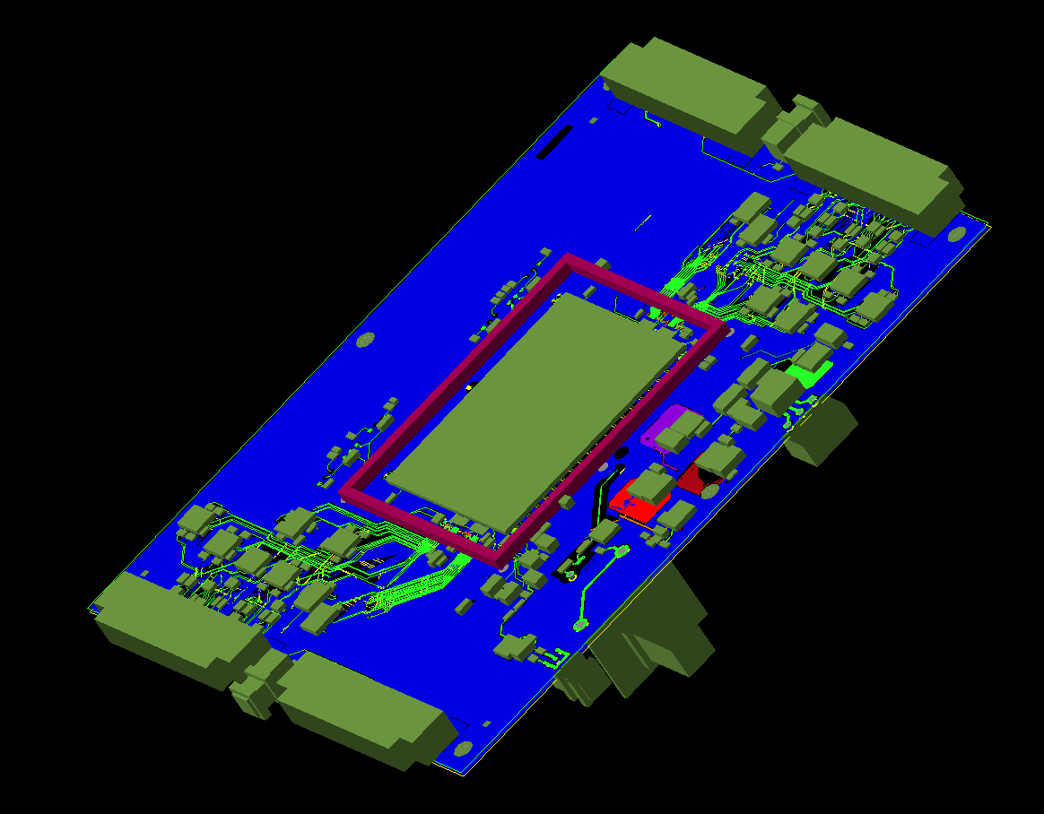
Breadboard with XDXL ASIC

Slide 14
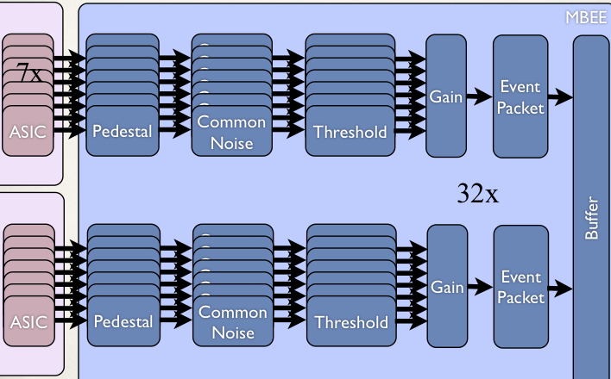
MBEE
Processing pipeline per detector half

Slide 15
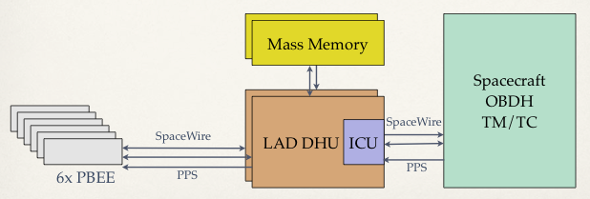
LAD data handling
MBEE: module back-end electronics
PBEE: panel back-end electronics
DHU: data handling unit

Slide 16
SDD environment test plan
Vacuum test: test the vacuum operation compliance of the SDD detectors (high voltage on surface)
50 MeV proton irradiation test: confirm test results on leakage current achieved on the ALICE detector using a FBK detector prototype; verify X- ray spectroscopy performance after proton irradiation (DPNC, PSI)
5 MeV proton irradiation test: 5 MeV protons will stop in the center of the detector, where charge transfer occurs: verify both NIEL effects and impacts on the CTE (Charge Transfer Efficiency) (DPNC, PSI)

Slide 17
SDD environment test plan
Soft proton irradiation test: soft (< 400 keV) protons will stop at the Si-SiO2 interface in the detector, where surface leakage current generation occurs: verify the level of leakage current increase, and possible effects on the oxide.
Debris irradiation test: a few micrometeorites and/or debris are expected to impact on the detectors in orbit; little is known about their effect on the detector functionalities.

Slide 18
Preliminary test at PSI
Alice SDD D4 detector
50 MeV proton beam
Step | Flux (p/cm²/s) | Actual step fluence (p/cm²) | Total fluence after step completion (p/cm²) | Corresponding to
1 | 1·10⁵ | 6.50·10⁶ | 6.50·10⁶ | half of the minimum
2 | 1·10⁵ | 6.70·10⁶ | 1.32·10⁷ | 600 km 0° inclination
3 | 1·10⁵ | 3.24·10⁷ | 4.60·10⁷ | 600 km 2.5° inclination
4 | 1·10⁵ | 1.50·10⁸ | 1.96·10⁸ | 600 km 5° inclination
5 | 2·10⁵ | 2.30·10⁹ | 2.52·10⁹ | 13 times the maximum

Slide 19
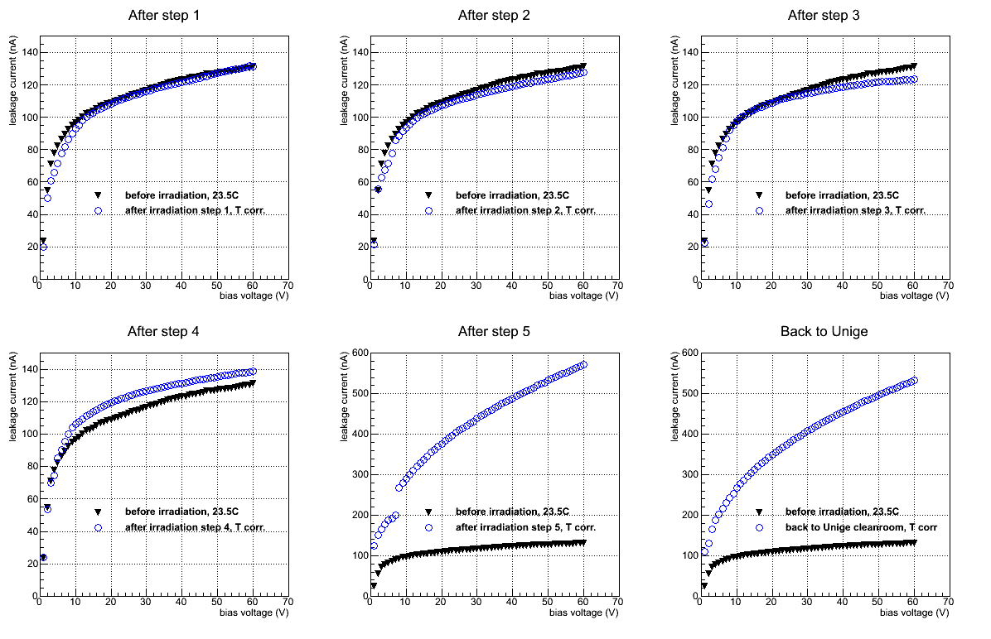
Leakage currents, temp. corrected

Slide 20
SDD measurements @Trieste

Slide 21
Schedule
Assessment phase:
  Soft protons (with energy < 1 MeV): data still to be analyzed.
  Tests with 5 and 50 MeV protons on FBK sensor to be done in August at PSI.
  Complete sensor development plan with CSEM
  Complete FEE bread-board design
  Complete module level AIV plan
Down selection of M3 missions by ESA in 2013 ➔ Definition phase

